Slide 1
JavaScript Objects
Hy-Tech Club: Web 201

Slide 2
Agenda
Introduction
Objects
Properties
JSON

Slide 3
Related Variables
let personName = "Alex";
let personAge = 14;
let personCity = "Westlake";
These variables all describe the same person
Currently, they are not tied together in any way…
It is possible to use objects to group them!
Notes:
Introduce the idea of related variables all grouped together.
All of these variables are properties of a person, but they all exist separately.
Objects could be used to group these properties together.

Slide 4
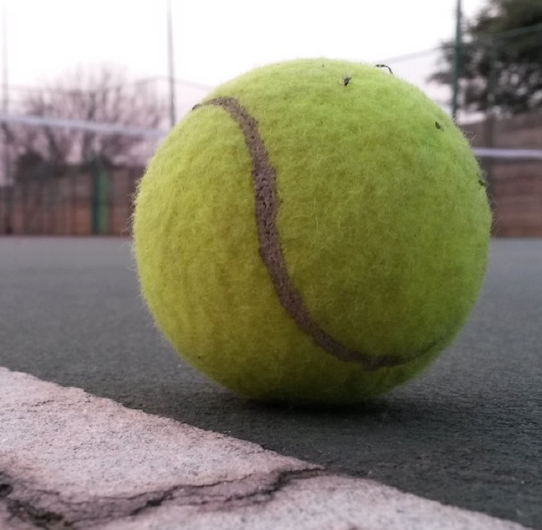
Objects
Notes:
Ask the students to name some objects (any objects) and describe them.

Slide 5
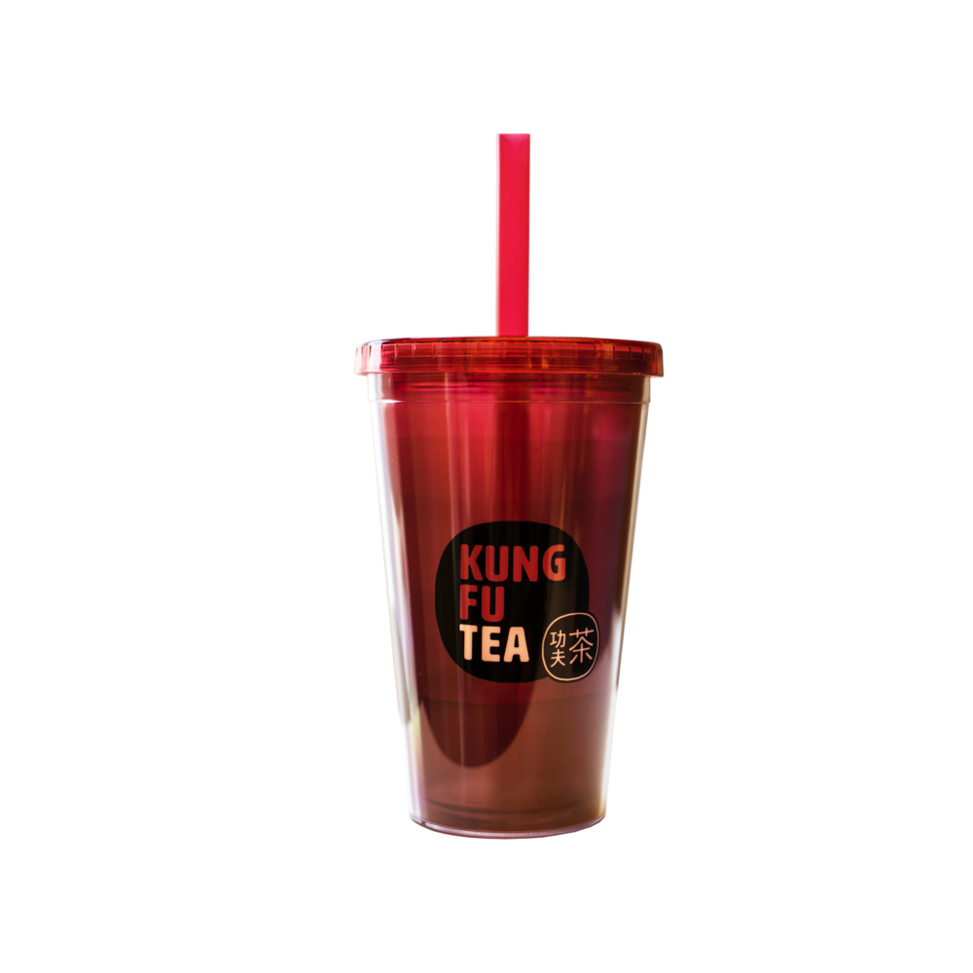
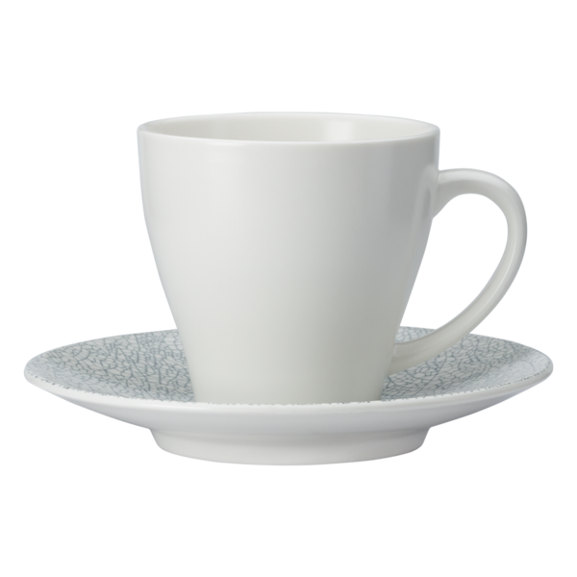
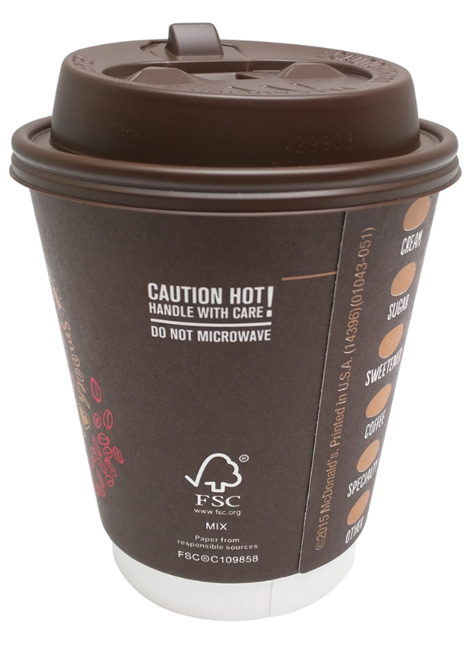
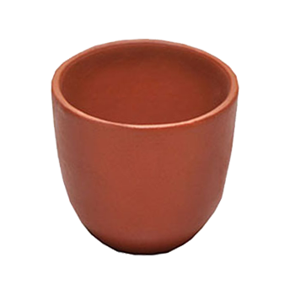
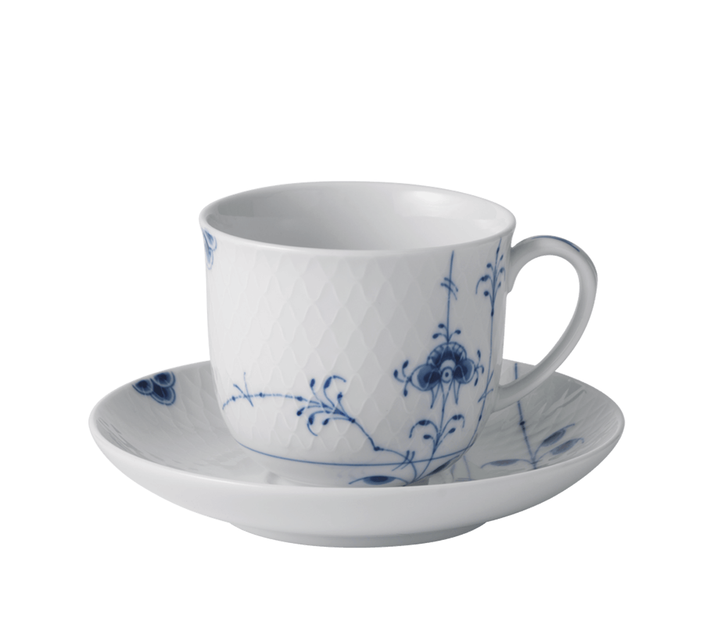
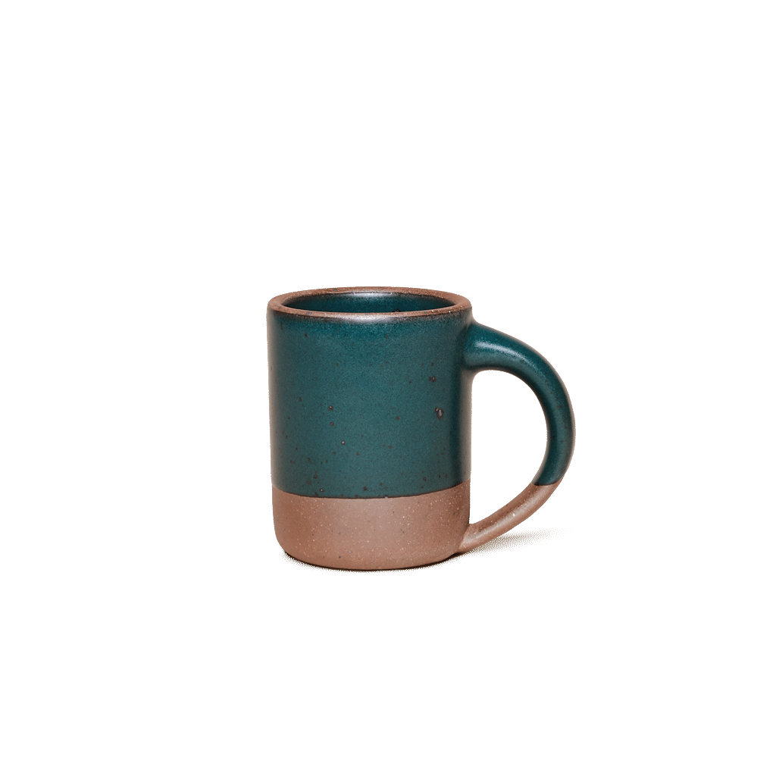
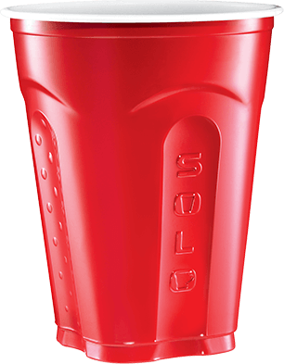
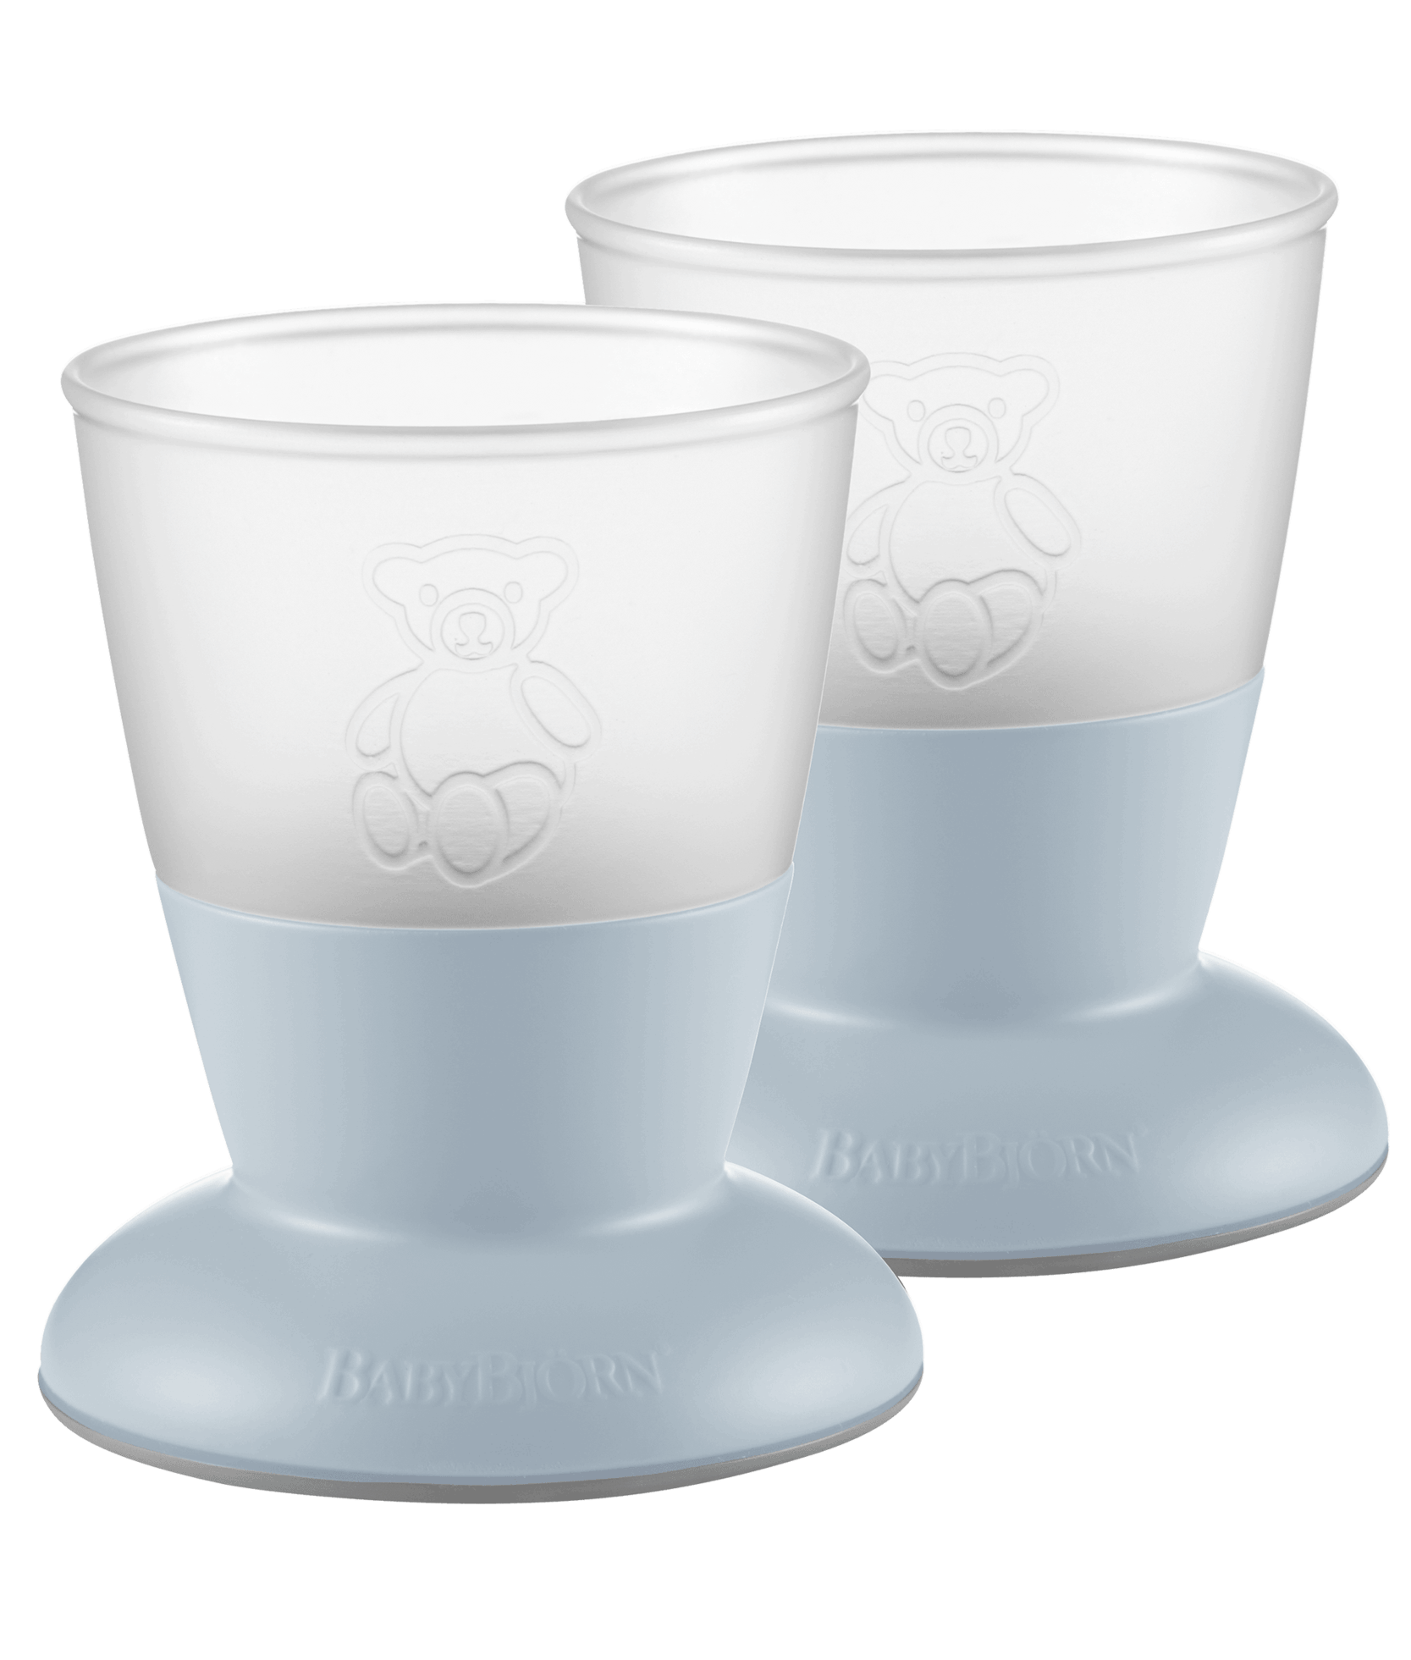
Objects Have Properties
What are some properties for a cup?
Color
Volume
Material
Hot
Notes:
In JavaScript, an object is a standalone entity, with properties and type. Compare it with a cup, for example. A cup is an object, with properties. A cup has a color, a volume, a material it is made of, etc. The same way, JavaScript objects can have properties, which define their characteristics.

Slide 6
Objects in JavaScript – Syntax
let solo = {
color: "red",
volume: 18,
material: "plastic",
hot: false
}
Notes:
How could we represent the red solo cup in JavaScript?
An object is just a variable, so we use let to declare it. Use curly brackets to surround each property of the object. Use a colon to attach a value to a property. Use a comma to separate each property-value.
JSON stands for JavaScript Object Notation. It is a lightweight data-interchange format based on JavaScript objects.

Slide 7
What about this object?
let teacup = {
color: "white",
volume: 8,
material: "ceramic",
hot: true
}
Notes:
Have a student come up to the board and try to define the teacup object. Then, show the answer.

Slide 8
Review: Initializing an object with properties
let person = {
name: "Alex",
age: 14,
city: "Westlake"
}
let
Object Name
=
{
Property Name
:
Property Value
,
Other Properties
}
Notes:
This person variable is now an object that contains multiple properties. Properties are the variables that are part of objects.
Break down the syntax for a JS object. Make sure to make a note of each character used.

Slide 9
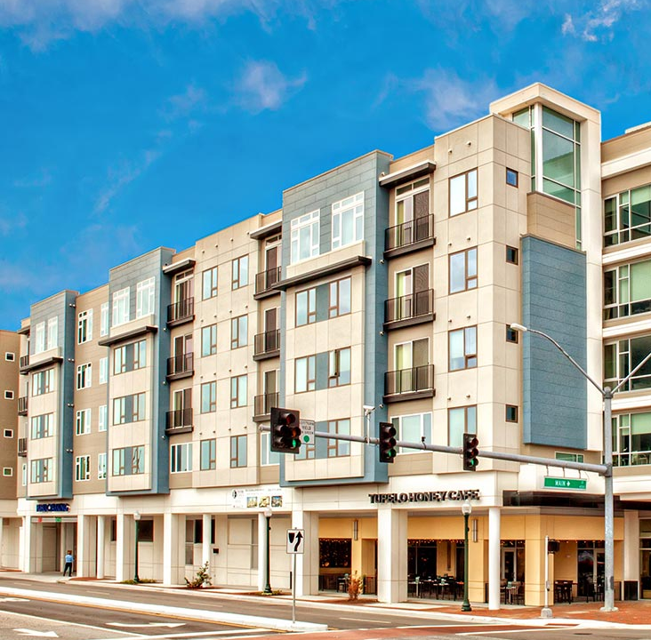
Properties
Notes:
Let’s talk a little more about properties.

Slide 10
What is a Property?
A property is a variable that is attached to an object
Each property on an object has a value
EXAMPLE
let solo = {
material: "plastic"
}
Property: material
Value: "plastic"
Notes:
A property of an object can be explained as a variable that is attached to the object. Object properties are basically the same as ordinary JavaScript variables, except for the attachment to objects. The properties of an object define the characteristics of the object. Just like variables, each property has a value that can change based on the object.
A value can be anything: a string, a number, even another object or a function!!

Slide 11
Getting a Property
Use dot notation to get a property value from an object
<object_name>.<property_name>
EXAMPLE
let teacup = {
material: "ceramic"
}
let objectMaterial = teacup.material;
alert(`the teacup is ${objectMaterial}`);
object_name: teacup
property_name: material
Notes:
If an object exists, you can access the properties attached to it using dot notation. This means <object_name>.<property_name>
For example, if you wanted to show the user the material for a cup, you could use teacup DOT material.
What message will the user see? “the teacup is ceramic”

Slide 12
Setting a Property
Use dot notation to set a property value from an object too!
<object_name>.<property_name> = <value>
EXAMPLE
teacup.color = "blue";
alert(`the teacup is ${teacup.color}`);
Notes:
Setting properties uses dot notation as well.
For example, if the user painted the cup to be another color, it is possible to set the color property using teacup DOT color.
What message will the user see? “the teacup is blue”

Slide 13

What is JSON data?
JavaScript Object Notation
{
"name": "Clifford",
"size": "Big",
"color": "Red",
"species": "Vizsla"
}
Stored in .json files
Keys must be strings
Convertible to objects
Used by DBs and APIs

Slide 14

Quiz Time!

Slide 15

Mini-quiz
let flight = {
departCity: "CLE",
arriveCity: "LAX",
numberOfSeats: 108,
flightTime: 244
}
How would you get the departure city from this object?
Notes:
For this part, go around the room (or ask students to come up to the whiteboard) to answer the questions.

Slide 16
Mini-quiz
let flight = {
departCity: "CLE",
arriveCity: "LAX",
numberOfSeats: 108,
flightTime: 244
}
flight.departCity
Notes:
For this part, go around the room (or ask students to come up to the whiteboard) to answer the questions.

Slide 17
Mini-quiz
let flight = {
departCity: "CLE",
arriveCity: "LAX",
numberOfSeats: 108,
flightTime: 244
}
How would you get the arrival city from this object?
Notes:
For this part, go around the room (or ask students to come up to the whiteboard) to answer the questions.

Slide 18
Mini-quiz
let flight = {
departCity: "CLE",
arriveCity: "LAX",
numberOfSeats: 108,
flightTime: 244
}
flight.arriveCity
Notes:
For this part, go around the room (or ask students to come up to the whiteboard) to answer the questions.

Slide 19
Mini-quiz
let flight = {
departCity: "CLE",
arriveCity: "LAX",
numberOfSeats: 108,
flightTime: 244
}
How would you set the flight time to 250?
Notes:
For this part, go around the room (or ask students to come up to the whiteboard) to answer the questions.

Slide 20
Mini-quiz
let flight = {
departCity: "CLE",
arriveCity: "LAX",
numberOfSeats: 108,
flightTime: 244
}
flight.flightTime = 250
Notes:
For this part, go around the room (or ask students to come up to the whiteboard) to answer the questions.

Slide 21

Mini-quiz
Define a new object variable named dog with:
a name of “Air Bud”
a breed of “Golden Retriever”

Slide 22
Mini-quiz
let dog = {
name: "Air Bud",
breed: "Golden Retriever"
}
Notes:
For this part, go around the room (or ask students to come up to the whiteboard) to answer the questions.

Slide 23
Questions?

