Slide 1
JavaScript Crash Course
Hy-Tech Club: Web 103
Notes:
Welcome to this quick Crash Course to go over some of the JavaScript concepts that were covered in Web 102.

Slide 2
AGENDA
Variables
Input/Output
Buttons/Functions
Conditional Statements
DOM Manipulation
For Loops
Notes:
We will talk about variables, input and output, buttons and functions, conditional statements, DOM Manipulation, and for loops!

Slide 3
Variables
Variables are named storage locations for values like strings and numbers
let wizard = "Gandalf the Grey";
wizard = "Gandalf the White";
let number = 5;
number = number + 1;
Notes:
Does anyone know what variables are?
Here’s a quick description: variables are named storage locations for values like strings and numbers.
Here’s an example – we use the let keyword and the equals sign to create one, and just the equals sign to set one. Variables can be text or numbers, and the values can change.

Slide 4
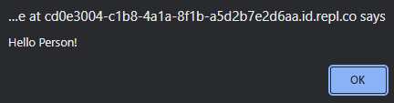
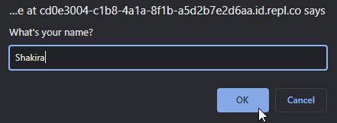
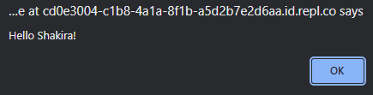
Input/Output
alert displays a message
prompt receives input text
alert("Hello Person!");
let person = prompt("What's your name?");
alert(`Hello ${person}!`);
Notes:
Basic input and output can be accomplished with alert and prompt.
Alerts will display a message in a pop-up box. Notice the parentheses and quotation marks.
It looks like this little pop-up when the message appears.
To get input, prompt does a similar thing, but with a little text box. Notice there is also a variable that stores the answer.
The pop-up for a prompt looks like a little message with a text box.
From there, you can use the variable value in an alert – notice the backticks and dollar sign + curly brackets to display the value.
The alert has the text value that the user inputted!

Slide 5

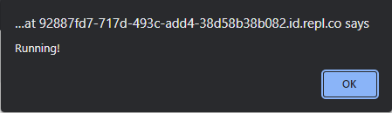
Buttons
Buttons run functions when someone clicks them
HTML
<button onclick="run()">Run Me</button>
JavaScript (function definition)
function run() {
alert("Running!");
}
Notes:
To get code to run on-demand, we can use buttons.
Buttons run a thing called functions when someone clicks them.
The HTML looks like this – note the onclick attribute, function call with parentheses, and button text.
This button would look like a box with “Run Me” inside.
On the JavaScript side, we have to define the function. We use the function keyword, the function name, parentheses, curly brackets, and the function body.
When the button is clicked, the pop-up will appear because of the alert!

Slide 6
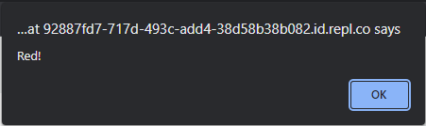
Conditional Statements
if and else decide whether or not to run a piece of code based on a boolean
let player = "Mario"
if (player === "Luigi") {
alert("Green!");
} else {
alert("Red!");
}
Notes:
Does anyone remember what conditional statements do? Anyone know what keywords we use?
The if and else keywords can decide whether a piece of code runs or not. Does anyone remember what a boolean is? It is a true or false value.
The code could look something like this – notice the if, parentheses, boolean check with triple equals, curly brackets, and else. What message would show up when this code runs?
It’s going to say “Red!” because player is not equal to Luigi.

Slide 7

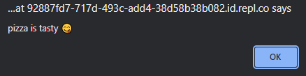
DOM Manipulation – read from input Get text from HTML inputs and use it in JS
HTML: <input id="food">
pizza
JavaScript:
let foodInput = document.querySelector("#food");
let foodValue = foodInput.value;
alert(`${foodValue} is tasty 😋`);
Notes:
Now things get fun. We can use DOM Manipulation to read text from an HTML input, and use it in JavaScript.
On the HTML side, it looks like this – note the id attribute – this will allow us to select the input in JS.
In JavaScript, we have a few lines here. The first line grabs the actual entire HTML element with document.querySelector, and stores it in the foodInput variable. The next line gets the actual text value using dot value and stores it in the foodValue variable. Finally, the alert takes that text and shows a message.
So let’s say someone entered the word “pizza” into the text box…
When the JavaScript code executes, it will display a message like this, taking the value and putting it into a pop-up message!

Slide 8
DOM Manipulation – Update and Create Update the text of elements, or create new ones
Create:
let newElement = document.createElement("p");
newElement.textContent = "New York";
document.body.appendChild(newElement);
Paris
New York
Cleveland
HTML: <p id="location">Paris</p>
JavaScript:
let locationElement = document.querySelector("#location");
locationElement.textContent = "Cleveland";
Update:
Notes:
The other side of DOM Manipulation is to update existing elements and create totally new ones!
First, updating an existing piece of HTML.
Say we have an HTML paragraph like this one that says “Paris” – note the id attribute. It looks like this piece of text.
One the JavaScript side, we can grab that whole HTML element in the same way – using document.querySelector and passing in the hashtag id. On the next line, it uses dot textContent to update the text.
When this JavaScript runs, it changes the text to “Cleveland”!
Now let’s look at creating a totally new element. This is possible using document.createElement. This creates a paragraph. Then, we set the text with dot textContent. Finally, we put it on the page with document.body.appendChild.
Once that code runs, it will add a totally new paragraph to the page!

Slide 9
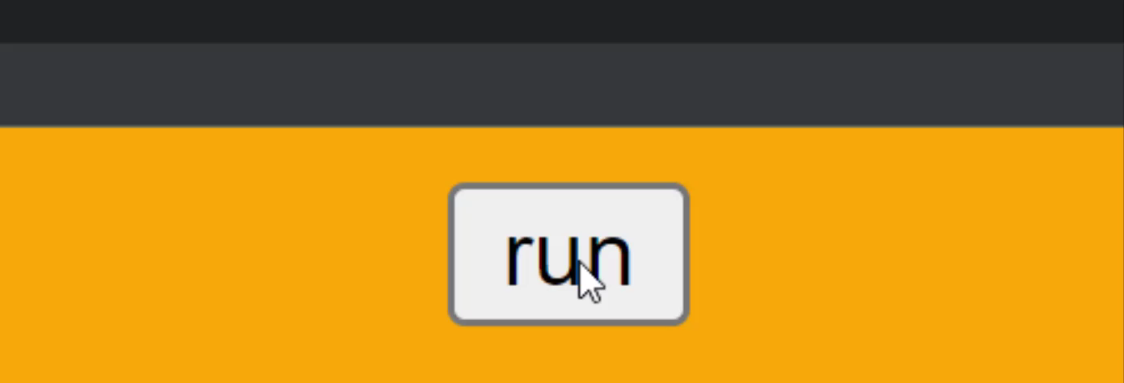
For loops
For Loops repeatedly run code
for (let i = 0; i < 5; i++) {
alert(`Message: ${i}`);
}
Notes:
The last big topic to cover is for loops – does anyone remember what for loops do?
They can repeatedly run a piece of code a certain number of times.
The code looks like this – it’s a lot of code, but it’s almost all boiler-plate. That means all you have to do is memorize these exact symbols, like the parentheses, semi-colons, pluses, less-than sign, and curly brackets. How many times will the alert run? It runs 5 times!
Let’s watch this quick clip of the code actually running. Notice that it also grabs the i value, which keeps track of the current iteration through the loop.

Slide 10
Putting it all together
Variables store data, alert and prompt are used for input and output, buttons run functions, if and else statements control program flow, DOM manipulation can get text from inputs and update elements, and for loops repeatedly run code. If you’re lost, don’t worry! We will be doing a code-along activity that uses all of these concepts, and there is a cheat sheet available as well 😎
Notes:
We talked about a ton of stuff in this presentation, and ran through it super fast! But don’t worry if you’re lost – we have a code-along activity where you’ll get to practice everything again.

Slide 11
THANK YOU
Any questions?
Notes:
Thank you! Does anyone have any questions?

