Slide 1


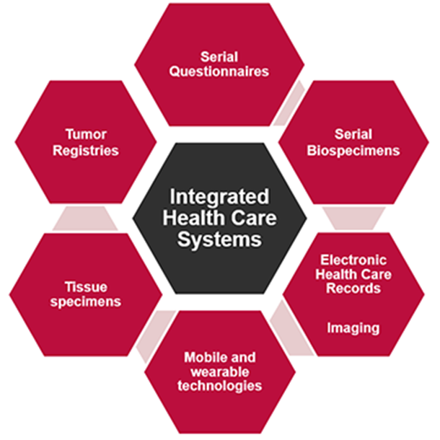
API
Open source* bidirectional information submission & Retrieval: Sites <--> NCI
Hosted by DCEG in secure FedRamp** data infrastructure.
Sites can securely send, view/update their own submitted data …
… they can do it directly – using their internal data submission environments, including ETL, SAS, etc. If requested (already for SAS and CloverLeaf) NCI may develop***, or assist the development of client connectors for specialized environments at the Sites.
… and/or with the assistance of a Web dashboards developed by NCI. Sites can also develop their own client Applications – NCI will assist with configuration of API calls if needed.
NCI will not require or request access to the Site’s own data infrastructure. Bidirectional exchanges are made through calls to NCI’s hosted API .
Sites are welcome to submit their own indexed entries, or rely on NCI to manage indexation.
* github.com/episphere/connect
** fedramp.gov
*** for example github.com/episphere/sas-connect
DCEG Cloud
API
<-- the "caller model": you call us, we don't call you

