Slide 1


Interactive Dashboard for Analyzing U.S.-Canada Tariffs Impact on Canada's Construction and Production Sectors
James Cole

Slide 2
1. Introduction
Indices Explained:
IPPI: Fabricated metal products (v1230995999).
RMPI: Metal ores (v1230998193).
BCPI: Metal fabrications
Data Range: 2020 to 2025
Tools: Streamlit, ECharts, PostgreSQL.

Slide 3
2. Methodology
Authentication: streamlit_authenticator, YAML config, bcrypt hashing.
Database: SQLAlchemy for save/query operations.
Visualization: ECharts for lines/charts with tariff markers; Pandas rolling.corr.
Usability: Date pickers, sliders (3-12 months), feedback messages.

Slide 4
3. Results
Fetching: Dynamic IPPI/RMPI/BCPI data from 2020-present.
Focus: Metals prices and fabrications.
Trends: Steady rise in 2025; Q2 near post-COVID highs (2020).
Projections: Higher prices by Q3 2025, worsening housing sector vs. 2020

Slide 5
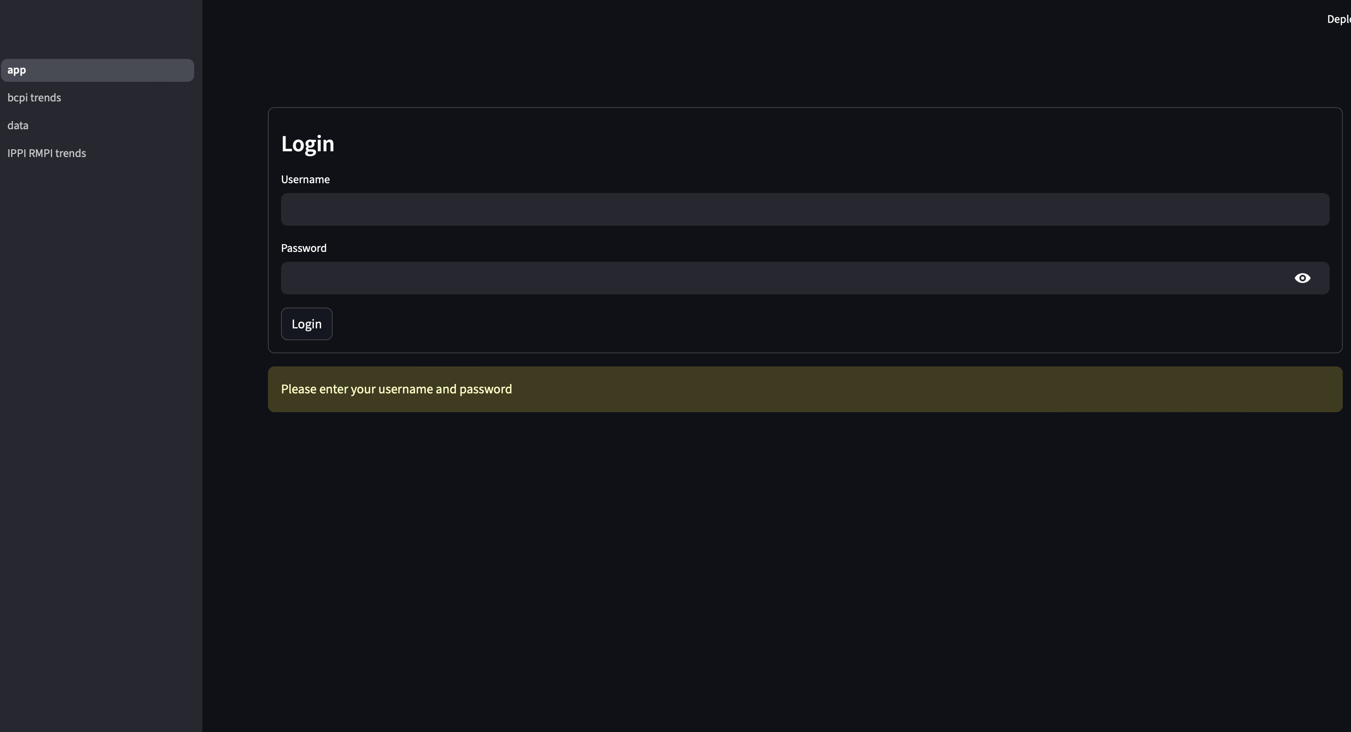
User Authentication

Slide 6
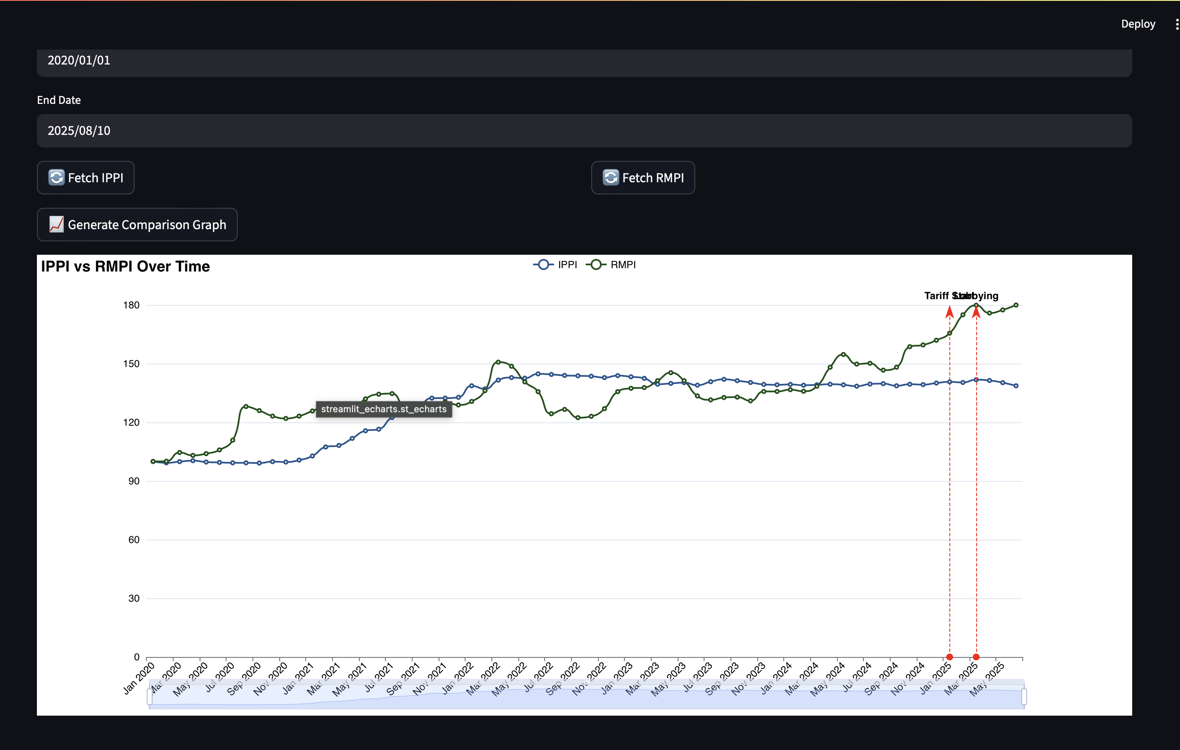
IPPI vs RMPI

Slide 7
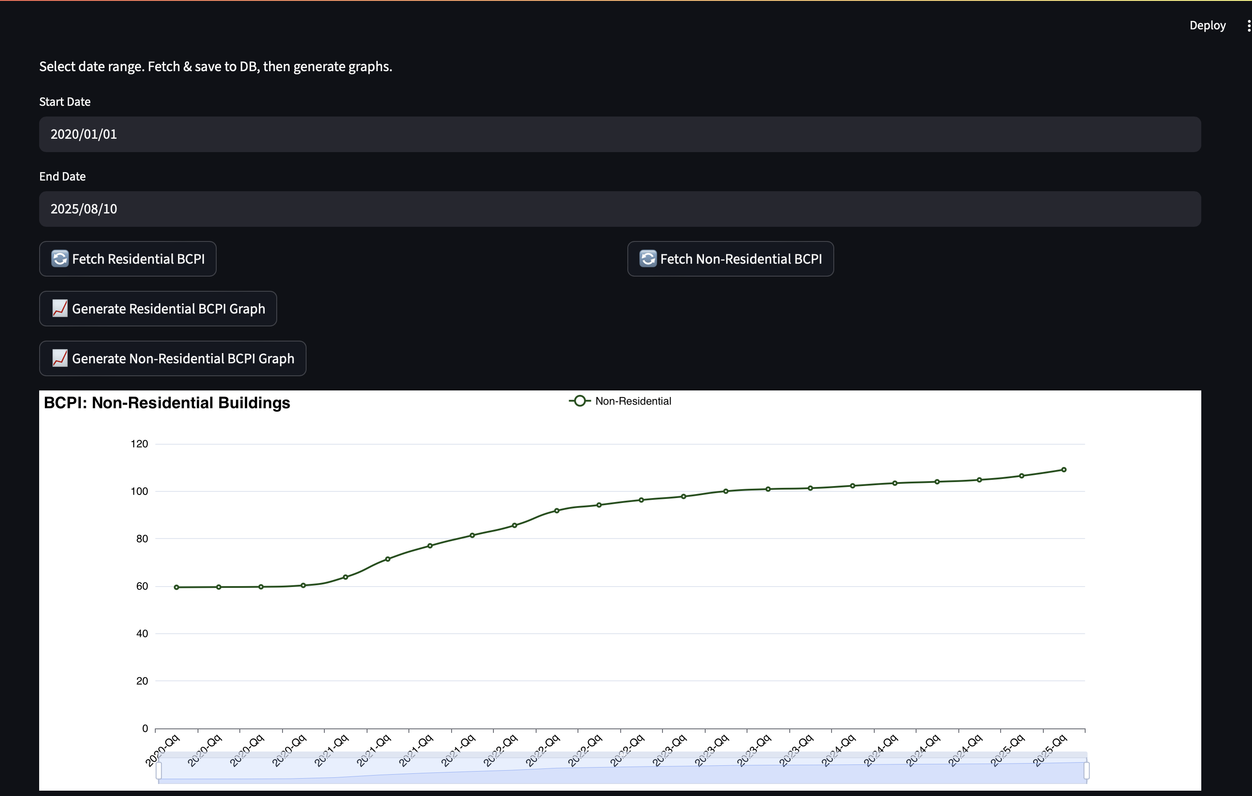
BCPI Division: Metal Fabrications Building type: Non residential

Slide 8
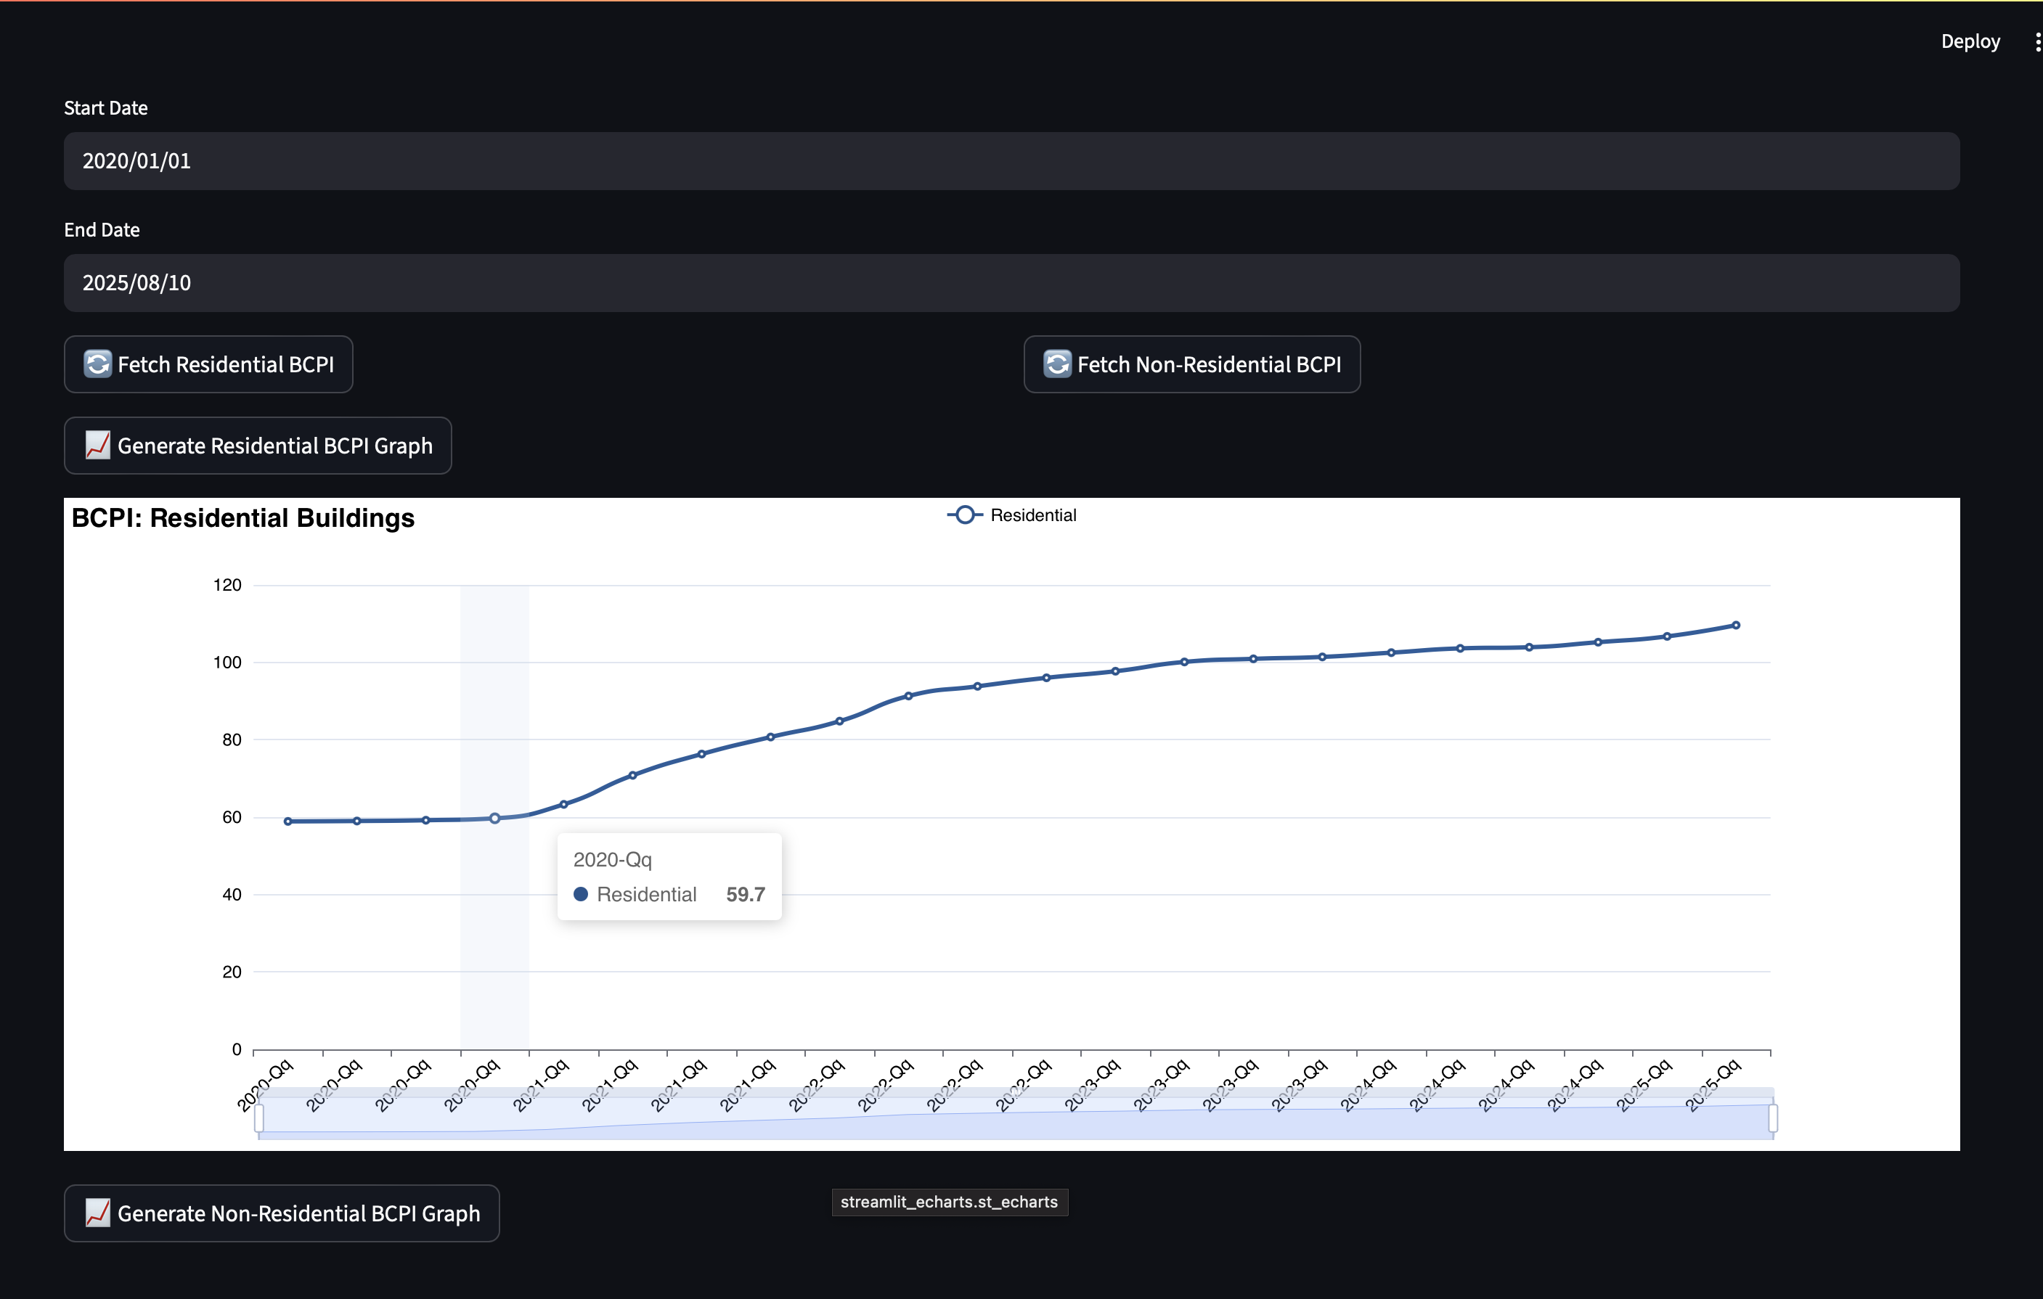
BCPI Division: Metal Fabrications Building type: Residential

