Slide 1
Jacques Bourg

Slide 2
Overview
Short CV
Signal and image processing
Machine learning and deep learning
Mathematical modelling
Software development
Experimental experience
Other

Slide 3



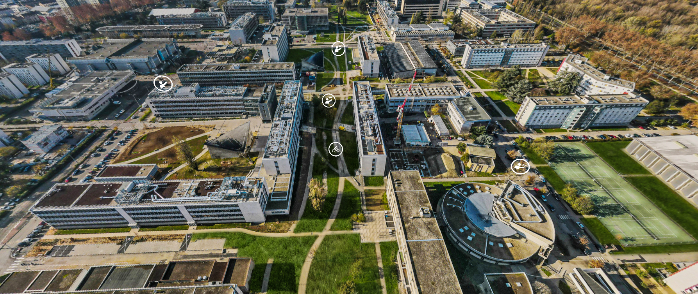
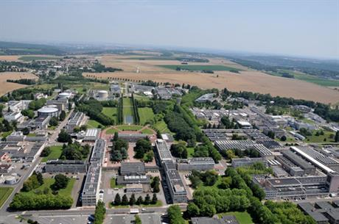
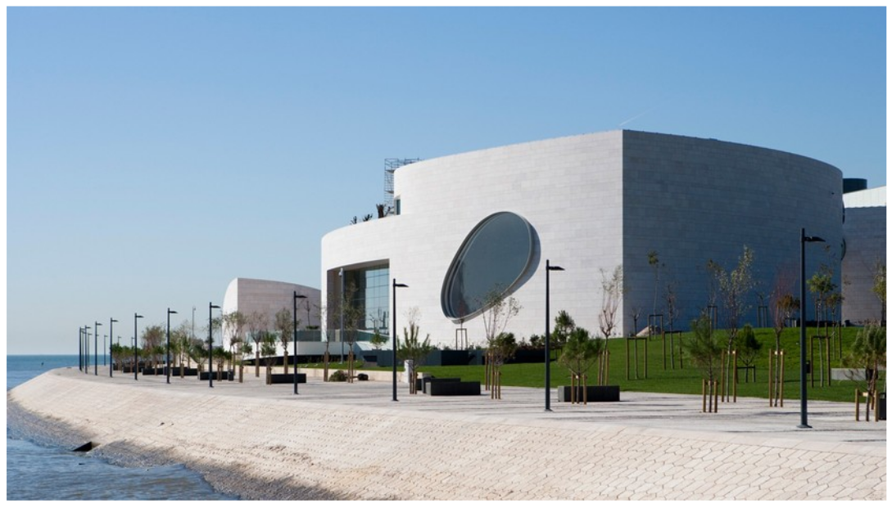



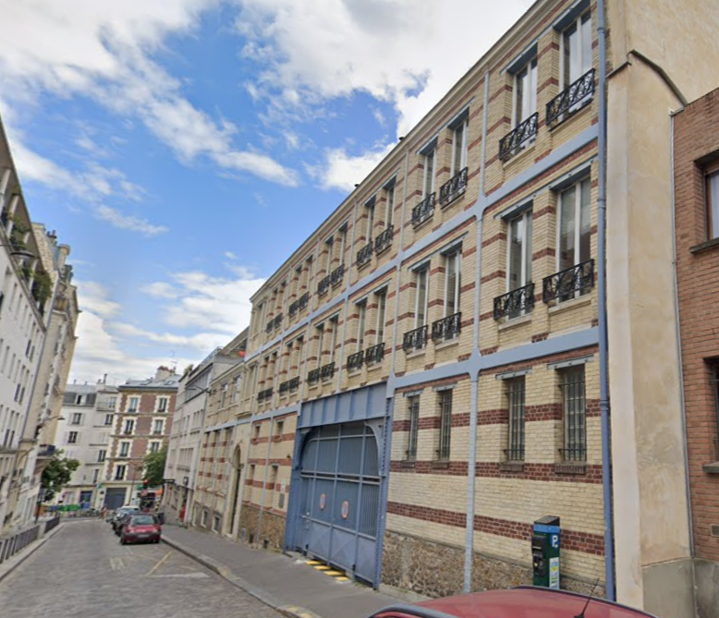
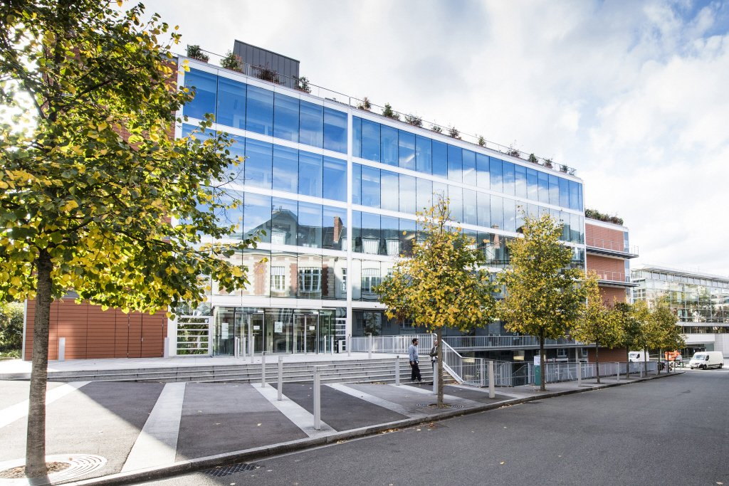
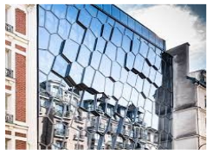
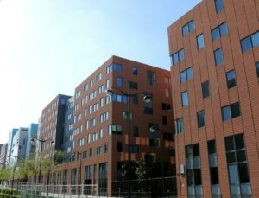



Slide 4
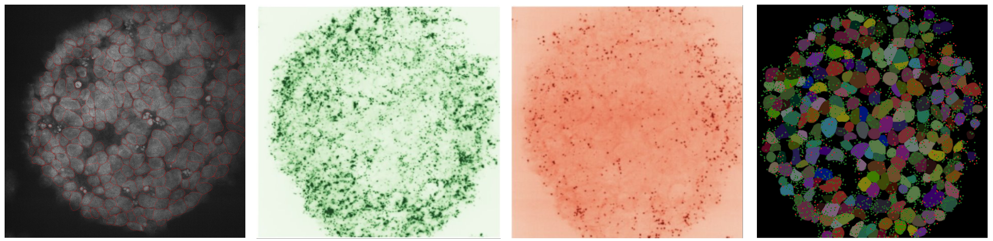
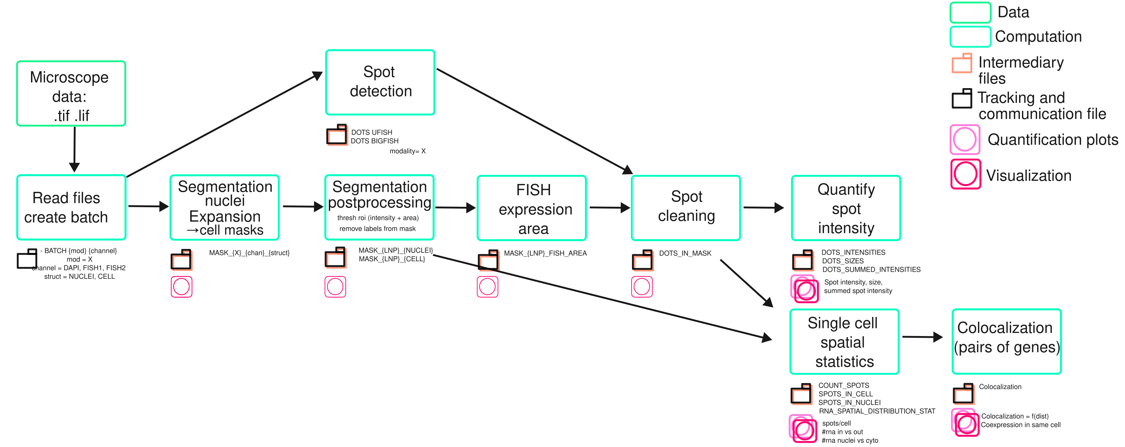
Signal and image processing 1/5
Pipeline to quantify rna expression in cells using
fluorescence imaging
Cross environment function calls (bash).
Deep learning state of the art frameworks :
Cellpose (segmentation), Ufish (spot detection).

Slide 5
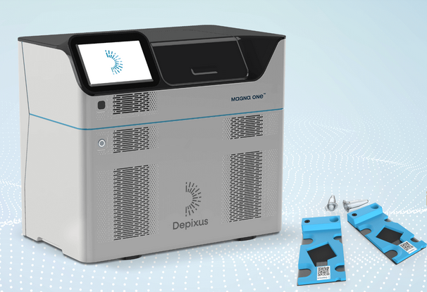
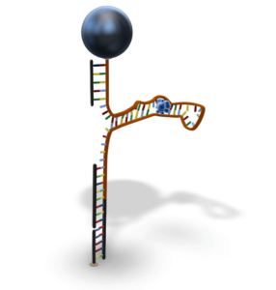
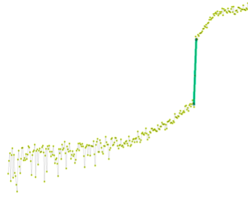
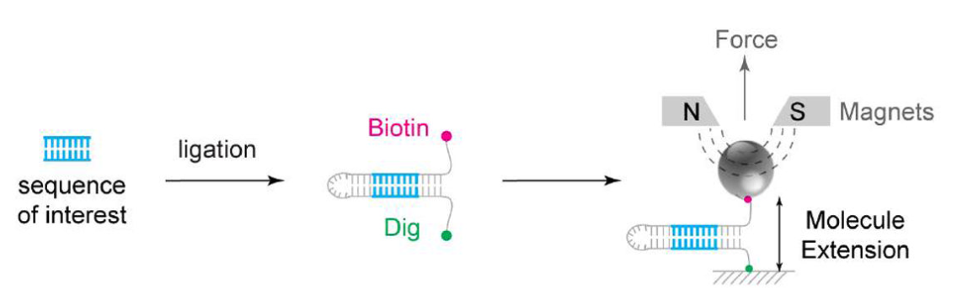
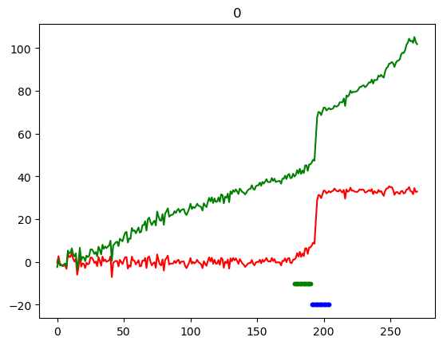
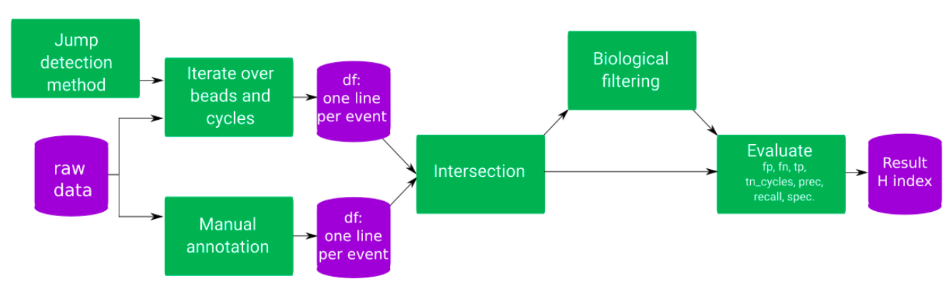
Signal and image processing 2/5
Molecule to molecule
interactions.
Drift removal algorithm
Pipeline to benchmark different state of the art change point detection
« Ruptures » Truong, Oudre, Vayatis, Selective review of offline change point detection methods, Signal Processing, Volume 167, 2020.

Slide 6
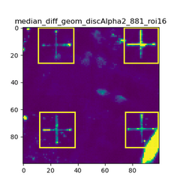
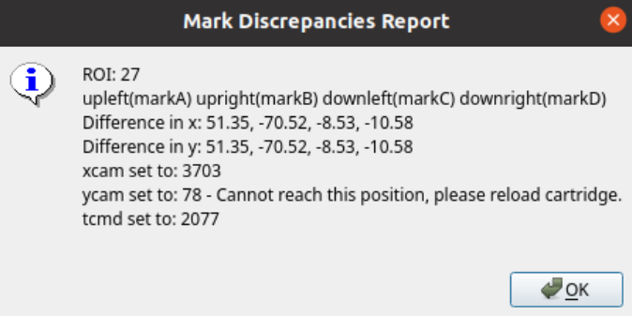
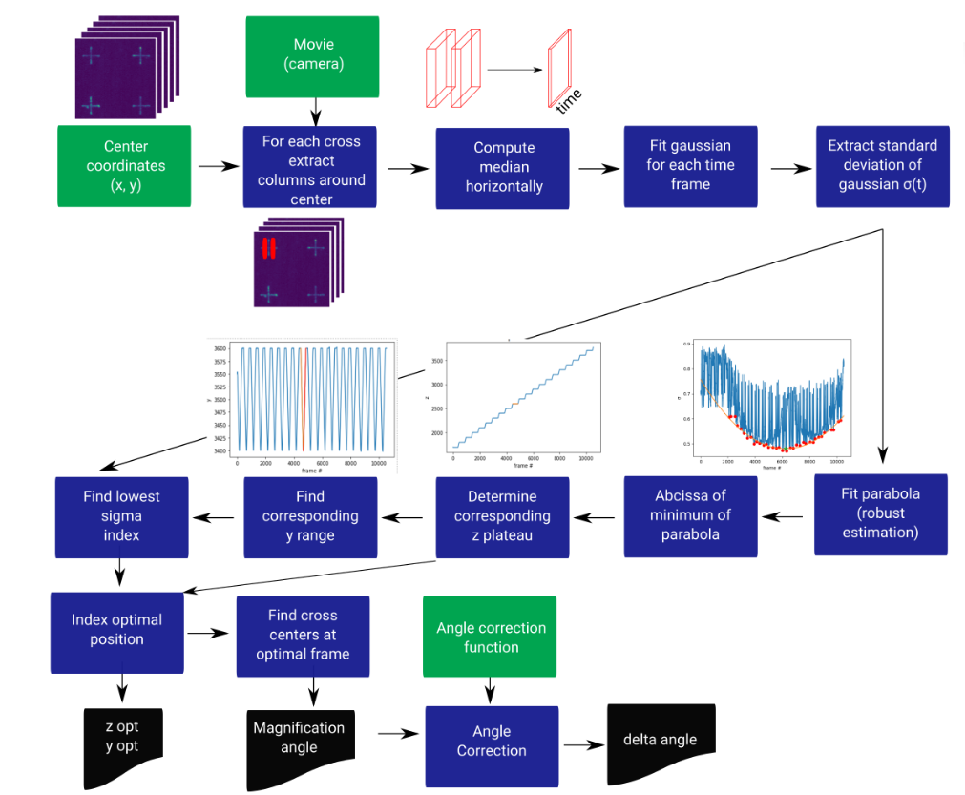
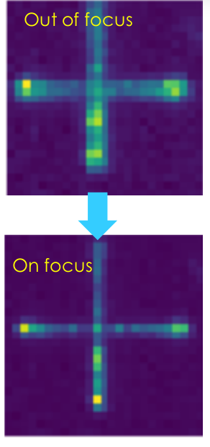
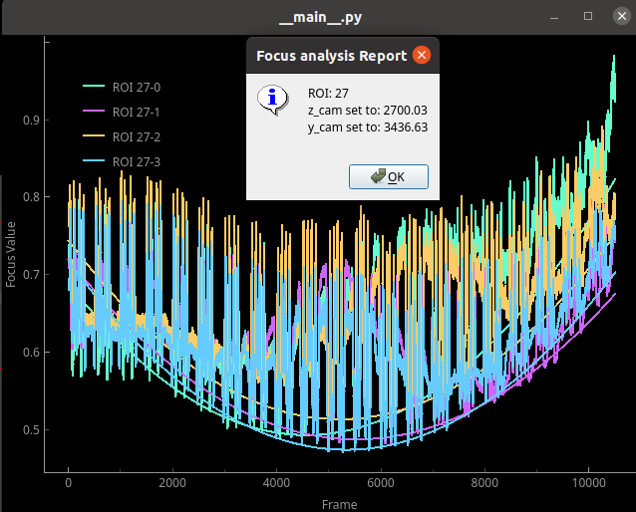
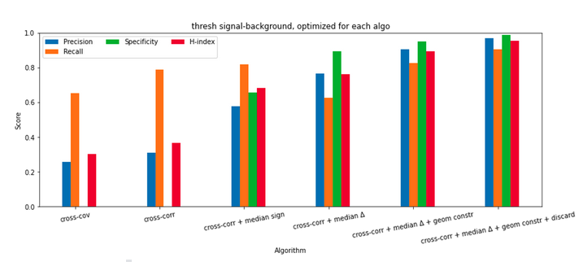
Signal and image processing 3/5
Cross detection algorithm :
* Cartridge insertion QC.
* Focus Analysis
Focus procedure
Algorithm design.
Data base benchmarking.
Performance assesing.

Slide 7
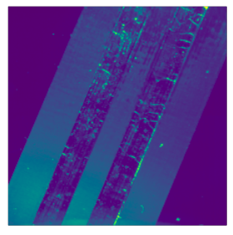
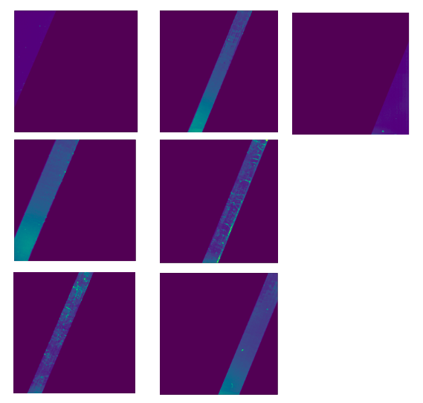
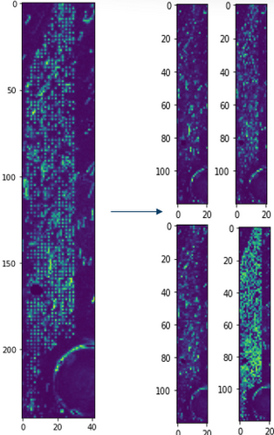
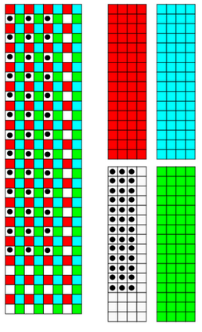
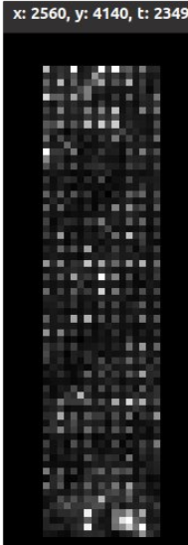
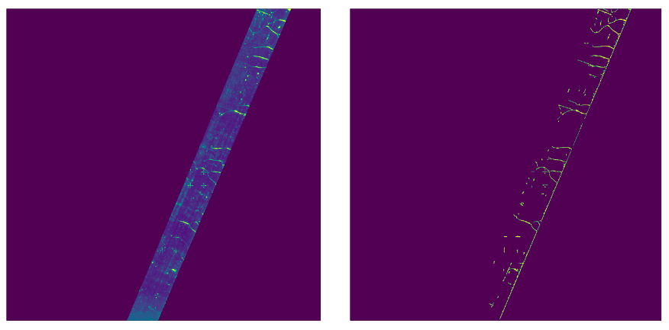
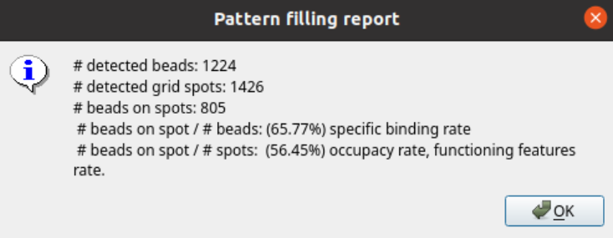
Signal and image processing 4/5
Canal detection
Grid detection : cartridge alignment protocol and surface chemistry quantification
Cross correlations, sobel edge detector, Hough transform, Registration using convolution.
Bubble segmentation on fluidic canal
Cross correlations, sobel edge detector, Hough transform, Registration using convolution.

Slide 8
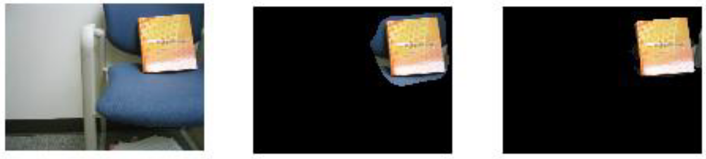
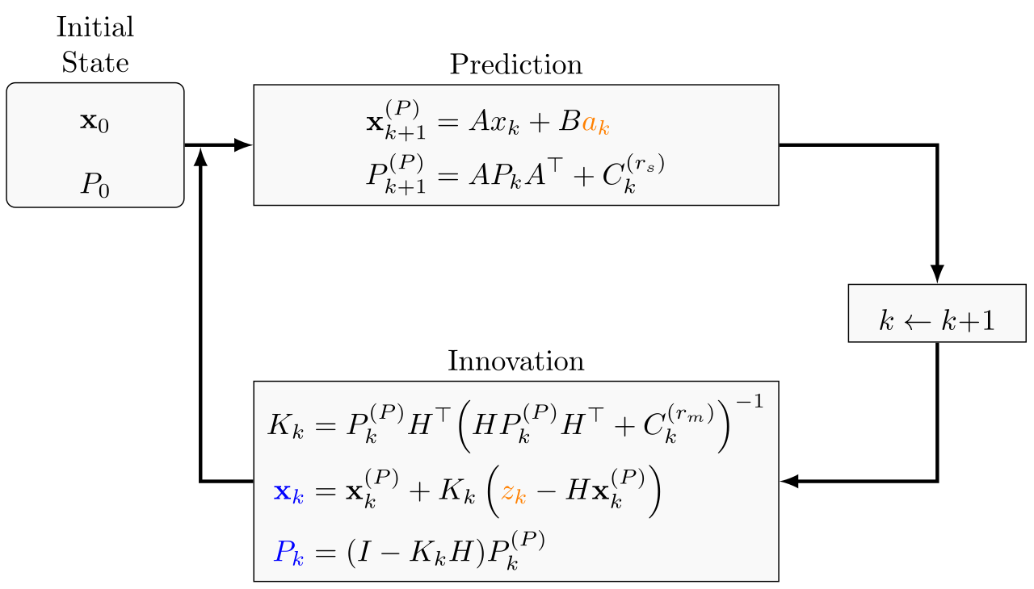
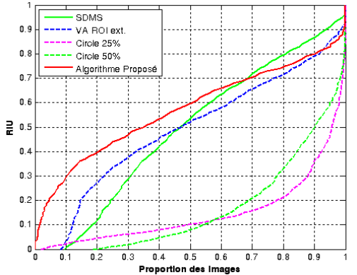
Signal and image processing 5 /5
Bottom up segmentation using
salient points and Mean-shift
Kalman filtering for early detection
of explosive compounds

Slide 9

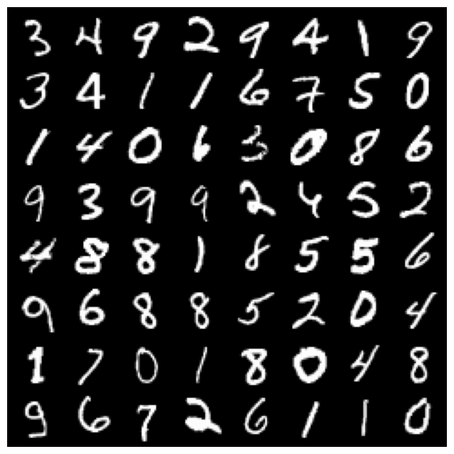
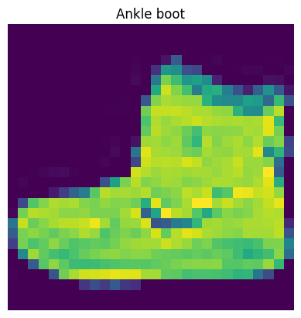
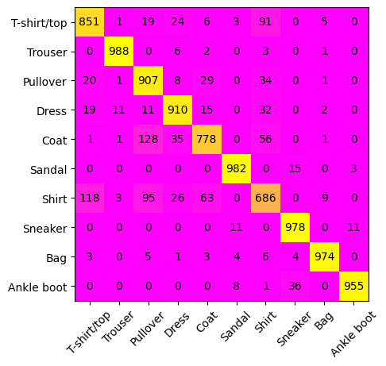










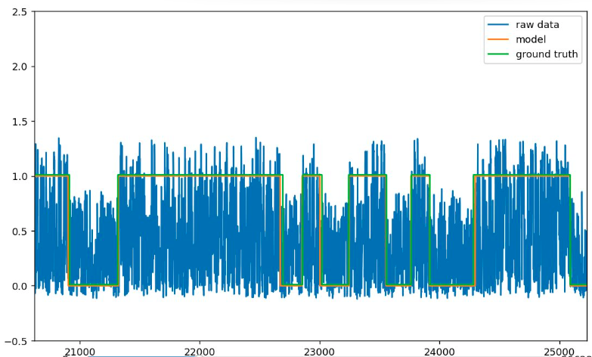
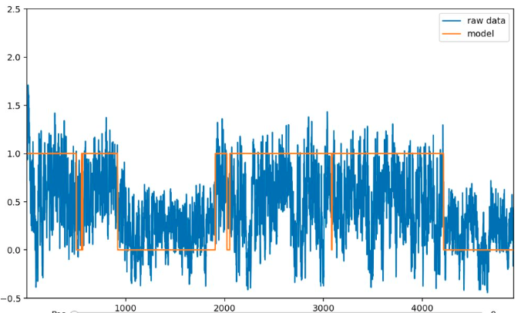
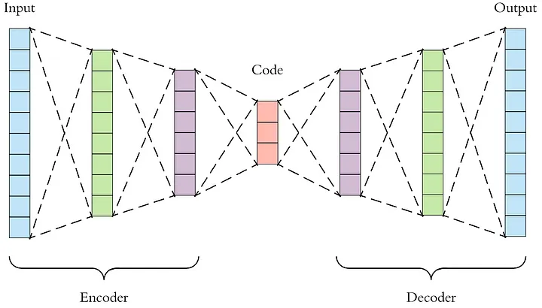
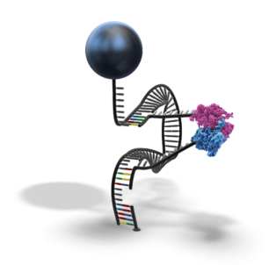
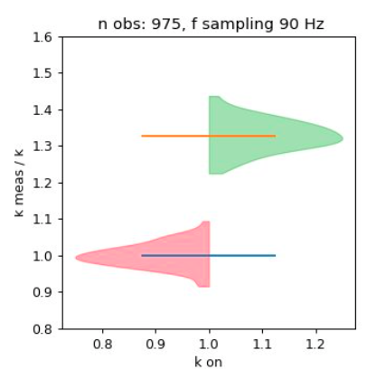
Machine and deep learning 1/2
* Several MOOCs
* Techniques : Linear regression, Logistic regression, PCA, K-means, KNN, SVM, Random Forests, Deep networks, CNNs.
* Autoencoder :
30 % error

Slide 10
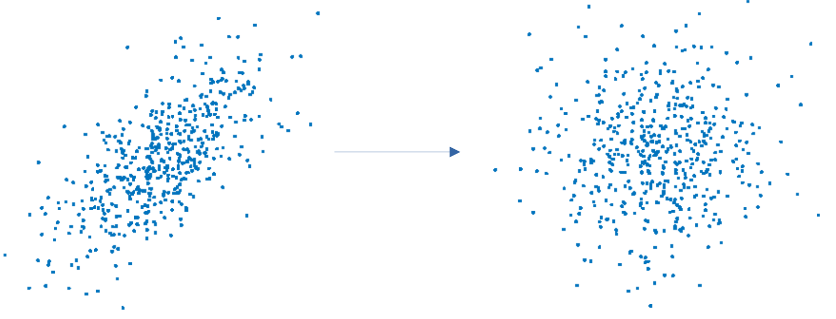
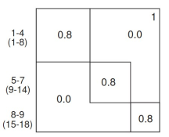
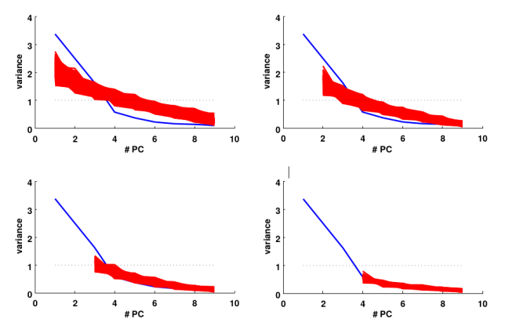
Machine and deep learning 2/2
Statistical significance of PCs
To what extent the observed data is not pure noise ?
Synthetically generated data : correlation matrix
Hypothesis testing framework
Shuffling
3 iterations to converge
Shuffling provoques a transfer of variance from the signal to the noise.
Solution :
Iteratively remove PC (signal) and shuffle.

Slide 11
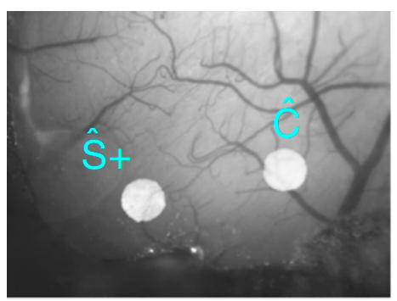
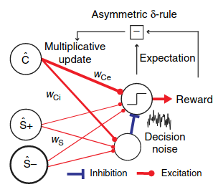
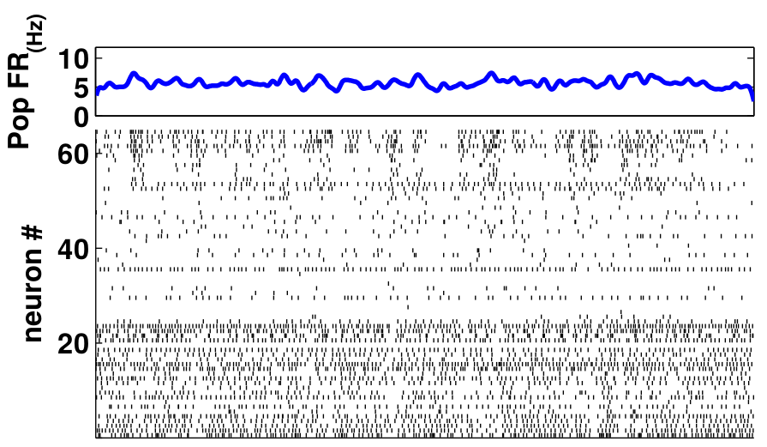
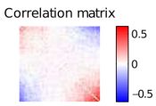
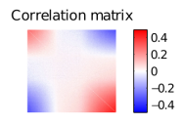

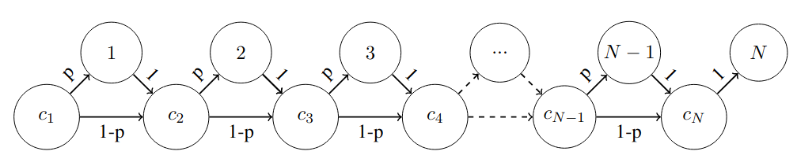
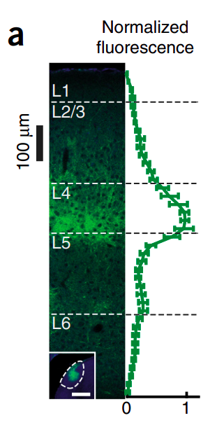
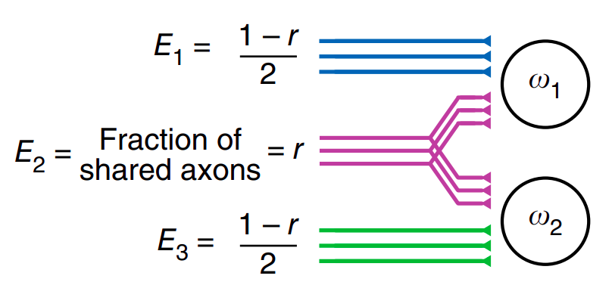

Mathematical modelling 1 / 2
* Network dynamics
(dyamical systems theory)
* Behavioral model of decision making
Data
Model
* Model of synaptic variability
* Combinatorial identities

Slide 12











Mathematical modelling 2 / 2
* Chemical modelling of the antibody-hairpin reaction :
* Probabilistic modelling of a hairping closing during a force cycle
* Experiment design : protein protein interaction

Slide 13















Software development
2P cell analysis, several stimuli
Core contributor for data analysis software :
- Mark alignment detection (cartridge well inserted).
- Determine optimal focus protocol (z).
- Grid detection for fine alignment of pixels
center with beads and fluidics protocol dev.
Library for data analysis

Slide 14






Experimental experience

Slide 15
Other
Teaching : neuron biophysics and sensory coding and perception (Paris Diderot and Orsay : 8 h/year). Pasteur : spot detection for rna imaging (3h), pasteur neubias course.
Conference presentations : speaker at COSYNE (Salt Lake City, 2015), (GDR neuro, Strasbourg 2017), APAN (Chicago, 2019).
HR : elaboration of technical tests, interviews and hiring of a senior data scientist.
Project leader of an integrative project : elaboration of functional blocks of the processes (Ishikawa fishbone diagrams) related to the instrument.

Slide 16





Publications
* A spatial code for temporal cues is necessary for sensory learning. Bagur*, Bourg* et al.
* Combinatorial identities using Bernoulli graphs. Bourg
* Multilaminar networks of cortical neurons integrate common inputs from sensory thalamus. Morgenstern, Bourg, and Petreanu.
* Cortical recruitment determines learning dynamics and strategy. Ceballo*, Bourg*, Kempf* et al.
* Targeted Cortical Manipulation of Auditory Perception. Ceballo et al.

