Slide 1
POLYDRUM
Battisti Luca
Kursun Bertan
Baco Gresia

Slide 2
The goals of this project are to overcome the limitations of the traditional drum machines, not able to provide to the musician the possibility to create a custom polyrhythm
It is possible for the artist to manage up to six different instruments independently, which can be controlled both from the graphic interface and the microcontroller
This project will serve not only a creative task, but also a didactic one, allowing students to get familiar with polyrhythm itself

Slide 3
Specifics
The user interface is written in HTML and CSS, the logic in Javascript. This project includes several external libraries, that are:
microBit.js to achieve Bluetooth connection between the microcontroller and the pc
plotly.js for signal visualization
Howler JS for audio API
math.js
jquery.js for the user interface

Slide 4
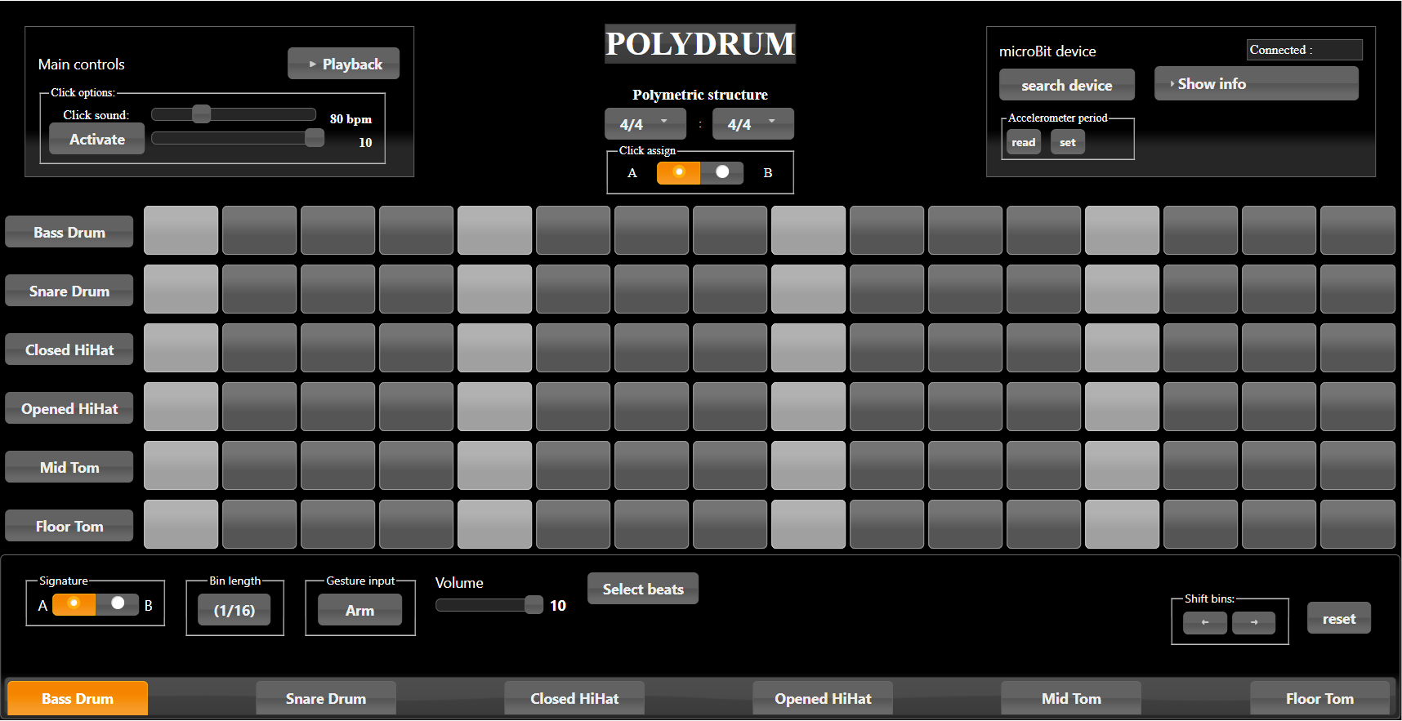
Graphic interface

Slide 5
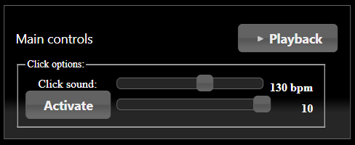
Main Controls

Slide 6
The artist can regulate the tempo through the slider
Click volume can be adjusted similarly
With “playback” the artist can hear the whole pattern

Slide 7
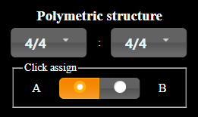
Polymetric structure

Slide 8
This area of the interface holds the very heart of polyrhythm. Indeed, the artist can choose his custom polyrhythm according to the Brian Ferneyhough’s notation:
m/n:i/j
where m/n means m beats, each an n-th of a whole note, while m/n:i/j means two rhythms fitting a measure that lasts n beats of the former and j beats of the latter, where the former rhythm repeats every m of its own beats and the latter every i of its own beats. So the overall cross-rhythm becomes m:j.
The software will automatically find a common tatum for all the instrument matrices.
Each part of the kit is initially assigned to signature A, but it can also be changed to put in evidence the bits related to signature B.

Slide 9
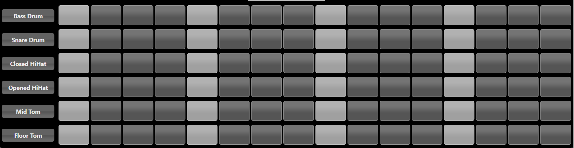
Matrices

Slide 10
All you need to do is click on a box to select it, and if you're not satisfied with the result you can just click it again to deactivate it
With the “Playback” button in the “Main controls” section you can hear the overall composition, which can be totally erased by clicking the “reset” button described in the following section.

Slide 11


Additional features

Slide 12
Depending on the instrument selected at the very bottom of the software, with “Select beats” one can highlight the beats corresponding to a given time signature for that given instruments
With Shift bins, on the other hand, we can shift in a circular and independent way, one bin at a time each matrix. This allows every kind of experiments, setting your creativity free!

Slide 13
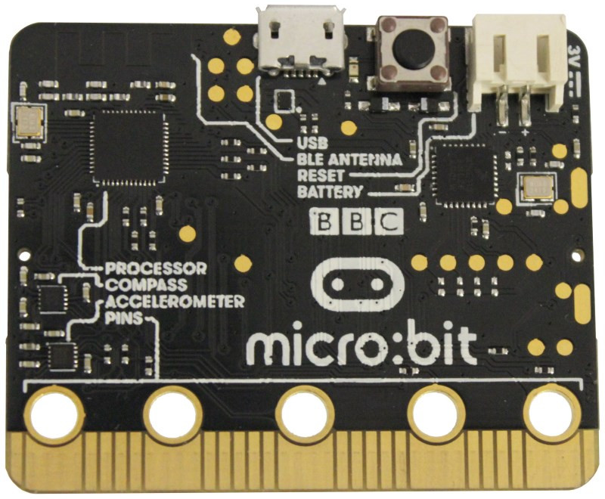
MICROBIT PAIRING

Slide 14
A microBit is essentially a microcontroller that allows the interaction between our gestures and sound coming from the software.
Simple gestures have been implemented for each on the instruments, emulating what happens by hitting the drums with drum sticks

Slide 15
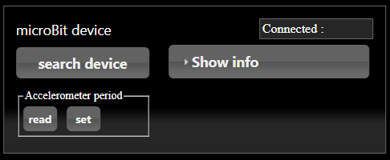
Connecting the microBit

Slide 16
The first step to exploit the gestures is to pair the device with the software through BLE connection
It is possible to set the accelerometer period for the best performances, as well as read the values for Yaw, Pitch and Slope in real time

Slide 17

Arm/Disarm function

Slide 18
The “Arm” function enables you to record sounds through gestures once the playback is on
Its is possible to modify the track on the fly by clicking on the boxes as explained in the previous section
For further info on the gestures implemented, please watch the explanatory video included in the project folder

Slide 19
Conclusions and further developments
This project gave us the chance to create something that can potentially allow people with a weak musical background to create music and express themselves.
Along with the creative side of out work, we are very proud to serve as a tool for young students and musicians like us for understanding polyrhythm and its characteristics, as this software can also be thought as a didactic interface for getting familiar with polyrhythm itself.
In adding the microBeat features, we were inspired by live performances of well known artists who, by exploting new technologies, can create sounds and merge them into music on the fly. No software is nowadays able to support musicians in a reliable and robust way, and we tried to give a contribution to a research that will (hopefully) make music accessible to everyone.

Slide 20
THANKS FOR WATCHING!

