Slide 1
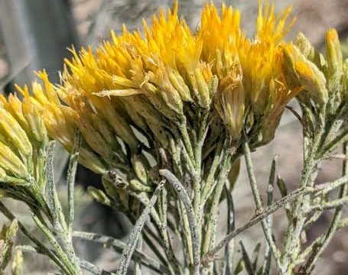
Deep Learning-Based Classification of Herbarium Images of Rubber Rabbitbrush: Implications for Analyzing Climate Change's Impact on Flowering Times

Slide 2
Overview:
Domain
Objectives
Methodology
Challenges
Plan and Future Approach
Citations

Slide 3
Domain

Slide 4
Phenology, the study of periodic life cycle events in organisms, illustrates how environmental factors impact an organism's life over time. This field also sheds light on how changes in these events can affect ecology, underscoring the importance of understanding and quantifying the interplay between phenological shifts and ecological balance, including impacts on population dynamics and nutrient exchanges (Forrest et al. 2010). The connection between environmental changes, particularly climate change, and plant phenology has been extensively documented.
For instance, record spring temperatures in the eastern United States during 2010 and 2012, peaking at 11.0°C and 10.7°C, led to significantly earlier flowering in some plant species (Ellwood et al. 2013). Similarly, a comprehensive analysis of 542 plant species across 21 European countries from 1971 to 2000 revealed a consistent trend of earlier phenological events (Menzel et al. 2006). Moreover, a recent study in the eastern United States, examining over 100 years of data on 36 plant species, found that plants flowered approximately 2.26 days earlier for each 1°C rise in annual average temperature, with no significant difference in response between native and non-native species (Geissler et al. 2023). This growing body of research underscores the profound impact of climate change on plant phenology and its broader ecological implications.

Slide 5
These type of studies give us insights that heavily rely on herbariums, especially in phenology. Herbariums, usually have records of characteristics of the individual plant such as young flower buds, senescing leaves, and bare branches along with meta-data about the information obtained. They're usually found inside online databases hosted by the Herbarium. However, a pertinent issue is that online herbarium specimens usually need phenological classification in the digitization process, which is resource and time intensive (Ellwood et al. 2019) but are crucial for understanding climate change’s impacts on phenological shifts. An effective digitization process involves specimen curation, image capture, image processing, electronic data capture and georeferencing locality descriptions. Since not every institution is taking a standardized approach, problems with the quality of our digitization emerge down the road (Nelson et al. 2012) and although insufficient funds at the local, national, and international scale to match the available workload have led to successful efforts to utilize public participation (Ellwood et al. 2018) there is still room for improvement in the domain of digitized specimen annotation.

Slide 6
Plant species in general are sensitive to environmental variables, with the timing of their phenological stages being disrupted or altered depending on external conditions. These shifts in phenology can have cascading effects through the ecosystem. For instance, the timing of when a forest leaves out signifies the start of the growing season and with it the progression of nutrient and water cycles. Likewise, if plants flower earlier in warmer springs but their insect pollinators have not yet emerged, plant and pollinator populations themselves can be negatively impacted (Ellwood et al. 2019).
Computer vision and deep learning techniques have been well documented strategies specifically for this purpose and have demonstrated reasonable results. (Unger et al. 2016) Demonstrated the validity of support vector machines for labeling plant specimens despite only using 10 images per species and with date ranges between 1820 and 1995. After they incorporated both normalization and feature extraction, they split up the data into two validation sets. Their success rate of 73 to 85% across both sets shows us that even with unfavorable conditions and a standard computer vision algorithm the results are somewhat satisfactory.

Slide 7
Objectives

Slide 8
1. Data Collection
2. Transfer Learning
3. Error Analysis
4. Statistical Analysis / Traditional Machine Learning

Slide 9
Data Collection:
Initially we were unsure of how to approach this. We were heavily leaning toward web-scraping until advisor figured out tabular data was downloadable directly from the herbarium website.
However, images downloading remained unclear. Eventually received R-script from member of symbiote support hub.
Climate data collection will begin after final truth values for unlabeled images has been established.

Slide 10
Transfer Learning:
After the initial look on data, we realized that although we had nearly 9000 images, many of those images weren’t labeled with a corresponding truth value related to the phenological stage.
Research suggests this is a common problem. Missing or improper annotation is exceedingly common in phenology area.
Data Science Advisor suggested technique known as Transfer-Learning, where models that have already been pre-trained on datasets can be used to label new unseen data in different problem. The truth values can act as a pseudo-label.

Slide 11
Error Analysis:
By incorporating transfer learning and leaving room for error in our interpretation of our images phenological values, we may need to find ways of building a robustness to ensure model’s predictions are sound.
We also acknowledge that not every image has been standardized or even shares common attributes with other specimens. The specimens vary in terms of where, when and how they were annotated. This could lead to model performance discrepancy in some data and not others.

Slide 12
Statistical Analysis / Machine Learning :
By establishing a more robust truth value for our unlabeled images early on, any analysis on future data becomes more robust and has more validity. Hence, this step is our final objective.
Final method yet to be determined but hoping to have something relevant to problem domain, data format and available research.

Slide 13
Methodology

Slide 14
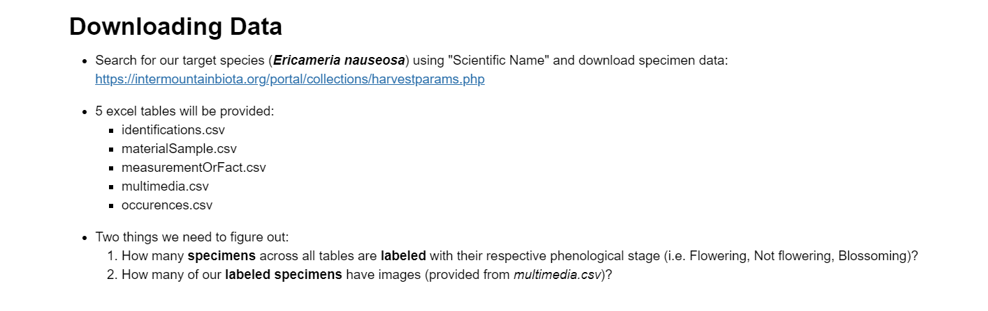

Slide 15
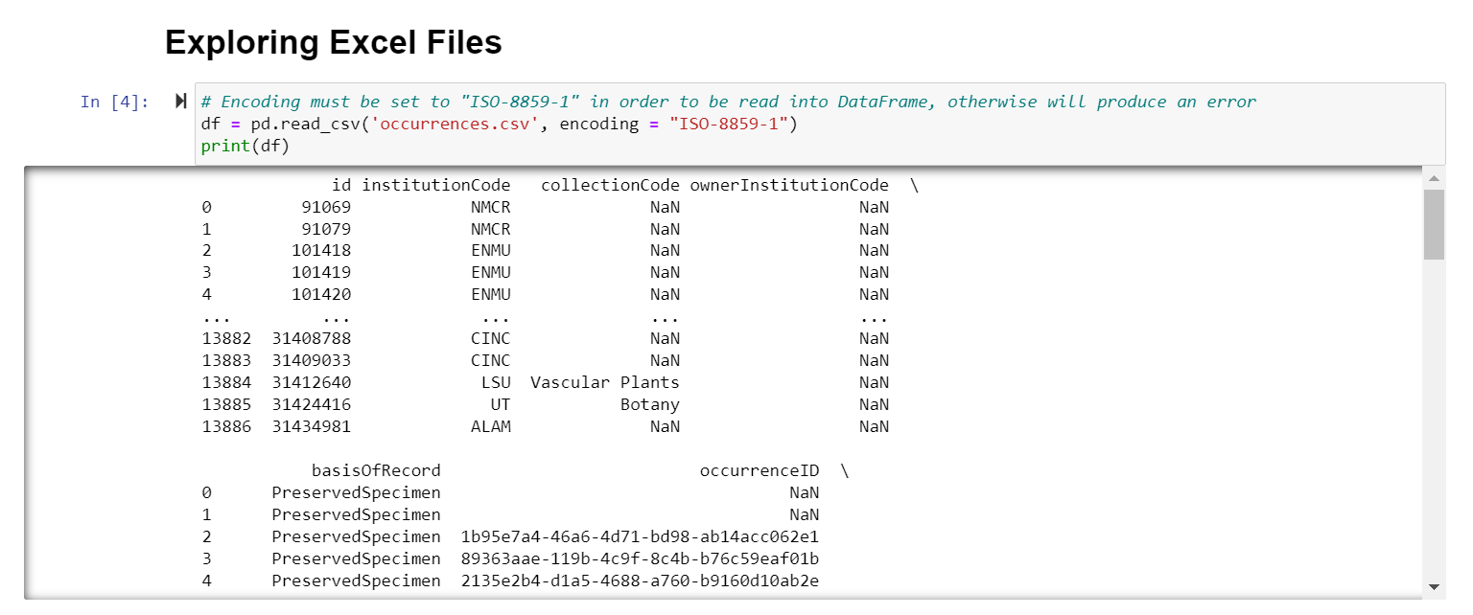
We open the main Excel file (occurrences.csv) and get an initial look at our data via a dataframe using Pandas.

Slide 16
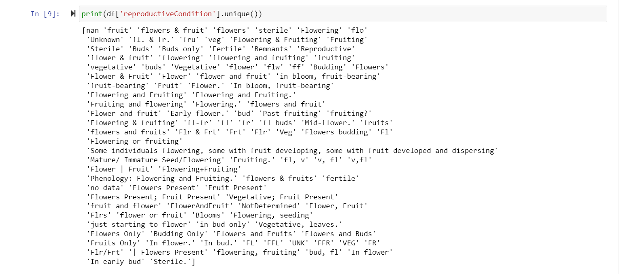
The “reproductiveCondition” column has our labels for the specimens but we have a lot of different labels.

Slide 17
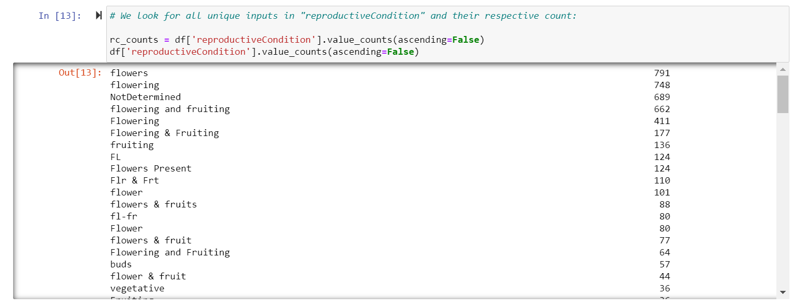
We print the counts for each value, to give us an idea of how many are in which category. Most are the same.

Slide 18
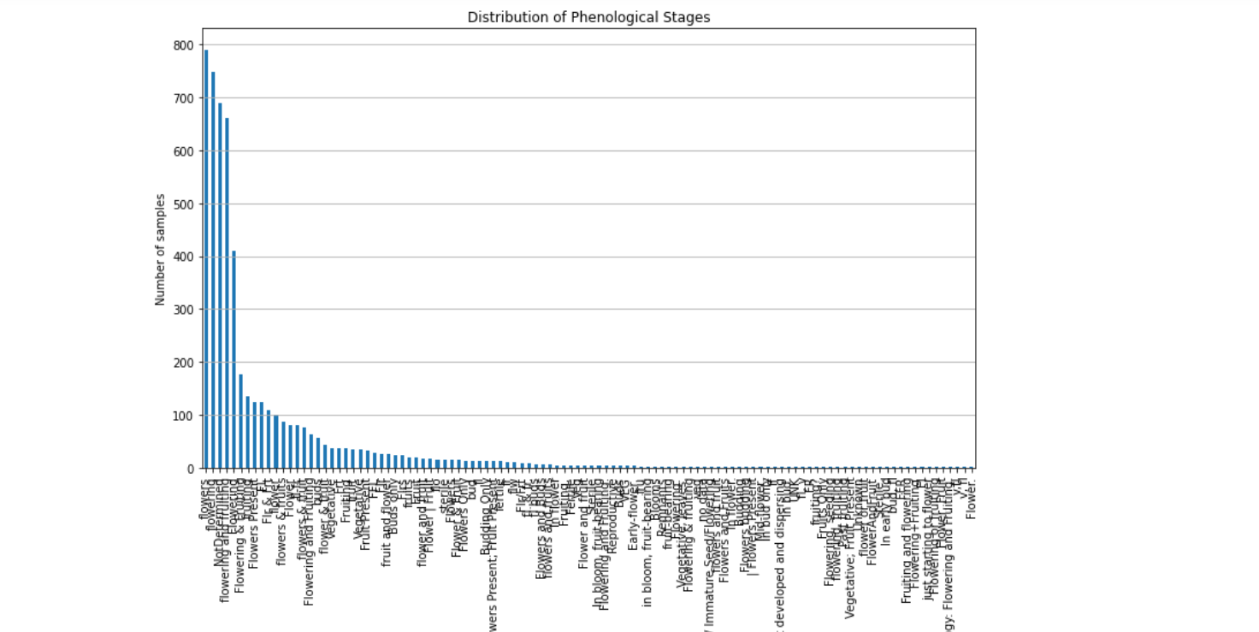
A visual representation of the counts. Note how most images fall under a handful of categories.

Slide 19
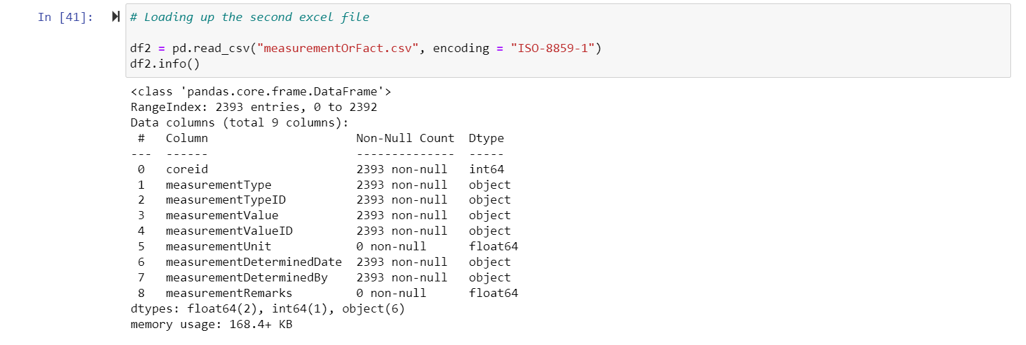
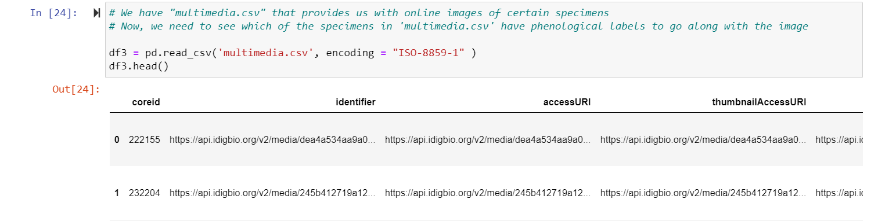

Slide 20
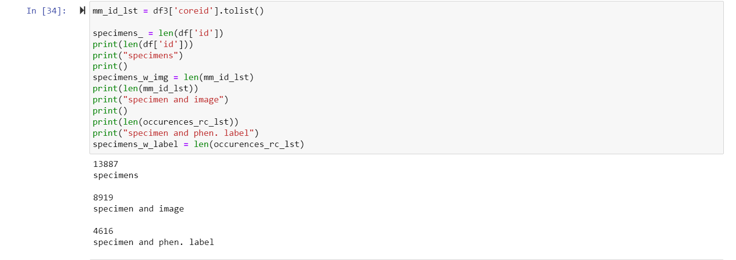
After downloading all our Excel files into dataframes, we add all the distinct specimens into lists with counts, depending on whether they had an image, label or both.

Slide 21
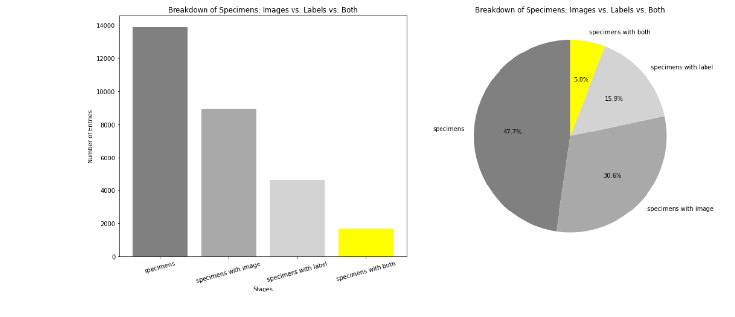
A visual representation of the total specimens and the sub-categories. We highlight the category that provides us with usable data for Transfer Learning.

Slide 22
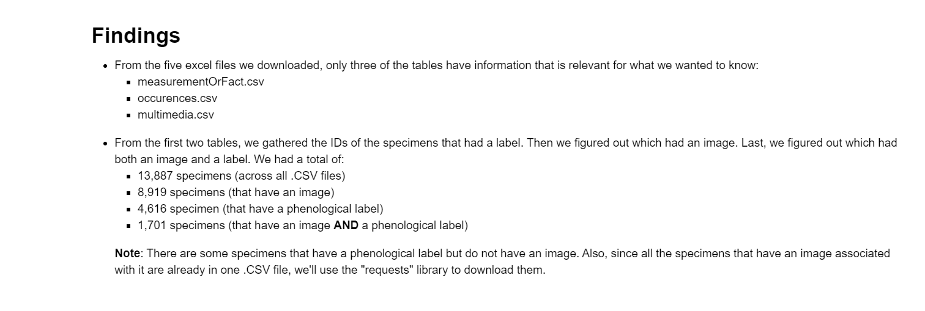
We summarize what we found out from our initial look into the data.

Slide 23
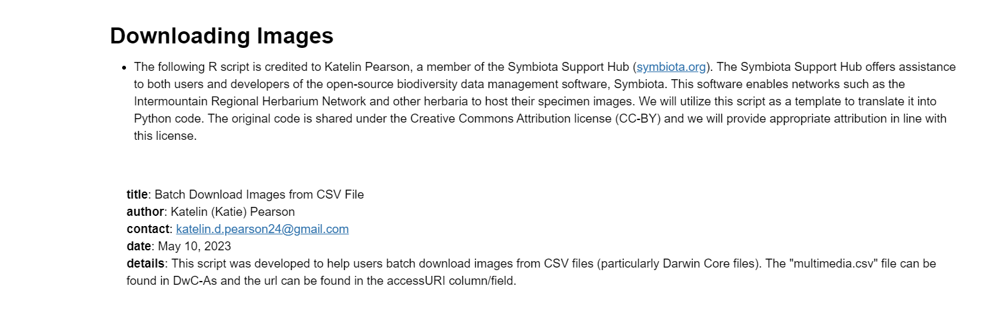
Introducing the R script that will be translated to help us download our images. We’ll show it in the next slide. Also, some information on the sharing license for our images is provided.

Slide 24
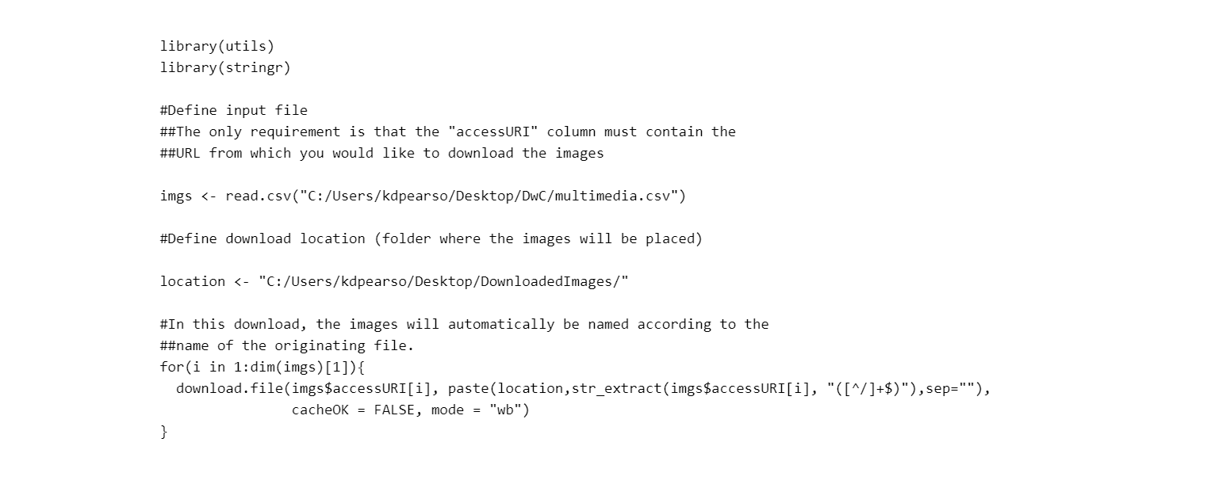
We will translate the script into Python while keeping it somewhat similar.

Slide 25
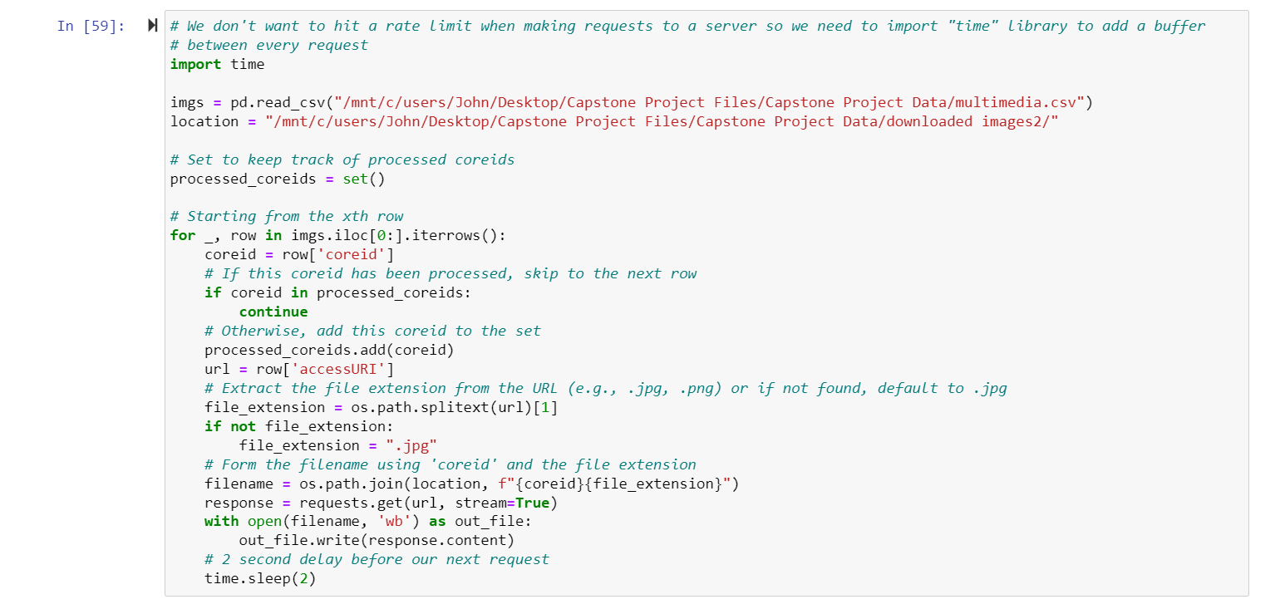
Batch Download Images from CSV File (in Python)

Slide 26
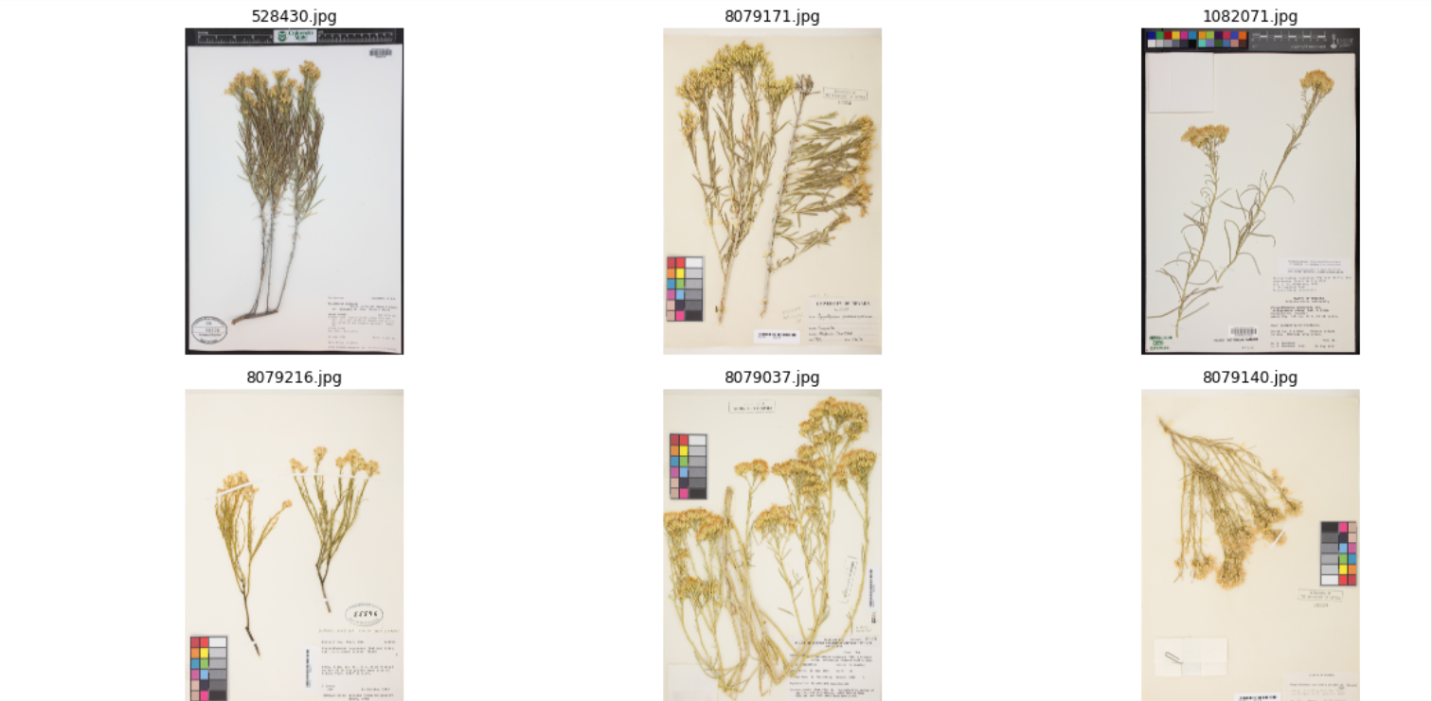
Some images from our downloaded sample. The images are noisy, so we’ll have to find some kind of algorithm to automate noise reduction (resizing, cropping, manipulating images).

Slide 27
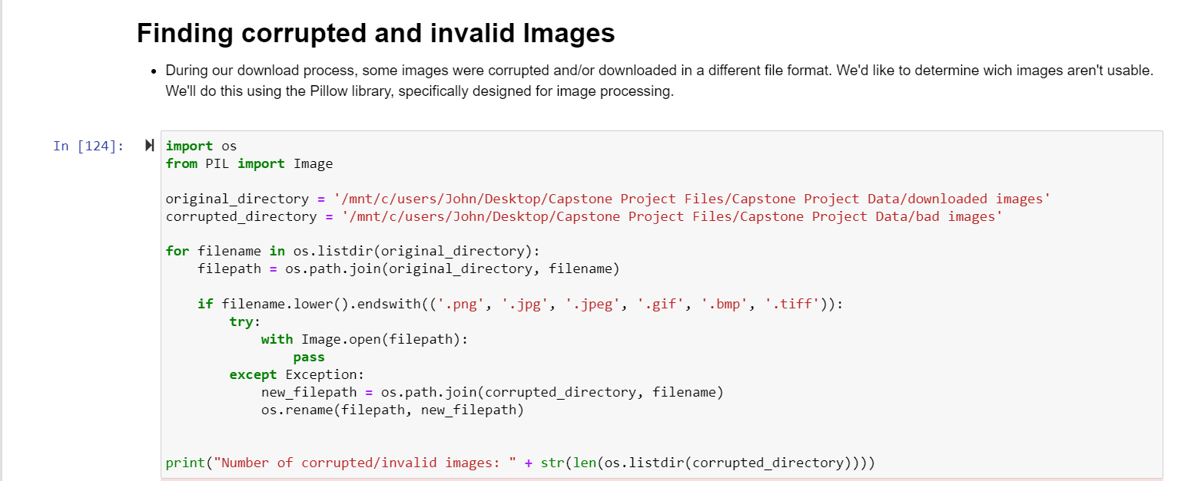
Some of our images were corrupted and wouldn’t open or were downloaded in a weird format. Here, we decide move all those images into a different directory.

Slide 28
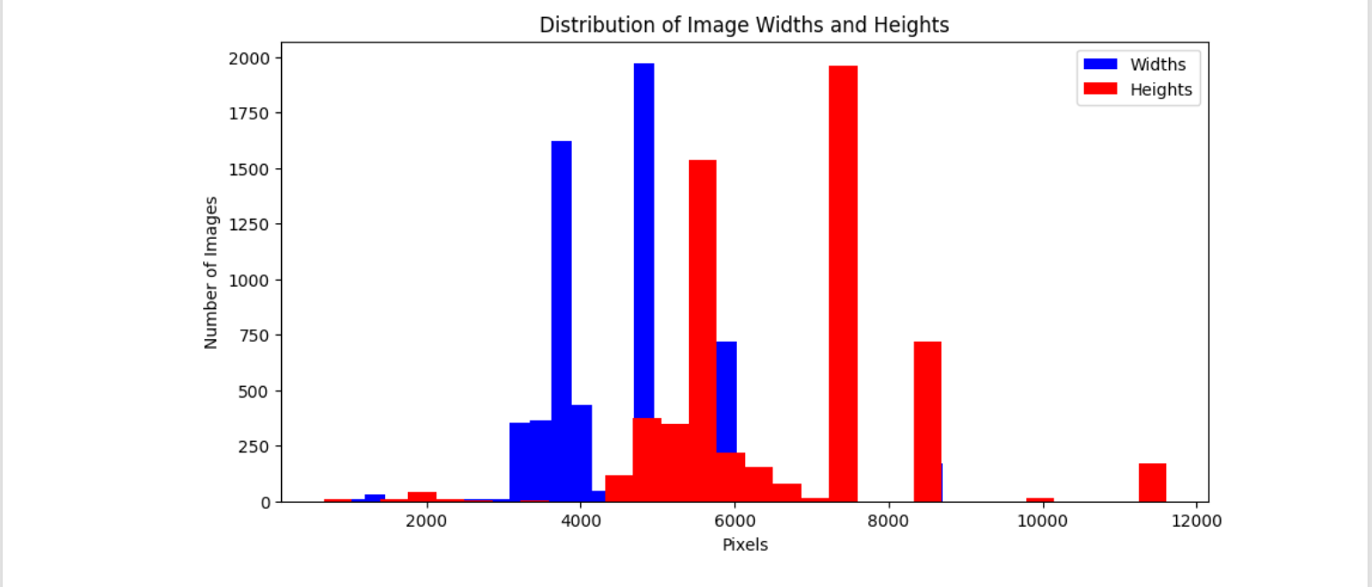
We were considering doing horizontal/vertical flips as part of future data augmentation. Before that, we wanted to get an idea of how our images were distributed to see if it would make sense.

Slide 29
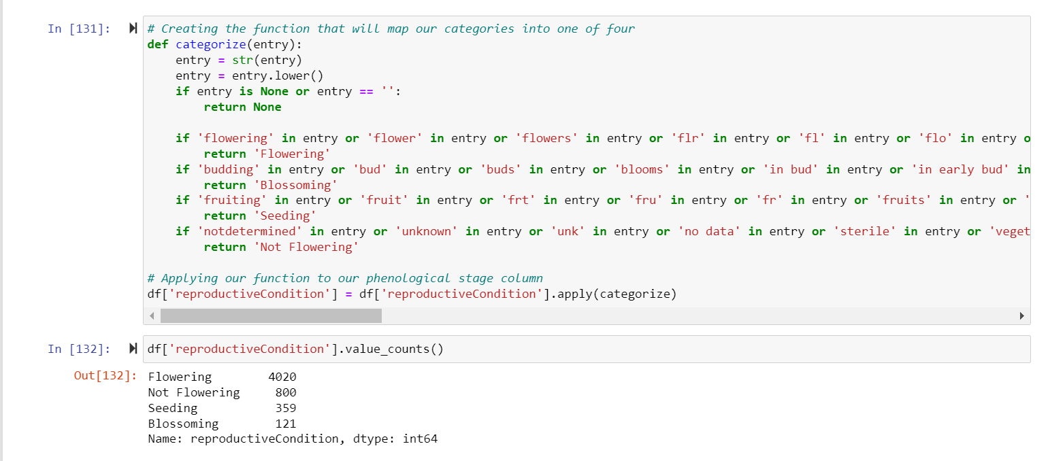
We get all our data into one of four categories.

Slide 30
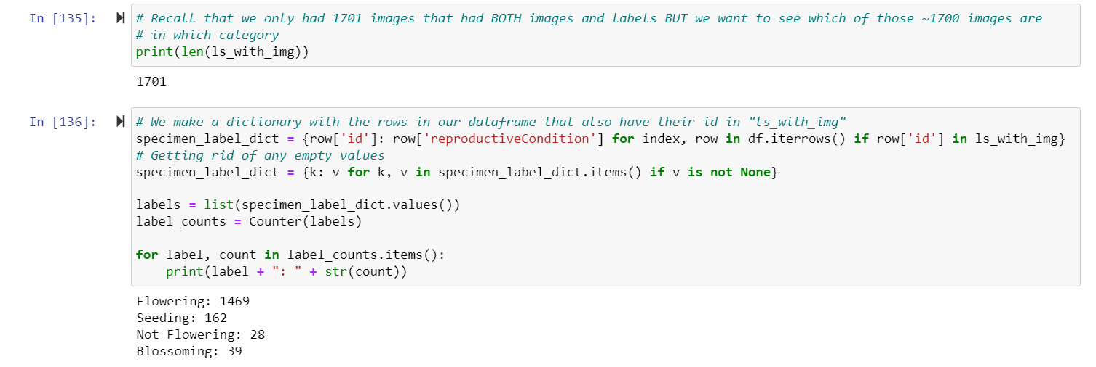
We now have our specimens with labels and images into one of four categories.

Slide 31
Challenges Encountered and Problem Solving

Slide 32
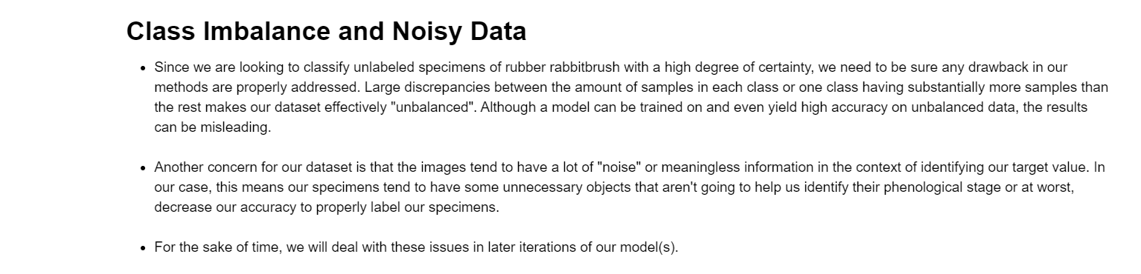

Slide 33
Plan for Next Semester

Slide 34
Import transfer learning models and run preliminary test runs on dataset.
Error analysis techniques in recent research.
Fine tuning vs Our method.
Remaining Data Collection.
Decide which kind of method is best suited for our final analysis.

Slide 35
Citations:
Ellwood ER, Temple SA, Primack RB, Bradley NL, Davis CC. 2013. Record-Breaking Early Flowering in the Eastern United States. Hérault B, editor. PLoS ONE. 8(1):e53788. doi:https://doi.org/10.1371/journal.pone.0053788.
Ellwood ER, Kimberly P, Guralnick R, Flemons P, Love K, Ellis S, Allen JM, Best JH, Carter R, Chagnoux S, et al. 2018. Worldwide Engagement for Digitizing Biocollections (WeDigBio): The Biocollections Community’s Citizen-Science Space on the Calendar. BioScience. 68(2):112–124. doi:https://doi.org/10.1093/biosci/bix143. [accessed 2022 Jun 2]. https://academic.oup.com/bioscience/article/68/2/112/4797259?login=true.
Ellwood ER, Pearson KD, Nelson G. 2019. Emerging frontiers in phenological research. Applications in Plant Sciences. 7(3). doi:https://doi.org/10.1002/aps3.1234. https://www.ncbi.nlm.nih.gov/pmc/articles/PMC6426156/.

Slide 36
Forrest J, Miller-Rushing AJ. 2010. Toward a synthetic understanding of the role of phenology in ecology and evolution. Philosophical Transactions of the Royal Society B: Biological Sciences. 365(1555):3101–3112. doi:https://doi.org/10.1098/rstb.2010.0145.
Geissler C, Davidson A, Niesenbaum RA. 2023. The influence of climate warming on flowering phenology in relation to historical annual and seasonal temperatures and plant functional traits. PeerJ. 11:e15188–e15188. doi:https://doi.org/10.7717/peerj.15188. https://www.ncbi.nlm.nih.gov/pmc/articles/PMC10124540/.
Lorieul T, Pearson KD, Ellwood ER, Goëau H, Molino J, Sweeney PW, Yost JM, Sachs J, Mata‐Montero E, Nelson G, et al. 2019. Toward a large‐scale and deep phenological stage annotation of herbarium specimens: Case studies from temperate, tropical, and equatorial floras. Applications in Plant Sciences. 7(3):e01233. doi:https://doi.org/10.1002/aps3.1233. [accessed 2019 Dec 16]. https://bsapubs.onlinelibrary.wiley.com/doi/pdf/10.1002/aps3.1233.
Menzel A, Sparks TH, Estrella N, Koch E, Aasa A, Ahas R, Alm-kübler K, Bissolli P, Braslavská O, Briede a, et al. 2006. European phenological response to climate change matches the warming pattern. Global Change Biology. 12(10):1969–1976. doi:https://doi.org/10.1111/j.1365-2486.2006.01193.x.

Slide 37
Nelson G, Paul D, Riccardi G, Mast A. 2012. Five task clusters that enable efficient and effective digitization of biological collections. ZooKeys. 209:19–45. doi:https://doi.org/10.3897/zookeys.209.3135.
Schuettpelz E, Frandsen PB, Dikow RB, Brown A, Orli SS, Peters MM, Metallo A, Funk VA, Dorr LJ. 2017. Applications of deep convolutional neural networks to digitized natural history collections. Biodiversity Data Journal. 5:e21139–e21139. doi:https://doi.org/10.3897/bdj.5.e21139.
Stucky BJ, Guralnick R, Deck J, Denny EG, Bolmgren K, Walls R. 2018. The Plant Phenology Ontology: A New Informatics Resource for Large-Scale Integration of Plant Phenology Data. Frontiers in Plant Science. 9. doi:https://doi.org/10.3389/fpls.2018.00517.
Unger J, Merhof D, Renner S. 2016. Computer vision applied to herbarium specimens of German trees: testing the future utility of the millions of herbarium specimen images for automated identification. BMC Evolutionary Biology. 16(1). doi:https://doi.org/10.1186/s12862-016-0827-5.

