Slide 1
Bridge to Success: Using Data to Improve Student Success Early Predictors of High School Graduation, Postsecondary Attendance, and Postsecondary Completion Oded Gurantz, John W. Gardner Center for Youth and Their Communities, Stanford University ogurantz@stanford.edu
Presentation to Harvard Strategic Data Project Team
September 27, 2011

Slide 2
Agenda
Provide background on the John W. Gardner Center for Youth and Their Communities (JGC)
Describe the Bridge to Success (BtS) initiative that aims to increase the number of San Francisco students earning a postsecondary credential by bringing together the San Francisco Unified School District (SFUSD) and the City College of San Francisco (CCSF)
Discuss specific findings and subsequent programmatic and policy implications resulting from JGC analyses

Slide 3
The JGC’s Mission
The JGC partners with communities to:
Develop leadership
Conduct community-driven research
Effect change
…to improve the lives of youth.

Slide 4
The JGC’s Guiding Principles
Work in deep partnership with communities
Respond to community needs
Conduct actionable research and create actionable knowledge

Slide 5
Youth Data Archive Background
The Youth Data Archive of the John W. Gardner Center for Youth and Their Communities:
Links individual-level data on youth across city, county, school district, and non-profit agencies
Works closely with community partners to identify cross-agency research questions that no one agency alone could answer
Supports partners to understand resulting analyses and take actionable steps

Slide 6
Bridge to Success Initiative
San Francisco received a Gates Foundation “Communities Learning in Partnership” one-year planning grant in 2009 and three-year implementation grant in 2010
Mayor’s Office of Interagency Planning brought together SFUSD, CCSF, and key community organizations to promote postsecondary success for underrepresented students
John W. Gardner Center began data analysis in support of this initiative in December 2009

Slide 7
Data Sources
SFUSD: Administrative data (e.g. demographics, course transcripts, standardized tests)
National Student Clearinghouse (NSC): Attendance and completion dates for most U.S. two- and four-year institutions
CCSF: Administrative data (e.g. course transcripts, placement exams, transfer and degree completion dates)

Slide 8
SFUSD Student Progress 2000-01 Cohort of First-Time Ninth Grade Students

Slide 9
SFUSD Student Progress

Slide 10
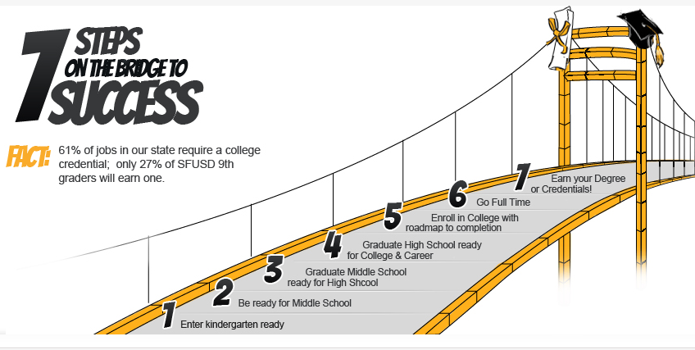
Bridge to Success Structure

Slide 11

Bridge to Success Structure
Team | Connection Points
Teaching | SFUSD Core Curriculum CCSF Education Master Plan and English and Math Pathway redesign
Counseling | SFUSD Restorative Practices, College/Career readiness, Special Ed Redesign CCSF DPSP, excellence in support services and counseling
Transitions | New work to fill gap identified in planning phase
Outreach | SFUSD Parent Engagement, Restorative Practices CCSF Communication and Information
Workforce/ Pathways | DCYF-SFUSD School Partner Model OEWD Sector Academies SFUSD Core Curriculum, Career Academies, Dual Enrollment CCSF Career paths & certificates
The five working groups can request data analysis from the “Data” team, pending joint agency approval

Slide 12
Examples of BtS Actions
Finding | Action
Importance of timely enrollment in core English and math courses at CCSF | New priority enrollment system for SFUSD students attending CCSF
Characteristics of students who graduate from SFUSD but do not attend a postsecondary institution | Summer bridge program to help students transition into CCSF
Development of key Early Warning Indicators for incoming 9th grade students [NEXT PAGE] | Presentation of indicators to administrators, principals, counselors and preparation for initial usage during the 2011-2012 school year

Slide 13
Early Warning Indicators
* Data combined from two cohorts of students who were enrolled in SFUSD both semesters of eighth graders and then entered ninth grade during the fall semester of the 2005-06 and 2006-07 school years. Results were averaged to provide SFUSD a picture of how indicators would impact a typical school year. This resulted in a cohort of 3,382 students who had a four-year high school graduation rate of 72.9%.
Two key indicators using 8th grade data:
GPA less than 2.0
Attendance Rate less than 87.5%

Slide 14
EWI - Why Does Identifying Students Matter?
Passing all core courses in the first semester of 9th grade significantly increases graduation rates
Almost half of students who entered with one risk factor passed all their core courses

Slide 15
BtS Math Analysis
Examined the relationship between math performance in high school and the math placement test at CCSF
Course grades predicted math placement but passing Algebra 2 did not align well with placing at college math
AP Math
Pre-Calculus
Algebra 2

Slide 16
BtS Math Analysis
Most students who met No Child Left Behind math standards on the California Standards Test (Proficient or Advanced) placed at the college-level

Slide 17
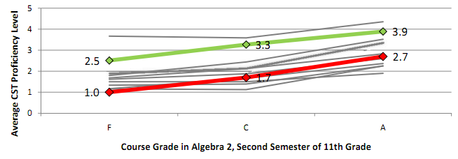
BtS Math Analysis
Why is there a disconnect between course performance and CST performance in predicting math placement?
Students at different high schools did not perform the same on CCSF’s placement test, even when they took similar math courses and received similar grades

Slide 18
BtS Math Actions
CCSF adopted high school Early Assessment Program (EAP) results as additional “waiver” criteria for math placement test
CCSF is piloting a one-semester “Preparation for Statistics” course as an alternative to current Elementary/Intermediate Algebra sequence
JGC and BtS partners beginning to share findings more broadly within SFUSD and CCSF

Slide 19
Next Steps
Exploration of articulation in English alignment between SFUSD and CCSF
Continued investigation over the next year focused on issues of remediation for SFUSD students
Inclusion of data from Department of Children, Youth, and Families and other youth-serving organizations

Slide 20
Bridge to Success: Using Data to Improve Student Success Early Predictors of High School Graduation, Postsecondary Attendance, and Postsecondary Completion Oded Gurantz, John W. Gardner Center for Youth and Their Communities, Stanford University ogurantz@stanford.edu
Presentation to Harvard Strategic Data Project Team
September 27, 2011

