Slide 1
Paper annotation results
Johannes B. Gruber

Slide 2
Introduction

Slide 3
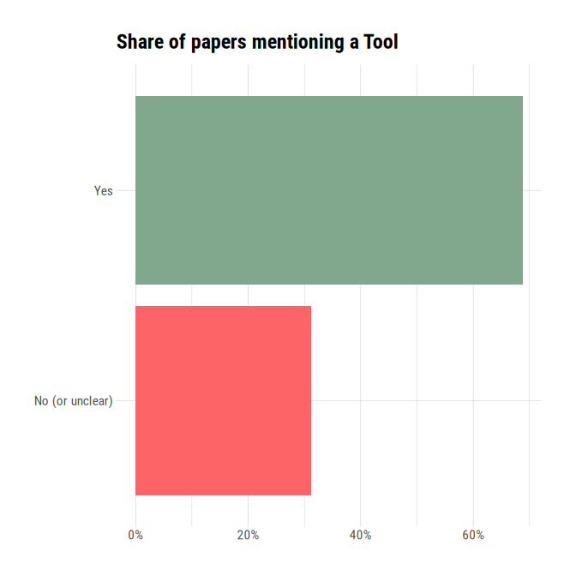
Tool-Mentioned

Slide 4
Extrapolated, this means 0.6875 * 0.53 * 5252 ~ 1913 papers that use a tool for opinion mining

Slide 5
Tools
tool | n
keras | 2
tensorflow | 2
fasttext | 1
modal | 1
mufico | 1
scikit | 1
scikit-learn | 1
sentiwordnet | 1
tensorflow | 1
vadersentimen | 1
algorithmia | 1
babelnet | 1
bert+tensorflow | 1
carol (unconventional survey methodology) | 1
computational linguistics and psycholinguistics (clips) research center offers a python library | 1
gensim | 1
gibbslda++ | 1
hycor | 1
keras | 1
nltk | 1
rapidminer | 1
scikit-learn | 1
sentimental analysis of hindi (sah) | 1
sentistrength | 1
textblob | 1
tour for dynamic topic and sentiment analysis of user reviews | 1
weka | 1
weka data-mining software | 1
weka toolbox | 1
wordnet | 1

Slide 6
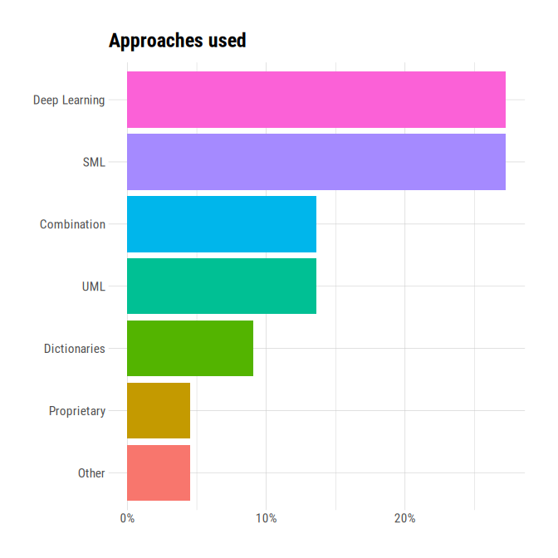
Approach

Slide 7
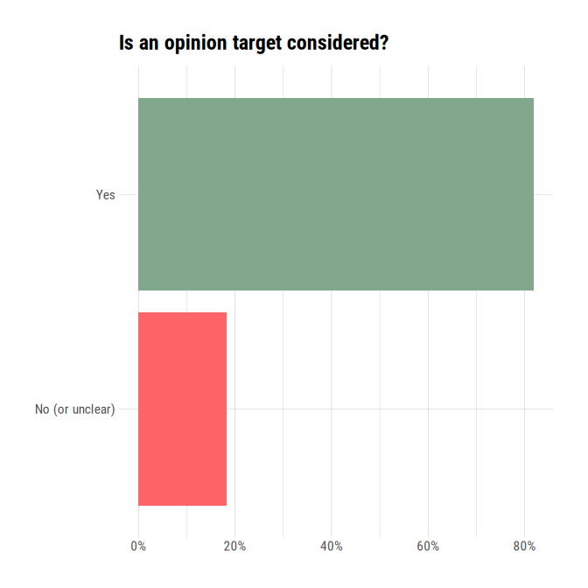
Target

Slide 8
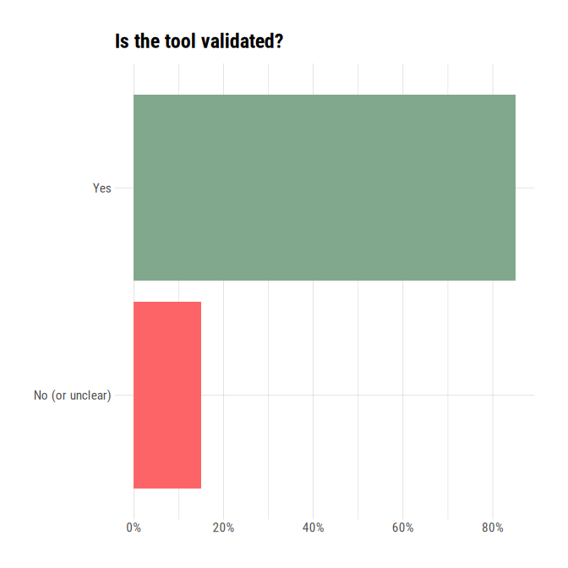
Validation

Slide 9
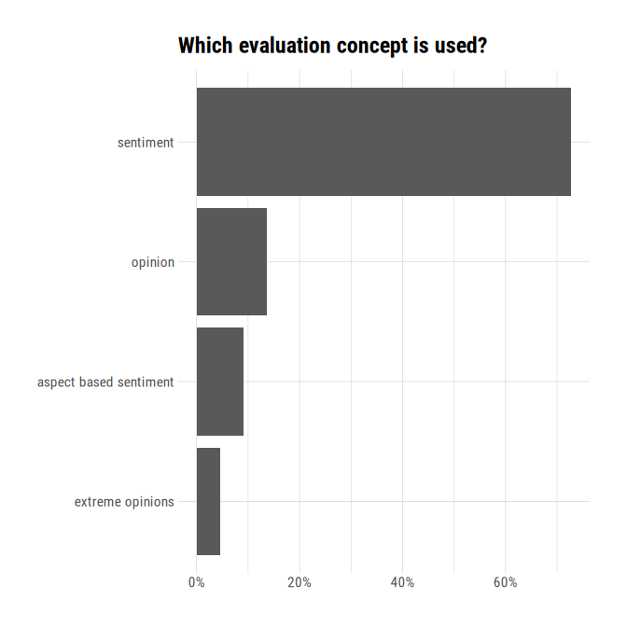
Evaluation

Slide 10
Target
Final | n
- | 2
5 topics in Albania as follow: tourism, politics, the including of VAT tax in small business, waste import and Higher Education Law | 1
Audio survey about ways to impove women's university lives | 1
Book Reviews | 1
COVID-19 | 1
Dynamic: Jair Bolsonaro or Fernando Haddad | 1
Dynamic: Topic | 1
Hotels Reviews | 1
Hotels and restaurant reviews | 1
Issues identified in app reviews | 1
Movie Reviews | 1
Palestinian/Israeli Conflict in Western Media | 1
Restaurant reviews; Game reviews | 1
Sentiment | 1
Tweets about Covid | 1
city events | 1
online discussions about diseases: allergies, crohn and breast cancer | 1
online opinions toward vaginal mesh | 1
perception of the use of virtual classrooms | 1
product reviews | 1
sentiment in 'Bitcoin Discussion' bulletin board | 1

