Slide 1
You Snooze, You lose
Early to bed and early to rise, makes one healthy, wealthy and wise.

Slide 2

Are you always late in the morning?

Slide 3
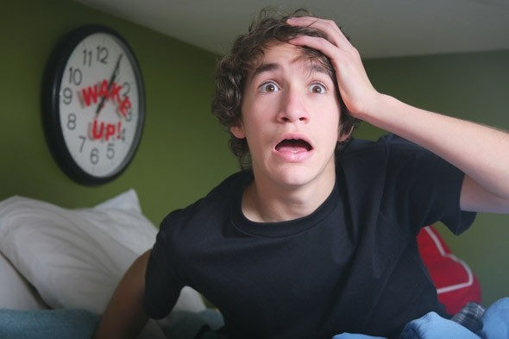
Do you hit the snooze at least 5 times?

Slide 4
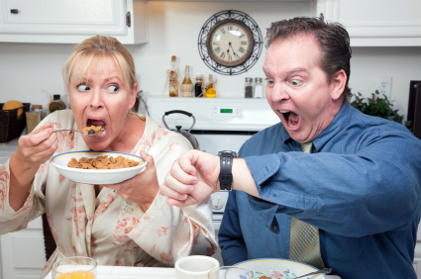
Is this yOU?

Slide 5
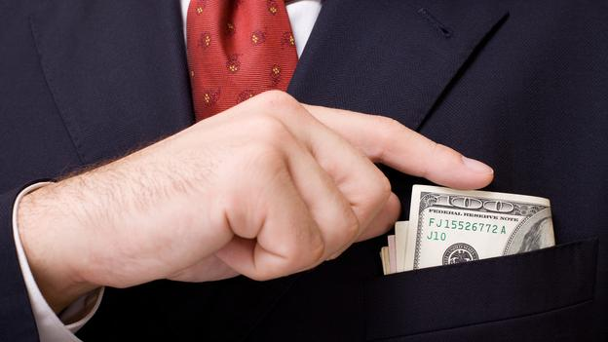
You Snooze You Lose
Introducing the new ground breaking app to get you out of bed and into success.

Slide 6
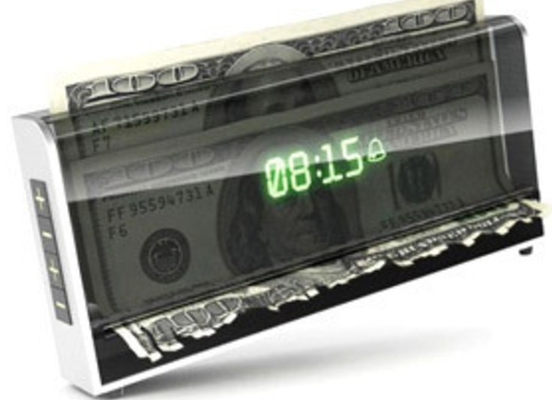

Slide 7
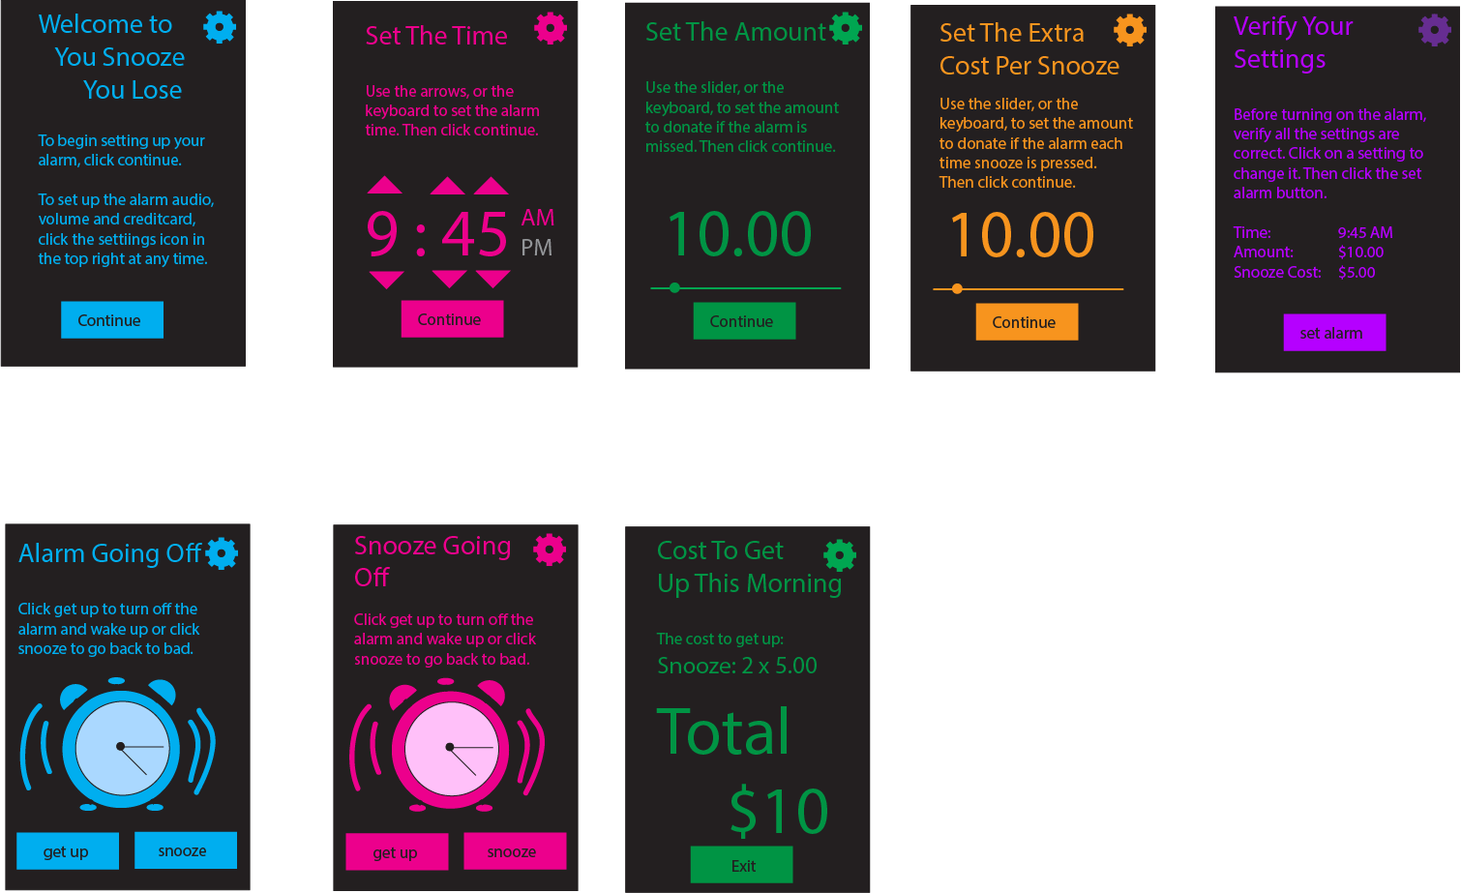

Slide 8
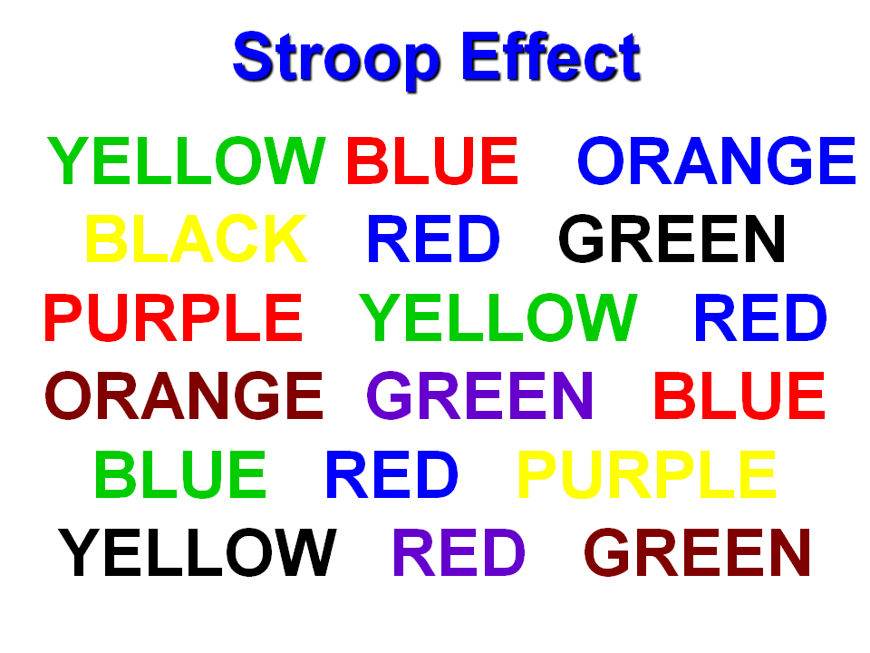
When the alarm goes off, can you prove you’re awake.

Slide 9
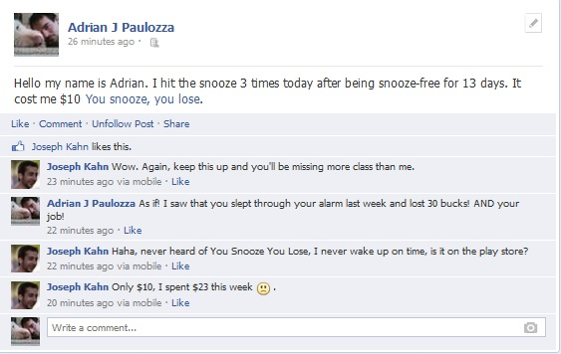

Slide 10
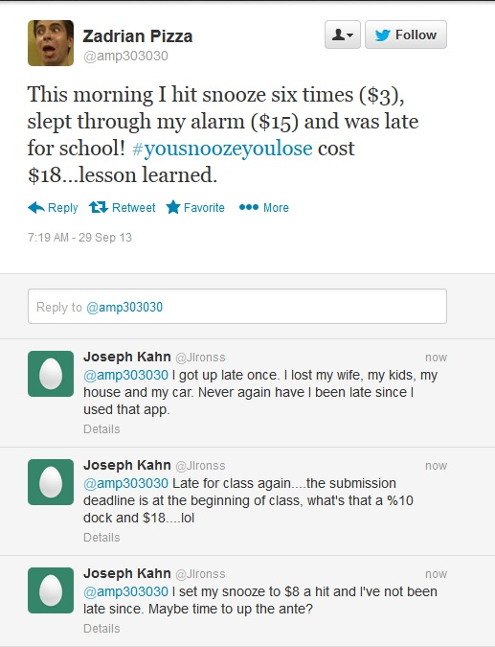

Slide 11


Slide 12
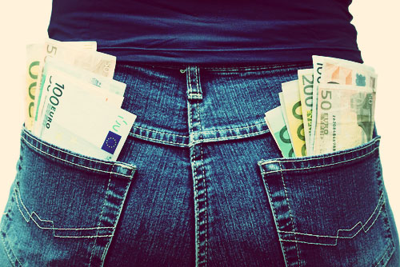
Where does the money go?

