Slide 1


Men’s Shed Web Application
Napier University Group Project Trimester two 2023

Slide 2
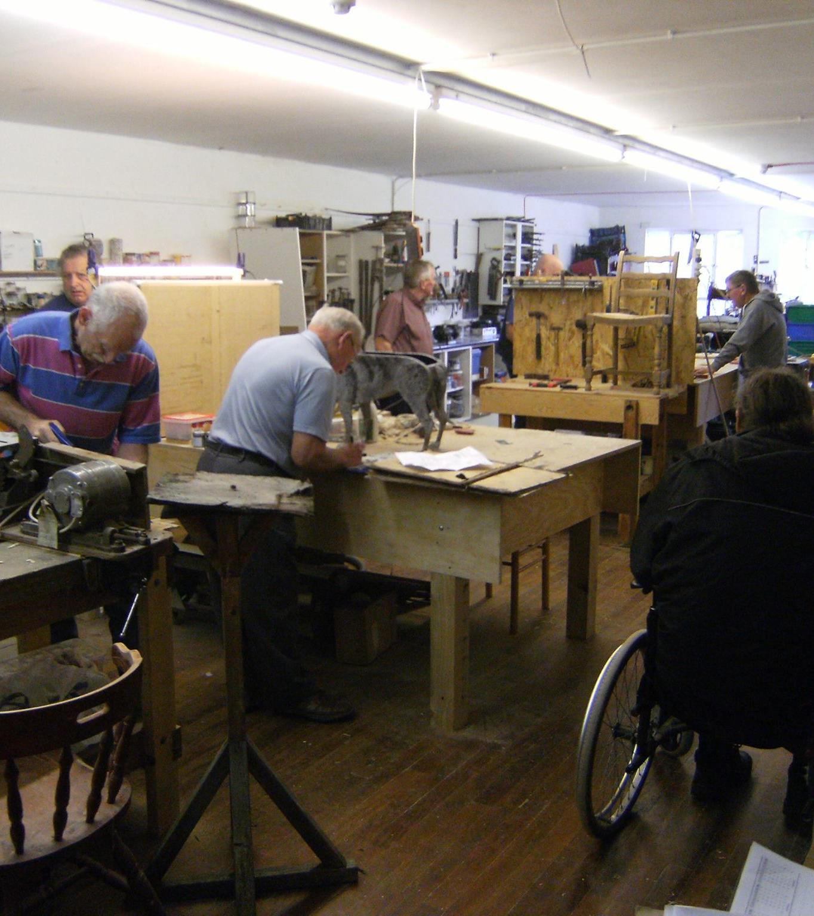
Project Brief Men’s Shed Web Application
Project Aims
Technical Approach
Demonstration of Work
Limitations

Slide 3
Project Aims
Develop a piece of work for a live project proposed by a real client.
The client is Dunfermline Men’s Shed.
Form a multidiscipline team of students
Core application with:
User interface
Database
Administrators & User Interfaces.
Administrators access to maintain Data.

Slide 4
Technical Approach Backend
The first feature implemented by the PBD and SBD was the creation of the SQLite database used to store and present Mens Shed data.
Mens Shed web application signup feature, which allows users to create an account Python Flask framework
The login feature takes users’ data from the Users table within the SQLite database to authenticate that a current user using Bcrypt Hashing
The Tool search function allows users to search for tools that the Mens Shed organisation has in the database using SQLite queries.
Notes:
F

Slide 5
Technical Approach Front end

Slide 6
Demonstration of Work

Slide 7
Limitations
The Booking function currently implemented within the Mens Shed web app is currently just a prototype.
The database itself can not store graphic images

Slide 8




Stakeholder Satisfaction
Documentation
Communication
Work Quality
Project Pace

Slide 9

Any Questions Thank You!

