Slide 1


Men’s Shed Web Application
Napier University Group Project Trimester two 2023 Group 13

Slide 2
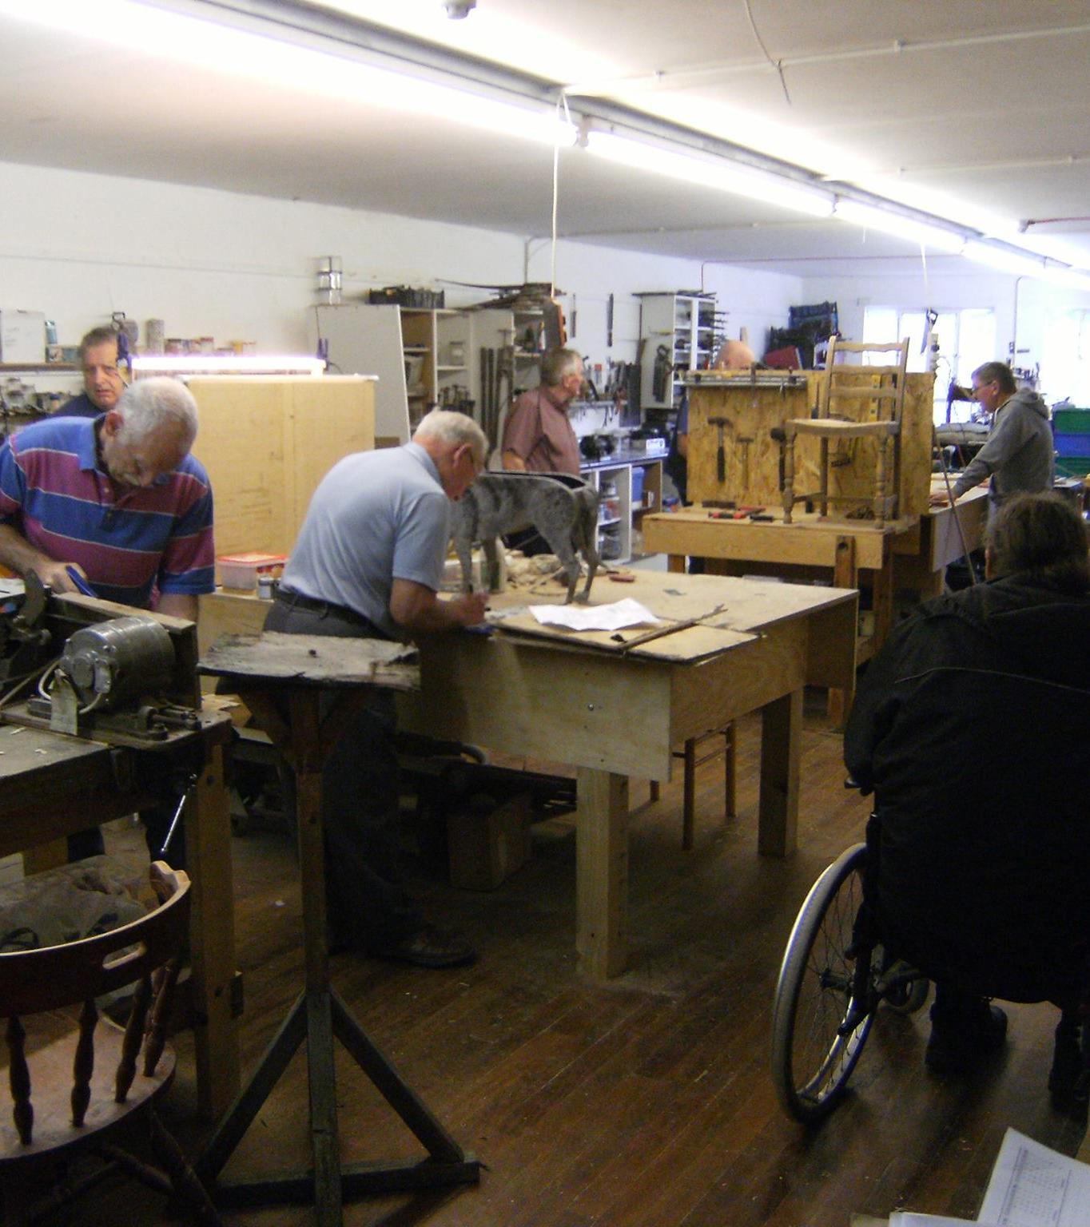
Project Brief Men’s Shed Web Application
Project Aims
Technical Approach
Demonstration of Work
Limitations

Slide 3
Project Aims
Develop a piece of work for a live project proposed by a real client. Dunfermline Men’s Shed.
Form a multidiscipline team of students
Build a core application with:
User interface
Database
Administrators & User Interfaces.
Administrators access to maintain Data.
Using Python as the Main Language for development.
Notes:
The Men’s Shed project
The aim of the project was to build a base application that could be picked up and enhanced by future university groups.
The reasons why this was decided:
The application in its entirety was too big for a single trimester with competing learning.
Some of the elements in the big picture such as:
The app should provide borrowing/reserving features. This shows when something is in use and when it will be available again. This requires the following database and app features:
Data administrator portal
Add/update/retire resources.
User Registration
Resource calendar
Resource status (e.g., Physical Library items still to be audited with pictures, ISBN digits). Mobile Power Tools tested and audited.
The software should be adaptable.
The Shed workshop should be bookable for 15 minutes. The Shed and activity determine the maximum time. Deliverables
Design and implementation of the system back-end (including the database)
Design and implementation of the app, which should run at least on Android and desktop devices.
Source code
Documentation as appropriate
With the integration of all these elements, it was felt that we would be setting ourselves up to fail badly.

Slide 4
Technical Approach Backend
The first feature implemented by the PBD and SBD was the creation of the SQLite database used to store and present Mens Shed data.
Mens Shed web application signup feature, which allows users to create an account Python Flask framework
The login feature takes users’ data from the Users table within the SQLite database to authenticate that a current user using Bcrypt Hashing
The Tool search function allows users to search for tools that the Mens Shed organisation has in the database using SQLite queries.
The Booking function allows users to Book items held within the database for a certain period of time by adding the users booking to the bookings table in the SQLite database. The users booking will then be deleted from the SQLite database once their booking time ends.
The Admin access only function allows users who have admin access to enter pages that other users cannot. This is done by setting a users admin access column to true in the SQLite database via the SQLite command line.
Notes:
Many tools and methods were used to create the backend functionality of the Mens Shed web application.
SQLite is a database engine library that can be embedded in apps.
Flask is a micro web framework written in Python. It is classified as a microframework because it does not require particular tools or libraries.
Bcrypt hashing is used to encrypt users passwords within the database to ensure each users password is secure
The SQLite command line can be used to make changes to the SQLite database via the command line e.g. querying the database or giving a user admin access

Slide 5
Technical Approach Front end
We used a CSS file for styling the pages. However
we switched to Bootstrap templates at an early stage. This allowed us to create a much more dynamic design
For the final application, we settled on Jinja2 templates
Notes:
-We first began designing the interface using standard HTML pages built from scratch. We used a CSS file for styling the pages. This method meant creating separate files for each page. We soon found that this method was somewhat tedious and did not translate well for the application.
-Upon suggestion from other team members, we switched to Bootstrap templates at an early stage. This allowed us to create a much more dynamic design for our pages and greatly reduced the code that needed to be written.
-For the final application, we settled on Jinja2 templates, as this severely reduced the lines of code required for each page and allowed us to split elements of the page into blocks.

Slide 6
Demonstration of Work
Virtual Environment Deployment: http://127.0.0.1:5000/
Pythonanywhere Deployment: http://mensshed.pythonanywhere.com/

Slide 7
Limitations
The Booking function currently implemented within the Mens Shed web app is currently just a prototype.
The Booking function has the user choose an item by item ID which makes it hard to choose the correct item.
The tool search function displays the link to pictures rather than the actual image.
The database itself can not store graphic images
Roadmap to the Future
This application is a basis for future development by other groups
Notes:
The booking function using item ID is only temporary and can be changed later in development.
The tool search function can either remove the column for the images or find a way to display the images from the links later in development.

Slide 8




Stakeholder Satisfaction
Documentation
Communication
Work Quality
Project Pace

Slide 9

Any Questions Thank You!

