Slide 1
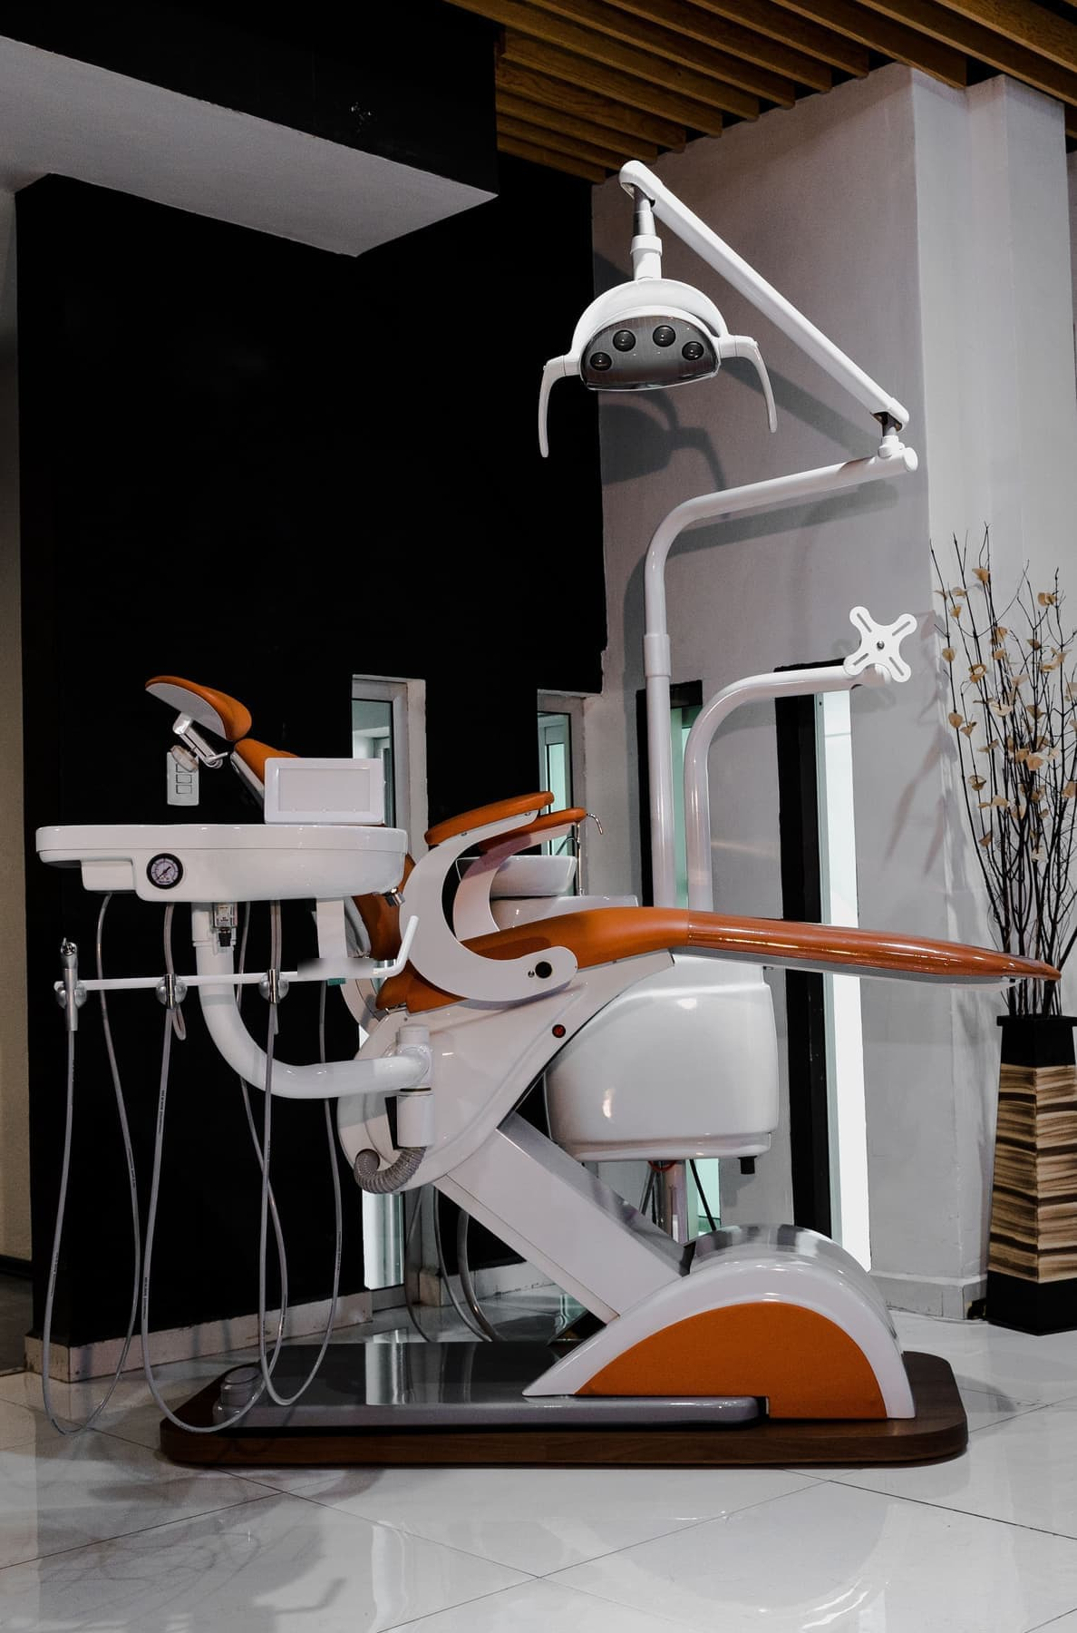

ADVERTISER PACK
2026 / 27
Reach the people
who buy.
For the people who own, run, buy and finance UK dental practices.
DENTALBUSINESSNEWS.COM
COGENT MULTIMEDIA LTD
Photo: Pepe Carive via Pexels
Notes:
Cover. Masthead is the brand kit's reversed wordmark, not retyped.

Slide 2
WHO YOU REACH
The people who
sign off the spend.
THE LIST TODAY
2,601
named dental professionals on the newsletter list, 2,358 of them in the UK.
Dental Business News goes to owners, principals, practice managers and the people who buy for UK dental practices. It launched on 18 September 2026, so the list is young and still loading. These are the real figures rather than projections.
Dental Business News, 20 October 2026
256
UK practice owners, principals and practice managers. The buyers, counted strictly.
247 owners and principals, 9 managers
WHAT THEY BUY
Practice management software and technology
48.3%
average open rate across our first seven issues, against an all-industry average of 35.63%.
Equipment, chairs and imaging
Practice finance and patient finance
Valuation, brokerage and legal advice
11,935 delivered, 5,759 unique opens · Mailchimp benchmark, Dec 2023
Accountancy, insurance and indemnity
Recruitment, training and marketing
50
articles published since launch in September, 19 of them in the last week alone.
Deals, NHS contract, regulation, finance, premises and workforce
DENTAL BUSINESS NEWS · WHO YOU REACH
2 / 6
Notes:
Audience figures pulled from the database on 19 Oct 2026. Update before reissuing.

Slide 3
WHAT YOU CAN BUY
Four ways in.
Website banners
Sponsored newsletter content
970×250
300×250
Your brand across the whole site, or on the one section you choose.
Sponsored
Your story in The Monday Check-Up, next to our editorial and labelled as sponsored.
Every format is digital. The list is where the value is on a title this young, so it is priced first and the display is priced honestly.
728×90
970×250 · 728×90 · 300×250
40 words · logo · one link
HOW A BOOKING RUNS
01
You tell us the audience and what you want it to do.
Newsletter sponsorship
Solus email
02
We confirm format, date and price in writing.
Sponsor
03
You send artwork, or copy and we build it.
Your brand as the named sponsor of every issue of The Monday Check-Up.
Your email
Your own email, sent to our subscribers. Nobody else in it. Full UK list or the 256 decision makers only.
04
You approve it before anything goes out.
Banner
05
We send the report on your campaign alone.
Per issue, or four at a time
We build it, or send finished HTML
RECOMMENDED FOR A FIRST CAMPAIGN
A sponsored article plus a solus email to
the 256 decision makers.
DENTAL BUSINESS NEWS · WHAT YOU CAN BUY
3 / 6
Notes:
Mock-ups are drawn shapes, so they recolour with the brand if needed.

Slide 4
RATES
FORMAT
RATE
What it costs.
EMAIL
Solus email, full UK list
Your message alone to 2,358 UK names
£400
Founding advertiser rates while the title is in its first year. Everything is sold one advertiser at a time and booked in the order enquiries are confirmed.
Solus email, decision makers
Owners, principals and practice managers only
£200
Newsletter sponsorship
Named sponsor, per issue
£125
Newsletter sponsorship
Four consecutive issues
£400
CONTENT
Sponsored article
Written by us, labelled, permanent, followed link
£450
Article plus solus email
To the decision makers. The recommended first buy.
£550
DISPLAY
Billboard, 970×250
Top of the homepage, per month
£250
TALK IT THROUGH
Leaderboard, 728×90
Per month
£200
jb@dentalbusinessnews.com
MPU, 300×250
Two sidebar positions, sold separately, per month
£150
Category sponsorship
One section, includes its MPU, per month
£400
All rates exclude VAT. · Invoiced on publication, payable within 30 days.
DENTAL BUSINESS NEWS · RATES
4 / 6
Notes:
Rates are JB's to confirm. Change them here and rebuild, or edit in PowerPoint.

Slide 5
WHAT RESULTS YOU GET
YOUR CAMPAIGN REPORT
YOURS ALONE
The numbers
you get back.
EMAIL CAMPAIGN
Delivered
Inboxes it actually reached
X,XXX
Unique opens
People who opened, counted once
X,XXX · XX.X%
Within X working days of your campaign finishing you get a report on your campaign and no other. The figures come straight from the sending platform and the site analytics.
Unique clicks
People who clicked, counted once
XXX · X.X%
Click to open
Of those who opened, who then clicked
XX.X%
Unsubscribes
Off the list after your send
X · X.XX%
HOW WE COUNT
Hard bounces
Addresses that no longer exist
X · X.XX%
Unique counts, never totals, so one person opening twice is one open.
ON THE SITE
Impressions
Times your creative was served
XX,XXX
Every click destination listed, so you can see what actually pulled.
Clicks
And the click-through rate
XXX · X.XX%
No house average standing in for your result.
Article views
If you bought a sponsored article
X,XXX
If it underperformed, the report says so.
Median time on page
How long they actually stayed
X:XX
Every X is a figure filled in from your campaign. No benchmark we have not measured.
WHEN YOU GET IT
Within X working days of the send.
DENTAL BUSINESS NEWS · WHAT RESULTS YOU GET
5 / 6
Notes:
Placeholders only. The title has run no paid campaign, and nothing in the database stores opens or clicks yet.

Slide 6
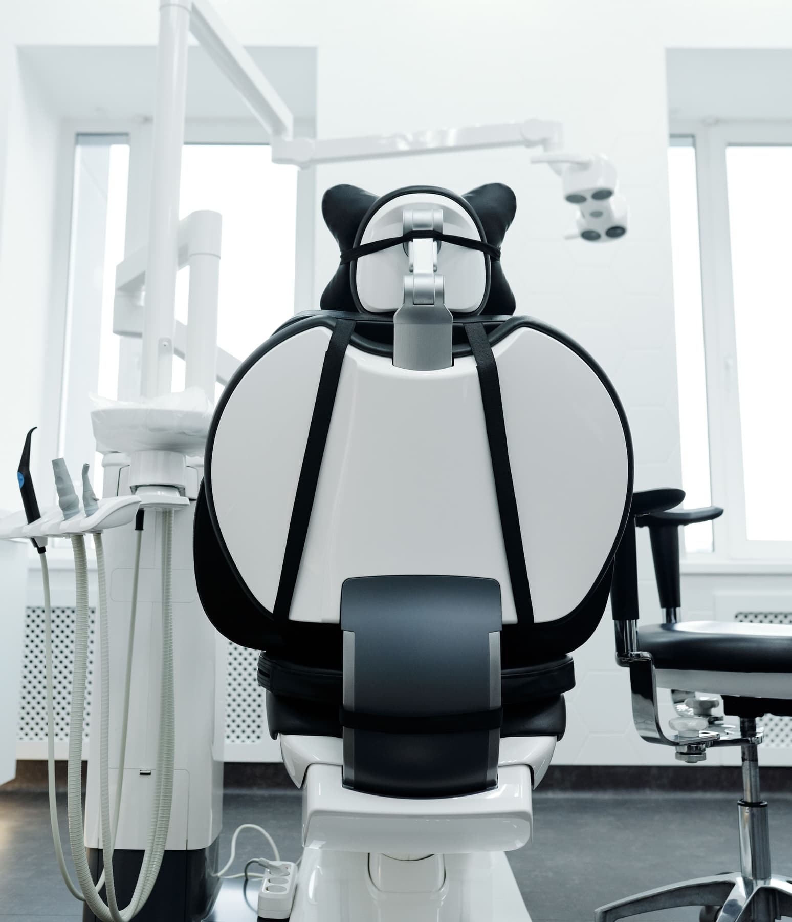
ADVERTISE WITH US
Get in touch.
Tell us who you are trying to reach and what you want it to do, and we will come back with a plan, availability and a price.
ADVERTISING
jb@dentalbusinessnews.com
SEND US A STORY
dentalbusinessnews.com/submit-news
SUBSCRIBE FREE
dentalbusinessnews.com/newsletter
PUBLISHED BY · COGENT MULTIMEDIA LTD, 5 JUBILEE WAY, FAVERSHAM, KENT
Photo: Cedric Fauntleroy via Pexels

