Slide 1
Day 02 - Automation
Automation takes a lot of your plate

Slide 2
Test Driven Development (TDD)

Slide 3
Agenda
TDD Overview
Test First vs. Test Last
TDD Benefits and Limitations
TDD Survey
Summary

Slide 4
Quotes
Kent Beck said:
“Test-first code tends to be more cohesive and less coupled than code in which testing isn’t a part of the intimate coding cycle” [2]
“If you can’t write a test for what you are about to code, then you shouldn’t even be thinking about coding” [2]
You know who Kent Beck is, right?
&
Notes:
Kent Beck (born 1961)
is an American software engineer and the creator of extreme programming,^{[1]} a software development methodology that eschews rigid formal specification for a collaborative and iterative design process.
Beck was one of the 17 original signatories of the Agile Manifesto,^{[1]} the founding document for agile software development.
Extreme and Agile methods are closely associated with Test-Driven Development (TDD), of which Beck is perhaps the leading proponent.

Slide 5
TDD Overview
Made popular by Extreme Programming
Method of developing software not just testing software
Software is Developed in short iterations
Unit Tests are developed FIRST before the code

Slide 6
TDD Overview
How It Works:
Add a Test
Use Cases / User Stories are used to understand the requirement clearly
Run all tests and see the new one fail
Ensures test harness is working correctly
Ensures that test does not mistakenly pass
Write some code
Only code that is designed to pass the test
No additional functionality should be included because it will be untested

Slide 7
TDD Overview
How It Works (cont.):
Run the automated tests and see them succeed
If tests pass, programmer can be confident code meets all tested requirements
Refactor code
Cleanup the code
Re-run tests to ensure cleanup did not break anything
Repeat!

Slide 8
Test First vs. Test Last
Test First | Test Last
Pick a piece of functionality | Pick a piece of functionality
Write a test that expresses a small task that fails | Write production code that implements entire functionality
Write production code until test passes | Write tests to validate all functionality
Run all tests | Run all tests
Rework code until all tests pass | Rework code until all tests pass
Repeat

Slide 9
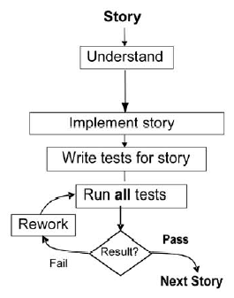
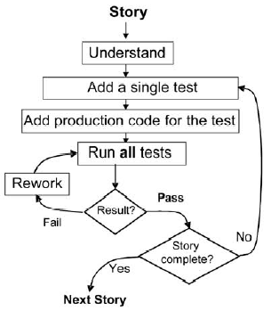
Test First vs. Test Last
Re-work
Graphics

Slide 10
PROS
Pros of TDD
Instant Feedback
Developer knows instantly if new code works and if it interferes with existing code
Better Development Practices
Encourages the programmers to decompose the problem into manageable, formalized programming tasks
Provides context in which low-level design decisions are made
By focusing on writing only the code necessary to pass tests, designs can be cleaner and clearer than is often achieved by other methods

Slide 11
PROS
Pros of TDD
Quality Assurance
Having up-to-date tests in place ensures a certain level of quality
Enables continuous regression testing
TDD practices drive programmers to write code that is automatically testable
Whenever a software defect is found, unit test cases are added to the test suite prior to fixing the code

Slide 12
PROS
Pros of TDD
Lower Rework Effort
Since the scope of a single test is limited, when the test fails, rework is easier
Eliminating defects early in the process usually avoids lengthy and tedious debugging later in the project
“Cost of Change” is that the longer a defect remains the more difficult and costly to remove

Slide 13
CONS
Limitations of TDD
Counterproductive and hard to learn
Difficult in Some Situations
GUIs, Relational Databases, Web Service
Requires mock objects
TDD does not often include an upfront design
Focus is on implementation and less on the logical structure

Slide 14
CONS
TDD Limitations
Difficult to write test cases for hard-to-test code
Requires a higher level of experience from programmers
TDD blurs distinct phases of software development
Design, code and test

Slide 15
TDD Survey
Results of a survey conducted by 24 professional programmers
Concern/Sub-concerns | % Agree
Productivity-Aggregate | 78
Facilitates better requirements | 88
Reduces debugging effort | 96
Reduces development time | 50
Effectiveness-aggregate | 80
Yields higher code quality | 92
Promotes simpler design | 79
Is noticeably effective | 71
Difficulties in adoption – aggregate | 40
Getting into TDD mindset | 56
Lack of upfront design a hindrance | 23

Slide 16
TDD Summary
The research studies results are inconsistent
Quality
Productivity
TDD can be effective if you consider
Goals of your software group
Kind of software being developed
The skill level and experience of your developers

Slide 17
Acceptance Test-Driven Development (ATDD)

Slide 18
Agenda
What is Acceptance Test-Driven Development (ATDD)
ATDD versus Test-Driven Development (TDD)
ATDD Process
Pros and Cons of ATDD
ATDD Tools
ATDD Mindset

Slide 19
What is ATDD?
Stands for Acceptance Test Driven Development
A collaborative process where the product owner, end users, and Agile team members define acceptance criteria
Focus is on the business rules
Done prior to the start of the coding
Acceptance tests must be automated using tools that the business user can use
Specification by example
Truly defines Done

Slide 20
ATDD vs. TDD
Complement each other
Both based on write the test first, then code
Both document the requirements that the ensuing code must meet TDD is about building the software right ATDD is about building the right software

Slide 21
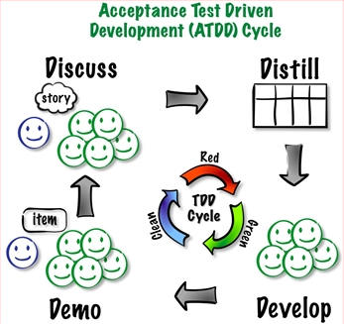
ATDD Process
Notes:
8. ADTT Process 8

Slide 22
PROS
Pros of ATDD
Overall project delivery time 30-40% faster
On average only a quarter of the defects relative to the conventional develop->test approach
Significant reductions in long-term maintenance costs
Better shared understanding of requirements due to;
Closer collaboration
Specification by example
Clear definition of done
Notes:
9. Pros
• Overall project delivery time 30-40% faster
• On average only a quarter of the defects relative to the conventional develop->test approach
• Significant reductions in long-term maintenance costs
• Better shared understanding of requirements due to;
• Closer collaboration
• Specification by example
• Clear definition of done

Slide 23
PROS
Pros of ATDD
Product Owners and Management get greater transparency and control over what is implemented
Percentage of passed tests a clear indication of progress
Testers can focus on more interesting exploratory testing
Increased trust between business and IT
Notes:
10. Pros
• Product Owners and Management get greater transparency and control over what is implemented
• Percentage of passed tests a clear indication of progress
• Testers can focus on more interesting exploratory testing
• Increased trust between business and IT

Slide 24
DevOps Overview
Cons of ATDD
Requires significant championing, training, mentoring, and executive support to be successful
Increases initial development time by 15-35%
Requires close collaboration with the users/SMEs
Notes:
11. Cons
• Requires significant championing, training, mentoring, and executive support to be successful
• Increases initial development time by 15-35%
• Requires close collaboration with the users/SMEs

Slide 25

ATDD Tools - FitNesse
FitNesse
FitNesse
Implemented as a Wiki Server
Test conditions entered in a tabular format
Can even use Excel to create test tables
Supports all major dev languages
Integrates with Continuous Integration environments
Notes:
12. Tools
• FitNesse
• Implemented as a Wiki Server
• Test conditions entered in a tabular format
• Can even use Excel to create test tables
• Supports all major dev languages
• Integrates with Continuous Integration environments

Slide 26
ATDD Tools - FitNesse
Cucumber
Uses natural language Given, When, Then
Works with Ruby, Jave, .Net, and Flex
Integrates with CI environments
Notes:
13. Tools
• Cucumber
• Uses natural language Given, When, Then
• Works with Ruby, Jave, .Net, and Flex
• Integrates with CI environments
http://cukes.info

Slide 27
DevOps Overview
Template
Template
Template
Template
$ template
xx.xxx.xx.x
Notes:
12. Tools • FitNesse • Implemented as a Wiki Server • Test conditions entered in a tabular format • Can even use Excel to create test tables • Supports all major dev languages • Integrates with Continuous Integration environments http://www.fitnesse.org 12
13. Tools • Cucumber • Uses natural language Given, When, Then • Works with Ruby, Jave, .Net, and Flex • Integrates with CI environments http://cukes.info 13
14. Mindset • Like TDD, ATDD seems like putting the cart before the horse and takes a mental shift to a write the test first mentality • Need to see beyond roles and silos to embrace a common ownership of the acceptance tests • Requires a shift to a strong collaborative spirit between IT and business • Need to be organizationally and personally ready to endure the learning curve • Best adopted in conjunction with TDD and CI. 14

Slide 28
End of Chapter

Slide 29
TDD, ATDD & Test Automation

