Slide 1
Introduction to Class
What we need to know to get started

Slide 2
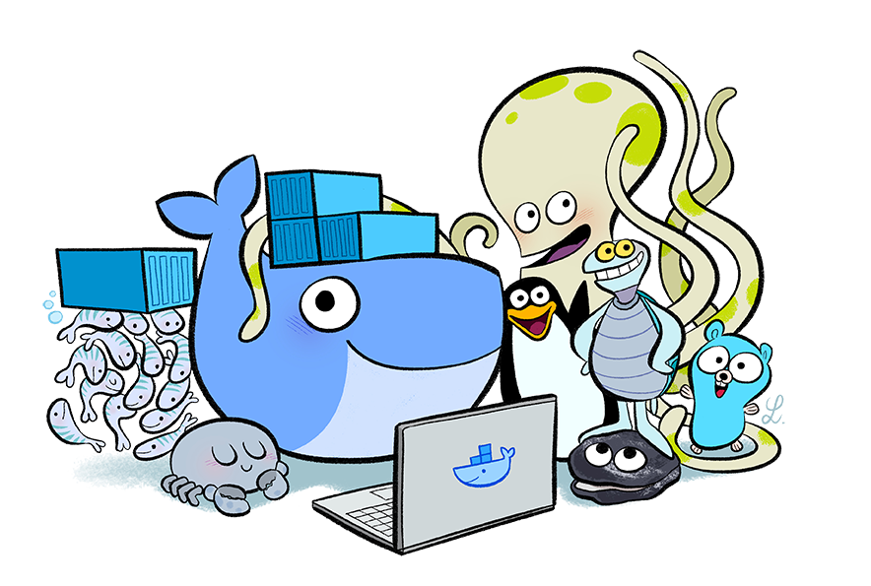
Getting to Know Each Other
Welcome!
A little about myself...
Tell me about yourself...

Slide 3

Course Agenda
Day 1
Introduction to Class
Understanding the Big Picture
Docker Containers
Application Sever in Docker Container
Docker Registry
Day 2
Containerizing Java EE Application
Docker Networking and Storage
DevOps and Beyond
Docker on the Cloud
Day3
Multi-Container Application Management
Docker Compose
Docker Swarm
Introduction to Kubernetes

Slide 4
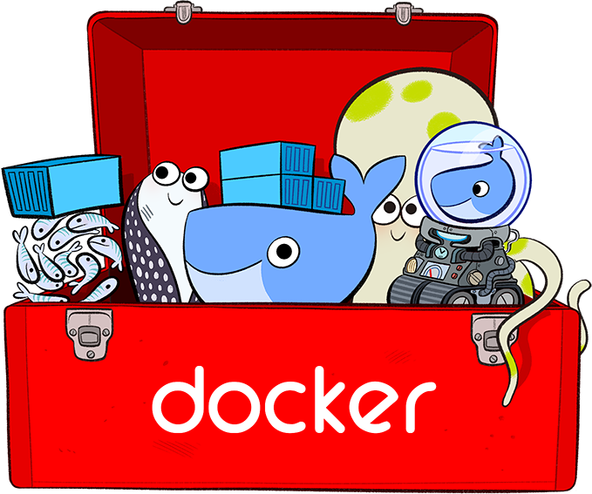
Course Logistics
Lecture Time
Lab Time
Lab Environment
Short Breaks
Time to eat!
Bathroom Breaks

Slide 5
End of Chapter

