Slide 1
Application Server in a Docker Container
Making containers application servers

Slide 2
What is an Application Server?
In this lesson, you’ll be using a Tomcat, but what is a application server?
Docker provides Tomcat images on Docker Hub to do this with
We’ll look at port-mapping, container parameters, and more!
Wikipedia says:
“An application server is a software framework that provides both facilities to create web applications and a server environment to run them.”

Slide 3

Understanding Tomcat
Apache Tomcat (or simply Tomcat) is an open source web server and servlet container developed by the Apache Software Foundation (ASF).
Tomcat implements the Java Servlet and the JavaServer Pages (JSP) specifications from Oracle.
It provides a "pure Java" HTTP web server environment for Java code to run in.

Slide 4
Understanding Tomcat
In the simplest configuration Tomcat runs in a single operating system process
The process runs a Java virtual machine (JVM)
Every single HTTP request from a browser to Tomcat is processed in the Tomcat process in a separate thread

Slide 5
Deploy Apache Tomcat in Docker
Now let’s run a JVM based application like Apache Tomcat:
Output:
docker run --rm –p 8888:8080 tomcat:8.0
16-Oct-2016 18:30:51.541 INFO [localhost-startStop-1] org.apache.catalina.startup.HostConfig.deployDirectory Deployment of web application directory /usr/local/tomcat/webapps/manager has finished in 28 ms
16-Oct-2016 18:30:51.542 INFO [localhost-startStop-1] org.apache.catalina.startup.HostConfig.deployDirectory Deploying web application directory /usr/local/tomcat/webapps/examples
16-Oct-2016 18:30:52.108 INFO [localhost-startStop-1] org.apache.catalina.startup.HostConfig.deployDirectory Deployment of web application directory /usr/local/tomcat/webapps/examples has finished in 566 ms
16-Oct-2016 18:30:52.117 INFO [localhost-startStop-1] org.apache.catalina.startup.HostConfig.deployDirectory Deploying web application directory /usr/local/tomcat/webapps/ROOT
16-Oct-2016 18:30:52.161 INFO [localhost-startStop-1] org.apache.catalina.startup.HostConfig.deployDirectory Deployment of web application directory /usr/local/tomcat/webapps/ROOT has finished in 45 ms
16-Oct-2016 18:30:52.176 INFO [main] org.apache.coyote.AbstractProtocol.start Starting ProtocolHandler ["http-nio-8080"]
16-Oct-2016 18:30:52.206 INFO [main] org.apache.coyote.AbstractProtocol.start Starting ProtocolHandler ["ajp-nio-8009"]
16-Oct-2016 18:30:52.208 INFO [main] org.apache.catalina.startup.Catalina.start Server startup in 1589 ms

Slide 6
Deploy Apache Tomcat
Let’s explore that command for a quick sec:
The option (--rm) tells Docker we want to remove the container when it’s done running.
We are exposing ports 8888:8080 with (-p), which tells Docker we want to map the container’s port 8080 to the host port of 8888
If we were to connect to http://localhost:8888 we should be able to reach our tomct server.
docker run --rm -p 8888:8080 tomcat:8.0

Slide 7


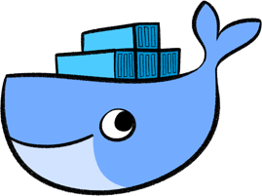
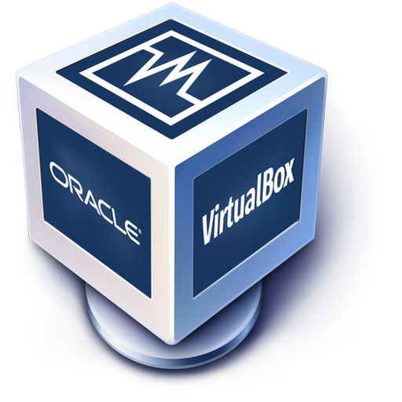
Deploy Apache Tomcat VM
If we are operating Docker from inside a VM image, there is some additional work to be done. Here’s a look at the problem:
Virtual Machine OS
Docker Host
8888
Client
8080
Tomcat
Notes:
Our Docker Host has been mapped properly, but we cannot reach it from our host (Windows/MacOSX) because the VM does not expose those ports.

Slide 8
Deploy Apache Tomcat VM
Our Docker Host has been mapped properly, but we cannot reach it from our host (Windows/MacOSX) because the VM does not expose those ports.
Virtual Machine OS
Docker Host
8888
Client
8080
Tomcat
Notes:
Our Docker Host has been mapped properly, but we cannot reach it from our host (Windows/MacOSX) because the VM does not expose those ports.

Slide 9
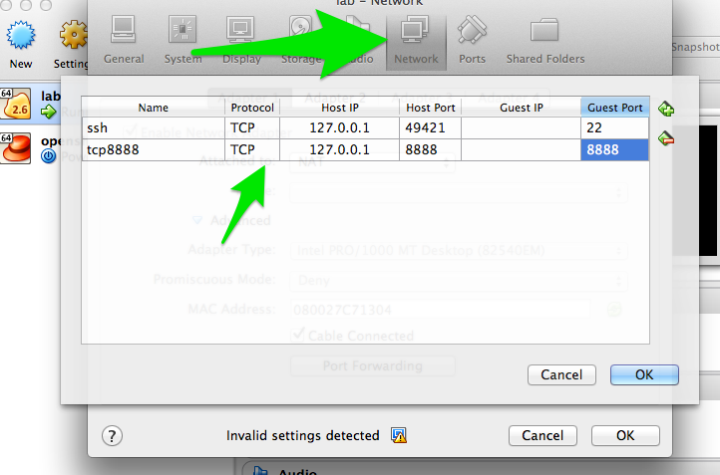
Map Ports for Tomcat VM
Enable port forwarding between the VM Host (windows/Mac) and the VM Guest (Docker host):

Slide 10
Map Ports for Tomcat
The outcome is represented in the diagram below:
Virtual Machine OS
8888
Docker Host
8888
Client
8080
Tomcat
Notes:
Exposing the ports solves the problem.
SHARE:
We will look at some better breakdown examples of this in 06-Docker Networking

Slide 11
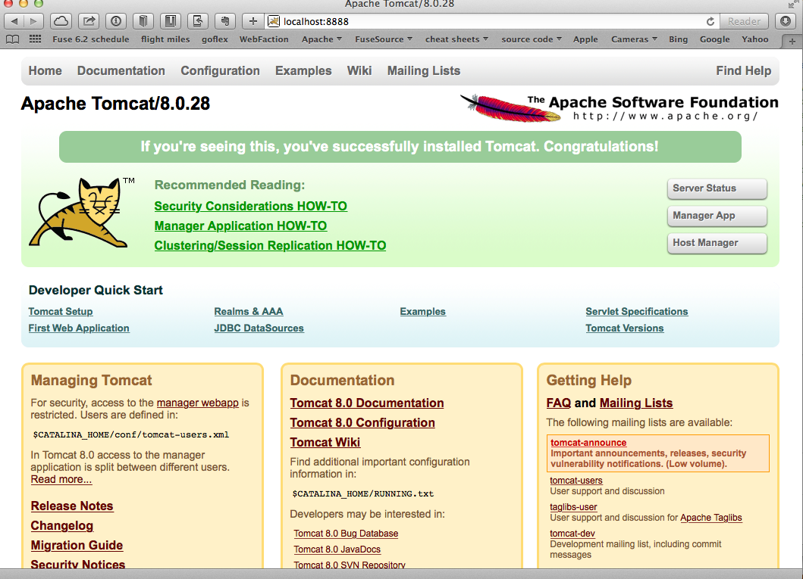
Deploy Apache Tomcat
Now, when we navigate to http://localhost:8888 in our browser, we see:
Notes:
Our Docker Host has been mapped properly, but we cannot reach it from our host (Windows/MacOSX) because the VM does not expose those ports.

Slide 12
Deploy Apache Tomcat
We now have a running container that has tomcat in it.
Let’s explore the tomcat container really quick.
Let’s fire up a new shell window and observe Tomcat’s processes, like this:
Output:
docker ps
CONTAINER ID IMAGE COMMAND
xxxxxxxxxxxx tomcat:8.0 ...
Notes:
We have a running container that has tomcat in it! WooHoo! Let’s explore the tomcat container really quick.
Fire up a new shell window (separate than the running tomcat docker container from previous)

Slide 13
Explore Inside Tomcat Container
Let’s log into the container to explore:
We should now be at the bash prompt for the tomcat container.
We can navigate around like we would normally.
docker exec –it <container_id> bash
Notes:
We have a running container that has tomcat in it! WooHoo! Let’s explore the tomcat container really quick.
Fire up a new shell window (separate than the running tomcat docker container from previous)

Slide 14
Deploy Apache Tomcat
We can exit out of the Tomcat container, like this:
If we then switch back to the other window where Tomcat is running, we can exit by issuing the CTR+C command.
We then have no containers running and we can verify that, with:
NOTE: Because of the (--rm) option, the container removed itself when finished.
# exit
docker ps -a

Slide 15
Common Key Container Parameters
Here are some other useful Docker run flags:
--name Gives containers a unique name
-d Runs containers in daemon mode (in the background)
--dns Gives containers a different name server from the host
-it Interactive with tty (caution using this with -d)
-e Passes in environment variables to the container
--expose Exposes ports from the Docker container
-P Exposes all published ports on containers
-p Map a specific port from the container to the host (host:container)

Slide 16
Container Identification
Use or delete?
Template
$ template
xx.xxx.xx.x
Notes:
Is the following worth it?
Container identification
Name (–name)
The operator can identify a container in three ways:
Identifier type Example value
UUID long identifier “f78375b1c487e03c9438c729345e54db9d20cfa2ac1fc3494b6eb60872e74778”
UUID short identifier “f78375b1c487”
Name “evil_ptolemy”
The UUID identifiers come from the Docker daemon. If you do not assign a container name with the --name option, then the daemon generates a random string name for you. Defining a name can be a handy way to add meaning to a container. If you specify a name, you can use it when referencing the container within a Docker network. This works for both background and foreground Docker containers.
Note: Containers on the default bridge network must be linked to communicate by name.
PID equivalent
Finally, to help with automation, you can have Docker write the container ID out to a file of your choosing. This is similar to how some programs might write out their process ID to a file (you’ve seen them as PID files):
--cidfile="": Write the container ID to the file
Image[:tag]
While not strictly a means of identifying a container, you can specify a version of an image you’d like to run the container with by adding image[:tag] to the command. For example, docker run ubuntu:14.04.
Image[@digest]
Images using the v2 or later image format have a content-addressable identifier called a digest. As long as the input used to generate the image is unchanged, the digest value is predictable and referenceable.
The following example runs a container from the alpine image with thesha256:9cacb71397b640eca97488cf08582ae4e4068513101088e9f96c9814bfda95e0 digest:
$ docker run alpine@sha256:9cacb71397b640eca97488cf08582ae4e4068513101088e9f96c9814bfda95e0 date

Slide 17
Docker Container Command
Use or delete?
Template
$ template
xx.xxx.xx.x
Notes:
Review the following link and see if that’s worth adding
SOURCE:
https://docs.docker.com/engine/reference/commandline/container/

Slide 18
Deploy Apache Tomcat as a Daemon
Let’s use some of those previous run command-line flags and start tomcat in the background:
NOTE: We also gave this container a name, so we can refer to it by name instead of container id
docker run -d --name="tomcat8" -p 8888:8080 tomcat:8.0
Notes:
MORE MATERIAL:
https://docs.docker.com/engine/reference/run/#operator-exclusive-options

Slide 19
Print Apache Tomcat Logs
With Tomcat running as a daemon (-d) in the background, we can print it’s logs, like this:
Output:
docker logs tomcat8
16-Oct-2016 19:19:20.441 INFO [localhost-startStop-1] org.apache.catalina.startup.HostConfig.deployDirectory Deployment of web application directory /usr/local/tomcat/webapps/examples has finished in 526 ms
16-Oct-2016 19:19:20.447 INFO [localhost-startStop-1] org.apache.catalina.startup.HostConfig.deployDirectory Deploying web application directory /usr/local/tomcat/webapps/ROOT
16-Oct-2016 19:19:20.507 INFO [localhost-startStop-1] org.apache.catalina.startup.HostConfig.deployDirectory Deployment of web application directory /usr/local/tomcat/webapps/ROOT has finished in 60 ms
16-Oct-2016 19:19:20.515 INFO [main] org.apache.coyote.AbstractProtocol.start Starting ProtocolHandler ["http-nio-8080"]
16-Oct-2016 19:19:20.527 INFO [main] org.apache.coyote.AbstractProtocol.start Starting ProtocolHandler ["ajp-nio-8009"]
16-Oct-2016 19:19:20.547 INFO [main] org.apache.catalina.startup.Catalina.start Server startup in 1497 ms

Slide 20
Print Apache Tomcat Processes
Let’s use a couple of interesting Docker commands with our tomcat8 container:
[Output] Instead of the normal Linux top container, it just displays the processes running in the container:
docker top tomcat8
PID USER COMMAND
5301 root /usr/bin/java -Djava.util.logging.config.file=/usr/local/tomcat/conf/logging.properties -Djava.util.logging.manager=org.apache.juli.ClassLoaderLogManager -Djava.endorsed.dirs=/usr/local/tomcat/endorsed -classpath /usr/local/tomcat/bin/bootstrap.jar:/usr/local/tomcat/bin/tomcat-juli.jar -Dcatalina.base=/usr/local/tomcat -Dcatalina.home=/usr/local/tomcat -Djava.io.tmpdir=/usr/local/tomcat/temp org.apache.catalina.startup.Bootstrap start

Slide 21
Inspect Apache Tomcat Daemon
Let’s say we want to ”inspect” tomcat8, we can do that like this:
We can also use a --format template to pick out specific info from that output :
Output:
docker inspect tomcat8
docker inspect --format='{{.Config.Env}}' tomcat8
root@server(~) $ docker inspect --format='{{.Config.Env}}' tomcat8
[PATH=/usr/local/tomcat/bin:/usr/local/sbin:/usr/local/bin:/usr/sbin:/usr/bin:/sbin:/bin LANG=C.UTF-8 JAVA_VERSION=7u79 JAVA_DEBIAN_VERSION=7u79-2.5.6-1~deb8u1 CATALINA_HOME=/usr/local/tomcat TOMCAT_MAJOR=8 TOMCAT_VERSION=8.0.28 TOMCAT_TGZ_URL=https://www.apache.org/dist/tomcat/tomcat-8/v8.0.28/bin/apache-tomcat-8.0.28.tar.gz]

Slide 22
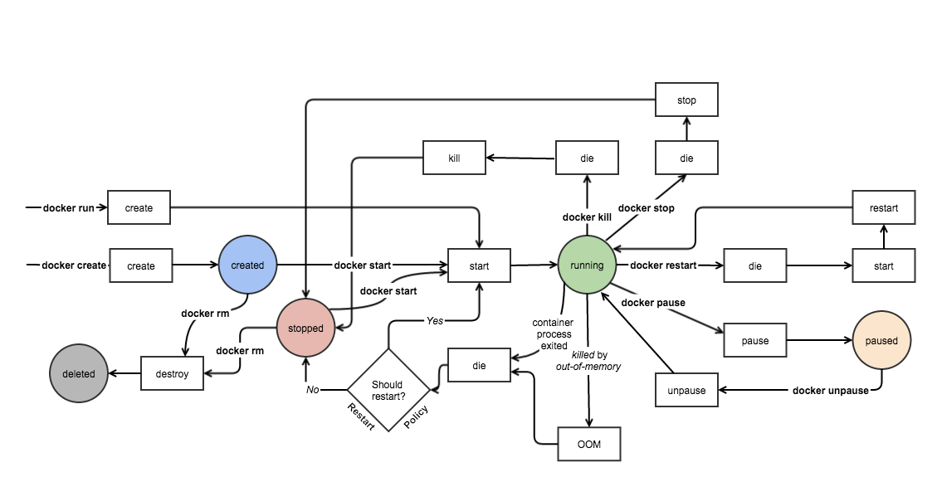
Lifecycle of a Container
Many things can be done with containers, but how long does it last?
Here’s a diagram of a container’s lifecycle:
Image Source and Credits: http://www.slideshare.net/w_akram/docker-introduction-59904719
Notes:
Image Source and Credits: http://www.slideshare.net/w_akram/docker-introduction-59904719
SOURCE:
https://medium.com/@nagarwal/lifecycle-of-docker-container-d2da9f85959
POSSIBLE MATERIAL:
Keep containers alive during daemon downtime
https://docs.docker.com/config/containers/live-restore/

Slide 23
Lifecycle of a Container
Create Container
Create a container to run it later on with required image:
Run Container
Run the docker container with the required image and specified command/ process; ‘-d’ flag is used for running the container in background:
Pause Container
Used to pause the processes running inside the container.
$ docker create --name <container-name> <image-name>
$ docker run -it -d --name <container-name> <image-name> bash
$ docker pause <container-id/name>
Notes:
SHARE:
Though the above pic is self explanatory, we’ll just discuss the basics / CLI commands for working with docker containers.
Create container
Create a container to run it later on with required image.
docker create --name <container-name> <image-name>
Run docker container
Run the docker container with the required image and specified command / process. ‘-d’ flag is used for running the container in background.
docker run -it -d --name <container-name> <image-name> bash
Pause container
Used to pause the processes running inside the container.
docker pause <container-id/name>
SHARE:
Unpause container
Used to unpause the processes inside the container.
docker unpause <container-id/name>
SOURCE:
https://medium.com/@nagarwal/lifecycle-of-docker-container-d2da9f85959
POSSIBLE MATERIAL:
Keep containers alive during daemon downtime
https://docs.docker.com/config/containers/live-restore/

Slide 24
Lifecycle of a Container
Stop Container
To stop the container and processes running inside the container:
To stop all the running Docker containers:
Start Container
Start the container, if present in stopped state:
$ docker stop <container-id/name>
$ docker stop $(docker ps -a -q)
$ docker start <container-id/name>
Notes:
Stop container
To stop the container and processes running inside the container:
docker stop <container-id/name>
To stop all the running docker containers
docker stop $(docker ps -a -q)
Start container
Start the container, if present in stopped state.
docker start <container-id/name>
SOURCE:
https://medium.com/@nagarwal/lifecycle-of-docker-container-d2da9f85959
POSSIBLE MATERIAL:
Keep containers alive during daemon downtime
https://docs.docker.com/config/containers/live-restore/

Slide 25
Lifecycle of a Container
Restart Container
It is used to restart the container as well as processes running inside the container:
Kill Container
We can kill the running container:
$ docker restart <container-id/name>
$ docker kill <container-id/name>
Notes:
Restart container
It is used to restart the container as well as processes running inside the container.
docker restart <container-id/name>
Kill container
We can kill the running container.
docker kill <container-id/name>
SOURCE:
https://medium.com/@nagarwal/lifecycle-of-docker-container-d2da9f85959
POSSIBLE MATERIAL:
Keep containers alive during daemon downtime
https://docs.docker.com/config/containers/live-restore/

Slide 26
Stop and Remove Container
We know how to stop it, but how do we completely destroy it?
Destroy Container
Its preferred to destroy container, only if present in stopped state instead of forcefully destroying the running container:
NOTE: To destroy the parent image of a container, just add an “i”, like (rmi)
To remove all the stopped Docker containers
$ docker rm <container-id/name>
$ docker rm $(docker ps -q -f status=exited)
Notes:
Destroy container
Its preferred to destroy container, only if present in stopped state instead of forcefully destroying the running container.
docker rm <container-id/name>
To remove all the stopped docker containers
docker rm $(docker ps -q -f status=exited)

Slide 27
Hands-on Exercise(s)

Slide 28
Hands-on Exercise(s)
Put lab info here...

Slide 29
End of Chapter

