Slide 1
Containerizing Java EE Application
Docker and java work great together
Notes:
POSSIBLE MATERIAL:
9 Docker recipes for Java EE Applications – Tech Tip #80 (2015) - http://blog.arungupta.me/9-docker-recipes-javaee-applications-techtip80/
Step-by-Step High Availability with Docker and Java EE (2016) - https://community.oracle.com/docs/DOC-998210 (THIS!)

Slide 2
Understanding Structure of a Modern Java EE App

Slide 3
Understanding Java EE App Server
Wikipedia says: “An application server is a software framework that provides both facilities to create web applications and a server environment to run them.”
Java Platform, Enterprise Edition or Java EE (was J2EE) defines the core set of API and features of Java Application Servers
Java application servers behave like an extended virtual machine for running applications
It transparently handles connections to the database on one side, and, often, connections to the Web client on the other
Open source Java application servers that support Java EE include: JOnAS from Object Web, WildFly (formerly JBoss AS) from JBoss, TomEE from Apache, and more.
Notes:
Split into multiple slides
NEED MORE?

Slide 4
Introduction to Dockerfile
Docker build images by reading instructions from a Dockerfile
A Dockerfile is a text document that contains all the commands a user could call on the command line to assemble an image
docker image build command uses this file and executes all the commands in succession to create an image
build command is also passed a context that is used during image creation
This context can be a path on your local filesystem or a URL to a Git repository
Notes:
Dockerfile
Docker build images by reading instructions from a Dockerfile.
A Dockerfile is a text document that contains all the commands a user could call on the command line to assemble an image.
docker image build command uses this file and executes all the commands in succession to create an image.
build command is also passed a context that is used during image creation.
This context can be a path on your local filesystem or a URL to a Git repository.
SOURCE:
https://github.com/docker/labs/blob/master/developer-tools/java/chapters/ch03-build-image.adoc

Slide 5
Introduction to Dockerfile
The common commands are listed below:
Command | Purpose | Example
FROM | First non-comment instruction in Dockerfile | FROM ubuntu
COPY | Copies mulitple source files from the context to the file system of the container at the specified path | COPY .bash_profile /home
ENV | Sets the environment variable | ENV HOSTNAME=test
RUN | Executes a command | RUN apt-get update
CMD | Defaults for an executing container | CMD ["/bin/echo", "hello world"]
EXPOSE | Informs the network ports that the container will listen on | EXPOSE 8093
Notes:
The common commands are listed below:
Command Purpose Example
FROM
First non-comment instruction in Dockerfile
FROM ubuntu
COPY
Copies mulitple source files from the context to the file system of the container at the specified path
COPY .bash_profile /home
ENV
Sets the environment variable
ENV HOSTNAME=test
RUN
Executes a command
RUN apt-get update
CMD
Defaults for an executing container
CMD ["/bin/echo", "hello world"]
EXPOSE
Informs the network ports that the container will listen on
EXPOSE 8093
SOURCE:
https://github.com/docker/labs/blob/master/developer-tools/java/chapters/ch03-build-image.adoc

Slide 6

Create Our First Dockerfile Image
Create a new directory hellodocker
In that directory, create a new text file Dockerfile, using the following:
Build the image using the command:
(.) in this command is the context for the command docker image build
-t adds a tag to the image
The following output is shown...
FROM ubuntu:latest
CMD ["/bin/echo", "hello world"]
$ docker image build . -t helloworld
Next,
Slide
Notes:
Create your first image
Create a new directory hellodocker.
In that directory, create a new text file Dockerfile. Use the following contents:
FROM ubuntu:latest
CMD ["/bin/echo", "hello world"]
SHARE:
This image uses ubuntu as the base image.
CMD command defines the command that needs to run.
It provides a different entry point of /bin/echo and gives the argument “hello world”.
Build the image using the command:
docker image build . -t helloworld
(.) in this command is the context for the command docker image build.
-t adds a tag to the image.
The following output is shown:
Sending build context to Docker daemon 2.048kB Step 1/2 : FROM ubuntu:latest latest: Pulling from library/ubuntu 9fb6c798fa41: Pull complete 3b61febd4aef: Pull complete 9d99b9777eb0: Pull complete d010c8cf75d7: Pull complete 7fac07fb303e: Pull complete Digest: sha256:31371c117d65387be2640b8254464102c36c4e23d2abe1f6f4667e47716483f1 Status: Downloaded newer image for ubuntu:latest ---> 2d696327ab2e Step 2/2 : CMD /bin/echo hello world ---> Running in 9356a508590c ---> e61f88f3a0f7 Removing intermediate container 9356a508590c Successfully built e61f88f3a0f7
Successfully tagged helloworld:latest
List the images available using docker image ls:
REPOSITORY TAG IMAGE ID CREATED SIZE helloworld latest e61f88f3a0f7 3 minutes ago 122MB ubuntu latest 2d696327ab2e 4 days ago 122MB
Other images may be shown as well but we are interested in these two images for now.
Run the container using the command:
docker container run helloworld
to see the output:
hello world
If you do not see the expected output, check your Dockerfile that the content exactly matches as shown above. Build the image again and now run it.
Change the base image from ubuntu to busybox in Dockerfile. Build the image again:
docker image build -t helloworld:2 .
and view the images using docker image ls command:
REPOSITORY TAG IMAGE ID CREATED SIZE helloworld 2 7fbedda27c66 3 seconds ago 1.13MB helloworld latest e61f88f3a0f7 5 minutes ago 122MB ubuntu latest 2d696327ab2e 4 days ago 122MB busybox latest 54511612f1c4 9 days ago 1.13MB
helloworld:2 is the format that allows to specify the image name and assign a tag/version to it separated by :.
SOURCE:
https://github.com/docker/labs/blob/master/developer-tools/java/chapters/ch03-build-image.adoc

Slide 7
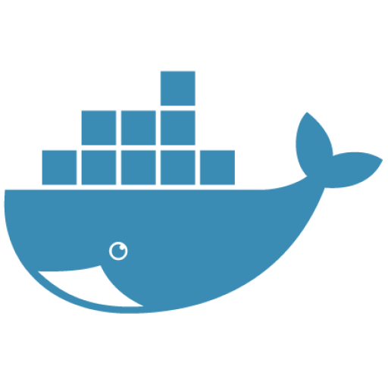
Create Our First Dockerfile Image
Sending build context to Docker daemon 2.048kB
Step 1/2 : FROM ubuntu:latest
latest: Pulling from library/ubuntu
9fb6c798fa41: Pull complete
3b61febd4aef: Pull complete
9d99b9777eb0: Pull complete
d010c8cf75d7: Pull complete
7fac07fb303e: Pull complete
Digest: sha256:31371c117d65387be2640b8254464102c36c4e23d2abe1f6f4667e47716483f1
Status: Downloaded newer image for ubuntu:latest
---> 2d696327ab2e
Step 2/2 : CMD /bin/echo hello world
---> Running in 9356a508590c
---> e61f88f3a0f7
Removing intermediate container 9356a508590c
Successfully built e61f88f3a0f7
Successfully tagged helloworld:latest
Notes:
The following output is shown:
Sending build context to Docker daemon 2.048kB
Step 1/2 : FROM ubuntu:latest
latest: Pulling from library/ubuntu
9fb6c798fa41: Pull complete
3b61febd4aef: Pull complete
9d99b9777eb0: Pull complete
d010c8cf75d7: Pull complete
7fac07fb303e: Pull complete
Digest: sha256:31371c117d65387be2640b8254464102c36c4e23d2abe1f6f4667e47716483f1
Status: Downloaded newer image for ubuntu:latest
---> 2d696327ab2e
Step 2/2 : CMD /bin/echo hello world
---> Running in 9356a508590c
---> e61f88f3a0f7
Removing intermediate container 9356a508590c
Successfully built e61f88f3a0f7
Successfully tagged helloworld:latest
SOURCE:
https://github.com/docker/labs/blob/master/developer-tools/java/chapters/ch03-build-image.adoc

Slide 8
Create Our First Dockerfile Image
List the images available using docker image ls:
Now, run the container our Dockerfile created by using the run command:
Output confirms that it works!
REPOSITORY TAG IMAGE ID CREATED SIZE
helloworld latest e61f88f3a0f7 3 minutes ago 122MB
ubuntu latest 2d696327ab2e 4 days ago 122MB
$ docker container run helloworld
hello world
Notes:
List the images available using docker image ls:
REPOSITORY TAG IMAGE ID CREATED SIZE
helloworld latest e61f88f3a0f7 3 minutes ago 122MB ubuntu latest 2d696327ab2e 4 days ago 122MB
SHARE:
Other images may be shown as well but we are interested in these two images for now.
Run the container using the command:
docker container run helloworld
to see the output:
hello world
SHARE (extra):
If you do not see the expected output, check your Dockerfile that the content exactly matches as shown above. Build the image again and now run it.
We could also change the base image from ubuntu to busybox in Dockerfile. Build the image again:
docker image build -t helloworld:2 .
and view the images using docker image ls command:
REPOSITORY TAG IMAGE ID CREATED SIZE helloworld 2 7fbedda27c66 3 seconds ago 1.13MB helloworld latest e61f88f3a0f7 5 minutes ago 122MB ubuntu latest 2d696327ab2e 4 days ago 122MB busybox latest 54511612f1c4 9 days ago 1.13MB
helloworld:2 is the format that allows to specify the image name and assign a tag/version to it separated by :.
SOURCE:
https://github.com/docker/labs/blob/master/developer-tools/java/chapters/ch03-build-image.adoc

Slide 9
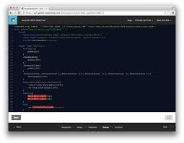
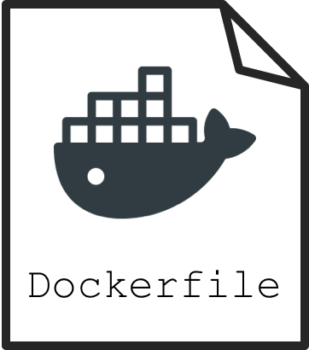
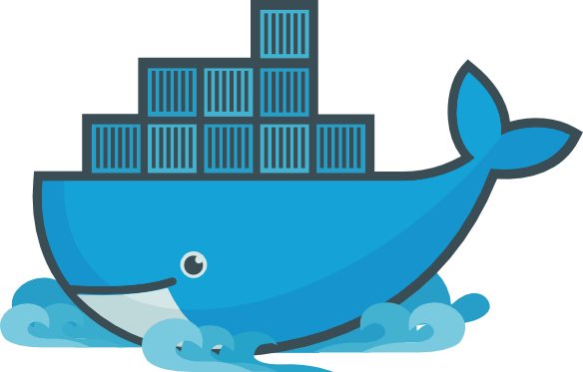
Understanding Dockerization
Dockerizing an application is the process of converting an application to run within a Docker container
While Dockerizing most applications is straight-forward, there are a few problems that need to be worked around each time

Slide 10
Stay Mindful of the Cons
Two common problems that occur during Dockerization are:
Making an application use environment variables when it relies on configuration files
Sending application logs to STDOUT/STDERR when it defaults to files in the container’s file system
Remember both of these as we make our way through this course!

Slide 11
Create a Simple Java Application
Create a new Java project:
Build the project:
Run the Java class:
This shows the output:
Now, let’s package this application as a Docker image!
$ mvn archetype:generate -DgroupId=org.examples.java \ c -DartifactId=helloworld -DinteractiveMode=false
$ cd helloworld mvn package
$ java -cp target/helloworld-1.0-SNAPSHOT.jar org.examples.java.App
Hello World!
Notes:
Create a new Java project:
mvn archetype:generate -DgroupId=org.examples.java -DartifactId=helloworld -DinteractiveMode=false
Build the project:
cd helloworld mvn package
Run the Java class:
java -cp target/helloworld-1.0-SNAPSHOT.jar org.examples.java.App
This shows the output:
Hello World!
Let’s package this application as a Docker image.

Slide 12
Java Docker image
Run the OpenJDK container in an interactive manner:
This will open a terminal in the container; check the version of Java:
Output:
NOTE: A different JDK version may be shown.
Exit out of the container by typing exit in the container shell.
$ docker container run -it openjdk
$ root@8d0af9da5258:/# java -version
openjdk version "1.8.0_141"
OpenJDK Runtime Environment (build 1.8.0_141-8u141-b15-1~deb9u1-b15)
OpenJDK 64-Bit Server VM (build 25.141-b15, mixed mode)
Notes:
Java Docker image
Run the OpenJDK container in an interactive manner:
docker container run -it openjdk
This will open a terminal in the container. Check the version of Java:
root@8d0af9da5258:/# java -version
openjdk version "1.8.0_141"
OpenJDK Runtime Environment (build 1.8.0_141-8u141-b15-1~deb9u1-b15)
OpenJDK 64-Bit Server VM (build 25.141-b15, mixed mode)
A different JDK version may be shown in your case.
Exit out of the container by typing exit in the container shell.

Slide 13
Package and Run Java App as Docker Image
Create a new Dockerfile in helloworld directory and use the following content:
Build the image:
Output:
This shows the exactly same output that was printed when the Java class was invoked using Java CLI.
FROM openjdk:latest
COPY target/helloworld-1.0-SNAPSHOT.jar /usr/src/helloworld-1.0-SNAPSHOT.jar
CMD java -cp /usr/src/helloworld-1.0-SNAPSHOT.jar org.examples.java.App
Don’t
Forget
Me!
$ docker image build -t hello-java:latest .
Hello World!
Notes:
Package and run Java application as Docker image
Create a new Dockerfile in helloworld directory and use the following content:
FROM openjdk:latest
COPY target/helloworld-1.0-SNAPSHOT.jar /usr/src/helloworld-1.0-SNAPSHOT.jar
CMD java -cp /usr/src/helloworld-1.0-SNAPSHOT.jar org.examples.java.App
Build the image:
docker image build -t hello-java:latest .
Run the image:
docker container run hello-java:latest
This displays the output:
Hello World!
This shows the exactly same output that was printed when the Java class was invoked using Java CLI.
.

Slide 14
Difference Between CMD and ENTRYPOINT
CMD will work for most of the cases
Default entry point for a container is /bin/sh, the default shells
Running a container as docker container run -it ubuntu uses that command and starts the default shell
The output is shown as:
$ docker container run -it ubuntu
root@88976ddee107:/#
Notes:
Difference between CMD and ENTRYPOINT
CMD will work for most of the cases.
Default entry point for a container is /bin/sh, the default shell.
Running a container as docker container run -it ubuntu uses that command and starts the default shell.
The output is shown as:
$ docker container run -it ubuntu
root@88976ddee107:/#

Slide 15
Difference Between CMD and ENTRYPOINT
ENTRYPOINT allows to override the entry point to some other command, and even customize it
For example, a container can be started as:
This command overrides the entry point to the container to /bin/cat
The argument(s) passed to the CLI are used by the entry point.
$ docker container run -it --entrypoint=/bin/cat \ ubuntu /etc/passwd root:x:0:0:root:/root:/bin/bash \ daemon:x:1:1:daemon:/usr/sbin:/usr/sbin/nologin \ bin:x:2:2:bin:/bin:/usr/sbin/nologin \ sys:x:3:3:sys:/dev:/usr/sbin/nologin . . .
root@88976ddee107:/#
Notes:
Difference between CMD and ENTRYPOINT
ENTRYPOINT allows to override the entry point to some other command, and even customize it.
For example, a container can be started as:
$ docker container run -it --entrypoint=/bin/cat ubuntu /etc/passwd root:x:0:0:root:/root:/bin/bash daemon:x:1:1:daemon:/usr/sbin:/usr/sbin/nologin bin:x:2:2:bin:/bin:/usr/sbin/nologin sys:x:3:3:sys:/dev:/usr/sbin/nologin . . .
This command overrides the entry point to the container to /bin/cat.
The argument(s) passed to the CLI are used by the entry point.

Slide 16
Difference Between ADD and COPY
COPY will work for most of the cases
ADD has all capabilities of COPY and has the following additional features:
Allows tar file auto-extraction in the image
For example:
Allows files to be downloaded from a remote URL
ADD app.tar.gz /opt/var/myapp
Notes:
Difference between ADD and COPY
COPY will work for most of the cases.
ADD has all capabilities of COPY and has the following additional features:
1. Allows tar file auto-extraction in the image, for example, ADD app.tar.gz /opt/var/myapp
2. Allows files to be downloaded from a remote URL
SHARE:
However, the downloaded files will become part of the image. This causes the image size to bloat. So its recommended to use curl or wget to download the archive explicitly, extract, and remove the archive.

Slide 17
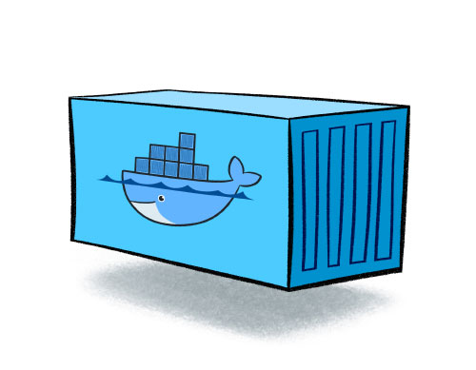
Import and Export Images
Docker images can be saved using image save command to a .tar file:
These tar files can then be imported using load command:
docker image save helloworld > helloworld.tar
docker image load -i helloworld.tar
Notes:
Import and export images
Docker images can be saved using image save command to a .tar file:
docker image save helloworld > helloworld.tar
These tar files can then be imported using load command:
docker image load -i helloworld.tar

Slide 18
Starting Our Application Server - Interactively
Run WildFly container in an interactive mode, like this:
This will show the output as:
$ docker container run -it jboss/wildfly
=========================================================================
JBoss Bootstrap Environment
JBOSS_HOME: /opt/jboss/wildfly
JAVA: /usr/lib/jvm/java/bin/java
. . .
00:26:27,455 INFO [org.jboss.as] (Controller Boot Thread) WFLYSRV0060: Http management interface listening on http://127.0.0.1:9990/management
00:26:27,456 INFO [org.jboss.as] (Controller Boot Thread) WFLYSRV0051: Admin console listening on http://127.0.0.1:9990
00:26:27,457 INFO [org.jboss.as] (Controller Boot Thread) WFLYSRV0025: WildFly Full 10.1.0.Final
Notes:
Interactively
Run WildFly container in an interactive mode
docker container run -it jboss/wildfly
This will show the output as:
=========================================================================
JBoss Bootstrap Environment
JBOSS_HOME: /opt/jboss/wildfly
JAVA: /usr/lib/jvm/java/bin/java
. . .
00:26:27,455 INFO [org.jboss.as] (Controller Boot Thread) WFLYSRV0060: Http management interface listening on http://127.0.0.1:9990/management
00:26:27,456 INFO [org.jboss.as] (Controller Boot Thread) WFLYSRV0051: Admin console listening on http://127.0.0.1:9990 00:26:27,457 INFO [org.jboss.as] (Controller Boot Thread) WFLYSRV0025: WildFly Full 10.1.0.Final (WildFly Core 2.2.0.Final) started in 3796ms - Started 331 of 577 services (393 services are lazy, passive or on-demand)
SHARE:
This shows that the server started correctly, congratulations!
By default, Docker runs in the foreground. -i allows to interact with the STDIN and -t attach a TTY to the process. Switches can be combined together and used as -it.
Hit Ctrl+C to stop the container.
Detached container
Restart the container in detached mode:
docker container run -d jboss/wildfly 254418caddb1e260e8489f872f51af4422bc4801d17746967d9777f565714600
-d, instead of -it, runs the container in detached mode.
The output is the unique id assigned to the container. Logs of the container can be seen using the command docker container logs <CONTAINER_ID>, where <CONTAINER_ID> is the id of the container.
Status of the container can be checked using the docker container ls command:
CONTAINER ID IMAGE COMMAND CREATED STATUS PORTS NAMES 254418caddb1 jboss/wildfly "/opt/jboss/wildfl..." 2 minutes ago Up 2 minutes 8080/tcp gifted_haibt
Also try docker container ls -a to see all the containers on this machine.

Slide 19

Starting Our Application Server - Interactively
By default, Docker runs in the foreground!
-i allows to interact with the STDIN and -t attach a TTY to the process
Switches can be combined together and used as -it, as we’ve seen already
Hit Ctrl+C to stop the container
Notes:
Interactively
By default, Docker runs in the foreground.
-i allows to interact with the STDIN and -t attach a TTY to the process.
Switches can be combined together and used as -it.
Hit Ctrl+C to stop the container.

Slide 20
Starting Our Application Server - Detached Mode
Unique
ID
Restart the container in detached mode:
-d, instead of -it, runs the container in detached mode
The output is the unique id assigned to the container
This “container ID” can be used in lots of commands!
$ docker container run -d jboss/wildfly
254418caddb1e260e8489f872f51af4422bc4801d17746967d9777f565714600
Notes:
Detached container
Restart the container in detached mode:
docker container run -d jboss/wildfly
254418caddb1e260e8489f872f51af4422bc4801d17746967d9777f565714600
-d, instead of -it, runs the container in detached mode.
The output is the unique id assigned to the container.

Slide 21
Starting Our Application Server - Detached Mode
Logs of the container can be seen using the following command:
Remember, status of a container can be checked using the docker container ls command, which gives us:
Normally, there would be many listed and our ID is a way we could find it!
Also remember docker container ls -a shows all the containers
$ docker container logs <CONTAINER_ID>
Unique
ID
CONTAINER ID IMAGE COMMAND CREATED STATUS PORTS NAMES
254418caddb1 jboss/wildfly "/opt/jboss/wildfl..." 2 minutes ago Up 2 minutes 8080/tcp gifted_haibt
Notes:
Logs of the container can be seen using the command docker container logs <CONTAINER_ID>, where <CONTAINER_ID> is the id of the container.
Status of the container can be checked using the docker container ls command:
CONTAINER ID IMAGE COMMAND CREATED STATUS PORTS NAMES
254418caddb1 jboss/wildfly "/opt/jboss/wildfl...” 2 minutes ago Up 2 minutes 8080/tcp gifted_haibt
Also try docker container ls -a to see all the containers on this machine.

Slide 22
Starting Our Application Server - Default Ports
To accept incoming connections requires providing port options when invoking docker run
The container, we just started, can’t be accessed by our browser
We need to stop it again and restart with different options
Restart the container as:
-P map any exposed ports inside the image to a random port on Docker host
$ docker container stop `docker container ps | grep wildfly | awk '{print $1}'`
$ docker container run -d -P --name wildfly jboss/wildfly
Notes:
With default port
If you want the container to accept incoming connections, you will need to provide special options when invoking docker run.
The container, we just started, can’t be accessed by our browser.
We need to stop it again and restart with different options.
docker container stop `docker container ps | grep wildfly | awk '{print $1}'`
Restart the container as:
docker container run -d -P --name wildfly jboss/wildfly
-P map any exposed ports inside the image to a random port on Docker host.

Slide 23
Starting Our Application Server - Default Ports
In addition, --name option is used to give this container a name
This name can then later be used to get more details about the container or stop it
Of course, this can be verified using docker container ls command:
The port mapping is shown in the PORTS column
CONTAINER ID IMAGE COMMAND CREATED STATUS PORTS NAMES
89fbfbceeb56 jboss/wildfly "/opt/jboss/wildfl..." 9 seconds ago Up 8 seconds 0.0.0.0:32768->8080/tcp wildfly
Notes:
(cont.)
In addition, --name option is used to give this container a name.
This name can then later be used to get more details about the container or stop it.
This can be verified using docker container ls command:
CONTAINER ID IMAGE COMMAND CREATED STATUS PORTS NAMES
89fbfbceeb56 jboss/wildfly "/opt/jboss/wildfl..." 9 seconds ago Up 8 seconds 0.0.0.0:32768->8080/tcp wildfly
The port mapping is shown in the PORTS column.

Slide 24
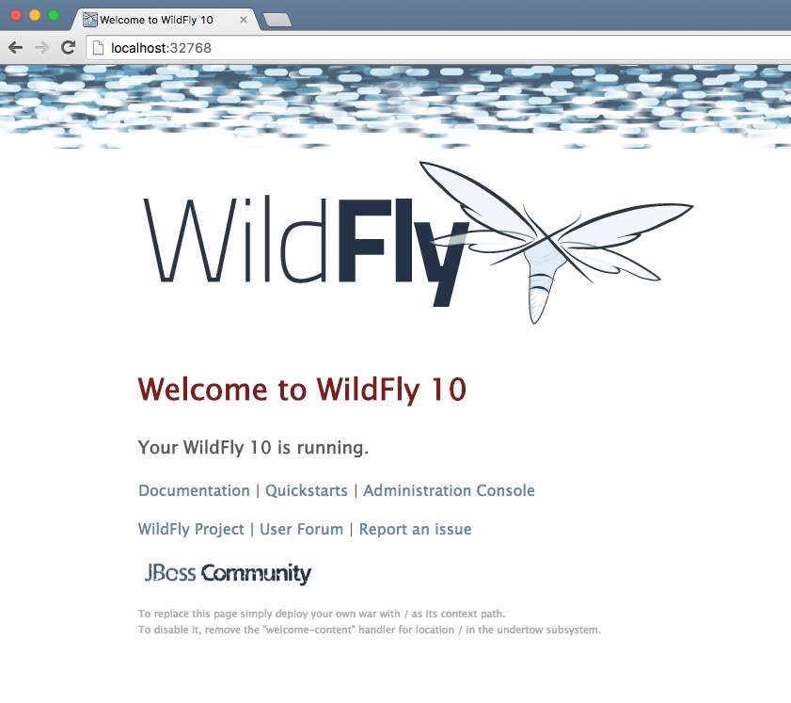
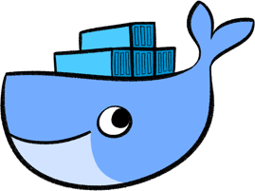
Starting Our Application Server - Default Ports
Now, we can access our server’s welcome page, via localhost!
We will access WildFly server at http://localhost:32768
Cool, huh?
Notes:
Access WildFly server at http://localhost:32768.
Make sure to use the correct port number as shown in your case.
SHARE:
Note-Exact port number may be different in your case.

Slide 25
Deploy a WAR File
Now that your application server is running, lets deploy a WAR file to it!
Create a new directory hellojavaee
Create a new text file and name it Dockerfile
Use the following contents:
Now, what do you think comes next?
FROM jboss/wildfly:latest
RUN curl -L https://github.com/javaee-samples/javaee7-simple-sample/releases/download/v1.10/javaee7-simple-sample-1.10.war -o /opt/jboss/wildfly/standalone/deployments/javaee-simple-sample.war
Notes:
Deploy a WAR file to application server
Now that your application server is running, lets see how to deploy a WAR file to it.
Create a new directory hellojavaee.
Create a new text file and name it Dockerfile.
Use the following contents:
FROM jboss/wildfly:latest
RUN curl -L https://github.com/javaee-samples/javaee7-simple-sample/releases/download/v1.10/javaee7-simple-sample-1.10.war -o /opt/jboss/wildfly/standalone/deployments/javaee-simple-sample.war

Slide 26
Deploy a WAR File
Create an image:
Start the container:
Access the endpoint:
See the output:
Don’t
Forget
Me!
$ docker image build -t javaee-sample .
$ docker container run -d -p 8080:8080 --name wildfly javaee-sample
$ url http://localhost:8080/javaee-simple-sample/resources/persons
Refrence: cs_05-output.bash
Notes:
Deploy a WAR file to application server
Create an image:
docker image build -t javaee-sample .
Start the container:
docker container run -d -p 8080:8080 --name wildfly javaee-sample
Access the endpoint:
curl http://localhost:8080/javaee-simple-sample/resources/persons
Optional: brew install XML-Coreutils will install XML formatting utility on Mac. This output can then be piped to xml-fmt to display a formatted result.
See the output:
Refrence: cs_05-output.bash
NOTE: This is found inside the code_snippet folder.

Slide 27
Stopping and Removing Application
Stop a specific container by id or name:
Stop all running containers:
Stop only the exited containers:
$ docker container stop <CONTAINER ID>
$ docker container stop <NAME>
$ docker container stop $(docker container ps -q)
$ docker container ps -a -f "exited=-1”
Notes:
Stop container
Stop a specific container by id or name:
docker container stop <CONTAINER ID>
docker container stop <NAME>
Stop all running containers:
docker container stop $(docker container ps -q)
Stop only the exited containers:
docker container ps -a -f "exited=-1”
Remove container
Remove a specific container by id or name:
docker container rm <CONTAINER_ID> docker container rm <NAME>
Remove containers meeting a regular expression
docker container ps -a | grep wildfly | awk '{print $1}' | xargs docker container rm
Remove all containers, without any criteria
docker container rm $(docker container ps -aq)

Slide 28
Stopping and Removing Application
Remove a specific container by id or name:
Remove containers meeting a regular expression:
Remove all containers, without any criteria:
$ docker container rm <CONTAINER ID>
$ docker container rm <NAME>
$ docker container ps -a | grep wildfly |
awk '{print $1}' | xargs docker container rm
$ docker container rm $(docker container ps -aq)
Notes:
Remove container
Remove a specific container by id or name:
docker container rm <CONTAINER_ID>
docker container rm <NAME>
Remove containers meeting a regular expression
docker container ps -a | grep wildfly | awk '{print $1}' | xargs docker container rm
Remove all containers, without any criteria
docker container rm $(docker container ps -aq)

Slide 29
Hands-on Exercise(s)

Slide 30
Hands-on Exercise(s)
Template
$ template
xx.xxx.xx.x

Slide 31
End of Chapter

