Slide 1
Docker Linking and Stateful Containers
How we Link and create stateful containers
Notes:
POSSIBLE RESOURCES:
The following link provides a GREAT article on advanced networking!
https://success.docker.com/article/Docker_Reference_Architecture-_Designing_Scalable,_Portable_Docker_Container_Networks

Slide 2
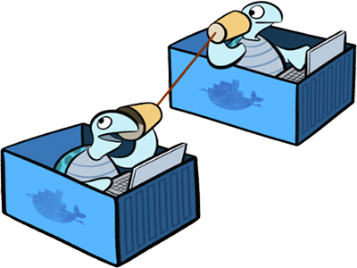
Understanding Networking Overview
Docker containers and services can connect together or non-Docker workloads
Containers and services do not need to be aware they are deployed on Docker, or whether their peers are also Docker workloads or not
No matter the OS, or a mix of, you can use Docker to manage them in a platform-agnostic way.
Notes:
Overview
One of the reasons Docker containers and services are so powerful is that you can connect them together,
or connect them to non-Docker workloads.
Docker containers and services do not even need to be aware that they are deployed on Docker,
or whether their peers are also Docker workloads or not.
Whether your Docker hosts run Linux, Windows, or a mix of the two, you can use Docker to manage them in a platform-agnostic way.
SHARE:
This topic defines some basic Docker networking concepts and prepares you to design and deploy your applications to take full advantage of these capabilities.
Most of this content applies to all Docker installations. However, a few advanced features are only available to Docker EE customers.

Slide 3
Docker Network Drivers
Docker’s networking subsystem is pluggable, using drivers
Several drivers exist by default, and provide core networking functionality:
bridge:
The default network driver. If you don’t specify a driver, this is the type of network you are creating. Bridge networks are usually used when your applications run in standalone containers that need to communicate.
host:
For standalone containers, remove network isolation between the container and the Docker host, and use the host’s networking directly. host is only available for swarm services on Docker 17.06 and higher.
Notes:
Docker Network drivers
Docker’s networking subsystem is pluggable, using drivers.
Several drivers exist by default, and provide core networking functionality:
bridge:
The default network driver. If you don’t specify a driver, this is the type of network you are creating. Bridge networks are usually used when your applications run in standalone containers that need to communicate. See bridge networks.
https://docs.docker.com/network/bridge/
host:
For standalone containers, remove network isolation between the container and the Docker host, and use the host’s networking directly. host is only available for swarm services on Docker 17.06 and higher. See use the host network.
https://docs.docker.com/network/host/

Slide 4
Docker Network Drivers
overlay:
Overlay networks connect multiple Docker daemons together and enable swarm services to communicate with each other. You can also use overlay networks to facilitate communication between a swarm service and a standalone container, or between two standalone containers on different Docker daemons. This strategy removes the need to do OS-level routing between these containers.
macvlan:
Macvlan networks allow you to assign a MAC address to a container, making it appear as a physical device on your network. The Docker daemon routes traffic to containers by their MAC addresses. Using the macvlan driver is sometimes the best choice when dealing with legacy applications that expect to be directly connected to the physical network, rather than routed through the Docker host’s network stack.
Notes:
Docker Network drivers
overlay:
Overlay networks connect multiple Docker daemons together and enable swarm services to communicate with each other. You can also use overlay networks to facilitate communication between a swarm service and a standalone container, or between two standalone containers on different Docker daemons. This strategy removes the need to do OS-level routing between these containers. See overlay networks.
https://docs.docker.com/network/overlay/
macvlan:
Macvlan networks allow you to assign a MAC address to a container, making it appear as a physical device on your network. The Docker daemon routes traffic to containers by their MAC addresses. Using the macvlan driver is sometimes the best choice when dealing with legacy applications that expect to be directly connected to the physical network, rather than routed through the Docker host’s network stack. See Macvlan networks.
https://docs.docker.com/network/macvlan/
none: For this container, disable all networking. Usually used in conjunction with a custom network driver. none is not available for swarm services.
See disable container networking.
Network plugins: You can install and use third-party network plugins with Docker. These plugins are available from Docker Store or from third-party vendors. See the vendor’s documentation for installing and using a given network plugin.
to all Docker installations. However, a few advanced features are only available to Docker EE customers.

Slide 5

Docker Network Drivers
none:
For this container, disable all networking. Usually used in conjunction with a custom network driver. none is not available for swarm services.
Network Plugins:
You can install and use third-party network plugins with Docker. These plugins are available from Docker Store or from third-party vendors.
Notes:
Docker Network drivers
none:
For this container, disable all networking. Usually used in conjunction with a custom network driver. none is not available for swarm services.
Network plugins:
You can install and use third-party network plugins with Docker.
These plugins are available from Docker Store or from third-party vendors.
See the vendor’s documentation for installing and using a given network plugin.

Slide 6
Network Driver Summary
User-defined bridge networks are best when you need multiple containers to communicate on the same Docker host.
Host networks are best when the network stack should not be isolated from the Docker host, but you want other aspects of the container to be isolated.
Overlay networks are best when you need containers running on different Docker hosts to communicate, or when multiple applications work together using swarm services.
Macvlan networks are best when you are migrating from a VM setup or need your containers to look like physical hosts on your network, each with a unique MAC address.
Third-party network plugins allow you to integrate Docker with specialized network stacks.
Notes:
Network driver summary
User-defined bridge networks
are best when you need multiple containers to communicate on the same Docker host.
Host networks
are best when the network stack should not be isolated from the Docker host, but you want other aspects of the container to be isolated.
Overlay networks
are best when you need containers running on different Docker hosts to communicate, or when multiple applications work together using swarm services.
Macvlan networks
are best when you are migrating from a VM setup or need your containers to look like physical hosts on your network, each with a unique MAC address.
Third-party network plugins
sallow you to integrate Docker with specialized network stacks.

Slide 7
Docker EE Networking Features
The following two features are only possible when using Docker EE and managing your Docker services using Universal Control Plane (UCP):
The HTTP routing mesh allows you to share the same network IP address and port among multiple services. UCP routes the traffic to the appropriate service using the combination of hostname and port, as requested from the client.
Session stickiness allows you to specify information in the HTTP header which UCP uses to route subsequent requests to the same service task, for applications which require stateful sessions.
Notes:
Docker EE networking features
The following two features are only possible when using Docker EE and managing your Docker services using Universal Control Plane (UCP):
The HTTP routing mesh allows you to share the same network IP address and port among multiple services. UCP routes the traffic to the appropriate service using the combination of hostname and port, as requested from the client.
Session stickiness allows you to specify information in the HTTP header which UCP uses to route subsequent requests to the same service task, for applications which require stateful sessions.

Slide 8
Container Networking Specific
Type of network a container uses, whether it is a bridge, an overlay, a macvlan network, or a custom network plugin, is transparent from within the container.
From the container’s point of view, it has:
A network interface with an IP address
A gateway
A routing table
DNS services
and other networking details (assuming the container is not using the none network driver)
This topic is about networking concerns from the point of view of the container
Notes:
Container networking
type of network a container uses, whether it is a bridge, an overlay, a macvlan network, or a custom network plugin, is transparent from within the container.
From the container’s point of view, it has a network interface with an IP address, a gateway, a routing table, DNS services, and other networking details (assuming the container is not using the none network driver).
This topic is about networking concerns from the point of view of the container.

Slide 9

Published Ports
By default, when you create a container, it does not publish any of its ports to the outside world
To make a port available to services outside of Docker, or to Docker containers which are not connected to the container’s network, use --publish (-p) flag
This creates a firewall rule which maps a container port to a port on the Docker host, like we saw in Docker Registry
Let’s breakdown some examples of this in the next slide...
Next,
Slide!
Notes:
Published ports
By default, when you create a container, it does not publish any of its ports to the outside world.
To make a port available to services outside of Docker, or to Docker containers which are not connected to the container’s network, use the --publish or -p flag.
This creates a firewall rule which maps a container port to a port on the Docker host.

Slide 10
Published Ports
Here are some examples:
Flag Value | Description
-p 8080:80 | Map TCP port 80 in the container to port 8080 on the Docker host.
-p 8080:80/udp | Map UDP port 80 in the container to port 8080 on the Docker host.
-p 8080:80/tcp -p 8080:80/udp | Map TCP port 80 in the container to TCP port 8080 on the Docker host, and map UDP port 80 in the container to UDP port 8080 on the Docker host.
Notes:
Here are some examples.
Flag value Description
-p 8080:80 Map TCP port 80 in the container to port 8080 on the Docker host.
-p 8080:80/udp Map UDP port 80 in the container to port 8080 on the Docker host.
-p 8080:80/tcp -p 8080:80/udp Map TCP port 80 in the container to TCP port 8080 on the Docker host, and map UDP port 80 in the container to UDP port 8080 on the Docker host.

Slide 11
Additional Ways to Find Port Mapping Details
The exact mapped port can also be found using docker port command:
This shows the output as:
Port mapping can be also be found using docker inspect command:
$ docker container port <CONTAINER_ID> or <NAME>
8080/tcp -> 0.0.0.0:8080
docker container inspect --format='{{(index (index . NetworkSettings.Ports "8080/tcp") 0).HostPort}}' <CONTAINER ID>
Notes:
Additional ways to find port mapping
The exact mapped port can also be found using docker port command:
docker container port <CONTAINER_ID> or <NAME>
This shows the output as:
8080/tcp -> 0.0.0.0:8080
Port mapping can be also be found using docker inspect command:
docker container inspect --format='{{(index (index .NetworkSettings.Ports "8080/tcp") 0).HostPort}}' <CONTAINER ID>

Slide 12

IP Address and Hostname
By default, the container is assigned an IP address for every Docker network it connects to
The IP address is assigned from the pool assigned to the network
Each network also has a default subnet mask and gateway
When the container starts, it can only be connected to a single network, using --network
However, you can connect a running container to multiple networks using docker network connect
Notes:
IP address and hostname
By default, the container is assigned an IP address for every Docker network it connects to.
The IP address is assigned from the pool assigned to the network,
so the Docker daemon effectively acts as a DHCP server for each container.
Each network also has a default subnet mask and gateway.
When the container starts, it can only be connected to a single network, using --network.
However, you can connect a running container to multiple networks using docker network connect.
When you start a container using the --network flag, you can specify the IP address assigned to the container on that network using the --ip or --ip6 flags.
When you connect an existing container to a different network using docker network connect, you can use the --ip or --ip6 flags on that command to specify the container’s IP address on the additional network.
In the same way, a container’s hostname defaults to be the container’s name in Docker. You can override the hostname using --hostname. When connecting to an existing network using docker network connect, you can use the --alias flag to specify an additional network alias for the

Slide 13
IP Address and Hostname
When starting containers using --network, you can specify the IP address using the --ip or --ip6 flags
When you connect an existing container to a different network using docker network connect, you can use --ip or --ip6 flags to specify the container’s IP address on the additional network
In the same way, a container’s hostname defaults to be the container’s name in Docker
You can override the hostname using --hostname
When connecting to an existing network using docker network connect, you can use the --alias flag to specify an additional network alias for the
Notes:
IP address and hostname
By default, the container is assigned an IP address for every Docker network it connects to.
The IP address is assigned from the pool assigned to the network,
so the Docker daemon effectively acts as a DHCP server for each container.
Each network also has a default subnet mask and gateway.
When the container starts, it can only be connected to a single network, using --network.
However, you can connect a running container to multiple networks using docker network connect.
When you start a container using the --network flag, you can specify the IP address assigned to the container on that network using the --ip or --ip6 flags.
When you connect an existing container to a different network using docker network connect, you can use the --ip or --ip6 flags on that command to specify the container’s IP address on the additional network.
In the same way, a container’s hostname defaults to be the container’s name in Docker.
You can override the hostname using --hostname.
When connecting to an existing network using docker network connect, you can use the --alias flag to specify an additional network alias for the container on that network.

Slide 14
DNS Services
By default, a container inherits the DNS settings of the Docker daemon, including the /etc/hosts and /etc/resolv.conf
You can override these settings on a per-container basis
Let’s look at a few example options...
Next,
Slide!
Notes:
By default, a container inherits the DNS settings of the Docker daemon, including the /etc/hosts and /etc/resolv.conf.
You can override these settings on a per-container basis.

Slide 15
DNS Services
Flag Value | Description
--dns | The IP address of a DNS server. To specify multiple DNS servers, use multiple --dns flags. If the container cannot reach any of the IP addresses you specify, Google’s public DNS server 8.8.8.8 is added, so that your container can resolve internet domains.
--dns-search | A DNS search domain to search non-fully-qualified hostnames. To specify multiple DNS search prefixes, use multiple --dns-search flags.
--dns-opt | A key-value pair representing a DNS option and its value. See your operating system’s documentation for resolv.conf for valid options.
--hostname | The hostname a container uses for itself. Defaults to the container’s name if not specified.
Notes:
Flag Description
--dns The IP address of a DNS server. To specify multiple DNS servers, use multiple --dns flags. If the container cannot reach any of the IP addresses you specify, Google’s public DNS server 8.8.8.8 is added, so that your container can resolve internet domains.
--dns-search A DNS search domain to search non-fully-qualified hostnames. To specify multiple DNS search prefixes, use multiple --dns-search flags.
--dns-opt A key-value pair representing a DNS option and its value. See your operating system’s documentation for resolv.conf for valid options.
--hostname The hostname a container uses for itself. Defaults to the container’s name if not specified.

Slide 16
User-defined Bridge
When you create a new container, you can specify one or more network flags
This example connects a Nginx container to the my-net network
Also, it publishes port 80 in the container to port 8080 on the Docker host, so external clients can access that port
Any other container connected to the my-net network has access to all ports on the my-nginx container, and vice versa:
$ docker create --name my-nginx \
--network my-net \
--publish 8080:80 \
nginx:latest
Notes:
Connect a container to a user-defined bridge
When you create a new container, you can specify one or more --network flags.
This example connects a Nginx container to the my-net network.
It also publishes port 80 in the container to port 8080 on the Docker host, so external clients can access that port.
Any other container connected to the my-net network has access to all ports on the my-nginx container, and vice versa.
$ docker create --name my-nginx \
--network my-net \
--publish 8080:80 \
nginx:latest

Slide 17
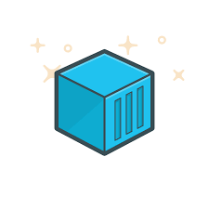
User-defined Bridge
To connect a running container to an existing user-defined bridge, use the docker network connect command
The following command connects an already-running my-nginx container to an already-existing my-net network:
$ docker network connect my-net my-nginx
Notes:
Connect a container to a user-defined bridge
To connect a running container to an existing user-defined bridge, use thedocker network connect command.
The following command connects an already-running my-nginx container to an already-existing my-net network:
$ docker network connect my-net my-nginx

Slide 18
Quick Look at Docker Networking
Docker
Container
Docker
Container
Docker
Container
Docker
Container
eth0
eth0
eth0
eth0
veth
veth
veth
veth
Docker Bridge

Slide 19
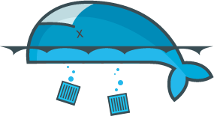
Docker Containers Die
Containers are ephemeral
Nothing is saved from a container if it goes away
Containers get new IP addresses
Don’t treat containers like VMs: They are NOT
But what about stateful applications?

Slide 20
Managing Data in Docker
It is possible to store data within the writable layer of a container, but there are some downsides:
The data doesn’t persist when that container is no longer running
A container’s writable layer is tightly coupled to the host machine where the container is running
Writing into a container’s writable layer requires a storage driver to manage the filesystem.
Docker offers three different ways to mount data into a container from the Docker host:
volumes
bind mounts
tmpfs volumes
Notes:
Manage data in Docker
It is possible to store data within the writable layer of a container, but there are some downsides:
1.The data doesn’t persist when that container is no longer running,
SHARE:
and it can be difficult to get the data out of the container if another process needs it.
2. A container’s writable layer is tightly coupled to the host machine where the container is running.
SHARE:
You can’t easily move the data somewhere else.
3. Writing into a container’s writable layer requires a storage driver to manage the filesystem.
SHARE:
The storage driver provides a union filesystem, using the Linux kernel. This extra abstraction reduces performance as compared to using data volumes, which write directly to the host filesystem.
Docker offers three different ways to mount data into a container from the Docker host:
1. volumes
2. bind mounts
3. tmpfs volumes.
SHARE:
When in doubt, volumes are almost always the right choice. Keep reading for more information about each mechanism for mounting data into containers.

Slide 21
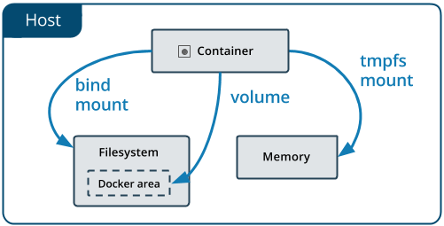
Choosing the Right Mount Type
No matter which type of mount you choose the data looks the same
To visualize the difference, think about where the data lives on the Docker host
Notes:
No matter which type of mount you choose to use, the data looks the same from within the container.
SHARE:
It is exposed as either a directory or an individual file in the container’s filesystem.
An easy way to visualize the difference among volumes, bind mounts, and tmpfs mounts is to think about where the data lives on the Docker host.
SHARE:
Volumes are stored in a part of the host filesystem which is managed by Docker(/var/lib/docker/volumes/ on Linux). Non-Docker processes should not modify this part of the filesystem. Volumes are the best way to persist data in Docker.
Bind mounts may be stored anywhere on the host system. They may even be important system files or directories. Non-Docker processes on the Docker host or a Docker container can modify them at any time.
tmpfs mounts are stored in the host system’s memory only, and are never written to the host system’s filesystem.

Slide 22
Concept of Volumes
Volumes are the preferred mechanism for persisting data, generally
Bind mounts are dependent on the directory structure of the host
Volumes have several advantages over bind mounts:
Volumes are easier to back up or migrate
You can manage volumes using Docker CLI commands or the Docker API
Volumes work on both Linux and Windows containers
Volumes can be more safely shared among multiple containers
Volume drivers allow you to store volumes on remote hosts or cloud providers, to encrypt the contents of volumes, or to add other functionality
A new volume’s contents can be pre-populated by a container
Notes:
Use volumes
Volumes are the preferred mechanism for persisting data generated by and used by Docker containers.
While bind mounts are dependent on the directory structure of the host machine,
SHARE:
volumes are completely managed by Docker.
Volumes have several advantages over bind mounts:
1. Volumes are easier to back up or migrate than bind mounts.
2. You can manage volumes using Docker CLI commands or the Docker API.
3. Volumes work on both Linux and Windows containers.
4. Volumes can be more safely shared among multiple containers.
5. Volume drivers allow you to store volumes on remote hosts or cloud providers, to encrypt the contents of volumes, or to add other functionality.
6. A new volume’s contents can be pre-populated by a container.

Slide 23
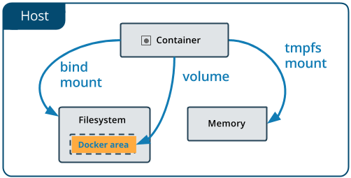
Concept of Volumes
Volumes are also a better choice than persisting data in a container’s writable layer, because using a volume does not increase the size of containers
And, the volume’s contents exist outside the lifecycle of a given container!
Notes:
Use volumes
In addition, volumes are often a better choice than persisting data in a container’s writable layer, because using a volume does not increase the size of containers using it, and the volume’s contents exist outside the lifecycle of a given container.
If your container generates non-persistent state data, consider using a tmpfs mount to avoid storing the data anywhere permanently, and to increase the container’s performance by avoiding writing into the container’s writable layer.
Volumes use rprivate bind propagation, and bind propagation is not configurable for volumes.

Slide 24
Concept of Volumes
If your container generates non-persistent state data, consider a tmpfs mount
Avoid storing the data anywhere permanently
Increase the container’s performance by avoiding writing into the container’s writable layer
Volumes use rprivate bind propagation, and bind propagation is not configurable for volumes
Notes:
Use volumes
If your container generates non-persistent state data, consider using a tmpfs mount to
avoid storing the data anywhere permanently,
and to increase the container’s performance by avoiding writing into the container’s writable layer.
Volumes use rprivate bind propagation, and bind propagation is not configurable for volumes.

Slide 25
Confronting the Stateful Challenge
Docker volumes to the rescue of all our stateful containers
Volumes create persistent data outside of the container
Can be mapped directly to host locations
Can also be deployed independently of hosts
Example:
docker run -d -P --name web -v /webapp training/webapp python app.py
d

Slide 26

Docker Data Volume
Example:
Host
Container
docker run -d -P --name web -v /webapp training/webapp python app.py
/var/lib/docker/.../tmp
/wabapp

Slide 27
Direct Host Volumes
We can also map volumes directly to host specific locations:
Useful for known locations on host
Can use NFS mounts
Files are visible outside of the container and are persisted
Can restart new containers up with same location

Slide 28
Docker Host Volumes Direct Location
Example:
docker run -d -P --name web -v /src/webapp:/opt/webapp training/webapp python app.py
Host
Container
known/file/location
/wabapp

Slide 29
Containers as Data Volumes
Start a container that will manage the volume:
Now other containers can use that container so they’re not tied directly to the volumes (mounting them, etc):
docker create -v /dbdata --name dbdata training/postgres /bin/true
docker run -d --volumes-from dbdata --name db1 training/postgres

Slide 30
Containers as Data Volumes
Here’s a diagram of what that might look like:
Host
Container
Container
Container
/wabapp
known/file/location

Slide 31
Inspect Volumes
How can we inspect our volumes? Let’s first list our current volumes:
Now, pulling from the list that prints out, we can plugin a volume id, like this:
docker volume ls
docker volume inspect <name-or-id>

Slide 32
Choose the -v or --mount Flag
Originally, the -v or --volume flag was used for standalone containers and the --mount flag was used for swarm services
However, starting with Docker 17.06, you can also use --mount with standalone containers
In general, --mount is more explicit and verbose
The biggest difference is that the -v syntax combines all the options together in one field, while the --mount syntax separates them
Notes:
Originally, the -v or --volume flag was used for standalone containers and the --mount flag was used for swarm services.
However, starting with Docker 17.06, you can also use --mount with standalone containers.
In general, --mount is more explicit and verbose.
The biggest difference is that the -v syntax combines all the options together in one field, while the --mount syntax separates them.
SHARE:
Tip: New users should use the --mount syntax. Experienced users may be more familiar with the -v or --volume syntax, but are encouraged to use --mount, because research has shown it to be easier to use.
MORE MATERIAL TO POSSIBLE ADD IN THE FUTURE:
Here is a comparison of the syntax for each flag.
If you need to specify volume driver options, you must use --mount.
-v or --volume: Consists of three fields, separated by colon characters (:). The fields must be in the correct order, and the meaning of each field is not immediately obvious.
In the case of named volumes, the first field is the name of the volume, and is unique on a given host machine. For anonymous volumes, the first field is omitted.
The second field is the path where the file or directory are mounted in the container.
The third field is optional, and is a comma-separated list of options, such as ro. These options are discussed below.
--mount: Consists of multiple key-value pairs, separated by commas and each consisting of a <key>=<value> tuple. The --mount syntax is more verbose than -v or --volume, but the order of the keys is not significant, and the value of the flag is easier to understand.
The type of the mount, which can be bind, volume, or tmpfs. This topic discusses volumes, so the type is always volume.
The source of the mount. For named volumes, this is the name of the volume. For anonymous volumes, this field is omitted. May be specified as source or src.
The destination takes as its value the path where the file or directory is mounted in the container. May be specified as destination, dst, or target.
The readonly option, if present, causes the bind mount to be mounted into the container as read-only.
The volume-opt option, which can be specified more than once, takes a key-value pair consisting of the option name and its value.
The examples below show both the --mount and -v syntax where possible, and --mount is presented first.

Slide 33
Differences Between -v and --mount Behavior
Because volume flags have been a part of Docker for a long time, their behavior can’t be changed
This means that there’s only one behavior that’s different between the two
If you use -v or --volume to bind-mount a file or directory that does not yet exist on the Docker host, -v creates the endpoint for you
If you use --mount to bind-mount a file or directory that does not exist on the host, Docker does not automatically create it for you
Notes:
Differences between -v and --mount behavior
Because the -v and --volume flags have been a part of Docker for a long time, their behavior cannot be changed.
This means that there is one behavior that is different between -v and --mount.
If you use -v or --volume to bind-mount a file or directory that does not yet exist on the Docker host, -v creates the endpoint for you.
SHARE:
It is always created as a directory.
If you use --mount to bind-mount a file or directory that does not yet exist on the Docker host, Docker does not automatically create it for you,
SHARE:
but generates an error.

Slide 34
Bind Mounts
Bind mounts have been around since the early days of Docker
Bind mounts have limited functionality compared to volumes
When you use a bind mount, a file or directory on the host machine is mounted into a container
The file or directory is referenced by its full or relative path on the host machine
By contrast, with volumes, a new directory is created within Docker’s storage directory on the host machine
Notes:
Use bind mounts
Bind mounts have been around since the early days of Docker.
Bind mounts have limited functionality compared to volumes.
When you use a bind mount, a file or directory on the host machine is mounted into a container.
The file or directory is referenced by its full or relative path on the host machine.
By contrast, when you use a volume, a new directory is created within Docker’s storage directory on the host machine,
SHARE:
and Docker manages that directory’s contents.

Slide 35
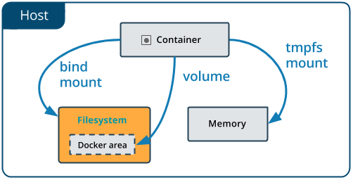
Bind Mounts
The file or directory does not need to exist on the Docker host already!
Bind mounts are very performant, but they rely on the host machine’s filesystem having a specific directory structure available
If developing new Docker applications, consider using named volumes instead
Notes:
BIND MOUNTS
The file or directory does not need to exist on the Docker host already.
SHARE:
It is created on demand if it does not yet exist.
Bind mounts are very performant, but they rely on the host machine’s filesystem having a specific directory structure available.
If you are developing new Docker applications, consider using named volumes instead.
SHARE:
You can’t use Docker CLI commands to directly manage bind mounts.
IMAGE HERE

Slide 36
Start a Container Using a Bind Mount
Consider a case where...
You have a directory source and that when you build the source code, the artifacts are saved into another directory source/target/
You want the artifacts to be available to the container at /app/, and you want the container to get access to a new build each time you build the source on your development host
Use the following command to bind-mount the target/ directory into your container at /app/
$ docker run -d \
-it \
--name devtest \
--mount type=bind,source="$(pwd)"/target,target=/app \
nginx:latest
Notes:
Start a container with a bind mount
Consider a case where...
you have a directory source and that when you build the source code, the artifacts are saved into another directory source/target/.
You want the artifacts to be available to the container at /app/, and you want the container to get access to a new build each time you build the source on your development host.
Use the following command to bind-mount the target/ directory into your container at /app/.
SHARE:
Run the command from within the source directory.
$ docker run -d \ -it \ --name devtest \ --mount type=bind,source="$(pwd)"/target,target=/app \ nginx:latest
SHARE:
The $(pwd) sub-command expands to the current working directory on Linux or macOS hosts.
The --mount and -v examples below produce the same result.
You can’t run them both unless you remove the devtest container after running the first one.

Slide 37
Start a Container Using a Bind Mount
Use docker inspect devtest to verify that the bind mount was created correctly
Look for the Mounts section:
"Mounts": [
{
"Type": "bind",
"Source": "/tmp/source/target",
"Destination": "/app",
"Mode": "",
"RW": true,
"Propagation": "rprivate"
}
],
Notes:
Use docker inspect devtest to verify that the bind mount was created correctly.
Look for the Mounts section:
"Mounts": [
{
"Type": "bind",
"Source": "/tmp/source/target",
"Destination": "/app",
"Mode": "",
"RW": true,
"Propagation": "rprivate"
}
],
SHARE:
This shows that the mount is a bind mount, it shows the correct source and destination, it shows that the mount is read-write, and that the propagation is set to rprivate.
Stop the container:
$ docker container stop devtest
$ docker container rm devtest

Slide 38
About Storage Drivers
To use storage drivers effectively, it’s important to know how Docker builds and stores images
Use this information to make informed choices about the best way to persist data from your applications and avoid performance problems
Storage drivers allow you to persist data in the writable layer of your container
This is the least efficient way to persist data!
Notes:
About storage drivers
To use storage drivers effectively, it’s important to know how Docker builds and stores images, how these images are used by containers.
You can use this information to make informed choices about the best way to persist data from your applications and avoid performance problems along the way.
Storage drivers allow you to persist data in the writable layer of your container.
This is the least efficient way to persist data.
SHARE:
Note:
Volumes or bind mounts provide much better read and write performance, and volumes provide more security and isolation than either storage drivers or bind mounts.
Neither volumes nor bind mounts use most of the concepts described in this topic.

Slide 39
Images and Layers
A Docker image is built up from a series of layers
Each layer represents an instruction in the image’s Dockerfile.
Each layer except the very last one is read-only
Consider the following Dockerfile:
Finally, the last layer specifies what command to run within the container
FROM ubuntu:15.04
COPY . /app
RUN make /app
CMD python /app/app.py
FROM creates a layer; ubuntu:15.04 image
COPY command adds some files from (.)
The RUN command builds your application
CMD specifies what to run in the container
Notes:
A Docker image is built up from a series of layers.
Each layer represents an instruction in the image’s Dockerfile.
Each layer except the very last one is read-only.
Consider the following Dockerfile:
FROM ubuntu:15.04
COPY . /app
RUN make /app
CMD python /app/app.py
SHARE:
This Dockerfile contains four commands, each of which creates a layer.
The FROM statement starts out by creating a layer from the ubuntu:15.04 image.
The COPY command adds some files from your Docker client’s current directory.
The RUN command builds your application using the makecommand.
Finally, the last layer specifies what command to run within the container.

Slide 40
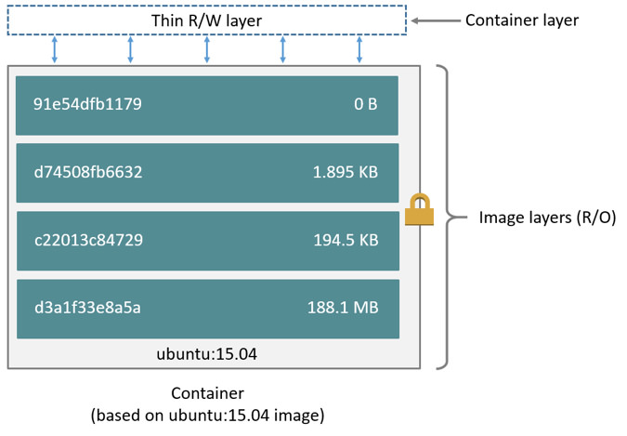
Images and Layers
Each layer is only a set of differences from the layer before it
When you create a new container, you add a new writable layer on top of the underlying layers
All changes made are written to this thin writable container layer
The diagram below shows a container based on the Ubuntu 15.04 image:
A storage driver handles the details about the way these layers interact with each other
Notes:
Each layer is only a set of differences from the layer before it.
SHARE
The layers are stacked on top of each other.
When you create a new container, you add a new writable layer on top of the underlying layers.
SHARE
This layer is often called the “container layer”.
All changes made to the running container, such as writing new files, modifying existing files, and deleting files, are written to this thin writable container layer.
The diagram below shows a container based on the Ubuntu 15.04 image:
IMAGE
A storage driver handles the details about the way these layers interact with each other.
SHARE:
Different storage drivers are available, which have advantages and disadvantages in different situations.

Slide 41

Containers and Layers
The major difference between a container and an image is the top writable layer
When the container is deleted, the writable layer is also deleted
The underlying image remains unchanged
Multiple containers can share access to the same underlying image and yet have their own data state
Notes:
The major difference between a container and an image is the top writable layer.
SHARE:
Like we just learned all writes to the container that add new or modify existing data are stored in this writable layer.
When the container is deleted, the writable layer is also deleted.
The underlying image remains unchanged
Because each container has its own writable container layer, and all changes are stored in this container layer, multiple containers can share access to the same underlying image and yet have their own data state.

Slide 42
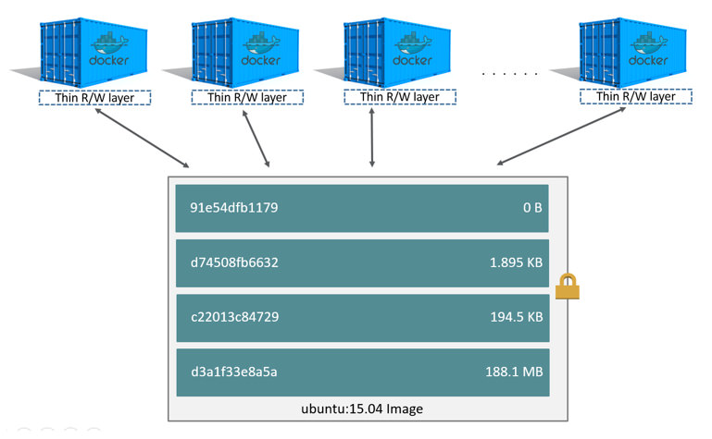
Containers and Layers
The diagram below shows multiple containers sharing a Ubuntu 15.04 image:
Notes:
The diagram below shows multiple containers sharing the same Ubuntu 15.04 image.
SHARE:
- If you need multiple images to have shared access to the exact same data, store this data in a Docker volume and mount it into your containers.
- Docker uses storage drivers to manage the contents of the image layers and the writable container layer.
- Each storage driver handles the implementation differently, but all drivers use stackable image layers and the copy-on-write (CoW) strategy.

Slide 43
Data Volumes and Storage Drivers
Any data written to the container, not stored in a data volume is deleted!
A data volume is a directory or file in the Docker host’s filesystem that is mounted directly into a container
Data volumes are not controlled by the storage driver
Reads and writes to data volumes bypass the storage driver and operate at native host speeds
You can mount any number of data volumes into a container
Multiple containers can also share one or more data volumes.
Notes:
When a container is deleted,
any data written to the container that is not stored in a data volume is deleted along with the container.
A data volume is a directory or file in the Docker host’s filesystem that is mounted directly into a container.
Data volumes are not controlled by the storage driver.
Reads and writes to data volumes bypass the storage driver and operate at native host speeds.
You can mount any number of data volumes into a container.
Multiple containers can also share one or more data volumes.

Slide 44
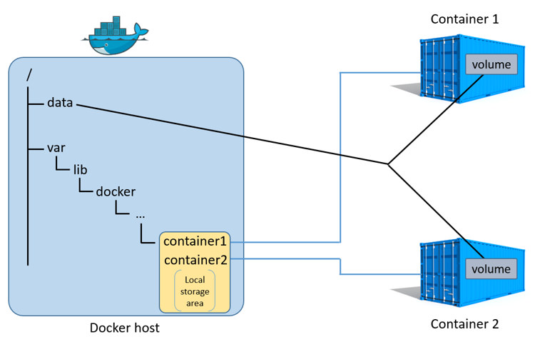
Data Volumes and Storage Drivers
The diagram below shows a single Docker host running two containers:
Data volumes reside outside of the local storage area on the Docker host
Any data stored in data volumes persists on the Docker host
Notes:
The diagram below shows a single Docker host running two containers.
SHARE:
Each container exists inside of its own address space within the Docker host’s local storage area (/var/lib/docker/...).
There is also a single shared data volume located at /data on the Docker host.
This is mounted directly into both containers.
Data volumes reside outside of the local storage area on the Docker host,
SHARE:
further reinforcing their independence from the storage driver’s control.
When a container is deleted, any data stored in data volumes persists on the Docker host.

Slide 45
Hands-on Exercise(s)

Slide 46
Hands-on Exercise(s)
Hands-on Exercise
Notes:
xx

Slide 47
End of Chapter

