Slide 1
Docker on the Cloud
manage builds, swarms, Infrastructure, and nodes

Slide 2
Introduction to Docker Cloud

Slide 3
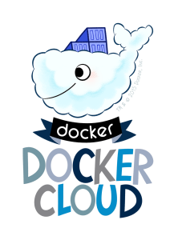
Introduction to Docker Cloud
Docker says:
“Docker Cloud provides a hosted service with build and testing
facilities for Dockerized application images; tools to help you
set up and manage host infrastructure; and application
lifecycle features to automate deploying services created
from images.”
Notes:
Docker Cloud provides a hosted registry service with build and testing facilities for Dockerized application images;
tools to help you set up and manage host infrastructure;
and application lifecycle features to automate deploying (and redeploying) services created from images.

Slide 4
What is a node?
A node is an individual Linux host used to deploy and run your applications
Docker Cloud does not provide hosting services, so all of your applications, services, and containers run on your own hosts
Your hosts can come from several different sources, including physical servers, virtual machines or cloud providers
Notes:
Introducing Docker Cloud
What is a node?
A node is an individual Linux host used to deploy and run your applications.
Docker Cloud does not provide hosting services, so all of your applications, services, and containers run on your own hosts.
Your hosts can come from several different sources, including physical servers, virtual machines or cloud providers.

Slide 5
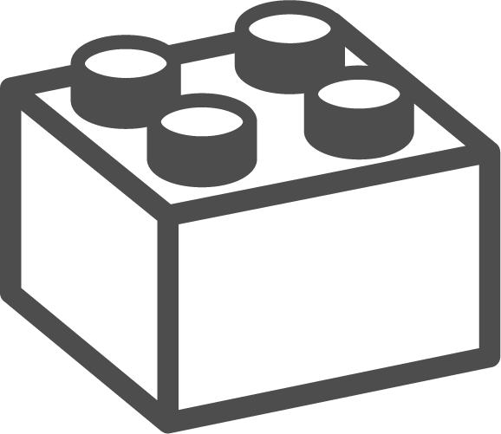
What is a node cluster?
When launching a node from a cloud provider you actually create a node cluster
Node Clusters are groups of nodes of the same type and from the same cloud provider
Node clusters allow you to scale the infrastructure by provisioning more nodes with a drag of a slider
Pretty cool, huh?
Notes:
What is a node cluster?
When launching a node from a cloud provider you actually create a node cluster.
Node Clusters are groups of nodes of the same type and from the same cloud provider.
Node clusters allow you to scale the infrastructure by provisioning more nodes with a drag of a slider.

Slide 6
What is a node cluster?
Use cloud service providers
Docker Cloud makes it easy to provision nodes from existing cloud providers
You can provision new nodes directly from within Docker Cloud
Native support for AWS, DigitalOcean, Azure, Packet.net, and IBM SoftLayer.
Use your own hosts (“Bring your own nodes”)
You can also provide your own node or nodes
This means you can use any Linux host connected to the Internet as a Docker Cloud node as long as you can install a Cloud agent
The agent registers itself with your Docker account, and allows you to use Docker Cloud to deploy containerized applications
Notes:
Use cloud service providers
Docker Cloud makes it easy to provision nodes from existing cloud providers.
If you already have an account with an infrastructure as a service provider, you can provision new nodes directly from within Docker Cloud.
Today we have native support for Amazon Web Services, DigitalOcean, Microsoft Azure, Packet.net, and IBM SoftLayer.
Use your own hosts (“Bring your own nodes”)
You can also provide your own node or nodes.
This means you can use any Linux host connected to the Internet as a Docker Cloud node as long as you can install a Cloud agent.
The agent registers itself with your Docker account, and allows you to use Docker Cloud to deploy containerized applications.

Slide 7
What is a service?
Services are logical groups of containers from the same image
Services make it simple to scale your application across different nodes
In Docker Cloud you drag a slider to increase or decrease the availability, performance, and redundancy of the application
Services can also be linked one to another even if they are deployed on different nodes, regions, or even cloud providers
Notes:
What is a service?
Services are logical groups of containers from the same image.
Services make it simple to scale your application across different nodes.
In Docker Cloud you drag a slider to increase or decrease the availability, performance, and redundancy of the application.
Services can also be linked one to another even if they are deployed on different nodes, regions, or even cloud providers.

Slide 8
Docker ID
Docker Cloud uses your Docker ID for access and access control, and this allows you to link your Hub and Cloud accounts.
If you already have an account on Docker Hub, you can use the same credentials to log in to Docker Cloud.
If you don’t have a Docker ID yet, you can sign up for one from the Cloud website
Or using the docker login command in the Docker CLI.
The name you choose for your Docker ID becomes part of your account namespace
Notes:
SHARE:
Let’s get started! To work with Docker Cloud we first need a Docker ID.
(These are the same credentials you used for Docker Hub if you had an account there.)
DOCKER ID
Docker Cloud uses your Docker ID for access and access control, and this allows you to link your Hub and Cloud accounts.
If you already have an account on Docker Hub, you can use the same credentials to log in to Docker Cloud.
If you don’t have a Docker ID yet, you can sign up for one from the Cloud website
Or using the docker login command in the Docker CLI.
The name you choose for your Docker ID becomes part of your account namespace.

Slide 9
Advantages of Docker on the Cloud

Slide 10
Images, Builds, and Testing
Docker Cloud uses the hosted Docker Cloud Registry
Allowing you to publish Dockerized images online, either publicly or privately
Docker Cloud can also store pre-built images
Or, link to your source code so it can build the code into Docker images
Optionally testing the resulting images before pushing them to a repository
Notes:
ADVANTAGE: 1
Images, Builds, and Testing
Docker Cloud uses the hosted Docker Cloud Registry,
which allows you to publish Dockerized images on the internet either publicly or privately.
Docker Cloud can also store pre-built images,
or link to your source code so it can build the code into Docker images,
and optionally test the resulting images before pushing them to a repository.

Slide 11
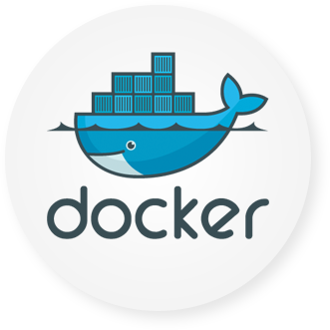
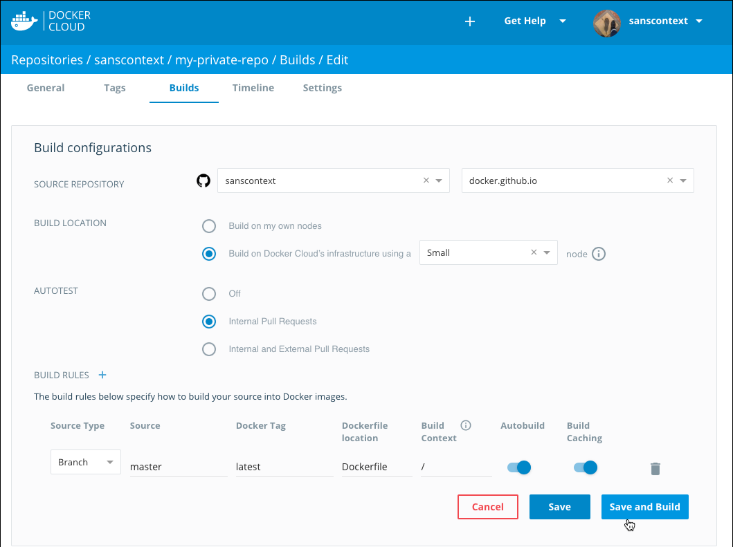
Images, Builds, and Testing
Notes:
ADVANTAGE: 1
Images, Builds, and Testing
Docker Cloud uses the hosted Docker Cloud Registry,
which allows you to publish Dockerized images on the internet either publicly or privately.
Docker Cloud can also store pre-built images,
or link to your source code so it can build the code into Docker images,
and optionally test the resulting images before pushing them to a repository.

Slide 12
Swarm Management (Beta Swarm Mode)
With Beta Swarm Mode, you can create new swarms from within Docker Cloud
You can register existing swarms to Docker Cloud, or provision swarms to your cloud providers
Your Docker ID authenticates and securely accesses personal or team swarms
Docker Cloud allows you to connect your local Docker Engine to any swarm you have access to in Docker Cloud
Notes:
ADVANTAGE: 2
Swarm Management (Beta Swarm Mode)
With Beta Swarm Mode, you can create new swarms from within Docker Cloud,
register existing swarms to Docker Cloud, or provision swarms to your cloud providers.
Your Docker ID authenticates and securely accesses personal or team swarms.
Docker Cloud allows you to connect your local Docker Engine to any swarm you have access to in Docker Cloud.

Slide 13
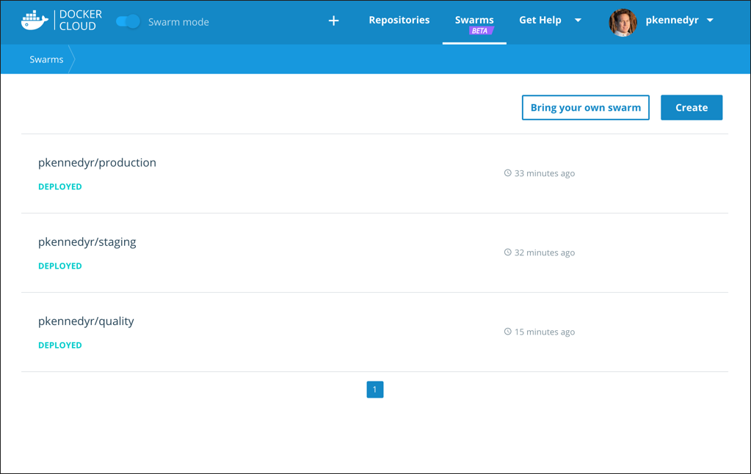
Swarm Management (Beta Swarm Mode)
Notes:
ADVANTAGE: 2
Swarm Management (Beta Swarm Mode)
With Beta Swarm Mode, you can create new swarms from within Docker Cloud,
register existing swarms to Docker Cloud, or provision swarms to your cloud providers.
Your Docker ID authenticates and securely accesses personal or team swarms.
Docker Cloud allows you to connect your local Docker Engine to any swarm you have access to in Docker Cloud.

Slide 14
Infrastructure management (Standard Mode)
Before doing anything with your images, you need somewhere to run them
Docker Cloud allows you to link to your infrastructure
Or, like to your cloud services provider so you can provision new nodes automatically
Once you have nodes set up, you can deploy images directly from Docker Cloud repositories
Notes:
ADVANTAGE: 2
Infrastructure management (Standard Mode)
Before you can do anything with your images, you need somewhere to run them.
Docker Cloud allows you to link to your infrastructure
cloud services provider so you can provision new nodes automatically.
Once you have nodes set up, you can deploy images directly from Docker Cloud repositories.

Slide 15
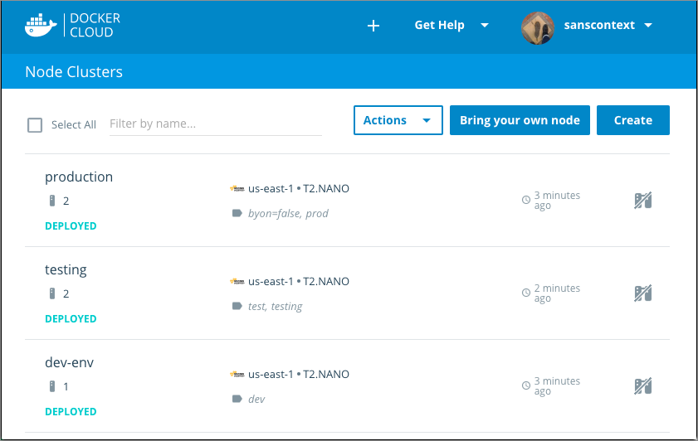
Infrastructure management (Standard Mode)
Notes:
ADVANTAGE: 2
Infrastructure management (Standard Mode)
Before you can do anything with your images, you need somewhere to run them.
Docker Cloud allows you to link to your infrastructure
cloud services provider so you can provision new nodes automatically.
Once you have nodes set up, you can deploy images directly from Docker Cloud repositories.

Slide 16
Services, Stacks, and Applications (Standard Mode)
Images are just one layer in containerized applications
Once you’ve built an image, you can use it to deploy services
Or, use Docker Cloud’s stackfiles to combine it with other services and microservices, to form a full application
Notes:
ADVANTAGE: 4 (Final one)
Services, Stacks, and Applications (Standard Mode)
Images are just one layer in containerized applications.
Once you’ve built an image, you can use it to deploy services (which are composed of one or more containers created from an image),
or use Docker Cloud’s stackfiles to combine it with other services and microservices, to form a full application.

Slide 17
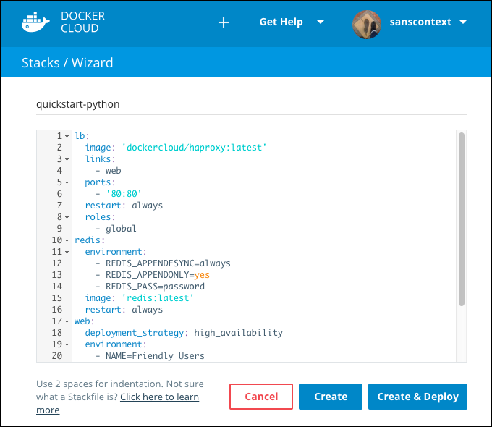
Services, Stacks, and Applications (Standard Mode)
Notes:
ADVANTAGE: 4 (Final one)
Services, Stacks, and Applications (Standard Mode)
Images are just one layer in containerized applications.
Once you’ve built an image, you can use it to deploy services (which are composed of one or more containers created from an image),
or use Docker Cloud’s stackfiles to combine it with other services and microservices, to form a full application.

Slide 18
Manage Builds & Images
Notes:
(1) Manage builds and images
Manage swarms (beta swarm mode)
Manage Infrastructure (standard mode)
Manage nodes and apps (standard mode)

Slide 19
Manage Builds & Images
Docker Cloud provides a hosted registry service where you can create repositories to store your Docker images
You can choose to push images to the repositories, or link to your source code and build them directly in Docker Cloud
You can build images manually, or set up automated builds to rebuild your Docker image on each git push to the source code
You can also create automated tests, and when the tests pass use autoredeploy to automatically update your running services when a build passes its tests
Notes:
Docker Cloud provides a hosted registry service where you can create repositories to store your Docker images.
You can choose to push images to the repositories, or link to your source code and build them directly in Docker Cloud.
You can build images manually, or set up automated builds to rebuild your Docker image on each git push to the source code.
You can also create automated tests, and when the tests pass use autoredeploy to automatically update your running services when a build passes its tests.
Repositories in Docker Cloud
Push images to Docker Cloud
Link to a source code repository
Automated builds
Docker Security Scanning
Automated repository tests
Advanced options for Autobuild and Autotest
THERE IS MORE TO DRAW FROM AT:
https://docs.docker.com/docker-cloud/builds/

Slide 20
Docker Cloud - Automated Builds
When you set up autobuilds, you create a list of branches and tags that you want to build into Docker images
When you push code to a source code branch for one of those listed image tags, the push uses a webhook to trigger a new build
The built image is then pushed to the Docker Cloud registry or to an external registry
Notes:
SHARE:
Docker Cloud can automatically build images from source code in an external repository and automatically push the built image to your Docker repositories.
When you set up automated builds (also called autobuilds), you create a list of branches and tags that you want to build into Docker images.
When you push code to a source code branch (for example in Github) for one of those listed image tags,
the push uses a webhook to trigger a new build, which produces a Docker image.
The built image is then pushed to the Docker Cloud registry or to an external registry.
SOURCE:
https://docs.docker.com/docker-cloud/builds/automated-build/

Slide 21

Docker Cloud - Automated Builds
If you have automated tests configured, these run after building but before pushing to the registry
Use these tests to create a CI workflow where a build that fails its tests does not push the built image
Automated tests do not push images to the registry on their own.
You can also just use docker push to push pre-built images to these repositories, even if you have automatic builds set up
Here’s a look at the Docker Cloud build dashboard...
Next,
Slide!
Notes:
If you have automated tests configured, these run after building but before pushing to the registry.
You can use these tests to create a continuous integration workflow where a build that fails its tests does not push the built image.
Automated tests do not push images to the registry on their own.
You can also just use docker push to push pre-built images to these repositories, even if you have automatic builds set up.
IMAGE:
build-dashboard.png
Configure automated build settings
You can configure repositories in Docker Cloud so that they automatically build an image each time you push new code to your source provider. If you have automated tests configured, the new image is only pushed when the tests succeed.
Before you set up automated builds you need to create a repository to build, and link to your source code provider.
1. From the Repositories section, click into a repository to view its details.
2. Click the Builds tab.
3. If you are setting up automated builds for the first time, select the code repository service where the image’s source code is stored.
Otherwise, if you are editing the build settings for an existing automated build, click Configure automated builds.
4. Select the source repository to build the Docker images from.
You might need to specify an organization or user (the namespace) from the source code provider. Once you select a namespace, its source code repositories appear in the Select repository dropdown list.
5. Choose where to run your build processes.
You can either run the process on your own infrastructure and optionally set up specific nodes to build on, or select Build on Docker Cloud’s infrastructure you can use the hosted build service offered on Docker Cloud’s infrastructure. If you use Docker’s infrastructure, select a builder size to run the build process on. This hosted build service is free while it is in Beta.
IMAGE:
edit-repository-builds.png
6. If in the previous step you selected Build on Docker Cloud’s infrastructure, then you are given the option to select the Docker Version used to build this repository. You can choose between the Stable and Edge versions of Docker.
Selecting Edge lets you to take advantage of multi-stage builds. For more information and examples, see the topic on how to use multi-stage builds.
You can learn more about stable and edge channels in the Install Docker overview and the Docker CE Edge topics.
7. Optionally, enable autotests.
8. Review the default Build Rules, and optionally click the plus sign to add and configure more build rules.
Build rules control what Docker Cloud builds into images from the contents of the source code repository, and how the resulting images are tagged within the Docker repository.
A default build rule is set up for you, which you can edit or delete. This default set builds from the Branch in your source code repository called master, and creates a Docker image tagged with latest.
9. For each branch or tag, enable or disable the Autobuild toggle.
Only branches or tags with autobuild enabled are built, tested, and have the resulting image pushed to the repository. Branches with autobuild disabled are built for test purposes (if enabled at the repository level), but the built Docker image is not pushed to the repository.
10. For each branch or tag, enable or disable the Build Caching toggle.
Build caching can save time if you are building a large image frequently or have many dependencies. You might want to leave build caching disabled to make sure all of your dependencies are resolved at build time, or if you have a large layer that is quicker to build locally.
11. Click Save to save the settings, or click Save and build to save and run an initial test.
A webhook is automatically added to your source code repository to notify Docker Cloud on every push. Only pushes to branches that are listed as the source for one or more tags trigger a build.
SOURCE:
https://docs.docker.com/docker-cloud/builds/automated-build/

Slide 22
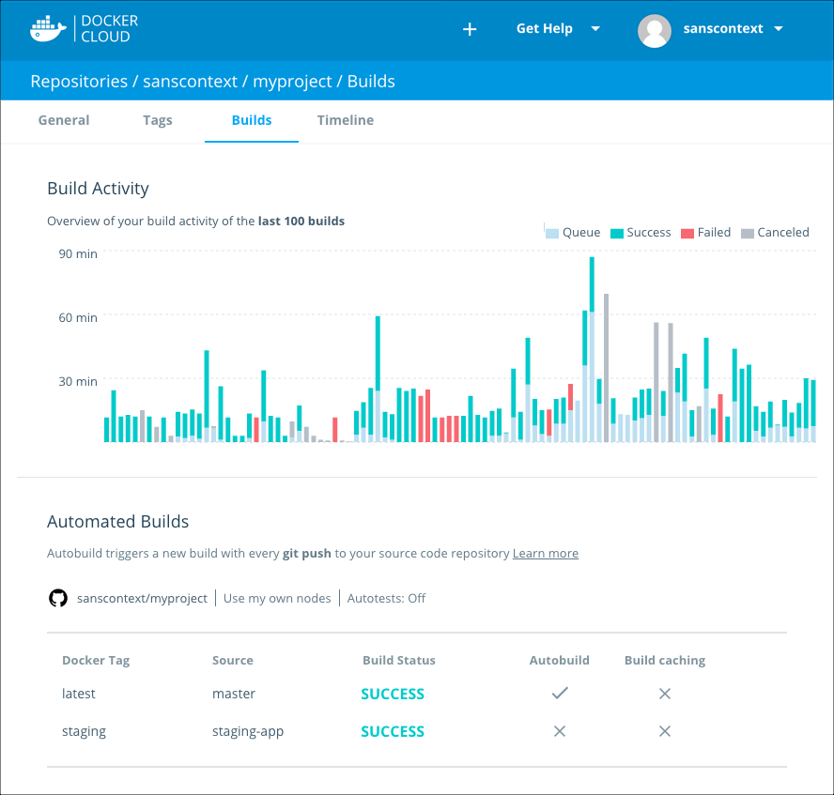
Docker Cloud – Automated Builds
Notes:
IMAGE:
build-dashboard.png
---- EXTRA - Possibly add in the future, or SHARE---
Configure automated build settings
You can configure repositories in Docker Cloud so that they automatically build an image each time you push new code to your source provider. If you have automated tests configured, the new image is only pushed when the tests succeed.
Before you set up automated builds you need to create a repository to build, and link to your source code provider.
1. From the Repositories section, click into a repository to view its details.
2. Click the Builds tab.
3. If you are setting up automated builds for the first time, select the code repository service where the image’s source code is stored.
Otherwise, if you are editing the build settings for an existing automated build, click Configure automated builds.
4. Select the source repository to build the Docker images from.
You might need to specify an organization or user (the namespace) from the source code provider. Once you select a namespace, its source code repositories appear in the Select repository dropdown list.
5. Choose where to run your build processes.
You can either run the process on your own infrastructure and optionally set up specific nodes to build on, or select Build on Docker Cloud’s infrastructure you can use the hosted build service offered on Docker Cloud’s infrastructure. If you use Docker’s infrastructure, select a builder size to run the build process on. This hosted build service is free while it is in Beta.
IMAGE:
edit-repository-builds.png
6. If in the previous step you selected Build on Docker Cloud’s infrastructure, then you are given the option to select the Docker Version used to build this repository. You can choose between the Stable and Edge versions of Docker.
Selecting Edge lets you to take advantage of multi-stage builds. For more information and examples, see the topic on how to use multi-stage builds.
You can learn more about stable and edge channels in the Install Docker overview and the Docker CE Edge topics.
7. Optionally, enable autotests.
8. Review the default Build Rules, and optionally click the plus sign to add and configure more build rules.
Build rules control what Docker Cloud builds into images from the contents of the source code repository, and how the resulting images are tagged within the Docker repository.
A default build rule is set up for you, which you can edit or delete. This default set builds from the Branch in your source code repository called master, and creates a Docker image tagged with latest.
9. For each branch or tag, enable or disable the Autobuild toggle.
Only branches or tags with autobuild enabled are built, tested, and have the resulting image pushed to the repository. Branches with autobuild disabled are built for test purposes (if enabled at the repository level), but the built Docker image is not pushed to the repository.
10. For each branch or tag, enable or disable the Build Caching toggle.
Build caching can save time if you are building a large image frequently or have many dependencies. You might want to leave build caching disabled to make sure all of your dependencies are resolved at build time, or if you have a large layer that is quicker to build locally.
11. Click Save to save the settings, or click Save and build to save and run an initial test.
A webhook is automatically added to your source code repository to notify Docker Cloud on every push. Only pushes to branches that are listed as the source for one or more tags trigger a build.
SOURCE:
https://docs.docker.com/docker-cloud/builds/automated-build/

Slide 23
Manage Swarms
Notes:
Manage builds and images
(2) Manage swarms (beta swarm mode)
Manage Infrastructure (standard mode)
Manage nodes and apps (standard mode)

Slide 24
Manage Swarms
Docker Cloud now allows you to connect to clusters of Docker Engines in swarm mode
With Beta Swarm Mode in Docker Cloud, you can provision swarms to popular cloud providers, or register existing swarms to Docker Cloud
Use your Docker ID to authenticate and securely access personal or team swarms
Notes:
Docker Cloud now allows you to connect to clusters of Docker Engines in swarm mode.
With Beta Swarm Mode in Docker Cloud, you can provision swarms to popular cloud providers, or register existing swarms to Docker Cloud.
Use your Docker ID to authenticate and securely access personal or team swarms.
Using Swarm Mode with Docker Cloud
Swarm Mode and organizations
Register existing swarms
Create a new swarm on AWS in Docker Cloud
Create a new swarm on Microsoft Azure in Docker Cloud
Connect to a swarm through Docker Cloud
Link Amazon Web Services to Docker Cloud
Link Microsoft Azure Cloud Services to Docker Cloud
Set up SSH keys

Slide 25
Create a New Swarm on Azure in Docker Cloud
You can now create new Docker Swarms from within Docker Cloud as well as register existing swarms
When you create a swarm, Docker Cloud connects to the Cloud provider on your behalf, and uses the provider’s APIs and a provider-specific template to launch Docker instances
The instances are then joined to a swarm and the swarm is configured using your input
When you access the swarm from Docker Cloud, the system forwards your commands directly to the Docker instances running in the swarm
Notes:
Create a new swarm on Microsoft Azure in Docker Cloud
You can now create new Docker Swarms from within Docker Cloud as well as register existing swarms.
When you create a swarm, Docker Cloud connects to the Cloud provider on your behalf, and uses the provider’s APIs and a provider-specific template to launch Docker instances.
The instances are then joined to a swarm and the swarm is configured using your input.
When you access the swarm from Docker Cloud, the system forwards your commands directly to the Docker instances running in the swarm.

Slide 26
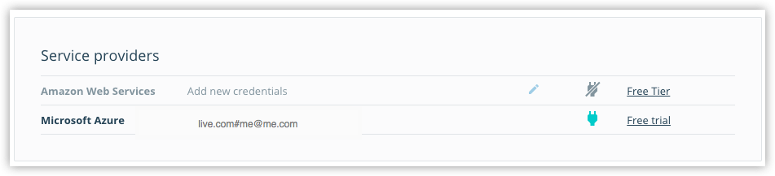
Create a New Swarm on Azure in Docker Cloud
To create a swarm, you need to give Docker Cloud permission to deploy swarm nodes on your behalf in your cloud services provider account
If you haven’t yet linked Docker Cloud to Azure, you’ll first need to follow those steps
Once it’s linked, it shows up on the Swarms -> Create page as a connected service provider
Notes:
Link Docker Cloud to your service provider
To create a swarm, you need to give Docker Cloud permission to deploy swarm nodes on your behalf in your cloud services provider account.
If you haven’t yet linked Docker Cloud to Azure,
follow the steps in Link Microsoft Azure Cloud Services to Docker Cloud.
Once it’s linked, it shows up on the Swarms -> Create page as a connected service provider.
IMAGE:
azure-creds-cloud.png
SHARE:
Note: If you are using a Microsoft Azure Visual Studio MSDN subscription, you need to enable programmatic deployments on the Docker CE VM Azure Marketplace item.
See the Microsoft Azure blog post on Working with Marketplace Images on Azure Resource Manager for instructions on how to do this.

Slide 27
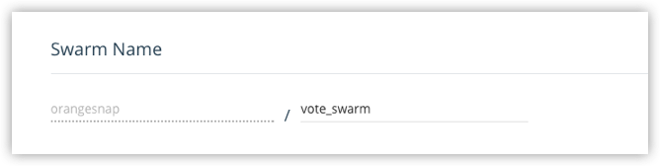
Create a Swarm
Here’s the quick rundown:
If necessary, log in to Docker Cloud and switch to Swarm Mode.
Click Swarms in the top navigation, then click Create.
Enter a name for the new swarm.
Notes:
Create a swarm
1. If necessary, log in to Docker Cloud and switch to Swarm Mode
2. Click Swarms in the top navigation, then click Create.
SHARE:
Alternatively, you can select + -> Swarm from the top navigation to get to the same page.
3. Enter a name for the new swarm.
SHARE:
Your Docker ID is pre-populated. In the example, our swarm name is “vote_swarm”.
IMAGE:
azure-create-swarm-1-name.png
SHARE:
Tip: Use all lower case letters for swarm names. No spaces, capitalized letters, or special characters other than ., _, or - are allowed.

Slide 28
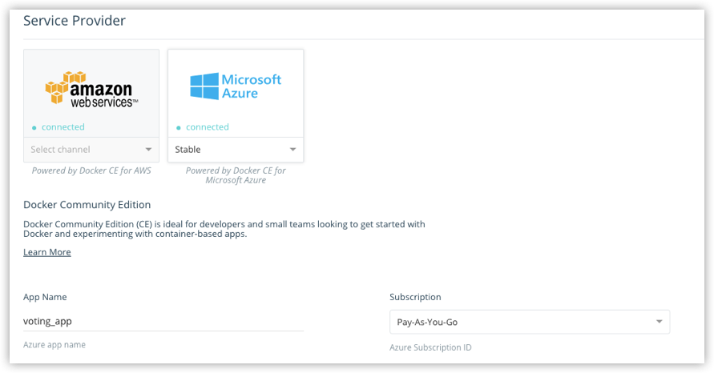
Create a Swarm
Select Microsoft Azure as the service provider, select a channel (Stable or Edge) from the drop-down menu, provide an App name, and select the Azure Subscription you want to use.
Notes:
Create a swarm
4. Select Microsoft Azure as the service provider, select a channel (Stable or Edge) from the drop-down menu, provide an App name, and select the Azure Subscription you want to use.
SHARE:
You can learn more about stable and edge channels in the Install Docker overview and the Docker CE Edge topics.
In this example, we use the Stable channel, our app name is “voting_app” and we’ve selected a Pay-As-You-Go subscription.
IMAGE:
azure-create-swarm-0.png

Slide 29
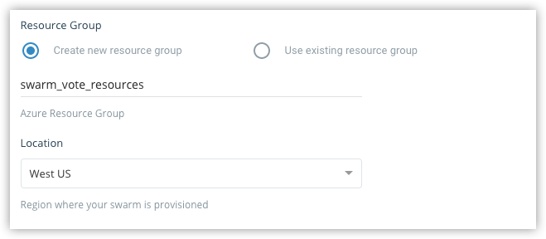
Create a Swarm
Make sure that Create new resource group is selected, provide a name for the group, and select a location from the drop-down menu.
Notes:
Create a swarm
5. Make sure that Create new resource group is selected, provide a name for the group, and select a location from the drop-down menu.
SHARE:
Our example app is called swarm_vote_resources, and it is located in West US.
IMAGE:
azure-create-swarm-3-resource-group.png
SHARE:
Tip: Be sure to create a new resource group for a swarm. If you choose to use an existing group, the swarm fails as Azure does not currently support this.

Slide 30
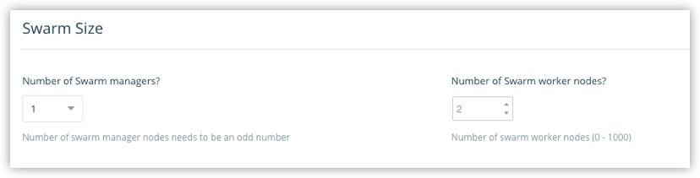
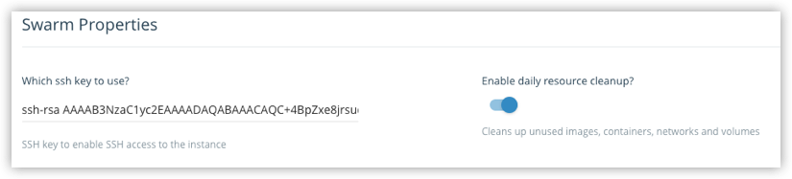
Create a Swarm
Choose how many swarm managers and worker nodes to deploy.
Configure swarm properties, SSH key and resource cleanup.
Notes:
Create a swarm
6. Choose how many swarm managers and worker nodes to deploy.
SHARE:
Here, we create one manager and two worker nodes. (This maps nicely to the Swarm tutorial setup and the voting app sample in Docker Labs.)
IMAGE:
cloud-create-swarm-4-size.png
7. Configure swarm properties, SSH key and resource cleanup.
SHARE:
Copy-paste the public SSH key you want to use to connect to the nodes.
(Provide the one for which you have the private key locally.)
IMAGE:
azure-create-swarm-5-properties.png
SHARE:
To list existing SSH keys: ls -al ~/.ssh
To copy the public SSH key to your clipboard: pbcopy < ~/.ssh/id_rsa.pub
Choose whether to provide daily resource cleanup.
(Enabling this option helps avoid charges for resources that you are no longer using.)

Slide 31
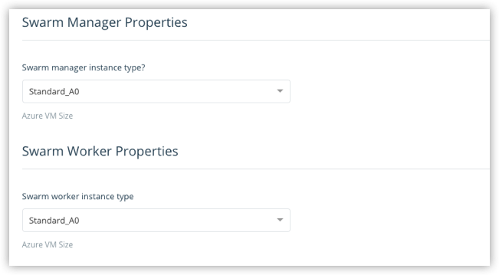
Create a Swarm
Select the machine sizes for the managers, and for the worker.
Notes:
8. Select the machine sizes for the managers, and for the workers.
IMAGE:
azure-create-swarm-6-manager-worker.png
SHARE:
The larger your swarm, the larger the machine size you should use.
To learn more about resource setup, see configuration options in the Docker for Azure topics.

Slide 32
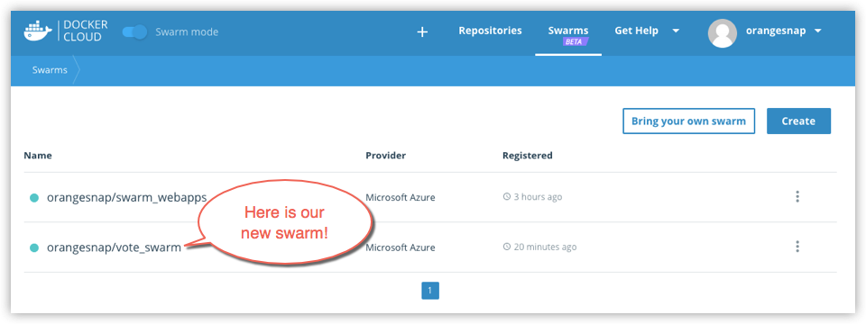
Create a Swarm
Pretty cool, if you ask me!
Click Create.
Here’s our swarm!
Notes:
9. Click Create.
SHARE:
Docker for Azure bootstraps all of the recommended infrastructure to start using Docker on Azure automatically.
You don’t need to worry about rolling your own instances, security groups, or load balancers when using Docker for Azure.
This takes a few minutes. When the swarm is ready, its indicator on the Swarms page shows steady green.
IMAGE:
azure-create-swarm-7-list.png
SHARE:
Note: At this time, you cannot add nodes to a swarm from within Docker Cloud. To add new nodes to an existing swarm, log in to your Azure account, and add nodes manually. (You can unregister or dissolve swarms directly from Docker Cloud.)

Slide 33
Manage Infrastructure
Notes:
Manage builds and images
Manage swarms (beta swarm mode)
(3) Manage Infrastructure (standard mode)
Manage nodes and apps (standard mode)

Slide 34
Manage Infrastructure (standard mode)
Cloud uses an agent and system containers to deploy and manage nodes (hosts) on your behalf
All nodes accessible to your account are connected by an overlay or mesh network
Deploy nodes from Docker Cloud
When you use Docker Cloud to deploy nodes on a hosted provider, the service stores your cloud provider credentials
And then deploys nodes for you using the services’ API to perform actions on your behalf
Notes:
Docker Cloud infrastructure overview (Standard Mode)
Cloud uses an agent and system containers to deploy and manage nodes (hosts) on your behalf.
All nodes accessible to your account are connected by an overlay or mesh network,
SHARE:
regardless of host or cloud service provider.
Deploy nodes from Docker Cloud
When you use Docker Cloud to deploy nodes on a hosted provider, the service stores your cloud provider credentials
and then deploys nodes for you using the services’ API to perform actions on your behalf.
SOURCE:
https://docs.docker.com/docker-cloud/infrastructure/

Slide 35
Manage Infrastructure (standard mode)
Bring your own host
If you are using Bring Your Own Host, Docker Cloud provides a script that:
installs the Docker Cloud Agent on the host
downloads and installs the latest Docker CS Engine version and the AUFS storage driver
sets up TLS certificates and the Docker security configuration
registers the host with Docker Cloud under your user account
Once this connection is established, the Docker Cloud Agent manages the node and performs updates when the user requests them
And it can also create and maintain a reverse tunnel to Docker Cloud if firewall restrictions prevent a direct connection
Notes:
Bring your own host
If you are using Bring Your Own Host, Docker Cloud provides a script that:
- installs the Docker Cloud Agent on the host
- downloads and installs the latest Docker CS Engine version and the AUFS storage driver
- sets up TLS certificates and the Docker security configuration
- registers the host with Docker Cloud under your user account
Once this connection is established, the Docker Cloud Agent manages the node and performs updates when the user requests them,
and can also create and maintain a reverse tunnel to Docker Cloud if firewall restrictions prevent a direct connection.
SOURCE:
https://docs.docker.com/docker-cloud/infrastructure/

Slide 36
Manage Infrastructure (standard mode)
Internal networking
Docker Cloud communicates with the Docker daemon running in the node using the following IPs, on port 2375/tcp
52.204.126.235/32
52.6.30.174/32
52.205.192.142/32
52.205.2.114/32
If the port is not accessible, Docker Cloud creates a secure reverse tunnel from the nodes to Docker Cloud
When you add a node on Docker Cloud, the node joins the Weave private overlay network for containers in other nodes by connecting on ports 6783/tcp and 6783/udp
Notes:
Internal networking
Docker Cloud communicates with the Docker daemon running in the node using the following IPs, on port 2375/tcp.
52.204.126.235/32
52.6.30.174/32
52.205.192.142/32
52.205.2.114/32
If the port is not accessible, Docker Cloud creates a secure reverse tunnel from the nodes to Docker Cloud.
When you add a node on Docker Cloud, the node joins the Weave private overlay network for containers in other nodes by connecting on ports 6783/tcp and 6783/udp.
SHARE:
(You should make sure these ports are open.)

Slide 37
Manage Infrastructure (standard mode)
Internal Overlay Network
Docker Cloud creates a per-user overlay network which connects all containers across all of the user’s hosts
This network connects all of your containers on the 10.7.0.0/16 subnet, and gives every container a local IP
This IP persists on each container even if the container is redeployed and ends up on a different host
Every container can reach any other container on any port within the subnet
Notes:
Internal overlay network
Docker Cloud creates a per-user overlay network which connects all containers across all of the user’s hosts.
This network connects all of your containers on the 10.7.0.0/16 subnet, and gives every container a local IP.
This IP persists on each container even if the container is redeployed and ends up on a different host.
Every container can reach any other container on any port within the subnet.
SOURCE:
https://docs.docker.com/docker-cloud/infrastructure/

Slide 38

Manage Infrastructure (standard mode)
External Access
The easiest way to access nodes is to ensure that your public ssh key is available to them
You can quickly copy your public key to all of the nodes in your Docker Cloud account by running the authorizedkeys container
Notes:
External access
The easiest way to access nodes is to ensure that your public ssh key is available to them.
You can quickly copy your public key to all of the nodes in your Docker Cloud account by running the authorizedkeys container.
SOURCE:
https://docs.docker.com/docker-cloud/infrastructure/
--- SHOULD WE ADD ANY OF THE FOLLOWING
Further subject covered – possibly to add
SSH into a Docker Cloud-managed node
Read more about Deployment strategies
Learn how to Upgrade Docker Engine on a node
Use the Docker Cloud Agent to Bring your Own Host
Link to Amazon Web Services hosts
Using Docker Cloud on AWS FAQ
Link to DigitalOcean hosts
Link to Microsoft Azure hosts
Link to Packet hosts
Using Docker Cloud and Packet FAQ
Link to SoftLayer hosts

Slide 39
Manage Nodes and Apps
Notes:
Manage builds and images
Manage swarms (beta swarm mode)
Manage Infrastructure (standard mode)
(4) Manage nodes and apps (standard mode)

Slide 40
Manage Nodes and Apps (standard mode)
These topics cover the traditional, pre-Swarm model for deploying and managing nodes, services, and applications in Docker Cloud
Applications in Docker Cloud
Applications in Docker Cloud are usually several Services linked together using the specifications from a Stackfile or a Compose file
You can also create individual services using the Docker Cloud Services wizard
And you can attach Volumes to use as long-lived storage for your services
If you are using autobuild and autotest features, you can also se autoredeploy to automatically redeploy the application
Notes:
These topics cover the traditional, pre-Swarm model for deploying and managing nodes, services, and applications in Docker Cloud.
Getting started with Docker Cloud
Applications in Docker Cloud
Cloud stack file YAML reference
Applications in Docker Cloud are usually several Services linked together using the specifications from a Stackfile or a Compose file.
You can also create individual services using the Docker Cloud Services wizard,
and you can attach Volumes to use as long-lived storage for your services.
If you are using Docker Cloud’s autobuild and autotest features, you can also use autoredeploy to automatically redeploy the application
each time its underlying services are updated.

Slide 41
Docker Machine

Slide 42
START DOCKER MACHINE CLASS SLIDES
FOLLOWING SLIDES ARE FROM A FULL DOCKER CHAPTER. SO, THERE ARE TOO MANY, BUT LET ARE GOOD SLIDES. PLEASE LOOK THROUGH THEM AND ELIMATE THOSE YOU FEEL ARE UNNECESSERY. THE OTHER OPTION IS WE COULD SPLIT THEM INTO ANTOHER SECTION, IF YOU FEEL THE MATERIAL IS SUITIBLE FOR YOUR CLASS..

Slide 43
Docker Machine Overview
Docker Machine is a tool that lets you install Docker Engine on virtual hosts, and manage the hosts with docker-machine commands.
You can use Machine to create Docker hosts on your local Mac or Windows box.
Also, on your company network, in your data center, or on cloud providers like AWS or Digital Ocean.
Notes:
We have two good ways to group components for development purposes and then clean them up when you want to start over.
This approach works fine for local development and grouping. In shared environments the best approach is to properly label your components (services, RCs, pods, etc) and delete them using labels, as above.

Slide 44
Docker Machine Overview
Using docker-machine commands, you can:
Start
Inspect
Stop
Restart a managed host
Upgrade the Docker client and daemon
Configure a Docker client to talk to your host.
Notes:
We have two good ways to group components for development purposes and then clean them up when you want to start over.
This approach works fine for local development and grouping. In shared environments the best approach is to properly label your components (services, RCs, pods, etc) and delete them using labels, as above.

Slide 45
Setting Machine Environment
Point the Machine CLI at a running, managed host, and you can run docker commands directly on that host.
For example, run docker-machine env default to point to a host called default.
NOTE: You may have to name the VM specifically, like this:
docker-machine env <name>
Notes:
We have two good ways to group components for development purposes and then clean them up when you want to start over.
This approach works fine for local development and grouping. In shared environments the best approach is to properly label your components (services, RCs, pods, etc) and delete them using labels, as above.

Slide 46
Setting Machine Environment
Once you follow the on-screen instructions to complete the env setup, you can run docker ps, docker run hello-world, and so forth.
Output:
export DOCKER_TLS_VERIFY="1"
export DOCKER_HOST="tcp://XXX.XXX.XX.XXX:XXXX"
export DOCKER_CERT_PATH= <PATH>
export DOCKER_MACHINE_NAME= <NAME>
# Run this command to configure your shell:
# eval $(docker-machine env dev)
Notes:
We have two good ways to group components for development purposes and then clean them up when you want to start over.
This approach works fine for local development and grouping. In shared environments the best approach is to properly label your components (services, RCs, pods, etc) and delete them using labels, as above.

Slide 47

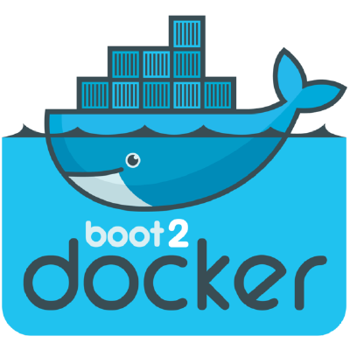
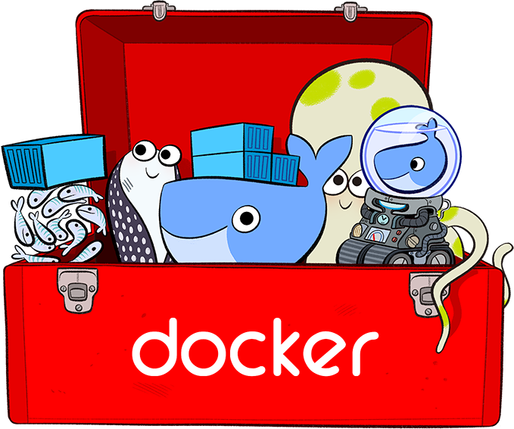
The Good Old Days
Machine was the only way to run Docker on Mac or Windows previous to Docker v1.12.
Docker for Mac & Docker for Windows are available as native apps now and are the better choice for this use case on newer desktops and laptops.
The installers for Docker for Mac and Docker for Windows include Docker Machine, along with Docker Compose.
So, no more need for confusion.
Notes:
We have two good ways to group components for development purposes and then clean them up when you want to start over.
This approach works fine for local development and grouping. In shared environments the best approach is to properly label your components (services, RCs, pods, etc) and delete them using labels, as above.

Slide 48
Why Use It, Now?
Docker Machine enables you to provision multiple remote Docker hosts on various flavors of Linux.
Additionally, Machine allows you to run Docker on older Mac or Windows systems, as described in the previous topic.
Basically, Docker Machine has two broad use cases:
Notes:
We have two good ways to group components for development purposes and then clean them up when you want to start over.
This approach works fine for local development and grouping. In shared environments the best approach is to properly label your components (services, RCs, pods, etc) and delete them using labels, as above.

Slide 49

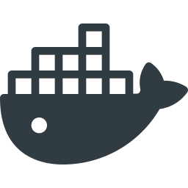
Why Use It, Now?
#1 - You own an older desktop system and want to run Docker on Mac or Windows
docker –version
docker run hello-world
...
docker –version
docker run hello-world
...
Docker Machine for Mac
Docker Machine for Windows
Notes:
We have two good ways to group components for development purposes and then clean them up when you want to start over.
This approach works fine for local development and grouping. In shared environments the best approach is to properly label your components (services, RCs, pods, etc) and delete them using labels, as above.

Slide 50
The Older Desktop Option
If the computer doesn’t meet the requirements for DockerforMac and Docker for Windows apps, then you need Docker Machine in order to run Docker Engine locally.
Installing Docker Machine on a Mac or Windows box with the Docker Toolbox installer, provisions a local virtual machine with Docker Engine.
This gives you the ability to connect it, and run docker commands.
Notes:
We have two good ways to group components for development purposes and then clean them up when you want to start over.
This approach works fine for local development and grouping. In shared environments the best approach is to properly label your components (services, RCs, pods, etc) and delete them using labels, as above.

Slide 51

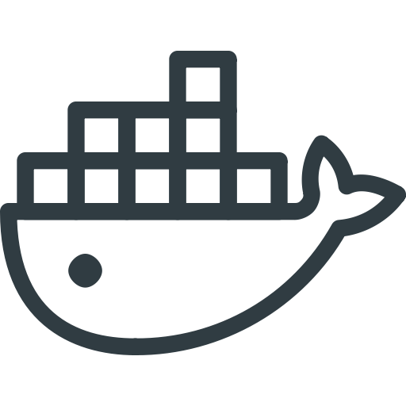

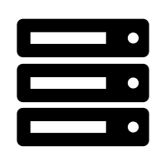
Why Use It, Now?
#2 - You want to provision Docker hosts on remote systems
...
...
docker <command>
...
Notes:
We have two good ways to group components for development purposes and then clean them up when you want to start over.
This approach works fine for local development and grouping. In shared environments the best approach is to properly label your components (services, RCs, pods, etc) and delete them using labels, as above.

Slide 52
Remote Host Option
Rememeber, Docker Engine runs natively on Linux systems.
If you have a Linux box as your primary system, and want to run Docker commands, all you need to do is download and install Docker Engine.
However, if you want an efficient way to provision multiple Docker hosts on a network, in the cloud or even locally, you need Docker Machine.
Notes:
We have two good ways to group components for development purposes and then clean them up when you want to start over.
This approach works fine for local development and grouping. In shared environments the best approach is to properly label your components (services, RCs, pods, etc) and delete them using labels, as above.

Slide 53
Remote Host Option
Whether your primary system is Mac, Windows, or Linux, you can install Docker Machine on it and use docker-machine commands to provision and manage large numbers of Docker hosts.
Machine automatically creates hosts, installs Docker Engine on them, then configures the Docker clients. Each managed host (machine) is the combination of a Docker host and a configured client.
Notes:
We have two good ways to group components for development purposes and then clean them up when you want to start over.
This approach works fine for local development and grouping. In shared environments the best approach is to properly label your components (services, RCs, pods, etc) and delete them using labels, as above.

Slide 54
Docker Engine vs. Docker Machine
When people say “Docker” they typically mean Docker Engine
Engine, the client-server application consist of:
the Docker daemon
a REST API that specifies interfaces for interacting with the daemon
a command line interface (CLI) client that talks to the daemon (through the REST API wrapper)
Client
docker CLI
REST API
Server
docker daemon
Notes:
We have two good ways to group components for development purposes and then clean them up when you want to start over.
This approach works fine for local development and grouping. In shared environments the best approach is to properly label your components (services, RCs, pods, etc) and delete them using labels, as above.

Slide 55
Docker Engine vs. Docker Machine
Docker Engine accepts docker commands from the CLI, such as docker run <image>, docker ps to list running containers, docker images to list images, and so on
Docker Machine is a tool for provisioning and managing your Dockerized hosts (hosts with Docker Engine on them).
Typically, you install Docker Machine on your local system. Docker Machine has its own command line client docker-machine
You can use Machine to install Docker Engine on one or more virtual systems. These virtual systems can be local (as when you use Machine to install and run Docker Engine in VirtualBox on Mac or Windows) or remote (as when you use Machine to provision Dockerized hosts on cloud providers). The Dockerized hosts themselves can be thought of, and are sometimes referred to as, managed “machines”.
Notes:
We have two good ways to group components for development purposes and then clean them up when you want to start over.
This approach works fine for local development and grouping. In shared environments the best approach is to properly label your components (services, RCs, pods, etc) and delete them using labels, as above.

Slide 56
Docker Engine vs. Docker Machine
Docker Engine accepts docker commands from the CLI, such as docker run <image>, docker ps to list running containers, docker images to list images, and so on
Docker Machine is a tool for provisioning and managing your Dockerized hosts (hosts with Docker Engine on them).
Typically, you install Docker Machine on your local system. Docker Machine has its own command line client docker-machine
Notes:
We have two good ways to group components for development purposes and then clean them up when you want to start over.
This approach works fine for local development and grouping. In shared environments the best approach is to properly label your components (services, RCs, pods, etc) and delete them using labels, as above.

Slide 57
Docker Engine vs. Docker Machine
You can use Machine to install Docker Engine on one or more virtual systems.
Virtual systems can be local (as when you use Machine to install and run Docker Engine in VirtualBox on Mac or Windows)
Or, they can be remote (as when you use Machine to provision Dockerized hosts on cloud providers).
The Dockerized hosts themselves can be thought of, and are sometimes referred to as, managed “machines”.
Notes:
We have two good ways to group components for development purposes and then clean them up when you want to start over.
This approach works fine for local development and grouping. In shared environments the best approach is to properly label your components (services, RCs, pods, etc) and delete them using labels, as above.

Slide 58
Remote Machine Host Diagram
Client
docker-machine
REST API
Client
docker CLI
server
docker daemon
REST API
docker-machine create
...
...
docker run <image>
Notes:
We have two good ways to group components for development purposes and then clean them up when you want to start over.
This approach works fine for local development and grouping. In shared environments the best approach is to properly label your components (services, RCs, pods, etc) and delete them using labels, as above.

Slide 59

Getting Started Using Local VM
Let’s take a look at using docker-machine to create, use and manage a Docker host inside of a local virtual machine.
Notes:
We have two good ways to group components for development purposes and then clean them up when you want to start over.
This approach works fine for local development and grouping. In shared environments the best approach is to properly label your components (services, RCs, pods, etc) and delete them using labels, as above.

Slide 60
Docker Machine Rust
With the advent of Docker for Mac and Docker for Windows as replacements for Docker Toolbox, we recommend that you use these for your primary Docker workflows.
You can use these applications to run Docker natively on your local system without using Docker Machine at all.
Notes:
We have two good ways to group components for development purposes and then clean them up when you want to start over.
This approach works fine for local development and grouping. In shared environments the best approach is to properly label your components (services, RCs, pods, etc) and delete them using labels, as above.

Slide 61
Docker Machine Rust
However, if you want to create multiple local machines, you still need Docker Machine to create and manage machines for multi-node experimentation.
Both Docker for Mac and Docker for Windows include the newest version of Docker Machine, so when you install either of these, you get docker-machine.
Notes:
We have two good ways to group components for development purposes and then clean them up when you want to start over.
This approach works fine for local development and grouping. In shared environments the best approach is to properly label your components (services, RCs, pods, etc) and delete them using labels, as above.

Slide 62
Prerequisite Information
Keep the following considerations in mind when using Machine to create local VMs.
Docker for Windows - You can use docker-machine create with the hyperv driver to create additional local machines.
Docker for Mac - You can use docker-machine create with the virtualbox driver to create additional local machines.
Notes:
We have two good ways to group components for development purposes and then clean them up when you want to start over.
This approach works fine for local development and grouping. In shared environments the best approach is to properly label your components (services, RCs, pods, etc) and delete them using labels, as above.

Slide 63
Windows Prerequisite Information
Docker for Windows
Docker for Windows uses Microsoft Hyper-V for virtualization, and Hyper-V is not compatible with Oracle VirtualBox.
Therefore, you cannot run the two solutions simultaneously.
But you can still use docker-machine to create more local VMs by using the Microsoft Hyper-V driver.
Notes:
We have two good ways to group components for development purposes and then clean them up when you want to start over.
This approach works fine for local development and grouping. In shared environments the best approach is to properly label your components (services, RCs, pods, etc) and delete them using labels, as above.

Slide 64

Mac Prerequisite Information
Docker for Mac
Docker for Mac uses HyperKit, a lightweight macOS virtualization solution built on top of the Hypervisor.framework in macOS 10.10 Yosemite and higher.
Currently, there is no docker-machine create driver for HyperKit, so you will use virtualbox driver to create local machines.
You can run both HyperKit and Oracle VirtualBox on the same system.
Notes:
We have two good ways to group components for development purposes and then clean them up when you want to start over.
This approach works fine for local development and grouping. In shared environments the best approach is to properly label your components (services, RCs, pods, etc) and delete them using labels, as above.

Slide 65
Running Containers
To run a Docker container, you:
Create a new (or start an existing) Docker virtual machine.
Switch your environment to your new VM.
Use the docker client to create, load, and manage containers.
Once you create a machine, you can reuse it as often as you like.
Like any VirtualBox VM, it maintains its configuration between uses.
The examples here show how to create and start a machine, run Docker commands, and work with containers.
docker node ls
ID HOSTNAME STATUS AVAILABILITY MANAGER STATUS5re1humv246m6clujn0zng9jy docker Ready Activerbavg04vwiijyzzjwdjoc3io2 * docker Ready Active Leader
Notes:
We have two good ways to group components for development purposes and then clean them up when you want to start over.
This approach works fine for local development and grouping. In shared environments the best approach is to properly label your components (services, RCs, pods, etc) and delete them using labels, as above.

Slide 66
Machine Containers Example
Let’s look at how to create a new container, using Docker Machine.
First, open a command shell or terminal window.
Use docker-machine ls to list available machines:
Output (No machines have been created):
docker-machine ls
NAME ACTIVE DRIVER STATE URL SWARM DOCKER ERRORS
Notes:
We have two good ways to group components for development purposes and then clean them up when you want to start over.
This approach works fine for local development and grouping. In shared environments the best approach is to properly label your components (services, RCs, pods, etc) and delete them using labels, as above.

Slide 67
Machine Containers Example
To create a Machine, we’d need to start by following the steps below:
Run docker-machine create <command>
Pass the appropriate driver to the --driver flag and provide a machine name.
If this is your first machine, name it default as shown in the example.
If you already have a “default” machine, choose another name for this new machine.
If you are using Docker for Mac, use virtualbox as the driver, as shown in this example.
On Docker for Windows systems that support Hyper-V, use the hyperv driver
Notes:
We have two good ways to group components for development purposes and then clean them up when you want to start over.
This approach works fine for local development and grouping. In shared environments the best approach is to properly label your components (services, RCs, pods, etc) and delete them using labels, as above.

Slide 68
Creating a New Machine
So, our command should look something like this:
Output:
This downloads a lightweight Linux distribution boot2docker, with the Docker daemon installed, pluscreates and starts a VirtualBox.
docker-machine create --driver virtualbox default
Running pre-create checks...
Creating machine...
...
Notes:
We have two good ways to group components for development purposes and then clean them up when you want to start over.
This approach works fine for local development and grouping. In shared environments the best approach is to properly label your components (services, RCs, pods, etc) and delete them using labels, as above.

Slide 69
Print Newly Created Machine
To list available machines, we want to use docker-machine ls again.
This time we should find our container listed.
Output:
NAME ACTIVE DRIVER STATE URL ...
default * virtualbox Running tcp://XXX.XXX.XX.XXX:XXXX ...
Notes:
We have two good ways to group components for development purposes and then clean them up when you want to start over.
This approach works fine for local development and grouping. In shared environments the best approach is to properly label your components (services, RCs, pods, etc) and delete them using labels, as above.

Slide 70
Get Docker Machine Env Varibles
Let’s look at the environment variable for your new VM.
To do that, we will use the following command:
Output:
docker-machine env <machine-name>
export DOCKER_TLS_VERIFY=“..."
export DOCKER_HOST=“..."
export DOCKER_CERT_PATH=“..."
export DOCKER_MACHINE_NAME=“..."
# Run this command to configure your shell:
# eval "$(docker-machine env default)"
Notes:
We have two good ways to group components for development purposes and then clean them up when you want to start over.
This approach works fine for local development and grouping. In shared environments the best approach is to properly label your components (services, RCs, pods, etc) and delete them using labels, as above.

Slide 71
Connecting Env Settings
Now, we need to connect our shell to the new machine.
We’ll use the following command, which can be found in the output:
Okay! Now, our environment variables are set for the current shell that the Docker client will read which specify the TLS settings.
You need to do this each time you open a new shell or restart your machine.
You can now run Docker commands on this host.
eval "$(docker-machine env default)"
Notes:
We have two good ways to group components for development purposes and then clean them up when you want to start over.
This approach works fine for local development and grouping. In shared environments the best approach is to properly label your components (services, RCs, pods, etc) and delete them using labels, as above.

Slide 72
Experiment With Machine Containers
Run a container with docker run to verify your set up.
Use docker run to download and run busybox with a simple echo command, like this:
Output:
docker run busybox echo hello world
Unable to find image 'busybox' locally
Pulling repository busybox
e72ac664f4f0: Download complete
511136ea3c5a: Download complete
df7546f9f060: Download complete
e433a6c5b276: Download complete
hello world
Notes:
We have two good ways to group components for development purposes and then clean them up when you want to start over.
This approach works fine for local development and grouping. In shared environments the best approach is to properly label your components (services, RCs, pods, etc) and delete them using labels, as above.

Slide 73
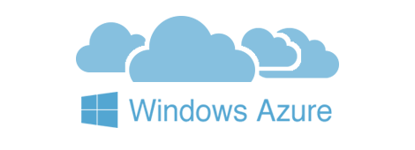

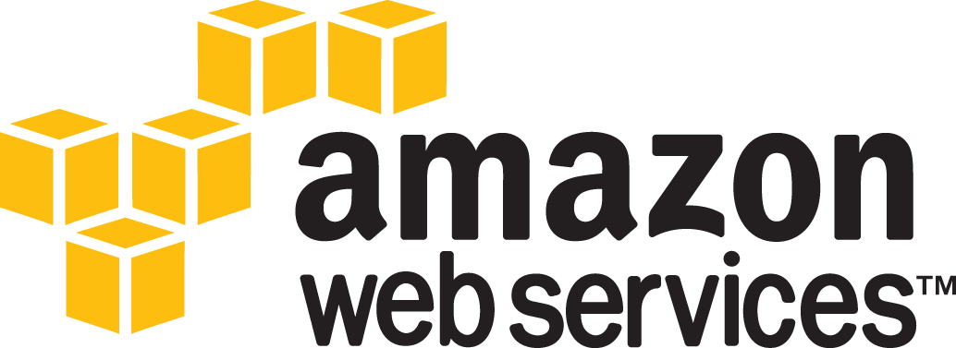
Introducing Machine Cloud Drivers
When you install Docker Machine, you get a set of drivers for various cloud providers.
Also available, Docker Machine driver plugins for use with other cloud platforms are available from 3rd party contributors.
NOTE: These are use-at-your-own-risk plugins, not maintained by or formally associated with Docker.
Notes:
We have two good ways to group components for development purposes and then clean them up when you want to start over.
This approach works fine for local development and grouping. In shared environments the best approach is to properly label your components (services, RCs, pods, etc) and delete them using labels, as above.

Slide 74
Exploring the Cloud
Docker Machine driver plugins are available for many cloud platforms, so you can use Machine to provision cloud hosts.
When you use Docker Machine for provisioning, you create cloud hosts with Docker Engine installed on them.
We’ll need to create an account with the cloud provider.
Notes:
We have two good ways to group components for development purposes and then clean them up when you want to start over.
This approach works fine for local development and grouping. In shared environments the best approach is to properly label your components (services, RCs, pods, etc) and delete them using labels, as above.

Slide 75
Exploring the Cloud
We will provide account verification, security credentials, and configuration options for the providers as flags to docker-machine create.
The flags are unique for each cloud-specific driver. For instance, to pass a Digital Ocean access token you use the --digitalocean-access-token flag.
Let’s look at some examples on the next slide...
Notes:
We have two good ways to group components for development purposes and then clean them up when you want to start over.
This approach works fine for local development and grouping. In shared environments the best approach is to properly label your components (services, RCs, pods, etc) and delete them using labels, as above.

Slide 76
Digital Ocean Example
For Digital Ocean, this command creates a Droplet (cloud host) called “docker-sandbox”:
docker-machine create --driver digitalocean --digitalocean-access-token xxx docker-sandbox
Notes:
We have two good ways to group components for development purposes and then clean them up when you want to start over.
This approach works fine for local development and grouping. In shared environments the best approach is to properly label your components (services, RCs, pods, etc) and delete them using labels, as above.

Slide 77
Amazon Web Services (AWS) Example
For AWS, this command creates an instance called “aws-sandbox” in EC2:
docker-machine create --driver amazonec2 --amazonec2-access-key AKI******* --amazonec2-secret-key 8T93C******* aws-sandbox
Notes:
We have two good ways to group components for development purposes and then clean them up when you want to start over.
This approach works fine for local development and grouping. In shared environments the best approach is to properly label your components (services, RCs, pods, etc) and delete them using labels, as above.

Slide 78
Docker Machine Swarm
Docker Machine can also provision Docker Swarm clusters.
This can be used with any driver and will be secured with TLS.
Notes:
We have two good ways to group components for development purposes and then clean them up when you want to start over.
This approach works fine for local development and grouping. In shared environments the best approach is to properly label your components (services, RCs, pods, etc) and delete them using labels, as above.

Slide 79
Start and Stop
If you are finished using a host for the time being, you can stop it with docker-machine stop and later start it again with docker-machine start.
Stop the machine, like this:
And we would start it back up, like this:
docker-machine stop <machine-name>
docker-machine start <machine-name>
Notes:
We have two good ways to group components for development purposes and then clean them up when you want to start over.
This approach works fine for local development and grouping. In shared environments the best approach is to properly label your components (services, RCs, pods, etc) and delete them using labels, as above.

Slide 80
END DOCKER MACHINE SLIDE

Slide 81
Azure Support for Docker

Slide 82
Why Docker for Azure?
The Docker for Azure project was created and is being actively developed to ensure that Docker users can enjoy a fantastic out-of-the-box experience on Azure
It is now generally available and can now be used by everyone
As an informed user, you might be curious to know what this project offers you for running your development, staging, or production workloads
Notes:
Why Docker for Azure?
The Docker for Azure project was created and is being actively developed to ensure that Docker users can enjoy a fantastic out-of-the-box experience on Azure.
It is now generally available and can now be used by everyone.
As an informed user, you might be curious to know what this project offers you for running your development, staging, or production workloads.
SOURCE:
https://docs.docker.com/docker-for-azure/

Slide 83
Native for Docker
Docker for Azure provides a Docker-native solution that avoids operational complexity and adding unneeded additional APIs to the Docker stack
Docker for Azure allows you to interact with Docker instead of distracting you with the need to navigate extra layers on top of Docker
The skills that you’ve already learned, using Docker automatically carry over to using Docker on Azure
Notes:
Native to Docker
Docker for Azure provides a Docker-native solution that avoids operational complexity and adding unneeded additional APIs to the Docker stack.
Docker for Azure allows you to interact with Docker directly (including native Docker orchestration), instead of distracting you with the need to navigate extra layers on top of Docker. You can focus instead on the thing that matters most: running your workloads. This helps you and your team to deliver more value to the business faster, to speak one common “language”, and to have fewer details to keep in your head at once.
The skills that you and your team have already learned, and continue to learn, using Docker on the desktop or elsewhere automatically carry over to using Docker on Azure. The added consistency across clouds also helps to ensure that a migration or multi-cloud strategy is easier to accomplish in the future if desired.
SOURCE:
https://docs.docker.com/docker-for-azure/

Slide 84
Skip the Boilerplate and Maintenance
Docker for Azure bootstraps all of the recommended infrastructure to start using Docker on Azure automatically
You don’t need to worry about rolling your own instances, security groups, or load balancers when using Docker for Azure
Likewise, setting up and using Docker swarm mode functionality for container orchestration is managed across the cluster’s lifecycle when you use Docker for Azure. Docker has already coordinated the various bits of automation you would otherwise be gluing together on your own to bootstrap Docker swarm mode on these platforms. When the cluster is finished booting, you can jump right in and start running docker service commands.
We also provide a prescriptive upgrade path that helps users upgrade between various versions of Docker in a smooth and automatic way. Instead of experiencing “maintenance dread” as you ponder your future responsibilities upgrading the software you are using, you can easily upgrade to new versions when they are released.
Notes:
Skip the boilerplate and maintenance work
Docker for Azure bootstraps all of the recommended infrastructure to start using Docker on Azure automatically.
You don’t need to worry about rolling your own instances, security groups, or load balancers when using Docker for Azure.
Likewise, setting up and using Docker swarm mode functionality for container orchestration is managed across the cluster’s lifecycle when you use Docker for Azure.
Docker has already coordinated the various bits of automation you would otherwise be gluing together on your own to bootstrap Docker swarm mode on these platforms.
When the cluster is finished booting, you can jump right in and start running docker service commands.
We also provide a prescriptive upgrade path that helps users upgrade between various versions of Docker in a smooth and automatic way.
Instead of experiencing “maintenance dread” as you ponder your future responsibilities upgrading the software you are using, you can easily upgrade to new versions when they are released.
Minimal, Docker-focused base
The custom Linux distribution used by Docker for Azure is carefully developed and configured to run Docker well. Everything from the kernel configuration to the networking stack is customized to make it a favorable place to run Docker. For instance, we make sure that the kernel versions are compatible with the latest and greatest in Docker functionality, such as theoverlay2 storage driver.
Instead of facing the trade-offs of a general purpose operating system, Docker’s custom Linux distribution focuses on only one thing: providing the best Docker experience for you and your team.
Self-cleaning and self-healing
Even the most conscientious admin can be caught off guard by issues such as unexpectedly aggressive logging or the Linux kernel killing memory-hungry processes. In Docker for Azure, your cluster is resilient to a variety of such issues by default.
Log rotation native to the host is configured for you automatically, so chatty logs don’t use up all of your disk space.
Likewise, the “system prune” option allows you to ensure unused Docker resources such as old images are cleaned up automatically. The lifecycle of nodes is managed using auto-scaling groups or similar constructs, so that if a node enters an unhealthy state for unforeseen reasons, the node is taken out of load balancer rotation and/or replaced automatically and all of its container tasks are rescheduled.
These self-cleaning and self-healing properties are enabled by default and don’t need configuration, so you can breathe easier as the risk of downtime is reduced.
Logging native to the platforms
Centralized logging is a critical component of many modern infrastructure stacks. To have these logs indexed and searchable proves invaluable for debugging application and system issues as they come up. Out of the box, Docker for Azure forwards logs from containers to a native cloud provider abstraction (a storage account in the created resource group).
Next-generation Docker bug reporting tools
One common pain point in open source issue reporting is effectively communicating the current state of your infrastructure and the issues you are seeing to the upstream. In Docker for Azure, you receive new tools to communicate any issues you experience quickly and securely to Docker employees. The Docker for Azure shell includes a docker-diagnose script which, at your request, transmits detailed diagnostic information to Docker support staff to reduce the traditional “please-post-the-output-of-this-command” back and forth frequently encountered in bug reports.
SOURCE:
https://docs.docker.com/docker-for-azure/

Slide 85
Skip the Boilerplate and Maintenance
Docker for Azure bootstraps all of the recommended infrastructure to start using Docker on Azure automatically
You don’t need to worry about rolling your own instances, security groups, or load balancers when using Docker for Azure
Likewise, setting up and using Docker swarm mode functionality for container orchestration is managed across the cluster’s
When the cluster is finished booting, you can jump right in and start running docker service commands
Also provides a prescriptive upgrade path that helps users upgrade between various versions of Docker in a smooth and automatic way
Notes:
Skip the boilerplate and maintenance work
Docker for Azure bootstraps all of the recommended infrastructure to start using Docker on Azure automatically.
You don’t need to worry about rolling your own instances, security groups, or load balancers when using Docker for Azure.
Likewise, setting up and using Docker swarm mode functionality for container orchestration is managed across the cluster’s lifecycle when you use Docker for Azure.
SHARE:
Docker has already coordinated the various bits of automation you would otherwise be gluing together on your own to bootstrap Docker swarm mode on these platforms.
When the cluster is finished booting, you can jump right in and start running docker service commands.
We also provide a prescriptive upgrade path that helps users upgrade between various versions of Docker in a smooth and automatic way.
SHARE:
Instead of experiencing “maintenance dread” as you ponder your future responsibilities upgrading the software you are using, you can easily upgrade to new versions when they are released.
Minimal, Docker-focused base
The custom Linux distribution used by Docker for Azure is carefully developed and configured to run Docker well. Everything from the kernel configuration to the networking stack is customized to make it a favorable place to run Docker. For instance, we make sure that the kernel versions are compatible with the latest and greatest in Docker functionality, such as theoverlay2 storage driver.
Instead of facing the trade-offs of a general purpose operating system, Docker’s custom Linux distribution focuses on only one thing: providing the best Docker experience for you and your team.
Self-cleaning and self-healing
Even the most conscientious admin can be caught off guard by issues such as unexpectedly aggressive logging or the Linux kernel killing memory-hungry processes. In Docker for Azure, your cluster is resilient to a variety of such issues by default.
Log rotation native to the host is configured for you automatically, so chatty logs don’t use up all of your disk space.
Likewise, the “system prune” option allows you to ensure unused Docker resources such as old images are cleaned up automatically. The lifecycle of nodes is managed using auto-scaling groups or similar constructs, so that if a node enters an unhealthy state for unforeseen reasons, the node is taken out of load balancer rotation and/or replaced automatically and all of its container tasks are rescheduled.
These self-cleaning and self-healing properties are enabled by default and don’t need configuration, so you can breathe easier as the risk of downtime is reduced.
Logging native to the platforms
Centralized logging is a critical component of many modern infrastructure stacks. To have these logs indexed and searchable proves invaluable for debugging application and system issues as they come up. Out of the box, Docker for Azure forwards logs from containers to a native cloud provider abstraction (a storage account in the created resource group).
Next-generation Docker bug reporting tools
One common pain point in open source issue reporting is effectively communicating the current state of your infrastructure and the issues you are seeing to the upstream. In Docker for Azure, you receive new tools to communicate any issues you experience quickly and securely to Docker employees. The Docker for Azure shell includes a docker-diagnose script which, at your request, transmits detailed diagnostic information to Docker support staff to reduce the traditional “please-post-the-output-of-this-command” back and forth frequently encountered in bug reports.
SOURCE:
https://docs.docker.com/docker-for-azure/

Slide 86
Azure Basic Concepts

Slide 87
Azure Basic Concepts
Template
$ template
xx.xxx.xx.x
Notes:
Deploy app using azure:
https://docs.docker.com/docker-for-azure/deploy/

Slide 88
Quick Demo of Docker on Azure

Slide 89
Quick Demo of Docker on Azure
Template
Notes:
Bhavuk, the following is a link to a possible lab demo you could do. We actually cover the exact material shared on the first page (the page you arrive at when you click the link), and there is two following pages of demo. It’s really small though. You could almost do both. Maybe!
https://docs.docker.com/docker-cloud/getting-started/intro_cloud/#use-your-own-hosts-bring-your-own-nodes

Slide 90
End of Chapter

