Slide 1
Docker Compose
Managing multi-container Docker applications

Slide 2
Overview

Slide 3
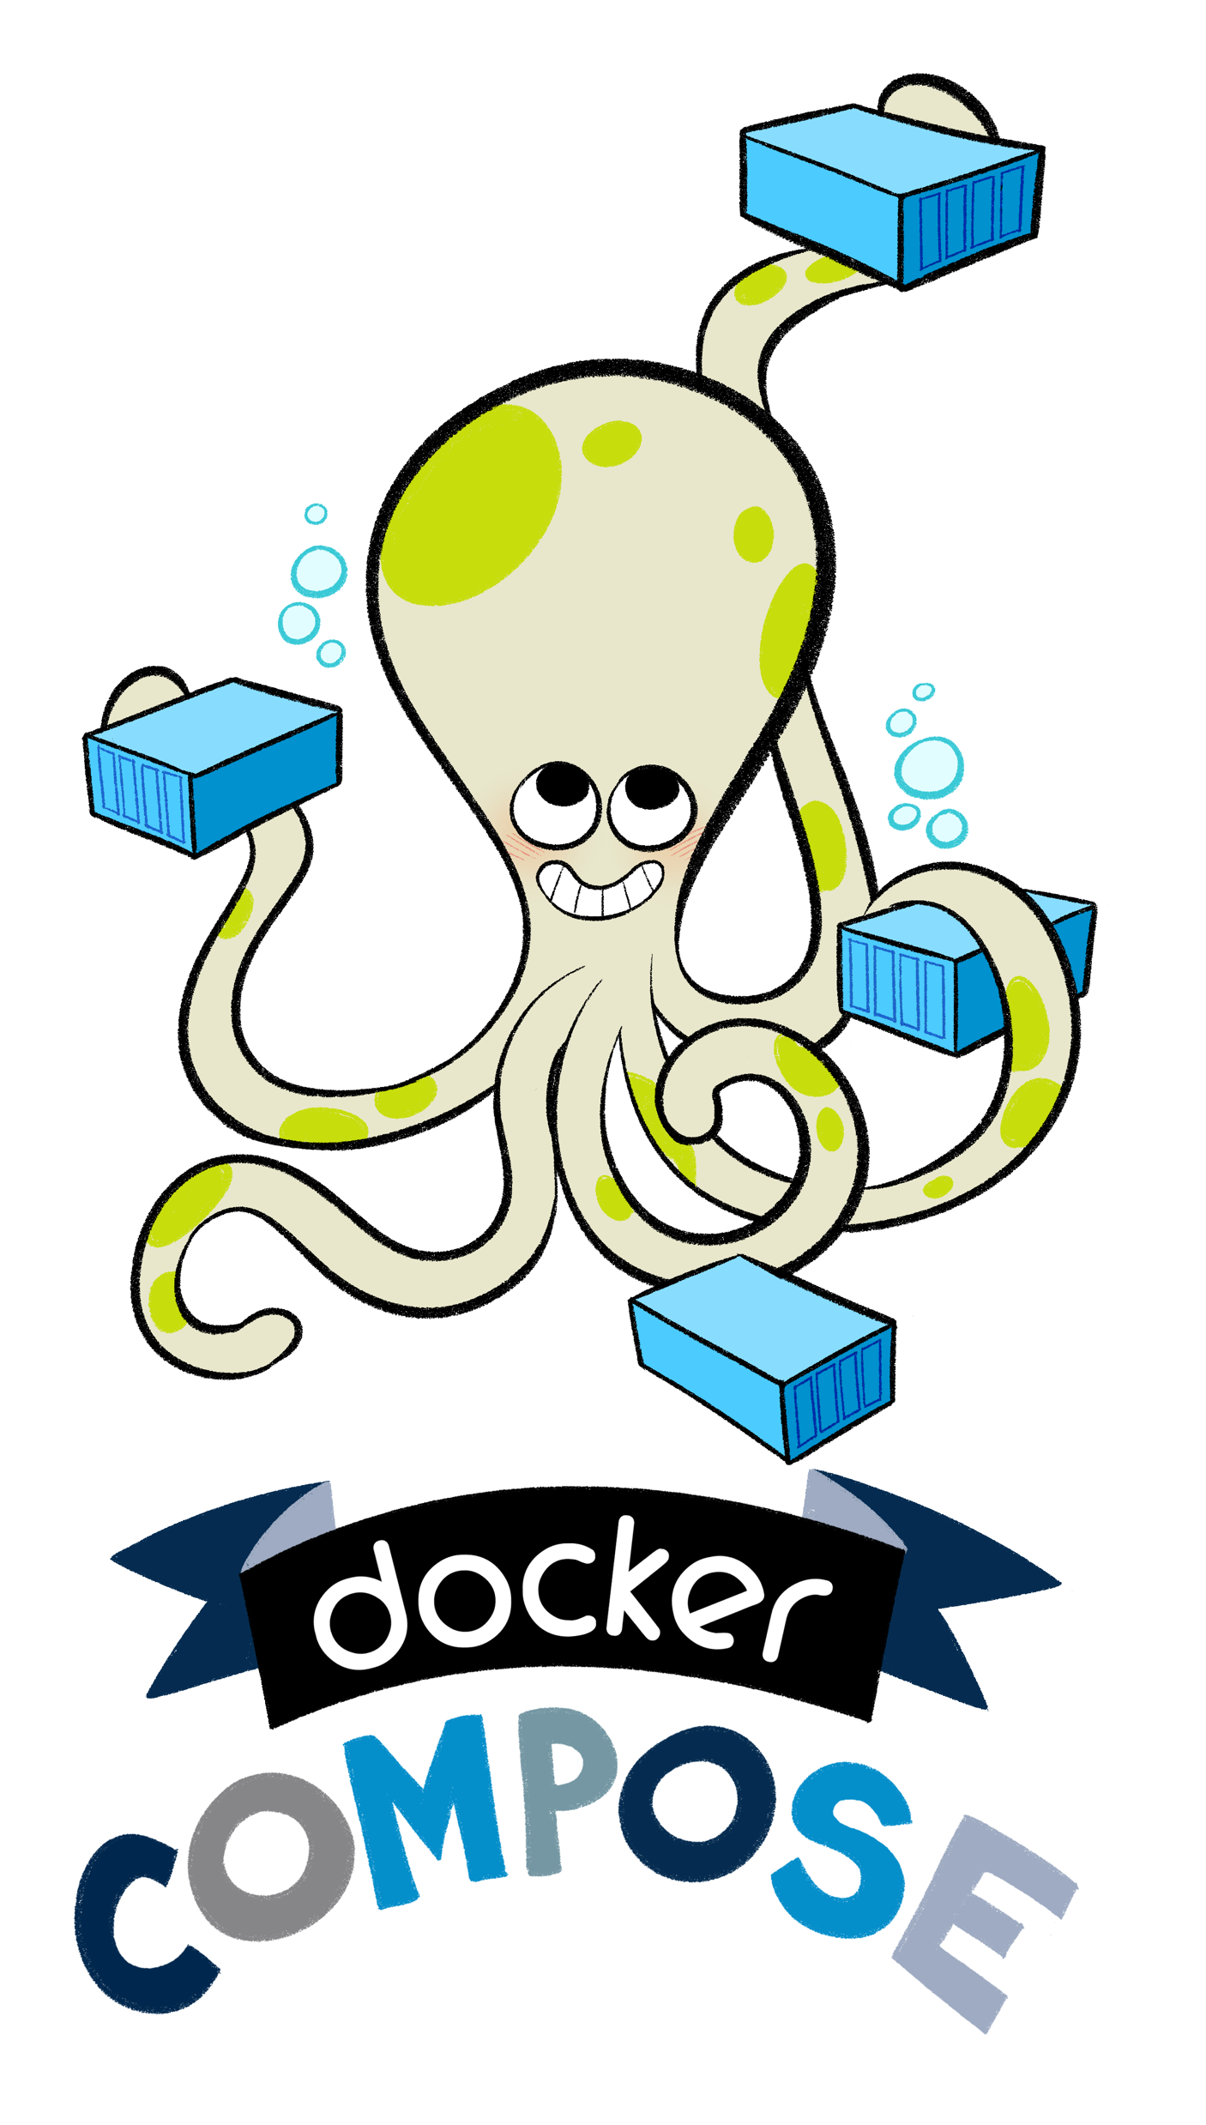
Overview
So, we’ve seen a bit of it already, but what is Docker Compose?
“Docker Compose is a tool for defining and running complex applications with Docker. With Compose, you define a multi-container application in a single file, then spin your application up in a single command which does everything that needs to be done to get it running.”
— github.com/docker/compose
Notes:
Docker Compose is a tool for defining and running complex applications with Docker.
With Compose, you define a multi-container application in a single file, then spin your application up in a single command which does everything that needs to be done to get it running.
— github.com/docker/compose

Slide 4
Compose Introduction
When working with multiple containers, it can be difficult to manage starting, along with the configuration, of variables and links.
To solve this problem, Docker has a tool called Docker Compose, to manage the orchestration and launching of containers.
Notes:
We have two good ways to group components for development purposes and then clean them up when you want to start over.
This approach works fine for local development and grouping. In shared environments the best approach is to properly label your components (services, RCs, pods, etc) and delete them using labels, as above.

Slide 5
Compose Introduction
Docker Compose is based on a docker-compose.yml file.
This file defines all of the containers and settings you need to launch your set of clusters.
The properties map onto how you use the docker run commands, however, are now stored in source control and shared along with your code.
Notes:
We have two good ways to group components for development purposes and then clean them up when you want to start over.
This approach works fine for local development and grouping. In shared environments the best approach is to properly label your components (services, RCs, pods, etc) and delete them using labels, as above.

Slide 6
Getting to Know Compose
An application using Docker containers will typically consist of multiple containers
With Docker Compose, there is no need to write shell scripts to start your containers
All the containers are defined in a configuration file
Services, and then docker-compose script is used to start, stop, and restart the application
And all the services in that application, and all the containers within that service
Notes:
An application using Docker containers will typically consist of multiple containers.
With Docker Compose, there is no need to write shell scripts to start your containers.
All the containers are defined in a configuration file using
services, and then docker-compose script is used to start, stop, and restart the application and all the services in that application,
and all the containers within that service.
The complete list of commands is:

Slide 7
Compose Commands
Command | Description | Command | Description
build | Build or rebuild services | restart | Restart services
help | Get help on a command | rm | Remove stopped containers
kill | Kill containers | run | Run a one-off command
logs | View output from containers | scale | Set number of containers for services
port | Print the public port for a port binding | start | Start services
ps | List containers | stop | Stop services
pull | Pulls service images | up | Create and start containers
Notes:
The complete list of commands is:

Slide 8
Compose Commands
An application using Docker containers will typically consist of multiple containers
With Docker Compose, there is no need to write shell scripts to start your containers
All the containers are defined in a configuration file
Services, and then docker-compose script is used to start, stop, and restart the application
And all the services in that application, and all the containers within that service
Notes:
The complete list of commands is:

Slide 9
Installation of Docker Compose

Slide 10
Installation of Docker Compose
You can run Compose on macOS, Windows, and 64-bit Linux
Prerequisites
Docker Compose relies on Docker Engine for any meaningful work, so make sure you have Docker Engine installed either locally or remote, depending on your setup
On desktop systems like Docker for Mac and Windows, Docker Compose is included as part of those desktop installs
On Linux systems, first install the Docker for your OS as described on the Get Docker page, then come back here for instructions on installing Compose on Linux systems
To run Compose as a non-root user, see ”Manage Docker as a non-root user”
Notes:
Install Docker Compose
You can run Compose on macOS, Windows, and 64-bit Linux.
Prerequisites
Docker Compose relies on Docker Engine for any meaningful work, so make sure you have Docker Engine installed either locally or remote, depending on your setup.
On desktop systems like Docker for Mac and Windows, Docker Compose is included as part of those desktop installs.
On Linux systems, first install the Docker for your OS as described on the Get Docker page, then come back here for instructions on installing Compose on Linux systems.
To run Compose as a non-root user, see Manage Docker as a non-root user.
SOURCE:
https://docs.docker.com/compose/install/

Slide 11
Installation of Docker Compose on Linux
On Linux, you can download the Docker Compose binary
Run this command to download the latest version of Docker Compose:
Apply executable permissions to the binary:
Optionally, install command completion for the bash and zsh shell.
Test the installation.
$ sudo curl -L https://github.com/docker/compose/releases/download/1.19.0/docker
-compose-`uname -s`-`uname -m` -o /usr/local/bin/docker-compose
$ sudo chmod +x /usr/local/bin/docker-compose
$ docker-compose --version
docker-compose version 1.19.0, build 1719ceb
Notes:
On Linux, you can download the Docker Compose binary
from the Compose repository release page on GitHub.
Run this command to download the latest version of Docker Compose:
sudo curl -L https://github.com/docker/compose/releases/download/1.19.0/docker-compose-`uname -s`-`uname -m` -o /usr/local/bin/docker-compose
SHARE:
Use the latest Compose release number in the download command.
The above command is an example, and it may become out-of-date. To ensure you have the latest version, check the Compose repository release page on GitHub.
If you have problems installing with curl, see Alternative Install Options tab above.
Apply executable permissions to the binary:
sudo chmod +x /usr/local/bin/docker-compose
Optionally, install command completion for the bash and zsh shell.
Test the installation.
$ docker-compose --version
Output:
docker-compose version 1.19.0, build 1719ceb
SOURCE:
https://docs.docker.com/compose/install/

Slide 12
Docker Compose Configuration File

Slide 13
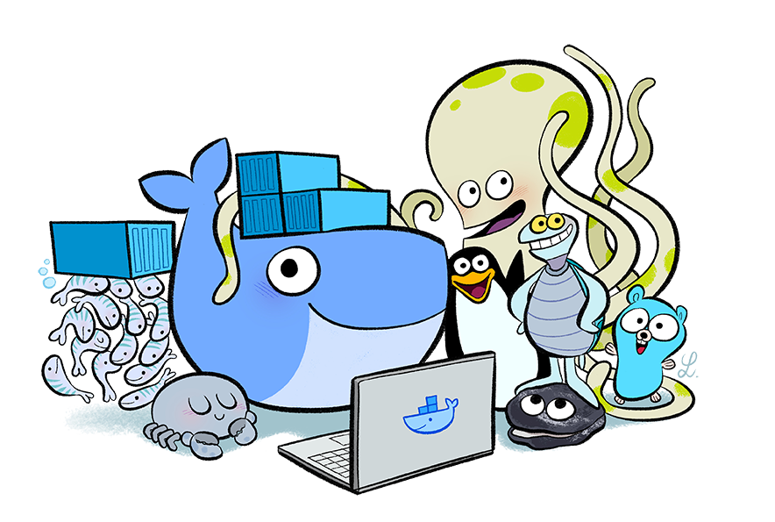
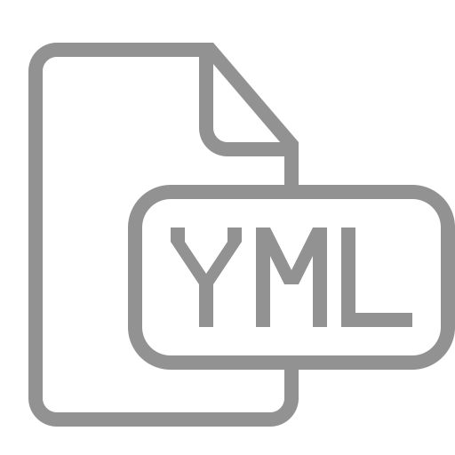
YAML Format
The format of YAML (Yet Another Markup Language), looks like this:
container_name:
property: value
- or options
Notes:
We have two good ways to group components for development purposes and then clean them up when you want to start over.
This approach works fine for local development and grouping. In shared environments the best approach is to properly label your components (services, RCs, pods, etc) and delete them using labels, as above.

Slide 14
Defining Our First Container
In this example, let’s say we have a Node.js application, which requires connecting to Redis.
To start, we need to define our docker-compose.yml file to launch the Node.js application.
Current Directory (.)
./
Dockerfile
Makerfile
docker-compose.yaml
node_modules/
redis/
.npmignore
README.md
connection_breaker.js
index.js
lib/
package.json
package.json
server.js
Notes:
We have two good ways to group components for development purposes and then clean them up when you want to start over.
This approach works fine for local development and grouping. In shared environments the best approach is to properly label your components (services, RCs, pods, etc) and delete them using labels, as above.

Slide 15
Formatting Basic
Given the format shared previously, the file needs to name the container 'web' and set the build property to the current directory.
web:
build: .
Copying the following code into our YAML file, will define a container called web, which is based on the build of the current directory.
NOTE: Remember we have a Node.js app in our current directory.
Notes:
We have two good ways to group components for development purposes and then clean them up when you want to start over.
This approach works fine for local development and grouping. In shared environments the best approach is to properly label your components (services, RCs, pods, etc) and delete them using labels, as above.

Slide 16
Defining Container Properties
Docker Compose supports all of the properties which can be defined using docker run.
To link two containers together to specify a links property and list required connections.
For example, the following would link to the redis source container defined in the same file and assign the same name to the alias.
links:
- redis
Notes:
We have two good ways to group components for development purposes and then clean them up when you want to start over.
This approach works fine for local development and grouping. In shared environments the best approach is to properly label your components (services, RCs, pods, etc) and delete them using labels, as above.

Slide 17

Defining Container Properties
The same format is used for other properties, such as ports:
ports:
- "3000”
- “3001”
- "8000"
Notes:
We have two good ways to group components for development purposes and then clean them up when you want to start over.
This approach works fine for local development and grouping. In shared environments the best approach is to properly label your components (services, RCs, pods, etc) and delete them using labels, as above.

Slide 18

First Container Overview
So, after all that, our yaml file would look something like this
This is just the very beginning!
web:
build: .
links:
- redis
ports:
- "3000"
- "3001"
- "8000"
Pretty
Cool, huh?
Notes:
We have two good ways to group components for development purposes and then clean them up when you want to start over.
This approach works fine for local development and grouping. In shared environments the best approach is to properly label your components (services, RCs, pods, etc) and delete them using labels, as above.

Slide 19
Building a Multi-Container Application

Slide 20
Docker Compose Configuration File
First
$ VBoxManage --version
5.0.6r103037

Slide 21
Defining a Second Container
In the previous step, we used the Dockerfile in the current directory (.) as the base for our container
In this step, we want to use an existing image from Docker Hub as a second container
To define the second container you simply use the same format as before on a new line
The YAML format is flexible enough to define multiple containers within the same file
Notes:
We have two good ways to group components for development purposes and then clean them up when you want to start over.
This approach works fine for local development and grouping. In shared environments the best approach is to properly label your components (services, RCs, pods, etc) and delete them using labels, as above.

Slide 22
Second Container Properties
Defining the second container with the name redis, which will use the image redis. Following the YAML format, the container details would be:
redis:
image: redis:alpine
volumes: - /var/redis/data:/data
Notes:
We have two good ways to group components for development purposes and then clean them up when you want to start over.
This approach works fine for local development and grouping. In shared environments the best approach is to properly label your components (services, RCs, pods, etc) and delete them using labels, as above.

Slide 23
Starting Compose Up
With the docker-compose.yml file we created in place, you can launch all the applications with a single command of up, like this:
If you wanted to bring up a single container, then we could use up <name>.
docker compose up
docker compose up <name>
Notes:
We have two good ways to group components for development purposes and then clean them up when you want to start over.
This approach works fine for local development and grouping. In shared environments the best approach is to properly label your components (services, RCs, pods, etc) and delete them using labels, as above.

Slide 24
Docker Compose Management
Docker Compose starts containers, but it also provides a commands to manage all the containers.
To see the details of the launched containers we could use:
To access all the logs via a single snapshot stream we could use:
Other commands follow the same pattern, and as always can be seen by typing the command itself: docker-compose.
docker-compose ps
docker-compose logs
Notes:
We have two good ways to group components for development purposes and then clean them up when you want to start over.
This approach works fine for local development and grouping. In shared environments the best approach is to properly label your components (services, RCs, pods, etc) and delete them using labels, as above.

Slide 25
Scaling With Compose
Let’s talk about how Compose can also be used to scale up the number of running containers.
The scale option allows you to specify the service and then the number of instances you want.
If the number is greater than the instances already running, it will launch additional containers.
And if the number is less, it will stop the unrequired containers.
Notes:
We have two good ways to group components for development purposes and then clean them up when you want to start over.
This approach works fine for local development and grouping. In shared environments the best approach is to properly label your components (services, RCs, pods, etc) and delete them using labels, as above.

Slide 26
Scaling With Compose
To scale the number of web containers we're running we’d use this command:
And we could scale it back down using:
docker-compose scale web=3
docker-compose scale web=1
App
Notes:
We have two good ways to group components for development purposes and then clean them up when you want to start over.
This approach works fine for local development and grouping. In shared environments the best approach is to properly label your components (services, RCs, pods, etc) and delete them using labels, as above.

Slide 27
Stop and Remove
As when we launch an application with start, to stop a set of containers we can use the command:
And to remove all the containers we can use the command:
docker-compose stop
docker-compose rm
Notes:
We have two good ways to group components for development purposes and then clean them up when you want to start over.
This approach works fine for local development and grouping. In shared environments the best approach is to properly label your components (services, RCs, pods, etc) and delete them using labels, as above.

Slide 28
Multi-Container Application Management
manage apps spanning Multiple Containers

Slide 29
How to Deploy Multi-Tier Application

Slide 30
How to Deploy Multi-Tier Application
Template
$ template
xx.xxx.xx.x

Slide 31
Multi-Container Management Options

Slide 32
Multi-Container Management Options
Template
$ template
xx.xxx.xx.x

Slide 33
Multi-Container Application Using Compose

Slide 34
Multi-Container Application Using Compose
The application used in this section is a Java EE application talking to a database
The application publishes a REST endpoint that can be invoked using `curl’
It is deployed using WildFly Swarm that communicates to MySQL database.
WildFly Swarm and MySQL will be running in two separate containers, and thus making this a multi-container application
Notes:
BEWARE: TO DO THESE EXERCISES, YOU NEED TO CLONE:
git@Docker/labs
The application used in this section is a Java EE application talking to a database.
The application publishes a REST endpoint that can be invoked using `curl.
It is deployed using WildFly Swarm that communicates to MySQL database.
WildFly Swarm and MySQL will be running in two separate containers, and thus making this a multi-container application.

Slide 35
Multi-Container Application Using Compose
The entry point to Docker Compose is a Compose file, usually called docker-compose.yml
Create a new directory javaee. In that directory, create a new file docker-compose.yml in it.
Use the following contents:
Reference: cs_09-35.yaml
Notes:
The entry point to Docker Compose is a Compose file, usually called docker-compose.yml.
Create a new directory javaee. In that directory, create a new file docker-compose.yml in it.
Use the following contents:
-------
version: '3.3' services: db: container_name: db image: mysql:8 environment: MYSQL_DATABASE: employees MYSQL_USER: mysql MYSQL_PASSWORD: mysql MYSQL_ROOT_PASSWORD: supersecret ports: - 3306:3306 web: image: arungupta/docker-javaee:dockerconeu17 ports: - 8080:8080 - 9990:9990 depends_on: - db
-------

Slide 36
Our Compose File
Two services in this Compose are defined by the name db and web attributes
Image name for each service defined using image attribute
The mysql:8 image starts the MySQL server
Environment attribute defines environment variables to initialize MySQL server
Java EE application uses the db service as specified in the connection-url as specified
The arungupta/docker-javaee:dockerconeu17 image starts WildFly Swarm application server
Port forwarding is achieved using ports attribute
depends_on attribute allows to express dependency between services
Notes:
In this Compose file:
Two services in this Compose are defined by the name db and web attributes
Image name for each service defined using image attribute
The mysql:8 image starts the MySQL server.
environment attribute defines environment variables to initialize MySQL server.
SHARE:
- MYSQL_DATABASE allows you to specify the name of a database to be created on image startup.
- MYSQL_USER and MYSQL_PASSWORD are used in conjunction to create a new user and to set that user’s password. This user will be granted superuser permissions for the database specified by the MYSQL_DATABASE variable.
- MYSQL_ROOT_PASSWORD is mandatory and specifies the password that will be set for the MySQL root superuser account.
Java EE application uses the db service as specified in the connection-url as specified
at https://github.com/arun-gupta/docker-javaee/blob/master/employees/src/main/resources/project-defaults.yml/.
The arungupta/docker-javaee:dockerconeu17 image starts WildFly Swarm application server.
SHARE:
It consists of the Java EE application built from https://github.com/arun-gupta/docker-javaee.
Clone that project if you want to build your own image.
Port forwarding is achieved using ports attribute.
depends_on attribute allows to express dependency between services.
SHARE:
In this case, MySQL will be started before WildFly. Application-level health check are still user’s responsibility.

Slide 37
Start Our Application
All services in the application can be started, in detached mode, by giving the command:
An alternate Compose file name can be specified using -f option
An alternate directory where the compose file exists can be specified using -p option
This shows the output as:
$ docker-compose up -d
Creating network "javaee_default" with the default driver
Creating db ...
Creating db ... done
Creating javaee_web_1 ...
Creating javaee_web_1 ... done
Notes:
Start application
All services in the application can be started, in detached mode, by giving the command:
docker-compose up -d
An alternate Compose file name can be specified using -f option.
An alternate directory where the compose file exists can be specified using -p option.
This shows the output as:
docker-compose up -d
Output:
Creating network "javaee_default" with the default driver
Creating db ...
Creating db ... done
Creating javaee_web_1 ...
Creating javaee_web_1 ... done
SHARE:
The output may differ slightly if the images are downloaded as well.
Started services can be verified using the command docker-compose ps:
Name Command State Ports
------------------------------------------------------------------------------------------------------
db docker-entrypoint.sh mysqld Up 0.0.0.0:3306->3306/tcp
javaee_web_1 /bin/sh -c java -jar /opt/ ... Up 0.0.0.0:8080->8080/tcp, 0.0.0.0:9990->9990/tcp
This provides a consolidated view of all the services, and containers within each of them.
Alternatively, the containers in this application, and any additional containers running on this Docker host can be verified by using the usual docker container ls command:
Name Command State Ports
------------------------------------------------------------------------------------------------------
db docker-entrypoint.sh mysqld Up 0.0.0.0:3306->3306/tcp
javaee_web_1 /bin/sh -c java -jar /opt/ ... Up 0.0.0.0:8080->8080/tcp, 0.0.0.0:9990->9990/tcp
javaee $ docker container ls
CONTAINER ID IMAGE COMMAND CREATED STATUS PORTS NAMES
e862a5eb9484 arungupta/docker-javaee:dockerconeu17 "/bin/sh -c 'java ..." 38 seconds ago Up 36 seconds 0.0.0.0:8080->8080/tcp, 0.0.0.0:9990->9990/tcp javaee_web_1 08792c20c066 mysql:8 "docker-entrypoint..." 39 seconds ago Up 37 seconds 0.0.0.0:3306->3306/tcp db
Service logs can be seen using docker-compose logs command, and looks like:
Attaching to dockerjavaee_web_1, db
web_1 | 23:54:21,584 INFO [org.jboss.msc] (main) JBoss MSC version 1.2.6.Final
web_1 | 23:54:21,688 INFO [org.jboss.as] (MSC service thread 1-8) WFLYSRV0049: WildFly Core 2.0.10.Final "Kenny" starting
web_1 | 2017-10-06 23:54:22,687 INFO [org.wildfly.extension.io] (ServerService Thread Pool -- 20) WFLYIO001: Worker 'default' has auto-configured to 8 core threads with 64 task threads based on your 4 available processors . . .
web_1 | 2017-10-06 23:54:23,259 INFO [org.jboss.as.connector.subsystems.datasources] (MSC service thread 1-3) WFLYJCA0001: Bound data source [java:jboss/datasources/ExampleDS]
web_1 | 2017-10-06 23:54:24,962 INFO [org.jboss.as] (Controller Boot Thread) WFLYSRV0025: WildFly Core 2.0.10.Final "Kenny" started in 3406ms - Started 112 of 124 services (21 services are lazy, passive or on-demand)
web_1 | 2017-10-06 23:54:25,020 INFO [org.wildfly.extension.undertow] (MSC service thread 1-4) WFLYUT0006: Undertow HTTP listener default listening on 0.0.0.0:8080
web_1 | 2017-10-06 23:54:26,146 INFO [org.wildfly.swarm.runtime.deployer] (main) deploying docker-javaee.war
web_1 | 2017-10-06 23:54:26,169 INFO [org.jboss.as.server.deployment] (MSC service thread 1-3) WFLYSRV0027: Starting deployment of "docker-javaee.war" (runtime-name: "docker-javaee.war")
web_1 | 2017-10-06 23:54:27,748 INFO [org.jboss.as.jpa] (MSC service thread 1-2) WFLYJPA0002: Read persistence.xml for MyPU
web_1 | 2017-10-06 23:54:27,887 WARN [org.jboss.as.dependency.private] (MSC service thread 1-7) WFLYSRV0018: Deployment "deployment.docker-javaee.war" is using a private module ("org.jboss.jts:main") which may be changed or removed in future versions without notice. . . .
web_1 | 2017-10-06 23:54:29,128 INFO [stdout] (ServerService Thread Pool -- 4) Hibernate: create table EMPLOYEE_SCHEMA (id integer not null, name varchar(40), primary key (id))
web_1 | 2017-10-06 23:54:29,132 INFO [stdout] (ServerService Thread Pool -- 4) Hibernate: INSERT INTO EMPLOYEE_SCHEMA(ID, NAME) VALUES (1, 'Penny')
web_1 | 2017-10-06 23:54:29,133 INFO [stdout] (ServerService Thread Pool -- 4) Hibernate: INSERT INTO EMPLOYEE_SCHEMA(ID, NAME) VALUES (2, 'Sheldon')
web_1 | 2017-10-06 23:54:29,133 INFO [stdout] (ServerService Thread Pool -- 4) Hibernate: INSERT INTO EMPLOYEE_SCHEMA(ID, NAME) VALUES (3, 'Amy')
web_1 | 2017-10-06 23:54:29,133 INFO [stdout] (ServerService Thread Pool -- 4) Hibernate: INSERT INTO EMPLOYEE_SCHEMA(ID, NAME) VALUES (4, 'Leonard') . . .
web_1 | 2017-10-06 23:54:30,050 INFO [org.wildfly.extension.undertow] (ServerService Thread Pool -- 4) WFLYUT0021: Registered web context: /
web_1 | 2017-10-06 23:54:30,518 INFO [org.jboss.as.server] (main) WFLYSRV0010: Deployed "docker-javaee.war" (runtime-name : "docker-javaee.war")
web_1 | 2017-10-06 23:56:01,766 INFO [stdout] (default task-1) Hibernate: select employee0_.id as id1_0_, employee0_.name as name2_0_ from EMPLOYEE_SCHEMA employee0_
db | Initializing database
. . .
db |
db |
db | MySQL init process done. Ready for start up.
db |
. . .
db | 2017-10-06T23:54:29.434423Z 0 [Note] /usr/sbin/mysqld: ready for connections. Version: '8.0.3-rc-log' socket: '/var/run/mysqld/mysqld.sock' port: 3306 MySQL Community Server (GPL)
db | 2017-10-06T23:54:30.281973Z 0
[Note] InnoDB: Buffer pool(s) load completed at 171006 23:54:30
depends_on attribute in the Compose definition file ensures the container start up order.
But application-level start up needs to be ensured by the applications running inside container.
In our case, this can be achieved by WildFly Swarm using swarm.datasources.data-sources.KEY.stale-connection-checker-class-name as defined at https://reference.wildfly-swarm.io/fractions/datasources.html.

Slide 38
Start Our Application
We’ve learned we can be verify using docker-compose ps
This provides a consolidated view of all the services, and containers within each of them
Alternatively, the containers in this application are verified by using the usual docker container ls command
Service logs can be seen using docker-compose logs command
depends_on attribute in the Compose definition file ensures the container start up order
Notes:
Start application
Started services can be verified using the command docker-compose ps:
SHARE:
Name Command State Ports
------------------------------------------------------------------------------------------------------
db docker-entrypoint.sh mysqld Up 0.0.0.0:3306->3306/tcp
javaee_web_1 /bin/sh -c java -jar /opt/ ... Up 0.0.0.0:8080->8080/tcp, 0.0.0.0:9990->9990/tcp
This provides a consolidated view of all the services, and containers within each of them.
Alternatively, the containers in this application, and any additional containers running on this Docker host can be verified by using the usual docker container ls command:
SHARE:
Name Command State Ports
------------------------------------------------------------------------------------------------------
db docker-entrypoint.sh mysqld Up 0.0.0.0:3306->3306/tcp
javaee_web_1 /bin/sh -c java -jar /opt/ ... Up 0.0.0.0:8080->8080/tcp, 0.0.0.0:9990->9990/tcp
javaee $ docker container ls
CONTAINER ID IMAGE COMMAND CREATED STATUS PORTS NAMES
e862a5eb9484 arungupta/docker-javaee:dockerconeu17 "/bin/sh -c 'java ..." 38 seconds ago Up 36 seconds 0.0.0.0:8080->8080/tcp, 0.0.0.0:9990->9990/tcp javaee_web_1 08792c20c066 mysql:8 "docker-entrypoint..." 39 seconds ago Up 37 seconds 0.0.0.0:3306->3306/tcp db
Service logs can be seen using docker-compose logs command, and looks like:
SHARE:
Reference: cs_09-38.bash – if you want to share outpu with students
Attaching to dockerjavaee_web_1, db
web_1 | 23:54:21,584 INFO [org.jboss.msc] (main) JBoss MSC version 1.2.6.Final
web_1 | 23:54:21,688 INFO [org.jboss.as] (MSC service thread 1-8) WFLYSRV0049: WildFly Core 2.0.10.Final "Kenny" starting
web_1 | 2017-10-06 23:54:22,687 INFO [org.wildfly.extension.io] (ServerService Thread Pool -- 20) WFLYIO001: Worker 'default' has auto-configured to 8 core threads with 64 task threads based on your 4 available processors . . .
web_1 | 2017-10-06 23:54:23,259 INFO [org.jboss.as.connector.subsystems.datasources] (MSC service thread 1-3) WFLYJCA0001: Bound data source [java:jboss/datasources/ExampleDS]
web_1 | 2017-10-06 23:54:24,962 INFO [org.jboss.as] (Controller Boot Thread) WFLYSRV0025: WildFly Core 2.0.10.Final "Kenny" started in 3406ms - Started 112 of 124 services (21 services are lazy, passive or on-demand)
web_1 | 2017-10-06 23:54:25,020 INFO [org.wildfly.extension.undertow] (MSC service thread 1-4) WFLYUT0006: Undertow HTTP listener default listening on 0.0.0.0:8080
web_1 | 2017-10-06 23:54:26,146 INFO [org.wildfly.swarm.runtime.deployer] (main) deploying docker-javaee.war
web_1 | 2017-10-06 23:54:26,169 INFO [org.jboss.as.server.deployment] (MSC service thread 1-3) WFLYSRV0027: Starting deployment of "docker-javaee.war" (runtime-name: "docker-javaee.war")
web_1 | 2017-10-06 23:54:27,748 INFO [org.jboss.as.jpa] (MSC service thread 1-2) WFLYJPA0002: Read persistence.xml for MyPU
web_1 | 2017-10-06 23:54:27,887 WARN [org.jboss.as.dependency.private] (MSC service thread 1-7) WFLYSRV0018: Deployment "deployment.docker-javaee.war" is using a private module ("org.jboss.jts:main") which may be changed or removed in future versions without notice. . . .
web_1 | 2017-10-06 23:54:29,128 INFO [stdout] (ServerService Thread Pool -- 4) Hibernate: create table EMPLOYEE_SCHEMA (id integer not null, name varchar(40), primary key (id))
web_1 | 2017-10-06 23:54:29,132 INFO [stdout] (ServerService Thread Pool -- 4) Hibernate: INSERT INTO EMPLOYEE_SCHEMA(ID, NAME) VALUES (1, 'Penny')
web_1 | 2017-10-06 23:54:29,133 INFO [stdout] (ServerService Thread Pool -- 4) Hibernate: INSERT INTO EMPLOYEE_SCHEMA(ID, NAME) VALUES (2, 'Sheldon')
web_1 | 2017-10-06 23:54:29,133 INFO [stdout] (ServerService Thread Pool -- 4) Hibernate: INSERT INTO EMPLOYEE_SCHEMA(ID, NAME) VALUES (3, 'Amy')
web_1 | 2017-10-06 23:54:29,133 INFO [stdout] (ServerService Thread Pool -- 4) Hibernate: INSERT INTO EMPLOYEE_SCHEMA(ID, NAME) VALUES (4, 'Leonard') . . .
web_1 | 2017-10-06 23:54:30,050 INFO [org.wildfly.extension.undertow] (ServerService Thread Pool -- 4) WFLYUT0021: Registered web context: /
web_1 | 2017-10-06 23:54:30,518 INFO [org.jboss.as.server] (main) WFLYSRV0010: Deployed "docker-javaee.war" (runtime-name : "docker-javaee.war")
web_1 | 2017-10-06 23:56:01,766 INFO [stdout] (default task-1) Hibernate: select employee0_.id as id1_0_, employee0_.name as name2_0_ from EMPLOYEE_SCHEMA employee0_
db | Initializing database
. . .
db |
db |
db | MySQL init process done. Ready for start up.
db |
. . .
db | 2017-10-06T23:54:29.434423Z 0 [Note] /usr/sbin/mysqld: ready for connections. Version: '8.0.3-rc-log' socket: '/var/run/mysqld/mysqld.sock' port: 3306 MySQL Community Server (GPL)
db | 2017-10-06T23:54:30.281973Z 0
[Note] InnoDB: Buffer pool(s) load completed at 171006 23:54:30
depends_on attribute in the Compose definition file ensures the container start up order.
SHARE:
But application-level start up needs to be ensured by the applications running inside container.
In our case, this can be achieved by WildFly Swarm using swarm.datasources.data-sources.KEY.stale-connection-checker-class-name as defined at https://reference.wildfly-swarm.io/fractions/datasources.html.

Slide 39
Verify Our Application
Now that the WildFly Swarm and MySQL have been configured, let’s access the application!
You need to specify IP address of the host where WildFly is running
The endpoint can be accessed in this case as:
The output is shown as:
This shows the result from querying the database
Um, what if we just want one?
$ curl -v http://localhost:8080/resources/employees
Reference: cs_09-39.bash
Notes:
Verify application
Now that the WildFly Swarm and MySQL have been configured, let’s access the application.
You need to specify IP address of the host where WildFly is running (localhost in our case).
The endpoint can be accessed in this case as:
curl -v http://localhost:8080/resources/employees
The output is shown as:
curl -v http://localhost:8080/resources/employees
Trying ::1...
* TCP_NODELAY set
* Connected to localhost (::1) port 8080 (#0)
> GET /resources/employees HTTP/1.1
> Host: localhost:8080
> User-Agent: curl/7.51.0
> Accept: */*
>
< HTTP/1.1 200 OK
< Connection: keep-alive
< Content-Type: application/xml
< Content-Length: 478
< Date: Sat, 07 Oct 2017 00:05:41 GMT
<
* Curl_http_done: called premature == 0
* Connection #0 to host localhost left intact
<?xml version="1.0" encoding="UTF-8" standalone="yes"?><collection><employee><id>1</id><name>Penny</name></employee><employee><id>2</id><name>Sheldon</name></employee><employee><id>3</id><name>Amy</name></employee><employee><id>4</id><name>Leonard</name></employee><employee><id>5</id><name>Bernadette</name></employee><employee><id>6</id><name>Raj</name></employee><employee><id>7</id><name>Howard</name></employee><employee><id>8</id><name>Priya</name></employee></collection>
This shows the result from querying the database.
A single resource can be obtained:
curl -v http://localhost:8080/resources/employees/1
It shows the output:
curl -v http://localhost:8080/resources/employees/1
Trying ::1...
* TCP_NODELAY set
* Connected to localhost (::1) port 8080 (#0)
> GET /resources/employees/1 HTTP/1.1
> Host: localhost:8080
> User-Agent: curl/7.51.0
> Accept: */*
>
< HTTP/1.1 200 OK
< Connection: keep-alive
< Content-Type: application/xml
< Content-Length: 104
< Date: Sat, 07 Oct 2017 00:06:33 GMT
< * Curl_http_done: called premature == 0 * Connection #0 to host localhost left intact
<?xml version="1.0" encoding="UTF-8" standalone="yes"?><employee><id>1</id><name>Penny</name></employee>

Slide 40
Verify Our Application
A single resource can be obtained:
It shows the output:
$ curl -v http://localhost:8080/resources/employees/1
Reference: cs_09-40.bash
Trying ::1...
* TCP_NODELAY set
* Connected to localhost (::1) port 8080 (#0)
> GET /resources/employees/1 HTTP/1.1
> Host: localhost:8080
> User-Agent: curl/7.51.0
> Accept: */*
>
< HTTP/1.1 200 OK
< Connection: keep-alive
< Content-Type: application/xml
< Content-Length: 104
< Date: Sat, 07 Oct 2017 00:06:33 GMT
< * Curl_http_done: called premature == 0 * Connection #0 to host localhost left intact
<?xml version="1.0" encoding="UTF-8" standalone="yes"?><employee><id>1</id><name>Penny</name></employee>
Notes:
Verify application
A single resource can be obtained:
curl -v http://localhost:8080/resources/employees/1
Reference: cs_09-40.bash – for larger print to share with students
It shows the output:
curl -v http://localhost:8080/resources/employees/1
Trying ::1...
* TCP_NODELAY set
* Connected to localhost (::1) port 8080 (#0)
> GET /resources/employees/1 HTTP/1.1
> Host: localhost:8080
> User-Agent: curl/7.51.0
> Accept: */*
>
< HTTP/1.1 200 OK
< Connection: keep-alive
< Content-Type: application/xml
< Content-Length: 104
< Date: Sat, 07 Oct 2017 00:06:33 GMT
< * Curl_http_done: called premature == 0 * Connection #0 to host localhost left intact
<?xml version="1.0" encoding="UTF-8" standalone="yes"?><employee><id>1</id><name>Penny</name></employee>

Slide 41
Shutdown Our Application
Shutdown the application using docker-compose down:
This stops the container in each service and removes all the services
It also deletes any networks that were created as part of this application.
Stopping javaee_web_1 ... done
Stopping db ... done
Removing javaee_web_1 ... done
Removing db ... done
Removing network javaee_default
Notes:
Shutdown application
Shutdown the application using docker-compose down:
Stopping javaee_web_1 ... done
Stopping db ... done
Removing javaee_web_1 ... done
Removing db ... done
Removing network javaee_default
This stops the container in each service and removes all the services.
It also deletes any networks that were created as part of this application.

Slide 42
Multi-Container Application Using Compose and Swarm Mode

Slide 43
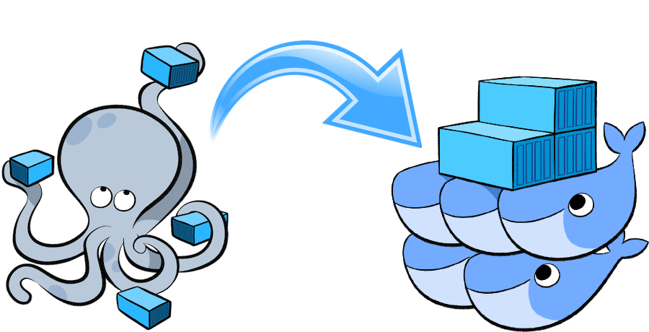
Multi-Container Application Using Swarm
xx.xxx.xx.x
This section will deploy an application that will provide a CRUD/REST interface on a data bucket in MySQL
This is achieved by using a Java EE application deployed on WildFly to access the database
Initialize Swarm
Initialize Swarm mode using the following command:
This starts a Swarm Manager!
$ docker swarm init
Notes:
BEWARE: TO DO THESE EXERCISES, YOU NEED TO CLONE:
git@Docker/labs
This section will deploy an application that will provide a CRUD/REST interface on a data bucket in MySQL.
This is achieved by using a Java EE application deployed on WildFly to access the database.
Initialize Swarm
Initialize Swarm mode using the following command:
docker swarm init
This starts a Swarm Manager.
SHARE:
By default, a manager node is also a worker but can be configured to be a manager-only.

Slide 44
Multi-Container Application Using Swarm
Find some information about this one-node cluster using the command docker info
The log output is large, and gives extensive information as we’ve already seen:
This cluster has 1 node, and that is a manager
By default, the manager node is also a worker node
This means the containers can run on this node
Reference: cs_09-info.bash
Notes:
Initialize Swarm
Find some information about this one-node cluster using the command docker info
cs_09-info.bash
This cluster has 1 node, and that is a manager.
By default, the manager node is also a worker node.
This means the containers can run on this node.

Slide 45
Multi-Container Application Using Swarm
This section describes how to deploy a multi-container application using Docker Compose to Swarm mode use Docker CLI
Create a new directory and cd to it:
Create a new Compose definition docker-compose.yml using our previous configuration file:
$ mkdir webapp
$ cd webapp
Reference: cs_09-35.yaml
Notes:
Multi-container application
This section describes how to deploy a multi-container application using Docker Compose to Swarm mode use Docker CLI.
Create a new directory and cd to it:
mkdir webapp
cd webapp
Create a new Compose definition docker-compose.yml using Reference: cs_09-35.yaml

Slide 46
Multi-Container Application Using Swarm
This application can be started as:
This shows the output as:
WildFly Swarm and MySQL services are started on this node
A new overlay network is created
$ docker stack deploy --compose-file=docker-compose.yml webapp
Ignoring deprecated options:
container_name: Setting the container name is not supported.
Creating network webapp_default
Creating service webapp_db
Creating service webapp_web
Notes:
Multi-container application
This application can be started as:
docker stack deploy --compose-file=docker-compose.yml webapp
This shows the output as:
Ignoring deprecated options:
container_name: Setting the container name is not supported.
Creating network webapp_default
Creating service webapp_db
Creating service webapp_web
WildFly Swarm and MySQL services are started on this node.
SHARE:
Each service has a single container. If the Swarm mode is enabled on multiple nodes then the containers will be distributed across them.
A new overlay network is created.
SHARE:
This can be verified using the command docker network ls. This network allows multiple containers on different hosts to communicate with each other.

Slide 47
Verify Service and Containers in Application
Based on our previous work with Compose, how can we verify our service and containers application?
Verify that the WildFly and MySQL services are running using docker service ls
More details about the service can be obtained using docker service inspect webapp_web
Logs for the service can be seen using docker service logs -f webapp_web
Notes:
Verify service and containers in application
SHARE:
Verify that the WildFly and MySQL services are running using docker service ls:
ID NAME MODE REPLICAS IMAGE PORTS
j21lwelj529f webapp_db replicated 1/1 mysql:8 *:3306->3306/tcp m0m44axt35cg webapp_web replicated 1/1 arungupta/docker-javaee:dockerconeu17 *:8080->8080/tcp,*:9990->9990/tcp
More details about the service can be obtained using docker service inspect webapp_web:
cs_09-inspect.bash
Logs for the service can be seen using docker service logs -f webapp_web:
cs_09-logs.bash
Make sure to wait for the last log statement to show.

Slide 48
Access Application
Now that the WildFly and MySQL servers have been configured, let’s access the application
You need to specify IP address of the host where WildFly is running
The endpoint can be accessed in this case as:
The output is shown as:
This shows all employees stored in the database!
$ curl -v http://localhost:8080/resources/employees
Reference: cs_09-curl.bash
Notes:
Access application
Now that the WildFly and MySQL servers have been configured, let’s access the application.
You need to specify IP address of the host where WildFly is running (localhost in our case).
The endpoint can be accessed in this case as: curl -v http://localhost:8080/resources/employees
The output is shown as:
cs_09-curl.bash
This shows all employees stored in the database.

Slide 49
Multi-Container Application Using Swarm
If you only want to stop the application temporarily while keeping any networks that were created as part of this application, you can:
...the recommended way is to set the amount of service replicas to 0
It shows the output:
$ docker service scale webapp_db=0 webapp_web=0
webapp_db scaled to 0
webapp_web scaled to 0
Since --detach=false was not specified, tasks will be scaled in the background.
In a future release, --detach=false will become the default.
Notes:
Stop application
If you only want to stop the application temporarily while keeping any networks that were created as part of this application, the recommended way is to set the amount of service replicas to 0.
docker service scale webapp_db=0 webapp_web=0
It shows the output:
webapp_db scaled to 0
webapp_web scaled to 0
Since --detach=false was not specified, tasks will be scaled in the background.
In a future release, --detach=false will become the default.
SHARE:
This is especially useful if the stack contains volumes and you want to keep the data. It allows you to simply start the stack again with setting the replicas to a number higher than 0.

Slide 50
Multi-Container Application Using Swarm
Shutdown the application using docker stack rm webapp:
Output:
This stops the container in each service and removes the services. It also deletes any networks that were created as part of this application
Removing service webapp_db
Removing service webapp_web
Removing network webapp_default
Notes:
Remove application completely
Shutdown the application using docker stack rm webapp:
Removing service webapp_db
Removing service webapp_web
Removing network webapp_default
This stops the container in each service and removes the services. It also deletes any networks that were created as part of this application.

Slide 51
Key Options

Slide 52
Key Options
Template
$ template
xx.xxx.xx.x

Slide 53
Key Considerations for Choosing Frameworks

Slide 54
Key Considerations for Choosing Framework
Template
$ template
xx.xxx.xx.x

Slide 55
Hands-on Exercise(s)

Slide 56
Hands-on Exercise(s)
First
$ VBoxManage --version
5.0.6r103037

Slide 57
End of Chapter

