Slide 1
Docker Swarm
Connecting and managing multiple containers

Slide 2
Overview

Slide 3
Overview
Template
$ template
xx.xxx.xx.x

Slide 4
Recap Docker
Containers run on single Docker host
Containers are ephemeral
Containers can have external persistence
Containers do not contain
Operating system matters

Slide 5
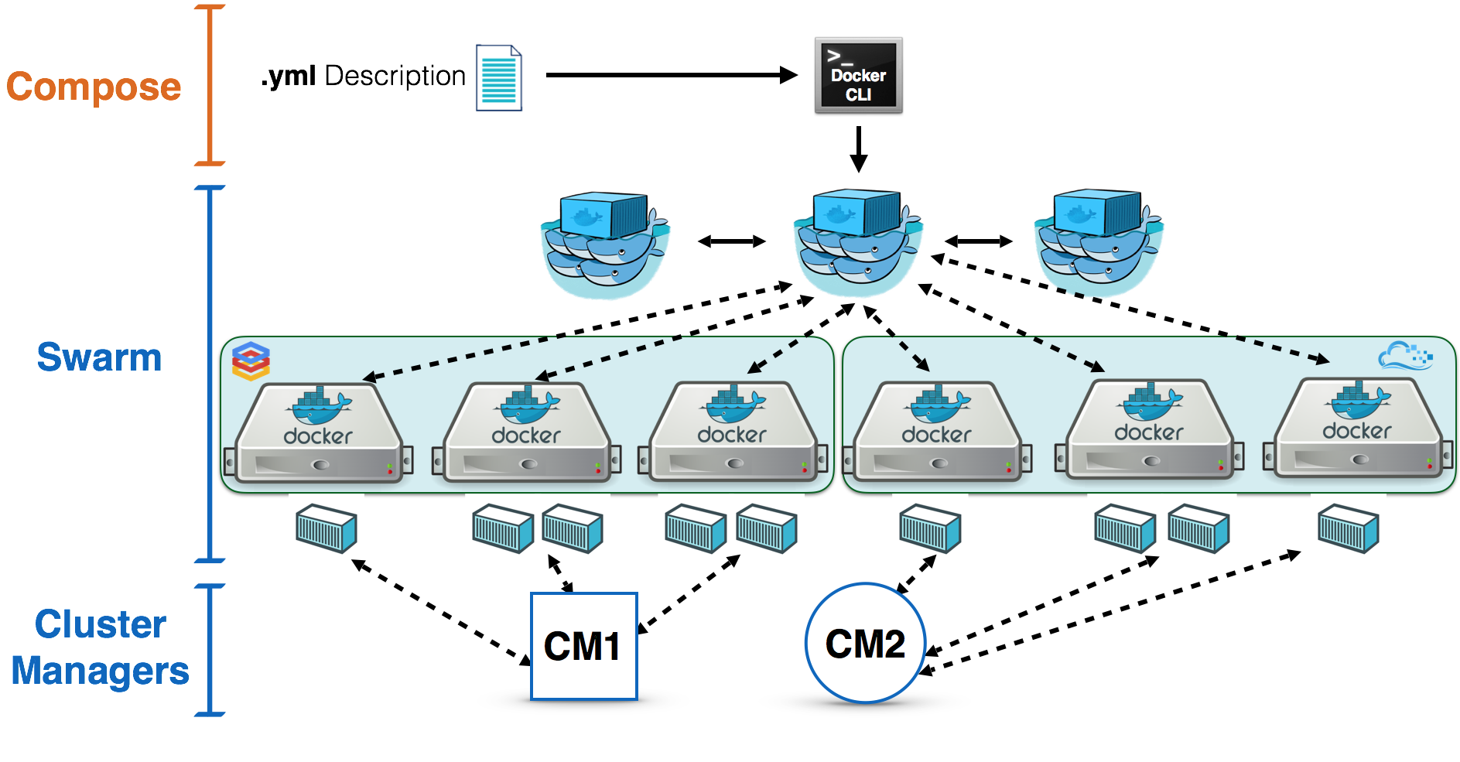
Swarm Overview
Describe swarm in a sentence of two, here.

Slide 6
Initialize Swarm Process
Turn single host Docker host into a Multi-host with Docker Swarm Mode.
All containers are only deployed onto the engine.
Swarm Mode turns it into a multi-host cluster-aware engine.
The first node to initialize the Swarm Mode becomes the manager.
As new nodes join the cluster, they can adjust their roles between managers or workers.
You should run 3-5 managers in a production environment to ensure high availability.

Slide 7
Create Swarm Mode Cluster
Swarm Mode is built into the Docker CLI. You can find an overview the possibility commands via:
The most important one is how to initialize Swarm Mode. Initialization is done via init, like this:
After running the command, the Docker Engine knows how to work with a cluster and becomes the manager.
The results of an initialization is a token used to add additional nodes in a secure fashion.
docker swarm --help
docker swarm init
Notes:
We have two good ways to group components for development purposes and then clean them up when you want to start over.
This approach works fine for local development and grouping. In shared environments the best approach is to properly label your components (services, RCs, pods, etc) and delete them using labels, as above.

Slide 8
Swarm Init Output
Once you initialize Docker Swarm, the token output will look something like this:
WSwarm initialized: current node (gpnnuxrri0tzaszblvhdrwqsh) is now a manager.
To add a worker to this swarm, run the following command:
docker swarm join \
--token SWMTKN-1-1xffnpg61r5wgel28ehuh8o3ip5z2iiwmplbemnksfho5akdqy-3zkn8ssrkcnjei34f5rmd4n3q \
172.17.0.65:2377
To add a manager to this swarm, run 'docker swarm join-token manager' and follow the instructions.
Notes:
We have two good ways to group components for development purposes and then clean them up when you want to start over.
This approach works fine for local development and grouping. In shared environments the best approach is to properly label your components (services, RCs, pods, etc) and delete them using labels, as above.

Slide 9
Creating a Cluster
With Swarm Mode enabled, it is possible to add additional nodes and issues commands across all of them.
If nodes happen to disappear, for example because of a crash, the containers which were running on those hosts will be automatically rescheduled onto other available nodes.
The rescheduling ensures you do not lose capacity and provides high-availability.
On each additional node, you wish to add to the cluster, use the Docker CLI to join the existing group.
Joining is done by pointing the other host to a current manager of the cluster.
Notes:
We have two good ways to group components for development purposes and then clean them up when you want to start over.
This approach works fine for local development and grouping. In shared environments the best approach is to properly label your components (services, RCs, pods, etc) and delete them using labels, as above.

Slide 10

Creating a Cluster
Docker now uses an additional port, 2377, for managing the Swarm.
The port should be blocked from public access and only accessed by trusted users and nodes.
We recommend using VPNs or private networks to secure access.
Notes:
We have two good ways to group components for development purposes and then clean them up when you want to start over.
This approach works fine for local development and grouping. In shared environments the best approach is to properly label your components (services, RCs, pods, etc) and delete them using labels, as above.

Slide 11
Join Cluster
The first task is to obtain the token required to add a node to the cluster.
For demonstration purposes, we'll ask the manager what the token is via swarm join-token.
NOTE: In production, this token should be stored securely and only accessible by trusted individuals.
token=$(docker -H 172.17.0.65:2345 swarm join-token -q worker) && echo $token
Notes:
We have two good ways to group components for development purposes and then clean them up when you want to start over.
This approach works fine for local development and grouping. In shared environments the best approach is to properly label your components (services, RCs, pods, etc) and delete them using labels, as above.

Slide 12
Join Cluster
On the second host, join the cluster by requesting access via the manager.
The token is provided as an additional parameter, like this:
docker swarm join 172.17.0.65:2377 --token $token
Notes:
We have two good ways to group components for development purposes and then clean them up when you want to start over.
This approach works fine for local development and grouping. In shared environments the best approach is to properly label your components (services, RCs, pods, etc) and delete them using labels, as above.

Slide 13
Join Cluster
By default, the manager will automatically accept new nodes being added to the cluster.
You can view all nodes in the cluster using:
Output:
docker node ls
ID HOSTNAME STATUS AVAILABILITY MANAGER STATUS5re1humv246m6clujn0zng9jy docker Ready Activerbavg04vwiijyzzjwdjoc3io2 * docker Ready Active Leader
Notes:
We have two good ways to group components for development purposes and then clean them up when you want to start over.
This approach works fine for local development and grouping. In shared environments the best approach is to properly label your components (services, RCs, pods, etc) and delete them using labels, as above.

Slide 14
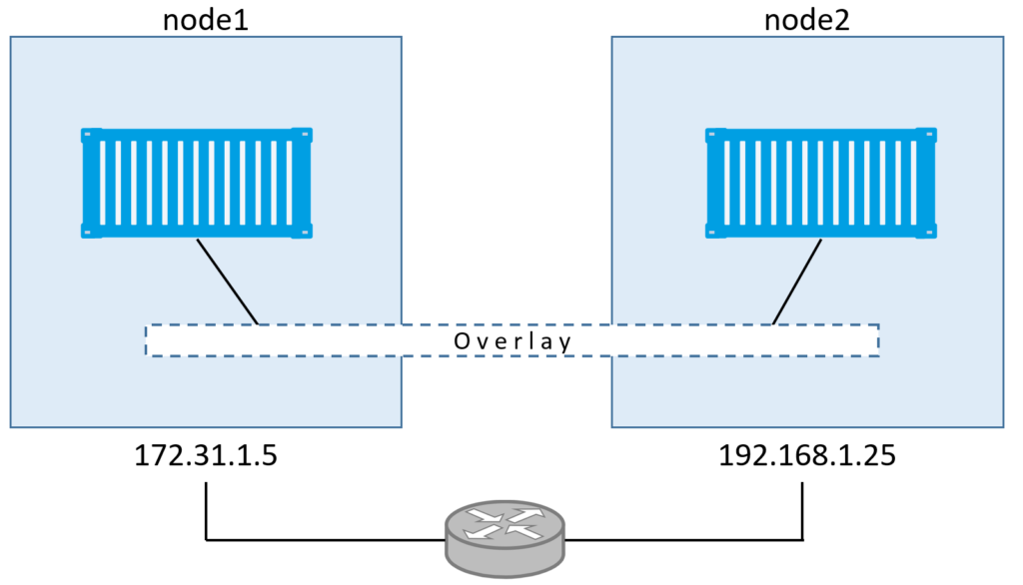
Overlay Network
Swarm Mode also introduces another networking model.
In previous versions, Docker required the use of an external key-value store, such as Consul, to ensure consistency across the network.
The need for consensus and KV has now been incorporated internally into Docker and no longer depends on external services.
Notes:
We have two good ways to group components for development purposes and then clean them up when you want to start over.
This approach works fine for local development and grouping. In shared environments the best approach is to properly label your components (services, RCs, pods, etc) and delete them using labels, as above.

Slide 15
Overlay Network
The improved networking approach follows the same syntax as previously.
The overlay network is used to enable containers on different hosts to communicate.
Under the covers, this is a Virtual Extensible LAN (VXLAN), designed for large scale cloud based deployments.
Notes:
We have two good ways to group components for development purposes and then clean them up when you want to start over.
This approach works fine for local development and grouping. In shared environments the best approach is to properly label your components (services, RCs, pods, etc) and delete them using labels, as above.

Slide 16
Overlay Network
The following command will create a new overlay network called skynet:
All containers registered to this network can communicate with each other, regardless of which node they are deployed onto.
docker network create -d overlay skynet
Notes:
We have two good ways to group components for development purposes and then clean them up when you want to start over.
This approach works fine for local development and grouping. In shared environments the best approach is to properly label your components (services, RCs, pods, etc) and delete them using labels, as above.

Slide 17
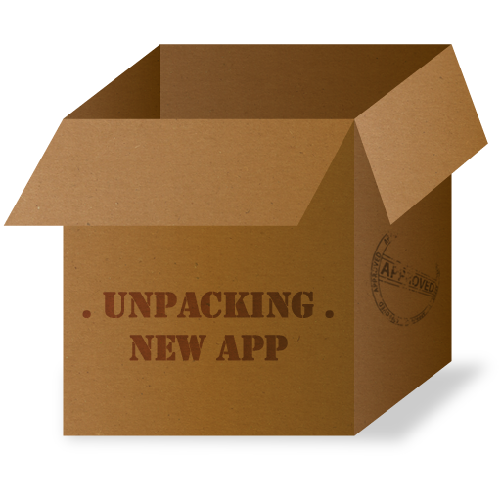
Deploy Service
By default, Docker uses a spread replication model for deciding which containers should run on which hosts.
The spread approach ensures that containers are deployed across the cluster evenly.
If one of the nodes are removed from the cluster, the containers running are spread across the other available nodes.
Notes:
We have two good ways to group components for development purposes and then clean them up when you want to start over.
This approach works fine for local development and grouping. In shared environments the best approach is to properly label your components (services, RCs, pods, etc) and delete them using labels, as above.

Slide 18
Deploy Service
The new Services concept is used to run containers across the cluster.
This is a higher-level concept than containers.
A service allows you to define how applications should be deployed at scale.
By updating the service, Docker updates the container required in a managed way.
Notes:
We have two good ways to group components for development purposes and then clean them up when you want to start over.
This approach works fine for local development and grouping. In shared environments the best approach is to properly label your components (services, RCs, pods, etc) and delete them using labels, as above.

Slide 19
Deployment
As an example, let’s deploy the Docker Image katacoda/docker-http-server.
We will give it a friendly name like, http.
And we will attach it to the newly created skynet network.
For ensuring replication and availability, we will run two instances of replicas, of the container across our cluster.
Notes:
We have two good ways to group components for development purposes and then clean them up when you want to start over.
This approach works fine for local development and grouping. In shared environments the best approach is to properly label your components (services, RCs, pods, etc) and delete them using labels, as above.

Slide 20
Deployment
Finally, we will load balance these two containers together on port 80.
Sending an HTTP request to any of the nodes in the cluster will process the request by one of the containers within the cluster.
NOTE: The node which accepts the request might not be the node where the container responses. Instead, Docker load-balances requests across all available containers.
So, what should our code look like?
Notes:
We have two good ways to group components for development purposes and then clean them up when you want to start over.
This approach works fine for local development and grouping. In shared environments the best approach is to properly label your components (services, RCs, pods, etc) and delete them using labels, as above.

Slide 21
Deployment
Here it is:
Assigned it to “skynet” network
Named it “http”
docker service create --name http --network skynet --replicas 2 -p 80:80 katacoda/docker-http-server
Exposed port 80
Created 2 replicas
Indicated which Image to use

Slide 22
Deployment Verification
You can view the services running on the cluster using the CLI command
Output:
docker service ls
ID NAME MODE REPLICAS IMAGE 4l4yr9hv663w http replicated 2/2 katacoda/docker-http- server:latest
Notes:
We have two good ways to group components for development purposes and then clean them up when you want to start over.
This approach works fine for local development and grouping. In shared environments the best approach is to properly label your components (services, RCs, pods, etc) and delete them using labels, as above.

Slide 23
Deployment Verification
As containers are started you will see them using the ps command. You should see one instance of the container on each host.
Listing containers on the first host using docker ps will produce:
Listing containers on the second host using docker ps produces:
CONTAINER ID IMAGE…
<host-1-id> Image:name
CONTAINER ID IMAGE…
<host-2-id> Image:name
Notes:
We have two good ways to group components for development purposes and then clean them up when you want to start over.
This approach works fine for local development and grouping. In shared environments the best approach is to properly label your components (services, RCs, pods, etc) and delete them using labels, as above.

Slide 24
Deployment Verification
If we issue an HTTP request to the public port, it will be processed by the two containers:
Output:
If we issue the same command again, what do you think the results will be?
curl <localhost>
<h1>This request was processed by host: “host-1-id”</h1>
Notes:
We have two good ways to group components for development purposes and then clean them up when you want to start over.
This approach works fine for local development and grouping. In shared environments the best approach is to properly label your components (services, RCs, pods, etc) and delete them using labels, as above.

Slide 25
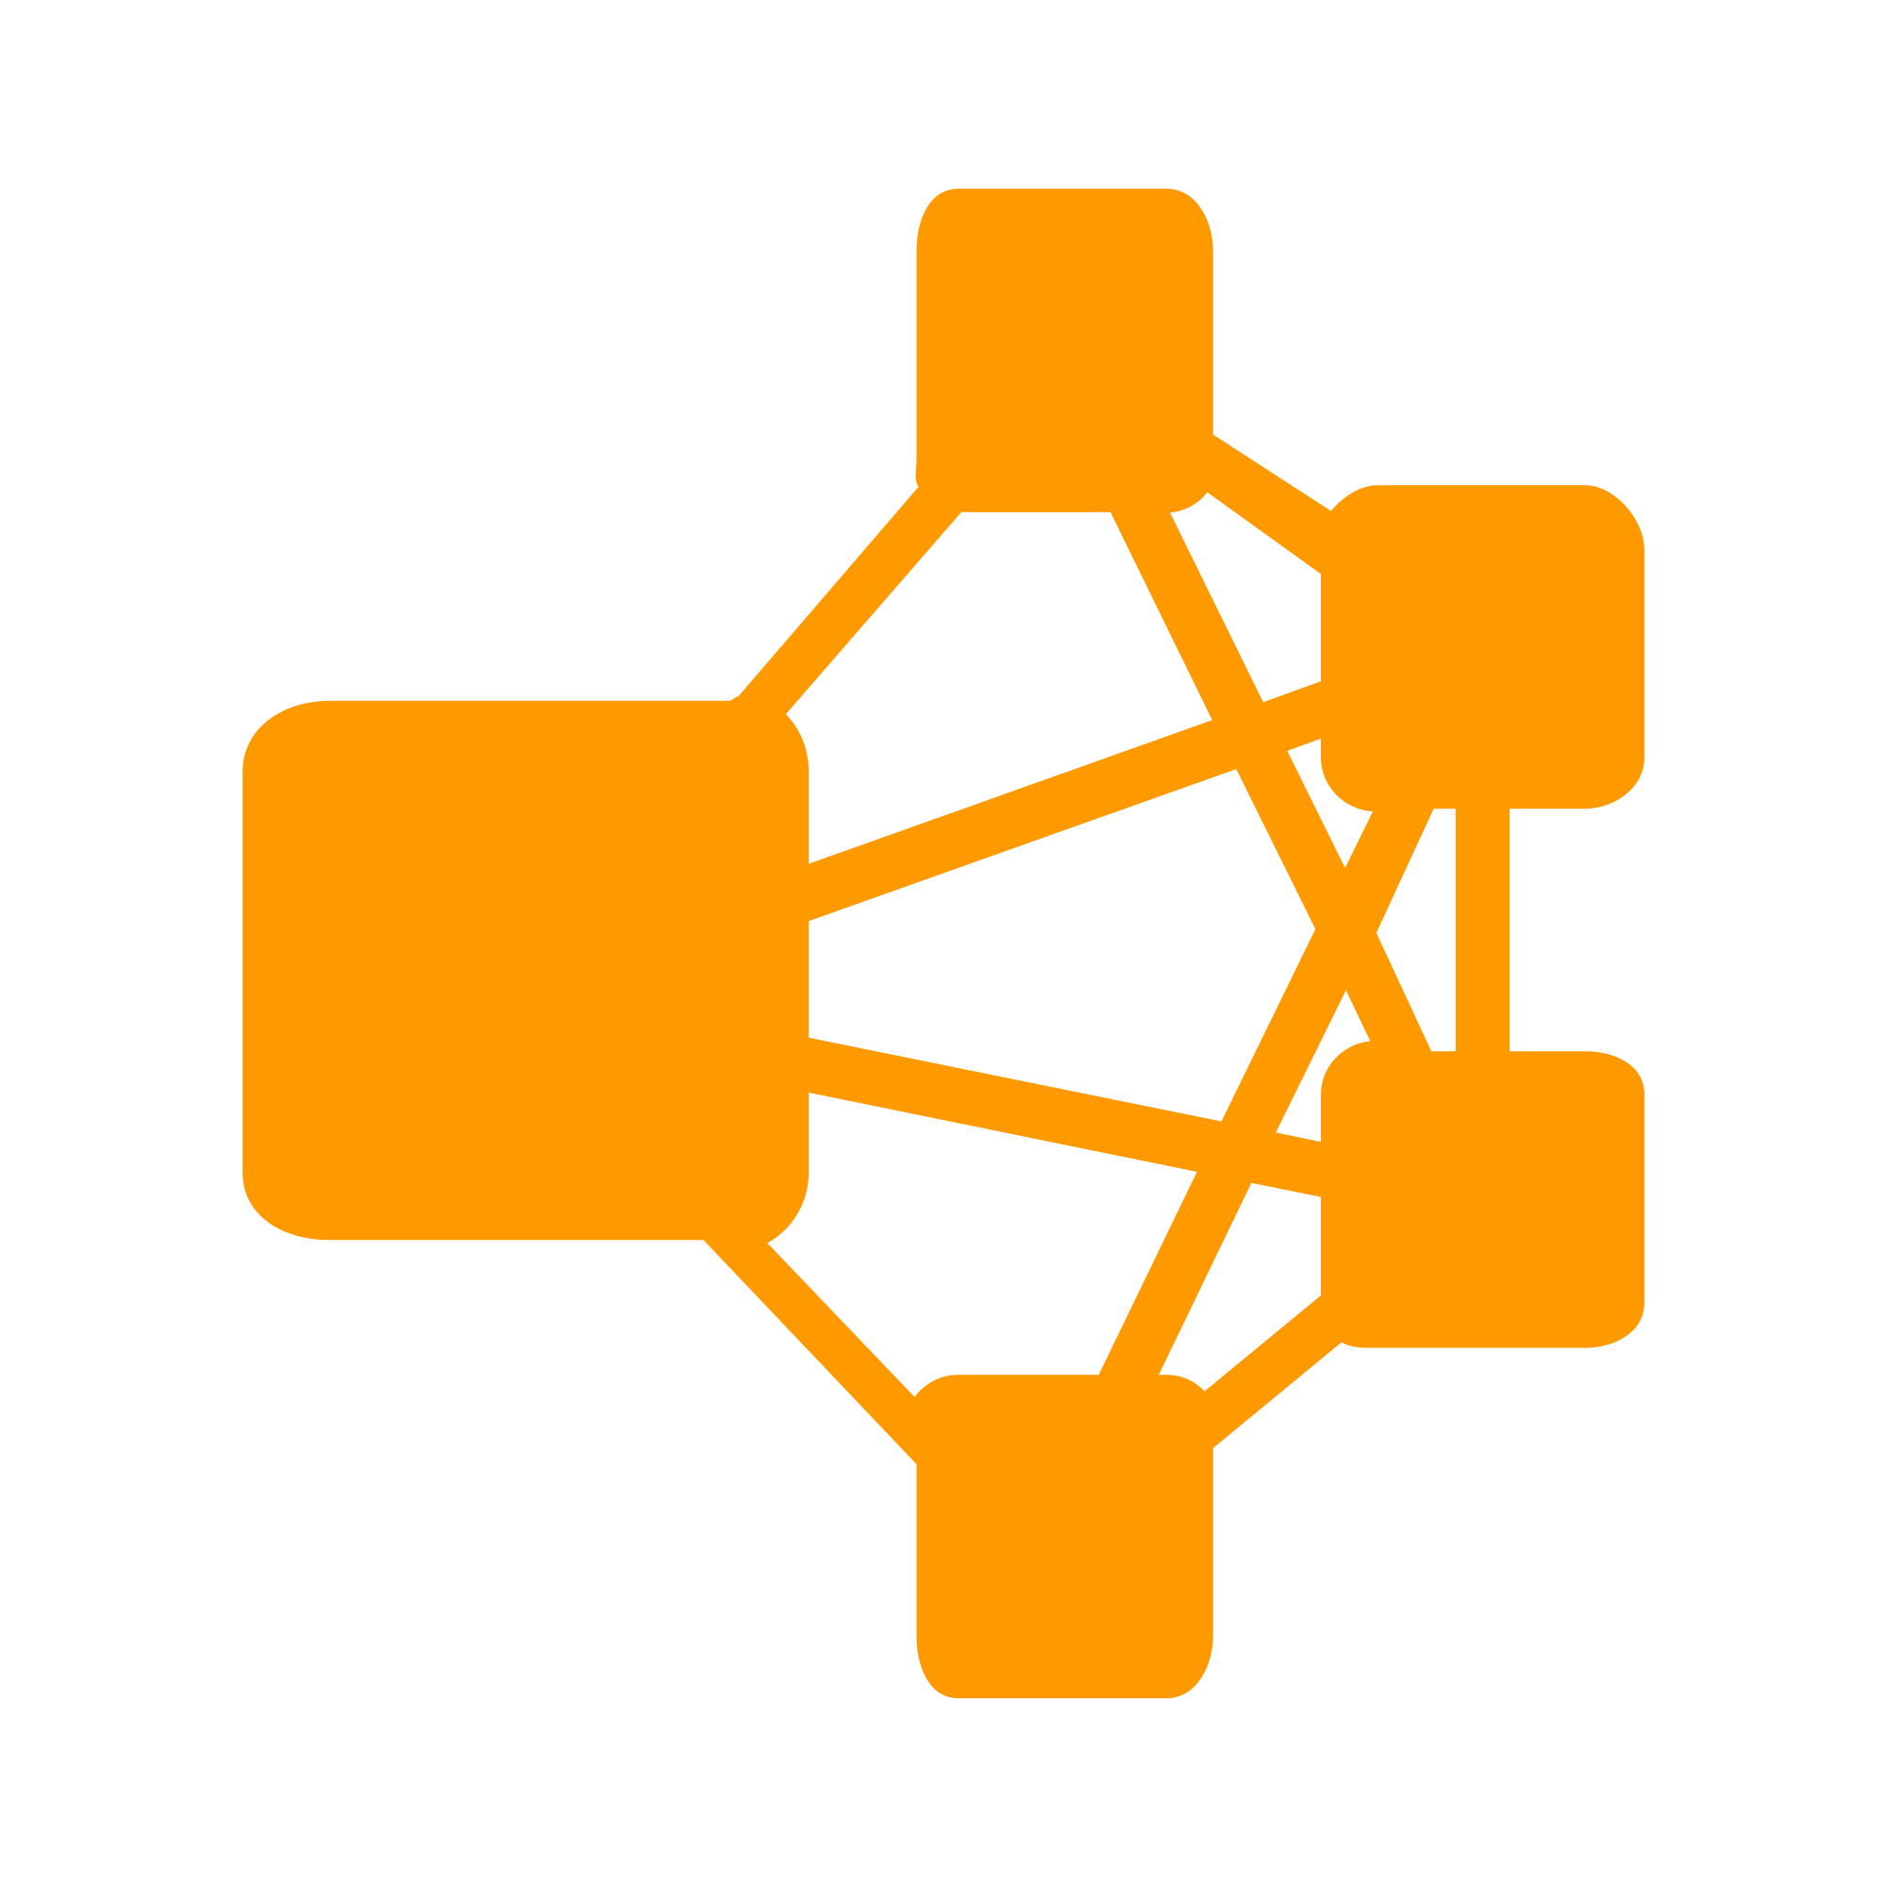
Deployment Verification
Everything happens just like before, except this request was processed by host 2’s container instance:
<h1>This request was processed by host: “host-2-id”</h1>
Notice which container id is given. Again,
using ps we could verify this.
Notes:
We have two good ways to group components for development purposes and then clean them up when you want to start over.
This approach works fine for local development and grouping. In shared environments the best approach is to properly label your components (services, RCs, pods, etc) and delete them using labels, as above.

Slide 26
What if we do it again?

Slide 27
Health Inspection
The Service concept allows you to inspect the health and state of your cluster and the running applications.
You can view the list of all the tasks associated with a service across the cluster:
NOTE: In this case, each task is a container.
Output:
docker service ps http
ID NAME IMAGE NODE
<service-id-1> http.1 katacoda/docker-http-server:latest docker
<service-id-2> http.2 katacoda/docker-http-server:latest docker
Notes:
We have two good ways to group components for development purposes and then clean them up when you want to start over.
This approach works fine for local development and grouping. In shared environments the best approach is to properly label your components (services, RCs, pods, etc) and delete them using labels, as above.

Slide 28
Health Inspection
You can view more details and the configuration of a service by using:
Output:
docker service inspect --pretty http
ID: 9b60zdcri52tvo1sskwsta44f
Name: http
Service Mode: Replicated
Replicas: 2
...
Notes:
We have two good ways to group components for development purposes and then clean them up when you want to start over.
This approach works fine for local development and grouping. In shared environments the best approach is to properly label your components (services, RCs, pods, etc) and delete them using labels, as above.

Slide 29
Health Inspection
On each node, you can ask what tasks it is currently running.
NOTE: Self refers to the manager node Leader:
Output:
docker node ps self
ID NAME IMAGE NODE …
<service-id-1> http.2 katacoda/docker-http-server:latest docker …
Notes:
We have two good ways to group components for development purposes and then clean them up when you want to start over.
This approach works fine for local development and grouping. In shared environments the best approach is to properly label your components (services, RCs, pods, etc) and delete them using labels, as above.

Slide 30
Health Inspection
Using the ID of a node you can query individual hosts
Output:
docker node ps $(docker node ls -q | head -n1)
ID NAME IMAGE NODE …
<service-id-2> http.1 katacoda/docker-http-server:latest docker …
Notes:
We have two good ways to group components for development purposes and then clean them up when you want to start over.
This approach works fine for local development and grouping. In shared environments the best approach is to properly label your components (services, RCs, pods, etc) and delete them using labels, as above.

Slide 31
Scaling and Resiliency

Slide 32
Scaling and Resiliency
Template
$ template
xx.xxx.xx.x
Notes:
B, please review the following as a hopeful source for this slide’s section
POSSIBLE SOURCE:
https://docs.docker.com/engine/swarm/swarm-tutorial/scale-service/
Below link is from the “Scale Your App” section
https://docs.docker.com/engine/swarm/

Slide 33
Rolling Updates

Slide 34
Rolling Updates
Template
$ template
xx.xxx.xx.x
Notes:
B, Please review the following as a hopeful source for this slide’s section
POSSIBLE SOURCE:
https://docs.docker.com/engine/swarm/swarm-tutorial/rolling-update/

Slide 35
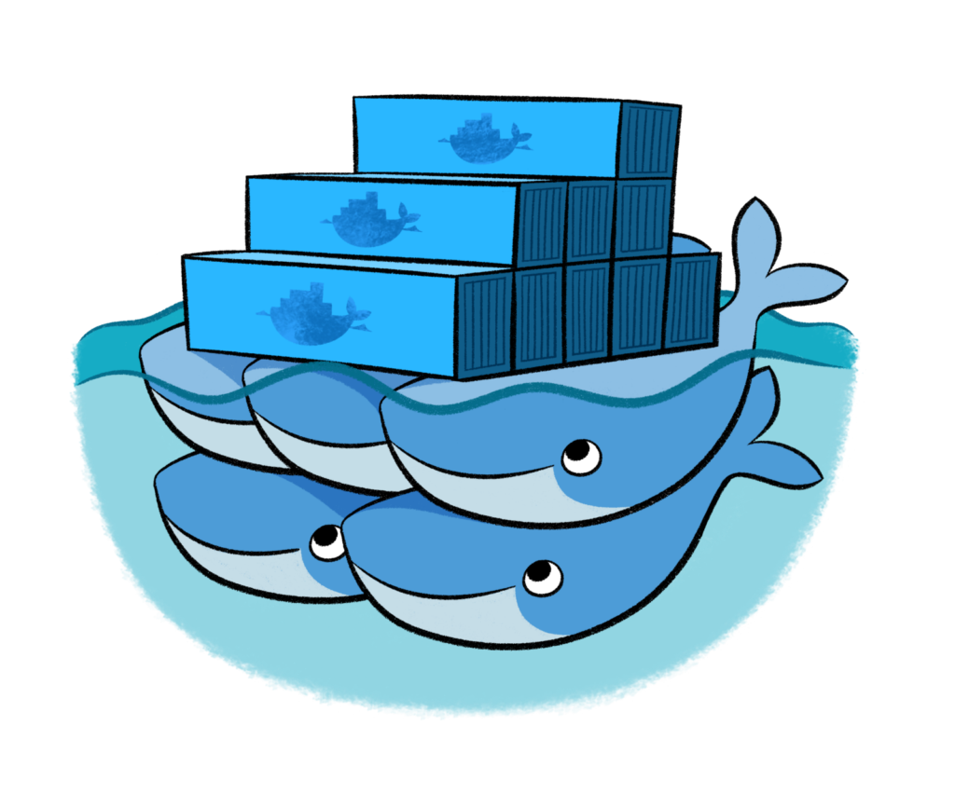
Scale Service
A Service also allows us to scale how many instances of a task is running across the cluster.
As it understands how to launch containers and which containers are running, it can easily start, or remove, containers as required.
At the moment the scaling is manual.
However, the API could be hooked up to an external system such as a metrics dashboard.
Notes:
We have two good ways to group components for development purposes and then clean them up when you want to start over.
This approach works fine for local development and grouping. In shared environments the best approach is to properly label your components (services, RCs, pods, etc) and delete them using labels, as above.

Slide 36
Scale Service
In our example, we had two load-balanced containers running, processing our requests curl docker.
Command below would scale our http service to be run across five containers:
On each host, you will see additional nodes being started.
The load balancer will automatically be updated.
Requests will now be processed across the new containers.
docker service scale http=5
Notes:
We have two good ways to group components for development purposes and then clean them up when you want to start over.
This approach works fine for local development and grouping. In shared environments the best approach is to properly label your components (services, RCs, pods, etc) and delete them using labels, as above.

Slide 37
Result Summary
The result of this scenario is a two-node Swarm cluster which can run load-balanced containers that can be scaled up and down.
Notes:
We have two good ways to group components for development purposes and then clean them up when you want to start over.
This approach works fine for local development and grouping. In shared environments the best approach is to properly label your components (services, RCs, pods, etc) and delete them using labels, as above.

Slide 38
Hands-on Exercise(s)

Slide 39
Hands-on Exercise(s)
T
Notes:
We have two good ways to group components for development purposes and then clean them up when you want to start over.
This approach works fine for local development and grouping. In shared environments the best approach is to properly label your components (services, RCs, pods, etc) and delete them using labels, as above.

Slide 40
End of Chapter

