Slide 1
Advanced Kubernetes
Concepts, Management, Middleware

Slide 2
Recap

Slide 3
Recap Docker
Containers run on single Docker host
Containers are ephemeral
Nothing watchdogs the containers
Containers can have external persistence
Containers do not contain
Operating system matters

Slide 4
Recap Kubernetes
So, what is Kubernetes?
And, what is Kubernetes, not?
Notes:
Kubernetes is an open-source platform for automating deployment, scaling, and operations of application containers across clusters of hosts, providing container-centric infrastructure.
With Kubernetes, you are able to quickly and efficiently respond to customer demand:
Deploy your applications quickly and predictably.
Scale your applications on the fly.
Roll out new features seamlessly.
Limit hardware usage to required resources only.
Our goal is to foster an ecosystem of components and tools that relieve the burden of running applications in public and private clouds.
Kubernetes is:
Portable: public, private, hybrid, multi-cloud
Extensible: modular, pluggable, hookable, composable
Self-healing: auto-placement, auto-restart, auto-replication, auto-scaling
Google started the Kubernetes project in 2014. Kubernetes builds upon a decade and a half of experience that Google has with running production workloads at scale, combined with best-of-breed ideas and practices from the community.
LEGACY APP
Typically, legacy applications are database management systems (DBMSs) running on mainframes or minicomputers. An important feature of new software products is the ability to work with a company'slegacy applications, or at least be able to import data from them.
NOT:::
Does not limit the types of applications supported. It does not dictate application frameworks (e.g., Wildfly), restrict the set of supported language runtimes (for example, Java, Python, Ruby), cater to only 12-factor applications, nor distinguish apps from services. Kubernetes aims to support an extremely diverse variety of workloads, including stateless, stateful, and data-processing workloads. If an application can run in a container, it should run great on Kubernetes.
Does not provide middleware (e.g., message buses), data-processing frameworks (for example, Spark), databases (e.g., mysql), nor cluster storage systems (e.g., Ceph) as built-in services. Such applications run on Kubernetes.
Does not have a click-to-deploy service marketplace.
Does not deploy source code and does not build your application. Continuous Integration (CI) workflow is an area where different users and projects have their own requirements and preferences, so it supports layering CI workflows on Kubernetes but doesn’t dictate how layering should work.
Allows users to choose their logging, monitoring, and alerting systems. (It provides some integrations as proof of concept.)
Does not provide nor mandate a comprehensive application configuration language/system (for example, jsonnet).
Does not provide nor adopt any comprehensive machine configuration, maintenance, management, or self-healing systems.

Slide 5
And Why Container?
I mean, who really uses containers?
Notes:
EVERYTHING Google does is in a container.
The Old Way to deploy applications was to install the applications on a host using the operating system package manager. This had the disadvantage of entangling the applications’ executables, configuration, libraries, and lifecycles with each other and with the host OS. One could build immutable virtual-machine images in order to achieve predictable rollouts and rollbacks, but VMs are heavyweight and non-portable.
The New Way is to deploy containers based on operating-system-level virtualization rather than hardware virtualization. These containers are isolated from each other and from the host: they have their own filesystems, they can’t see each others’ processes, and their computational resource usage can be bounded. They are easier to build than VMs, and because they are decoupled from the underlying infrastructure and from the host filesystem, they are portable across clouds and OS distributions.

Slide 6
Container Benefit Summary
Agile application creation and deployment: Increased ease and efficiency of container image creation compared to VM image use.
Continuous development, integration, and deployment: Provides for reliable and frequent container image build and deployment with quick and easy rollbacks (due to image immutability).
Dev and Ops separation of concerns: Create application container images at build/release time rather than deployment time, thereby decoupling applications from infrastructure.
Environmental consistency across development, testing, and production: Runs the same on a laptop as it does in the cloud.

Slide 7
Container Benefit Summary
Cloud and OS distribution portability: Runs on Ubuntu, RHEL, CoreOS, Google Container Engine, and anywhere else.
Application-centric management: Raises the level of abstraction from running an OS on virtual hardware to run an application on an OS using logical resources.
Loosely coupled, distributed, elastic, liberated micro-services: Applications are broken into smaller, independent pieces and can be deployed and managed dynamically – not a fat monolithic stack running on one big single-purpose machine.
Resource isolation: Predictable application performance.
Resource utilization: High efficiency and density.

Slide 8
Reconciliation of End State
Cluster
Declare
Make it

Slide 9
Kubernetes Core Concepts
Simplicity, Simplicity, Simplicity
Pods
Labels / Selectors
Replication Controllers
Services
API

Slide 10
Why You Win with Docker and Kubernetes
Immutable infrastructure
DevOps
CI/CD

Slide 11
Kubernetes Namespaces
Divide cluster across uses, tiers, and teams
Unique within a namespace; not across multiple namespaces
Very powerful when combined with Labels
Example: qa/dev/prod can be implemented with Namespaces
Notes:
Kubernetes supports multiple virtual clusters backed by the same physical cluster. These virtual clusters are called namespaces.

Slide 12
When To Use Multiple Namespaces
Teams & Projects
Scope of resources
Multiple Users
Notes:
Namespaces are intended for use in environments with many users spread across multiple teams, or projects. For clusters with a few to tens of users, you should not need to create or think about namespaces at all. Start using namespaces when you need the features they provide.
Namespaces provide a scope for names. Names of resources need to be unique within a namespace, but not across namespaces.
Namespaces are a way to divide cluster resources between multiple uses (via resource quota).
In future versions of Kubernetes, objects in the same namespace will have the same access control policies by default.
It is not necessary to use multiple namespaces just to separate slightly different resources, such as different versions of the same software: use labels to distinguish resources within the same namespace.

Slide 13

Kubernetes Namespaces
List the namespaces available to the cluster:
List all the pods across all the namespaces
kubectl get namespaces
kubectl get pods --all-namespaces
Notes:
Kubernetes starts with two initial namespaces:
default The default namespace for objects with no other namespace
kube-system The namespace for objects created by the Kubernetes system

Slide 14
Kubernetes Namespaces
Let’s create a new namespace for our guestbook application:
Let’s list the pods in the guestbook namespace:
NOTE: There shouldn’t be any at the moment.
curl -s -L https://raw.githubusercontent.com/christian-posta/docker-kubernetes-workshop/demos/guestbook/namespace.yaml | kubectl create -f -
kubectl get pods --namespace=guestbook

Slide 15
Kubernetes Contexts / Namespaces
You can log into multiple Kubernetes clusters with the same client and switch between clusters/contexts at the command line.
You can also specify which namespaces to use when pointing to specific clusters.
For example, to view the current cluster context:
kubectl config view
Notes:
You can log into multiple Kubernetes clusters with the same client and switch between clusters/contexts at the command line. You can also specify which namespaces to use when pointing to specific clusters. For example, to view the current cluster context, as above.

Slide 16
Kubernetes Contexts / Namespaces
Output:
- context:
cluster: master-fuse-osecloud-com:8443
namespace: microservice
user: admin/master-fuse-osecloud-com:8443
name: microservice/master-fuse-osecloud-com:8443/admin
- context:
cluster: vagrant
user: vagrant
name: vagrant
current-context: vagrant
kind: Config
preferences: {}
users:
- name: admin/master-fuse-osecloud-com:8443
user:
token: kZ_L5Oj5sJ8nJUVJD4quq813Q1pRv4yZWhOjuJEw79w
- name: vagrant
user:
client-certificate-data: REDACTED
client-key-data: REDACTED
password: vagrant
username: vagrant
Notes:
You can log into multiple Kubernetes clusters with the same client and switch between clusters/contexts at the command line. You can also specify which namespaces to use when pointing to specific clusters. For example, to view the current cluster context, as above.

Slide 17
Setting and Using Context/Namespaces
We can create a new context that points to our vagrant cluster:
Now, let’s switch to use that context so we can put any new pods/RCs into this new namespace:
Now double check we’re in the new context/namespace:
kubectl config set-context guestbook --namespace=guestbook --user=vagrant --cluster=vagrant
kubectl config use-context guestbook
kubectl config view | grep current-context | awk '{print $2}'

Slide 18
Setting and Using Context/Namespaces
Now let’s deploy a replication controller:
Now, let’s see how many pods we have:
Output:
curl -s -L https://raw.githubusercontent.com/christian-posta/docker-kubernetes-workshop/demos/guestbook/frontend-controller.yaml | kubectl create -f -
kubectl get pods
NAME READY STATUS RESTARTS AGE
frontend-juz6j 0/1 Pending 0 5s

Slide 19
Namespaces and DNS
When you create a Service, it creates a corresponding DNS entry.
This entry is of the form <service-name>.<namespace-name>.svc.cluster.local
Notes:
which means that if a container just uses <service-name> it will resolve to the service which is local to a namespace.
This is useful for using the same configuration across multiple namespaces such as Development, Staging and Production. If you want to reach across namespaces, you need to use the fully qualified domain name (FQDN).

Slide 20
Removing Components Namespaces
We have two good ways to group components for development purposes and then clean them up when you want to start over.
Kubernetes labels
Namespaces
You can delete all resources in a namespace like this:
kubectl config use-context vagrant
kubectl delete namespace guestbook
Notes:
We have two good ways to group components for development purposes and then clean them up when you want to start over.
This approach works fine for local development and grouping. In shared environments the best approach is to properly label your components (services, RCs, pods, etc) and delete them using labels, as above.

Slide 21
Removing Components Labels
The Namespace approach works fine for local development and grouping.
However, in shared environments the best approach is to properly label your components (services, RCs, pods, etc) and delete them using labels.
That would look something like this:
kubectl delete all -l "label=value"
Notes:
We have two good ways to group components for development purposes and then clean them up when you want to start over.
This approach works fine for local development and grouping. In shared environments the best approach is to properly label your components (services, RCs, pods, etc) and delete them using labels, as above.

Slide 22
Not all Objects in a Namespace
Most objects are in a namespace
Pods
Replication controllers
Services
Namespaces themselves not in namespace
Nodes, PersistentVolumes
Notes:
Most Kubernetes resources (e.g. pods, services, replication controllers, and others) are in some namespace. However namespace resources are not themselves in a namespace. And low-level resources, such as nodes and persistentVolumes, are not in any namespace. Events are an exception: they may or may not have a namespace, depending on the object the event is about.

Slide 23
Resource Quotas
If the API Server has ResourceQuota passed to the kube-apiserver's --admission_control argument, then a namespace can set a ResourceQuota object to limit resources.
Example from the vagrant/master:
root 6055 0.0 0.0 3172 48 ? Ss 00:04 0:00 /bin/sh -c /usr/local/bin/kube-apiserver --address=127.0.0.1 --etcd_servers=http://127.0.0.1:4001 --cloud_provider=vagrant --runtime_config=api/v1 --admission_control=NamespaceLifecycle,NamespaceExists,LimitRanger,SecurityContextDeny,ServiceAccount,ResourceQuota --service-cluster-ip-range=10.247.0.0/16 --client_ca_file=/srv/kubernetes/ca.crt --basic_auth_file=/srv/kubernetes/basic_auth.csv --cluster_name=kubernetes --tls_cert_file=/srv/kubernetes/server.cert --tls_private_key_file=/srv/kubernetes/server.key --secure_port=443 --token_auth_file=/srv/kubernetes/known_tokens.csv --bind-address=10.245.1.2 --v=2 --allow_privileged=False 1>>/var/log/kube-apiserver.log 2>&1
Notes:
If the API Server has ResourceQuota passed to the kube-apiserver's --admission_control argument, then a namespace can set a ResourceQuota object to limit resources.
For an example from the vagrant/master see the above.

Slide 24
Resource Quotas
Pods must use Resource Limits or will fail to accept the Pod
Can use a LimitRange to add default limits
Admin creates a ResourceQuota for the namespace
If a Pod would cause the Resource Limits to breach, the pod is rejected
If the aggregate Resource Limits are set higher than actual available resources, first-come first-serve

Slide 25
Use Labels … for Nodes Too!
You can organize your Nodes based on classifications, tiers, and resource types.
For example, for some data-intensive applications you may wish to request that the scheduler put those pods on nodes that have SSD storage/PV support:
kubectl label nodes node-foo disktype=ssd
Notes:
You can organize your Nodes based on classifications/tiers/resource types. For example, for some data-intensive applications you may wish to request that the scheduler put those pods on nodes that have SSD storage/PV support.
Now if you add a node selector section to your Pod, the pod will only end up on nodes with the disktype=ssd label.

Slide 26
Use Labels … for Nodes Too!
Now if you add a node selector section to your Pod, the pod will only end up on nodes with the disktype=ssd label.
Example:
apiVersion: v1
kind: Pod
metadata:
name: nginx
labels:
env: test
spec:
containers:
- name: nginx
image: nginx
imagePullPolicy: IfNotPresent
nodeSelector:
disktype: ssd
Notes:
You can organize your Nodes based on classifications/tiers/resource types. For example, for some data-intensive applications you may wish to request that the scheduler put those pods on nodes that have SSD storage/PV support.
Now if you add a node selector section to your Pod, the pod will only end up on nodes with the disktype=ssd label.

Slide 27
Kubernetes: Security
Caged Whales and kube-scales

Slide 28
Security Goals
Appropriate boundaries between cluster, pods, users who manage cluster/application developers
Appropriate boundaries enforced between containers and hosts
via docker/linux cap/selinux/apparmor/etc
Ability to delegate administrative functions to users where it makes sense
Hide credentials/keys/passwords from others
Notes:
Kubernetes provides many controls that can greatly improve your application security. Configuring them requires intimate knowledge with Kubernetes and the deployment’s security requirements. The best practices we highlight here are aligned to the container lifecycle: build, ship and run, and are specifically tailored to Kubernetes deployments.

Slide 29
Security Roles
Administration/Full Authority
Project/Namespace Admin
Developer

Slide 30
What’s Expected
Kubernetes expects attributes that are common to REST API requests.
This means that Kubernetes authorization works with existing organization-wide or cloud-provider-wide access control systems.

Slide 31
Allow or Deny
Kubernetes authorizes API requests using the API server.
It evaluates all of the request attributes against all policies and allows or denies the request. All parts of an API request must be allowed by some policy in order to proceed. This means that permissions are denied by default.
(Although Kubernetes uses the API server, access controls and policies that depend on specific fields of specific kinds of objects are handled by Admission Controllers.)
When multiple authorization modules are configured, each is checked in sequence, and if any module authorizes the request, then the request can proceed. If all modules deny the request, then the request is denied (HTTP status code 403).

Slide 32
Allow or Deny
Kubernetes authorizes API requests using the API server.
It evaluates all of the request attributes against all policies and allows or denies the request. All parts of an API request must be allowed by some policy in order to proceed. This means that permissions are denied by default.
(Although Kubernetes uses the API server, access controls and policies that depend on specific fields of specific kinds of objects are handled by Admission Controllers.)
When multiple authorization modules are configured, each is checked in sequence, and if any module authorizes the request, then the request can proceed. If all modules deny the request, then the request is denied (HTTP status code 403).

Slide 33
Reviewing Request Attributes
user - The user string provided during authentication
group - The list of group names to which the authenticated user belongs
“extra” - A map of arbitrary string keys to string values, provided by the authentication layer
API - Indicates whether the request is for an API resource
Request path - Path to miscellaneous non-resource endpoints like /api or /healthz (see kubectl).
API request verb - API verbs get, list, create, update, patch, watch, proxy, redirect, delete, and deletecollection are used for resource requests. To determine the request verb for a resource API endpoint, see Determine the request verb below.

Slide 34
Reviewing Request Attributes
HTTP request verb - HTTP verbs get, post, put, and delete are used for non-resource requests
Resource - The ID or name of the resource that is being accessed (for resource requests only) –* For resource requests using get, update, patch, and delete verbs, you must provide the resource name.
Subresource - The subresource that is being accessed (for resource requests only)
Namespace - The namespace of the object that is being accessed (for namespaced resource requests only)
API group - The API group being accessed (for resource requests only). An empty string designates the core API group.

Slide 35
Securing the API Server
Used to allow authentication via client certificates
--client_ca_file
Allow authentication via tokens; tokens are long-lived and cannot be refreshed (atm)
--token_auth_file
HTTP basic httpswd file
--basic_auth_file

Slide 36
Authorization Modules
ABAC Mode - Attribute-based access control (ABAC) defines an access control paradigm whereby access rights are granted to users through the use of policies which combine attributes together. The policies can use any type of attributes (user attributes, resource attributes, object, environment attributes etc).
RBAC Mode - Role-based access control (RBAC) is a method of regulating access to computer or network resources based on the roles of individual users within an enterprise. In this context, access is the ability of an individual user to perform a specific task, such as view, create, or modify a file.

Slide 37
Authorization Modules
Webhook Mode - A WebHook is an HTTP callback: an HTTP POST that occurs when something happens; a simple event-notification via HTTP POST. A web application implementing WebHooks will POST a message to a URL when certain things happen. To learn more about using the Webhook mode, see Webhook Mode
Custom Modules - You can create custom modules for using with Kubernetes. To learn more, see Custom Modules below.

Slide 38
Attribute Based Access Control (ABAC)
The four attributes that apply to authorization measures:
The user (as authenticated already)
Read only/Write — GET commands are read-only
The resource in question (pod/RC/service,etc)
The namespace
Notes:
Attribute-based access control (ABAC) defines an access control paradigm (PARA-DIME) whereby access rights are granted to users through the use of policies which combine attributes together.

Slide 39
Specify Policies
Specifying policies: when starting the API server, pass a single-line JSON file to --authorization_policy_file
{"user":"ceposta"}
{"user":"ceposta", "resource": "pods", "readonly": true}
{"user":"ceposta", "resource": "events"}
{"user":"ceposta", "resource": "pods", "readonly": true, "ns": "projectBalvenie"}
NOTE: This file is only reloaded when restarting API server
Notes:
NOTE
This file is only reloaded when restarting API server

Slide 40
Service Accounts Intro
Service accounts vs User accounts
User accounts for humans; service accounts for services within Pods
Service accounts are "namespaced"
Service account creation is much simpler/lightweight vs User creation
Allow services to access the Kubernetes API

Slide 41
Service Accounts Admission
Acts as part of the API server, decorates pods with Service Account information:
Will assign default Service Account if one not specified
Will reject a Service Account if it specified and does not exist
Add ImagePullSecrets - for private repos
Adds volume for token-based API access - secret
Runs synchronously when pods are created

Slide 42
Secrets
Image secrets
Secret volumes
Service accounts actually use secrets to pass API tokens
Can pass sensitive data
Passwords
Keys
Certificates
apiVersion: v1
kind: Secret
metadata:
name: mysecret
type: Opaque
data:
password: dmFsdWUtMg0K
username: dmFsdWUtMQ0K
Notes:
NOTE
Secret "keys" in the map above, must follow DNS subdomain naming convention. The values are base64 encoded
Objects of type secret are intended to hold sensitive information, such as passwords, OAuth tokens, and ssh keys. Putting this information in a secret is safer and more flexible than putting it verbatim in a pod definition or in a docker image. See Secrets design document for more information.
Overview of Secrets
A Secret is an object that contains a small amount of sensitive data such as a password, a token, or a key. Such information might otherwise be put in a Pod specification or in an image; putting it in a Secret object allows for more control over how it is used, and reduces the risk of accidental exposure.
Users can create secrets, and the system also creates some secrets.
To use a secret, a pod needs to reference the secret. A secret can be used with a pod in two ways: as files in a volume mounted on one or more of its containers, or used by kubelet when pulling images for the pod.
Built-in Secrets
Service Accounts Automatically Create and Attach Secrets with API Credentials
Kubernetes automatically creates secrets which contain credentials for accessing the API and it automatically modifies your pods to use this type of secret.
The automatic creation and use of API credentials can be disabled or overridden if desired. However, if all you need to do is securely access the apiserver, this is the recommended workflow.
Creating a Secret Using kubectl create secret
Say that some pods need to access a database. The username and password that the pods should use is in the files ./username.txt and ./password.txt on your local machine.
# Create files needed for rest of example. $ echo -n "admin" > ./username.txt $ echo -n "1f2d1e2e67df" > ./password.txt
The kubectl create secret command packages these files into a Secret and creates the object on the Apiserver.
$ kubectl create secret generic db-user-pass --from-file=./username.txt --from-file=./password.txt secret "db-user-pass" created
You can check that the secret was created like this:
$ kubectl get secrets
Creating a Secret Manually
You can also create a secret object in a file first, in json or yaml format, and then create that object.
Using Secrets
Secrets can be mounted as data volumes or be exposed as environment variables to be used by a container in a pod. They can also be used by other parts of the system, without being directly exposed to the pod. For example, they can hold credentials that other parts of the system should use to interact with external systems on your behalf.

Slide 43
Pod Using a Secret
Example:
apiVersion: "v1"
kind: "Pod"
metadata:
name: "mypod"
namespace: "myns"
spec:
containers:
-
name: "mypod"
image: "redis"
volumeMounts:
-
name: "foo"
mountPath: "/etc/foo"
readOnly: true
volumes:
-
name: "foo"
secret:
secretName: "mysecret"

Slide 44
Kubernetes Networking

Slide 45
Docker Networking
Local, host-only bridge (docker0)
Create new adapters to the bridge (veth) for each container that’s created
Veth is mapped to eth0 on a container
Eth0 is assigned an IP from the range dedicated to the virtual bridge
Result: Docker containers can talk to each other only on the same machine
Containers on different hosts could have the exact same IP

Slide 46
Docker Networking
In order for Docker containers to communicate across hosts, they need to allocate ports on the host
This means containers must coordinate appropriately or allocate dynamically
And know when not to run out of ports
This is difficult to do, doesn’t scale very well
Dynamic port allocation tricky — now each app MUST take a “port” parameter and configured at runtime

Slide 47
Quickly Understand Default Docker Networking
Docker
Container
Docker
Container
Docker
Container
Docker
Container
eth0
eth0
eth0
eth0
veth
veth
veth
veth
Docker Bridge

Slide 48
Kubernetes Networking
All pods can communicate with other pods w/out any NAT
All nodes can communicate with pods without NAT
The IP the pod sees is the same IP seen outside of the pod
Cannot take Docker hosts out of the box and expect Kubenetes to work
This is a simpler model
Reduces friction when coming from VM environments where this is more or less true

Slide 49
Pod to Pod, Pod to External
Flat networking space
So the transition is consistent VM→Pod
No additional container or application gymnastics /NAT/etc. to have to go through each time you deploy
Pods have their own “port space” independent of other pods
Don’t need to explicitly create Docker links between containers
Would only work on a single node anyway

Slide 50
Pod to Pod, Pod to External
Otherwise, dynamic allocation of ports on Host every time a pod needs a port gets very complicated for orchestration and scheduling
Exhaustion of ports
Reuse of ports
Tricky app configuration
Watching/cache invalidation
Redirection, etc.
Conflicts
NAT breaks self-registration mechanisms, etc.

Slide 51
Pods Have Single IP Address for all Containers
IP address visible inside and outside of the container
Self-registration works fine as you would expect as does DNS
Implemented as a “pod container” which holds the network namespace (net) and “app containers” which join with Docker’s —net=container:<id>
In Docker world, the IP inside the container is NOT what an entity outside of the container sees, even in another container

Slide 52
Container to Container With Pod
All containers behave as though they’re on a single host,
i.e. They see the same ports and network, plus they can communicate with each other over localhost
Simplicity
Well known ports, 80, 22, etc.
Security
Ports bound on localhost are only visible within the pod/containers, never outside
Performance
Don’t have to take network stack penalties, marshaling, un-marhsaling, etc.

Slide 53
Container to Container With Pod
Very similar to running multiple processes in a VM host for example
Con: No container-local ports, could clash, etc. but these are minor inconveniences at the moment and workarounds are being implemented
However, pods come with the premise of shared resources (volumes, CPU, memory, etc.) so a reduction in isolation is really expected
If you need isolation, use Pods not containers to achieve this

Slide 54
Pod to Service
Service IPs are VIP
And kube-proxy alters iptables on the node to trap service IPs and redirect them to the correct backend
Simple, hi-performance, HA solution

Slide 55
External to Pod
This gets tricky...
Need to set up external load balancer to fwd all service IPs and load balance against all nodes
The kube-proxy should trap that IP and send it to service?
Expose services directly to node hosts? —> suitable for poc type workloads, but not suitable for real prod workloads

Slide 56
DEMO
Suppose to be a demo here.

Slide 57
Cluster Add-Ons

Slide 58
Cluster DNS
Add-Ons implemented as Services and Replication Controllers
Sky DNS used to implement DNS add-on
A pod that bridges between Kubernetes services and DNS
Master
Api Server
SkyDNS Pod
Cluster DNS
SkyDNS
etcd
kube2sky

Slide 59
Cluster DNS
A Kubernetes service that is the DNS provider
i.e. has an VIP, etc.
Kublet configured to decorate the pods with correct DNS server
Can configure the kubelet manually if not automatically set up:
--cluster_dns=<DNS service ip>
--cluster_domain=<default local domain>

Slide 60
Cluster DNS
A records are created for services in the form svc-name.ns-name.svc.cluster.local
Headless service - no clusterIP - are DNS round-robin
SRV records (discovering services and ports) _my-port-name._my-port-protocol.my-svc.my-namespace.svc.cluster.local
Resolves to the hostname my-svc.my-namespace.svc.cluster.local and the port

Slide 61
Cluster Logging with Elasticsearch and Fluentd
Log collector on each node
Implemented with fluentd, as a pod
Watches all containers' logs on that node and pump them to Elastic search cluster
Elasticsearch can be queried via Kibana

Slide 62
Elasticsearch and Fluentd
Kubernetes Cluster (Master not shown)
146.148.59.62
146.148.37.102
Flunentd
Flunentd
Flunentd
Flunentd
stdout & stderr
stdout & stderr
stdout & stderr
stdout & stderr
Elasticsearch
10.0.0.1:9200
Wordpress
Ngnix
Kibana
10.0.0.1:5601
Redis
Container
Log Files
Container
Log Files
Container
Log Files
Container
Log Files
PostgresSQL
MongoDB
/var/lib/docker/
container/...
/var/lib/docker/
container/...
/var/lib/docker/
container/...
/var/lib/docker/
container/...
Node 1
146.148.87.82
Node 2
146.148.37.102
Node 3
146.148.59.62
Node 4
146.148.95.77

Slide 63
Elasticsearch and Fluentd
Docker Container
Inside a Pod
Kubernetes
Pods
Flunentd
Flunentd
Flunentd
Flunentd
stdout & stderr
stdout & stderr
stdout & stderr
stdout & stderr
Elasticsearch
10.0.0.1:9200
Wordpress
Ngnix
Kibana
10.0.0.1:5601
Redis
Container
Log Files
Container
Log Files
Container
Log Files
Container
Log Files
PostgresSQL
MongoDB
/var/lib/docker/
container/…
/var/lib/docker/
container/…
/var/lib/docker/
container/…
/var/lib/docker/
container/…
Node 1
146.148.87.82
Node 2
146.148.37.102
Node 3
146.148.59.62
Node 4
146.148.95.77

Slide 64
Elasticsearch and Fluentd
Kubernetes
Services
Elasticsearch Service
130.211.122.249:9200
Kibana Service
23.236.59.213:5602
146.148.59.62
146.148.37.102
Flunentd
Flunentd
Flunentd
Flunentd
stdout & stderr
stdout & stderr
stdout & stderr
stdout & stderr
Elasticsearch
10.0.0.1:9200
Wordpress
Ngnix
Kibana
10.0.0.1:5601
Redis
Container
Log Files
Container
Log Files
Container
Log Files
Container
Log Files
PostgresSQL
MongoDB
/var/lib/docker/
container/…
/var/lib/docker/
container/…
/var/lib/docker/
container/…
/var/lib/docker/
container/…
Node 1
146.148.87.82
Node 2
146.148.37.102
Node 3
146.148.59.62
Node 4
146.148.95.77

Slide 65
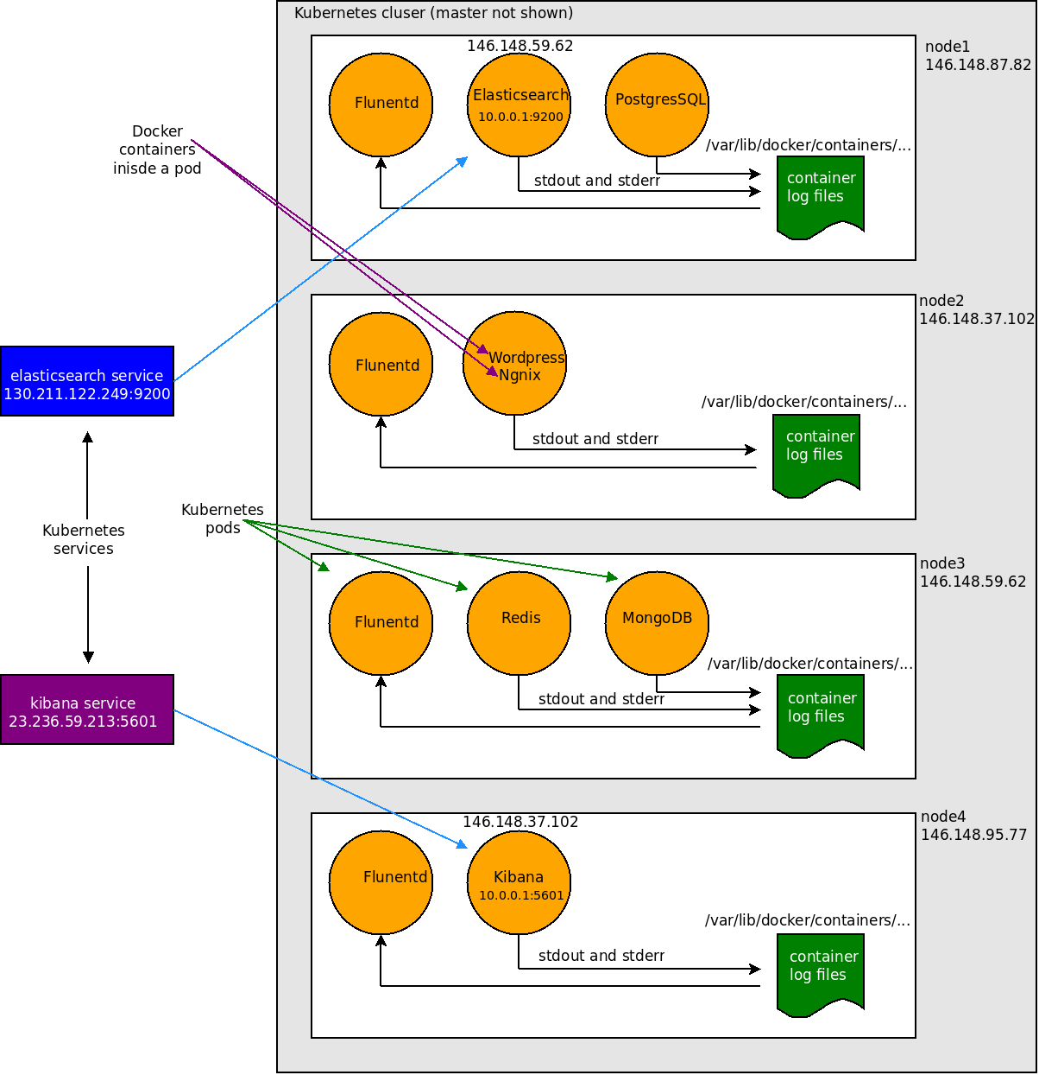
ORIGINAL GRAPHIC THAT WAS REPLACED

Slide 66
DEMO
Elasticsearch and fluentd Demo

Slide 67
Container Level Monitoring
Need visibility into the cluster as an aggregate and individually where appropriate
cAdvisor
Heapster
Influxdb/Prometheus/Graphite
Grafana
You can compare options at:
prometheus.io/docs/introduction/comparison/

Slide 68
Container Level Monitoring
Master
Storage
Backend
Node
Node
Kubelet
cAdvisor
Heapster
Kubelet
cAdvisor

Slide 69
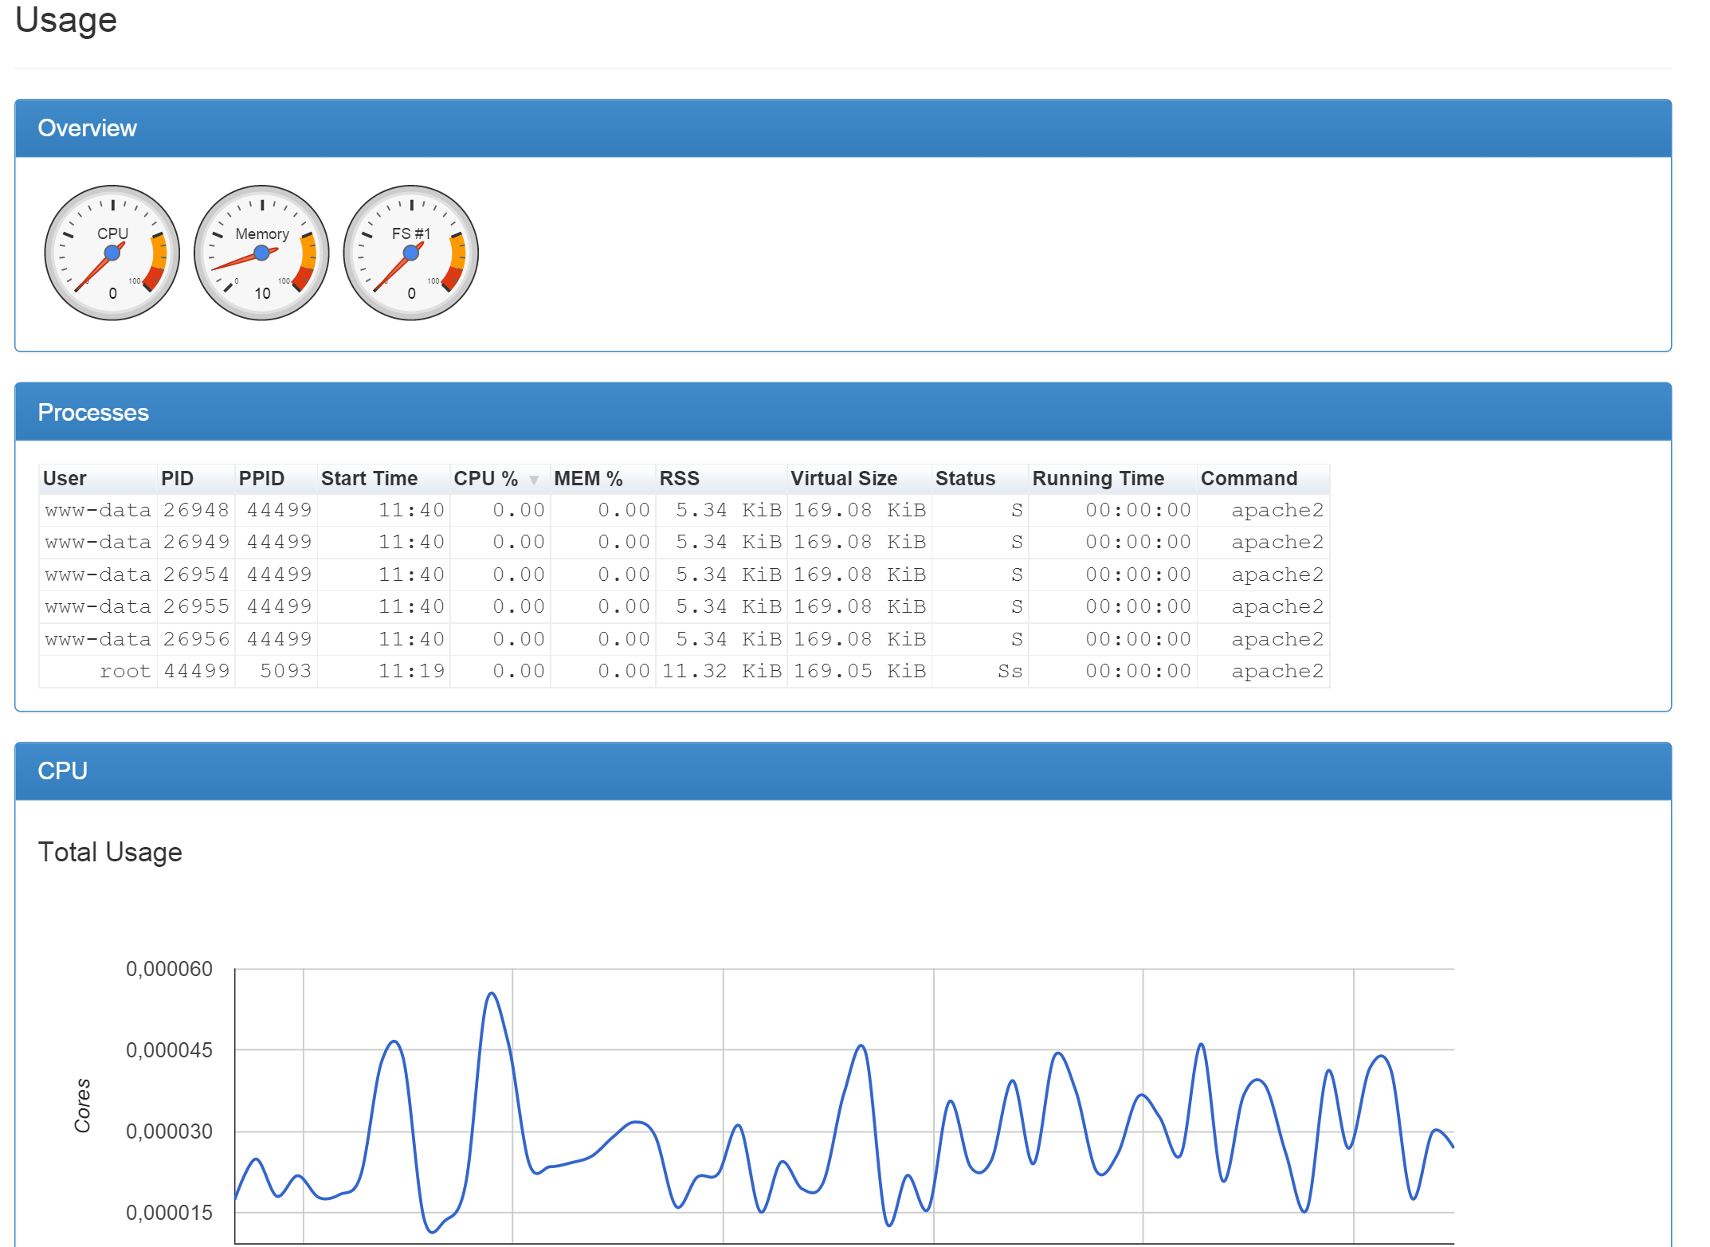
cAdvisor UI

Slide 70
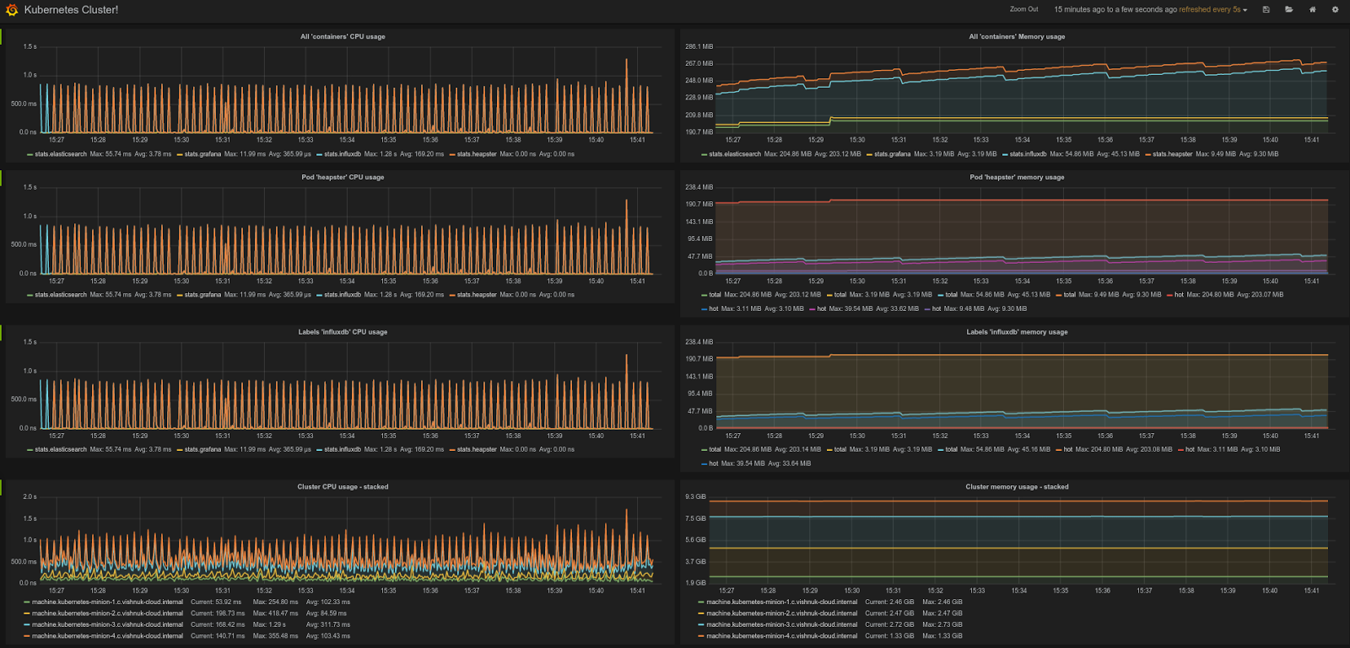
Influxdb

Slide 71
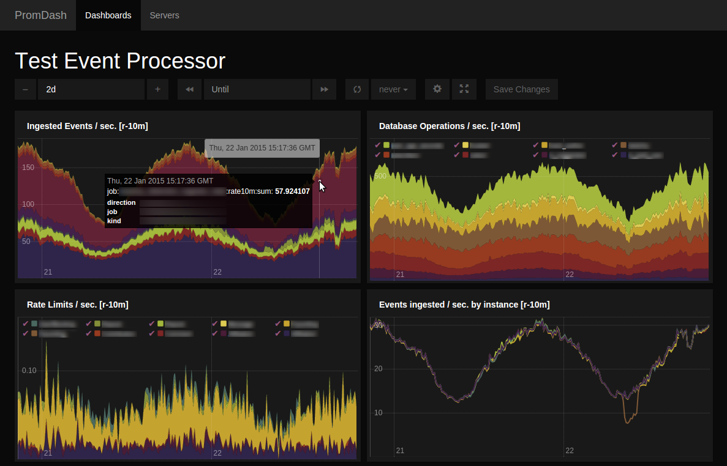
Prometheus

Slide 72
Cluster High Availability

Slide 73
High Availability
kubectl, clients, etc.
Load Balancer
3
2
1
Master Node
apiserver
4
etcd
scheduler
3
2
1
controller
manager
Podmaster
Worker
Node
kubelet
monit

Slide 74
High Availability Components
HA master nodes
An etcd datastore
Replicated, load-balanced, API server
Elected scheduler and controllers

Slide 75
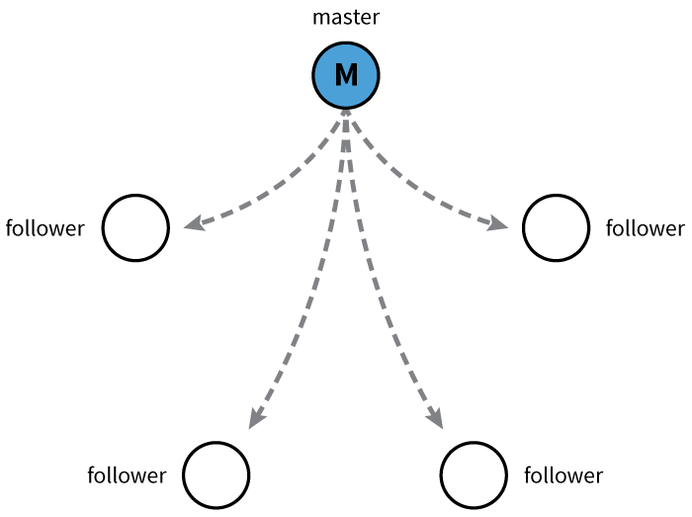
ETCD
Open source project started at CoreOS
Distributed database
CAP Theorem? == CP
Raft algorithm/protocol
Watchable
And etcd provides HA datastore

Slide 76
High Availability Components
Run kubelet on the master nodes to monitor the API server process and restart on failure
So, systemctl enables kubelet and systemctl enables docker.
Replicated etcd
Run shared storage locations for each of the etcd nodes
Network loadbalancers over the API servers
Run podmaster which coordinates a lease-lock election using etcd

Slide 77
Updating Applications - Releasing Updates
Notes:
The main argument for Deployments is a general one between the declarative and the imperative way of deploying and managing software. It applies not only on the application-level, but also on the infrastructure-level (but that’s for another post to contemplate). Note: If you are already convinced that declarative management is the way to go you can skip this chapter and jump directly into the Kubernetes Deployments concept further below.
The Imperative Way
The imperative way is usually the one you use to try out things and get to a working system. You manually tweak it and at some point it is to your liking. However, if you keep on using this imperative style for deploying and managing your software you will encounter several problems (even if you automate the steps).
The Declarative Way
The declarative way on the other hand, is what you should come up with once you go into actually deploying and managing your software in production or integrating with continuous delivery pipelines. You might have tried out stuff the imperative way before, but once you know how it should look like, you sit down and “make it official” by writing it into a declarative definition. This avoids the above-mentioned problems and even brings some added benefits.

Slide 78
Release Types
Canary release
Blue/green deployment
A/B testing
Rolling upgrade/rollback
Notes:
Canary Release is the technique that we use to “softly” deploy a new version of an application into Production. It consists of letting only a part of the audience get access to the new version of the app, while the rest still access the “old” version one. This is very useful when we want to be sure about stability in case of any changes which may be breaking, and have big side effects.

Slide 79

Canary Release
Loadbalancer
V1
V1
V1
Notes:
Lastly, Canary releases are a way of sending out a new version of your app into production that plays the role of a “canary” to get an idea of how it will perform (integrate with other apps, CPU, memory, disk usage, etc.). It’s another release strategy that can mitigate the fact that regardless of the immense level of testing you do in lower environments you will still have some bugs in production. Canary releases let you test the waters before pulling the trigger on a full release.
The faster feedback you get, the faster you can fail the deployment, or proceed cautiously. For some of the same reasons as the blue-green deployments, be careful of things above to watch out for; ie, database changes can still trip you up.

Slide 80
Canary Release with Kubernetes
App to deploy:
Existing set of apps:
Service selector:
labels:
app: guestbook
tier: frontend
track: canary
labels:
app: guestbook
tier: frontend
track: stable
selector:
app: guestbook
tier: frontend
Notes:
https://github.com/kubernetes/kubernetes/issues/11505
Can do with labels (exclude certain labels)
The point is: canary release has never been easy to be put into practice. Depending on the environment we have, it can take so long to be put in place that we often prefer to leave this away.
However, with Docker containers and Kubernetes orchestration it is quite friendly to do that. Here I am going to show how to do a small canary deployment of a new version of a dummy website using this tool.

Slide 81
Blue/Green Deployment
Reverse
Proxy
App 1
App2
DB
App3
App 1
App2
DB
App3

Slide 82
Blue/Green Deployment
Reverse
Proxy
App 1
App2
DB
App3
App 1
App2
DB
App3

Slide 83
Blue/Green Deployment with Kubernetes
Have two separate replication controllers, one blue, one green
Have labels "color=green", "color=blue”
Service selector = "color=green"
Change selector to "color=blue" to switch
Can switch back
Notes:
http://blog.christianposta.com/deploy/blue-green-deployments-a-b-testing-and-canary-releases/

Slide 84
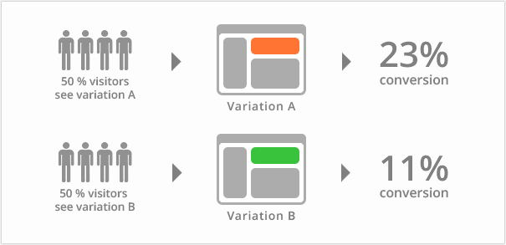
A/B Testing

Slide 85
Rolling Update
Bring up a container with the new version, same fleet of containers
Bring down one of the old version
Bring up a second container with the new version
Repeat
To be aware: potentially scaling while doing Rolling Updates

Slide 86
Rolling Update: How To
Use replication controllers to control the number of replicas at a given step
Use kubectl rolling-update
Replaces an old RC with a new RC
Must be in same namespace
Share at least one label name, different value
Example:
kubectl rolling-update frontend-v1 -f frontend-v2.json

Slide 87
Rolling Update: How To Recover
What happens if a failure is introduced part of the way through the rolling update?
Kubernetes keeps track and annotates the RC with info:
kubernetes.io/desired-replicas
The number that this replica controller needs to get to
kubernetes.io/update-partner
Who’s the other half of the replica-set
Recovery is achieved by running the same command again

Slide 88
Rolling Update: How To Recover
While size of foo-next < desired-replicas annotation on foo-next
Increase size of foo-next
If size of foo > 0 decrease size of foo
Go to Rename

Slide 89
Demo Rolling Update
NEEDS TO BE DETERMINDED
Notes:
https://kubernetes.io/docs/tasks/run-application/rolling-update-replication-controller/
ORIGNAL DEMO DOESN’T EXIST

Slide 90
Automating Generation
of Kubernetes resources for Java

Slide 91
Docker Maven Plugin
Set of maven goals for managing Docker builds and containers
Can be run as part of a CI/build step in your existing build or CI pipelines
Requires access to a Docker Daemon for builds
Can build images, start/stop containers, etc.
https://github.com/rhuss/docker-maven-plugin
Notes:
https://github.com/rhuss/docker-maven-plugin

Slide 92
Docker Maven Plugin
docker:start Create and start containers
docker:stop Stop and destroy containers
docker:build Build images
docker:watch Watch for doing rebuilds and restarts
docker:push Push images to a registry
docker:remove Remove images from local Docker host
docker:logs Show container logs

Slide 93
Docker Maven Plugin: Build
mvn package docker:build
Can build a Docker image as part of mvn lifecycle
Package files from project (build artifacts, configs, etc.) into a Docker image
Which files are selected using maven-assembly-plugin
Selected files are inserted into base image at specified location
Default /maven
See the assembly descriptor file format
Once image is built, can use maven-failsafe-plugin to run integration tests
Notes:
+ maven-assembly-plugin
https://maven.apache.org/plugins/maven-assembly-plugin/
+ See the assembly descriptor file format
https://maven.apache.org/plugins/maven-assembly-plugin/assembly.html
+ Once image is built, can use maven-failsafe-plugin to run integration tests
https://maven.apache.org/surefire/maven-failsafe-plugin/

Slide 94
Build Output
<configuration>
<images>
<image>
<alias>service</alias>
<name>jolokia/docker-demo:${project.version}</name>
<build>
<from>java:8</from>
<assembly>
<descriptor>docker-assembly.xml</descriptor>
</assembly>
<ports>
<port>8080</port>
</ports>
<cmd>
<shell>java -jar /maven/service.jar</shell>
</cmd>
</build>
...

Slide 95
Build Output
<run>
<ports>
<port>tomcat.port:8080</port>
</ports>
<wait>
<url>http://localhost:${tomcat.port}/access</url>
<time>10000</time>
</wait>
<links>
<link>database:db</link>
</links>
</run>
</image>
<image>
<alias>database</alias>
<name>postgres:9</name>
<run>
<wait>
<log>database system is ready to accept connections</log>
<time>20000</time>
</wait>
</run>
</image>
</images>
</configuration>

Slide 96
Docker Maven Plugin: Watch
Can watch for changes in project and rebuild
Rebuild Docker image
Re-start existing running container
Fast development feedback/loop
Examples:
mvn package docker:build docker:watch -Ddocker.watchMode=build
mvn docker:start docker:watch -Ddocker.watchMode=run *

Slide 97
Docker Maven Plugin: Watch
<configuration>
<!-- Check every 10 seconds by default -->
<watchInterval>10000</watchInterval>
<!-- Watch for doing rebuilds and restarts -->
<watchMode>both</watch>
<images>
<image>
<!-- Service checks every 5 seconds -->
<alias>service</alias>
....
<watch>
<interval>5000</interval>
</watch>
</image>
<image>
<!-- Database needs no watching -->
<alias>db<alias>
....
<watch>
<mode>none</mode>
</watch>
</image>
....
</images>
</configuration>

Slide 98
Fabric8 Maven Plugin
fabric8:json
fabric8:apply
fabric8:rolling
fabric8:devops
fabric8:create-routes
fabric8:recreate

Slide 99
Fabric8 Maven Plugin: JSON
Generates kubernetes.json file based on Maven settings
Can generate ReplicationController, Services, Pods
Attaches kubernetes.json and versions as part of the build
Will be included in the artifacts uploaded to artifact repo

Slide 100
JSON Options
Options:
Hand-generate your own file and let mvn coordinates be applied
Use default mvn properties and let fabric8:json generate the JSON file
Use annotation processors and typesafe DSL builders directly
Enrich the generated JSON with additional stuff

Slide 101
Fabric8 Maven Plugin: JSON
Example:
<project>
...
<properties>
<fabric8.env.FOO>bar</fabric8.env.FOO>
...
</properties>
...
</project>

Slide 102
Fabric8 Maven Plugin: JSON
docker.image
fabric8.combineDependencies
fabric8.container.name
fabric8.containerPrivileged
fabric8.env.FOO = BAR
fabric8.extra.json
fabric8.generateJson
fabric8.iconRef
fabric8.iconUrl
fabric8.iconUrlPrefix
Notes:
docker.image Used by the docker-maven-plugin to define the output docker image name.
fabric8.combineDependencies If enabled then the maven dependencies will be scanned for any dependency of <classifier>kubernetes</classifier> and <type>json</type> which are then combined into the resulting generated JSON file. See Combining JSON files
fabric8.container.name The docker container name of the application in the generated JSON. This defaults to ${project.artifactId}-container
fabric8.containerPrivileged Whether the generated container should be run in priviledged mode (defaults to false)
fabric8.env.FOO = BAR Defines the environment variable FOO and value BAR.
fabric8.extra.json Allows an extra JSON file to be merged into the generated kubernetes json file. Defaults to using the file target/classes/kubernetes-extra.json.
fabric8.generateJson If set to false then the generation of the JSON is disabled.
fabric8.iconRef Provides the resource name of the icon to use; found using the current classpath (including the ones shipped inside the maven plugin). For example icons/myicon.svg to find the icon in the src/main/resources/icons directorty. You can refer to a common set of icons by setting this option to a value of: activemq, camel, java, jetty, karaf, mule, spring-boot, tomcat, tomee, weld, wildfly
fabric8.iconUrl The URL to use to link to the icon in the generated Template.
fabric8.iconUrlPrefix The URL prefix added to the relative path of the icon file

Slide 103
Fabric8 Maven Plugin: JSON
fabric8.iconBranch
fabric8.imagePullPolicy
fabric8.imagePullPolicySnapshot
fabric8.includeAllEnvironmentVariables
fabric8.includeNamespaceEnvVar
fabric8.label.FOO = BAR
fabric8.livenessProbe.exec
fabric8.livenessProbe.httpGet.path
fabric8.livenessProbe.httpGet.port
fabric8.livenessProbe.httpGet.host
fabric8.livenessProbe.port
fabric8.namespaceEnvVar
Notes:
fabric8.iconBranch The SCM branch used when creating a URL to the icon file. The default value is master.
fabric8.imagePullPolicy Specifies the image pull policy; one of Always, Never or IfNotPresent, . Defaults to Always if the project version ends with SNAPSHOT otherwise it is left blank. On newer OpenShift / Kubernetes versions a blank value implies IfNotPresent
fabric8.imagePullPolicySnapshot Specifies the image pull policy used by default for SNAPSHOT maven versions.
fabric8.includeAllEnvironmentVariables Should the environment variable JSON Schema files, generate by the fabric-apt API plugin be discovered and included in the generated kuberentes JSON file. Defaults to true.
fabric8.includeNamespaceEnvVar Whether we should include the namespace in the containers' env vars. Defaults to true
fabric8.label.FOO = BAR Defines the kubernetes label FOO and value BAR.
fabric8.livenessProbe.exec Creates a exec action liveness probe with this command.
fabric8.livenessProbe.httpGet.path Creates a HTTP GET action liveness probe on with this path.
fabric8.livenessProbe.httpGet.port Creates a HTTP GET action liveness probe on this port.
fabric8.livenessProbe.httpGet.host Creates a HTTP GET action liveness probe on this host.
fabric8.livenessProbe.port Creates a TCP socket action liveness probe on specified port.
fabric8.namespaceEnvVar The name of the env var to add that will contain the namespace at container runtime. Defaults to KUBERNETES_NAMESPACE.

Slide 104
Fabric8 Maven Plugin: JSON
fabric8.parameter.FOO.description
fabric8.parameter.FOO.value
fabric8.port.container.FOO = 1234
fabric8.port.host.FOO = 4567
fabric8.provider
fabric8.readinessProbe.exec
fabric8.readinessProbe.httpGet.path
fabric8.readinessProbe.httpGet.port
fabric8.readinessProbe.httpGet.host
fabric8.readinessProbe.port
fabric8.replicas
fabric8.replicationController.name
Notes:
fabric8.parameter.FOO.descriptio`n Defines the description of the OpenShift template parameter FOO.
fabric8.parameter.FOO.value Defines the value of the OpenShift template parameter FOO.
fabric8.port.container.FOO = 1234 Declares that the pod’s container has a port named FOO with a container port 1234.
fabric8.port.host.FOO = 4567 Declares that the pod’s container has a port port named FOO which is mapped to host port 4567.
fabric8.provider The provider name to include in resource labels (defaults to fabric8).
fabric8.readinessProbe.exec Creates a exec action readiness probe with this command.
fabric8.readinessProbe.httpGet.path Creates a HTTP GET action readiness probe on with this path.
fabric8.readinessProbe.httpGet.port Creates a HTTP GET action readiness probe on this port.
fabric8.readinessProbe.httpGet.host Creates a HTTP GET action readiness probe on this host.
fabric8.readinessProbe.port Creates a TCP socket action readiness probe on specified port.
fabric8.replicas The number of pods to create for the Replication Controller if the plugin is generating the App JSON file.
fabric8.replicationController.name The name of the replication controller used in the generated JSON. This defaults to ${project.artifactId}-controller

Slide 105
Fabric8 Maven Plugin: Apply
Takes the kubernetes.json from fabric8:json and "applies" it to Kubernetes
Synonymous with kubectl create -f <resource
Can be applied part of mvn build/mvn lifecycle
Just configure these environment variables
KUBERNETES_MASTER - The location of the Kubernete Master
KUBERNETES_NAMESPACE - The default Namespace used on operations
Notes:
fabric8.serviceAccount The name of the service account to use in this pod (defaults to none)
fabric8.service.name The name of the Service to generate. Defaults to ${project.artifactId} (the artifact Id of the project)
fabric8.service.port The port of the Service to generate (if a kubernetes service is required).
fabric8.service.type The type of the service. Set to "LoadBalancer" if you wish an external load balancer to be created.
fabric8.service.containerPort The container port of the Service to generate (if a kubernetes service is required).
fabric8.service.protocol The protocol of the service. (If not specified then kubernetes will default it to TCP).
fabric8.service.port.<portName> The service port to generate (if a kubernetes service is required with multiple ports).
fabric8.service.containerPort.<portName> The container port to target to generate (if a kubernetes service is required with multiple ports).
fabric8.service.protocol.<portName> The protocol of this service port to generate (if a kubernetes service is required with multiple ports).
fabric8.volume.FOO.emptyDir = somemedium Defines the emtpy volume with name FOO and medium somemedium.
fabric8.volume.FOO.hostPath = /some/path Defines the host dir volume with name FOO.
fabric8.volume.FOO.mountPath = /some/path Defines the volume mount with name FOO.
fabric8.volume.FOO.readOnly Specifies whether or not a volume is read only.
fabric8.volume.FOO.secret = BAR Defines the secret name to be BAR for the FOO volume.

Slide 106
Fabric8 Maven Plugin: Apply
Example:
fabric8.apply.create
fabric8.apply.servicesOnly
fabric8.apply.ignoreServices
fabric8.apply.createRoutes
fabric8.domain
fabric8.namespace
mvn fabric8:apply -Dfabric8.recreate=true \ -Dfabric8.domain=foo.acme.com -Dfabric8.namespace=cheese
Notes:
fabric8.apply.create Should we create new resources (not in the kubernetes namespace). Defaults to true.
fabric8.apply.servicesOnly Should only services be processed. This lets you run 2 builds, process the services only first; then process non-services. Defaults to false.
fabric8.apply.ignoreServices Ignore any services in the JSON. This is useful if you wish to recreate all the ReplicationControllers and Pods but not recreate Services (which can cause PortalIP addresses to change for services which can break some Pods and could cause problems for load balancers. Defaults to false.
fabric8.apply.createRoutes If there is a route domain (see fabric8.domain) then this option will create an OpenShift Route for each service for the host expressio: ${servicename}.${fabric8.domain}. Defaults to true.
fabric8.domain The domain to expose the services as OpenShift Routes. Defaults to $KUBERNETES_DOMAIN.
fabric8.namespace Specifies the namespace (or OpenShift project name) to apply the kubernetes resources to. If not specified it will use the

Slide 107
Lab

Slide 108
End of Chapter

