Slide 1
Docker Containers
Discovering Docker Containers

Slide 2
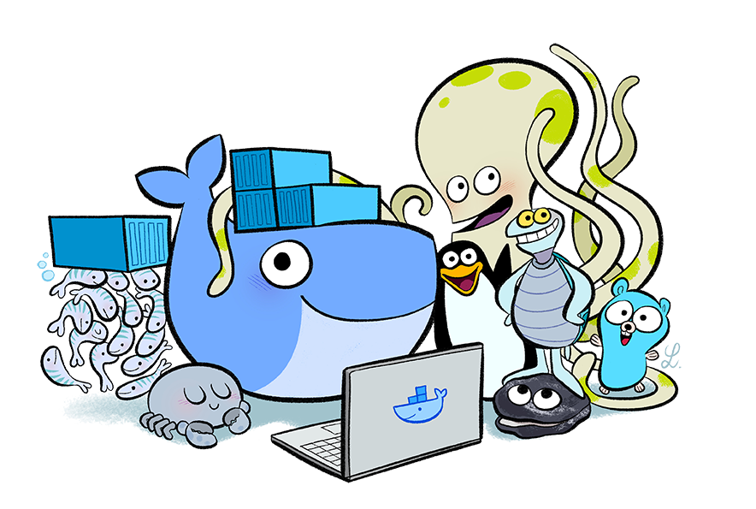
Getting to Know Each Other
Welcome!
A little about myself...
Tell me about yourself...

Slide 3

Course Agenda
Day 1
Introduction to Class
Understanding the Big Picture
Docker Containers
Application Sever in Docker Container
Docker Registry
Day 2
Docker Networking and Storage
Docker on the Cloud
Docker Hub and Registries
Dockerfile Management
Docker in Practice

Slide 4
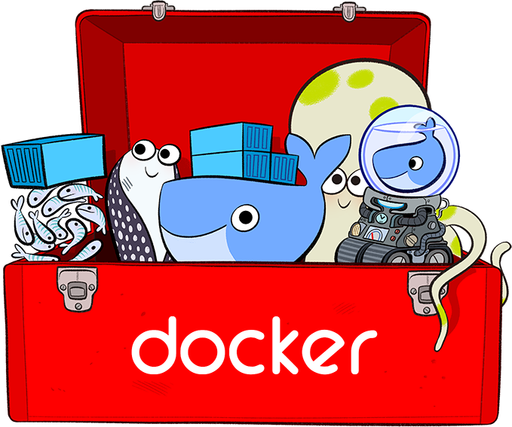
Course Logistics
Lecture Time
Lab Time
Lab Environment
Short Breaks
Time to eat!
Bathroom Breaks

