Slide 1
Docker
A Framework for Data Intensive Computing

Slide 2
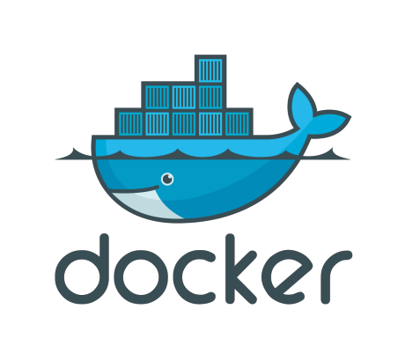
What is This Docker Thing?
A company?
A format?
An API?
Framework?
Or, maybe something in the Cloud!
Notes:
Overview
Docker is the world’s leading software container platform. Developers use Docker to eliminate “works on my machine” problems when collaborating on code with co-workers. Operators use Docker to run and manage apps side-by-side in isolated containers to get better compute density. Enterprises use Docker to build agile software delivery pipelines to ship new features faster, more securely and with confidence for both Linux and Windows Server apps.

Slide 3
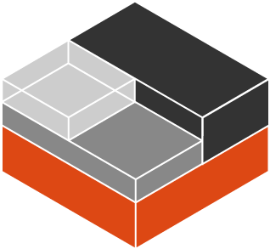
That’s Not New About Docker
Linux-native functionality
Control Groups (cgroups)
Kernel Namespaces
chroot
Linux Capabilities
Security (SELinux)

Slide 4
What Are Cgroups
Built into Kernel (RHEL7/Debian/etc)
Generically isolates resource usage (CPU, memory, disk, network)
Guarantee resources to app/set of apps
Can be adjusted on the fly
Can monitor the cgroup itself to see utilization
Notes:
Control groups
Control Groups are another key component of Linux Containers. They implement resource accounting and limiting. They provide many useful metrics, but they also help ensure that each container gets its fair share of memory, CPU, disk I/O; and, more importantly, that a single container cannot bring the system down by exhausting one of those resources.
So while they do not play a role in preventing one container from accessing or affecting the data and processes of another container, they are essential to fend off some denial-of-service attacks. They are particularly important on multi-tenant platforms, like public and private PaaS, to guarantee a consistent uptime (and performance) even when some applications start to misbehave.
Control Groups have been around for a while as well: the code was started in 2006, and initially merged in kernel 2.6.24.

Slide 5
What Are Cgroups
Wikipedia says:
“cgroups (abbreviated from control groups) is a Linux kernel feature that limits, accounts for, and isolates the resource usage (CPU, memory, disk I/O, network, etc.) of a collection of processes.“

Slide 6
Diagram of Control Groups
CPU
512 Shares
MEMORY
No Limit
NETWORK
No Limit
STORAGE
I/0
No limit
PROCESSES
Firefox-*, npmviewer.bin
CGROUP No. 1
USERS
@admin, student-1, student-2, guest

Slide 7
Kernel Namespaces
Isolating views of the system
You can make a process think it’s the only process
Built-in ways to "virtualize" a process
Wikipedia says:
“Namespaces are a feature of the Linux kernel that isolates and virtualizes system resources of a collection of processes. Examples of resources that can be virtualized include process IDs, hostnames, user IDs, network access, inter-process communication, and filesystems.”
Notes:
Kernel namespaces
Docker containers are very similar to LXC containers, and they have similar security features. When you start a container with docker run, behind the scenes Docker creates a set of namespaces and control groups for the container.
Namespaces provide the first and most straightforward form of isolation: processes running within a container cannot see, and even less affect, processes running in another container, or in the host system.

Slide 8
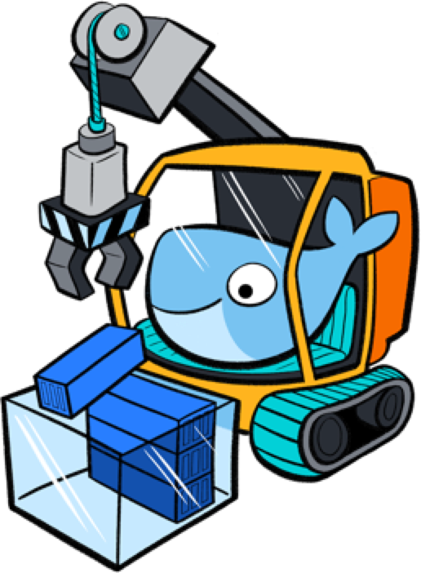
Kernel Namespaces
mnt mount points, filesystem
pid processes
net network stack
ipc inter-process comms
uts hostname
user UIDs

Slide 9
Linux capabilities
Like Linux, root has all capabilities.
Includes a fine-grained division of root's permissions for a processes.
CAP_NET_ADMIN - modify routing tables, firewalling, NAT, etc.
CAP_KILL - bypass any checks for sending the kill signals
CAP_SYS_ADMIN - mount, set hostname, etc.
Notes:
Linux kernel capabilities
By default, Docker starts containers with a restricted set of capabilities. What does that mean?
Capabilities turn the binary “root/non-root” dichotomy into a fine-grained access control system. Processes (like web servers) that just need to bind on a port below 1024 do not have to run as root: they can just be granted the net_bind_service capability instead. And there are many other capabilities, for almost all the specific areas where root privileges are usually needed.
This means a lot for container security; let’s see why!
Your average server (bare metal or virtual machine) needs to run a bunch of processes as root. Those typically include SSH, cron, syslogd; hardware management tools (e.g., load modules), network configuration tools (e.g., to handle DHCP, WPA, or VPNs), and much more. A container is very different, because almost all of those tasks are handled by the infrastructure around the container:
SSH access will typically be managed by a single server running on the Docker host;
cron, when necessary, should run as a user process, dedicated and tailored for the app that needs its scheduling service, rather than as a platform-wide facility;
log management will also typically be handed to Docker, or by third-party services like Loggly or Splunk;
hardware management is irrelevant, meaning that you never need to run udevd or equivalent daemons within containers;
network management happens outside of the containers, enforcing separation of concerns as much as possible, meaning that a container should never need to perform ifconfig, route, or ip commands (except when a container is specifically engineered to behave like a router or firewall, of course).

Slide 10
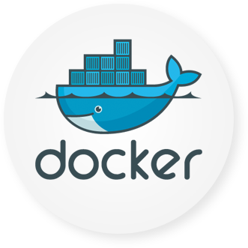
Docker Brings Together
Linux Kernel
Storage
Device Mapper
Btrfs
Aufs
Namespaces
Networking
PID
MNT
IPC
UTS
NET
veth
bridge
iptables
Cgroups
Security
cpu
cpuset
memory
device
Capability
SELinux
seccomp

Slide 11
Why is this Important?
Think about image formatting vs. golden imaging
When using API calls
Packaging
Structural separation of concerns (Devs/Ops)
Density and infrastructure utilization

Slide 12
Foundations of Docker
Writable Container
Apache
References
Parent
Image
Image
EMACS
Image
Debian
Base Image
Kernel
bootfs

Slide 13
Virtualization vs. Containerization
Virtualization
Containerization
app
lib
OS
app
lib
OS
app
lib
app
lib
namespaces
cgroups
chroots
Hypervisor
OS
OS
x86 Hardware
x86 Hardware
Notes:
Containers provide isolated runtime environments for applications: the entire user space environment is exclusively presented to the container, and any changes to it do not impact other containers’ environments. To provide this isolation, a combination of OS-based mechanisms is used: Linux name spaces are used for isolation and scoping mechanism. File system mounts define what files are accessible to the container. cgroups define resource consumption of containers. Still all containers share the same OS kernel which can realize memory footprint efficiencies when identical libraries are used by multiple containers.
With system virtualization, the hypervisor provides a full virtual machine to a guest: the entire OS image including the kernel is now dedicated to the virtual machine. CPU virtualization is used to provide each guest with an exclusive view of a full system environment, and these mechanisms also ensure isolation from other guests. Hypervisor-based management of virtual CPUs, memory and I/O devices is used to define resource consumption of guests.

Slide 14
Immutable Infrastructure
"We’ll put it back in Ansible"
Cattle vs. Pets
Don’t change it; replace it
System created fully from automation; avoid drift
Manual intervention is error prone
How does Docker help?
Notes:
Except a very few like Google that runs containers since almost 10 years, we used to/are using a server or a VM to host our web applications. Simply ask (if it’s not you) the “system” or “devops” team to install and configure whatever it is needed to run that replaces with the language you like web application. Once they finished, we can now updates the source code deployed on the server by using Capistrano or any other deployment tool. The result is that the code is updated on the web server(s).
https://www.slideshare.net/jpetazzo/immutable-infrastructure-with-docker-and-containers-gluecon-2015

Slide 15
Basic Docker Components
Docker Client
Docker Daemon
Images
Registry
Containers
Notes:
The Docker daemon can listen for Docker Remote API requests via three different types of Socket: unix, tcp, and fd.
By default, a unix domain socket (or IPC socket) is created at /var/run/docker.sock, requiring either root permission, or docker group membership.
If you need to access the Docker daemon remotely, you need to enable the tcp Socket. Beware that the default setup provides un-encrypted and un-authenticated direct access to the Docker daemon - and should be secured either using the built in HTTPS encrypted socket, or by putting a secure web proxy in front of it. You can listen on port 2375 on all network interfaces with -H tcp://0.0.0.0:2375, or on a particular network interface using its IP address: -H tcp://192.168.59.103:2375. It is conventional to use port 2375 for un-encrypted, and port 2376 for encrypted communication with the daemon.

Slide 16
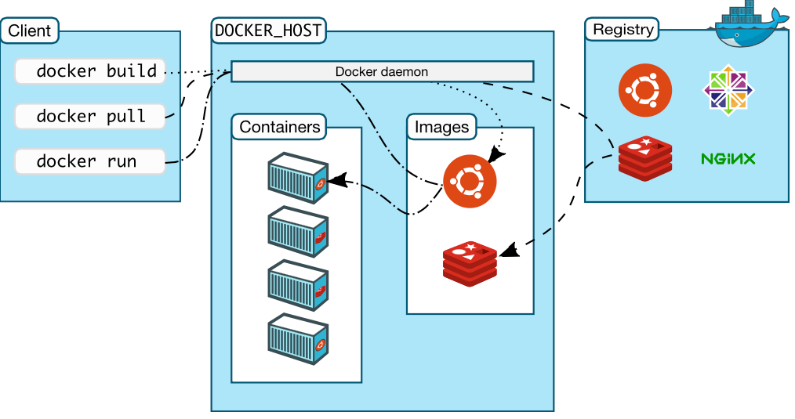
Basic Docker Components

Slide 17
Docker Images
Templates from which containers are created
Layered using union filesystems
Each change to the system is a layer added
Typically created from instructions stored in Dockerfiles
Stored in a Docker registry, locally or remotely

Slide 18
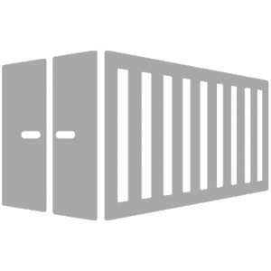
Docker Containers
Runtime instance of a Docker Image
Copy on write file system; changes localized
“Virtualized” with namespaces, cgroups, SELinux, etc.
Each has own IP address, networking, and volumes
Intended to run single process (process virtualization)
Notes:
Because your container is self-sufficient, you will just have to run the container without caring about anything else like mounting volumes, etc… That means you can share your application with your users or partners in a more easy way. A good example is the Blackfire company that shares their agent in an image that you just have todocker run.

Slide 19
Developer Workflow
Work from Vagrant image
Can trash and reboot it any time
Locally running Docker client
Source code in developer IDE
When ready, use tooling to generate Docker image, or hand craft
Run image locally - possibly with others
Push code, or image
CI process kicks in

Slide 20



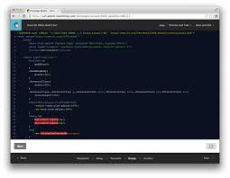

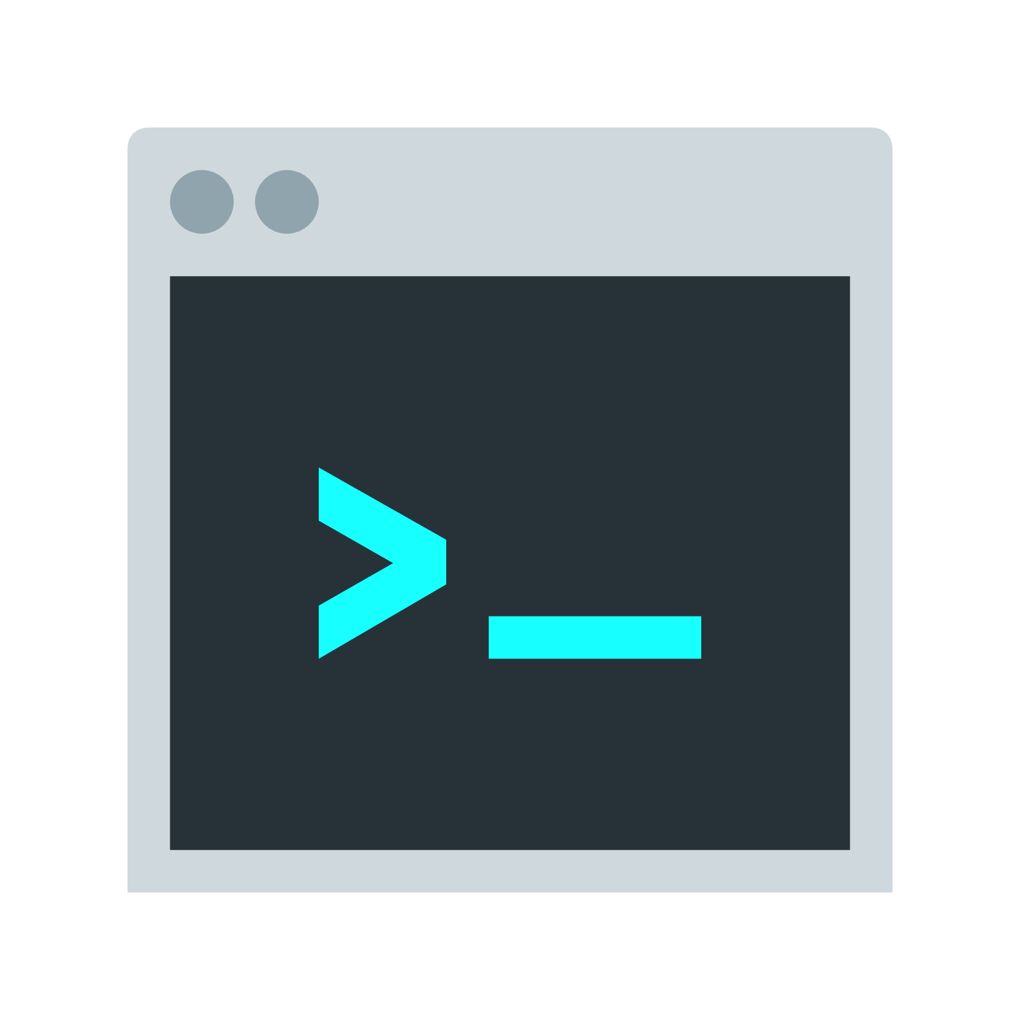
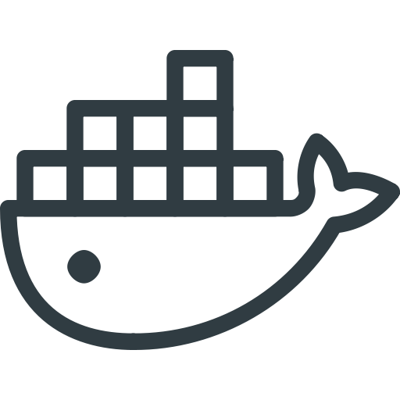
Developer Works Locally
Image
Development
Client
BUILD
Dockerfile

Slide 21
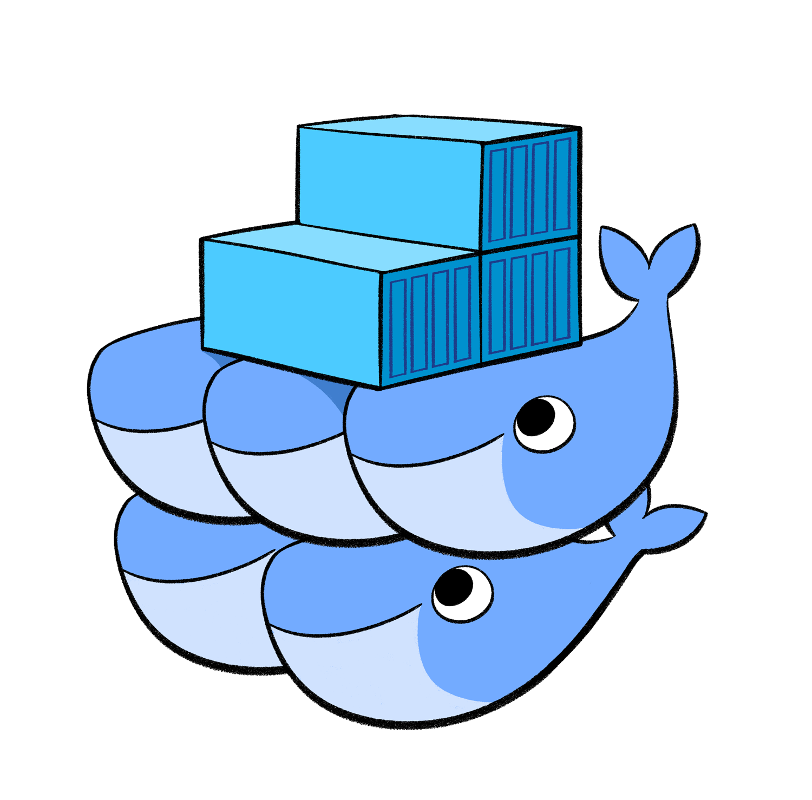


Developer Pushes Code
Development
Image
Client
BUILD
Dockerfile
Image
BUILD
Dockerfile

Slide 22
Hello Docker Container
Let’s create our first container

Slide 23

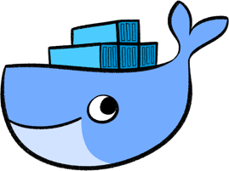
Pull a Docker Image
Let’s pull a Centos 7 image from DockerHub, like this:
Output:
docker pull centos:7
Pulling from library/centos
fa5be2806d4c: Pull complete
0cd86ce0a197: Pull complete
e9407f1d4b65: Pull complete
c9853740aa05: Pull complete
e9fa5d3a0d0e: Pull complete
Digest: sha256:xxxxxxxxxxxxx...
Status: Downloaded newer image for centos:7

Slide 24
List Docker Images
Now, let’s list all our locally installed images, like:
Output:
docker images
REPOSITORY TAG IMAGE ID CREATED VIRTUAL SIZE
centos 7 e9fa5d3a0d0e 2 days ago 172.3 MB

Slide 25
List Docker Images
We can pass the images command (-a) option to see all images, past and present:
Output:
docker images -a
REPOSITORY TAG IMAGE ID CREATED VIRTUAL SIZE
centos 7 e9fa5d3a0d0e 2 days ago 172.3 MB
<none> <none> c9853740aa05 2 days ago 172.3 MB
<none> <none> e9407f1d4b65 2 days ago 172.3 MB
<none> <none> 0cd86ce0a197 2 days ago 172.3 MB
<none> <none> fa5be2806d4c 5 weeks ago 0 B

Slide 26
Running Our First Docker Container
Here’s how we can then run a Linux command inside a Docker container:
Output:
Woah, what happened? It just printed "hello, world"? So what?
docker run –rm centos:7 echo “hello world”
hello world

Slide 27
Running Our First Docker Container
Let’s run a Linux shell inside a Docker container, from the inside:
Output:
docker run --it --rm centos:7 bash
[root@d7dfcc490cbe /]# _

Slide 28
Inside Our Container
Now from inside the Docker container itself, we’ll issue commands, like this:
Output:
# ll /etc/*-release
-rw-r--r-- 1 root root 38 Mar 31 2015 /etc/centos-release
-rw-r--r-- 1 root root 393 Mar 31 2015 /etc/os-release
lrwxrwxrwx 1 root root 14 Aug 14 21:00 /etc/redhat-release -> centos-release
lrwxrwxrwx 1 root root 14 Aug 14 21:00 /etc/system-release -> centos-release

Slide 29
Inside Our Container
We can now play around with Linux commands within the container:
If it looks like Linux and it works like Linux...
# hostname -f
# cat /etc/hosts
# ps aux
# yum -y install vim
# ip a

Slide 30
Let’s Make a Mess
Now, lets pretend we do some destructive stuff, on purpose:
And now say we delete this, too:
Now, if we tried to issue any commands, like ls, ps, or cd we’d get:
Whoops… cannot ls, cd or do anything useful anymore. What’d we’d do?
# rm –fr /usr/sbin
# rm –fr /usr/bin
bash: /usr/bin/ls: No such file or directory

Slide 31
How Easy Is Starting Over
In the last slide we pretended to destroy all our hard work.
Now, how easy is it to start over?
Just exit the container and fire up a new one:
And everything is back! Wow… right?
docker run --it --rm centos:7 bash

Slide 32
Lab

Slide 33
End of Chapter

