Slide 1
Docker Deploy an Application
A Framework for Data Intensive Computing

Slide 2
Deploy Apache Tomcat in Docker
Now let’s run a JVM based application like Apache Tomcat:
Output:
docker run --rm –p 8888:8080 tomcat:8.0
16-Oct-2016 18:30:51.541 INFO [localhost-startStop-1] org.apache.catalina.startup.HostConfig.deployDirectory Deployment of web application directory /usr/local/tomcat/webapps/manager has finished in 28 ms
16-Oct-2016 18:30:51.542 INFO [localhost-startStop-1] org.apache.catalina.startup.HostConfig.deployDirectory Deploying web application directory /usr/local/tomcat/webapps/examples
16-Oct-2016 18:30:52.108 INFO [localhost-startStop-1] org.apache.catalina.startup.HostConfig.deployDirectory Deployment of web application directory /usr/local/tomcat/webapps/examples has finished in 566 ms
16-Oct-2016 18:30:52.117 INFO [localhost-startStop-1] org.apache.catalina.startup.HostConfig.deployDirectory Deploying web application directory /usr/local/tomcat/webapps/ROOT
16-Oct-2016 18:30:52.161 INFO [localhost-startStop-1] org.apache.catalina.startup.HostConfig.deployDirectory Deployment of web application directory /usr/local/tomcat/webapps/ROOT has finished in 45 ms
16-Oct-2016 18:30:52.176 INFO [main] org.apache.coyote.AbstractProtocol.start Starting ProtocolHandler ["http-nio-8080"]
16-Oct-2016 18:30:52.206 INFO [main] org.apache.coyote.AbstractProtocol.start Starting ProtocolHandler ["ajp-nio-8009"]
16-Oct-2016 18:30:52.208 INFO [main] org.apache.catalina.startup.Catalina.start Server startup in 1589 ms

Slide 3

Understanding Tomcat
Apache Tomcat (or simply Tomcat) is an open source web server and servlet container developed by the Apache Software Foundation (ASF).
Tomcat implements the Java Servlet and the JavaServer Pages (JSP) specifications from Oracle.
It provides a "pure Java" HTTP web server environment for Java code to run in.

Slide 4
Understanding Tomcat
In the simplest config Tomcat runs in a single operating system process.
The process runs a Java virtual machine (JVM).
Every single HTTP request from a browser to Tomcat is processed in the Tomcat process in a separate thread.

Slide 5
Deploy Apache Tomcat
Let’s explore that command for a quick sec:
The option (--rm) tells Docker we want to remove the container when it’s done running.
We are exposing ports 8888:8080 with (-p), which tells Docker we want to map the container’s port 8080 to the host port of 8888
If we were to connect to http://localhost:8888 we should be able to reach our tomcat server.
docker run --rm -p 8888:8080 tomcat:8.0

Slide 6


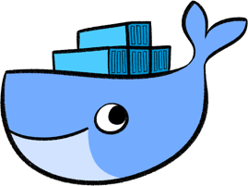
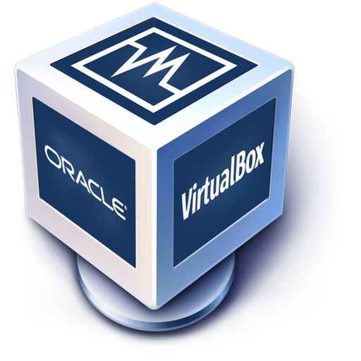
Deploy Apache Tomcat VM
If we are operating Docker from inside a VM image, there is some additional work to be done. Here’s a look at the problem:
Virtual Machine OS
Docker Host
8888
Client
8080
Tomcat
Notes:
Our Docker Host has been mapped properly, but we cannot reach it from our host (Windows/MacOSX) because the VM does not expose those ports.

Slide 7
Deploy Apache Tomcat VM
Our Docker Host has been mapped properly, but we cannot reach it from our host (Windows/MacOSX) because the VM does not expose those ports.
Virtual Machine OS
Docker Host
8888
Client
8080
Tomcat
Notes:
Our Docker Host has been mapped properly, but we cannot reach it from our host (Windows/MacOSX) because the VM does not expose those ports.

Slide 8
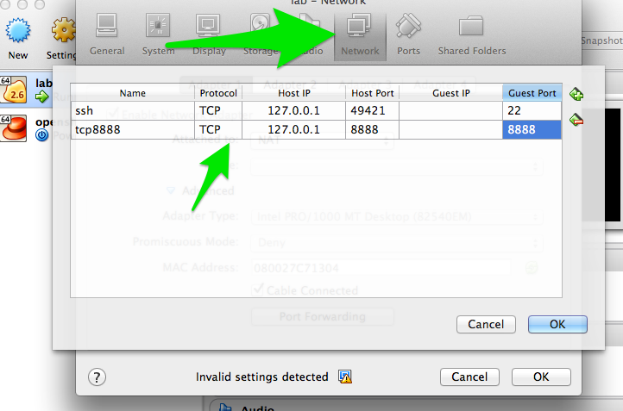
Map Ports for Tomcat VM
Enable port forwarding between the VM Host (windows/Mac) and the VM Guest (Docker host):

Slide 9
Map Ports for Tomcat
The outcome is represented in the diagram below:
Virtual Machine OS
8888
Docker Host
8888
Client
8080
Tomcat
Notes:
Exposing the ports solves the problem.

Slide 10
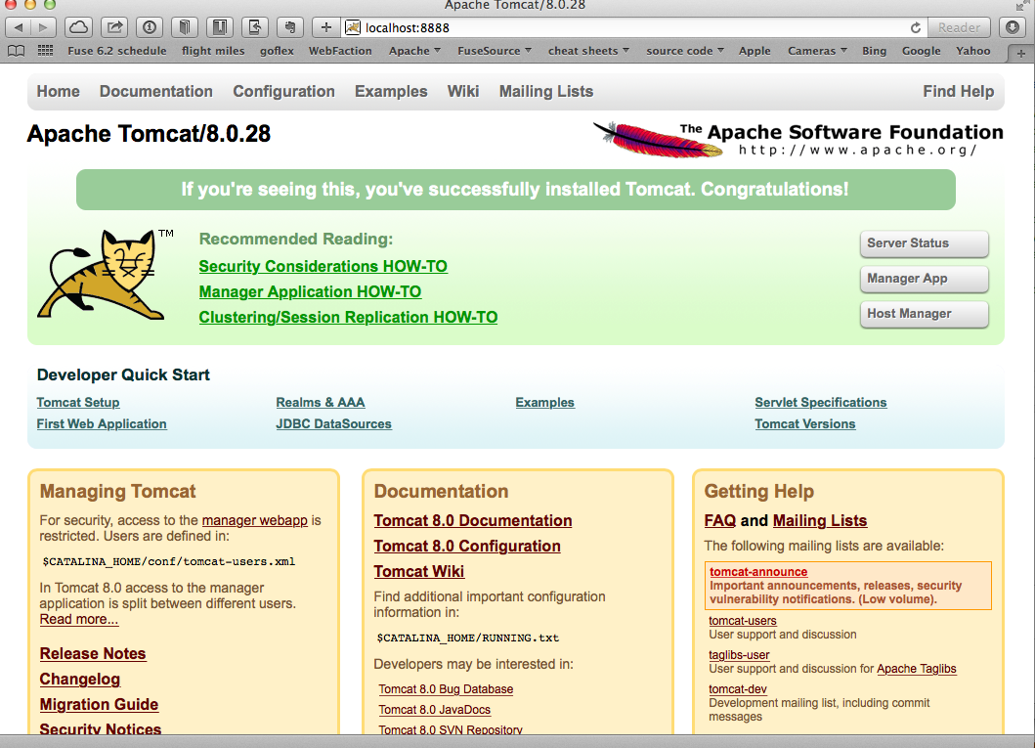
Deploy Apache Tomcat
Now, when we navigate to http://localhost:8888 in our browser, we see:
Notes:
Our Docker Host has been mapped properly, but we cannot reach it from our host (Windows/MacOSX) because the VM does not expose those ports.

Slide 11
Deploy Apache Tomcat
We now have a running container that has tomcat in it.
Let’s explore the tomcat container really quick.
Let’s fire up a new shell window and observe Tomcat’s processes, like this:
Output:
docker ps
CONTAINER ID IMAGE COMMAND
xxxxxxxxxxxx tomcat:8.0 ...
Notes:
We have a running container that has tomcat in it! WooHoo! Let’s explore the tomcat container really quick.
Fire up a new shell window (separate than the running tomcat docker container from previous)

Slide 12
Explore Inside Tomcat Container
Let’s log into the container to explore:
We should now be at the bash prompt for the tomcat container.
We can navigate around like we would normally.
docker exec –it <container_id> bash
Notes:
We have a running container that has tomcat in it! WooHoo! Let’s explore the tomcat container really quick.
Fire up a new shell window (separate than the running tomcat docker container from previous)

Slide 13
Deploy Apache Tomcat
We can exit out of the Tomcat container, like this:
If we then switch back to the other window where Tomcat is running, we can exit by issuing the CTR+C command.
We then have no containers running and we can verify that, with:
NOTE: Because of the (--rm) option, the container removed itself when finished.
# exit
docker ps -a

Slide 14
Other Useful Flags
Here are some other useful Docker run flags:
--name Gives containers a unique name
-d Runs containers in daemon mode (in the background)
--dns Gives containers a different name server from the host
-it Interactive with tty (caution using this with -d)
-e Passes in environment variables to the container
--expose Exposes ports from the Docker container
-P Exposes all published ports on containers
-p Map a specific port from the container to the host (host:container)

Slide 15
Deploy Apache Tomcat as a Daemon
Let’s use some of those previous run command-line flags and start tomcat in the background:
NOTE: We also gave this container a name, so we can refer to it by name instead of container id
docker run -d --name="tomcat8" -p 8888:8080 tomcat:8.0

Slide 16
Print Apache Tomcat Logs
With Tomcat running as a daemon (-d) in the background, we can print it’s logs, like this:
Output:
docker logs tomcat8
16-Oct-2016 19:19:20.441 INFO [localhost-startStop-1] org.apache.catalina.startup.HostConfig.deployDirectory Deployment of web application directory /usr/local/tomcat/webapps/examples has finished in 526 ms
16-Oct-2016 19:19:20.447 INFO [localhost-startStop-1] org.apache.catalina.startup.HostConfig.deployDirectory Deploying web application directory /usr/local/tomcat/webapps/ROOT
16-Oct-2016 19:19:20.507 INFO [localhost-startStop-1] org.apache.catalina.startup.HostConfig.deployDirectory Deployment of web application directory /usr/local/tomcat/webapps/ROOT has finished in 60 ms
16-Oct-2016 19:19:20.515 INFO [main] org.apache.coyote.AbstractProtocol.start Starting ProtocolHandler ["http-nio-8080"]
16-Oct-2016 19:19:20.527 INFO [main] org.apache.coyote.AbstractProtocol.start Starting ProtocolHandler ["ajp-nio-8009"]
16-Oct-2016 19:19:20.547 INFO [main] org.apache.catalina.startup.Catalina.start Server startup in 1497 ms

Slide 17
Print Apache Tomcat Processes
Let’s use a couple of interesting Docker commands with our tomcat8 container:
[Output] Instead of the normal Linux top container, it just displays the processes running in the container:
docker top tomcat8
PID USER COMMAND
5301 root /usr/bin/java -Djava.util.logging.config.file=/usr/local/tomcat/conf/logging.properties -Djava.util.logging.manager=org.apache.juli.ClassLoaderLogManager -Djava.endorsed.dirs=/usr/local/tomcat/endorsed -classpath /usr/local/tomcat/bin/bootstrap.jar:/usr/local/tomcat/bin/tomcat-juli.jar -Dcatalina.base=/usr/local/tomcat -Dcatalina.home=/usr/local/tomcat -Djava.io.tmpdir=/usr/local/tomcat/temp org.apache.catalina.startup.Bootstrap start

Slide 18
Inspect Apache Tomcat Daemon
Let’s say we want to ”inspect” tomcat8, we can do that like this:
We can also use a --format template to pick out specific info from that output :
Output:
docker inspect tomcat8
docker inspect --format='{{.Config.Env}}' tomcat8
root@server(~) $ docker inspect --format='{{.Config.Env}}' tomcat8
[PATH=/usr/local/tomcat/bin:/usr/local/sbin:/usr/local/bin:/usr/sbin:/usr/bin:/sbin:/bin LANG=C.UTF-8 JAVA_VERSION=7u79 JAVA_DEBIAN_VERSION=7u79-2.5.6-1~deb8u1 CATALINA_HOME=/usr/local/tomcat TOMCAT_MAJOR=8 TOMCAT_VERSION=8.0.28 TOMCAT_TGZ_URL=https://www.apache.org/dist/tomcat/tomcat-8/v8.0.28/bin/apache-tomcat-8.0.28.tar.gz]

Slide 19
Stop and Remove Container
When we finished, we stop the container, like this:
If we ran docker ps we wouldn’t see the container running any more.
However, docker ps -a will show all containers, even those stopped.
We can remove a container from that (-a) list, with:
docker stop tomcat
docker rm tomcat8
Notes:
Then neither docker ps nor docker ps -a should show the container.

Slide 20
Lab

Slide 21
End of Chapter

