Slide 1
Deploying Java EE Applications
A Framework for Data Intensive Computing

Slide 2
Understanding Java EE App Server
Wikipedia says: “An application server is a software framework that provides both facilities to create web applications and a server environment to run them.”
Java Platform, Enterprise Edition or Java EE (was J2EE) defines the core set of API and features of Java Application Servers.
Java application servers behave like an extended virtual machine for running applications.
It transparently handles connections to the database on one side, and, often, connections to the Web client on the other.
Open source Java application servers that support Java EE include: JOnAS from Object Web, WildFly (formerly JBoss AS) from JBoss, TomEE from Apache, and more.
Notes:
First map the ports 8080 and 9990 from the VM to your host following the steps previusly.
We will follow the similar steps we used to deploy Tomcat and will re-use the port mappings we had earlier. Verify your tomcat server is no longer running on 8888 and follow these steps:

Slide 3
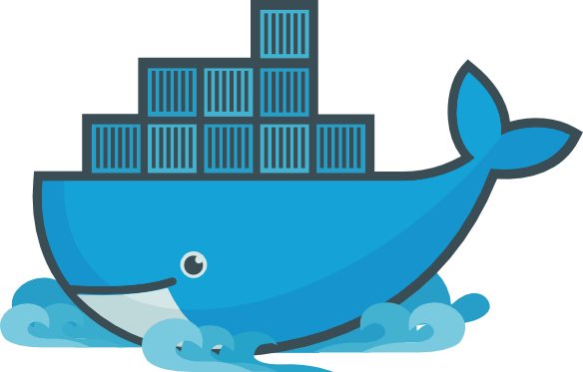
Understanding Dockerizing
Dockerizing an application is the process of converting an application to run within a Docker container.
While Dockerizing most applications is straight-forward, there are a few problems that need to be worked around each time.
Notes:
First map the ports 8080 and 9990 from the VM to your host following the steps previusly.
We will follow the similar steps we used to deploy Tomcat and will re-use the port mappings we had earlier. Verify your tomcat server is no longer running on 8888 and follow these steps:

Slide 4
Stay Mindful of the Cons
Two common problems that occur during Dockerization are:
Making an application use environment variables when it relies on configuration files.
Sending application logs to STDOUT/STDERR when it defaults to files in the container’s file system.
Remember both of these as we make our way through this course!
Notes:
First map the ports 8080 and 9990 from the VM to your host following the steps previusly.
We will follow the similar steps we used to deploy Tomcat and will re-use the port mappings we had earlier. Verify your tomcat server is no longer running on 8888 and follow these steps:

Slide 5
Deployment Preparation
First we map the ports 8080 and 9990 from the VM to your host following the steps previously discussed in the previous chapter, if needed.
We will follow the similar steps we used to deploy Tomcat and will re-use the port mappings we had earlier.
Verify your Tomcat server is no longer running on 8888.
Any containers are running, especially those that share same ports need to be stopped prior to starting more.
Notes:
First map the ports 8080 and 9990 from the VM to your host following the steps previusly.
We will follow the similar steps we used to deploy Tomcat and will re-use the port mappings we had earlier. Verify your tomcat server is no longer running on 8888 and follow these steps:

Slide 6
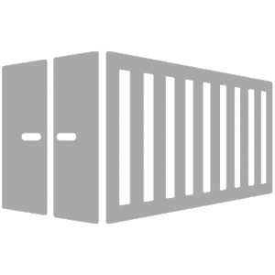
Deploying a Java EE App Server
First, we pull our image from Docker Hub:
Now, we have our image, that’s get it started and assign ports and a name:
To confirm our container is running, a name has been assigned, and the appropriate ports are functional:
docker pull arungupta/wildfly-management
docker run -d -p 9990:9990 -p 8080:8080 --name wildfly arungupta/wildfly-management
docker ps
Notes:
First map the ports 8080 and 9990 from the VM to your host following the steps previusly.
We will follow the similar steps we used to deploy Tomcat and will re-use the port mappings we had earlier. Verify your tomcat server is no longer running on 8888 and follow these steps:

Slide 7
Deploying a Java EE App Server
Navigate to http://localhost:8080 to see the main page of the server you’ve deployed.
Click "Administration Console" and login to the management console, with:
User: admin
Password: docker#admin
We can easily create a deployment, define datastorage and more.
But what’s the downsides, and is this The Docker Way?
Notes:
First map the ports 8080 and 9990 from the VM to your host following the steps previusly.
We will follow the similar steps we used to deploy Tomcat and will re-use the port mappings we had earlier. Verify your tomcat server is no longer running on 8888 and follow these steps:

Slide 8
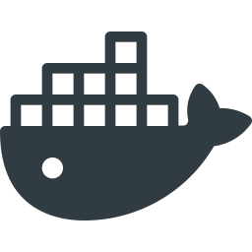
The Docker Way
Now, you can deploy applications using a platform like we just saw, but that’s not the Docker way.
The Docker way is to package up your app as a new layer on top of the app server Docker image.
Have we talked about a way to package all our components together?
We have...
Build
Run
Docker Image
Dockerfile
Container
Notes:
First map the ports 8080 and 9990 from the VM to your host following the steps previusly.
We will follow the similar steps we used to deploy Tomcat and will re-use the port mappings we had earlier. Verify your tomcat server is no longer running on 8888 and follow these steps:

Slide 9

WildFly
Now, with the WildFly server you can deploy your application in multiple ways:
You can use CLI
You can use the web console
You can use the management API directly
You can use the deployment scanner
Notes:
First map the ports 8080 and 9990 from the VM to your host following the steps previusly.
We will follow the similar steps we used to deploy Tomcat and will re-use the port mappings we had earlier. Verify your tomcat server is no longer running on 8888 and follow these steps:

Slide 10
Dockerfile WildFly Deployment
The most popular way of deploying an application is using the deployment scanner.
In WildFly this method is enabled by default and the only thing you need to do is to place your application inside of the deployments/ directory.
.Pick /opt/jboss/wildfly/standalone/deployments/ or /opt/jboss/wildfly/domain/deployments/ depending on which mode you choose.
Remember, standalone is default in the jboss/wildfly image -- see above.
Notes:
First map the ports 8080 and 9990 from the VM to your host following the steps previusly.
We will follow the similar steps we used to deploy Tomcat and will re-use the port mappings we had earlier. Verify your tomcat server is no longer running on 8888 and follow these steps:

Slide 11
Dockerfile Wildfly Deployment
The simplest and cleanest way to deploy an application to WildFly, is to use the deployment scanner method.
To do this you just need to extend the jboss/wildfly image by creating a new one.
Place your application inside the deployments/ directory with the ADD command.
NOTE: You can also do the changes to the configuration (if any) as additional steps (RUN command).
Notes:
First map the ports 8080 and 9990 from the VM to your host following the steps previusly.
We will follow the similar steps we used to deploy Tomcat and will re-use the port mappings we had earlier. Verify your tomcat server is no longer running on 8888 and follow these steps:

Slide 12
Dockerfile Wildfly Deployment
A simple example of how this might look is:
Create Dockerfile with following content:
FROM jboss/wildfly
ADD your-awesome-app.war /opt/jboss/wildfly/standalone/deployments/
Place your your-awesome-app.war file in the same directory as your Dockerfile.
Run the build with docker build --tag=wildfly-app .
Run the container with docker run -it wildfly-app.
Application will be deployed on the container boot.
Notes:
First map the ports 8080 and 9990 from the VM to your host following the steps previusly.
We will follow the similar steps we used to deploy Tomcat and will re-use the port mappings we had earlier. Verify your tomcat server is no longer running on 8888 and follow these steps:

Slide 13
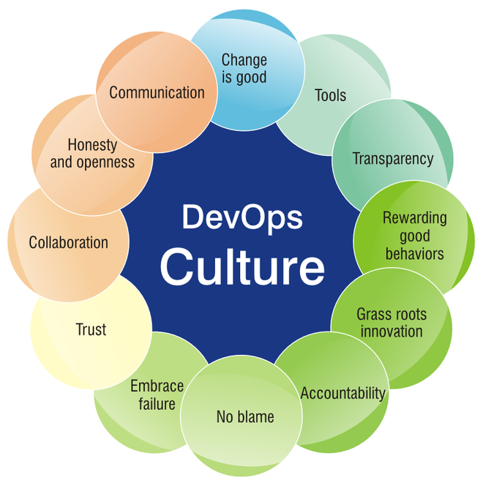
Dockerizing Benefits
This way of deployment is great because of a few things:
It utilizes Docker as the build tool providing stable builds
Rebuilding image this way is very fast
You only need to do changes to the base WildFly image that are required to run your application
So much of is DevOps, and DevOps is very philosophical in nature.
Notes:
First map the ports 8080 and 9990 from the VM to your host following the steps previusly.
We will follow the similar steps we used to deploy Tomcat and will re-use the port mappings we had earlier. Verify your tomcat server is no longer running on 8888 and follow these steps:

Slide 14
Ticket Monster Running on WildFly
Let’s look at an example that puts it all together:
# Use latest jboss/wildfly
FROM jboss/wildfly:latest
#Create admin user
RUN /opt/jboss/wildfly/bin/add-user.sh -u admin -p docker#admin --silent
# Add customization folder
COPY customization /opt/jboss/wildfly/customization/
USER root
# Run customization scripts as root
RUN chmod +x /opt/jboss/wildfly/customization/execute.sh
RUN /opt/jboss/wildfly/customization/execute.sh standalone standalone-ha.xml
...
Notes:
As discussed earlier, the "Docker way" is to package up your app as a new layer on top of the app server Docker image: Let’s look at an example Dockerfile:

Slide 15
Ticket Monster Running on WildFly
...
ADD ticket-monster.war /opt/jboss/wildfly/standalone/deployments/
# Fix for Error:
# Could not rename /opt/jboss/wildfly/standalone/configuration/standalone_xml_history/current
RUN rm -rf /opt/jboss/wildfly/standalone/configuration/standalone_xml_history
RUN chown -R jboss:jboss /opt/jboss/wildfly/
USER jboss
# Expose the ports we're interested in
EXPOSE 8080 9990
# Set the default command to run on boot
# This will boot WildFly in the standalone mode and bind to external interface and enable HA
CMD /opt/jboss/wildfly/bin/standalone.sh -b `hostname -i` -bmanagement `hostname -i`
-c standalone-ha.xml
Notes:
As discussed earlier, the "Docker way" is to package up your app as a new layer on top of the app server Docker image: Let’s look at an example Dockerfile:

Slide 16
Deploying Ticket Monster
Deploy the application. First stop and remove the previous wildfly deployment:
Now run the new app:
Now you could navigate to http://localhost:8080/movieplex7 to see the Java EE application
docker stop wildfly
docker rm wildfly
docker run -d -p 9990:9990 -p 8080:8080 --name wildfly arungupta/javaee7-hol

Slide 17
Extending an Image
To create a management user to access the administration console create a Dockerfile with the following content:
Then you can build the image:
Run it:
FROM jboss/wildfly
RUN /opt/jboss/wildfly/bin/add-user.sh admin Admin#70365 --silent
CMD ["/opt/jboss/wildfly/bin/standalone.sh", "-b", "0.0.0.0", "-bmanagement", "0.0.0.0"]
docker build --tag=jboss/wildfly-admin .
docker run -it -p 9990:9990 jboss/wildfly-admin
Notes:
First map the ports 8080 and 9990 from the VM to your host following the steps previusly.
We will follow the similar steps we used to deploy Tomcat and will re-use the port mappings we had earlier. Verify your tomcat server is no longer running on 8888 and follow these steps:

Slide 18
Lab

Slide 19
End of Chapter

