Slide 1
Docker Machine
Starting our virtual machines

Slide 2
Docker Machine Overview
Docker Machine is a tool that lets you install Docker Engine on virtual hosts, and manage the hosts with docker-machine commands.
You can use Machine to create Docker hosts on your local Mac or Windows box.
Also, on your company network, in your data center, or on cloud providers like AWS or Digital Ocean.
Notes:
We have two good ways to group components for development purposes and then clean them up when you want to start over.
This approach works fine for local development and grouping. In shared environments the best approach is to properly label your components (services, RCs, pods, etc) and delete them using labels, as above.

Slide 3
Docker Machine Overview
Using docker-machine commands, you can:
Start
Inspect
Stop
Restart a managed host
Upgrade the Docker client and daemon
Configure a Docker client to talk to your host.
Notes:
We have two good ways to group components for development purposes and then clean them up when you want to start over.
This approach works fine for local development and grouping. In shared environments the best approach is to properly label your components (services, RCs, pods, etc) and delete them using labels, as above.

Slide 4
Setting Machine Environment
Point the Machine CLI at a running, managed host, and you can run docker commands directly on that host.
For example, run docker-machine env default to point to a host called default.
NOTE: You may have to name the VM specifically, like this:
docker-machine env <name>
Notes:
We have two good ways to group components for development purposes and then clean them up when you want to start over.
This approach works fine for local development and grouping. In shared environments the best approach is to properly label your components (services, RCs, pods, etc) and delete them using labels, as above.

Slide 5
Setting Machine Environment
Once you follow the on-screen instructions to complete the env setup, you can run docker ps, docker run hello-world, and so forth.
Output:
export DOCKER_TLS_VERIFY="1"
export DOCKER_HOST="tcp://XXX.XXX.XX.XXX:XXXX"
export DOCKER_CERT_PATH= <PATH>
export DOCKER_MACHINE_NAME= <NAME>
# Run this command to configure your shell:
# eval $(docker-machine env dev)
Notes:
We have two good ways to group components for development purposes and then clean them up when you want to start over.
This approach works fine for local development and grouping. In shared environments the best approach is to properly label your components (services, RCs, pods, etc) and delete them using labels, as above.

Slide 6

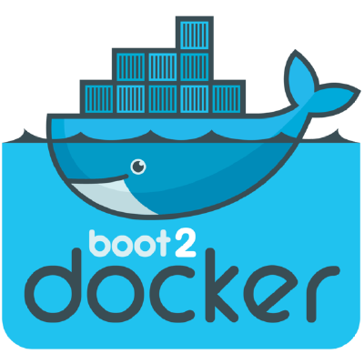
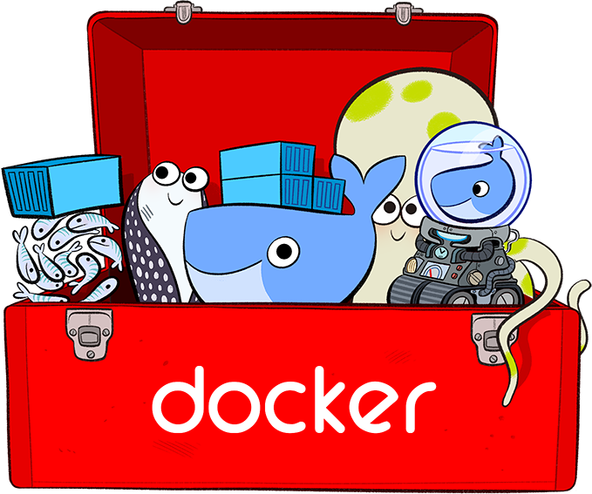
The Good Old Days
Machine was the only way to run Docker on Mac or Windows previous to Docker v1.12.
Docker for Mac & Docker for Windows are available as native apps now and are the better choice for this use case on newer desktops and laptops.
The installers for Docker for Mac and Docker for Windows include Docker Machine, along with Docker Compose.
So, no more need for confusion.
Notes:
We have two good ways to group components for development purposes and then clean them up when you want to start over.
This approach works fine for local development and grouping. In shared environments the best approach is to properly label your components (services, RCs, pods, etc) and delete them using labels, as above.

Slide 7
Why Use It, Now?
Docker Machine enables you to provision multiple remote Docker hosts on various flavors of Linux.
Additionally, Machine allows you to run Docker on older Mac or Windows systems, as described in the previous topic.
Basically, Docker Machine has two broad use cases:
Notes:
We have two good ways to group components for development purposes and then clean them up when you want to start over.
This approach works fine for local development and grouping. In shared environments the best approach is to properly label your components (services, RCs, pods, etc) and delete them using labels, as above.

Slide 8

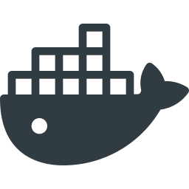
Why Use It, Now?
#1 - You own an older desktop system and want to run Docker on Mac or Windows
docker –version
docker run hello-world
...
docker –version
docker run hello-world
...
Docker Machine for Mac
Docker Machine for Windows
Notes:
We have two good ways to group components for development purposes and then clean them up when you want to start over.
This approach works fine for local development and grouping. In shared environments the best approach is to properly label your components (services, RCs, pods, etc) and delete them using labels, as above.

Slide 9
The Older Desktop Option
If the computer doesn’t meet the requirements for DockerforMac and Docker for Windows apps, then you need Docker Machine in order to run Docker Engine locally.
Installing Docker Machine on a Mac or Windows box with the Docker Toolbox installer, provisions a local virtual machine with Docker Engine.
This gives you the ability to connect it, and run docker commands.
Notes:
We have two good ways to group components for development purposes and then clean them up when you want to start over.
This approach works fine for local development and grouping. In shared environments the best approach is to properly label your components (services, RCs, pods, etc) and delete them using labels, as above.

Slide 10

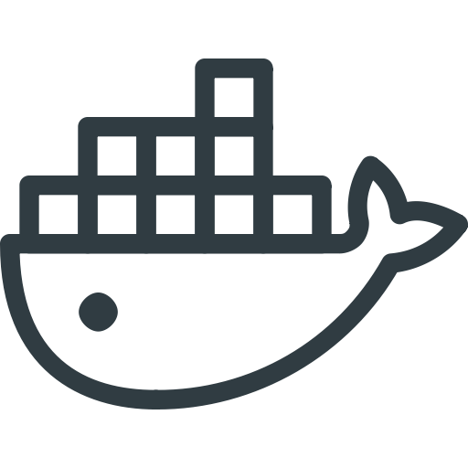

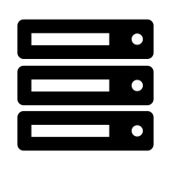
Why Use It, Now?
#2 - You want to provision Docker hosts on remote systems
...
...
docker <command>
...
Notes:
We have two good ways to group components for development purposes and then clean them up when you want to start over.
This approach works fine for local development and grouping. In shared environments the best approach is to properly label your components (services, RCs, pods, etc) and delete them using labels, as above.

Slide 11
Remote Host Option
Rememeber, Docker Engine runs natively on Linux systems.
If you have a Linux box as your primary system, and want to run Docker commands, all you need to do is download and install Docker Engine.
However, if you want an efficient way to provision multiple Docker hosts on a network, in the cloud or even locally, you need Docker Machine.
Notes:
We have two good ways to group components for development purposes and then clean them up when you want to start over.
This approach works fine for local development and grouping. In shared environments the best approach is to properly label your components (services, RCs, pods, etc) and delete them using labels, as above.

Slide 12
Remote Host Option
Whether your primary system is Mac, Windows, or Linux, you can install Docker Machine on it and use docker-machine commands to provision and manage large numbers of Docker hosts.
Machine automatically creates hosts, installs Docker Engine on them, then configures the Docker clients. Each managed host (machine) is the combination of a Docker host and a configured client.
Notes:
We have two good ways to group components for development purposes and then clean them up when you want to start over.
This approach works fine for local development and grouping. In shared environments the best approach is to properly label your components (services, RCs, pods, etc) and delete them using labels, as above.

Slide 13
Docker Engine vs. Docker Machine
When people say “Docker” they typically mean Docker Engine
Engine, the client-server application consist of:
the Docker daemon
a REST API that specifies interfaces for interacting with the daemon
a command line interface (CLI) client that talks to the daemon (through the REST API wrapper)
Client
docker CLI
REST API
Server
docker daemon
Notes:
We have two good ways to group components for development purposes and then clean them up when you want to start over.
This approach works fine for local development and grouping. In shared environments the best approach is to properly label your components (services, RCs, pods, etc) and delete them using labels, as above.

Slide 14
Docker Engine vs. Docker Machine
Docker Engine accepts docker commands from the CLI, such as docker run <image>, docker ps to list running containers, docker images to list images, and so on
Docker Machine is a tool for provisioning and managing your Dockerized hosts (hosts with Docker Engine on them).
Typically, you install Docker Machine on your local system. Docker Machine has its own command line client docker-machine
You can use Machine to install Docker Engine on one or more virtual systems. These virtual systems can be local (as when you use Machine to install and run Docker Engine in VirtualBox on Mac or Windows) or remote (as when you use Machine to provision Dockerized hosts on cloud providers). The Dockerized hosts themselves can be thought of, and are sometimes referred to as, managed “machines”.
Notes:
We have two good ways to group components for development purposes and then clean them up when you want to start over.
This approach works fine for local development and grouping. In shared environments the best approach is to properly label your components (services, RCs, pods, etc) and delete them using labels, as above.

Slide 15
Docker Engine vs. Docker Machine
Docker Engine accepts docker commands from the CLI, such as docker run <image>, docker ps to list running containers, docker images to list images, and so on
Docker Machine is a tool for provisioning and managing your Dockerized hosts (hosts with Docker Engine on them).
Typically, you install Docker Machine on your local system. Docker Machine has its own command line client docker-machine
Notes:
We have two good ways to group components for development purposes and then clean them up when you want to start over.
This approach works fine for local development and grouping. In shared environments the best approach is to properly label your components (services, RCs, pods, etc) and delete them using labels, as above.

Slide 16
Docker Engine vs. Docker Machine
You can use Machine to install Docker Engine on one or more virtual systems.
Virtual systems can be local (as when you use Machine to install and run Docker Engine in VirtualBox on Mac or Windows)
Or, they can be remote (as when you use Machine to provision Dockerized hosts on cloud providers).
The Dockerized hosts themselves can be thought of, and are sometimes referred to as, managed “machines”.
Notes:
We have two good ways to group components for development purposes and then clean them up when you want to start over.
This approach works fine for local development and grouping. In shared environments the best approach is to properly label your components (services, RCs, pods, etc) and delete them using labels, as above.

Slide 17
Remote Machine Host Diagram
Client
docker-machine
REST API
Client
docker CLI
server
docker daemon
REST API
docker-machine create
...
...
docker run <image>
Notes:
We have two good ways to group components for development purposes and then clean them up when you want to start over.
This approach works fine for local development and grouping. In shared environments the best approach is to properly label your components (services, RCs, pods, etc) and delete them using labels, as above.

Slide 18
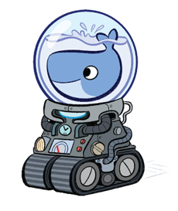
Getting Started Using Local VM
Let’s take a look at using docker-machine to create, use and manage a Docker host inside of a local virtual machine.
Notes:
We have two good ways to group components for development purposes and then clean them up when you want to start over.
This approach works fine for local development and grouping. In shared environments the best approach is to properly label your components (services, RCs, pods, etc) and delete them using labels, as above.

Slide 19
Docker Machine Rust
With the advent of Docker for Mac and Docker for Windows as replacements for Docker Toolbox, we recommend that you use these for your primary Docker workflows.
You can use these applications to run Docker natively on your local system without using Docker Machine at all.
Notes:
We have two good ways to group components for development purposes and then clean them up when you want to start over.
This approach works fine for local development and grouping. In shared environments the best approach is to properly label your components (services, RCs, pods, etc) and delete them using labels, as above.

Slide 20
Docker Machine Rust
However, if you want to create multiple local machines, you still need Docker Machine to create and manage machines for multi-node experimentation.
Both Docker for Mac and Docker for Windows include the newest version of Docker Machine, so when you install either of these, you get docker-machine.
Notes:
We have two good ways to group components for development purposes and then clean them up when you want to start over.
This approach works fine for local development and grouping. In shared environments the best approach is to properly label your components (services, RCs, pods, etc) and delete them using labels, as above.

Slide 21
Prerequisite Information
Keep the following considerations in mind when using Machine to create local VMs.
Docker for Windows - You can use docker-machine create with the hyperv driver to create additional local machines.
Docker for Mac - You can use docker-machine create with the virtualbox driver to create additional local machines.
Notes:
We have two good ways to group components for development purposes and then clean them up when you want to start over.
This approach works fine for local development and grouping. In shared environments the best approach is to properly label your components (services, RCs, pods, etc) and delete them using labels, as above.

Slide 22
Windows Prerequisite Information
Docker for Windows
Docker for Windows uses Microsoft Hyper-V for virtualization, and Hyper-V is not compatible with Oracle VirtualBox.
Therefore, you cannot run the two solutions simultaneously.
But you can still use docker-machine to create more local VMs by using the Microsoft Hyper-V driver.
Notes:
We have two good ways to group components for development purposes and then clean them up when you want to start over.
This approach works fine for local development and grouping. In shared environments the best approach is to properly label your components (services, RCs, pods, etc) and delete them using labels, as above.

Slide 23
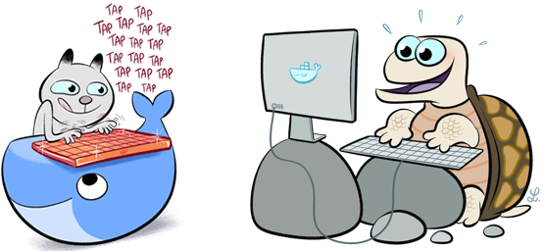
Mac Prerequisite Information
Docker for Mac
Docker for Mac uses HyperKit, a lightweight macOS virtualization solution built on top of the Hypervisor.framework in macOS 10.10 Yosemite and higher.
Currently, there is no docker-machine create driver for HyperKit, so you will use virtualbox driver to create local machines.
You can run both HyperKit and Oracle VirtualBox on the same system.
Notes:
We have two good ways to group components for development purposes and then clean them up when you want to start over.
This approach works fine for local development and grouping. In shared environments the best approach is to properly label your components (services, RCs, pods, etc) and delete them using labels, as above.

Slide 24
Running Containers
To run a Docker container, you:
Create a new (or start an existing) Docker virtual machine.
Switch your environment to your new VM.
Use the docker client to create, load, and manage containers.
Once you create a machine, you can reuse it as often as you like.
Like any VirtualBox VM, it maintains its configuration between uses.
The examples here show how to create and start a machine, run Docker commands, and work with containers.
docker node ls
ID HOSTNAME STATUS AVAILABILITY MANAGER STATUS5re1humv246m6clujn0zng9jy docker Ready Activerbavg04vwiijyzzjwdjoc3io2 * docker Ready Active Leader
Notes:
We have two good ways to group components for development purposes and then clean them up when you want to start over.
This approach works fine for local development and grouping. In shared environments the best approach is to properly label your components (services, RCs, pods, etc) and delete them using labels, as above.

Slide 25
Machine Containers Example
Let’s look at how to create a new container, using Docker Machine.
First, open a command shell or terminal window.
Use docker-machine ls to list available machines:
Output (No machines have been created):
docker-machine ls
NAME ACTIVE DRIVER STATE URL SWARM DOCKER ERRORS
Notes:
We have two good ways to group components for development purposes and then clean them up when you want to start over.
This approach works fine for local development and grouping. In shared environments the best approach is to properly label your components (services, RCs, pods, etc) and delete them using labels, as above.

Slide 26
Machine Containers Example
To create a Machine, we’d need to start by following the steps below:
Run docker-machine create <command>
Pass the appropriate driver to the --driver flag and provide a machine name.
If this is your first machine, name it default as shown in the example.
If you already have a “default” machine, choose another name for this new machine.
If you are using Docker for Mac, use virtualbox as the driver, as shown in this example.
On Docker for Windows systems that support Hyper-V, use the hyperv driver
Notes:
We have two good ways to group components for development purposes and then clean them up when you want to start over.
This approach works fine for local development and grouping. In shared environments the best approach is to properly label your components (services, RCs, pods, etc) and delete them using labels, as above.

Slide 27
Creating a New Machine
So, our command should look something like this:
Output:
This downloads a lightweight Linux distribution boot2docker, with the Docker daemon installed, pluscreates and starts a VirtualBox.
docker-machine create --driver virtualbox default
Running pre-create checks...
Creating machine...
...
Notes:
We have two good ways to group components for development purposes and then clean them up when you want to start over.
This approach works fine for local development and grouping. In shared environments the best approach is to properly label your components (services, RCs, pods, etc) and delete them using labels, as above.

Slide 28
Print Newly Created Machine
To list available machines, we want to use docker-machine ls again.
This time we should find our container listed.
Output:
NAME ACTIVE DRIVER STATE URL ...
default * virtualbox Running tcp://XXX.XXX.XX.XXX:XXXX ...
Notes:
We have two good ways to group components for development purposes and then clean them up when you want to start over.
This approach works fine for local development and grouping. In shared environments the best approach is to properly label your components (services, RCs, pods, etc) and delete them using labels, as above.

Slide 29
Get Docker Machine Env Varibles
Let’s look at the environment variable for your new VM.
To do that, we will use the following command:
Output:
docker-machine env <machine-name>
export DOCKER_TLS_VERIFY=“..."
export DOCKER_HOST=“..."
export DOCKER_CERT_PATH=“..."
export DOCKER_MACHINE_NAME=“..."
# Run this command to configure your shell:
# eval "$(docker-machine env default)"
Notes:
We have two good ways to group components for development purposes and then clean them up when you want to start over.
This approach works fine for local development and grouping. In shared environments the best approach is to properly label your components (services, RCs, pods, etc) and delete them using labels, as above.

Slide 30
Connecting Env Settings
Now, we need to connect our shell to the new machine.
We’ll use the following command, which can be found in the output:
Okay! Now, our environment variables are set for the current shell that the Docker client will read which specify the TLS settings.
You need to do this each time you open a new shell or restart your machine.
You can now run Docker commands on this host.
eval "$(docker-machine env default)"
Notes:
We have two good ways to group components for development purposes and then clean them up when you want to start over.
This approach works fine for local development and grouping. In shared environments the best approach is to properly label your components (services, RCs, pods, etc) and delete them using labels, as above.

Slide 31
Experiment With Machine Containers
Run a container with docker run to verify your set up.
Use docker run to download and run busybox with a simple echo command, like this:
Output:
docker run busybox echo hello world
Unable to find image 'busybox' locally
Pulling repository busybox
e72ac664f4f0: Download complete
511136ea3c5a: Download complete
df7546f9f060: Download complete
e433a6c5b276: Download complete
hello world
Notes:
We have two good ways to group components for development purposes and then clean them up when you want to start over.
This approach works fine for local development and grouping. In shared environments the best approach is to properly label your components (services, RCs, pods, etc) and delete them using labels, as above.

Slide 32
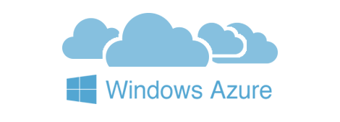

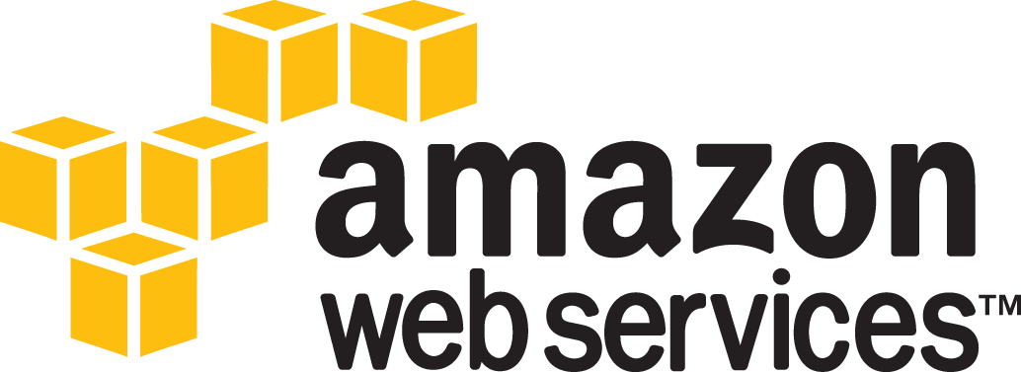
Introducing Machine Cloud Drivers
When you install Docker Machine, you get a set of drivers for various cloud providers.
Also available, Docker Machine driver plugins for use with other cloud platforms are available from 3rd party contributors.
NOTE: These are use-at-your-own-risk plugins, not maintained by or formally associated with Docker.
Notes:
We have two good ways to group components for development purposes and then clean them up when you want to start over.
This approach works fine for local development and grouping. In shared environments the best approach is to properly label your components (services, RCs, pods, etc) and delete them using labels, as above.

Slide 33
Exploring the Cloud
Docker Machine driver plugins are available for many cloud platforms, so you can use Machine to provision cloud hosts.
When you use Docker Machine for provisioning, you create cloud hosts with Docker Engine installed on them.
We’ll need to create an account with the cloud provider.
Notes:
We have two good ways to group components for development purposes and then clean them up when you want to start over.
This approach works fine for local development and grouping. In shared environments the best approach is to properly label your components (services, RCs, pods, etc) and delete them using labels, as above.

Slide 34
Exploring the Cloud
We will provide account verification, security credentials, and configuration options for the providers as flags to docker-machine create.
The flags are unique for each cloud-specific driver. For instance, to pass a Digital Ocean access token you use the --digitalocean-access-token flag.
Let’s look at some examples on the next slide...
Notes:
We have two good ways to group components for development purposes and then clean them up when you want to start over.
This approach works fine for local development and grouping. In shared environments the best approach is to properly label your components (services, RCs, pods, etc) and delete them using labels, as above.

Slide 35
Digital Ocean Example
For Digital Ocean, this command creates a Droplet (cloud host) called “docker-sandbox”:
docker-machine create --driver digitalocean --digitalocean-access-token xxx docker-sandbox
Notes:
We have two good ways to group components for development purposes and then clean them up when you want to start over.
This approach works fine for local development and grouping. In shared environments the best approach is to properly label your components (services, RCs, pods, etc) and delete them using labels, as above.

Slide 36
Amazon Web Services (AWS) Example
For AWS, this command creates an instance called “aws-sandbox” in EC2:
docker-machine create --driver amazonec2 --amazonec2-access-key AKI******* --amazonec2-secret-key 8T93C******* aws-sandbox
Notes:
We have two good ways to group components for development purposes and then clean them up when you want to start over.
This approach works fine for local development and grouping. In shared environments the best approach is to properly label your components (services, RCs, pods, etc) and delete them using labels, as above.

Slide 37
Docker Machine Swarm
Docker Machine can also provision Docker Swarm clusters.
This can be used with any driver and will be secured with TLS.
Notes:
We have two good ways to group components for development purposes and then clean them up when you want to start over.
This approach works fine for local development and grouping. In shared environments the best approach is to properly label your components (services, RCs, pods, etc) and delete them using labels, as above.

Slide 38
Start and Stop
If you are finished using a host for the time being, you can stop it with docker-machine stop and later start it again with docker-machine start.
Stop the machine, like this:
And we would start it back up, like this:
docker-machine stop <machine-name>
docker-machine start <machine-name>
Notes:
We have two good ways to group components for development purposes and then clean them up when you want to start over.
This approach works fine for local development and grouping. In shared environments the best approach is to properly label your components (services, RCs, pods, etc) and delete them using labels, as above.

Slide 39
Lecture Summary
In the lesson we covered Docker Machine and how to use it, generally.
We first looked at an overview of Docker Machine and why it’s used.
Then, we looked at how to set our machine environment variables.
We looked at the inside functionality of Docker Machine and how it works in local and remote cases.
Also, we compared Docker Machine and Docker Engine.
From there, we looked at how we would create a new machine and start it.
We then looked at how Docker Machine can function in the cloud.
Finally, we concluded with learning how to start and stop our machines.
Notes:
We have two good ways to group components for development purposes and then clean them up when you want to start over.
This approach works fine for local development and grouping. In shared environments the best approach is to properly label your components (services, RCs, pods, etc) and delete them using labels, as above.

Slide 40
Lab

Slide 41
End of Chapter

