Slide 1
Docker Compose
Write One and multiple many

Slide 2

Compose Introduction
When working with multiple containers, it can be difficult to manage starting, along with the configuration, of variables and links.
To solve this problem, Docker has a tool called Docker Compose, to manage the orchestration and launching of containers.
Notes:
We have two good ways to group components for development purposes and then clean them up when you want to start over.
This approach works fine for local development and grouping. In shared environments the best approach is to properly label your components (services, RCs, pods, etc) and delete them using labels, as above.

Slide 3
Compose Introduction
Docker Compose is based on a docker-compose.yml file.
This file defines all of the containers and settings you need to launch your set of clusters.
The properties map onto how you use the docker run commands, however, are now stored in source control and shared along with your code.
Notes:
We have two good ways to group components for development purposes and then clean them up when you want to start over.
This approach works fine for local development and grouping. In shared environments the best approach is to properly label your components (services, RCs, pods, etc) and delete them using labels, as above.

Slide 4
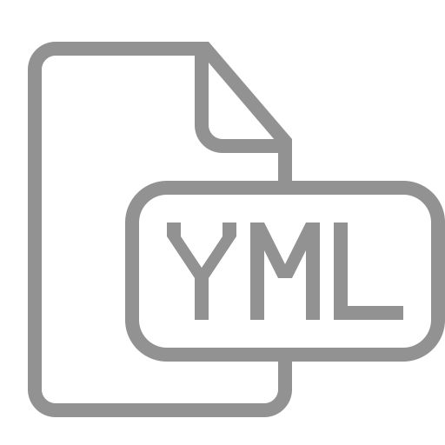
YAML Format
The format of YAML (Yet Another Markup Language), looks like this:
container_name:
property: value
- or options
Notes:
We have two good ways to group components for development purposes and then clean them up when you want to start over.
This approach works fine for local development and grouping. In shared environments the best approach is to properly label your components (services, RCs, pods, etc) and delete them using labels, as above.

Slide 5
Defining Our First Container
In this example, let’s say we have a Node.js application, which requires connecting to Redis.
To start, we need to define our docker-compose.yml file to launch the Node.js application.
Current Directory (.)
./
Dockerfile
Makerfile
docker-compose.yaml
node_modules/
redis/
.npmignore
README.md
connection_breaker.js
index.js
lib/
package.json
package.json
server.js
Notes:
We have two good ways to group components for development purposes and then clean them up when you want to start over.
This approach works fine for local development and grouping. In shared environments the best approach is to properly label your components (services, RCs, pods, etc) and delete them using labels, as above.

Slide 6
Formatting Basic
Given the format shared previously, the file needs to name the container 'web' and set the build property to the current directory.
web:
build: .
Copying the following code into our YAML file, will define a container called web, which is based on the build of the current directory.
NOTE: Remember we have a Node.js app in our current directory.
Notes:
We have two good ways to group components for development purposes and then clean them up when you want to start over.
This approach works fine for local development and grouping. In shared environments the best approach is to properly label your components (services, RCs, pods, etc) and delete them using labels, as above.

Slide 7
Defining Container Properties
Docker Compose supports all of the properties which can be defined using docker run.
To link two containers together to specify a links property and list required connections.
For example, the following would link to the redis source container defined in the same file and assign the same name to the alias.
links:
- redis
Notes:
We have two good ways to group components for development purposes and then clean them up when you want to start over.
This approach works fine for local development and grouping. In shared environments the best approach is to properly label your components (services, RCs, pods, etc) and delete them using labels, as above.

Slide 8
Defining Container Properties
The same format is used for other properties, such as ports:
ports:
- "3000”
- “3001”
- "8000"
Notes:
We have two good ways to group components for development purposes and then clean them up when you want to start over.
This approach works fine for local development and grouping. In shared environments the best approach is to properly label your components (services, RCs, pods, etc) and delete them using labels, as above.

Slide 9
First Container Overview
web:
build: .
links:
- redis
ports:
- "3000"
- "3001"
- "8000"
So, after all that, our yaml file would look something like this.
Notes:
We have two good ways to group components for development purposes and then clean them up when you want to start over.
This approach works fine for local development and grouping. In shared environments the best approach is to properly label your components (services, RCs, pods, etc) and delete them using labels, as above.

Slide 10
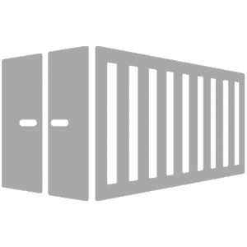
Defining a Second Container
In the previous step, we used the Dockerfile in the current directory (.) as the base for our container.
In this step, we want to use an existing image from Docker Hub as a second container.
To define the second container you simply use the same format as before on a new line.
The YAML format is flexible enough to define multiple containers within the same file.
Notes:
We have two good ways to group components for development purposes and then clean them up when you want to start over.
This approach works fine for local development and grouping. In shared environments the best approach is to properly label your components (services, RCs, pods, etc) and delete them using labels, as above.

Slide 11
Second Container Properties
Defining the second container with the name redis, which will use the image redis. Following the YAML format, the container details would be:
redis:
image: redis:alpine
volumes: - /var/redis/data:/data
Notes:
We have two good ways to group components for development purposes and then clean them up when you want to start over.
This approach works fine for local development and grouping. In shared environments the best approach is to properly label your components (services, RCs, pods, etc) and delete them using labels, as above.

Slide 12
Starting Compose Up
With the docker-compose.yml file we created in place, you can launch all the applications with a single command of up, like this:
If you wanted to bring up a single container, then we could use up <name>.
docker compose up
docker compose up <name>
Notes:
We have two good ways to group components for development purposes and then clean them up when you want to start over.
This approach works fine for local development and grouping. In shared environments the best approach is to properly label your components (services, RCs, pods, etc) and delete them using labels, as above.

Slide 13
Docker Compose Management
Docker Compose starts containers, but it also provides a commands to manage all the containers.
To see the details of the launched containers we could use:
To access all the logs via a single snapshot stream we could use:
Other commands follow the same pattern, and as always can be seen by typing the command itself: docker-compose.
docker-compose ps
docker-compose logs
Notes:
We have two good ways to group components for development purposes and then clean them up when you want to start over.
This approach works fine for local development and grouping. In shared environments the best approach is to properly label your components (services, RCs, pods, etc) and delete them using labels, as above.

Slide 14
Scaling With Compose
Let’s talk about how Compose can also be used to scale up the number of running containers.
The scale option allows you to specify the service and then the number of instances you want.
If the number is greater than the instances already running, it will launch additional containers.
And if the number is less, it will stop the unrequired containers.
Notes:
We have two good ways to group components for development purposes and then clean them up when you want to start over.
This approach works fine for local development and grouping. In shared environments the best approach is to properly label your components (services, RCs, pods, etc) and delete them using labels, as above.

Slide 15
Scaling With Compose
To scale the number of web containers we're running we’d use this command:
And we could scale it back down using:
docker-compose scale web=3
docker-compose scale web=1
App
Notes:
We have two good ways to group components for development purposes and then clean them up when you want to start over.
This approach works fine for local development and grouping. In shared environments the best approach is to properly label your components (services, RCs, pods, etc) and delete them using labels, as above.

Slide 16
Stop and Remove
As when we launch an application with start, to stop a set of containers we can use the command:
And to remove all the containers we can use the command:
docker-compose stop
docker-compose rm
Notes:
We have two good ways to group components for development purposes and then clean them up when you want to start over.
This approach works fine for local development and grouping. In shared environments the best approach is to properly label your components (services, RCs, pods, etc) and delete them using labels, as above.

Slide 17

Result Summary
In this lesson we explored how you can use Docker Compose to manage the orchestration of multi-container applications.
Notes:
We have two good ways to group components for development purposes and then clean them up when you want to start over.
This approach works fine for local development and grouping. In shared environments the best approach is to properly label your components (services, RCs, pods, etc) and delete them using labels, as above.

Slide 18
Lab

Slide 19
End of Chapter

