Slide 1
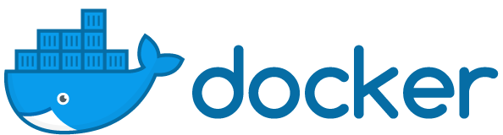

Containers, whales, and more
Powered by © 2017

Slide 2
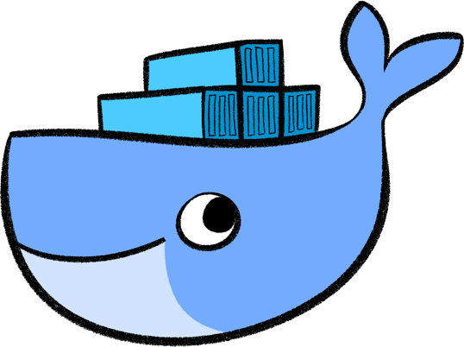
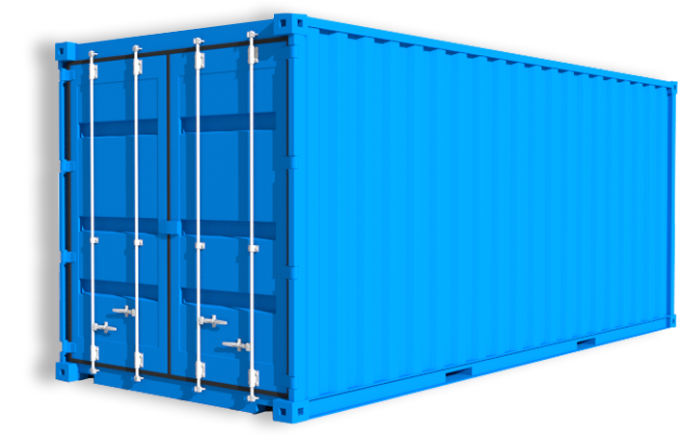
What is Docker?
Googles says:
“Docker is an open-source project that automates the deployment of applications inside software containers.”
Quote from Docker:
“Docker provides an additional layer of abstraction and automation of operating-system-level virtualization on Linux.”
All about
containers!
Powered by © 2017

Slide 3
History of Docker
Linux containers, the technology upon which Docker’s software was originally built, were introduced in 2008.
Docker was released as an open source project by dotCloud, a platform as a service company, in 2013.
One month after launching an interactive tutorial in August 2013, Docker said 10,000 developers tried it out.
When Docker announced its 1.0 release in June 2014, the Docker Engine software had already been downloaded 2.75 million times.
That number now stands at more than 100 million.
Powered by © 2017

Slide 4
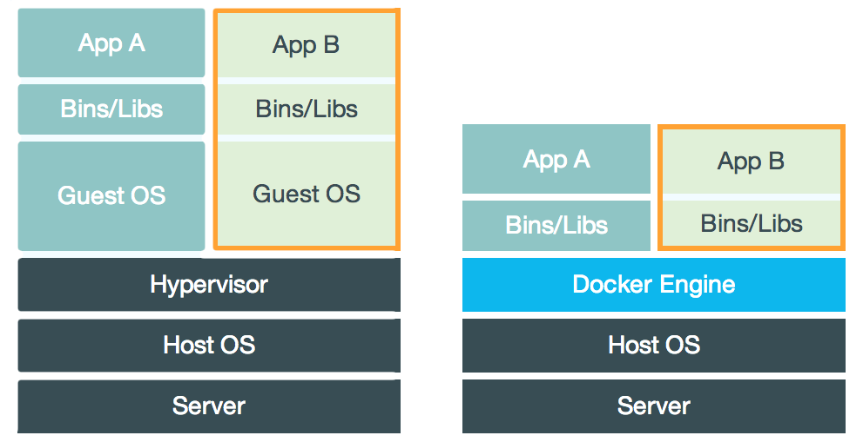
Docker vs. Virtual Machines
Docker is similar, but creates less dependancies
VM
Docker
It does that by using “Docker Engine” rather than a “Guest OS”
Powered by © 2017

Slide 5
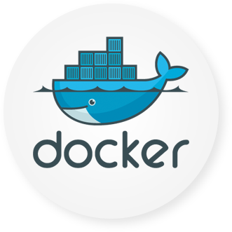
Foundations of Docker
Writable Container
Apache
References
Parent
Image
Image
EMACS
Image
Debian
Base Image
Kernel
bootfs
Powered by © 2017

Slide 6
Basic Terms To Know
Container - a live running instance of a Docker image
Image - a saved state of a container
Docker Hub - like Github, it is where you will ‘push’ and ‘pull’ images from
Tag - a kind of label or version control pinned to an image to distinguish it
Dockerfile - compiled code used to build a image from specifications
Powered by © 2017
Notes:
container
A container is a runtime instance of a docker image.
A Docker container consists of
-A Docker image
-Execution environment
-A standard set of instructions
The concept is borrowed from Shipping Containers, which define a standard to ship goods globally. Docker defines a standard to ship software.
image
Docker images are the basis of containers. An Image is an ordered collection of root filesystem changes and the corresponding execution parameters for use within a container runtime. An image typically contains a union of layered filesystems stacked on top of each other. An image does not have state and it never changes.
tag
A tag is a label applied to a Docker image in a repository. tags are how various images in a repository are distinguished from each other.
Note : This label is not related to the key=value labels set for docker daemon
aufs
aufs (advanced multi layered unification filesystem) is a Linux filesystem that Docker supports as a storage backend. It implements the union mount for Linux file systems.
base image
An image that has no parent is a base image.
boot2docker
boot2docker is a lightweight Linux distribution made specifically to run Docker containers. The boot2docker management tool for Mac and Windows was deprecated and replaced by docker-machine which you can install with the Docker Toolbox.
btrfs
btrfs (B-tree file system) is a Linux filesystem that Docker supports as a storage backend. It is a copy-on-write filesystem.
build
build is the process of building Docker images using a Dockerfile. The build uses a Dockerfile and a “context”. The context is the set of files in the directory in which the image is built.
cgroups
cgroups is a Linux kernel feature that limits, accounts for, and isolates the resource usage (CPU, memory, disk I/O, network, etc.) of a collection of processes. Docker relies on cgroups to control and isolate resource limits.
Also known as : control groups
Compose
Compose is a tool for defining and running complex applications with Docker. With compose, you define a multi-container application in a single file, then spin your application up in a single command which does everything that needs to be done to get it running.
Also known as : docker-compose, fig
container
A container is a runtime instance of a docker image.
A Docker container consists of
A Docker image
Execution environment
A standard set of instructions
The concept is borrowed from Shipping Containers, which define a standard to ship goods globally. Docker defines a standard to ship software.
data volume
A data volume is a specially-designated directory within one or more containers that bypasses the Union File System. Data volumes are designed to persist data, independent of the container’s life cycle. Docker therefore never automatically delete volumes when you remove a container, nor will it “garbage collect” volumes that are no longer referenced by a container.
Docker
The term Docker can refer to
The Docker project as a whole, which is a platform for developers and sysadmins to develop, ship, and run applications
The docker daemon process running on the host which manages images and containers
Docker Hub
The Docker Hub is a centralized resource for working with Docker and its components. It provides the following services:
Docker image hosting
User authentication
Automated image builds and work-flow tools such as build triggers and web hooks
Integration with GitHub and Bitbucket
Dockerfile
A Dockerfile is a text document that contains all the commands you would normally execute manually in order to build a Docker image. Docker can build images automatically by reading the instructions from a Dockerfile.
filesystem
A file system is the method an operating system uses to name files and assign them locations for efficient storage and retrieval.
Examples :
Linux : ext4, aufs, btrfs, zfs
Windows : NTFS
macOS : HFS+
image
Docker images are the basis of containers. An Image is an ordered collection of root filesystem changes and the corresponding execution parameters for use within a container runtime. An image typically contains a union of layered filesystems stacked on top of each other. An image does not have state and it never changes.
libcontainer
libcontainer provides a native Go implementation for creating containers with namespaces, cgroups, capabilities, and filesystem access controls. It allows you to manage the lifecycle of the container performing additional operations after the container is created.
libnetwork
libnetwork provides a native Go implementation for creating and managing container network namespaces and other network resources. It manage the networking lifecycle of the container performing additional operations after the container is created.
link
links provide a legacy interface to connect Docker containers running on the same host to each other without exposing the hosts’ network ports. Use the Docker networks feature instead.
Machine
Machine is a Docker tool which makes it really easy to create Docker hosts on your computer, on cloud providers and inside your own data center. It creates servers, installs Docker on them, then configures the Docker client to talk to them.
Also known as : docker-machine
node
A node is a physical or virtual machine running an instance of the Docker Engine in swarm mode.
Manager nodes perform swarm management and orchestration duties. By default manager nodes are also worker nodes.
Worker nodes execute tasks.
overlay network driver
Overlay network driver provides out of the box multi-host network connectivity for docker containers in a cluster.
overlay storage driver
OverlayFS is a filesystem service for Linux which implements a union mount for other file systems. It is supported by the Docker daemon as a storage driver.
registry
A Registry is a hosted service containing repositories of images which responds to the Registry API.
The default registry can be accessed using a browser at Docker Hub or using the docker search command.
repository
A repository is a set of Docker images. A repository can be shared by pushing it to a registry server. The different images in the repository can be labeled using tags.
Here is an example of the shared nginx repository and its tags
service
A service is the definition of how you want to run your application containers in a swarm. At the most basic level a service defines which container image to run in the swarm and which commands to run in the container. For orchestration purposes, the service defines the “desired state”, meaning how many containers to run as tasks and constraints for deploying the containers.
Frequently a service is a microservice within the context of some larger application. Examples of services might include an HTTP server, a database, or any other type of executable program that you wish to run in a distributed environment.
service discovery
Swarm mode service discovery is a DNS component internal to the swarm that automatically assigns each service on an overlay network in the swarm a VIP and DNS entry. Containers on the network share DNS mappings for the service via gossip so any container on the network can access the service via its service name.
You don’t need to expose service-specific ports to make the service available to other services on the same overlay network. The swarm’s internal load balancer automatically distributes requests to the service VIP among the active tasks.
swarm
A swarm is a cluster of one or more Docker Engines running in swarm mode.
Swarm
Do not confuse Docker Swarm with the swarm mode features in Docker Engine.
Docker Swarm is the name of a standalone native clustering tool for Docker. Docker Swarm pools together several Docker hosts and exposes them as a single virtual Docker host. It serves the standard Docker API, so any tool that already works with Docker can now transparently scale up to multiple hosts.
Also known as : docker-swarm
swarm mode
Swarm mode refers to cluster management and orchestration features embedded in Docker Engine. When you initialize a new swarm (cluster) or join nodes to a swarm, the Docker Engine runs in swarm mode.
tag
A tag is a label applied to a Docker image in a repository. tags are how various images in a repository are distinguished from each other.
Note : This label is not related to the key=value labels set for docker daemon
task
A task is the atomic unit of scheduling within a swarm. A task carries a Docker container and the commands to run inside the container. Manager nodes assign tasks to worker nodes according to the number of replicas set in the service scale.
The diagram below illustrates the relationship of services to tasks and containers.
services diagram
Toolbox
Docker Toolbox is the installer for Mac and Windows users.
Union file system
Union file systems, or UnionFS, are file systems that operate by creating layers, making them very lightweight and fast. Docker uses union file systems to provide the building blocks for containers.
virtual machine
A virtual machine is a program that emulates a complete computer and imitates dedicated hardware. It shares physical hardware resources with other users but isolates the operating system. The end user has the same experience on a Virtual Machine as they would have on dedicated hardware.
Compared to containers, a virtual machine is heavier to run, provides more isolation, gets its own set of resources and does minimal sharing.

Slide 7
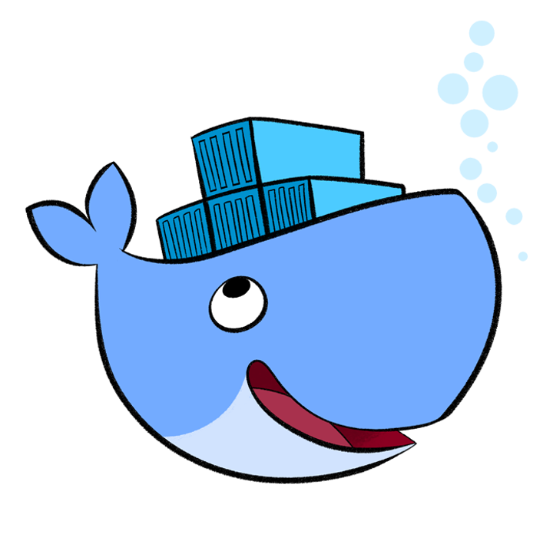
Installing Docker
With Docker 12 Linux, Mac, and Windows can all be installed directly.
However, your OS version matters!
You can also use Docker-Machine and Docker Toolbox to assist.
Or… you can
run it in a VM!
Powered by © 2017
Notes:
container
A container is a runtime instance of a docker image.
A Docker container consists of
-A Docker image
-Execution environment
-A standard set of instructions
The concept is borrowed from Shipping Containers, which define a standard to ship goods globally. Docker defines a standard to ship software.
image
Docker images are the basis of containers. An Image is an ordered collection of root filesystem changes and the corresponding execution parameters for use within a container runtime. An image typically contains a union of layered filesystems stacked on top of each other. An image does not have state and it never changes.
tag
A tag is a label applied to a Docker image in a repository. tags are how various images in a repository are distinguished from each other.
Note : This label is not related to the key=value labels set for docker daemon
aufs
aufs (advanced multi layered unification filesystem) is a Linux filesystem that Docker supports as a storage backend. It implements the union mount for Linux file systems.
base image
An image that has no parent is a base image.
boot2docker
boot2docker is a lightweight Linux distribution made specifically to run Docker containers. The boot2docker management tool for Mac and Windows was deprecated and replaced by docker-machine which you can install with the Docker Toolbox.
btrfs
btrfs (B-tree file system) is a Linux filesystem that Docker supports as a storage backend. It is a copy-on-write filesystem.
build
build is the process of building Docker images using a Dockerfile. The build uses a Dockerfile and a “context”. The context is the set of files in the directory in which the image is built.
cgroups
cgroups is a Linux kernel feature that limits, accounts for, and isolates the resource usage (CPU, memory, disk I/O, network, etc.) of a collection of processes. Docker relies on cgroups to control and isolate resource limits.
Also known as : control groups
Compose
Compose is a tool for defining and running complex applications with Docker. With compose, you define a multi-container application in a single file, then spin your application up in a single command which does everything that needs to be done to get it running.
Also known as : docker-compose, fig
container
A container is a runtime instance of a docker image.
A Docker container consists of
A Docker image
Execution environment
A standard set of instructions
The concept is borrowed from Shipping Containers, which define a standard to ship goods globally. Docker defines a standard to ship software.
data volume
A data volume is a specially-designated directory within one or more containers that bypasses the Union File System. Data volumes are designed to persist data, independent of the container’s life cycle. Docker therefore never automatically delete volumes when you remove a container, nor will it “garbage collect” volumes that are no longer referenced by a container.
Docker
The term Docker can refer to
The Docker project as a whole, which is a platform for developers and sysadmins to develop, ship, and run applications
The docker daemon process running on the host which manages images and containers
Docker Hub
The Docker Hub is a centralized resource for working with Docker and its components. It provides the following services:
Docker image hosting
User authentication
Automated image builds and work-flow tools such as build triggers and web hooks
Integration with GitHub and Bitbucket
Dockerfile
A Dockerfile is a text document that contains all the commands you would normally execute manually in order to build a Docker image. Docker can build images automatically by reading the instructions from a Dockerfile.
filesystem
A file system is the method an operating system uses to name files and assign them locations for efficient storage and retrieval.
Examples :
Linux : ext4, aufs, btrfs, zfs
Windows : NTFS
macOS : HFS+
image
Docker images are the basis of containers. An Image is an ordered collection of root filesystem changes and the corresponding execution parameters for use within a container runtime. An image typically contains a union of layered filesystems stacked on top of each other. An image does not have state and it never changes.
libcontainer
libcontainer provides a native Go implementation for creating containers with namespaces, cgroups, capabilities, and filesystem access controls. It allows you to manage the lifecycle of the container performing additional operations after the container is created.
libnetwork
libnetwork provides a native Go implementation for creating and managing container network namespaces and other network resources. It manage the networking lifecycle of the container performing additional operations after the container is created.
link
links provide a legacy interface to connect Docker containers running on the same host to each other without exposing the hosts’ network ports. Use the Docker networks feature instead.
Machine
Machine is a Docker tool which makes it really easy to create Docker hosts on your computer, on cloud providers and inside your own data center. It creates servers, installs Docker on them, then configures the Docker client to talk to them.
Also known as : docker-machine
node
A node is a physical or virtual machine running an instance of the Docker Engine in swarm mode.
Manager nodes perform swarm management and orchestration duties. By default manager nodes are also worker nodes.
Worker nodes execute tasks.
overlay network driver
Overlay network driver provides out of the box multi-host network connectivity for docker containers in a cluster.
overlay storage driver
OverlayFS is a filesystem service for Linux which implements a union mount for other file systems. It is supported by the Docker daemon as a storage driver.
registry
A Registry is a hosted service containing repositories of images which responds to the Registry API.
The default registry can be accessed using a browser at Docker Hub or using the docker search command.
repository
A repository is a set of Docker images. A repository can be shared by pushing it to a registry server. The different images in the repository can be labeled using tags.
Here is an example of the shared nginx repository and its tags
service
A service is the definition of how you want to run your application containers in a swarm. At the most basic level a service defines which container image to run in the swarm and which commands to run in the container. For orchestration purposes, the service defines the “desired state”, meaning how many containers to run as tasks and constraints for deploying the containers.
Frequently a service is a microservice within the context of some larger application. Examples of services might include an HTTP server, a database, or any other type of executable program that you wish to run in a distributed environment.
service discovery
Swarm mode service discovery is a DNS component internal to the swarm that automatically assigns each service on an overlay network in the swarm a VIP and DNS entry. Containers on the network share DNS mappings for the service via gossip so any container on the network can access the service via its service name.
You don’t need to expose service-specific ports to make the service available to other services on the same overlay network. The swarm’s internal load balancer automatically distributes requests to the service VIP among the active tasks.
swarm
A swarm is a cluster of one or more Docker Engines running in swarm mode.
Swarm
Do not confuse Docker Swarm with the swarm mode features in Docker Engine.
Docker Swarm is the name of a standalone native clustering tool for Docker. Docker Swarm pools together several Docker hosts and exposes them as a single virtual Docker host. It serves the standard Docker API, so any tool that already works with Docker can now transparently scale up to multiple hosts.
Also known as : docker-swarm
swarm mode
Swarm mode refers to cluster management and orchestration features embedded in Docker Engine. When you initialize a new swarm (cluster) or join nodes to a swarm, the Docker Engine runs in swarm mode.
tag
A tag is a label applied to a Docker image in a repository. tags are how various images in a repository are distinguished from each other.
Note : This label is not related to the key=value labels set for docker daemon
task
A task is the atomic unit of scheduling within a swarm. A task carries a Docker container and the commands to run inside the container. Manager nodes assign tasks to worker nodes according to the number of replicas set in the service scale.
The diagram below illustrates the relationship of services to tasks and containers.
services diagram
Toolbox
Docker Toolbox is the installer for Mac and Windows users.
Union file system
Union file systems, or UnionFS, are file systems that operate by creating layers, making them very lightweight and fast. Docker uses union file systems to provide the building blocks for containers.
virtual machine
A virtual machine is a program that emulates a complete computer and imitates dedicated hardware. It shares physical hardware resources with other users but isolates the operating system. The end user has the same experience on a Virtual Machine as they would have on dedicated hardware.
Compared to containers, a virtual machine is heavier to run, provides more isolation, gets its own set of resources and does minimal sharing.

Slide 8

Docker Engine vs. Docker Machine
In older versions of Docker, you might have using “boot2docker” or “Docker Toolbox.”
Since Docker 12.1 however, we can work directly through our host.
Another way of installing and managing Docker on the host is Docker Machine.
Docker Machine links a host with a VM running in the background
Docker Engine creates, runs, and manages your containers
Powered by © 2017

Slide 9
Basic Commands
In terminal, outside of a container…
See local repository of images
Check to see if containers are running
Pull a container down
Docker help menu
$ docker images
$ docker ps
$ docker pull <reponame/imagename:tag>
$ docker help
https://docs.docker.com/engine/reference/commandline/
Powered by © 2017

Slide 10
Basic Commands
How do we “get in” our container?
By spinning off an image using ‘run’
$ docker run <image-name, or image-id>
Container is running, but where is it?
Enter active containers with ‘exec -it’
$ docker exec -it <image-name, or image-id>
Powered by © 2017

Slide 11
Simple Exercise
Pull an Image down from Docker Hub:
$ docker pull busybox
Confirm image is in local repository:
$ docker images
Run container from new image and:
$ docker run -it busybox
Send a command from the inside:
# echo “Hello World!”
Powered by © 2017

Slide 12
Exposing Ports
When you first run an image you can:
Add ports, name the container, set hostname, select a network and more
We can also use ‘-it’ to “get in” to our container immediately
An example of how that might look:
$ docker run -it —-network networkname \
-p 8000 \
—-name name-container \
—-hostname name-host \
reponame/image-name:tag
Powered by © 2017

Slide 13
Web Server Exercise
Pull down a different image from the hub:
$ docker pull nginx
Run the image and add ports on startup:
$ docker run -p 8000:8000 nginx
Host Port
Docker Port
Open an <localhost:8000>
Observe terminal as you refresh page
Powered by © 2017

Slide 14
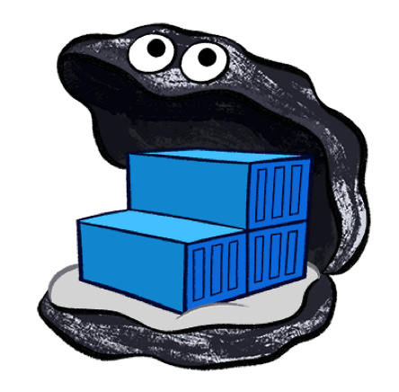
How do I save my work? You don’t!
You don’t save, you commit
$ docker pull <image-name>
Pull
$ docker run -it <image-name:tag>
Push
Image
$ docker push <image-name:tag>
Run
Commit
$ docker commit [OPTIONS] CONTAINER [REPOSITORY[:TAG]
Tag
$ docker tag <image-name> <image-name:tag>
Powered by © 2017

Slide 15
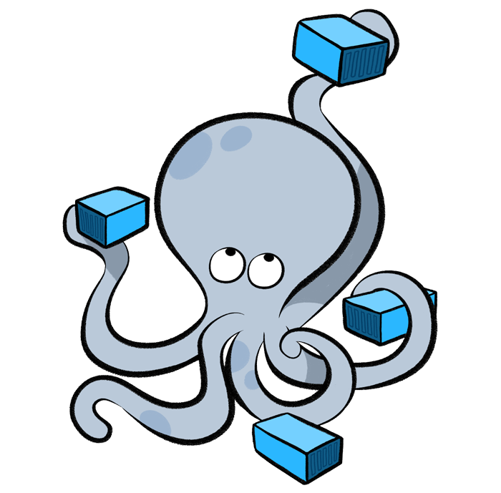
Compose
A tool for defining and running multi-container Docker applications
Compose uses a YAML file to configure your application’s services
With a single command, create and start all the services
Production, staging, development, testing, as well as CI workflows
Using Compose is basically a three-step process:
Define app’s environment with a Dockerfile
Define the services in docker-compose.yml
Lastly, run docker-compose up
Powered by © 2017

Slide 16
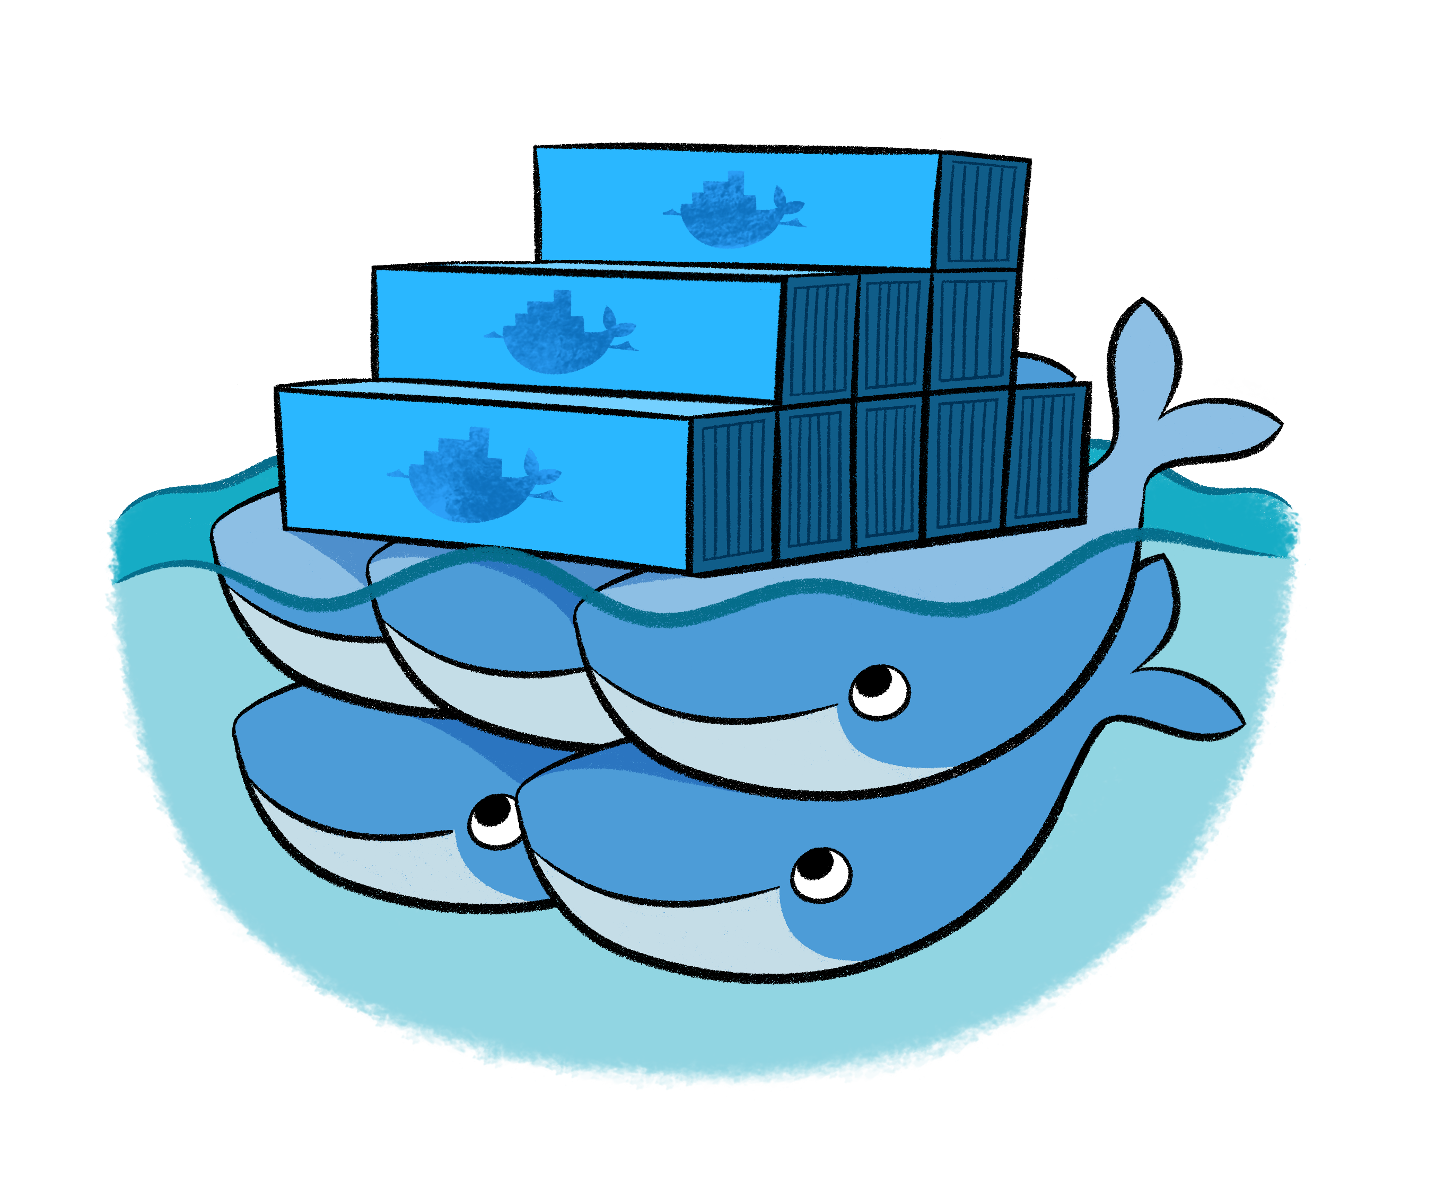
Swarm
Current versions of Docker include swarm mode
A cluster of Docker Engines called a swarm
Use the Docker CLI to interact with Docker Swarm
Feature Highlights:
Load Balancing
Rolling Updates
State reconciliation
Cluster Management
Decentralized Design
Scaling
Powered by © 2017
Notes:
Cluster management integrated with Docker Engine: Use the Docker Engine CLI to create a swarm of Docker Engines where you can deploy application services. You don’t need additional orchestration software to create or manage a swarm.
Decentralized design: Instead of handling differentiation between node roles at deployment time, the Docker Engine handles any specialization at runtime. You can deploy both kinds of nodes, managers and workers, using the Docker Engine. This means you can build an entire swarm from a single disk image.
Declarative service model: Docker Engine uses a declarative approach to let you define the desired state of the various services in your application stack. For example, you might describe an application comprised of a web front end service with message queueing services and a database backend.
Scaling: For each service, you can declare the number of tasks you want to run. When you scale up or down, the swarm manager automatically adapts by adding or removing tasks to maintain the desired state.
Desired state reconciliation: The swarm manager node constantly monitors the cluster state and reconciles any differences between the actual state and your expressed desired state. For example, if you set up a service to run 10 replicas of a container, and a worker machine hosting two of those replicas crashes, the manager will create two new replicas to replace the replicas that crashed. The swarm manager assigns the new replicas to workers that are running and available.
Multi-host networking: You can specify an overlay network for your services. The swarm manager automatically assigns addresses to the containers on the overlay network when it initializes or updates the application.
Service discovery: Swarm manager nodes assign each service in the swarm a unique DNS name and load balances running containers. You can query every container running in the swarm through a DNS server embedded in the swarm.
Load balancing: You can expose the ports for services to an external load balancer. Internally, the swarm lets you specify how to distribute service containers between nodes.
Secure by default: Each node in the swarm enforces TLS mutual authentication and encryption to secure communications between itself and all other nodes. You have the option to use self-signed root certificates or certificates from a custom root CA.
Rolling updates: At rollout time you can apply service updates to nodes incrementally. The swarm manager lets you control the delay between service deployment to different sets of nodes. If anything goes wrong, you can roll-back a task to a previous version of the service.

Slide 17
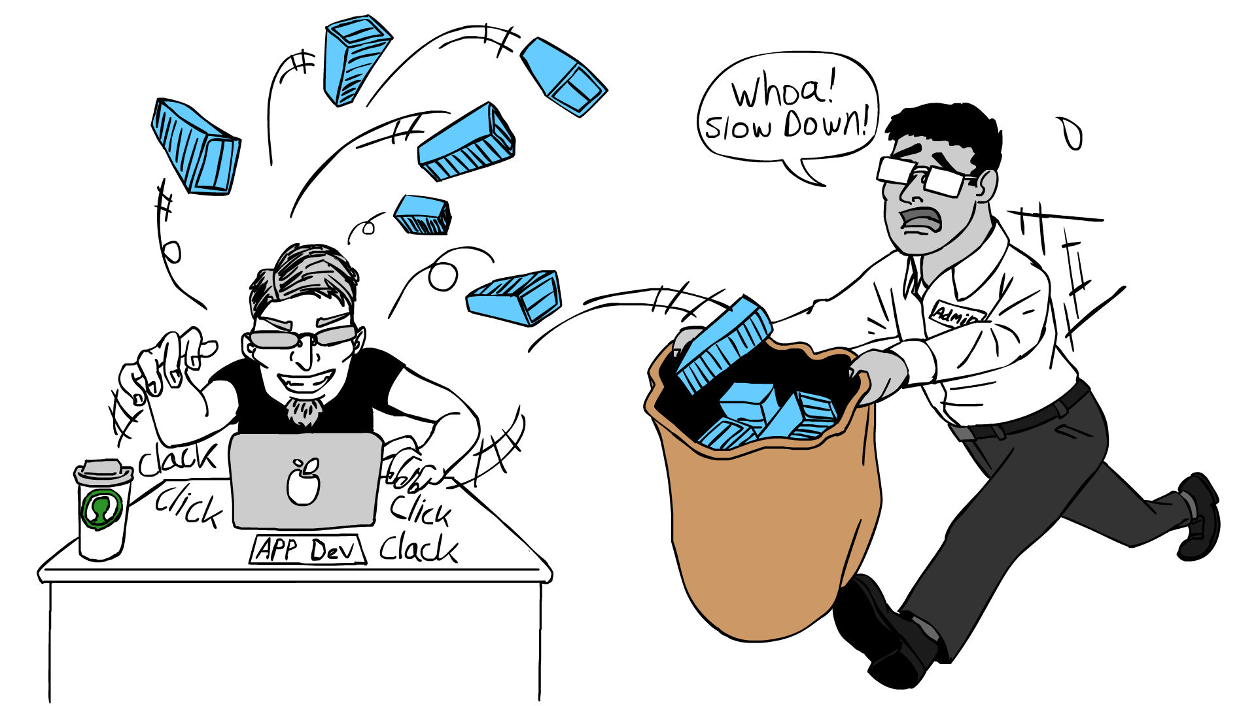
Powered by © 2017

Slide 18
Lab Time
Enough talk, let’s do something!
Powered by © 2017

Slide 19
End of Chapter
Powered by © 2017

