Slide 1

Security Configurations for Wireless Network
Jesse Missaghian University of Phoenix CYB/360: Wireless Security Jason Cupano 12/18/2023

Slide 2

Securing Our Digital Horizon
Unveiling the Blueprint of Enhanced Wireless Security
Dissecting Vulnerabilities and Reinforcing Defenses
Strategic Device Deployment for Optimal Protection
Elevating Encryption and Authentication Standards
Realizing a Future-Proof and Resilient Network
Notes:
Welcome to our journey through enhancing our network's security. In this presentation, we're going to unfold the blueprint of how we plan to fortify our wireless network against evolving cyber threats.
We'll start by dissecting the current vulnerabilities in our wireless network and how we're reinforcing our defenses to counter these weaknesses effectively.
Our strategy includes deploying strategic devices and technologies, from advanced firewalls to sophisticated intrusion detection systems, each playing a crucial role in our network's security.
We'll jump into the elevation of our encryption and authentication standards, focusing on the implementation of AES within WPA3 and advanced authentication protocols like EAP-TLS, to ensure robust protection of sensitive HR data.
We'll explore how these enhancements not only secure our network today but also make it resilient and adaptable to future technological advancements, ensuring long-term security and reliability.

Slide 3

Guarding the Airwaves: Wireless Security Imperatives
Combatting Eavesdropping with AES in WPA3
Reinforcing Network Gates Against Intruders
Shielding Data from MITM Attacks with HTTPS and PMF
Notes:
Eavesdropping and Encryption: Inherent vulnerabilities of wireless networks to eavesdropping make robust encryption a necessity. Implementing AES within the WPA3 framework provides a highly secure encryption layer, making data interception virtually impossible for eavesdroppers. This is crucial for HR data which often contains sensitive personal information.
Countering Unauthorized Access: The risk of unauthorized access escalates with weak encryption. Upgrading to WPA3 significantly enhances network security, utilizing a complex handshake protocol and state-of-the-art encryption algorithms, thus effectively barricading the network against intruders.
Mitigating Man-in-the-Middle (MITM) Attacks: To combat MITM attacks, we're not just relying on encryption. Implementing HTTPS protocols across all web interactions and activating WPA3's Protected Management Frames adds an additional layer of security, ensuring each data packet's authenticity and integrity.

Slide 4

Fortifying the Wireless Realm
Crafting Digital Barriers with VLANs for HR Data
Taming Wireless Signal Spillage with Directional Antennas
Rigorous Network Health Checks through Security Audits
Notes:
Segmentation for Enhanced Security: Implementing VLANs to segregate HR traffic from the rest of the network is a strategic move to mitigate risks. In the event of a network breach, VLANs act as barriers, preventing the spread of the breach and protecting sensitive HR data.
Overcoming Signal Containment Issues: The challenge of signal containment is met with precision through the use of directional antennas. This focused approach not only strengthens the signal within desired areas but also significantly reduces the likelihood of external entities intercepting wireless communications.
Regular Security Audits for a Robust Network: Conducting thorough security audits, including comprehensive vulnerability assessments and penetration testing, allows us to proactively identify and address potential weak points in the network. This is crucial for maintaining an up-to-date and resilient security posture, especially for a network handling sensitive HR data.

Slide 5

Probing the Network's Shield
Scouring for Weaknesses with Nessus
Enveloping HR Communications in TLS Encryption
Retrofitting the Network's Armor
Notes:
Vulnerability Scanning and Remediation: Utilizing advanced tools like Nessus for vulnerability scanning provides us with detailed insights into potential weaknesses within our network, including outdated firmware and weak password policies. Prompt remediation of these vulnerabilities is crucial for maintaining a secure wireless environment.
Securing HR Data Transmission: Given the sensitive nature of HR data, ensuring its secure transmission is paramount. By employing TLS protocols, we establish a secure communication channel for HR data, effectively safeguarding it against eavesdropping and tampering during transit.
Modernizing Network Infrastructure: Our analysis extends to identifying and upgrading outdated components within the network infrastructure. This involves not only updating hardware but also ensuring all network devices operate on the latest firmware versions, thereby closing known security gaps and enhancing overall network security.

Slide 6
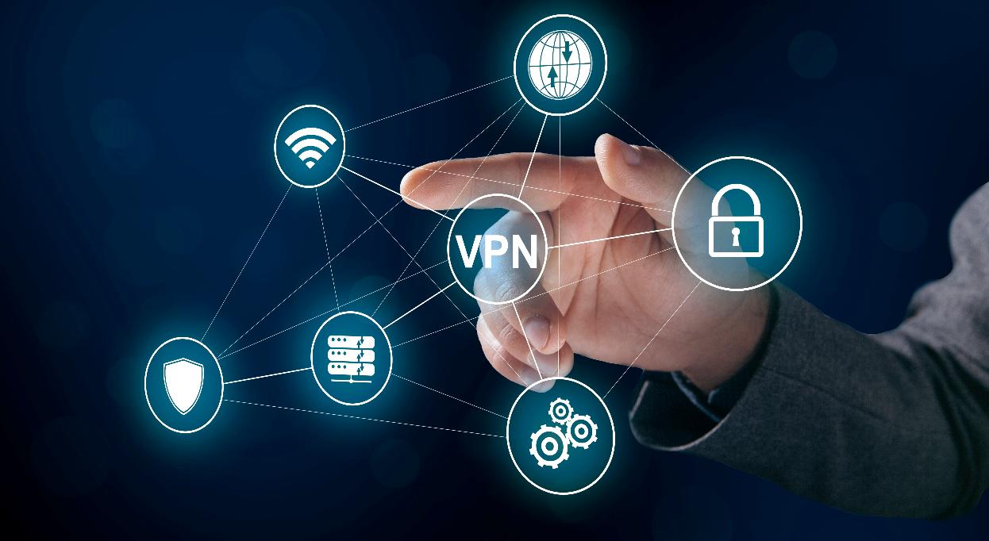
Strengthening the Network's Backbone
Dissecting and Fortifying Existing Protocols
Encrypting Data with the Gold Standard: AES
Elevating Authentication with EAP-TLS
Cementing Data Security with IPsec VPNs
Notes:
Evaluating Existing Protocols: Detailed examination of existing network protocols, such as Dynamic Host Configuration Protocol (DHCP) and Domain Name System (DNS), is crucial. We're particularly vigilant against DHCP spoofing and DNS hijacking, ensuring these protocols are configured to the highest security standards.
Adopting Advanced Encryption: Our choice of the Advanced Encryption Standard (AES) for encryption isn’t arbitrary. AES is globally recognized for its complexity and resilience against attacks, such as brute force. It’s a gold standard in encryption, providing a robust shield for our data.
Robust Authentication Mechanisms: We're scrutinizing our current authentication methods, replacing weaker protocols with Enhanced Authentication Protocol-Transport Layer Security (EAP-TLS). EAP-TLS is known for its stringent mutual authentication, utilizing digital certificates for both client and server, ensuring a two-way trust system.
Implementing Secure Communication Protocols: Emphasis is placed on secure communication protocols, notably IPsec for Virtual Private Networks (VPN). IPsec ensures that all data transmitted over the network is encrypted and secure, providing an impenetrable layer of security for data in transit.

Slide 7

Arming the Network with Advanced Tech
Deploying Cutting-Edge Firewalls and IDS/IPS
WAPs: Becoming Digital Sentry Posts
VLANs: Creating Secure HR Data Havens
Enlisting AI-Powered Network Sentinels
Notes:
Strategic Integration of Firewalls and IDS/IPS: The introduction of firewalls with deep packet inspection is a game-changer, enabling us to monitor, control, and secure network traffic. Intrusion Detection and Prevention Systems (IDS/IPS) are being deployed to detect and respond to threats in real time, enhancing our network's defensive posture.
Upgrading Wireless Access Points (WAPs): The upgraded WAPs support the latest WPA3 encryption and are equipped with advanced features like RF spectrum analysis, crucial for mitigating interference and ensuring optimal network performance. We're implementing stringent Access Control Lists (ACLs) on these WAPs, allowing precise control over network access.
VLANs for HR Data Segregation: Virtual LANs (VLANs) are configured to isolate HR data, creating a secure and exclusive network segment for HR-related traffic. This measure restricts access to sensitive data, significantly reducing the risk of internal and external data breaches.
Sophisticated Network Monitoring: Transitioning to advanced network monitoring tools like SolarWinds allows us comprehensive network surveillance. This upgrade is pivotal in providing real-time network analytics and alerts, ensuring we are promptly informed of any unusual activities or security threats.

Slide 8

Championing Proactive Network Defense
WIPS and WIDS: The Network's Vigilant Guardians
Staying Ahead of Threats with Real-Time Alerts
Crafting a Resilient Network Ecosystem
Embracing a Proactive Security Posture
Notes:
Crucial Role of WIPS and WIDS: Wireless Intrusion Prevention Systems (WIPS) and Wireless Intrusion Detection Systems (WIDS) are our network’s watchdogs. WIPS actively prevents intrusions by responding to threats, while WIDS specializes in monitoring and alerting us about potential security breaches.
Real-Time Threat Detection: These systems are pivotal in detecting unauthorized access, rogue Access Points (APs), and unusual traffic patterns. This capability is vital for early detection and intervention of potential threats, maintaining the sanctity of our wireless network.
Bolstering Network Resilience: Integrating WIPS and WIDS fortifies our network’s resilience. They continuously scan for threats, ensuring our network's defense mechanism is always active and up-to-date.
Proactive Security Posture: WIPS and WIDS are central to our proactive security strategy. Their continuous monitoring and alerting capabilities keep us ahead of potential security issues, allowing for timely and effective responses to any suspicious network activities.

Slide 9

Encrypting Data: The Pillar of Network Security
The Unassailable Fortress of AES Encryption
WPA3: The Vanguard of Wi-Fi Security
Ensuring HR Data's Confidential Journey
Preserving Data Integrity in the Digital Realm
Notes:
AES Encryption's Superiority: We chose the Advanced Encryption Standard (AES) due to its stellar reputation as a fast and secure symmetric key algorithm. AES is lauded for its ability to withstand various attack vectors, making it the gold standard for encrypting sensitive HR data. It's the digital equivalent of a high-security vault, providing robust protection for our valuable information.
Advantages of WPA3 Protocol: WPA3 stands as the fortress of Wi-Fi security protocols. It brings to the table enhanced features like individualized data encryption and robust defenses against brute-force attacks. Its capabilities in improving public Wi-Fi security are unparalleled, making it a crucial addition to our network security arsenal.
HR Data Protection with AES in WPA3: By encrypting HR data with AES within WPA3, we're setting up a double-layered security shield. This combination ensures maximum security, safeguarding the data against eavesdropping and ensuring its confidentiality during transmission.
Maintaining Data Integrity: Implementing AES within WPA3 does more than just encrypt; it preserves data integrity. This means our HR data isn't just locked away securely; it's also protected from any form of tampering, ensuring it stays accurate and unchanged during its digital journey.

Slide 10

Redesigning for Resilience - Part 1
Integrating Smart Security Appliances
Refining Network Access and Traffic Control
Constructing Digital Moats with VLANs
Upgrading to AI-Driven Network Surveillance
Notes:
Strategic Device Integration: The introduction of firewalls, Intrusion Detection Systems (IDS), and Intrusion Prevention Systems (IPS) into our network doesn't just fortify our defenses - it redefines them. These devices are not just shields; they're smart sentinels, analyzing traffic patterns and sniffing out anomalies to keep us safe.
Refining Network Configurations: We've fine-tuned our network settings, transforming our routers and switches into more vigilant guardians. This includes enforcing stricter firewall rules and enabling cutting-edge features that control and streamline network traffic.
VLANs for Isolating HR Data: Our Virtual LANs (VLANs) serve as digital corridors, exclusively for HR traffic. This isn’t just about segregating data; it's about optimizing network performance, making sure our HR data flows smoothly and securely, untouched by the general network hustle.
Elevating Network Monitoring: We've upgraded to state-of-the-art monitoring tools that do more than just watch over our network; they analyze and predict. AI-driven technologies are now our eyes and ears, offering proactive and efficient monitoring for quicker responses to security incidents.

Slide 11

Redesigning for Resilience - Part 2
WAPs: The New Frontier of Secure Connectivity
Authenticating with Precision: The EAP-TLS Edge
AES: Locking Down Every Data Byte
IDS/IPS: The Network's Rapid Response Force
Notes:
Elevating WAP Security: Our upgraded Wireless Access Points (WAPs) are not just new hardware; they're fortified gateways. With WPA3 support and enhanced network access controls, they act as vigilant gatekeepers, ensuring secure and authorized wireless communications.
Fortifying Authentication: We're not just checking IDs at the door; we're ensuring everyone has the right credentials. Advanced authentication methods like EAP-TLS offer mutual validation, surpassing traditional Pre-Shared Key (PSK) methods in security.
AES: The Encryption Standard: Implementing AES across the network is like putting a high-security lock on every piece of data. This encryption standard is pivotal in shielding HR data, acting as a digital fortress against unauthorized access and interception.
Proactive Defense with IDS/IPS: The deployment of Intrusion Detection and Prevention Systems is akin to having an advanced security team on constant alert. They're crucial in our security strategy, actively monitoring for breaches and responding swiftly to neutralize threats, reinforcing our network's defense.

Slide 12

The Why Behind Our Security Strategy
Staying One Step Ahead in the Cybersecurity Race
Zeroing In on HR Data Protection
Balancing Robust Security with Agile Performance
Preparing Today's Network for Tomorrow's Challenges
Notes:
Proactive Approach Against Cyber Threats: In the ever-shifting landscape of cyber threats, staying ahead is key. Our security enhancements are a direct response to this dynamic environment. By aligning with the latest industry best practices and compliance standards, we're not just building a fortress; we're future-proofing it against both known and emerging cyber threats. It’s about being proactive rather than reactive.
Focused on Protecting Sensitive Data: The core rationale behind our specific security choices revolves around safeguarding our HR data's confidentiality and integrity. Every measure, from advanced encryption to network segmentation, is chosen with precision, ensuring that our network is a safe harbor for sensitive information. It's not just about locking doors; it's about making sure only the right keys fit.
Striking the Right Balance: Enhancing security without hindering performance is like walking a tightrope. We meticulously strategize to bolster our defenses while maintaining, or even enhancing, our network's efficiency. This delicate balance ensures that our security measures fortify without slowing down the pace of our business operations.
Building for Tomorrow: Our security strategy isn’t just for today; it's built with an eye on the horizon. We've designed our network enhancements to be scalable and adaptable, ready to evolve with technological advancements. This foresight ensures that our network is not just secure for now, but primed to face the challenges and opportunities of tomorrow's digital landscape.

Slide 13

Securing Today, Envisioning Tomorrow
Recap: A Comprehensive Approach to Network Security
Advanced Protocols and Devices: Our Security Pillars
Achieving a Balance: Security and Performance Synergy
Embracing a Proactive Security Mindset
Notes:
As we conclude, let's recap our comprehensive approach to securing our wireless network. We've traversed through the various aspects of network security, from identifying vulnerabilities to implementing state-of-the-art protective measures.
Our journey has highlighted the significance of advanced protocols and devices. We've seen how AES encryption, WPA3 standards, firewalls, IDS/IPS, and network monitoring tools form the pillars of our network's security.
A key takeaway from our discussion is how we've achieved a balance between enhancing security and maintaining network performance. Our strategies ensure that our network remains efficient and user-friendly while being securely fortified.
Finally, we've embraced a proactive security mindset. By staying ahead of cyber threats, continuously updating our security measures, and preparing for future advancements, we're not just securing our network for today but also envisioning and preparing for the challenges and opportunities of tomorrow's digital landscape.

Slide 14

References
Coleman, D. D., & Westcott, D. A. (2021). CWNA Certified wireless network administrator study guide: Exam CWNA-108 (6th ed.). John Wiley & Sons, Inc.

