Slide 1
TRABAJO FINAL DE CURSO
USO DE CHATBOTS EN E-COMMERCE
CASO: InnovVentas
AI-900T00 Conceptos Básicos de IA en Microsoft Azure

Slide 2



EL EQUIPO
HUGO ANDRE CAHUA SOLANO
HENRY HUMBERTO CRUCES CASTRO
JEAN BECKAN OLIVITOS VILLANUEVA
“You can replace the image on the screen with your own”
“You can replace the image on the screen with your own”
“Hotel, Trivago”

Slide 3
InnovVentas
GOSTUDIO
Mercury is the closest planet to the Sun and the smallest one in the Solar System—it’s only a bit larger than our Moon. The planet’s name has nothing to do with the liquid metal since it was
named after the Roman messenger god, Mercury.

Slide 4
WHAT WE ARE WORKING ON
SECURE
ACCESSIBLE
FAST AND RELIABLE
Mercury is the closest planet to the Sun
Despite being red, Mars is a cold place, not hot
Neptune is the farthest planet from the Sun

Slide 5
ABOUT THE PROJECT
Mercury is the closest planet to the Sun and the smallest one in the Solar System—it’s only a bit larger than our Moon. The planet’s name has nothing to do with the liquid metal since it was named after the Roman messenger god, Mercury

Slide 6
NOW
POOR DESIGN
PROGRAMMING MISTAKES
LACK OF ADAPTABILITY

Slide 7
FUTURE
BRANDING
POSITIONING
ADAPTABILITY

Slide 8
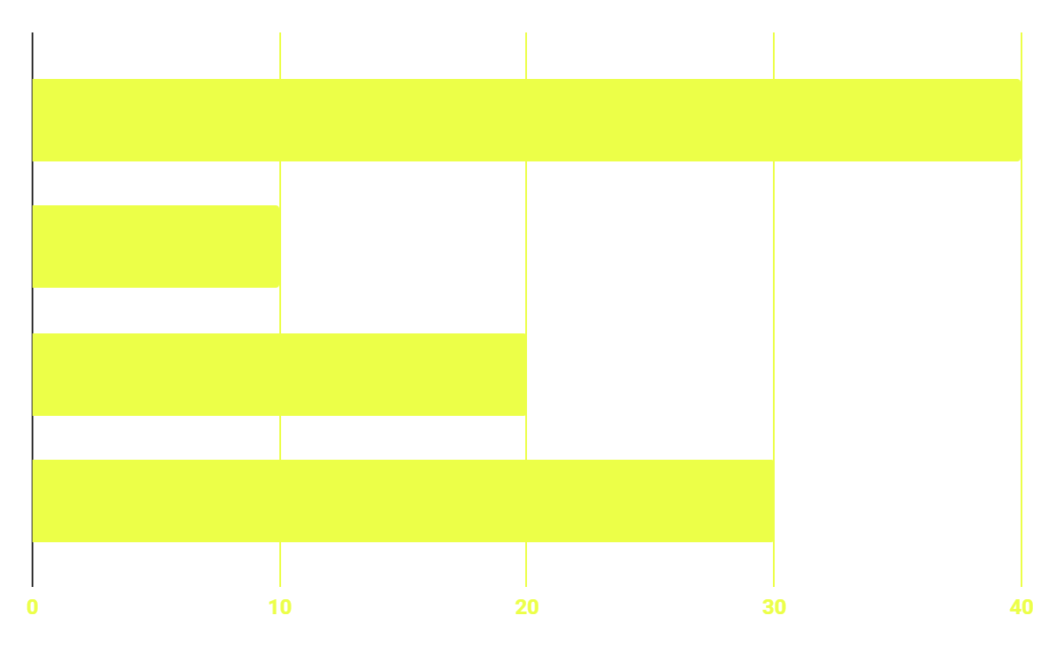
BUDGET
40%
20%
PROGRAMMING
10%
30%
DATABASE
WEB DESIGN
UX RESEARCH

Slide 9
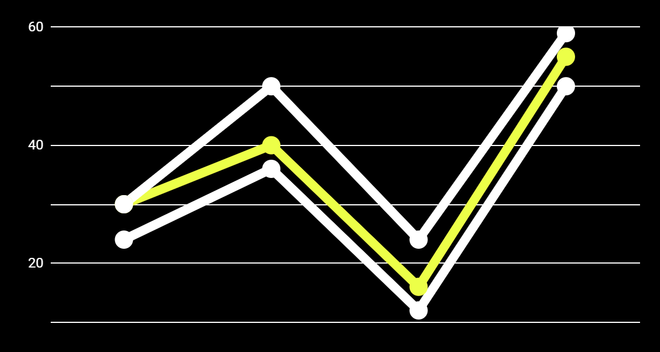
PREDICTED RESULTS
CONVERSIONS NEXT YEAR
+20%
MONTHLY VISITS
+33%
CONVERSION RATE
+40%
ANNUAL ORDERS

Slide 10
SNEAK PEEK
HEADER
TEXT
SLIDER
ICONS

Slide 11
OUR TIMELINE
WEEK 1
WEEK 3
BETA
RELEASE
FINAL
VERSION
WEEK 2
WEEK 4
Improvements
Increased traffic
Focus group
Progress review

Slide 12
THANKS!
Does anyone have any question?
addyouremail@freepik.com
+91 620 421 838
yourcompany.com

Slide 13
Use our editable graphic resources...
You can easily resize these resources without losing quality. To change the color, just ungroup the resource and click on the object you want to change. Then, click on the paint bucket and select the color you want. Group the resource again when you’re done. You can also look for more infographics on Slidesgo.

Slide 16
JANUARY
FEBRUARY
MARCH
APRIL
MAY
JUNE
PHASE 1
Task 1
Task 2
PHASE 2
Task 1
Task 2
JANUARY
FEBRUARY
MARCH
APRIL
PHASE 1
Task 1
Task 2

Slide 19
...and our sets of editable icons
You can resize these icons without losing quality.
You can change the stroke and fill color; just select the icon and click on the paint bucket/pen.
In Google Slides, you can also use Flaticon’s extension, allowing you to customize and add even more icons.

Slide 20
Educational Icons
Medical Icons

Slide 21
Business Icons
Teamwork Icons

Slide 22
Help & Support Icons
Avatar Icons

Slide 23
Creative Process Icons
Performing Arts Icons

Slide 24
Nature Icons

Slide 25
SEO & Marketing Icons

