Slide 1
Bacchus Group 4
Jeremy Ginter, Karissa Flora, Joshua Ramsey
12/17/2023

Slide 2

Case Study Description
The Bacchus Winery recently became under new ownership, and the new owners require a database to solve some of their problems. They require more information on the amount of time each of their employees worked, details on how their wine is selling and the distributors carrying them, and a report showing expected supply deliveries and their actual arrival date. Bacchus Winery currently has 25 employees on payroll. They produce four different wines, a Merlot, Cabernet, Chablis, and Chardonnay. They get their supplies from three separate supplies, with one providing corks and bottles, one providing boxes and labels, and one providing vats and tubing.

Slide 3

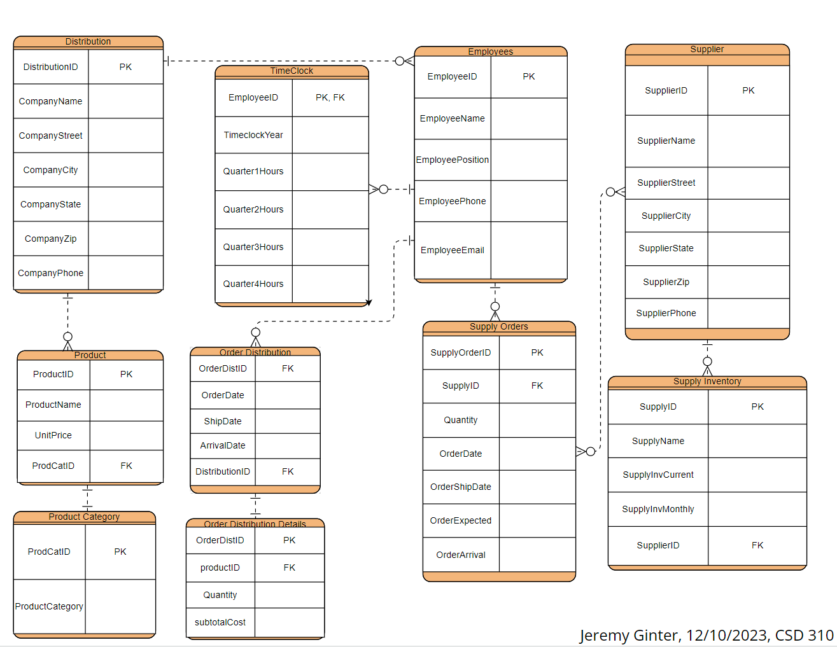
ERD

Slide 4
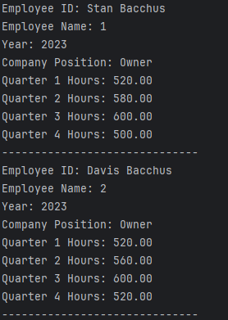
Employee Time Report
Employee Time Description
The Employee Time report shows each employee’s name and ID, the Year for the Data Displayed, the employee’s position, and the number of hours they worked each Quarter. This Report displays these results for all 25 employees and the owners.

Slide 5
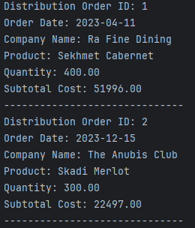
Distribution Report
Distribution Description
The Distribution report shows the individual order ID, the date of the order, the company ID and company name of the distributor that ordered the products, the quantity of products ordered, and the subtotal of all the products ordered.

Slide 6
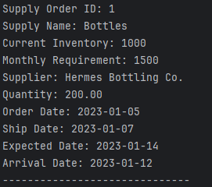
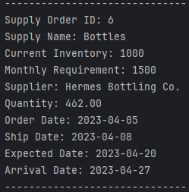
Supplier Deliveries Report
Supplier Deliveries Description
The Supplier Deliveries report shows the order ID and type of supply that was ordered, the supplier name, the current inventory and required inventory, amount ordered, the order and ship date, the expect arrival data, and the actual arrival date. Each order is organized by product ordered.

Slide 7
Assumptions
We assumed that a supply order would only be ordering one type of supply from a supplier at a time. This is to increase the simplicity of the report, making it easier to understand.
We assumed one type of product could be ordered by a distributor at one time.
We assumed data such as employee hours works, order quantities, inventory, and order dates in order to better show the example data in the reports.

