Slide 1
Decision Analysis and Forecasting for Agricultural Development
Nick Paul, Jonas Wage, Julia Müller
Robin Kurth and Simon Swatek

Slide 2

Who is our Decision maker?

Slide 3
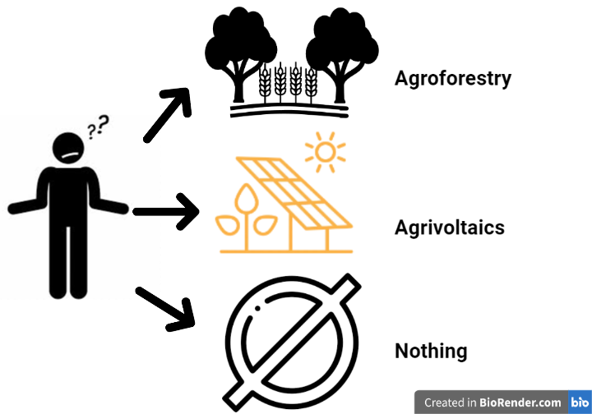
between which scenarios can he choose?
What is an opportunity for agriculture and the energy transition?

Slide 4
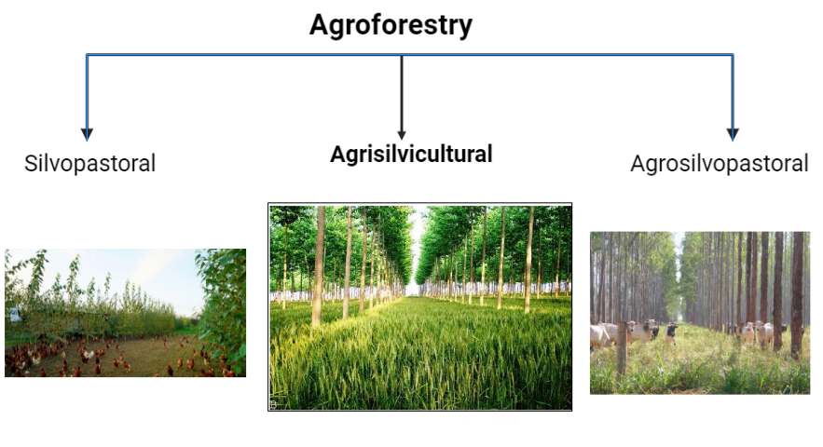
Scenario 1

Slide 5
Scenario 1

Slide 6
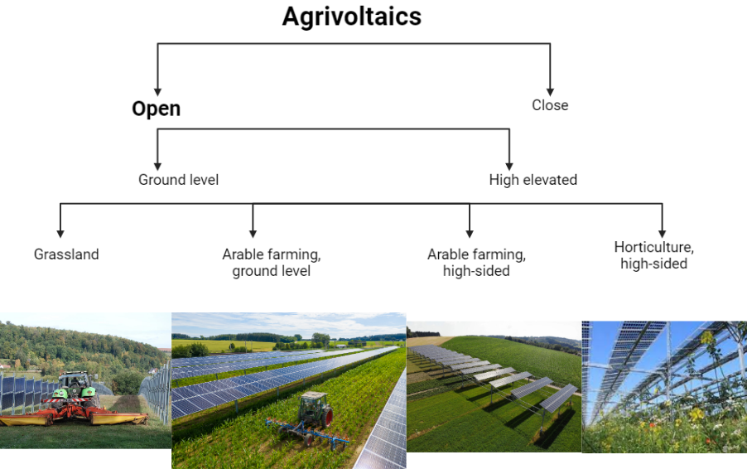
Scenario 2

Slide 7
Scenario 2

Slide 8
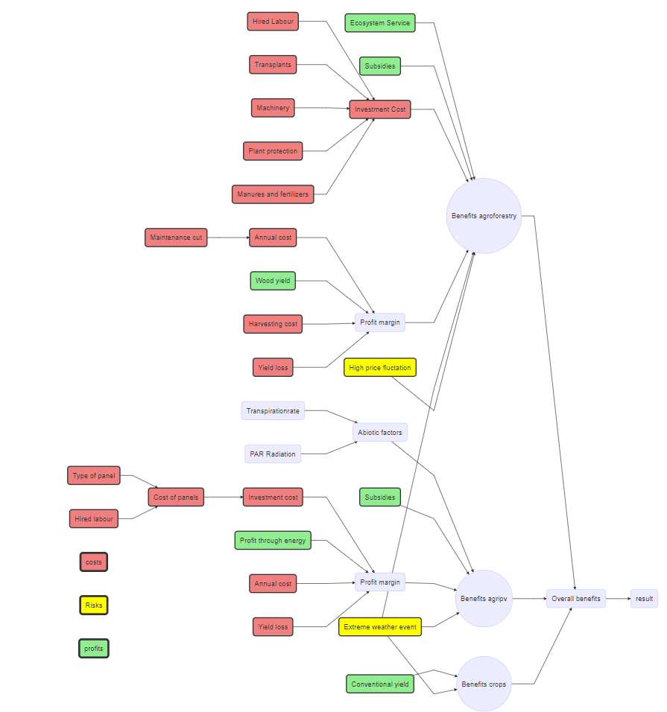
Flowdiagramm

Slide 9
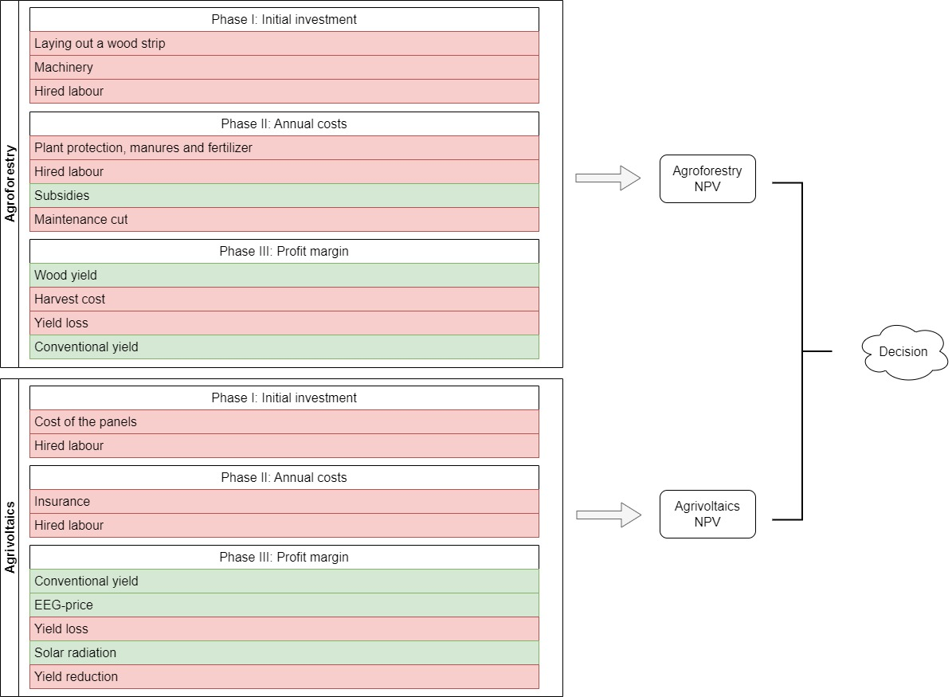
Flowdiagramm

Slide 10
What are we currently working on?
filling in the values for input estimates
upcoming talks with experts
the beginnings of code programming

