Slide 1
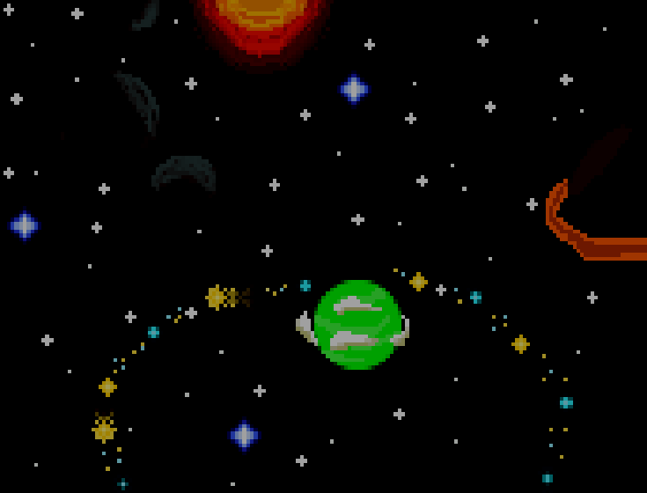

Group 34
Catabullet
Operation
Catapult
Features
Wesley Wang, Jan Lin, Lewis Cook, Daniel Olis
You can go die
When u die
Play Toilet Sound(Of the Day)
Place content here.
The design of the poster is up to you. Charts, images and diagrams like flowcharts work best to convey information. You can also use paragraphs of text for details.
Each poster will be mounted onto a trifold cardboard backing. The dotted lines on each side of this template show the locations of the folds. Remove these dotted lines when you are done designing your poster so they don’t get printed!
Place content here.

