Slide 1
Olympics vs. GDP
By: Joshua Bacon-Qaunaq

Slide 2
Summary
Hypothesis Question (slide 3)
Hypothesis Explanation (slide 4)
Resources (slide 5)
Planned Procedures (slide 6)
Expected Outputs (slide 7)
Extra Results (slide 8)

Slide 3
Hypothesis Question
Initial Question: Is it possible to determine that if a country is economically improving, does it’s performance in the Olympics also improve?
It would make sense to most people that if the GDP of a country increases, so will the living standard.
If living standards improve then it is implied that people will live better and healthier lives. But that is all speculation in this case, as the only data we will be looking at pertains to GDP and Olympics performance.
That is, to suggest that there is a corresponding trend between Olympics performance and GDP, then the athletes of said country will get better as the economy grows due to economic-based benefits.

Slide 4
Hypothesis Explanation
The assumption here would be that; as countries become stronger economically, the athletes should also become stronger physically. This would be due to some external factors that are correlated to, or based on the economic growth of said country.
Of course, there is a chance that a country could have a society that is focused more around physical activities. Which would mean that on average, that country’s athletes would be better in the Olympics and thus having better scores on average compared to other countries.
For that reason, it would be more suitable to also compare countries’ data pertaining to GDP and Olympic performance on itself, instead of only comparing Olympic performance of different countries- or on country GDP to other country GDP.

Slide 5
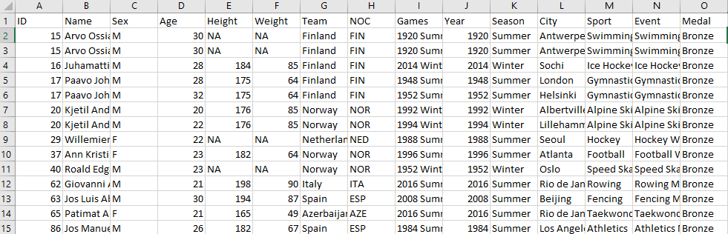
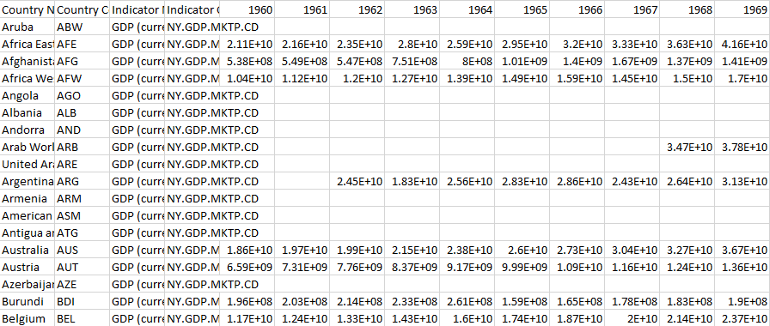
Resources
There are two data sets used for this project. A collection of 120 years worth of Olympics performance data from Kaggle and GDP data from 1960 to ~2022 from worldbank.
https://www.kaggle.com/datasets/heesoo37/120-years-of-olympic-history-athletes-and-results
https://data.worldbank.org/indicator/NY.GDP.MKTP.CD
https://github.com/JBaconQa/cs2704project

Slide 6
Planned Procedures
To do the statistics required for the datasets used in this project, python will obviously be used along with statistical packages to aid in the actual analysis on the data.
Multiple test sets using segments will be run and compared if possible to confirm that the data can be “related” and plotted on a graph. (ex: C1[GDP + OP] vs. C2[GDP + OP])
Once the test sets are complete, then specific tests will be chosen and run on the full data and graphed.
Then the test will be run again with random data segments removed to check whether the results have a similar trend to the complete data set tests.

Slide 7
Expected Output
I personally feel as though there will be a good connection to my hypothesis and the actual output. There is also some things that I feel will greatly skew the results of the test. That is because there are certain world events that occur that cause whole nations to become infatuated with an idea. Which can sometimes be a sport, and if there are cases like that, which there most likely has been cases like that, then it is very possible for those infatuations to skew the output no matter what the GDP actually is whether better or worse.

Slide 8
Extra Results
Performance of countries based on summer vs. winter and if their GDP also affects summer and winter performance in the olympics.
Average age of competing athletes in the olympics per year compared to the GDP of said year.
Best sports for each country and if it changes along with GDP or by itself.

