Slide 1
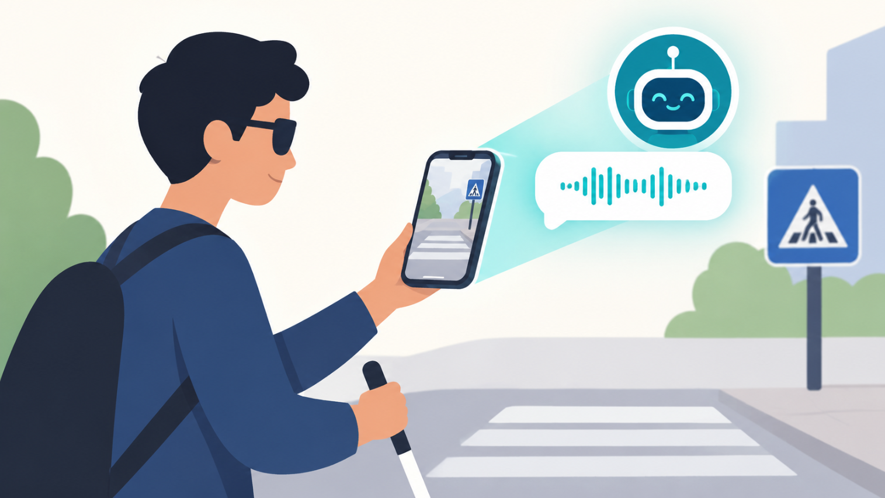
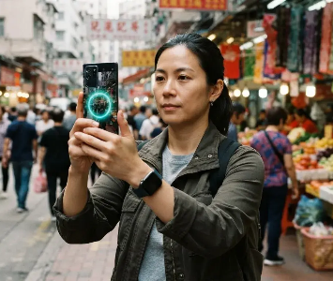
Prasunethon 2.0 Pitch
ANVAYA
See. Understand. Explain. Alert.
AI-Powered Accessibility
Assistant for Blind & Low-Vision
Users
Presented by J Bahulika

Slide 2
Everyday Information
Bills. Signs. Instructions. Objects.
Isn't Accessible to
Hazards.
For blind and low-vision users,
Everyone
understanding everyday visual
information can require assistance or
multiple tools.
READ
Understand bills, signs &
documents
UNDERSTAND
Know what objects &
scenes mean
ALERT
Focus on important
hazards & warnings

Slide 3
Meet ANVAYA
An AI accessibility assistant
that turns visual information
into clear, spoken guidance.
SEE
UNDERSTAND
EXPLAIN
PRIORITIZE
SPEAK
Capture what’s around
AI interprets the scene
Makes information
Highlights what
Delivers clear voice
you
easy to understand
matters most
guidance

Slide 4
ANVAYA in Everyday Life
One assistant. Many everyday
situations.
01
Read
02
UNDERSTAND
“Your bill is ₹2,840. Due August 25.”
“This sign means the entrance is on the left.”
03
ALERT
04
ASK
“Stairs ahead. Please proceed carefully.”
“What do I need to do here?”
05
SIMPLIFY
06
EVERYDAY OBJECTS
Turn complex information into plain language.
Identify and understand what’s around you

Slide 5
From Camera to Conversation
Visual input → AI understanding → Accessible guidance
Contextual-
1
2
ization
3
AI Vision
AI prioritizes
Voice Output
important
AI interprets visual
information
AI converts
context
prioritized data to
voice

Slide 6
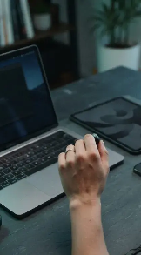
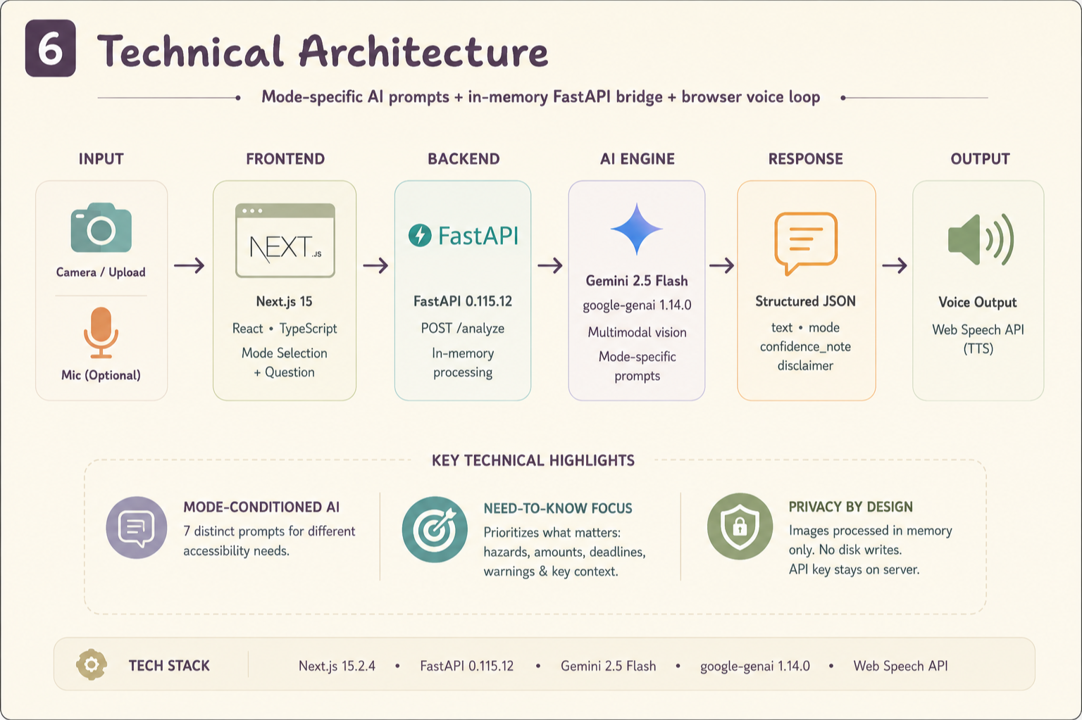

Slide 7
How Can ANVAYA
Impact: Greater independence,
less information overload, and
Grow?
easier access to everyday visual
information.
BUILD
INCLUSIVE
SCALE
OFFLINE
Core Assistant
Indian
Eyewear
No Internet
Languages
Access
Required

