Slide 1

Branch and Bound
2Lt Jeremy Banks

Slide 2
Application to research
Solving the WTA problem
Used by Gibbons (who took their solution from Ahuja)
“has become the most commonly used tool for solving NP-hard optimization problems” – Wikipedia
Searching for a faster way to achieve optimums
Notes:
Jeremy, this isn’t reinforcement learning… how does it apply to your research?
Alex needed optimal solutions to the WTA problem. This technique was used by both Gibbons and Ahuja
According to Wikipedia, it is the most commonly used tool for solving NP-hard optimization problems
Alex and I were looking for a faster way to calculate optimums because OR-tools was far too slow

Slide 3
The algorithm
S
Notes:
Let’s pretend that the S-node is our start node, and all edges are directed down

Slide 4
The algorithm
Use an upper-bound heuristic and store that solution as the Best-So-Far
Notes:
A common upper-bound heuristic is the greedy algorithm due to it’s simplicity and low memory/search requirements.
What we want from this is a worst-case scenario that isn’t completely out to lunch
We don’t just store the cost, but also the full solution, so that we can seed our search space.

Slide 5
The algorithm
Use an upper-bound heuristic and store that solution as the Best-So-Far
Add all of the nodes in the heuristic solution to a stack
Notes:
The start node is at the bottom of the stack, and the final node is at the top.

Slide 6
The algorithm
Use an upper-bound heuristic and store that solution as the Best-So-Far
Add all of the nodes in the heuristic solution to a stack
Pop the last node in the stack
If the node is terminal, evaluate it and compare it with B
Store better solutions, discard all others
Notes:
B being the best-so-far.
We evaluate the whole solution against our objective function

Slide 7
The algorithm
Use an upper-bound heuristic and store that solution as the Best-So-Far
Add all of the nodes in the heuristic solution to a stack
Pop the last node in the stack
If the node is terminal, evaluate it and compare it with B
Store better solutions, discard all others
If the node is non-terminal, branch on that node
Calculate lower-bounds on the child nodes
If the lower-bound > B, we discard that node
otherwise it goes into the queue
Notes:
Branch means that we produce a list of candidate nodes. These are child nodes that have not yet been evaluated
Bound means we determine the bound on each of the candidate nodes
The lower bound is the best-possible solution that this candidate node can produce, so if the node’s best-possible is worse than our best-so-far, we won’t waste compute-power evaluating its children.

Slide 8
A*
infinity
Use an upper-bound heuristic and store that as the Best-So-Far
Add all of the nodes in the heuristic solution to a stack
Pop the last node in the stack
If the node is terminal, evaluate it and compare it with B
Store better solutions, discard all others
If the node is non-terminal, branch on that node
Calculate lower-bounds on the child nodes
If the lower-bound > B, we discard that node
otherwise it goes into the queue
the root node
heap
heap
Notes:
The main differences are that A*
starts with infinity as the “best-so-far”
Uses a heap to track the lowest heuristic/distance combination
It only pushes the root node into the heap, rather than a heuristic solution

Slide 9
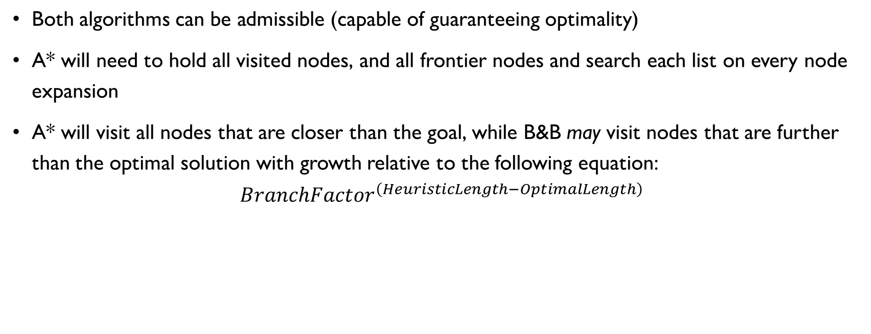
Comparison
Both algorithms can be admissible (capable of guaranteeing optimality)
A* will need to hold all visited nodes, and all frontier nodes and search each list on every node expansion
A* will visit all nodes that are closer than the goal, while B&B may visit nodes that are further than the optimal solution with growth relative to the following equation:
$$BranchFactor^{\left(HeuristicLength−OptimalLength\right)}$$
Notes:
Admissible means that no candidates OVER-estimate their cost, so the true cost will always be greater.
This is required in order to meet A*’s extended list benefits
B&B’s initial heuristic solution could send us to nodes that are much further than we would end up going. While pulling nodes off the stack, we could be evaluating each of those nodes. The end result will be roughly equal to the
Because B&B is guaranteeing optimality, it needs to search the same space that A* searched
Length being in respect to the number of nodes

Slide 10
Why not just use A*?
Time constraints
Memory Constraints
Practice makes perfect
Notes:
With A*, we don’t have any solution until we finish our search. With Branch and Bound’s heuristic solution and iterative shallowing, we can bail out if we run out of time where we may have found a solution somewhere between the heuristic and the optimal
Because we’re using a stack instead of a heap, and we don’t need to maintain a list of all of the frontier nodes, we will use less memory, and we will have fewer page faults from bouncing around trying to re-order our heap.
A* may search fewer nodes, but because of the fewer page faults from B&B it could search faster, especially in scenarios where the search spaces of both algorithms are identical, like the case where the heuristic solution is the optimal solution.
Ahuja claims that as problem size grows, the depth-first style of B&B is much faster, I attribute this to the lower memory-constraint above.

Slide 11
Summary
Can guarantee an optimal solution
Searches the space and doesn’t need to reach completion for a valid solution
Lower memory requirements than A*

