Slide 1
SPECIALISM PROJECT - SCALA
QA CINEMAS
Ayub, Iqra, Jake, Jasdeep, Simon
Feb 2021

Slide 2
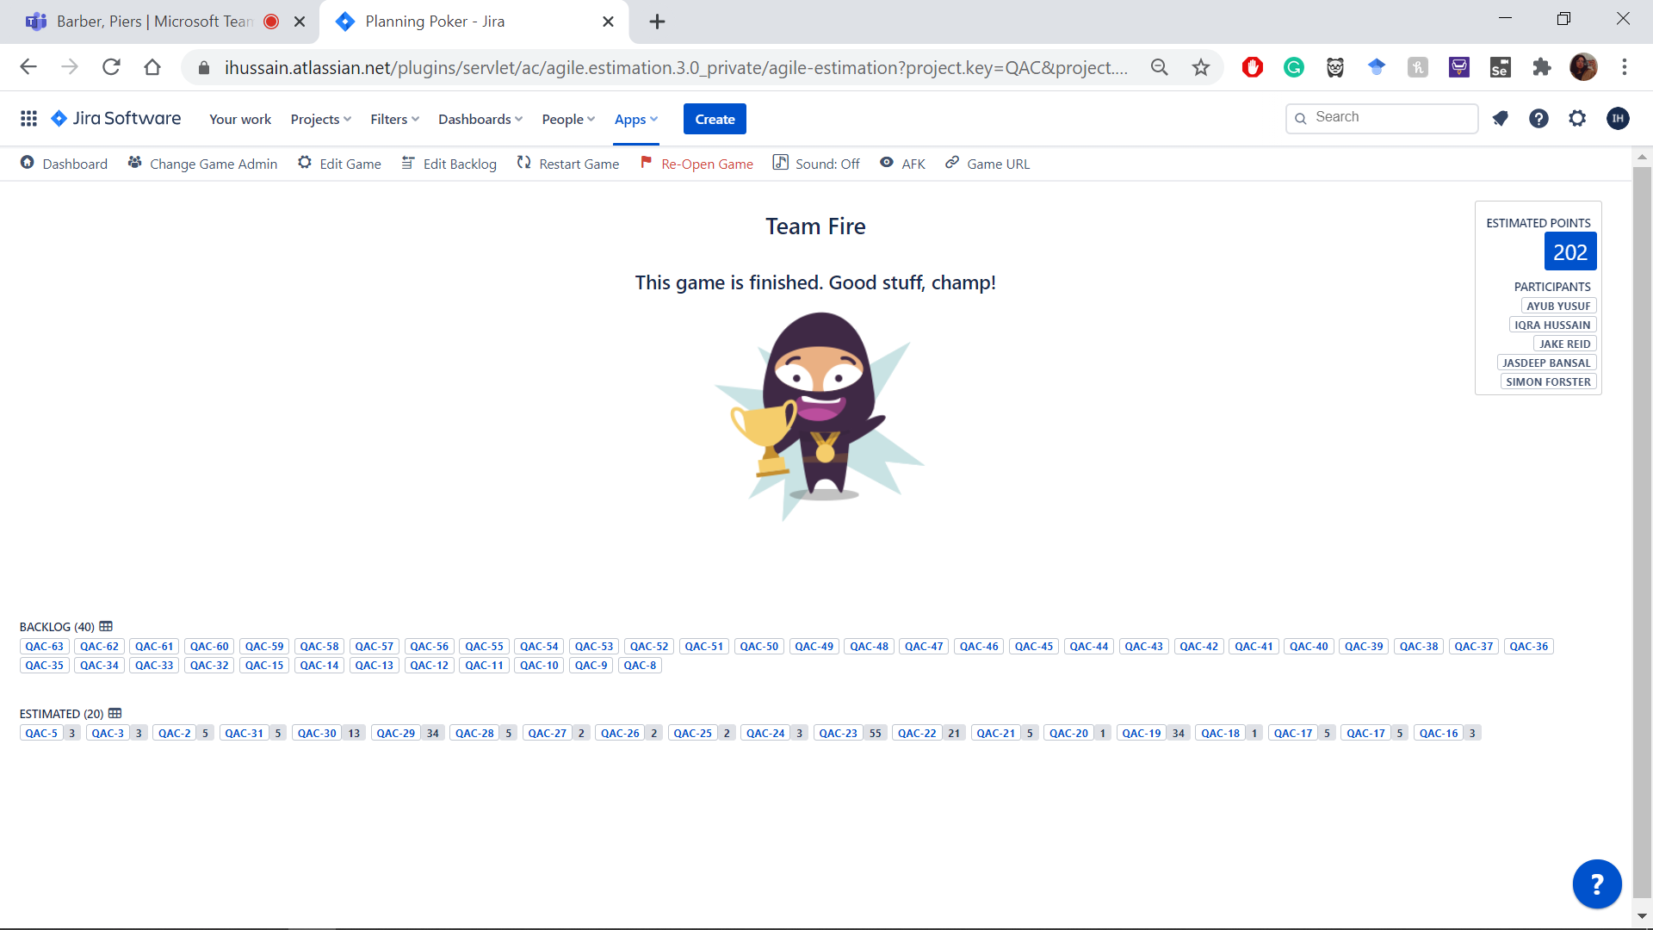
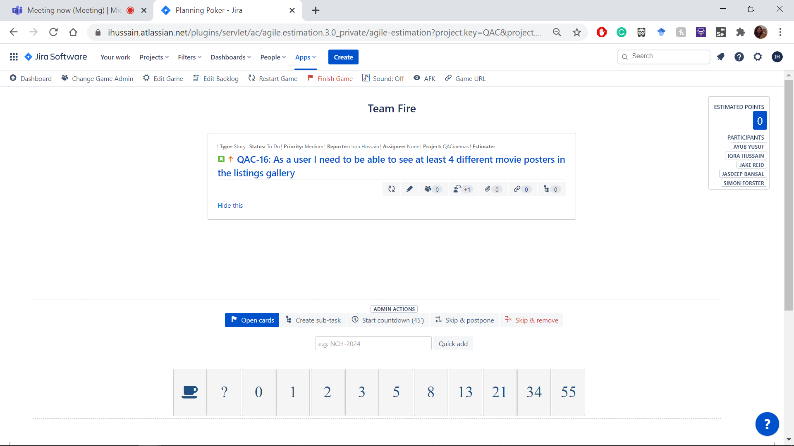
DESIGN - JIRA
Project breakdown
Planning poker
Notes:
Within the beginning of the project as a team we broke down the websites specification, creating user stories,epics and sub tasks within jira.
After breaking down the project into its respective tasks we then used planning poker to assess the effort needed for each task, this proved to be very helpful through project and enable us to strategize tasks based on their effort level and importance.

Slide 3
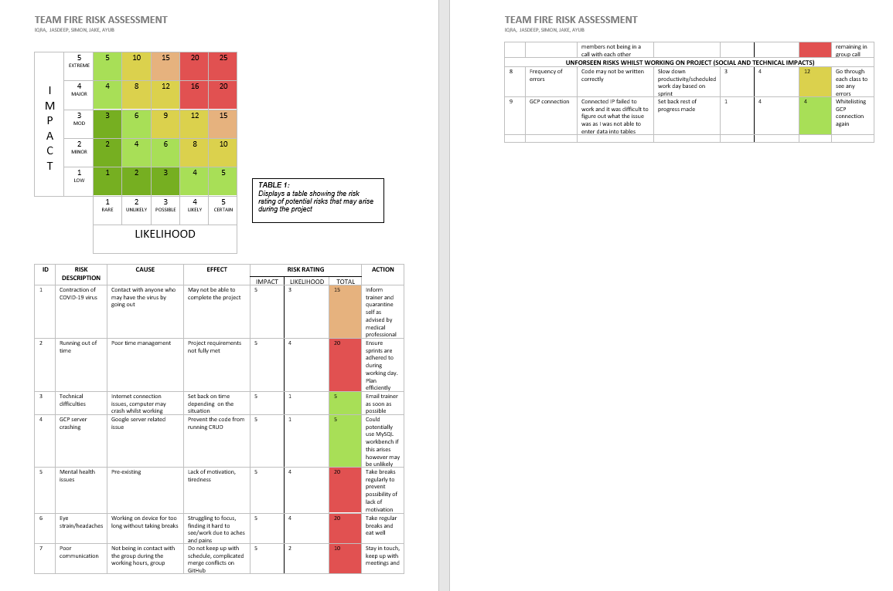
DESIGN - RISK ASSESSMENT
Notes:
Within the first stages of planning we initialized a risk assessment highlighting areas where problems could arise and their effect,
ranking them in two key areas the severity of the problem and the likelihood of them occurring. We then gave a overall value for the problem based off these two areas and wrote a possible solution.
We also added a section for unforeseen risks during the time we were working on the project as it had a great impact on our project

Slide 4
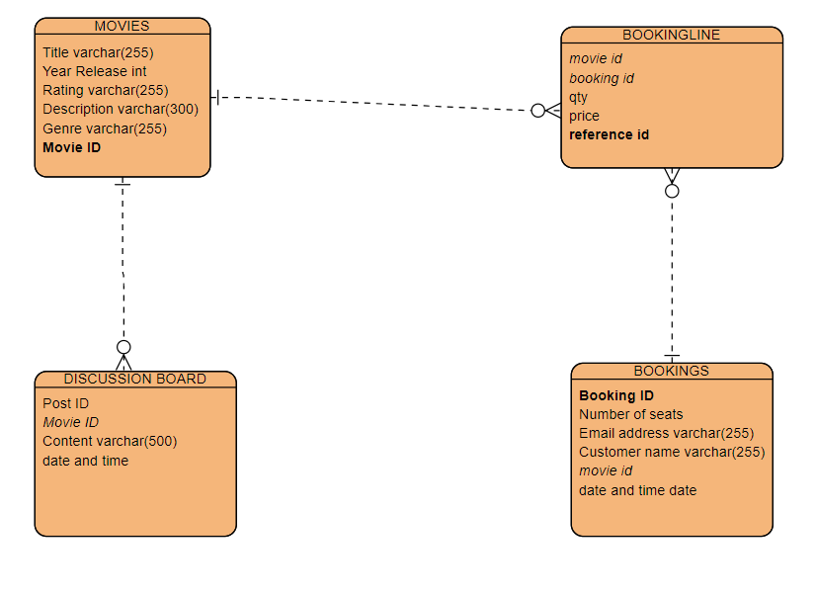
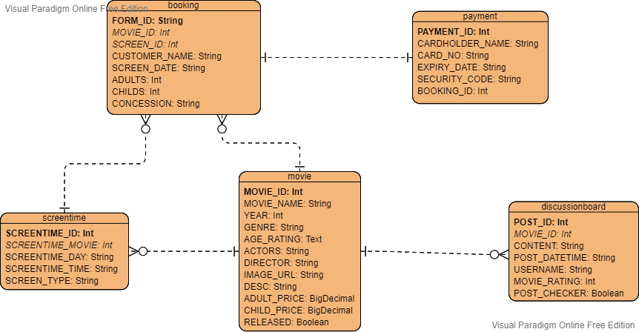
DESIGN – ERD
Planning ERD:
Final ERD:
Notes:
We started with a basic ERD diagram with 4 tables
Discussion post can contain only one movie
But a movie can appear in many different discussion posts
User can book a movie with intermediary table to handle many-to-many
2 changes were made
We added an extra table for screentimes
A screentime can appear in many bookings
A movie can have many different screentimes
We also created a payment table
It has a booking foreign key
A boolean post-checker was added to the discussion board to allow for moderation - Its default is false until it is set to true on the admin page
A boolean released was added to movie so that the listings gallery only shows movies with released=true

Slide 5
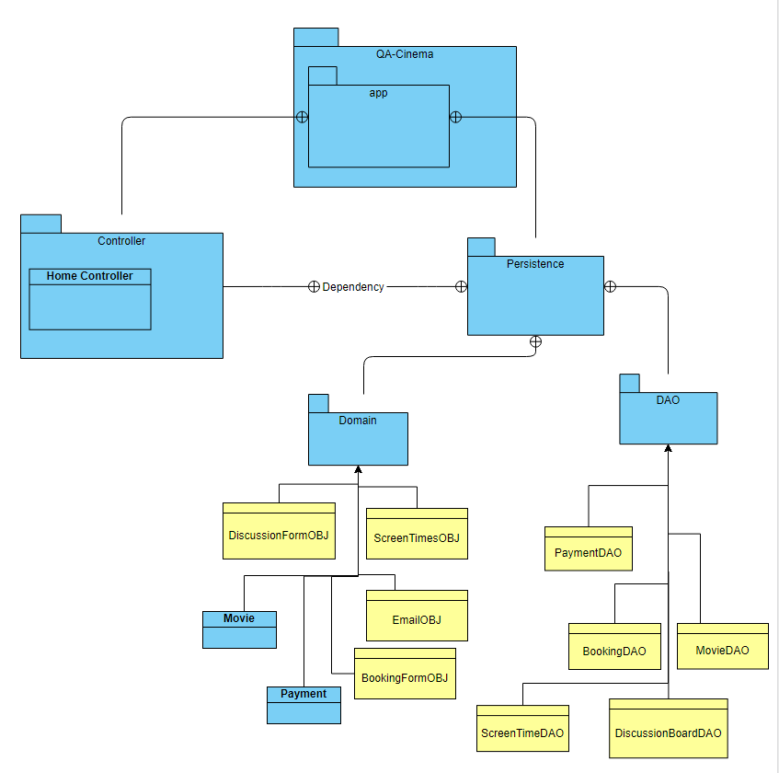
UML DIAGRAM

Slide 6
CONSULTANT JOURNEY
Version Control System: Git
Source Code Management: GitHub
Scrum Board: Jira
Full-Stack Development Technologies: PLAY Stack
Database Management System: MySQL
Back-End Programming Language: Scala
API Development Platform: Play
Front-End Development Framework: Twirl
Unit Testing: FlatSpec, Selenium

Slide 7
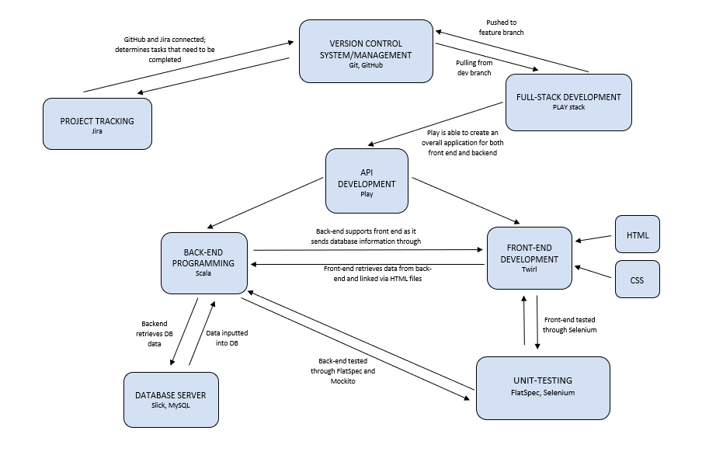
CI PIPELINE
Notes:
Here we can see how the project all comes together. The entirety of the program was created using the Scala programming language however, with Twirl, the program is able to render values through the implementation of a toString. This is how both the front end and back end are linked together. You can also see that for the database server, we used SQL so data could be retrieved from the server and implemented into the backend. Slick is specifically used to support the mySQL database and we used SQL workbench which was backed up by a JDBC driver dependency.
As for unit testing, we used FlatSpec which is a behaviour driven style of development. It is able to mock aspects of aspects of the webpage which we’ll see later. These mock tests were produced for the backend and for the front end we used an extension of flatspec which allowed us to use selenium which is able to test if the webpages are able to function as they are supposed to.

Slide 8
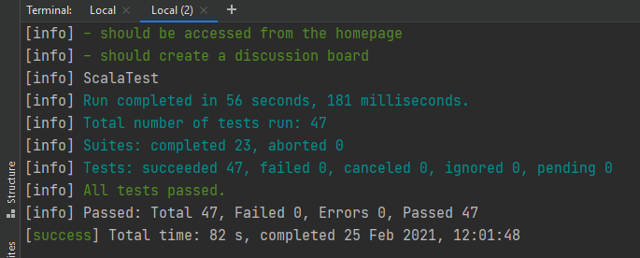
TESTING
23 test files
46 running tests
All pass with 0 fails
Notes:
.

Slide 9
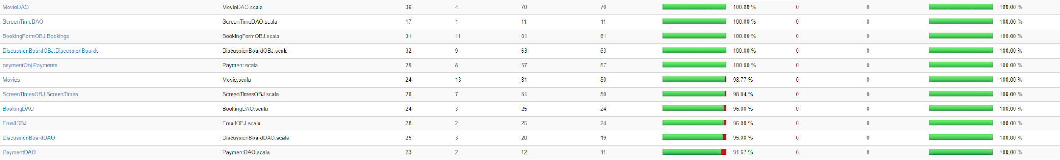
Testing Cont.
Coverage is 21.99%
Coverage is of the industry standard
Low because of what we couldn’t test
Notes:
Selenium testing - Jacoco (failed test which took up too much time) ; research process to find a way in which an output for selenium coverage was extensive. This is because there were many dependencies that failed to work as they were outdated/not able to support the sbt version. Jacoco is a commonly used test which is able to provide coverage results, however the issue was that it was not able to provide a file which displays the percentage of the overall coverage

Slide 10

DEMO
Notes:
DEMO STRUCTURE
Homepage - Jake
About tab - Jake
Movies - Simon (listings and releases)
Screens & Classifications - Iqra
Bookings - Ayub
Getting there - Iqra
Discussion Board - Jasdeep
Surrounding Venues - Iqra
Search - Simon

Slide 11
COMPLETED
RETURNED TO BACKLOG
Working website
Nearly all static pages
All functionality present
Partial testing completed
Navbar (final design)
Surrounding Venues (Static page)
Bookings
A fair amount of testing
Notes:
[Intro]
Hi, I’m Simon and I’m going to be talking through the specifics of our two sprints over the last couple weeks.
In our first sprint, which we planned to last 5 days over the first week, we had planned to achieve a working website that would fit the MVP.
[Completed]
We nearly managed to reach our goal during that time.
To specify what we managed to accomplish
We got a working website to run
With nearly all of the static pages working such as about us
We had all the backend functionality for the MVP working to an extent
A decent portion of the testing completed
[Returned to backlog]
What we did not manage to get done during this sprint which we had planned or wanted to included
The final navbar layout as we decided to hold off until all the pages were done
The surrounding venues pages hadn’t been completed
Although we had the core of the bookings and payments working, we put in back in the backlog as integrating them together had not been done
A decent amount of testing hadn’t been completed, given the fact the pages would have a different structure in the following week

Slide 12
SPRINT 1 RETROSPECTIVE
What went well:
Covered majority of the MVP
Went quite quickly
What could have gone better:
Started using coverage for testing earlier
Planned more at the start
Notes:
[Retrospective]
Now to give some points about what we did that went well and what we could have done better
[Went well]
We worked through a large workload quite quickly, nearly completing our planned goal for the week.
We worked through it quite quickly and still didn’t manage to complete our objective, so following into what could have gone better:
[Could have gone better]
Our objective of having an mvp including testing done in the first week was perhaps a little too grand, so putting more thought into that and reducing the load of the first sprint could have made the process smoother
We had no clue of how much coverage our testing in the first week was achieving, so maybe putting more time into setting up the project with all the testing resources would have been better in the first week
We ran into some design restrictions/refactoring during the end of the first sprint, and the start of the second sprint which could have been avoided by spending more time planning at the start
Our first sprint was a week Monday - Friday, on the Friday we completed our first sprint we had done a very good job at completing our tasks that we had set in out in our sprint with over 90% of the tasks being completed, the one that we had left were smaller tasks as we prioritised functional tasks for the first week, the tasks and user stories we had left got moved back to the backlog for the next Sprint.

Slide 13
SPRINT 2 REVIEW
COMPLETED
RETURNED TO BACKLOG
Static pages
Polished functionality
Testing >90% over DAOs and Domains
Needed to update a fair amount
Didn’t have time to implement GCP
No time to add an actors many-to-many table
Concession
Use an actual payment processor
Notes:
The previous sprint being what it was meant we had a somewhat clear focus for the second one consisting of embellishing the website, implementing the missing pieces and completing the testing.
[Completed]
This sprint, we managed to complete
All the static pages
The functionality, as well as polishing it making it more user friendly
And the testing, which needed a lot of updating as for
[Returned to backlog]
As this was the final sprint, whatever didn’t make it in here didn’t make it to the final product
What we didn’t manage to achieve was
Using GCP, we didn’t have time to configure a GCP mysql instance
We couldn’t add an extra table containing actors and a many to many relationship with movies, which would have allowed for better functionality
Our concession implementation is quite lacking and we would have liked to expand on that, giving the customers a menu to choose from
And finally we didn’t have time to implement an actual payment processor such as PayPal, we just showed that we could take payment details

Slide 14
SPRINT 2 RETROSPECTIVE
What went well:
Communication was effective and efficient using scrum.
We gave ourselves a full day for documentation.
What could have gone better:
Should have made sure testing and building was consistent
Chose not to style forms too much
Notes:
Looking back on this sprint, we have our final product.
Our communication and task delegation felt effective, and we were able to spend a full day on working on the presentation and documentation.
What we could have done better was prepare our testing suites and building tools earlier in order not to encounter as many issues with them at the end
And we decided not to try and style the forms too much as that would have seemed to take a lot of time
Finally, given more time, we could have implemented more features, knowing when to drop certain tasks would have saved us some time
Pass to iqra

Slide 15
CONCLUSION
Working with Scrum proved to be very successful as it created efficiency within the team
Scala is extremely useful although it is difficult to find credible sources which are useful as it is quite niche
The Play Framework proved to be useful as it combines both front-end and back-end processes
However, many things that can be used with Java (for example) are not compatible

Slide 16
THANK YOU FOR LISTENING

