Slide 1


Data Analysis
France Adventure Planner:
Looking for a weekend getaway destination?
Jean-Baptiste Allombert

Slide 2


Data overview :
The France Adventure Planner project is based on collecting and analysing weather and hotel data to help Parisians choose the best weekend destination based on real-time weather conditions
Multiple sources :
OpenWeatherMap API Provides detailed weather forecasts (temperature, weather conditions, rain probability, etc)
Nominatim API Retrieves Latitude & Longitude coordinates for selected cities.
Scrapy (Web Scraping) Extracts hotel recommendations from Booking.com.
GitHub Actions Automates the script execution to update data daily.

Slide 3
Objectives
The France Adventure Planner was designed with the following key objectives:
Help Parisians find the best weekend destinations based on real-time weather conditions.
Offer a user-friendly experience through an interactive Streamlit web application.
Enhanced decision-making with an all-in-one platform for seamless getaway planning, integrating weather forecasts, hotels and trains recommendations.
Automate data collection and processing to provide up-to-date insights without manual intervention.

Slide 5


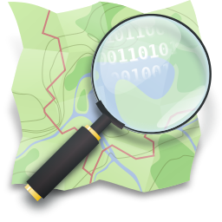




50 Cities | +400 Entries per day
Day +1
Day +2
Day +5
Day +3
Day +4
Automated every day at 9:30PM (UTC)
300 Cities
Full Dataset
Actions
8400 New entries per day

Slide 6
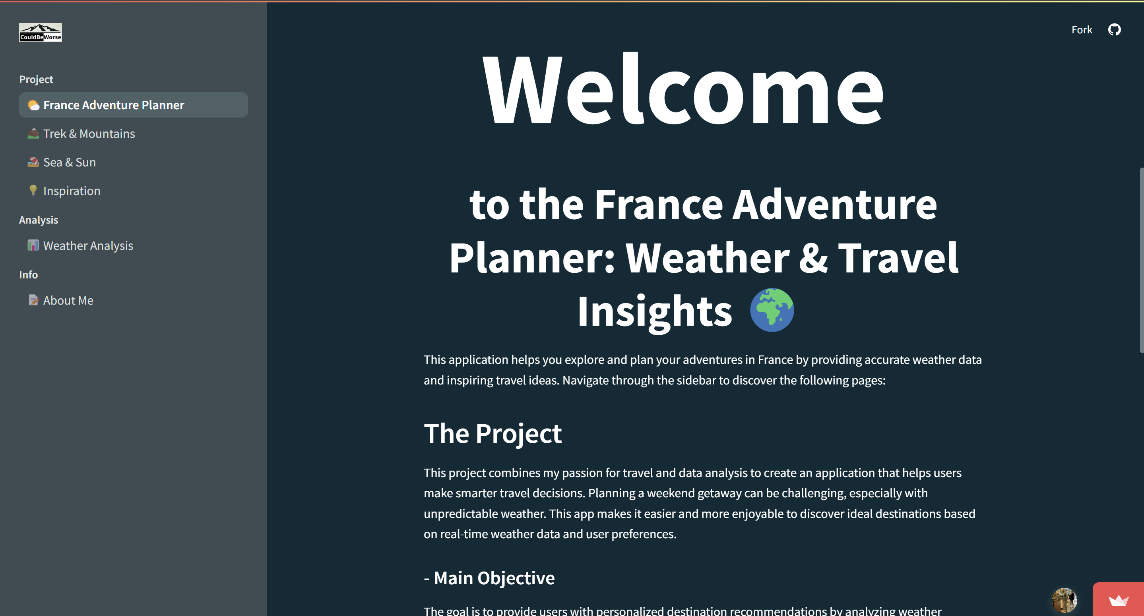
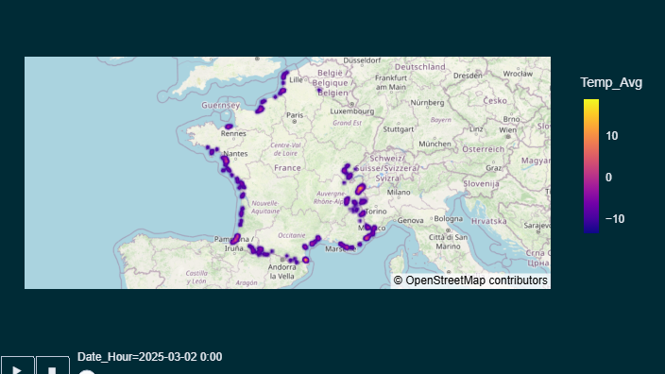

Slide 7
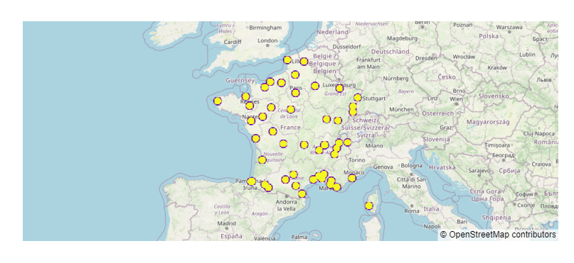
From 250 to 50
Mapping the most Weather-Consistent destinations in France
Notes:
Explanation of the Data for This Analysis
To evaluate the reliability of weather forecasts across France, I collected meteorological data for 50 cities from a larger dataset of 250 locations.
The data was recorded over a two-month period from December 5, 2024, to February 7, 2025, and was structured into 5 separate files, each corresponding to a different forecast horizon:
Jour 1 → Weather forecast for the next day
Jour 2 → Weather forecast for two days ahead
Jour 3 → Weather forecast for three days ahead
Jour 4 → Weather forecast for four days ahead
Jour 5 → Weather forecast for five days ahead
This segmentation allows for a detailed comparison of forecast accuracy over time, helping to identify which locations have the most reliable weather predictions in France.

Slide 8
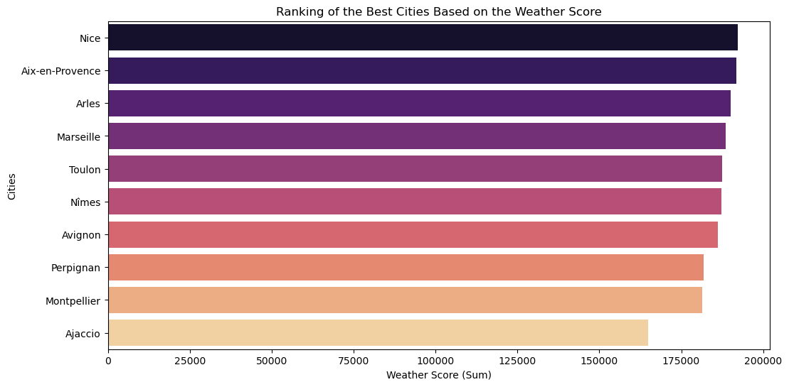
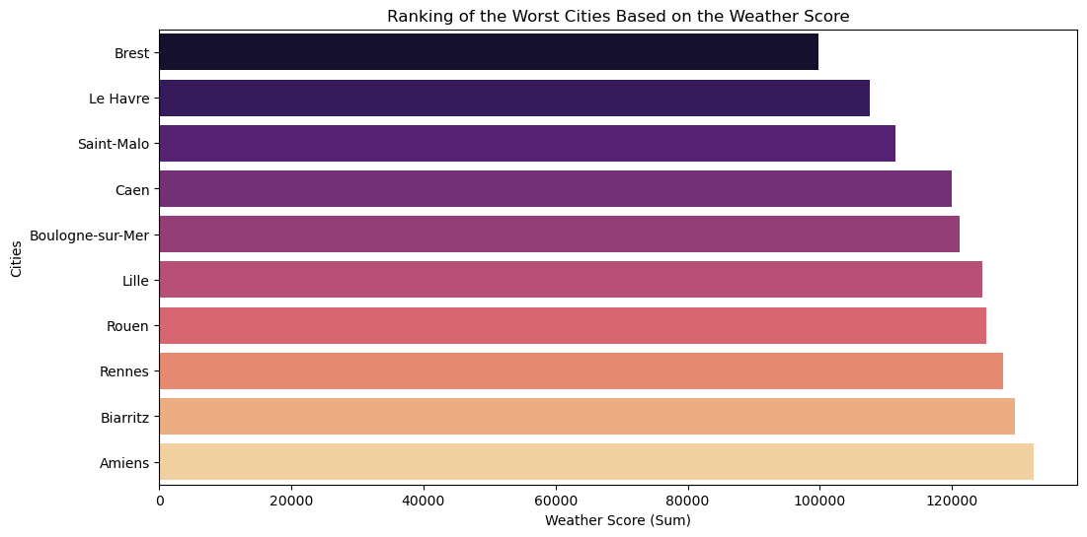
Weather Score
Top 3 cities with the highest score :
Nice 192.370
Aix-en-Provence 191.740
Arles 190.180
Top 3 cities with the lowest score :
Brest 99.870
Le Havre 107.550
Saint-Malo 111.530

Slide 9
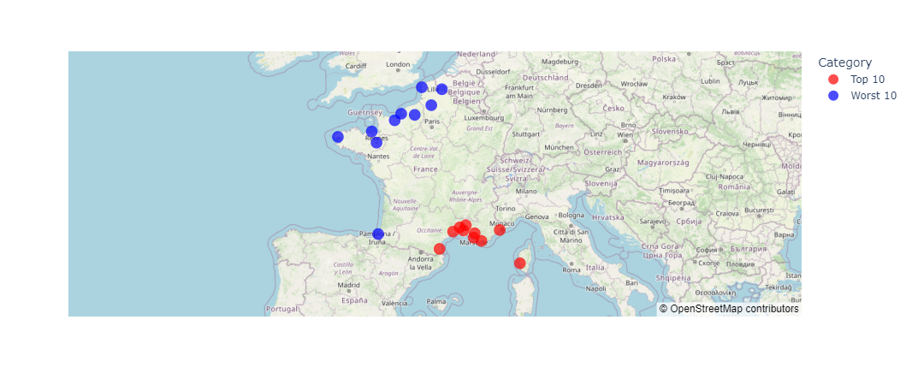
Weather Score

Slide 10
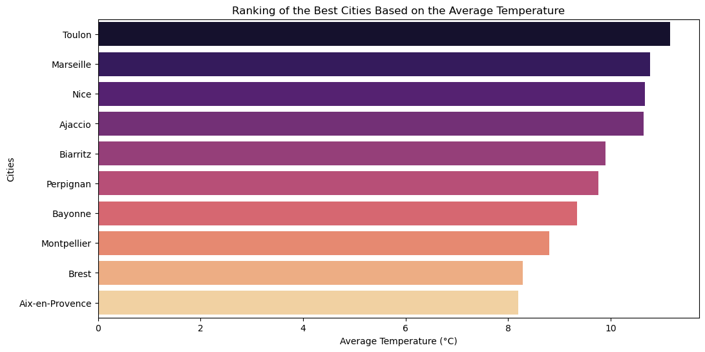
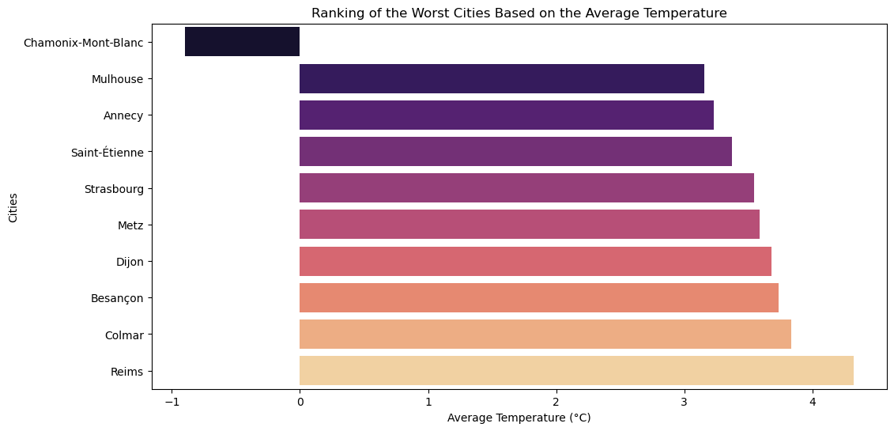
Temperature
Top 3 cities with the highest Temperature :
Toulon 11,16 °C
Marseille 10,76 °C
Nice 10,66 °C
Top 3 cities with the lowest Temperature :
Chamonix -0,89 °C
Mulhouse 3,15 °C
Annecy 3,23 °C

Slide 11
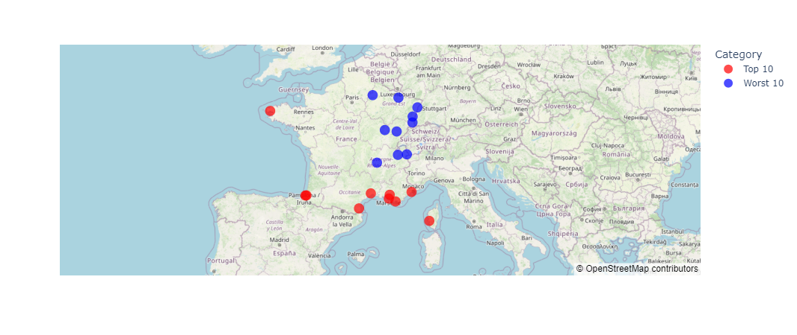
Temperature

Slide 12
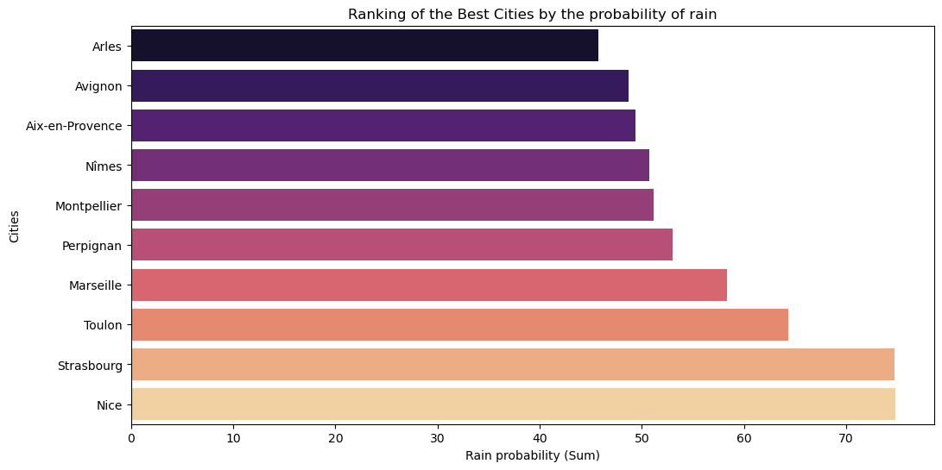
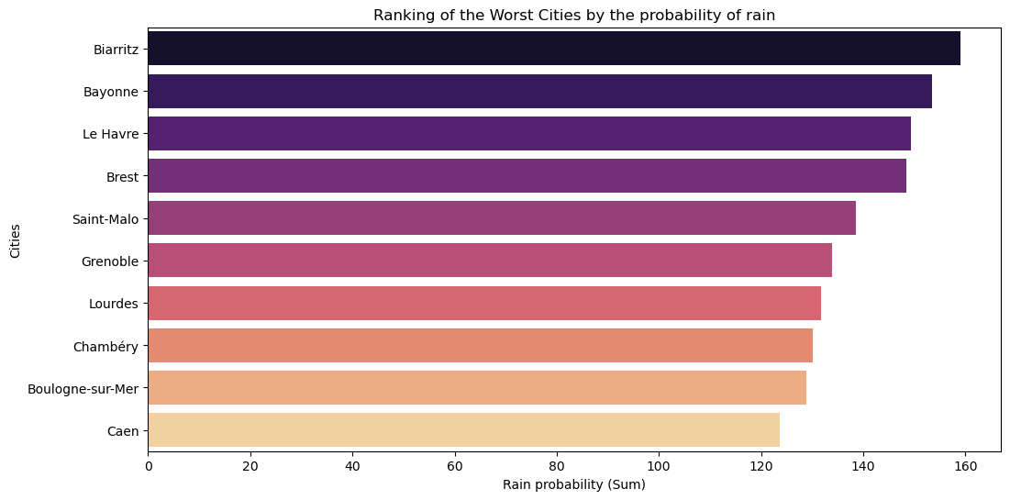
Rain Probability (Score max 520)
Top 3 cities with the lowest probability :
Arles 45,76
Avignon 48,69
Aix-en-Provence 49,40
Top 3 cities with the highest probability :
Biarritz 159,06
Bayonne 153,45
Le Havre 149,27

Slide 13
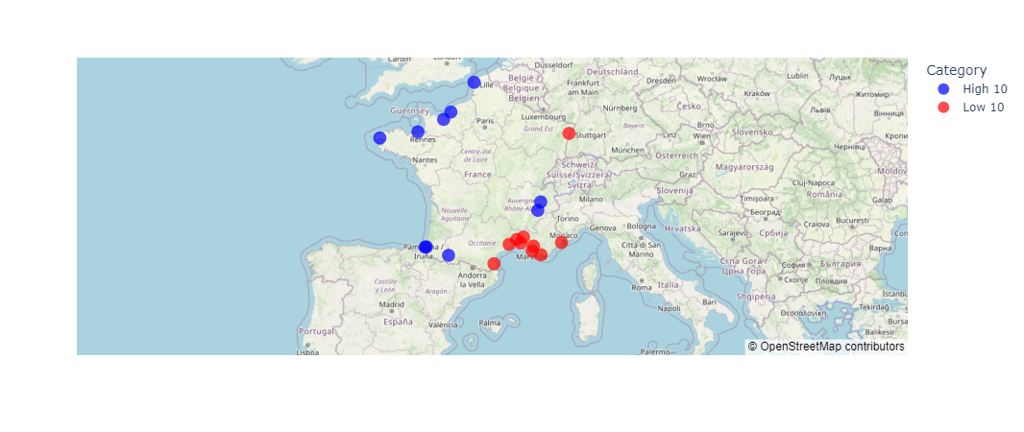
Rain Probability

Slide 14
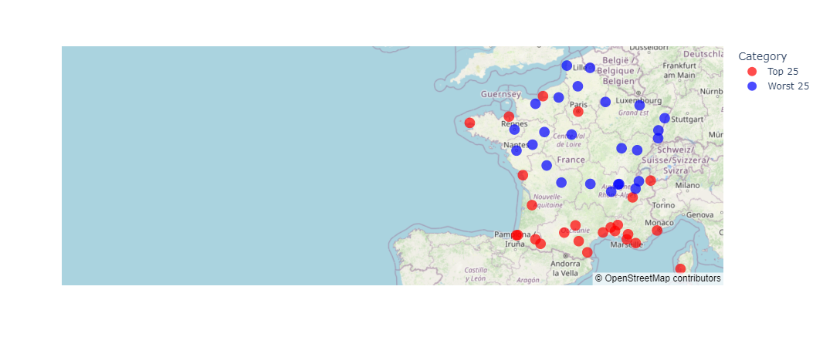
Weather Accuracy
Most reliable cities for weather predictions :
City | Average Score
Nice | 90.05
Toulon | 89.74
Marseille | 88.74
Least reliable cities for weather predictions :
City | Average Score
Rennes | 76.62
Nantes | 77.40
Clermont-Ferrand | 77.70

Slide 15
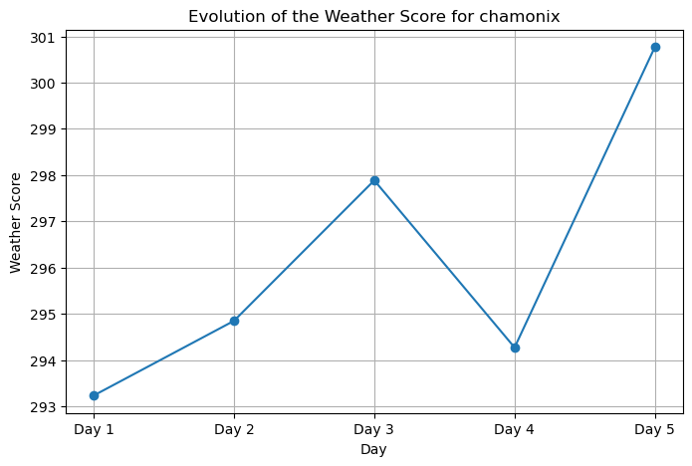
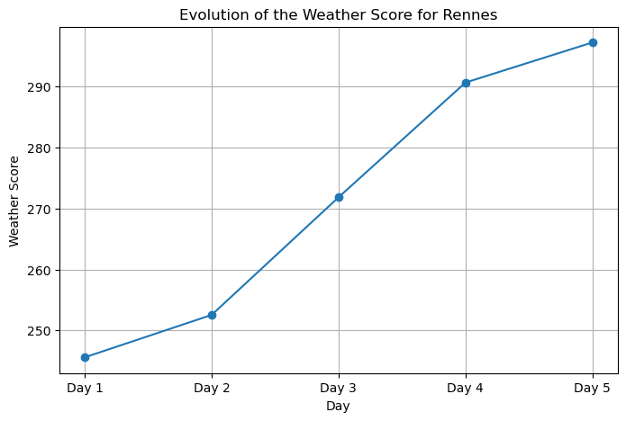
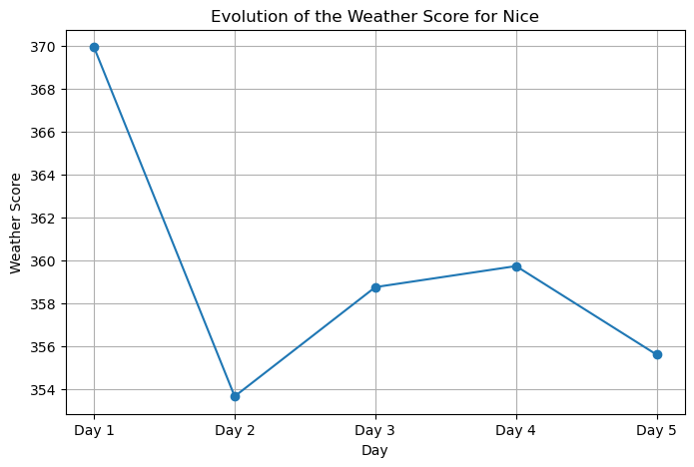
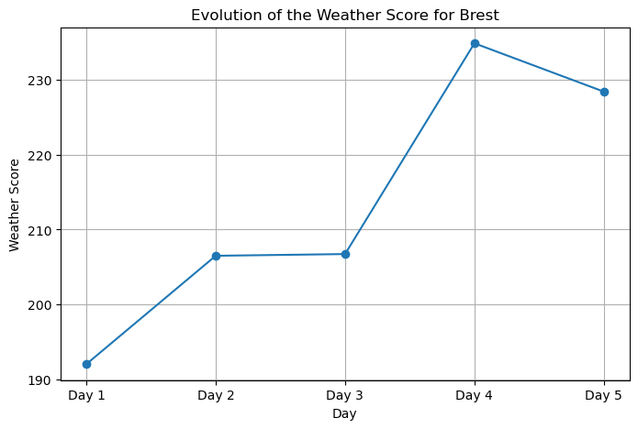
Weather Score Accuracy

Slide 16
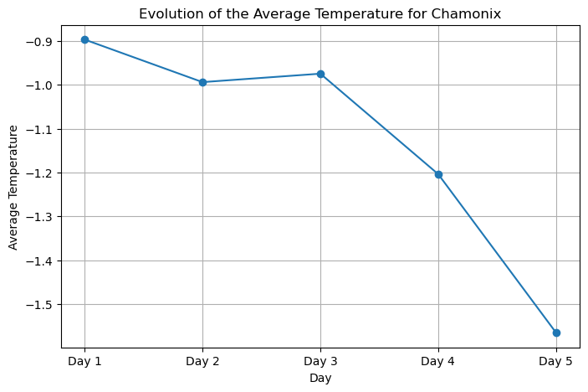
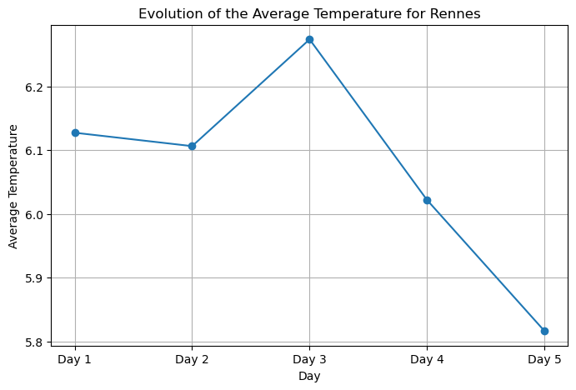
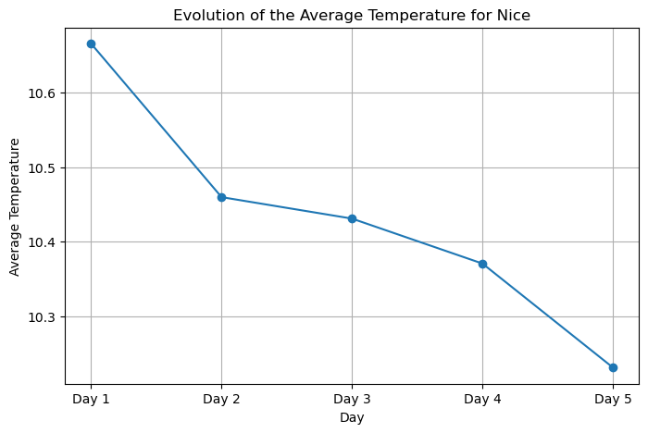
Temperature Accuracy

Slide 17
Improvements:
Increased data storage capacity : Expanding storage capacity to retain more historical weather data.
Paris activity page on the App : Developing a dedicated page providing users with recommendations for cultural activities, concert etc…
Theme Parks and attractions page : Adding a section for amusement parks in France including DisneyLand, Futuroscope and others.

Slide 18
Conclusion :
A fully automated application that helps users plan their trips based on accurate weather forecasts.
An intuitive tool for seamless weekend getaway planning.
An automated trip planner that provides real-time insights while storing data for in-depth analysis.
Notes:
France Adventure Planner is more than just a weather-based trip planner. It is a fully automated application that not only provides real-time insights for users but also stores data for advanced analysis. By leveraging data collection, processing, and visualization, the project offers both immediate usability and long-term analytical value.

Slide 19

Questions ?

