Slide 1
EE/CSCI 451 Introduction to Parallel and Distributed Computation
Discussion #8 3/6/2026
University of Southern California

Slide 2
Announcements
•Project is announced today
Proposal due Wednesday, 3/11 at 11:59PM on Brightspace
Start forming teams NOW!
•Midterm I Review
Sample Exam & Solutions on Piazza + Brightspace
Homework 2 Solutions on Piazza + Brightspace
HW 3 due 3/6 at 11:59PM on Brightspace (solutions posted on Monday)
PHW 4 due 3/9 at 11:59PM on Brightspace

Slide 3
Course Project (1)
Project
–Ideas
Research, Implement and Evaluate
Implement and Evaluate
Complete application parallelization and implementation
Should not be something trivial e.g. parallelizing shortest path or all pair shortest
path is not a good project idea.

Slide 4
Course Project (2)
Research, Implement, Evaluate
–Propose a new parallelization technique for an existing algorithm.
–Implement the parallelization technique using a programming platform
–Evaluate the performance of the parallel algorithm by comparing against the
existing serial baseline
–(Before submitting the proposal, you should have a rough idea of how to parallelize the problem you have chosen)

Slide 5
Course Project (3)
Implement and Evaluate
–Implement 2-3 already existing parallel algorithms
For example, different ways of doing matrix multiplication. NOT DIFFERENT LIBRARIES
(Pthreads, OpenMP)
–Compare and evaluate the algorithms on various benchmarks/datasets
–Benchmark/dataset selection will be an important part of the project
–(Before submitting the proposal you should have an idea of what kind of Benchmark/datasets you should be looking for. This shows that you have understood the parallel algorithms)

Slide 6
Course Project (4)
Complete application parallelization and implementation
–Implement an end-to-end application
–Should have a core parallelizable algorithm
–Should have supporting algorithms for preprocessing/postprocessing
–Evaluation criteria needs to be proposed based on the application
–(You can include a figure in the proposal showing the end-to-end application. Also
include an outline regarding how your project should be evaluated)

Slide 7
Course Project (5)
Project Proposal Template
–Introduction:
Background on the problem
Contributions/hypotheses of the project
–Description of the implementation
Parallelization techniques if proposing a new technique
Selection criteria of benchmarks if comparing parallel algorithms
Description of the application if developing an application
Implementation platform
–Evaluation/Criteria of Success
Mention any datasets, evaluation metrics, that you will be using.
We will evaluate the proposals and give feedback

Slide 8
Example: Research, Implement, Evaluate
Parallelization of the Louvain Community Detection Algorithm For Large Scale Graphs
Problem Definition: Given a graph 𝐺(𝑉, 𝐸) identify subsets of vertices which are densely connected to each other
Contributions
–Develop a parallelization technique for the problem
–A hybrid MPI/OpenMP implementation
–Comparison against serial baseline implementation

Slide 9
Example: Research, Implement, Evaluate
Frequency Domain Acceleration of CNN on GPUs
Contributions
–Develop a parallelization technique for the problem suitable for GPU
–A GPU based implementation
–Comparison against serial baseline implementation

Slide 10
Example: Implement, Evaluate
Benchmarking parallel algorithms for short-range molecular dynamics
Problem Definition: Compare existing parallel algorithms for Molecular Dynamics
(simulating the properties of liquids, solids and molecules)
Contributions:
–Implementation of 2 existing parallel algorithms (discussed in http://www.sciencedirect.com/science/article/pii/S002199918571039X)
–Perform scalability analysis: Evaluate performance in terms of the problem size

Slide 11
Example: Implement, Evaluate
Benchmarking parallel algorithms for collaborative filtering
Problem Definition: Compare existing parallel algorithms for Collaborative Filtering
Contributions:
–Implementation of 2 existing parallel algorithms :
1. Co-clustering¹
2. Alternative Least Squares with Weighted Regularization²
–Perform scalability analysis: Evaluate performance in terms of the problem size
http://ieeexplore.ieee.org/abstract/document/1565742/
http://www.grappa.univ-lille3.fr/~mary/cours/stats/centrale/reco/paper/MatrixFactorizationALS.pdf

Slide 12
Example: Application Implementation
Build a distributed regression tree-based classifier
Problem Definition: A system to perform regression tree-based classification on very
large datasets
Contributions:
–A work scheduling/data partitioning algorithm optimized for regression tree type data access pattern
–Implementation of a system which performs classification.
–Performance evaluation of the system

Slide 13
More Examples
Triangle counting on large graphs using SpMM on GPU
Ray tracer with Pthreads and CUDA: Evaluating CUDA performance on control- intensive applications
Parallel first-order logic inference
Application for Predictive Analysis of Stock Price Data using Parallel Computation of TA
Indicators
Parallelizing Image Processing Filters

Slide 14
Good Projects
Well-defined problem in terms of parallelization (Triangle counting , Ray tracing)
Understand the topic (performance metrics, dataset, terminology, etc.)
Understand the concepts taught in the lecture
Clear hypothesis, and experiments that supports the hypothesis

Slide 15
Common Mistakes
Trivial problem: parallelize matrix multiplication
“what is the non-trivial part of this problem?”
“what are the parallelization challenges?”
Lengthy hypothesis: if you are having more than two sentences/bullet points, you are
doing it wrong
Meaningless experiments
Implemented using Pthreads and OpenMP
Ran on P100, V100, and A100 GPUs
Unreasonable setup (usually due to lack of understanding about the topic and 451)
Small dataset
Unreasonable magnitude of the data
The problem does not need parallelization

Slide 16
Frequently Asked Questions
Is double dipping allowed?
Can you use codes on GitHub?
What kind of topics are qualified as a project?
My teammate disappears
Can you help me debug?

Slide 17
Course Project (6)
Submission:
Provide all necessary items for the graders to run the project (program, datasets,
README files, etc.)
Imagine you are providing a homework folder to the students. You need to provide
all necessary instructions so that others can run your code.
Project should be able to run entirely
E.g. for handwriting recognition, you should provide a set of images which contain handwritten characters as input dataset as part of the submission

Slide 18
Programming Platforms
Pthreads
OpenMP
MPI
GPU
MapReduce
Hybrid of two or more platforms above

Slide 19
The clock is ticking…
Project timeline
Week 7: Identify team members and project topic
Week 8: Project proposal due (Friday, 10/18)
Weeks 13-15: Student Project Presentations
Week 15: Project final report due

Slide 20

Find your teammate

Slide 21
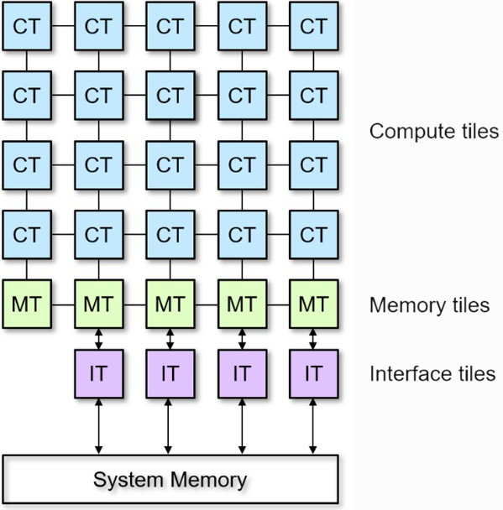
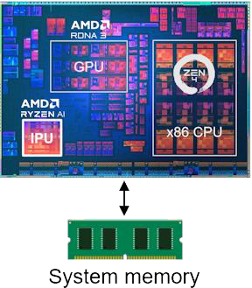
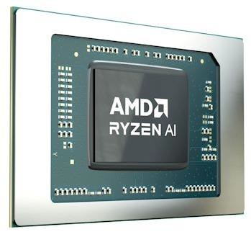
Neural Processing Unit (NPU)
AMD Ryzen AI Neural Processing Unit - AMD Ryzen AI NPU
–Offload computationally intensive AI workloads from the CPU/GPU
–Runs workloads more power efficiently
–Designed to exploit both data level and task level parallelism
–Consists of an array of compute, memory and interface tiles
–More on architecture and dataflow
https://riallto.ai - column architecture
https://riallto.ai - optimizing data flow
Riallto - http://www.riallto.ai
–An exploration software framework for the AMD Ryzen AI NPU
–Consists of a set of open-source materials
videos, Jupyter notebooks, interactive demonstrations, tutorials, etc.
21
This content is protected and may not be shared, uploaded, or distributed.

Slide 22
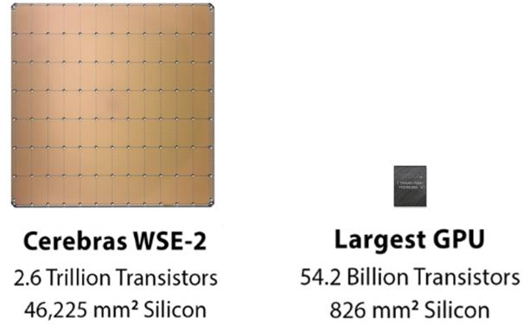
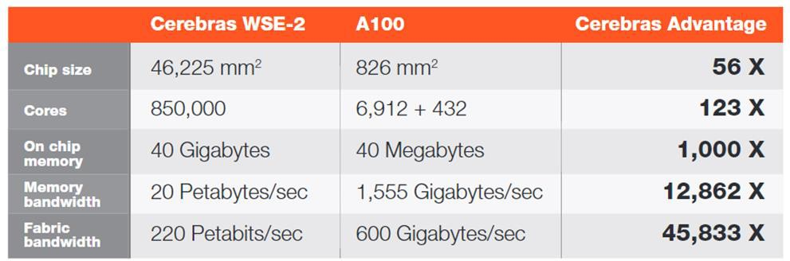
Cerebras CS2: Cluster-on-Chip
Cluster-on-Chip to accelerate deep learning
training
Wafer Scale Engine 2 (WSE-2) processor; a large “square” cut from a single wafer of silicon
Wafer is programmed for each neural network
before a training job
PyTorch/TensorFlow → Kernel Graph → Execution Plan → Executable (via Cerebras Graph Compiler tool)
https://docs.cerebras.net/en/latest/wsc/cereb
ras-basics/how-cerebras-works.html
22
This content is protected and may not be shared, uploaded, or distributed.

Slide 23
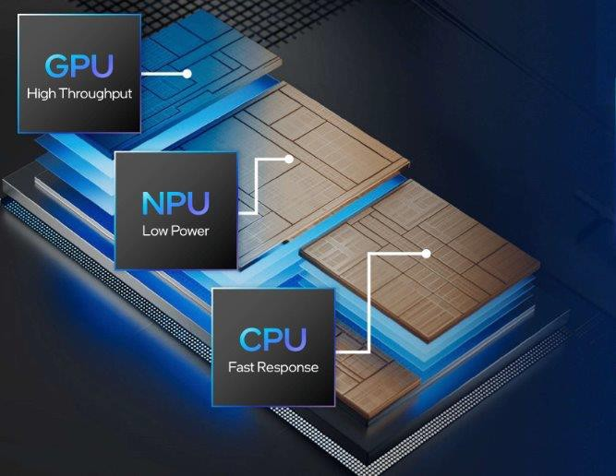

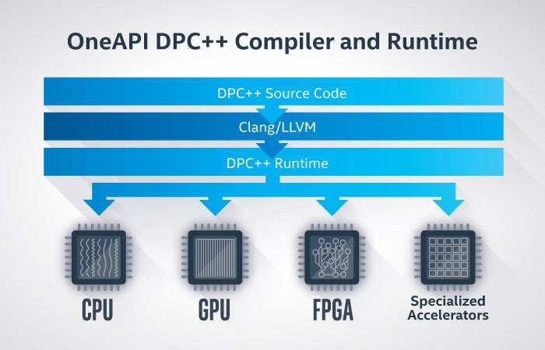
Intel AI PC
Platform integrating CPU, GPU (Intel Arc A380E), and NPU
(Intel NPU)
–Aims at performing AI tasks on-chip without server-side compute
–NPU has efficient bandwidth utilization for AI workloads in
comparison to GPUs
Using it for your project?
–Edge AI Performance: Develop AI models that run directly on local devices
–Parallel Computing Flexibility: Leverage task, data, and tensor-level parallelism for efficiency
–OneAPI Toolkit: Simplify development with Intel's Data Parallel C++
(DPC++) or extend with familiar frameworks like PyTorch
https://www.intel.com/content/www/us/en/developer/top
ic-technology/ai-pc/overview.html#gs.dtd1d9
23
This content is protected and may not be shared, uploaded, or distributed.

Slide 24
Resources
Graph Datasets: http://snap.stanford.edu/data/index.html
Electricity Consumption Datasets: http://www.pjm.com/markets-and-operations/ops-
analysis
Machine Learning Datasets:
https://en.wikipedia.org/wiki/List_of_datasets_for_machine_learning_research
Project Ideas: https://www.cs.cmu.edu/afs/cs/academic/class/15418-
f24/www/projects.html

Slide 25
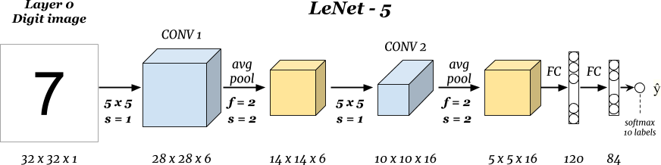
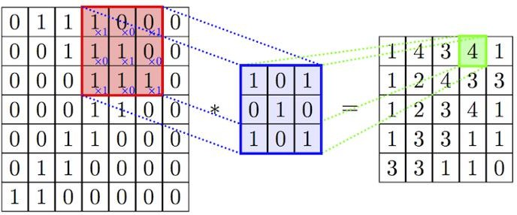
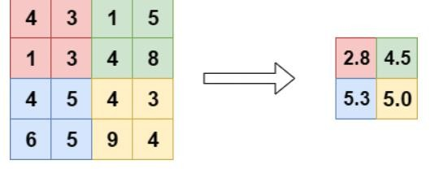
Parallelize Convolutional Neural Network
Convolution
Average Pooling
47
Input image
Filter
Output

Slide 26
Parallelize Convolutional Neural Network: loop parallelism
Pipeline each layer and exploit data parallelism within each layer
48

Slide 27
Parallelize Convolutional Neural Network: task parallelism
Input Image
Multiple task as the same time
i-4
Conv1
AvgPool1
Conv2
AvgPool2
FC
i-3
Conv1
AvgPool1
Conv2
AvgPool2
FC
Barrier
i-2
Conv1
AvgPool1
Conv2
AvgPool2
FC
i-1
Conv1
AvgPool1
Conv2
AvgPool2
FC
i
Conv1
AvgPool1
Conv2
AvgPool2
FC
49
Time

Slide 28
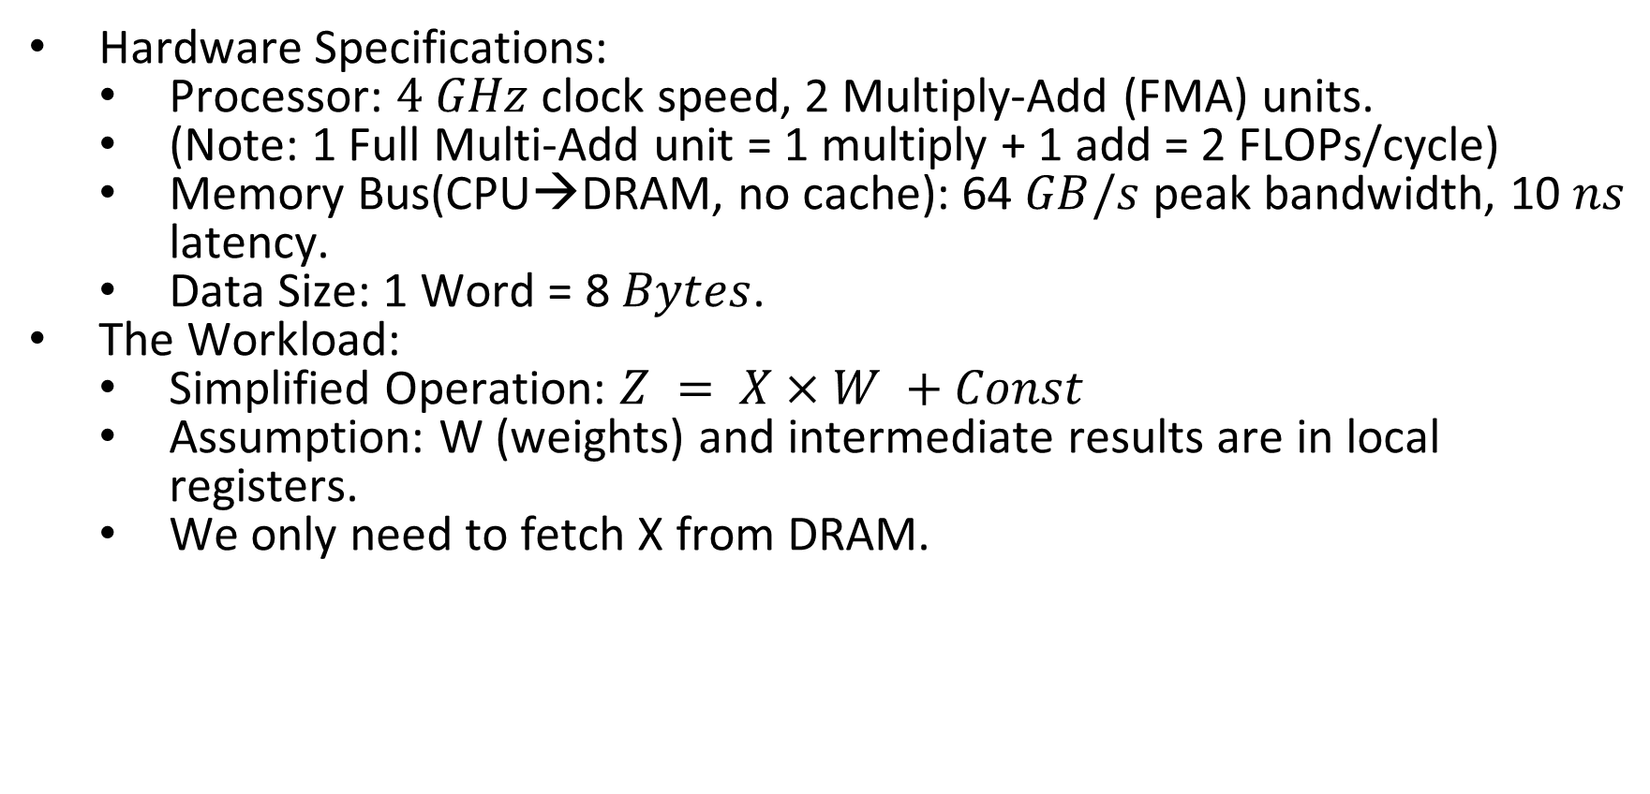
System Performance Evaluation
Hardware Specifications:
Processor: $4 GHz$clock speed, 2 Multiply-Add (FMA) units.
(Note: 1 Full Multi-Add unit = 1 multiply + 1 add = 2 FLOPs/cycle)
Memory Bus(CPU→DRAM, no cache): 64 $GB/s$ peak bandwidth, 10 $ns$ latency.
Data Size: 1 Word = 8 $Bytes$.
The Workload:
Simplified Operation: $Z = X×W +Const$
Assumption: W (weights) and intermediate results are in local registers.
We only need to fetch X from DRAM.

Slide 29
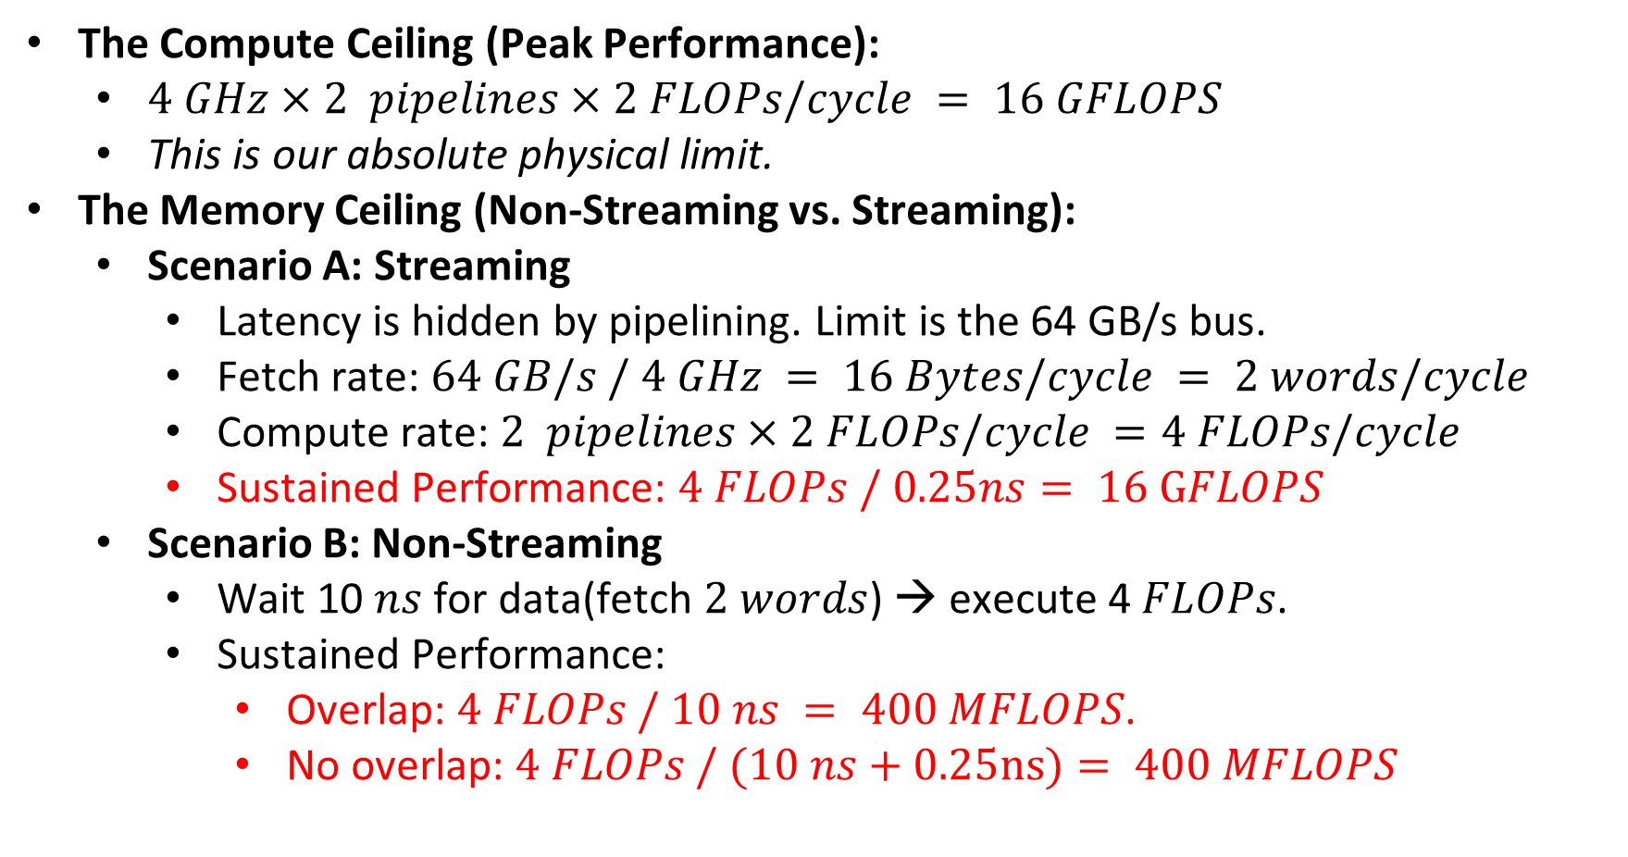
Compute vs. Memory Capacity
The Compute Ceiling (Peak Performance):
$4 GHz×2 pipelines×2 FLOPs/cycle = 16 GFLOPS$
This is our absolute physical limit.
The Memory Ceiling (Non-Streaming vs. Streaming):
Scenario A: Streaming
Latency is hidden by pipelining. Limit is the 64 GB/s bus.
Fetch rate: $64 GB/s / 4 GHz = 16 Bytes/cycle = 2 words/cycle$
Compute rate: $2 pipelines×2 FLOPs/cycle =4 FLOPs/cycle$
Sustained Performance: $4 FLOPs / 0.25ns= 16 GFLOPS$
Scenario B: Non-Streaming
Wait 10 $ns$ for data(fetch $2 words$) → execute 4 $FLOPs$.
Sustained Performance:
Overlap: $4 FLOPs / 10 ns = 400 MFLOPS$.
No overlap: $4 FLOPs / (10 ns+0.25ns)= 400 MFLOPS$

Slide 30
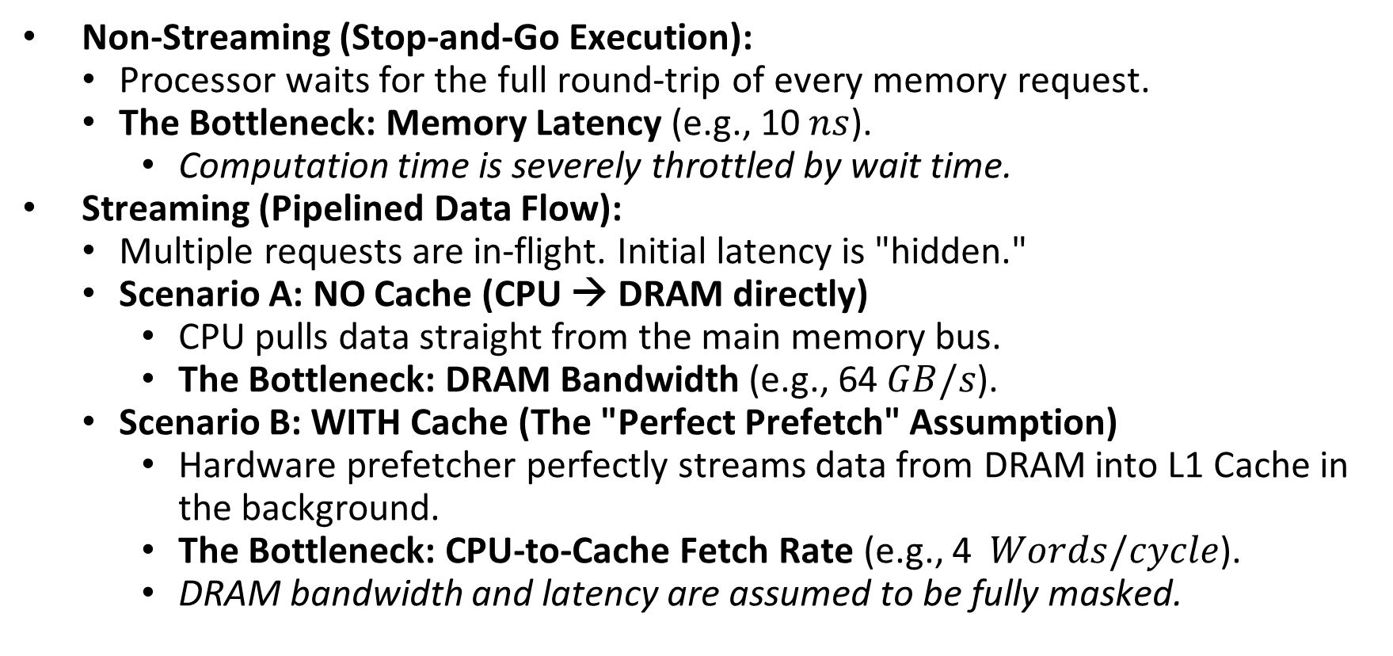
Streaming vs. Non-streaming
Non-Streaming (Stop-and-Go Execution):
Processor waits for the full round-trip of every memory request.
The Bottleneck: Memory Latency (e.g., 10 $ns$).
Computation time is severely throttled by wait time.
Streaming (Pipelined Data Flow):
Multiple requests are in-flight. Initial latency is "hidden."
Scenario A: NO Cache (CPU → DRAM directly)
CPU pulls data straight from the main memory bus.
The Bottleneck: DRAM Bandwidth (e.g., 64 $GB/s$).
Scenario B: WITH Cache (The "Perfect Prefetch" Assumption)
Hardware prefetcher perfectly streams data from DRAM into L1 Cache in the background.
The Bottleneck: CPU-to-Cache Fetch Rate (e.g., 4 $Words/cycle$).
DRAM bandwidth and latency are assumed to be fully masked.

Slide 31
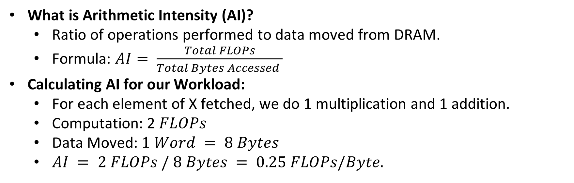
Arithmetic Intensity (AI)
What is Arithmetic Intensity (AI)?
Ratio of operations performed to data moved from DRAM.
Formula: $AI= \frac{Total FLOPs}{Total Bytes Accessed }$
Calculating AI for our Workload:
For each element of X fetched, we do 1 multiplication and 1 addition.
Computation: 2 $FLOPs$
Data Moved: $1 Word = 8 Bytes$
$AI = 2 FLOPs / 8 Bytes = 0.25 FLOPs/Byte.$

Slide 32
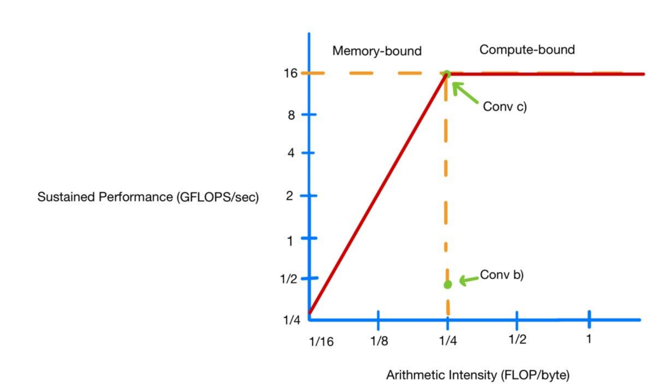
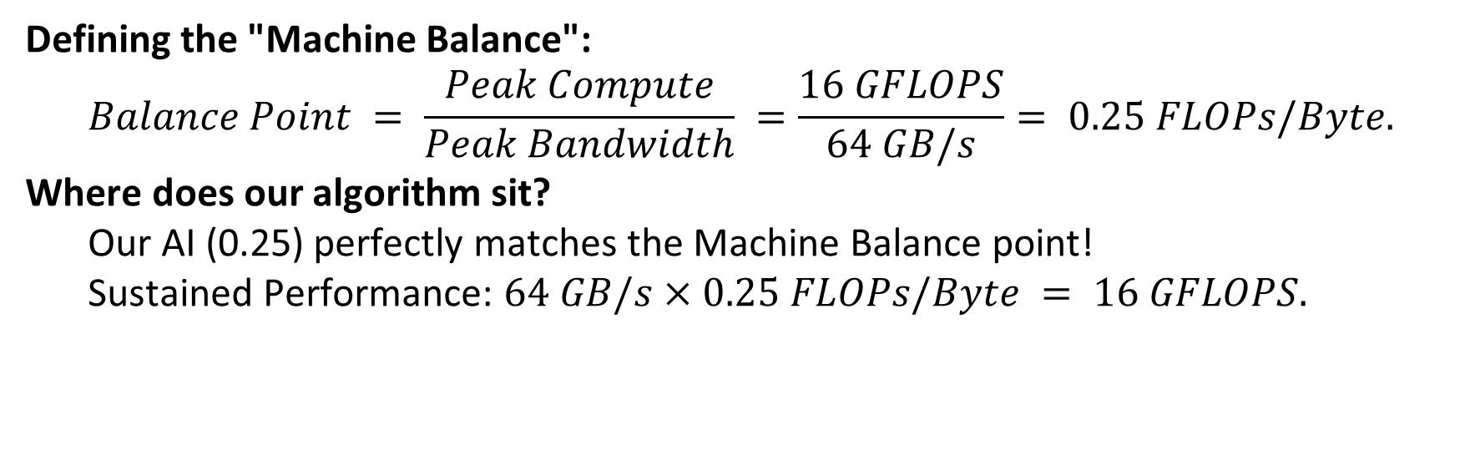
The Roofline Model
Defining the "Machine Balance":
$$Balance Point = \frac{Peak Compute}{Peak Bandwidth} =\frac{16 GFLOPS}{64 GB/s}= 0.25 FLOPs/Byte.$$
Where does our algorithm sit?
Our AI (0.25) perfectly matches the Machine Balance point!
Sustained Performance: $64 GB/s×0.25 FLOPs/Byte = 16 GFLOPS.$

Slide 33
The Impact of Cache & Data Reuse
Assumption: What if we add a local Cache and reuse elements?
Without Cache (No Reuse):
Every computation fetches from DRAM.
Stuck at AI = 0.25.
With Cache (Data Reuse):
We fetch X once from DRAM, store it in Cache, and reuse it K times.
Bytes moved from DRAM decreases significantly.
AI Increases! AI > 0.25)
The Roofline Shift:
Higher AI moves our operating point to the RIGHT on the Roofline graph.
System shifts from Balance Point to Compute-Bound.

Slide 34
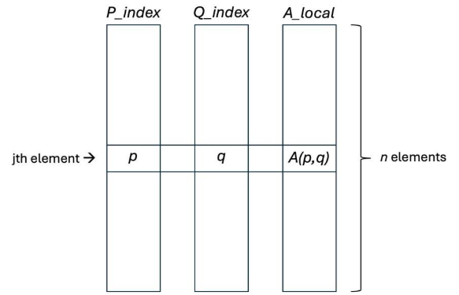
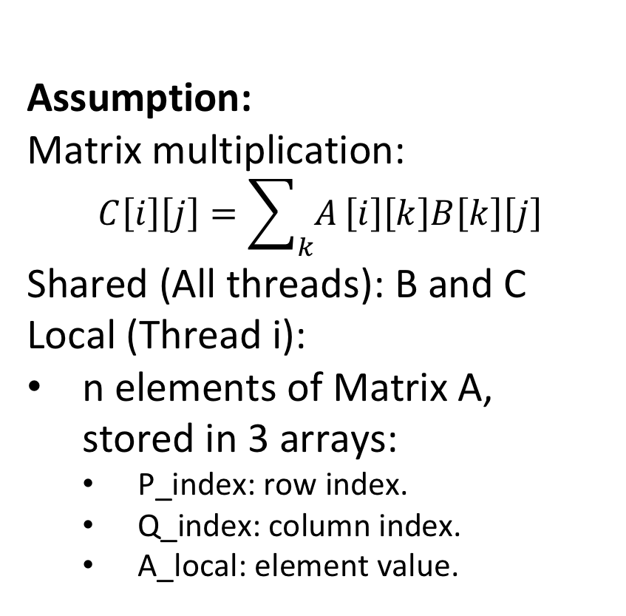
Shared Memory Programming (1)
Assumption:
Matrix multiplication:
$$C\left[i\right]\left[j\right]=\sum_{k}{A}\left[i\right]\left[k\right]B\left[k\right]\left[j\right]$$ Shared (All threads): B and C
Local (Thread i):
n elements of Matrix A, stored in 3 arrays:
P_index: row index.
Q_index: column index.
A_local: element value.

Slide 35
Shared Memory Programming (2)
a) Each Thread Has One Row of A
Each thread computes one row of C. No overlapping writes so no locks needed

Slide 36
Shared Memory Programming (3)
b) Each Thread Has One Column of A
Multiple threads update same C[i][j]. Writes overlap, so race condition possible. Need atomics, locks, or local accumulation + reduction.

Slide 37
Shared Memory Programming (4)
c) Using Arbitrary Elements of A
Worst-case contention on C. Threads may update any entry.
Better approach: Use private C_local → reduce at end.
Move synchronization outside inner loop.

Slide 38
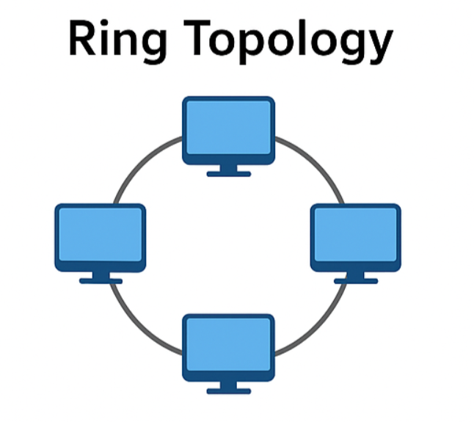
Message Passing
Setup:
n processors in 1-D wraparound mesh. Each has row i of A and B. Goal: Compute row i of C.
Blocking send/receive. No broadcast.

Slide 39
Message Passing (2)
Rotate rows of B around ring. At each step:
Multiply local A with current B row
Accumulate partial result
After n rotations → full row computed.

Slide 40
Message Passing (3)
Total communication: Θ(n²) Total computation: Θ(n² / n) = Θ(n)
Communication dominates. System is communication-bound.
Ring is synchronous, so bottleneck is slowest processor in the ring

Slide 41
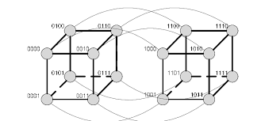
Hypercube Network (1)
16-Node Hypercube
16 = 2⁴ → 4-dimensional
Diameter = 4
Degree = 4
Bisection width = 8
More Generally
Diameter = N
Edges = (2ᴺ · N)/2
Bisection width = 2ᴺ⁻¹
Cut along one dimension → splits network evenly.

Slide 42
Hypercube Network (2)
E-Cube Routing Hint
Fix bits in ascending order. Path length = Hamming distance.
Each differing bit represents one dimension you must traverse.
Flipping that bit moves you closer to destination.
Permutation causes many paths to share early dimensions.
Congestion occurs on lowest-numbered dimensions.

Slide 43
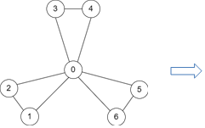
Windmill Embedding
Windmill Structure
n = 2m + 1 Node 0 is hub. Others form small paired edges.

Slide 44
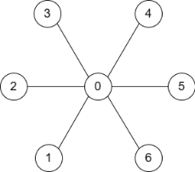
Star Embedding
Embedding into Star
Non-center edges → path length 2.
Dilation = 2
Congestion high at center
Center edge carries most traffic.

Slide 45
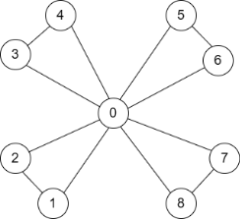
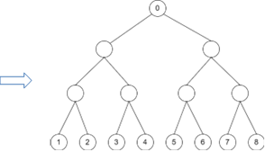
Star Embedding
Embedding into Binary Tree
Tree height ≈ log n
Dilation ≈ 2 log n
Congestion highest near root
Upper levels become bottleneck.

Slide 46
Questions?
Thank you

