Slide 1


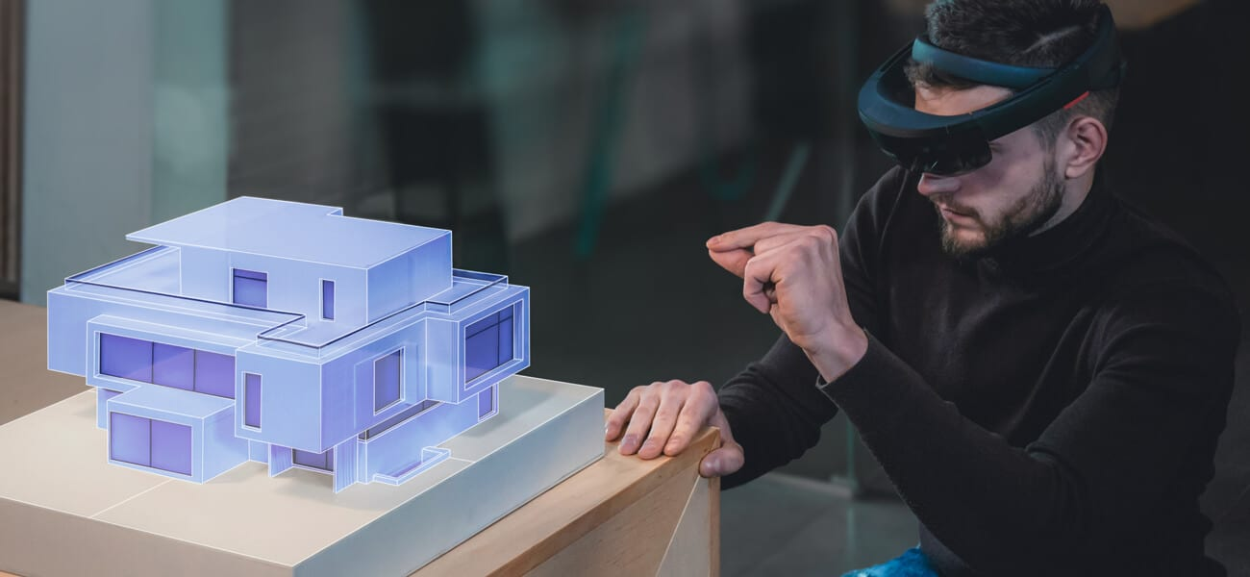
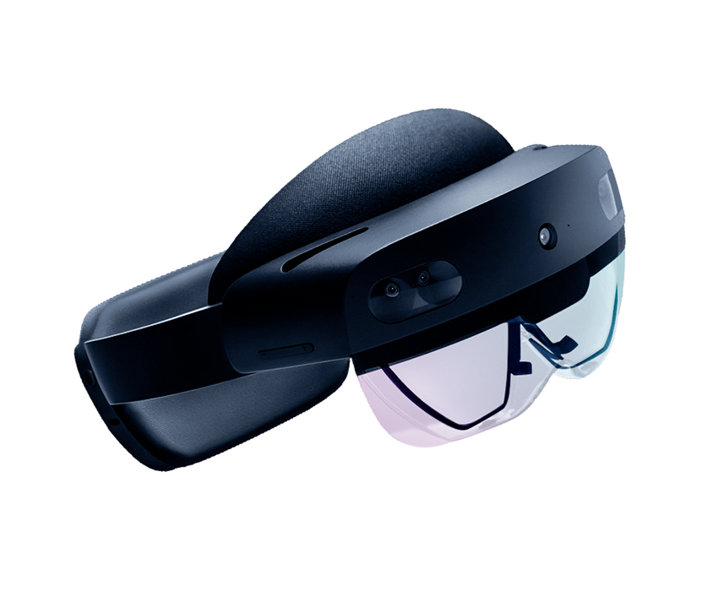
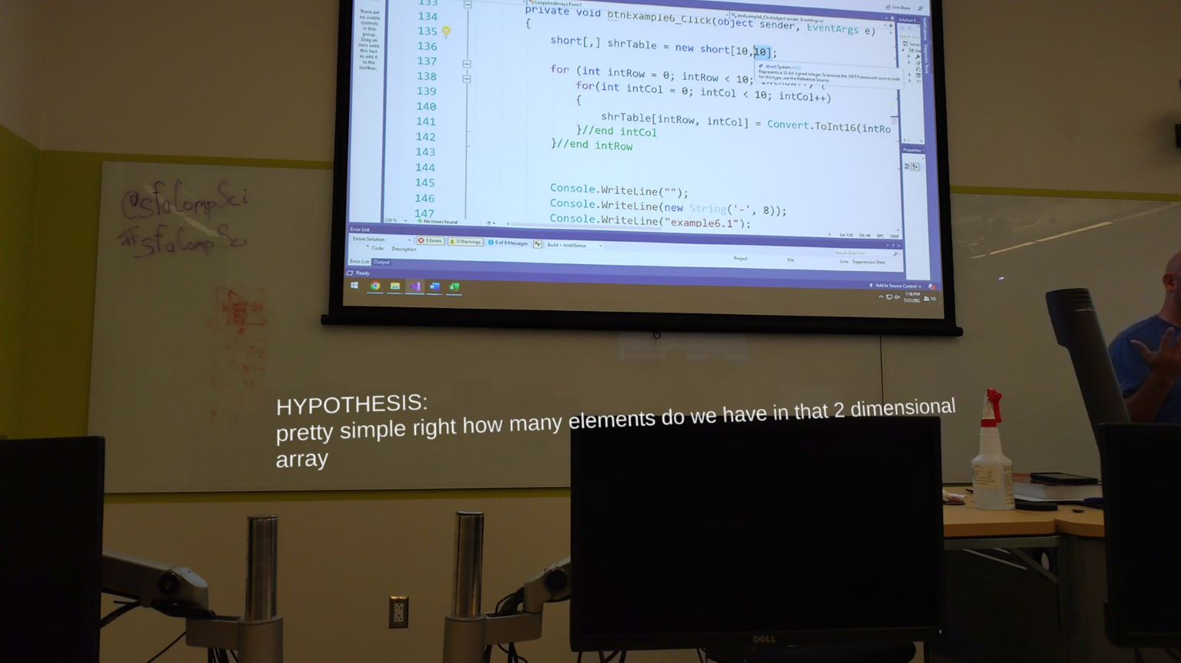
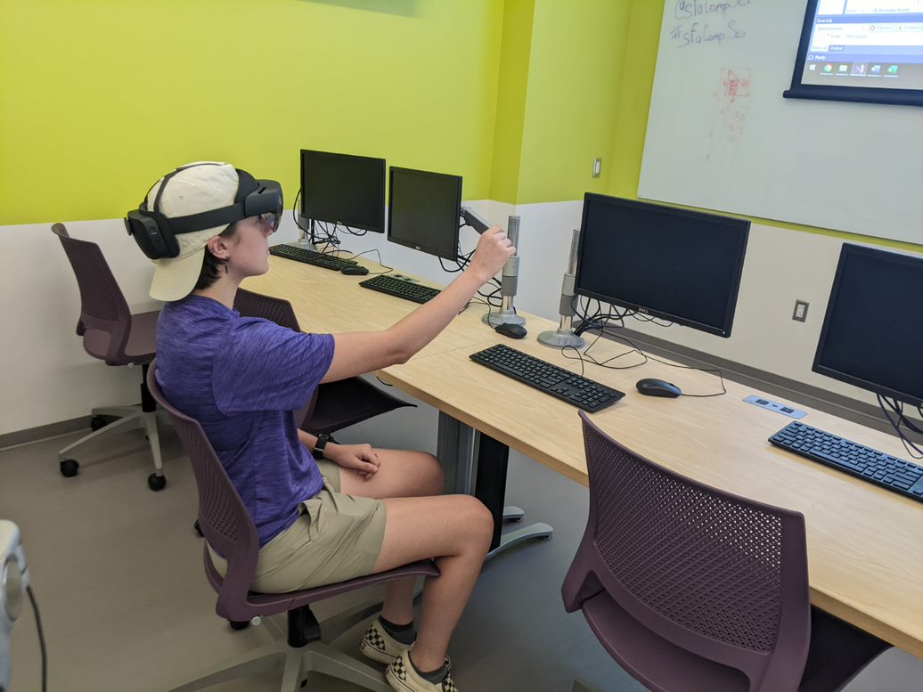
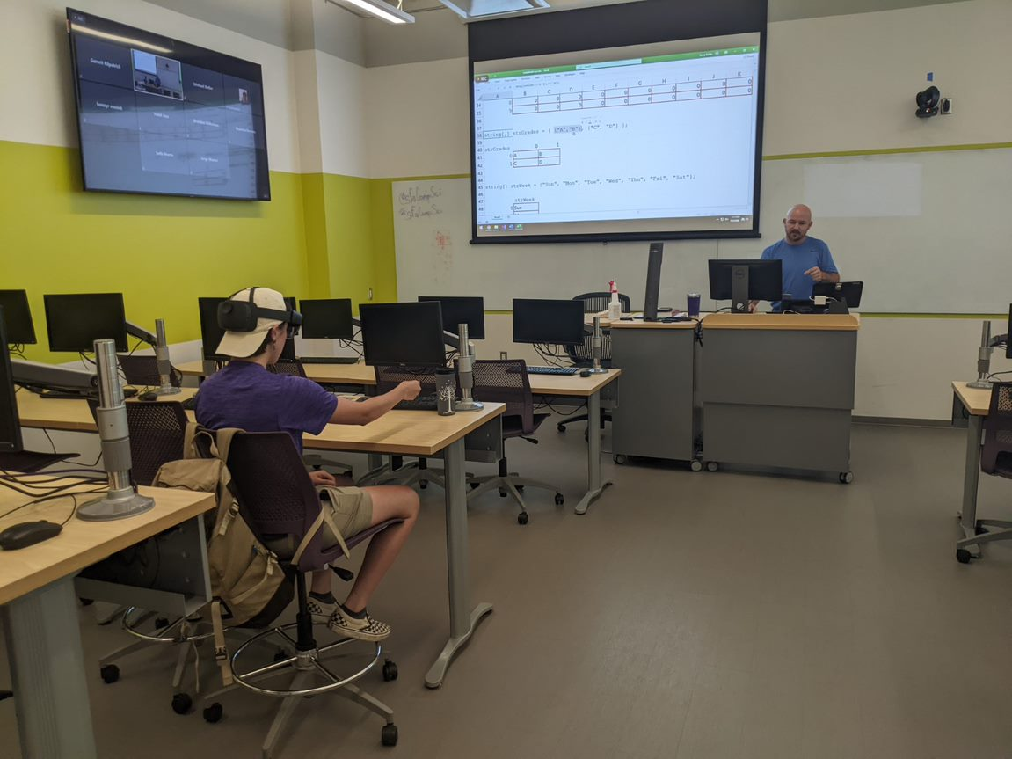
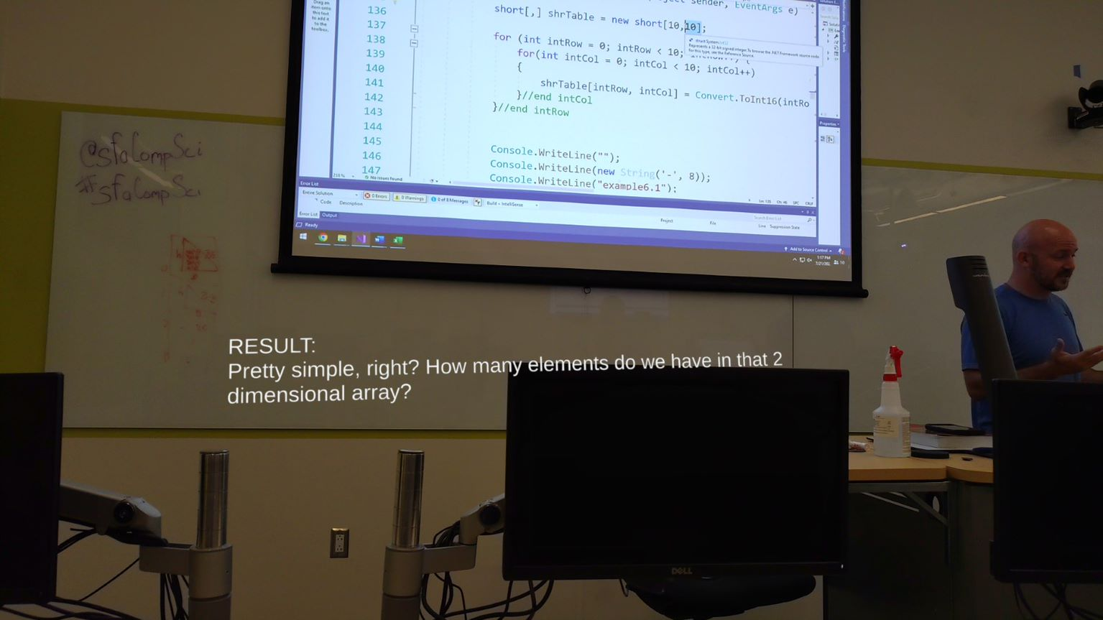
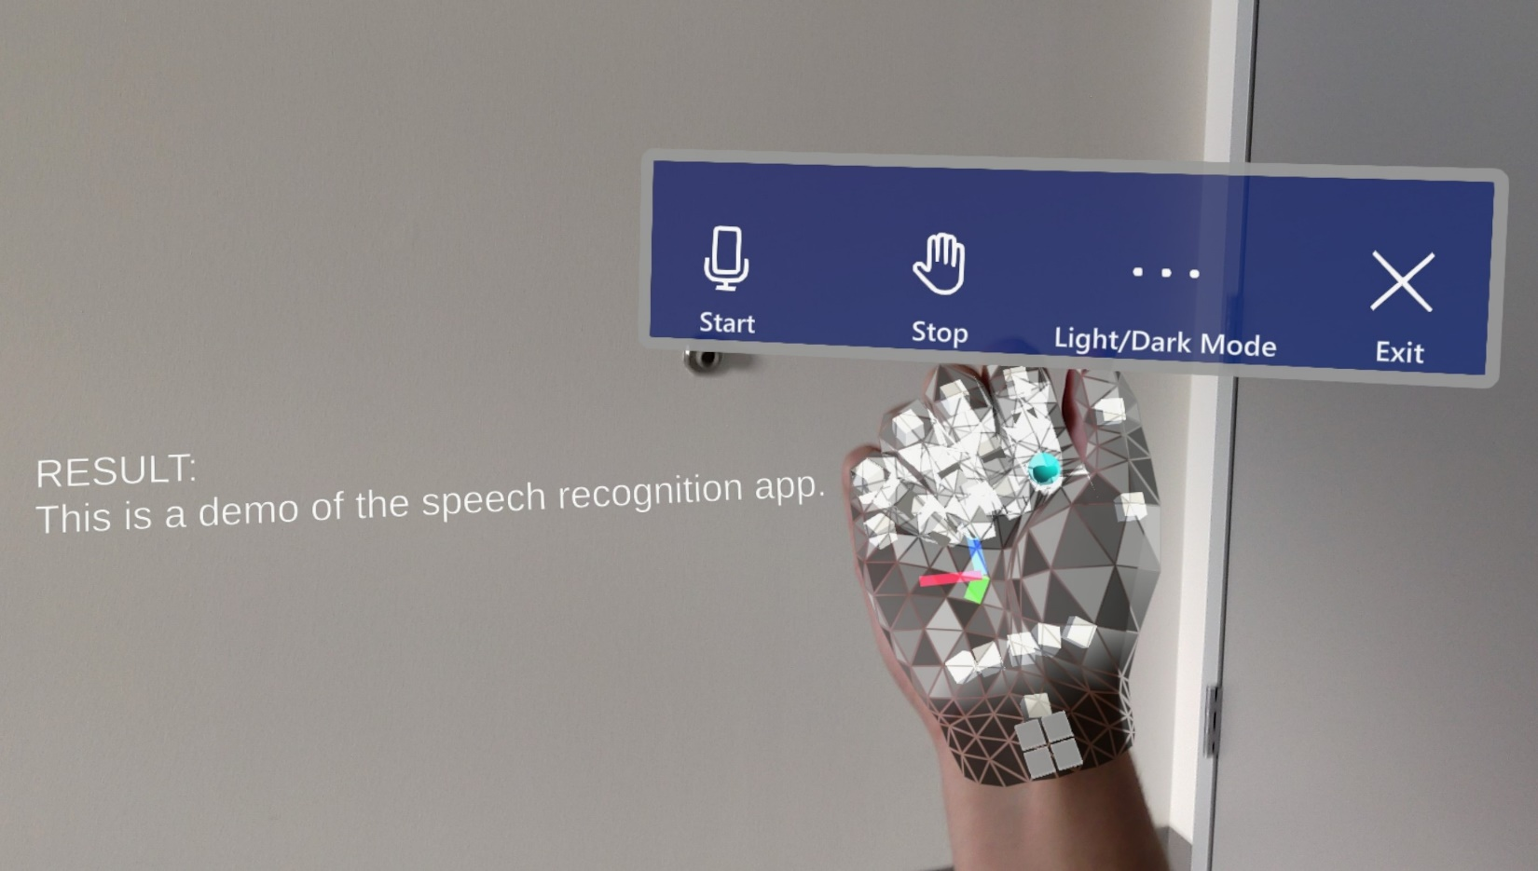

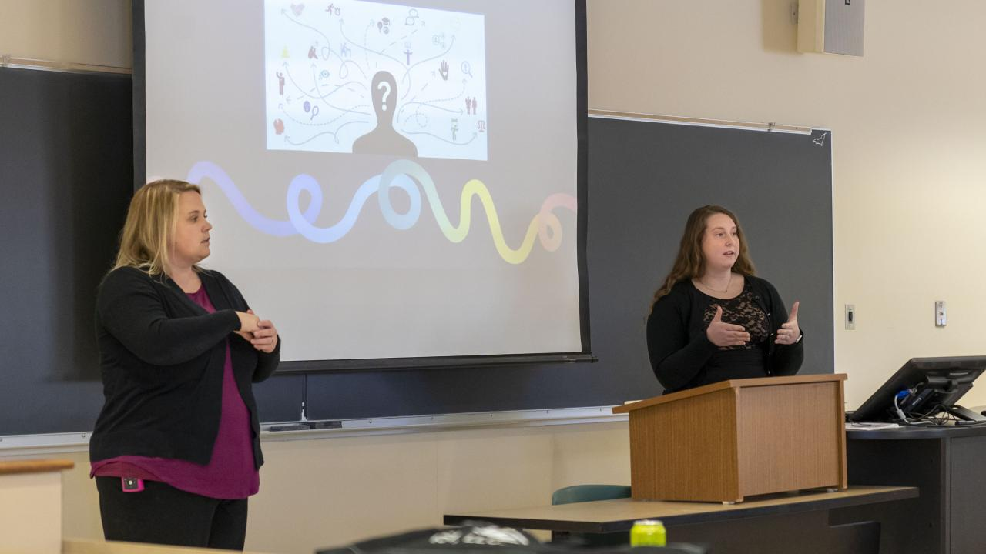
Enhancing The Classroom Experience For Hearing Impaired Students
Utilizing Mixed Reality Real-Time Subtitle System
Madison Kelsey, Dr. Jeremy Becnel
Department of Computer Science, Stephen F. Austin State University
Objective/Abstract
Mixed Reality
Prototype
The intent of this project is to develop a software application that provides practical functionality within an individual’s daily activities. The application accepts live audio from the user's environment, providing real-time captioning for the user.
The application is deployable on mixed reality platforms. The software is developed with Unity Game Engine, Visual Studio, and Azure’s Speech-To-Text API.
Mixed reality is a combination of virtual and augmented reality. Virtual reality renders a completely digital experience while augmented reality simply overlays digital objects in the real world.
Depicted below are captures of what the user sees when utilizing the prototype. The software first provides a hypothesis of the raw audio it is receiving. The software intentionally displays the hypothesis to further the insight of the user before displaying the predicted result and corresponding sentiment.
The software is optimized for a lecture environment with movable subtitles to allow the user to place them in an ideal location.
Natural Language Processing
Natural Language Processing (NLP) refers to the branch of computer science, specifically of artificial intelligence, with the intent of providing computers with the ability to understand text and spoken words in a similar way that human beings can.
NLP uses computational linguistics and statistical machine learning to enable computers to process language in the form of text or voice data. NLP allows the computer to ‘understand’ the language and the user’s intent or sentiment.
Azure’s Speech-To-Text API, owned by Microsoft, is a speech service feature that accurately transcribes audio to text.
To access the menu bar, the user can face their palm toward the headset. The menu bar is anchored to the wrist and will follow the joint. The user can turn their palm away to hide the menu.
Benefit
According to a study by the Hearing Loss Association of America, approximately 48 million Americans suffer from some degree of hearing loss.
In consideration of students with hearing impairment, disability services currently offers assistance in note-taking as well as providing an interpreter depending on the needs and preferences of the student.
Audio to Convert
Text Output
Future Work
Future improvements of this software include, but are not limited to, an option for translation of live audio input into the user’s preferred language. This would expand the range of users that could benefit from this software beyond strictly individuals with hearing impairment.
Another avenue of future work is the addition of ASL images, as research shows that individuals with hearing impairment have an easier time understanding ASL compared to written text [5].
Contact
Acknowledgements
References
Madison Kelsey
Department of Computer Science
P.O. Box 13063, SFA Station Nacogdoches, Texas 75962
kelseymd@jacks.sfasu.edu
This research was supported by the College of Sciences and Mathematics as part of the Summer Undergraduate Research Experience at Stephen F. Austin State University. I’d like to extend a thank you to S.U.R.E. and Stephen F. Austin State University for the opportunity to further my experience in mixed reality.
Thank you to the Computer Science department for the workspace and the equipment used throughout the entirety of the project.
1. Hearing Loss Association of America (https://www.hearingloss.org/wp-content/uploads/HLAA_HearingLoss_Facts_Statistics.pdf)
2. IBM - Natural Language Processing (https://www.ibm.com/cloud/learn/natural-language-processing)
3. Microsoft Azure (https://azure.microsoft.com/en-us/services/cognitive-services/speech-to-text/#overview)
4. Unity Real-Time Development Platform (https://unity.com/)
5. Written language of deaf and hard-of-hearing students in public schools (https://academic.oup.com/jdsde/article/10/3/244/413365)

