Slide 1

Video Game Early Access Identification
Team 2: Adam Gilbert Kathleen Ryan Gerri Dunnigan Jeremy Becnel

Slide 2

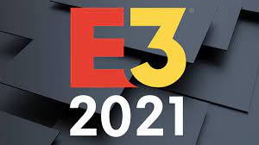




Early Access
Goal: Excite and increase potential consumers of an upcoming game release
Approach: Identify candidates for Early Access based on game interest and twitter following.
Benefit: Low-cost form of advertisement for new games.
Competition: Traditional advertising

Slide 3



Approach
Acquire Training Data
Clean Data
Train Model
Apply model to recent game tweets
Select early access participants
Comparative Analysis:
Deep Learning vs. NLTK

Slide 4
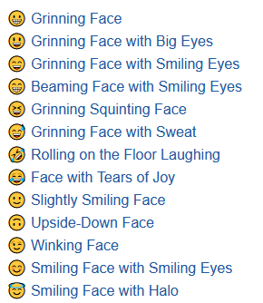
Acquiring Training Data
Concerns:
Intersection between movie and gaming jargon potentially minimal
Solution: Expand training base – Data Fusion
Include tweets from other content areas whose sentiments have been labeled.
Retrieved our own tweets mentioning popular games
Replaced emojis with their name equivalents.
4

Slide 5




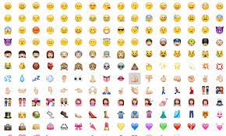
Training Data
Sources
Movie Reviews – labeled positive/negative
Airline Tweets (Kaggle) - labeled positive/negative/neutral
Political Tweets (Kaggle) – labeled positive/negative/neutral
General Twitter Tweets (Kaggle) – labeled positive/negative/neutral
Video Game Specific Emoji Tweets (Scraped and Analyzed) – we labeled positive/not positive
5

Slide 6

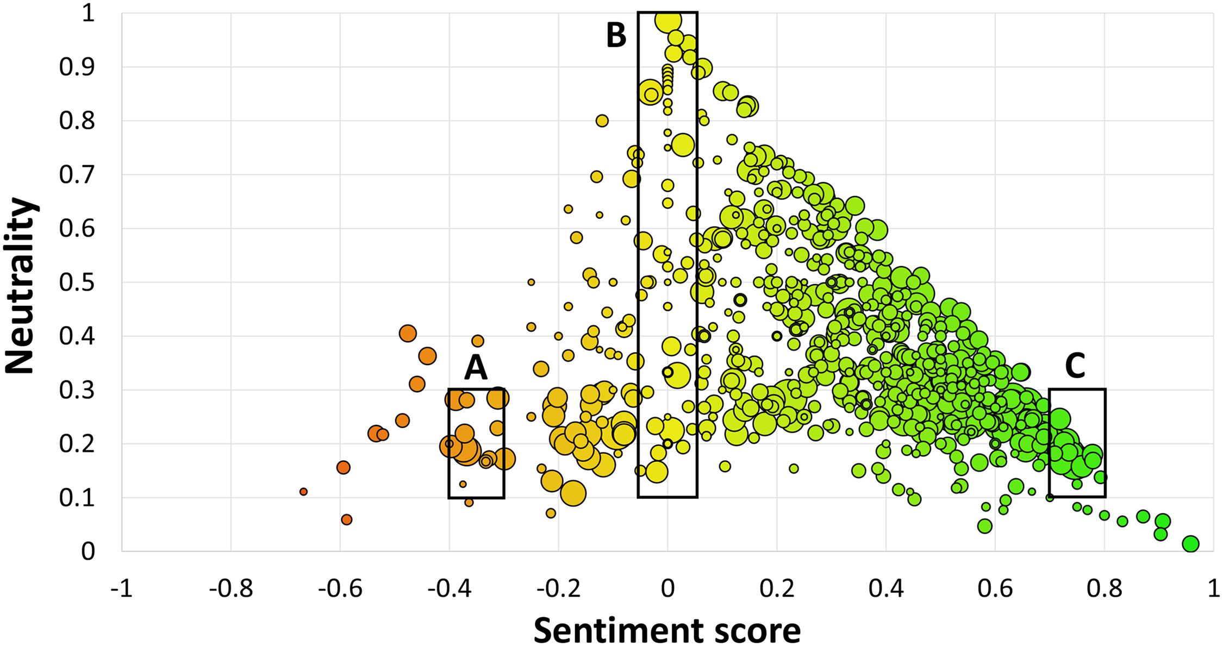

Gaming/Emoji Training Data
Considerations when retrieving tweets
Request, Sleep 16 minutes, Request....
Tracked the minimum id to request only lower ids
Labeled Video Game Specific Emoji Tweets based on their average emoji sentiment score
Most Frequently Occurring Emoji?
6
Notes:
emosent-py is a Python utility package to get Sentiment Rankings for Unicode Emojis.
Requested untruncated text
Eliminated duplicate tweet IDs and retweets

Slide 7
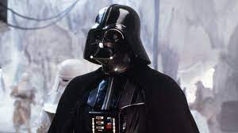
Training / Models
 | Positive | Not-positive
Positive (Actual) | 27,080 | 1919
Not-positive (Actual) | 4033 | 15,471
We ended up with ~200,000 items for training data
First Model
TfidVectorizers – feature extraction
Truncated SVD – Principal Component Analysis using Singular Value Decomposition
Neural Network – 3 hidden layers
Second Model
VADER Model for NLTK Sentiment Analysis
Luke, I am
your father!

Slide 8
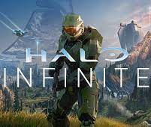
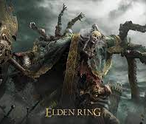

Process
Collect ~1000 recent tweets about each of the three games (each is coming out soon)
Transfer Learning – apply the trained neural network model to the video game tweets for each game
Apply VADER Model to video game tweets for each game
Of the positive tweets, find the 10 with the highest number of followers for early access
Halo Infinite
Elden Ring
Horizon
Forbidden West

Slide 9
Results
HALO INFINITE
Horizon
Elden Ring
4 tweets in top 10 in common between the two models
Neural Network more likely to “pick” ads
Each model included one non-positive tweet
4 tweets in the top 10 in common between the two models
Neural Network had all positive tweets (one was from the developer)
VADER has one incorrect in the top 10
Only 2 tweets in common between the two models
Neural Network – all tweets are positive (perhaps one neutral)
VADER – all tweets positive
Neural Network – higher overall follower count among positive tweets

Slide 10

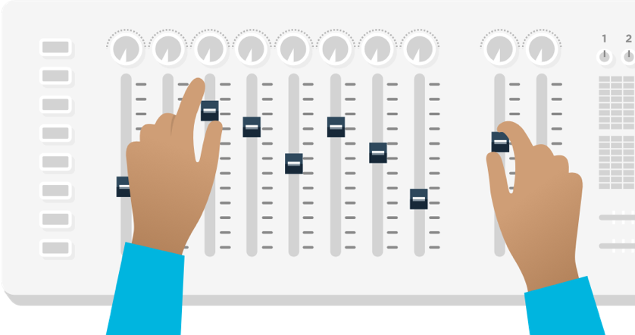
Improvements/Further Study
Data SCIENCE
FUTURE PROJECTS
gather and classify a larger number of tweets related to games
experiment with different models/parameters
Apply a similar model for twitch
Try to identify and analyze effectiveness of this initiative
do the followers of early access participants tweet about this game or begin to follow game on twitter
do preorders increase after early access initiative

Slide 11


Thank You

Slide 12

Cleaning The Data
Relabeled all sources in a binary fashion
Made all tweets consistent:
Changed to lower case
Removed URLs and punctuation
Replaced all emoji's with name equivalents

Slide 13
Checking Against a Sentiment Dictionary
Used a lexicon-based sentiment score as a sanity check (nltk VADER)
Identify cases where this score disagreed with our neural network
Check tweets via human intervention
Safeguard against accidentally giving a pre-release to an uninterested or negative user

