Slide 1
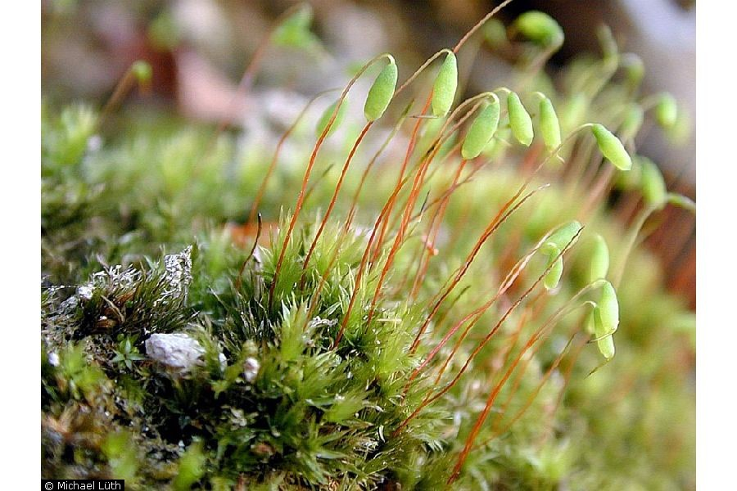
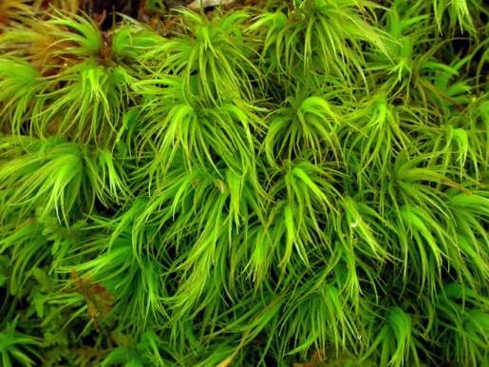
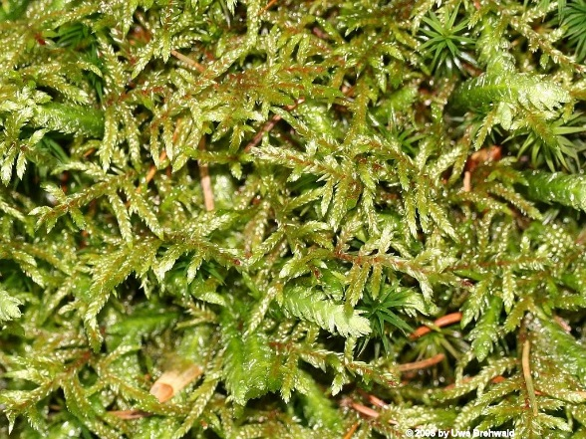
Constrained Ordination Canonical Correspondence Analysis (CCA) Redundancy Analysis (RDA)

Slide 2
Multivariate Models
Model Technique
y = x1 + x2 + … x Regression, ANOVA
y1 + y2 + … yi = x Multivariate ANOVA , MANTEL
Discriminant Analysis, CART
y1 + y2 + … yi = x1 + x2 + … xj Redundancy Analysis (RDA),
Can. Cor. Analysis (CCA)
y1 + y2 + … yi Ordination, Cluster Analysis
Multivariate Statistics

Slide 3
Multivariate Models
Model Technique
y = x1 + x2 + … x Regression, ANOVA
y1 + y2 + … yi = x Multivariate ANOVA , MANTEL
Discriminant Analysis, CART
y1 + y2 + … yi = x1 + x2 + … xj Redundancy Analysis (RDA),
Can. Cor. Analysis (CCA)
y1 + y2 + … yi Ordination, Cluster Analysis
Multivariate Statistics

Slide 4
Response Variables
Li Zhang
Michael Luth
Site | Species A | Species B | Species C
1 | 10 | 11 | 12
2 | 2 | 4 | 5
3 | 5 | 5 | 13
4 | 7 | 14 | 8
5 | 7 | 10 | 10
6 | 8 | 6 | 9
7 | 10 | 10 | 14
8 | 1 | 8 | 2
9 | 14 | 12 | 7

Slide 5
Multivariate Models
Model Technique
y = x1 + x2 + … x Regression, ANOVA
y1 + y2 + … yi = x Multivariate ANOVA , MANTEL
Discriminant Analysis, CART
y1 + y2 + … yi = x1 + x2 + … xj Redundancy Analysis (RDA),
Can. Cor. Analysis (CCA)
y1 + y2 + … yi Ordination, Cluster Analysis
Multivariate Statistics

Slide 6
Explanatory Variables
Li Zhang
Michael Luth
Site | Species A | Species B | Species C
1 | 10 | 11 | 12
2 | 2 | 4 | 5
3 | 5 | 5 | 13
4 | 7 | 14 | 8
5 | 7 | 10 | 10
6 | 8 | 6 | 9
7 | 10 | 10 | 14
8 | 1 | 8 | 2
9 | 14 | 12 | 7
Rainfall(mm) | DryMonths | MeanTempC | CanopyHt
363 | 9 | 26.4 | 30
1181 | 2 | 25.1 | 3
1500 | 2 | 29.5 | 8
2150 | 4 | 26.4 | 30
1004 | 1 | 25.3 | 10
1242 | 6 | 27.5 | 10
3874 | 3 | 27 | 30
3293 | 0 | 26 | 15
4349 | 4 | 26.6 | 35
Can site composition be explained by environmental variables?

Slide 7
Constrained Ordination (CO)
A case of multivariate multiple regression.
A combination of unconstrained ordination (PCA, CA)
and regression.
Extends unconstrained ordination in which the solution is
constrained to be expressed by explanatory variables.
Two approaches : 1) Canonical Correspondence Analysis (CCA)
2) Redundancy Analysis (RDA)

Slide 8
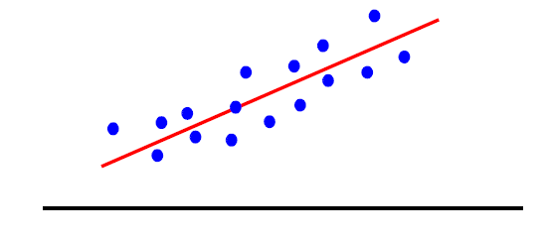
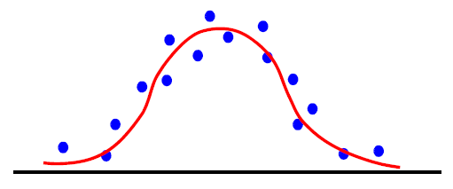
Linear vs. Unimodal Models
Redundancy Analysis (RDA)
Assumes a linear relationship between response
variables and explanatory variables.
Uses PCA for ordination
Canonical Correspondence Analysis (CCA)
Assumes a unimodal relationship between response
variables and explanatory variables.
Uses CA for ordination
Species Abundance
Temperature

Slide 9
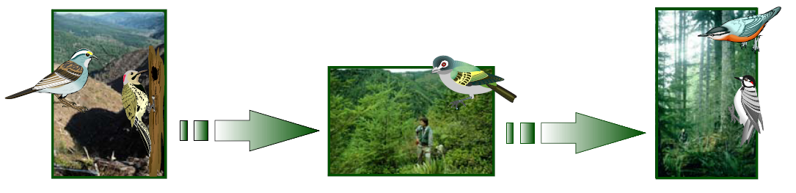
Constrained Ordination
CO shows how the structure of the response variable (e.g. bird community structure)
is influenced by explanatory variables (e.g. environment).
CO identifies:
1) which environmental variables are most important
2) how environmental variables are related
3) how communities change along the most important env. gradients
Figure: Kevin McGarigal

Slide 10
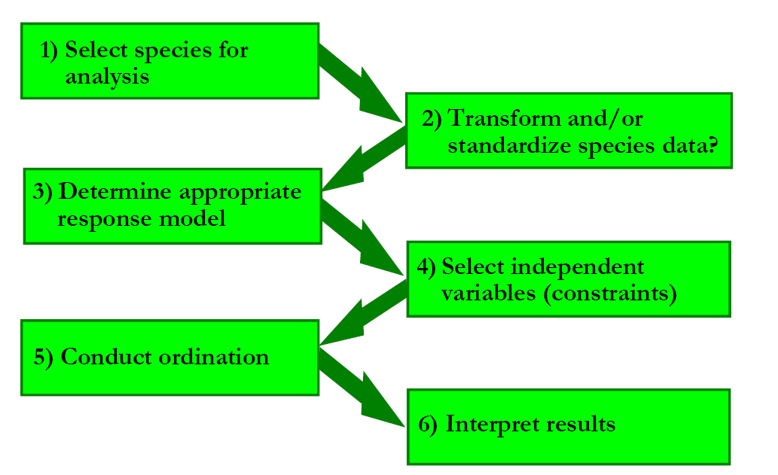
Steps in Constrained Ordination
Variables (i.e. columns)

Slide 11
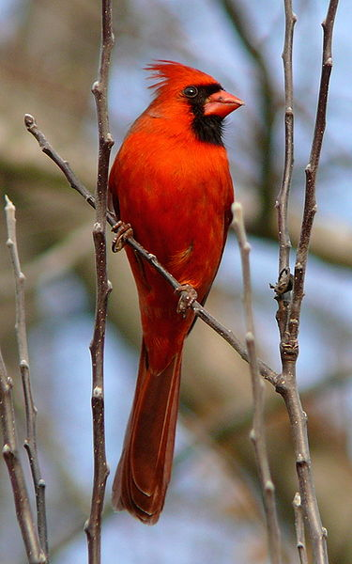
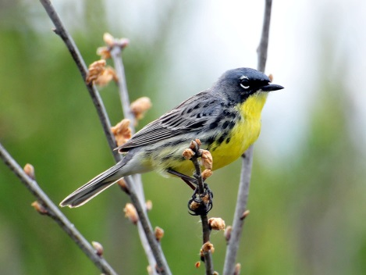
Selecting Species
Species within community data sets vary greatly in there occurrence,
abundance, habitat specificity.
Species that are common, widespread and extremely abundant
can obscure patterns in the multivariate data cloud.
Species that are rare and have few occurrences in a data set
may not be accurately placed in ecological space.
You must decide which species are “rare” and which are super-abundant
Ken Thompson

Slide 12


Selecting Species
Plot frequency of occurrence, set arbitrary thresholds for removals (i.e.,<5% or>95%)
Do removal experiment and compare eigenvalues:
- Does removing rare and/or common species increase eigenvalue?

Slide 13
Data Transformations
Strongly skewed distributions
can bias ordination.
- predominantly small abundances
- presence/absence pattern
Solution:
Log or square root transformation
Species Abundance

Slide 14
Data Transformations
Strongly skewed distributions
can bias ordination.
- predominantly small abundances
- presence/absence pattern
Solution:
Log or square root transformation
Hellinger transformation
Species Abundance

Slide 15
Data Standardization
Variation in sample (row) totals and
species (column) totals can bias ordination
Calculate the cv of row and column totals
Cv =15.64
Cv =154.44
Species Totals
Sample Totals

Slide 16
Data Standardization
Solution: Row and/or column standardize
Cv =154.44
Cv =15.64
Species Totals
Sample Totals

Slide 17
RDA VS CCA
Need to decide if a linear or unimodal
model is appropriate.
Use Detrended Correspondence Analysis (DCA)
to determine axis length.
Plot species abundances on axes

Slide 18
RDA VS CCA
Use DCA to determine axis length.
Detrended correspondence analysis reports
axis length as an output.
Short axes (<3) linear
Long axes (>3) unimodal

Slide 19
RDA VS CCA
Plot species abundances against ordination axes; a bit circular
Abundance
CCA axis 1

Slide 20
Selecting Independent Variables
Like other regression techniques:
- no multicolinearity among explanatory variables
- Occurs when variables are highly correlated
- Occurs when # of variables approaches # of samples
- Leads to unstable and uninterpretable canonical coefficients

Slide 21
Selecting Independent Variables
Include variables based on a priori hypotheses.
Use variable selection procedure to select “best” subset of variables
(e.g., remove one of each pair of highly Cor, stepwise AIC).
Rule of thumb (very loose), use 3-5 explanatory variables.
Overall sample size: N= 3(M+P)
M =# of species (columns of response matrix)
P = # of environmental variables (columns in predictor matrix)
Transform explanatory variables as necessary.

Slide 22
Constrained Ordination Steps
Run a multivariate regression of the response variable matrix Y
on the explanatory variable matrix X resulting in a matrix of
fitted values, Ŷ.
Ŷ = XB
B is the matrix of regression coefficients.
Conduct a PCA (for RDA) or a CA (for CCA) on the Ŷ matrix resulting
in a matrix A of eigenvectors. Elements of A are called species scores.
FACTOR LOADINGS

Slide 23
Constrained Ordination Steps
Next, you calculate two sets of scores from the PCA:
The F scores are calculated by multiplying the matrix of
eigenvectors, A, by the matrix of response variables Y.
F = YA
F are site scores based on observed species distributions.
The Z scores are calculated by multiplying the matrix of
eigenvectors, A, by the matrix of fitted response variables Ŷ.
Z = ŶA or Z = XBA
Z are site scores based on species distributions predicted by the environment.

Slide 24
Constrained Ordination Steps
Calculate the correlation between Z matrix (predicted site scores) and
environmental variables, X, to determine the influence of the environmental
variables on community composition.
*How much of the overall variation is explained by the predictor variables (constraints)?
*Which predictor variables are the strongest?

Slide 25
Constrained Ordination Example
Li Zhang
Michael Luth
Understory Vegetation
Northern Finland
24 sites
40 species
Site | Cal.vul | Emp.nig | Led.pal | Vac.myr | Vac.vit | Pin.syl
18 | 0.55 | 11.13 | 0 | 0 | 17.8 | 0.07
15 | 0.67 | 0.17 | 0 | 0.35 | 12.13 | 0.12
24 | 0.1 | 1.55 | 0 | 0 | 13.47 | 0.25
27 | 0 | 15.13 | 2.42 | 5.92 | 15.97 | 0
23 | 0 | 12.68 | 0 | 0 | 23.73 | 0.03
19 | 0 | 8.92 | 0 | 2.42 | 10.28 | 0.12

Slide 26
Constrained Ordination Example
Li Zhang
Michael Luth
Understory Vegetation
Northern Finland
24 sites
14 Soil variables
Site | N | P | K | Ca | Mg | S | Al
18 | 19.8 | 42.1 | 139.9 | 519.4 | 90 | 32.3 | 39
15 | 13.4 | 39.1 | 167.3 | 356.7 | 70.7 | 35.2 | 88.1
24 | 20.2 | 67.7 | 207.1 | 973.3 | 209.1 | 58.1 | 138
27 | 20.6 | 60.8 | 233.7 | 834 | 127.2 | 40.7 | 15.4
23 | 23.8 | 54.5 | 180.6 | 777 | 125.8 | 39.5 | 24.2
19 | 22.8 | 40.9 | 171.4 | 691.8 | 151.4 | 40.8 | 104.8

Slide 27
Selecting Species
Remove common species

Slide 28
Species Transformations

Slide 29
Species Transformations
Log Transformation

Slide 30
Data Standardization sample and species variability
Cv =15.64
Cv =212.44
Species Totals
Sample Totals

Slide 31
Data Standardization
Column total standardization
Cv =15.64
Cv =212.44
Species Totals
Sample Totals

Slide 32
RDA vs. CCA
 | DCA1 | DCA2 | DCA3 | DCA4
Eigenvalues | 0.5232 | 0.3254 | 0.2074 | 0.21694
Axis length | 3.1759 | 2.4843 | 1.7928 | 1.99248

Slide 33
RDA vs. CCA
 | DCA1 | DCA2 | DCA3 | DCA4
Eigenvalues | 0.5232 | 0.3254 | 0.2074 | 0.21694
Axis length | 3.1759 | 2.4843 | 1.7928 | 1.99248

Slide 34
RDA vs. CCA
 | DCA1 | DCA2 | DCA3 | DCA4
Eigenvalues | 0.5232 | 0.3254 | 0.2074 | 0.21694
Axis length | 3.1759 | 2.4843 | 1.7928 | 1.99248

Slide 35
RDA vs. CCA
 | DCA1 | DCA2 | DCA3 | DCA4
Eigenvalues | 0.5232 | 0.3254 | 0.2074 | 0.21694
Axis length | 3.1759 | 2.4843 | 1.7928 | 1.99248

Slide 36
Explanatory Variables
Pairwise correlations > 0.70
 | N | P | K | Ca | Mg | S | Al | Fe | Mn | Zn | Mo | Baresoil | Humdepth
P | -0.25
K | -0.15 | 0.75
Ca | -0.27 | 0.74 | 0.66
Mg | -0.16 | 0.6 | 0.63 | 0.8
S | -0.26 | 0.75 | 0.84 | 0.54 | 0.65
Al | -0.04 | 0.05 | 0.12 | -0.21 | -0.12 | 0.36
Fe | 0.17 | -0.13 | -0.09 | -0.33 | -0.2 | 0.06 | 0.82
Mn | 0.08 | 0.54 | 0.54 | 0.44 | 0.26 | 0.27 | -0.47 | -0.44
Zn | -0.13 | 0.7 | 0.6 | 0.68 | 0.71 | 0.71 | -0.06 | -0.31 | 0.36
Mo | -0.06 | 0.17 | 0.07 | -0.16 | 0.03 | 0.43 | 0.51 | 0.22 | -0.2 | 0.28
Baresoil | 0.11 | 0.01 | 0.17 | 0.18 | 0.24 | 0.08 | -0.4 | -0.46 | 0.25 | 0.04 | 0.03
Humdepth | 0.08 | 0.15 | 0.27 | 0.24 | 0.37 | 0.16 | -0.49 | -0.49 | 0.51 | 0.14 | 0.06 | 0.59
pH | -0.04 | -0.03 | -0.23 | 0.09 | -0.09 | -0.19 | 0.42 | 0.44 | -0.39 | -0.09 | -0.17 | -0.53 | -0.72

Slide 37
Explanatory Variables
Pairwise correlations > 0.70
 | N | P | K | Ca | Mg | S | Al | Fe | Mn | Zn | Mo | Baresoil | Humdepth
P | -0.25
K | -0.15 | 0.75
Ca | -0.27 | 0.74 | 0.66
Mg | -0.16 | 0.6 | 0.63 | 0.8
S | -0.26 | 0.75 | 0.84 | 0.54 | 0.65
Al | -0.04 | 0.05 | 0.12 | -0.21 | -0.12 | 0.36
Fe | 0.17 | -0.13 | -0.09 | -0.33 | -0.2 | 0.06 | 0.82
Mn | 0.08 | 0.54 | 0.54 | 0.44 | 0.26 | 0.27 | -0.47 | -0.44
Zn | -0.13 | 0.7 | 0.6 | 0.68 | 0.71 | 0.71 | -0.06 | -0.31 | 0.36
Mo | -0.06 | 0.17 | 0.07 | -0.16 | 0.03 | 0.43 | 0.51 | 0.22 | -0.2 | 0.28
Baresoil | 0.11 | 0.01 | 0.17 | 0.18 | 0.24 | 0.08 | -0.4 | -0.46 | 0.25 | 0.04 | 0.03
Humdepth | 0.08 | 0.15 | 0.27 | 0.24 | 0.37 | 0.16 | -0.49 | -0.49 | 0.51 | 0.14 | 0.06 | 0.59
pH | -0.04 | -0.03 | -0.23 | 0.09 | -0.09 | -0.19 | 0.42 | 0.44 | -0.39 | -0.09 | -0.17 | -0.53 | -0.72
*Z-transform variables (cv=91.17)

Slide 38
Run the Model (finally)
First let’s run the unconstrained model (i.e., CA)
 | Inertia | Rank
Total | 3.342
Unconstrained | 3.342 | 23
 | CA1 | CA2 | CA3 | CA4 | CA5 | CA6 | CA7
Eigenvalue | 0.54 | 0.4014 | 0.3668 | 0.3381 | 0.32691 | 0.24114 | 0.1995
Proportion Explained | 0.1609 | 0.1201 | 0.1098 | 0.1012 | 0.09782 | 0.07216 | 0.0597
Cumulative Proportion | 0.1609 | 0.281 | 0.3908 | 0.492 | 0.5898 | 0.66196 | 0.7217

Slide 39
Constrained Ordination Results
The constrained model is: Species = N + P + Al
 | Inertia | Proportion
Total | 3.342 | 1
Constrained | 0.7005 | 0.21
Unconstrained | 2.6415 | 0.79
 | CCA1 | CCA2 | CCA3 | CA1 | CA2 | CA3 | CA4
Eigenvalue | 0.32219 | 0.23057 | 0.1477 | 0.4595 | 0.3698 | 0.32542 | 0.24611
Proportion Explained | 0.09641 | 0.06899 | 0.0442 | 0.1375 | 0.1107 | 0.09738 | 0.07364
Cumulative Proportion | 0.09641 | 0.1654 | 0.2096 | 0.3471 | 0.4577 | 0.55511 | 0.62876

Slide 40
Constrained Ordination Results
The constrained model is: Species = N + P + Al
 | Inertia | Proportion
Total | 3.342 | 1
Constrained | 0.7005 | 0.21
Unconstrained | 2.6415 | 0.79
 | CCA1 | CCA2 | CCA3 | CA1 | CA2 | CA3 | CA4
Eigenvalue | 0.32219 | 0.23057 | 0.1477 | 0.4595 | 0.3698 | 0.32542 | 0.24611
Proportion Explained | 0.09641 | 0.06899 | 0.0442 | 0.1375 | 0.1107 | 0.09738 | 0.07364
Cumulative Proportion | 0.09641 | 0.1654 | 0.2096 | 0.3471 | 0.4577 | 0.55511 | 0.62876

Slide 41
Constrained Ordination Results
The constrained model is: Species = N + P + Al
 | Inertia | Proportion
Total | 3.342 | 1
Constrained | 0.7005 | 0.21
Unconstrained | 2.6415 | 0.79
 | CCA1 | CCA2 | CCA3 | CA1 | CA2 | CA3 | CA4
Eigenvalue | 0.32219 | 0.23057 | 0.1477 | 0.4595 | 0.3698 | 0.32542 | 0.24611
Proportion Explained | 0.09641 | 0.06899 | 0.0442 | 0.1375 | 0.1107 | 0.09738 | 0.07364
Cumulative Proportion | 0.09641 | 0.1654 | 0.2096 | 0.3471 | 0.4577 | 0.55511 | 0.62876

Slide 42
Constrained Ordination Results
Significance tests can inform on the effectiveness of the constrained ordination.
Monte Carlo permutation to test the null hypothesis that there is no relationship
between the predictor and response variables.
Permute the rows of the data frame and repeat the ordination.
Test if the amount of inertia explained by the predictor variable is greater than
random 95% of the time.

Slide 43
Constrained Ordination Results
 | Df | Chisq | F | N.Perm | Pr(>F)
Model | 3 | 0.7005 | 1.7678 | 199 | 0.01
Residual | 20 | 2.6415
Global test:
 | Df | Chisq | F | N.Perm | Pr(>F)
CCA1 | 1 | 0.3222 | 2.4395 | 199 | 0.005
CCA2 | 1 | 0.2306 | 1.7457 | 1599 | 0.06625
CCA3 | 1 | 0.1477 | 1.1183 | 99 | 0.57
Residual | 20 | 2.6415
Axes test:

Slide 44
Constrained Ordination Results
Two types of site scores represented by the F and Z matrices:
The F matrix contains the site scores calculated from the observed
species distributions.
The Z matrix contains the site scores calculated from the predicted
species distributions based on the environmental variables.

Slide 45
Constrained Ordination Results
F –Matrix (observed)
Z –Matrix (predicted)

Slide 46
Constrained Ordination Results
The Z matrix is where the sites scores should be; the F matrix is where they are.
Their correlation can give us some information on how well the constrained ordination performed.
CCA1 | CCA2 | CCA3
0.886872 | 0.881061 | 0.66695
** Not the best test due to the sensitivity of correlations to extreme scores and over-fitting**

Slide 47
Constrained Ordination Results
Intra-set correlation between Z matrix (predicted site scores) and environmental variables provide information on the rate of change in community composition per unit change in the environmental variable.
This information is used to plot out environmental variables in ordination space.
 | CCA1 | CCA2 | CCA3
N | -0.5097 | 0.02929 | -0.8617
P | 0.2811 | -0.94798 | 0.15
Al | 0.9184 | 0.0315 | -0.3912

Slide 48
Constrained Ordination Results Tri-Plots
21
5
1
Bar.lyc
Bet.pub
Ich.eri
18
7
3
16
13
Cla.ama
Dip.mon
Pti.cil
12
14
6
Ste.sp
Cet.isl
Cla.bot
Vac.uli
Pin.syl
Cla.fim
Cla.arb
Cla.ste
Cal.vul
Cla.coc
0
N
Pol.com
Cla.ran
0
Cla.cri
Al
19
Cla.chl
Cla.gra
Cla.sp
9
15
Dic.fus
Pol.pil
Site
Species
Environment
Led.pal
Emp.nig
10
Cla.def
Cla.unc
Vac.vit
22
Cet.eri
Dic.pol
Cla.cor
Pol.jun
Poh.nut
Cla.phy
23
11
Cet.niv
Vac.myr
Nep.arc
Ple.sch
Cla.cer
CCA2
Des.fle
Pel.aph
2
4
Dic.sp
-1
24
25
20
-2
27
Hyl.spl
-3
P
-1
28
-2
-1
0
1
2
3
CCA1

Slide 49
Constrained Ordination Results Tri-Plots
21
Sample locations show compositional
similarity to each other.
Samples are usually dominated by
species that are located near them
in ordination space.
5
1
Bar.lyc
Bet.pub
Ich.eri
18
7
3
16
13
Cla.ama
Dip.mon
Pti.cil
12
14
6
Ste.sp
Cet.isl
Cla.bot
Vac.uli
Pin.syl
Cla.fim
Cla.arb
Cla.ste
Cal.vul
Cla.coc
0
N
Pol.com
Cla.ran
0
Cla.cri
Al
19
Cla.chl
Cla.gra
Cla.sp
9
15
Dic.fus
Pol.pil
Led.pal
Emp.nig
10
Cla.def
Cla.unc
Vac.vit
22
Cet.eri
Dic.pol
Cla.cor
Pol.jun
Poh.nut
Cla.phy
23
11
Cet.niv
Vac.myr
Nep.arc
Ple.sch
Cla.cer
CCA2
Des.fle
Pel.aph
2
4
Dic.sp
-1
24
25
20
-2
27
Hyl.spl
-3
P
-1
28
-2
-1
0
1
2
3
CCA1

Slide 50
Constrained Ordination Results Tri-Plots
21
Species locations show distributional
similarity to each other.
Species are usually most abundant in
sites that are located near them
in ordination space.
5
1
Bar.lyc
Bet.pub
Ich.eri
18
7
3
16
13
Cla.ama
Dip.mon
Pti.cil
12
14
6
Ste.sp
Cet.isl
Cla.bot
Vac.uli
Pin.syl
Cla.fim
Cla.arb
Cla.ste
Cal.vul
Cla.coc
0
N
Pol.com
Cla.ran
0
Cla.cri
Al
19
Cla.chl
Cla.gra
Cla.sp
9
15
Dic.fus
Pol.pil
Led.pal
Emp.nig
10
Cla.def
Cla.unc
Vac.vit
22
Cet.eri
Dic.pol
Cla.cor
Pol.jun
Poh.nut
Cla.phy
23
11
Cet.niv
Vac.myr
Nep.arc
Ple.sch
Cla.cer
CCA2
Des.fle
Pel.aph
2
4
Dic.sp
-1
24
25
20
-2
27
Hyl.spl
-3
P
-1
28
-2
-1
0
1
2
3
CCA1

Slide 51
Constrained Ordination Results Tri-Plots
21
Length of environmental vectors shows
importance to the ordination
Direction indicates the correlation with
each axes.
Angles show the correlations between
the environmental variables themselves.
5
1
Bar.lyc
Bet.pub
Ich.eri
18
7
3
16
13
Cla.ama
Dip.mon
Pti.cil
12
14
6
Ste.sp
Cet.isl
Cla.bot
Vac.uli
Pin.syl
Cla.fim
Cla.arb
Cla.ste
Cal.vul
Cla.coc
0
N
Pol.com
Cla.ran
0
Cla.cri
Al
19
Cla.chl
Cla.gra
Cla.sp
9
15
Dic.fus
Pol.pil
Led.pal
Emp.nig
10
Cla.def
Cla.unc
Vac.vit
22
Cet.eri
Dic.pol
Cla.cor
Pol.jun
Poh.nut
Cla.phy
23
11
Cet.niv
Vac.myr
Nep.arc
Ple.sch
Cla.cer
CCA2
Des.fle
Pel.aph
2
4
Dic.sp
-1
24
25
20
-2
27
Hyl.spl
-3
P
-1
28
-2
-1
0
1
2
3
CCA1

Slide 52
Constrained Ordination Results Tri-Plots
21
Perpendicular lines give approximate
rankings of samples and sites.
5
1
Bar.lyc
Bet.pub
Ich.eri
18
7
3
16
13
Cla.ama
Dip.mon
Pti.cil
12
14
6
Ste.sp
Cet.isl
Cla.bot
Vac.uli
Pin.syl
Cla.fim
Cla.arb
Cla.ste
Cal.vul
Cla.coc
0
N
Pol.com
Cla.ran
0
Cla.cri
Al
19
Cla.chl
Cla.gra
Cla.sp
9
15
Dic.fus
Pol.pil
Led.pal
Emp.nig
10
Cla.def
Cla.unc
Vac.vit
22
Cet.eri
Dic.pol
Cla.cor
Pol.jun
Poh.nut
Cla.phy
23
11
Cet.niv
Vac.myr
Nep.arc
Ple.sch
Cla.cer
CCA2
Des.fle
Pel.aph
2
4
Dic.sp
-1
24
25
20
-2
27
Hyl.spl
-3
P
-1
28
-2
-1
0
1
2
3
CCA1

Slide 53
Constrained Ordination Results Tri-Plots
21
Perpendicular lines give approximate
rankings of samples and sites.
5
1
Bar.lyc
Bet.pub
Ich.eri
18
7
3
16
13
Cla.ama
Dip.mon
Pti.cil
12
14
6
Ste.sp
Cet.isl
Cla.bot
Vac.uli
Pin.syl
Cla.fim
Cla.arb
Cla.ste
Cal.vul
Cla.coc
0
N
Pol.com
Cla.ran
0
Cla.cri
Al
19
Cla.chl
Cla.gra
Cla.sp
9
15
Dic.fus
Pol.pil
Led.pal
Emp.nig
10
Cla.def
Cla.unc
Vac.vit
22
Cet.eri
Dic.pol
Cla.cor
Pol.jun
Poh.nut
Cla.phy
23
11
Cet.niv
Vac.myr
Nep.arc
Ple.sch
Cla.cer
CCA2
Des.fle
Pel.aph
2
4
Dic.sp
-1
24
25
20
Higher-than-average level of phosphorus
-2
27
Hyl.spl
-3
P
-1
28
-2
-1
0
1
2
3
CCA1

Slide 54
Constrained Ordination Results Tri-Plots
21
Perpendicular lines give approximate
rankings of samples and sites.
5
1
Bar.lyc
Bet.pub
Ich.eri
18
7
3
16
13
Cla.ama
Dip.mon
Pti.cil
12
14
6
Ste.sp
Cet.isl
Cla.bot
Vac.uli
Pin.syl
Cla.fim
Cla.arb
Cla.ste
Cal.vul
Cla.coc
0
N
Pol.com
Cla.ran
0
Cla.cri
Al
19
Cla.chl
Cla.gra
Cla.sp
9
15
Dic.fus
Pol.pil
Led.pal
Emp.nig
10
Cla.def
Cla.unc
Vac.vit
22
Cet.eri
Dic.pol
Cla.cor
Pol.jun
Poh.nut
Cla.phy
23
11
Cet.niv
Vac.myr
Nep.arc
Ple.sch
Cla.cer
CCA2
Des.fle
Pel.aph
2
4
Dic.sp
-1
24
25
20
Lower-than-average level of phosphorus
-2
27
Hyl.spl
-3
P
-1
28
-2
-1
0
1
2
3
CCA1

Slide 55
Constrained Ordination Wrap-Up
Method for relating predictor variables (e.g. environmental) to response
variables (e.g. species abundances across sites).
Extension of unconstrained ordination techniques (PCA and CA).
CCA for unimodal responses RDA (we may explore this next week)
for linear responses.
Taking into account rare and common species and standardizing data are key.
Tri-plots provide good visualization of complex environment, site, and species
relationships.

