Slide 1
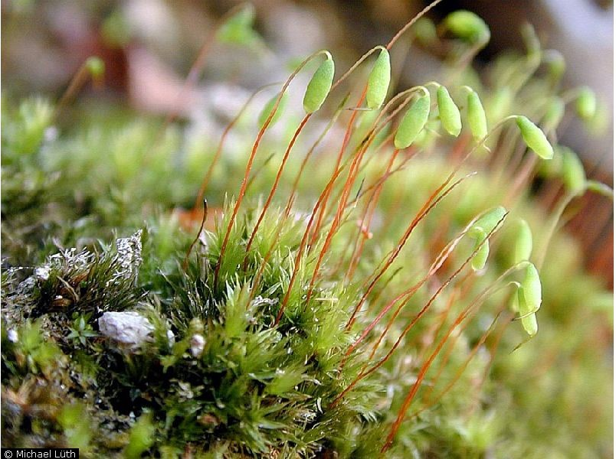
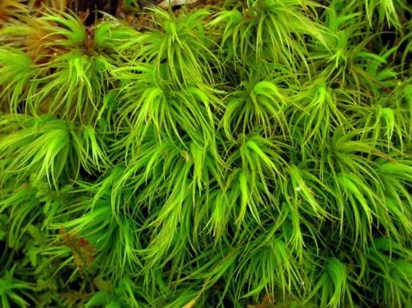
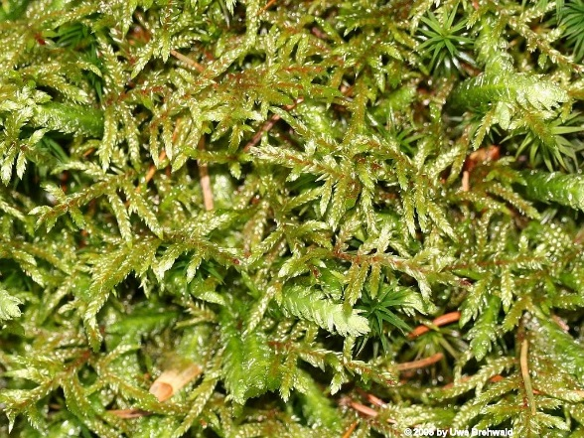
RDA and Variance Partitioning

Slide 2
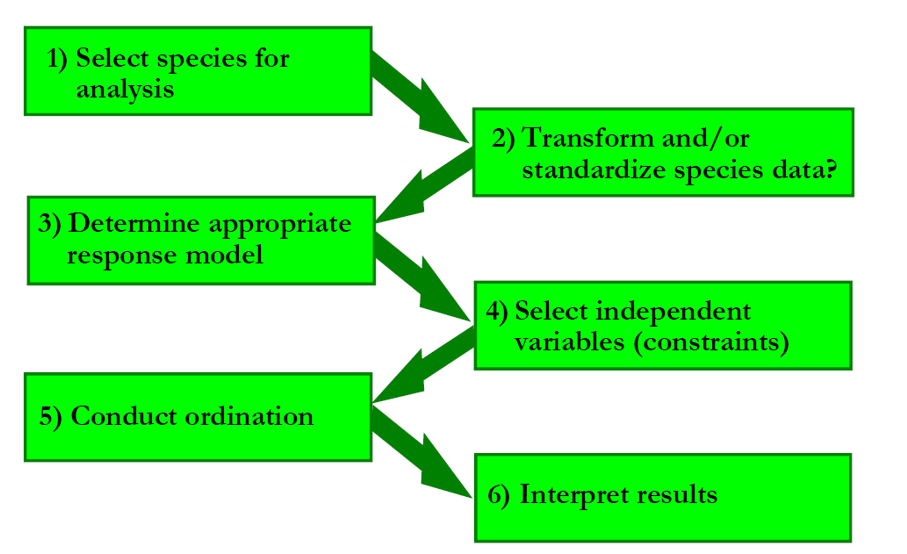
Steps in Constrained Ordination

Slide 3
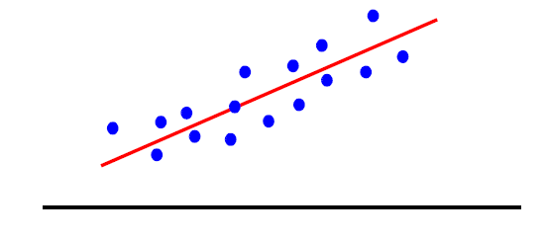
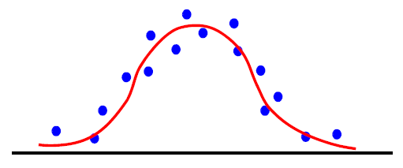
Linear vs. Unimodal Models
Redundancy Analysis (RDA)
Assumes a linear relationship between response
variables and explanatory variables.
Uses PCA for ordination
Canonical Correspondence Analysis (CCA)
Assumes a unimodal relationship between response
variables and explanatory variables.
Uses CA for ordination
Species Abundance
Temperature

Slide 4
Linear vs. Unimodal Models
Redundancy Analysis (RDA)
Assumes a linear relationship between response
variables and explanatory variables.
Uses PCA for ordination
Canonical Correspondence Analysis (CCA)
Assumes a unimodal relationship between response
variables and explanatory variables.
Uses CA for ordination
Species Abundance
Temperature

Slide 5
Steps in Constrained Ordination

Slide 6
Steps in Constrained Ordination

Slide 7
Constrained Ordination Steps
Run a multivariate regression of the response variable matrix Y
on the explanatory variable matrix X resulting in a matrix of
fitted values, Ŷ.
Ŷ = XB
B is the matrix of regression coefficients.
Conduct a PCA on the Ŷ matrix resulting in a matrix A
of eigenvectors. Elements of A are called species scores.
FACTOR LOADINGS

Slide 8
Constrained Ordination Steps
Next, you calculate two sets of scores from the PCA:
The F scores are calculated by multiplying the matrix of
eigenvectors, A, by the matrix of response variables Y.
F = YA
F are site scores based on observed species distributions.
The Z scores are calculated by multiplying the matrix of
eigenvectors, A, by the matrix of fitted response variables Ŷ.
Z = ŶA or Z = XBA
Z are site scores based on species distributions predicted by the environment.

Slide 9
Constrained Ordination Steps
Calculate the correlation between Z matrix (predicted site scores) and
environmental variables, X, to determine the influence of the environmental
variables on community composition.
These are the arrows on the tri-plot

Slide 10
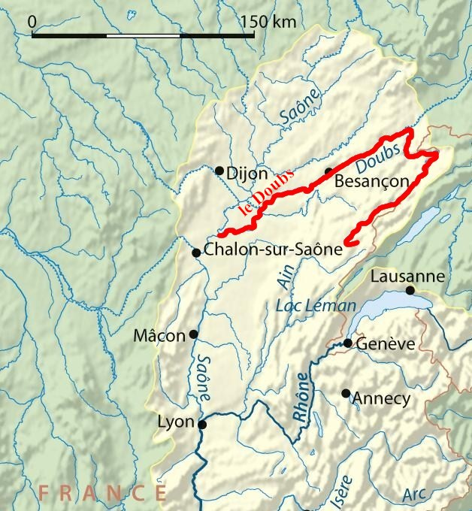
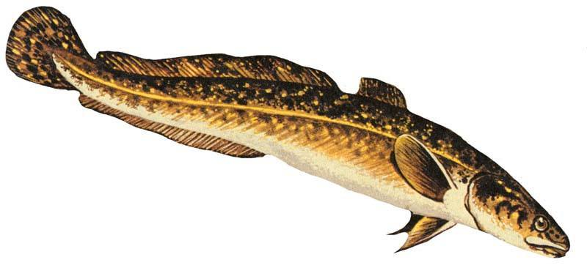
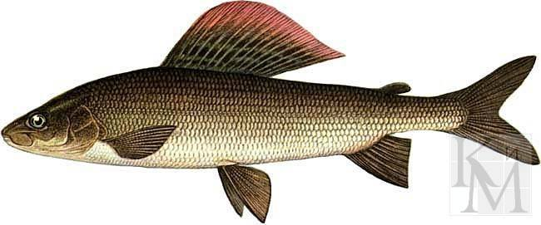
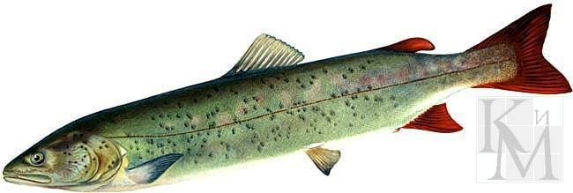
RDA Example: Doubs River Fish Communities (Verneaux 1973)
30 sites along the Doubs River
27 fish species
11 environmental variables
Wiki commons
Photos from: http://www.pripolar.com/

Slide 11
RDA Example: Doubs River Fish Communities
Y matrix
Site | TRU | VAI | LOC | OMB | BLA | HOT | TOX | VAN | . . .
1 | 0 | 3 | 0 | 0 | 0 | 0 | 0 | 0 | . . .
2 | 0 | 5 | 4 | 3 | 0 | 0 | 0 | 0 | . . .
3 | 0 | 5 | 5 | 5 | 0 | 0 | 0 | 0 | . . .
4 | 0 | 4 | 5 | 5 | 0 | 0 | 0 | 0 | . . .
5 | 0 | 2 | 3 | 2 | 0 | 0 | 0 | 0 | . . .
6 | 0 | 3 | 4 | 5 | 0 | 0 | 0 | 0 | . . .
7 | 0 | 5 | 4 | 5 | 0 | 0 | 0 | 0 | . . .

Slide 12
RDA Example: Doubs River Fish Communities
X matrix
Site | das | alt | pen | deb | pH | dur | pho | nit | amm | oxy | dbo
1 | 0.3 | 934 | 48 | 0.84 | 7.9 | 45 | 0.01 | 0.2 | 0 | 12.2 | 2.7
2 | 2.2 | 932 | 3 | 1 | 8 | 40 | 0.02 | 0.2 | 0.1 | 10.3 | 1.9
3 | 10.2 | 914 | 3.7 | 1.8 | 8.3 | 52 | 0.05 | 0.22 | 0.05 | 10.5 | 3.5
4 | 18.5 | 854 | 3.2 | 2.53 | 8 | 72 | 0.1 | 0.21 | 0 | 11 | 1.3
5 | 21.5 | 849 | 2.3 | 2.64 | 8.1 | 84 | 0.38 | 0.52 | 0.2 | 8 | 6.2
6 | 32.4 | 846 | 3.2 | 2.86 | 7.9 | 60 | 0.2 | 0.15 | 0 | 10.2 | 5.3
7 | 36.8 | 841 | 6.6 | 4 | 8.1 | 88 | 0.07 | 0.15 | 0 | 11.1 | 2.2
. . . | . . . | . . . | . . . | . . . | . . . | . . . | . . . | . . . | . . . | . . . | . . .

Slide 13
Selecting Independent Variables
Include variables based on a priori hypotheses.
Use variable selection procedure to select “best” subset of variables
(e.g., remove one of each pair of highly Cor, forward, stepwise).
Rule of thumb (very loose), use 3-5 explanatory variables.

Slide 14
Correlations among variables
 | alt | pen | deb | pH | dur | pho | nit | amm | oxy
pen | 0.21
deb | 0.74 | 0.13
pH | 0 | 0.05 | 0
dur | 0.62 | 0.28 | 0.54 | 0.01
pho | 0.19 | 0.04 | 0.14 | 0.01 | 0.14
nit | 0.57 | 0.1 | 0.35 | 0 | 0.29 | 0.64
amm | 0.15 | 0.03 | 0.09 | 0.01 | 0.09 | 0.94 | 0.64
oxy | 0.18 | 0.09 | 0.18 | 0.04 | 0.14 | 0.57 | 0.47 | 0.56
dbo | 0.15 | 0.03 | 0.09 | 0.03 | 0.11 | 0.83 | 0.47 | 0.82 | 0.71

Slide 15
RDA with all variables
 | Inertia | Proportion | Rank
Total | 0.5025 | 1
Constrained | 0.3654 | 0.7271 | 12
Unconstrained | 0.1371 | 0.2729 | 16
 | RDA1 | RDA2 | RDA3 | RDA4 | RDA5
Eigenvalue | 0.2281 | 0.0537 | 0.03212 | 0.02321 | 0.008707
Proportion explained | 0.4539 | 0.1069 | 0.06393 | 0.04618 | 0.01733
Cumulative proportion | 0.4539 | 0.5607 | 0.62467 | 0.67085 | 0.68818

Slide 16
RDA with all variables
 | Inertia | Proportion | Rank
Total | 0.5025 | 1
Constrained | 0.3654 | 0.7271 | 12
Unconstrained | 0.1371 | 0.2729 | 16
 | RDA1 | RDA2 | RDA3 | RDA4 | RDA5
Eigenvalue | 0.2281 | 0.0537 | 0.03212 | 0.02321 | 0.008707
Proportion explained | 0.4539 | 0.1069 | 0.06393 | 0.04618 | 0.01733
Cumulative proportion | 0.4539 | 0.5607 | 0.62467 | 0.67085 | 0.68818

Slide 17
RDA with all variables
 | Inertia | Proportion | Rank
Total | 0.5025 | 1
Constrained | 0.3654 | 0.7271 | 12
Unconstrained | 0.1371 | 0.2729 | 16
Adjusted R² = 0.52
 | RDA1 | RDA2 | RDA3 | RDA4 | RDA5
Eigenvalue | 0.2281 | 0.0537 | 0.03212 | 0.02321 | 0.008707
Proportion explained | 0.4539 | 0.1069 | 0.06393 | 0.04618 | 0.01733
Cumulative proportion | 0.4539 | 0.5607 | 0.62467 | 0.67085 | 0.68818
First 4 axes are significant via permutation test

Slide 18
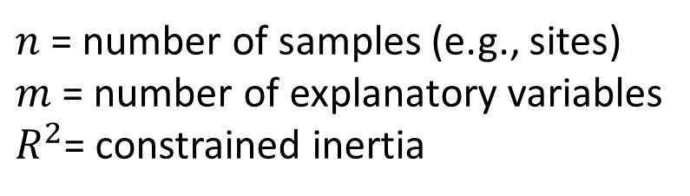
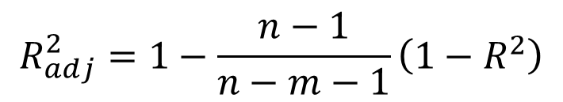
Adjusted R-squared Ezekiel’s formula (Ezekiel 1930)
$$R_{adj}^{2}=1−\frac{n−1}{n−m−1}\left(1−R^{2}\right)$$
$n$ = number of samples (e.g., sites)
$m$ = number of explanatory variables
$R^{2}$= constrained inertia

Slide 19
RDA with all variables

Slide 20
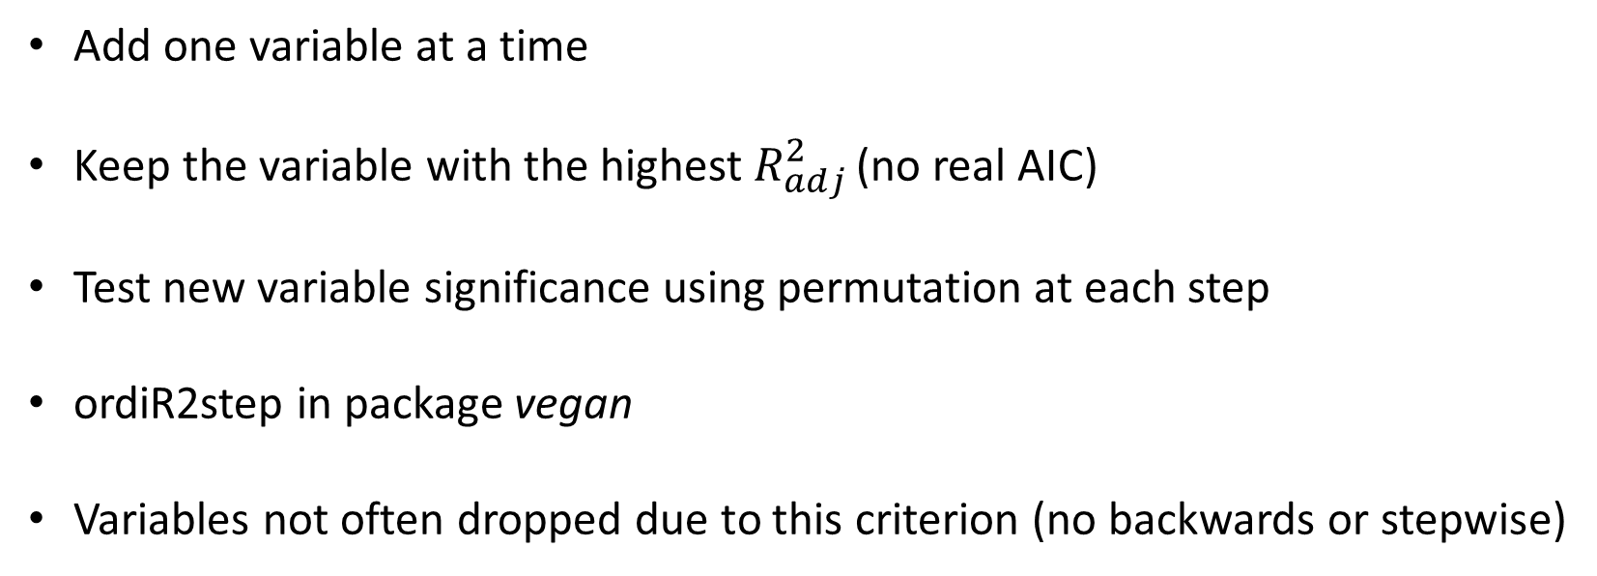
Forward Selection
Add one variable at a time
Keep the variable with the highest $R_{adj}^{2}$ (no real AIC)
Test new variable significance using permutation at each step
ordiR2step in package vegan
Variables not often dropped due to this criterion (no backwards or stepwise)

Slide 21
Forward Selection
Step: R2.adj= 0
Call: spe.hel ~ 1
R2.adjusted
+ alt 0.30317903
+ oxy 0.27664565
+ deb 0.26284719
+ nit 0.25885656
+ pen 0.22398493
+ dbo 0.16253018
+ dur 0.14287362
+ pho 0.13366338
+ amm 0.12940835
<none> 0.00000000
+ pH -0.01877893
Df AIC F N.Perm Pr(>F)
+ alt 1 -28.504 13.182 999 0.001 ***

Slide 22
Forward Selection
Step: R2.adj= 0.303179
Call: spe.hel ~ alt
R2.adjusted
+ oxy 0.4530243
+ dbo 0.4034321
+ amm 0.3755280
+ pho 0.3708315
+ nit 0.3462991
+ deb 0.3121070
+ dur 0.3116743
<none> 0.3031790
+ pH 0.2990327
+ pen 0.2817000
Df AIC F N.Perm Pr(>F)
+ oxy 1 -34.62 8.3967 999 0.001 ***

Slide 23
Forward Selection
Step: R2.adj= 0.4530243
Call: spe.hel ~ alt + oxy
R2.adjusted
+ dbo 0.5401552
+ pho 0.5117625
+ amm 0.5028443
+ dur 0.4712537
+ deb 0.4647864
<none> 0.4530243
+ nit 0.4476588
+ pH 0.4392323
+ pen 0.4233274
Df AIC F N.Perm Pr(>F)
+ dbo 1 -38.789 5.9264 999 0.001 ***

Slide 24
Forward Selection
Step: R2.adj= 0.5401552
Call: spe.hel ~ alt + oxy + dbo
R2.adjusted
+ dur 0.5621437
+ deb 0.5474307
<none> 0.5401552
+ pho 0.5372307
+ amm 0.5339205
+ nit 0.5338362
+ pH 0.5296165
+ pen 0.5203900
Df AIC F N.Perm Pr(>F)
+ dur 1 -39.394 2.2555 999 0.029 *

Slide 25
Forward Selection
Step: R2.adj= 0.5621437
Call: spe.hel ~ alt + oxy + dbo + dur
R2.adjusted
+ deb 0.5795888
<none> 0.5621437
+ pho 0.5600699
+ amm 0.5561073
+ nit 0.5543688
+ pH 0.5506929
+ pen 0.5459010
Df AIC F N.Perm Pr(>F)
+ deb 1 -39.807 1.9959 999 0.061 .
STOP

Slide 26
RDA with parsimonious model
spe.hel ~ alt + oxy + dbo + dur
 | Inertia | Proportion | Rank
Total | 0.5025 | 1
Constrained | 0.3139 | 0.6247 | 4
Unconstrained | 0.1886 | 0.3753 | 24
Adjusted R²= 0.56
 | RDA1 | RDA2 | RDA3 | RDA4
Eigenvalue | 0.2228 | 0.05131 | 0.02781 | 0.01197
Proportion | 0.4435 | 0.1021 | 0.05533 | 0.02381
Cumulative | 0.4435 | 0.54555 | 0.60088 | 0.62469
First three axes significant via permutation

Slide 27
Multivariate Models
Model Technique
y = x1 + x2 + … x Regression, ANOVA
y1 + y2 + … yi = x Multivariate ANOVA , MANTEL
Discriminant Analysis, CART
y1 + y2 + … yi = x1 + x2 + … xj Redundancy Analysis (RDA),
Can. Cor. Analysis (CCA)
y1 + y2 + … yi Ordination, Cluster Analysis
Multivariate Statistics

Slide 28
Partial RDA (and CCA)
How much variation is independently described by each variable?
Which is the most important variable?
Conduct RDA (CCA) for each variable while holding the effect of
the others constant.
This can also be done for multiple regression.

Slide 29
Partial RDA (and CCA)
spe.hel ~ alt + Condition(oxy + dbo + dur)
spe.hel ~ oxy + Condition(alt + dbo + dur)
spe.hel ~ dbo + Condition(alt + oxy + dur)
spe.hel ~ dur+ Condition(alt + oxy + dbo)

Slide 30
Partial RDA (and CCA)
spe.hel ~ alt + Condition(oxy + dbo + dur)
spe.hel ~ oxy + Condition(alt + dbo + dur)
spe.hel ~ dbo + Condition(alt + oxy + dur)
spe.hel ~ dur+ Condition(alt + oxy + dbo)

Slide 31
Partial RDA (and CCA)
spe.hel ~ alt + Condition(oxy + dbo + dur)
 | Inertia | Proportion | Rank
Total | 0.5025 | 1
Conditional | 0.2415 | 0.4805 | 3
Constrained | 0.0724 | 0.1442 | 1
Unconstrained | 0.1886 | 0.3753 | 24

Slide 32
Partial RDA (and CCA)
spe.hel ~ alt + Condition(oxy + dbo + dur)
 | Inertia | Proportion | Rank
Total | 0.5025 | 1
Conditional | 0.2415 | 0.4805 | 3
Constrained | 0.0724 | 0.1442 | 1
Unconstrained | 0.1886 | 0.3753 | 24
 | Df | Var | F | N.Perm | Pr(>F)
Model | 1 | 0.07245 | 9.2198 | 999 | 0.001 | ***
Residual | 24 | 0.1886

Slide 33
Variance Partitioning
[d]
Var 1
Var 2
[a]
[b]
[c]

Slide 34
Variance Partitioning
3 RDAs
[d]
Var 1
Var 2
Y ~ Var1 = [a] + [b]
Y ~ Var 2 = [c] + [b]
Y ~ Var1 + Var 2 = [a] + [b] + [c]
[a]
[b]
[c]
Calculate Adjusted R² for each RDA

Slide 35
Variance Partitioning
[d]
Var 1
Var 2
Compute the adjusted R² for each variance fraction using subtraction:
[a]
[b]
[c]
fraction[a]_{adj} = [a+b+c]_{adj} – [b+c] _{adj}
fraction[c]_{adj} = [a+b+c]_{adj} – [a+b] _{adj}
fraction[b]_{adj} = [a+b]_{adj} – [a]_{adj} = [c+b]_{adj} – [c]_{adj}
fraction[d]_{adj} = 1 – [a+b+c]_{adj}

Slide 36
Variance Partitioning
[d]
Var 1
Var 2
Compute the adjusted R² for each variance fraction using subtraction:
[a]
[b]
[c]
fraction[a]_{adj} = [a+b+c]_{adj} – [b+c] _{adj}
fraction[c]_{adj} = [a+b+c]_{adj} – [a+b] _{adj}
fraction[b]_{adj} = [a+b]_{adj} – [a]_{adj} = [c+b]_{adj} – [c]_{adj}
fraction[d]_{adj} = 1 – [a+b+c]_{adj}

Slide 37
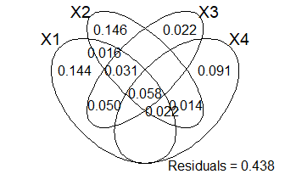
Variance Partitioning
oxy
dur
alt
dbo

Slide 38
More fun with partitioning…
Site | das | alt | pen | deb | pH | dur | pho | nit | amm | oxy | dbo
1 | 0.3 | 934 | 48 | 0.84 | 7.9 | 45 | 0.01 | 0.2 | 0 | 12.2 | 2.7
2 | 2.2 | 932 | 3 | 1 | 8 | 40 | 0.02 | 0.2 | 0.1 | 10.3 | 1.9
3 | 10.2 | 914 | 3.7 | 1.8 | 8.3 | 52 | 0.05 | 0.22 | 0.05 | 10.5 | 3.5
4 | 18.5 | 854 | 3.2 | 2.53 | 8 | 72 | 0.1 | 0.21 | 0 | 11 | 1.3
5 | 21.5 | 849 | 2.3 | 2.64 | 8.1 | 84 | 0.38 | 0.52 | 0.2 | 8 | 6.2
6 | 32.4 | 846 | 3.2 | 2.86 | 7.9 | 60 | 0.2 | 0.15 | 0 | 10.2 | 5.3
7 | 36.8 | 841 | 6.6 | 4 | 8.1 | 88 | 0.07 | 0.15 | 0 | 11.1 | 2.2

Slide 39
More fun with partitioning…
Physiography Water Quality
Site | das | alt | pen | deb | pH | dur | pho | nit | amm | oxy | dbo
1 | 0.3 | 934 | 48 | 0.84 | 7.9 | 45 | 0.01 | 0.2 | 0 | 12.2 | 2.7
2 | 2.2 | 932 | 3 | 1 | 8 | 40 | 0.02 | 0.2 | 0.1 | 10.3 | 1.9
3 | 10.2 | 914 | 3.7 | 1.8 | 8.3 | 52 | 0.05 | 0.22 | 0.05 | 10.5 | 3.5
4 | 18.5 | 854 | 3.2 | 2.53 | 8 | 72 | 0.1 | 0.21 | 0 | 11 | 1.3
5 | 21.5 | 849 | 2.3 | 2.64 | 8.1 | 84 | 0.38 | 0.52 | 0.2 | 8 | 6.2
6 | 32.4 | 846 | 3.2 | 2.86 | 7.9 | 60 | 0.2 | 0.15 | 0 | 10.2 | 5.3
7 | 36.8 | 841 | 6.6 | 4 | 8.1 | 88 | 0.07 | 0.15 | 0 | 11.1 | 2.2

Slide 40
Variance Partitioning
Physiography
Water Quality

Slide 41
Constrained Ordination Wrap-Up
Method for relating predictor variables (e.g. environmental) to response
variables (e.g. species abundances across sites).
Extension of unconstrained ordination techniques (PCA and CA).
CCA for unimodal responses RDA for linear responses.
Tri-plots provide good visualization of complex environment, site, and species
relationships.
Partial RDA (CCA) and variance partitioning allow for assessing the relative
importance of each variable in describing variation.

Slide 42
Constrained Ordination Wrap-Up
Method for relating predictor variables (e.g. environmental) to response
variables (e.g. species abundances across sites).
Extension of unconstrained ordination techniques (PCA and CA).
CCA for unimodal responses RDA for linear responses.
Tri-plots provide good visualization of complex environment, site, and species
relationships.
Partial RDA (CCA) and variance partitioning allow for assessing the relative
importance of each variable in describing variation.

Slide 43
Constrained Ordination Wrap-Up
CCA for unimodal responses RDA for linear responses.
Can use Hellinger transformation and RDA on unimodal responses
- See Legendre and Gallagher 2001 in the week 10 module
Distanced based RDA (db-RDA) for data that are not appropriate for PCA (RDA)

