Slide 1
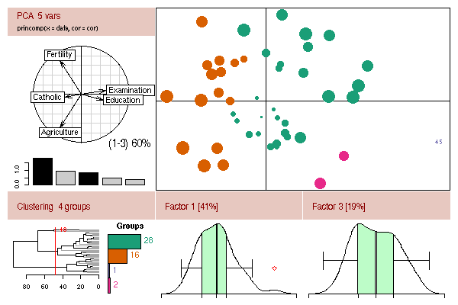
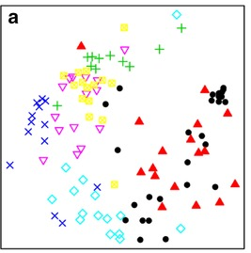
Multivariate Statistics for the Life Sciences WIS 6934
Lecture 1
What is Multivariate Statistics?

Slide 2
What are multivariate data?

Slide 3
What are multivariate data?
Multiple response variables are recorded for each unit (sample)

Slide 4
Multivariate data examples ?

Slide 5
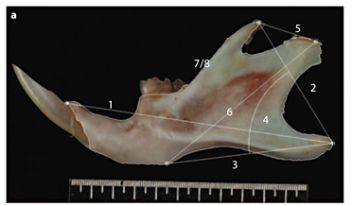
Multivariate data example # 1
Morphological measures of an individual specimen
Photo Credit - T. L. Coxon

Slide 6
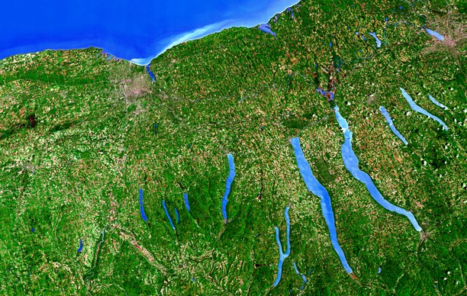
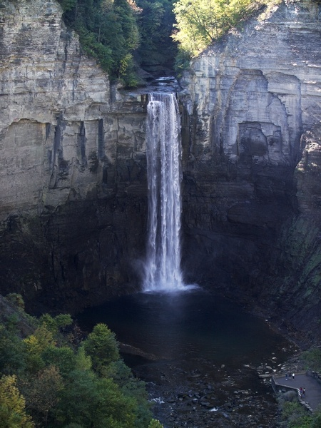

Multivariate data example # 2
Water chemistry measurements of a lake
pH
DO
Salinity
NO₃-N

Slide 7



Multivariate data example # 3
Forest Structure
Canopy height
Canopy cover
Shrub cover
Snag Density
DBH

Slide 8
Multivariate data example # 4
Species abundances in a community

Slide 9
Multivariate Data
 | Variable 1 | Variable 2 | Variable 3 | Variable 4 | Variable n
Unit 1 | 4 | 1 | 3 | 1 | 9
Unit 2 | 0 | 1 | 1 | 8 | 2
Unit 3 | . | . | . | . | .
Unit 4 | . | . | . | . | .
Unit n | 2 | 2 | 1 | 10 | 5

Slide 10
Multivariate Data
 | Measure 1 | Measure 2 | Measure 3 | Measure 4 | Measure n
Jaw 1 | 4 | 1 | 3 | 1 | 9
Jaw 2 | 0 | 1 | 1 | 8 | 2
Jaw 3 | . | . | . | . | .
Jaw 4 | . | . | . | . | .
Jaw n | 2 | 2 | 1 | 10 | 5

Slide 11
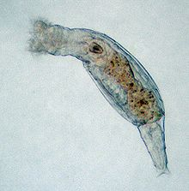

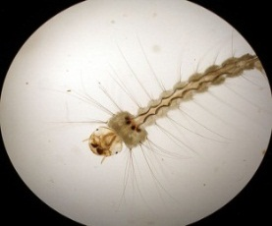


Multivariate Data
 | Species 1 | Species 2 | Species 3 | Species 4 | Species n
Pitcher 1 | 4 | 1 | 3 | 1 | 9
Pitcher 2 | 0 | 1 | 1 | 8 | 2
Pitcher 3 | . | . | . | . | .
Pitcher 4 | . | . | . | . | .
Pitcher n | 2 | 2 | 1 | 10 | 5

Slide 12
Multivariate Models
Model Technique
y = x1 + x2 + … x Regression, ANOVA
y1 + y2 + … yi = x Multivariate ANOVA
Discriminant Analysis, CART
y1 + y2 + … yi = x1 + x2 + … xj Constrained Ordination
y1 + y2 + … yi Ordination, Cluster Analysis
Multivariate Statistics
Adapted from Kevin McGarigal

Slide 13
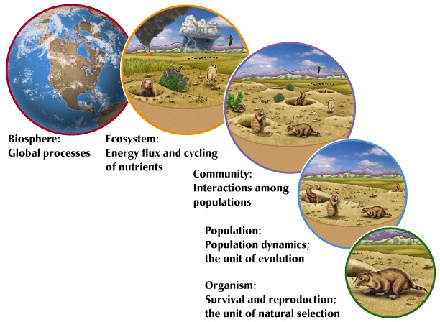
Univariate vs. Multivariate
Univariate is powerful when response is a single
variable and other variables can be controlled.
but, the world is a complex place…
Univariate analyses don’t control for
experiment-wise error.
Figure from J. M. Dirnberger

Slide 14
Advantages of Multivariate Statistics
Reflects more accurately the multidimensional, multivariate nature of complex systems
Allows for visualization of multivariate data
Provides a way to handle large data sets with many variables by summarizing the redundancy
Provides rules for combining variables in an “optimal” way
Provides for post-hoc analysis of new variables
Controls for experiment-wise error
Provide means for exploring complex data sets for patterns that can generate hypotheses to be
tested with experiments

Slide 15
3-D Glasses
4
2
0
4
Rotifer
3
-2
2
1
0
Midge
-4
-1
-2
-6
-3
-3
-2
-1
0
1
2
3
4
5
Mosquito

Slide 16
Advantages of Multivariate Statistics
Reflects more accurately the multidimensional, multivariate nature of complex systems
Allows for visualization of multivariate data
Provides a way to handle large data sets with many variables by summarizing the redundancy
Provides rules for combining variables in an “optimal” way
Provides for post-hoc analysis of new variables
Controls for experiment-wise error
Provide means for exploring complex data sets for patterns that can generate hypotheses to be
tested with experiments

Slide 17
Types of Variables
Categorical: Discrete values assigned for convenience, not quantitative
- Nominal Scale: order of categories is meaningless
ex., flower color (red, blue, green)
- Ordinal Scale: Order of categories is meaningful
ex., wealthy, middleclass, poor

Slide 18
Types of Variables
Continuous: Values are useful for quantitative expression and can assume values
at any point in a continuum of possible values
- Ratio Scale: Has an absolute zero point (i.e., true origin)
ex., height
- Interval Scale: Has an arbitrary zero point (i.e., no true origin)
ex., temperature in Celsius or Fahrenheit

Slide 19
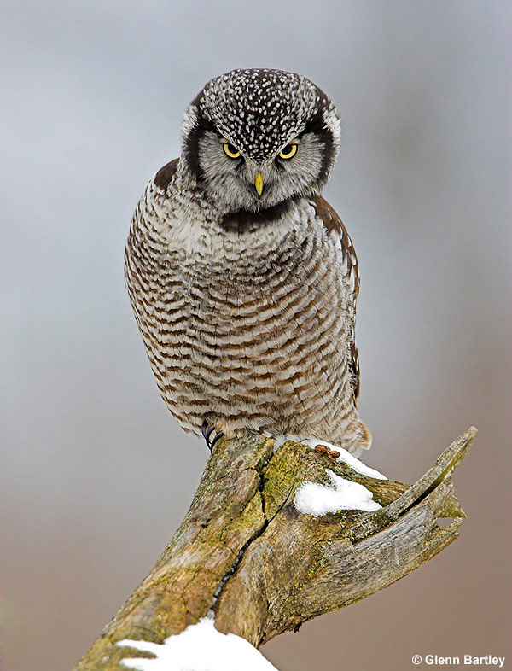
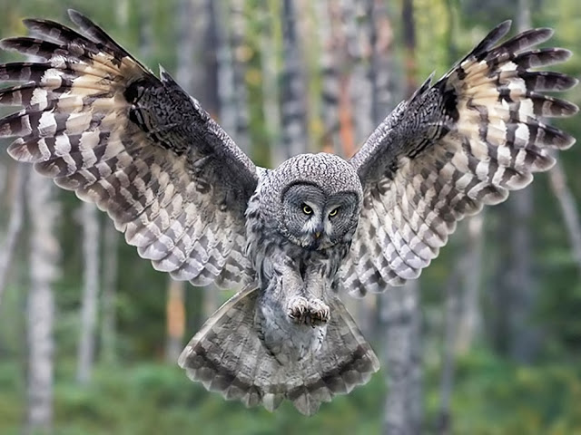
Types of Variables
Count: Values assigned in discrete indivisible units of the same size.
ex., species richness

Slide 20
Types of Variables Based on the Relationship with other Variables
Independent variable (x) – variable assumed to be the cause of change of dependent variables
(explanatory)
Dependent variable (y) – variable presumed to be responding to a change in the independent
(response) variable

Slide 21
Multivariate Madness!
Technique | Alternative Names
Ordination Principal components analysis (PCA) Factor analysis (FA) Principal coordinates analysis (PCoA) Non-Metric Multidimensional Scaling (NMDS) Correspondence analysis (CA) Canonical correspondence analysis (CCA) Cluster analysis Discriminant analysis (DA) Classification Canonical correlation analysis | Factor analysis (FA) None Multidimensional Scaling (MDS) None Reciprocal averaging (RA) None Classification Clumping Grouping Morphometrics Numerical Taxonomy Systematic Typology Discriminant function analysis (DFA) Fisher’s linear discriminant function analysis Canonical variants analysis Multiple discriminant analysis Discriminant function analysis Fisher’s linear discriminant function analysis Canonical variants analysis Multiple discriminant analysis Canonical analysis

Slide 22
Multivariate Techniques
Technique Objective
Unconstrained Ordination Extract gradients of maximum variation
(PCA, NMDS, Factor Analysis)
Cluster Analysis Establish groups of similar entities
(Family of techniques)
Discrimination Test for or describe differences among
(MANTEL, CART, DA) groups of entities or predict group
membership
Constrained Ordination Extract gradients of variation in dependent
(RDA, CCA) variables explained by independent variables
Adapted from K. McGarigal

Slide 23
Multivariate Techniques
Technique Dependence Type
Unconstrained Ordination Interdependence
(PCA, NMDS, Factor Analysis)
Cluster Analysis (Family of techniques) Interdependence
Discrimination Dependence
(MANTEL, CART, DA)
Constrained Ordination Dependence
(RDA, CCA)
Adapted from K. McGarigal

Slide 24
Multivariate Techniques
Technique Data Structure
Unconstrained Ordination One set: >>2 variables
(PCA, NMDS, Factor Analysis)
Cluster Analysis (Family of techniques) One set: >>2 variables
Discrimination Two sets: 1 grouping variable, >>2
(MANTEL, CART, DA) discriminating variables
Constrained Ordination Two sets:>>2 dependent variables,
(RDA, CCA) >>2 independent variables
Adapted from K. McGarigal

Slide 25
Ordination Example
from K. McGarigal

Slide 26
Cluster Analysis Example
from K. McGarigal

Slide 27
Discrimination Example
from K. McGarigal

Slide 28
Constrained Ordination Example
from K. McGarigal

Slide 29
Multivariate Statistics Key Points
Multivariate statistics involve cases with multiple “dependent” variables
All multivariate problems can be represented as a two-way data
matrix in which rows represent sampling units and columns
represent variables
All multivariate data sets can be conceptualized as a data cloud in
P-dimensional data space, where the dimensions (or axes) are defined
by the variables of interest
Adapted from K. McGarigal

Slide 30
Course Goals
Yes, Multivariate analyses are similar to each other and have really confusing
(and similar) names!
You will learn which techniques to employ for certain data structures
You will learn how to implement analyses using R
You will learn to interpret and disseminate results

Slide 31

Getting Started…
Programming in R
Loading, organizing, and managing multivariate data in R
Bring you own data set

