Slide 1
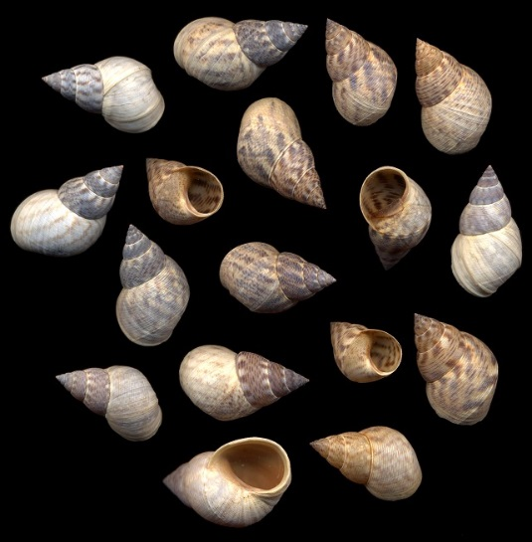
Cluster Analysis I
Cluster analysis overview, K-means clustering

Slide 2
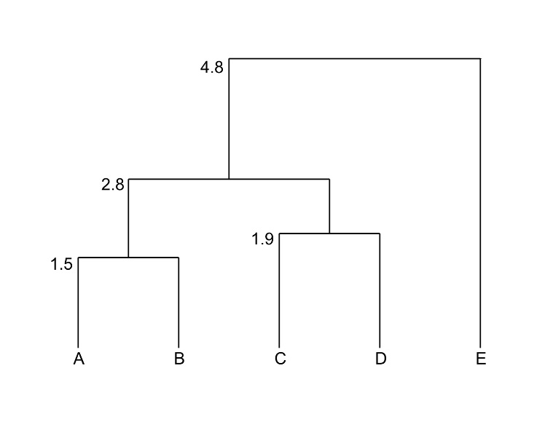
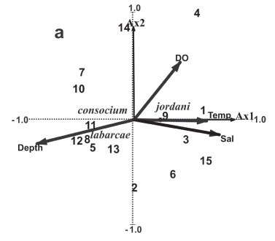
Cluster Analysis vs. Ordination
Ordination focuses on data reduction to
discover new gradients (axes) of variation
in a multivariate data set.
Cluster Analysis seeks to find “groups”
Can complement one another

Slide 3






Cluster Analysis
Goal: To organize sampling entities
into discrete classes (clusters), so that
within-group similarity is maximized and
among-group similarity is minimized.
City | SO2 | temp | predays
Wichita | 8 | 56.6 | 82
Dallas | 9 | 66.2 | 78
San Francisco | 12 | 56.7 | 67
Philadelphia | 69 | 54.6 | 115
Providence | 94 | 50 | 125
Chicago | 110 | 50.6 | 122
v
v
v

Slide 4
Cluster Analysis Techniques
Family of techniques with similar goals
Data sets have no pre-defined or well-defined groups
Characteristics of the data are used to assign entities into groups
Summarize data redundancy by reducing information on
a set of n samples to information on p groups of
nearly similar samples (p is hopefully <<< than n)

Slide 5
What is a cluster?
“continuous regions of p-dimensional space containing a relatively high density of
data points, separated by regions containing a relatively low density of points”
From Everitt 1977

Slide 6
Cluster Analysis – Data Set
Single set of variables; no distinction between independent
and dependent.
Continuous, categorical, or count variables; usually the same scale.
Every sample must be measured on the same set of variables.
There can be fewer samples (rows) than variables (columns).

Slide 7
Cluster Analysis Dataset: 2-way data matrix
City | SO2 | temp | predays
Wichita | 8 | 56.6 | 82
Dallas | 9 | 66.2 | 78
San Francisco | 12 | 56.7 | 67
Philadelphia | 69 | 54.6 | 115
Providence | 94 | 50 | 125
Chicago | 110 | 50.6 | 122
City-by-variable
2-way data matrix

Slide 8
Cluster Techniques

Slide 9
Non-hierarchical vs Hierarchical
Non-hierarchical
Hierarchical
A
E
B
C
D
Groups, but no relationships
Groups and relationships
within and between groups

Slide 10
Cluster Techniques

Slide 11
Agglomerative vs. Divisive
Agglomerative
t = 0
t = 1
t = 2
t =3
t =4
1
1
2
1
2
3
4
5
2
3
3
4
5
4
4
5
5
Divisive
t = 4
t = 3
t = 2
t = 1
t = 0
Agglomerative (bottom-up) Clustering
Each sample starts as its own singleton cluster
At each time-step, merge 2 most similar clusters
Stop when there is a single cluster of all samples
Divisive (top-down) Clustering
Start with all samples in the same cluster
At each time-step, remove the “outsiders” from the least cohesive cluster
Stop when each sample is in its own singleton cluster

Slide 12
Cluster Techniques

Slide 13
Cluster Techniques

Slide 14
Non-hierarchical Clustering (NHC)
NHC assigns each sample to a cluster, placing similar samples together.
Most straight-forward cluster technique. Main purpose is to maximize within-cluster
homogeneity.
Allows for inference about a sample’s properties based on it’s cluster membership.
Main goal is to summarize redundant samples into fewer groups for
subsequent analysis.
Several algorithms, all with the single criterion of achieving within-cluster homogeneity
produce similar results.

Slide 15
Non-hierarchical Clustering: K-means Clustering(most popular)
Divisive clustering technique
Must specify the number of clusters apriori.
Each cluster is assigned a centroid.
Iterative procedure assigning samples to clusters
in order to minimize within-cluster variability.

Slide 16
K-means Clustering Procedure
1) Selects K centroids (K rows chosen at random)
2) Assigns each data point to its closest centroid
3) Recalculates the centroids as the average of all data points
in a cluster (i.e., the centroids are p-length mean vectors, where
p is the number of variables)
4) Assigns data points to their closest centroids
5) Continues steps 3 and 4 until the observations are not reassigned
or the maximum number of iterations (R uses 10 as a default) is reached.

Slide 17
K-means Clustering Procedure
1) Selects K centroids (K rows chosen at random)
Pitcher ID | Site | S | LS | C | Top | Int | Det | Omn
1 | QUS | 1.01 | 1.35 | 0.94 | -0.11 | 0.32 | -0.94 | 1.86
2 | SUM | 1.01 | 0.92 | 0.10 | -0.11 | 0.32 | 0.27 | -0.48
3 | VT | 1.95 | 1.36 | -0.54 | -0.42 | 0.66 | 0.91 | 0.18
4 | BC | 1.32 | 1.40 | 0.46 | -0.23 | 0.45 | -0.05 | -0.05
5 | SLM | 1.32 | 1.34 | 0.34 | -0.23 | 0.45 | -0.05 | -0.59
6 | ALA | -2.11 | -2.22 | -2.33 | 4.22 | -4.52 | 1.78 | -2.23
7 | WIS | 1.95 | 1.36 | -0.54 | -0.42 | 0.66 | 0.91 | 0.18

Slide 18
K-means Clustering Procedure
1) Selects K centroids (K rows chosen at random)
2) Assigns each data point to its closest centroid
3) Recalculates the centroids as the average of all data points
in a cluster (i.e., the centroids are p-length mean vectors, where
p is the number of variables)
4) Assigns data points to their closest centroids
5) Continues steps 3 and 4 until the observations are not reassigned
or the maximum number of iterations (R uses 10 as a default) is reached.

Slide 19
K-means Clustering Procedure
2) Assigns each data point to its closest centroid
QUS
VT
ALA
BC
SUM
WIS
SLM

Slide 20
K-means Clustering Procedure
1) Selects K centroids (K rows chosen at random)
2) Assigns each data point to its closest centroid
3) Recalculates the centroids as the average of all data points
in a cluster (i.e., the centroids are p-length mean vectors, where
p is the number of variables)
4) Assigns data points to their closest centroids
5) Continues steps 3 and 4 until the observations are not reassigned
or the maximum number of iterations (R uses 10 as a default) is reached.

Slide 21
K-means Clustering Procedure
3) Recalculates the centroids as the average of all data points
in a cluster
QUS
VT
ALA
BC
SUM
WIS
SLM

Slide 22
K-means Clustering Procedure
1) Selects K centroids (K rows chosen at random)
2) Assigns each data point to its closest centroid
3) Recalculates the centroids as the average of all data points
in a cluster (i.e., the centroids are p-length mean vectors, where
p is the number of variables)
4) Assigns data points to their closest centroids
5) Continues steps 3 and 4 until the observations are not reassigned
or the maximum number of iterations (R uses 10 as a default) is reached.

Slide 23
K-means Clustering Procedure
4) Assigns data points to their closest centroids
QUS
VT
ALA
BC
SUM
WIS
SLM

Slide 24
K-means Clustering Procedure
4) Assigns data points to their closest centroids
QUS
VT
ALA
BC
SUM
?
WIS
SLM

Slide 25
K-means Clustering Procedure
4) Assigns data points to their closest centroids
QUS
VT
ALA
BC
SUM
WIS
SLM

Slide 26
K-means Clustering Procedure
1) Selects K centroids (K rows chosen at random)
2) Assigns each data point to its closest centroid
3) Recalculates the centroids as the average of all data points
in a cluster (i.e., the centroids are p-length mean vectors, where
p is the number of variables)
4) Assigns data points to their closest centroids
5) Continues steps 3 and 4 until the observations are not reassigned
or the maximum number of iterations (R uses 10 as a default) is reached.

Slide 27

More on assigning samples to clusters…
Algorithm by Hartigan (most popular) and Wong (1979) places
samples into clusters by minimizing the sum of squares.
Several different algorithms available for k-means.
$$\sum_{i=1}^{n}{\sum_{j=1}^{p}{{\left({\text{x}}_{ij}−{\overline{x}}_{kj}\right)}^{2}}}$$
SS(k) =

Slide 28
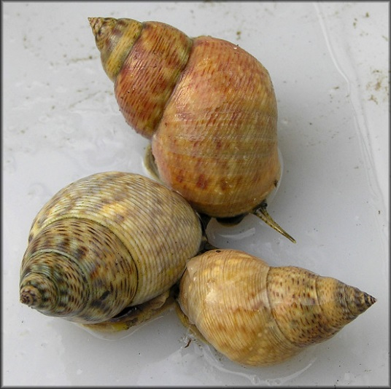
K-means example Shell morphology of Littoraria angulifera
 | Proportionality | Circularity | SpireHeight
Angola | 1.36 | 0.76 | 1.69
Bahamas | 1.51 | 0.76 | 1.86
Belize | 1.42 | 0.76 | 1.85
Brazil | 1.43 | 0.74 | 1.71
Florida | 1.45 | 0.74 | 1.86
Haiti | 1.49 | 0.76 | 1.89
Liberia | 1.36 | 0.75 | 1.69
Nicaragua | 1.48 | 0.74 | 1.69
Sierra Leone | 1.35 | 0.73 | 1.72
Photos from jaxshells.org

Slide 29
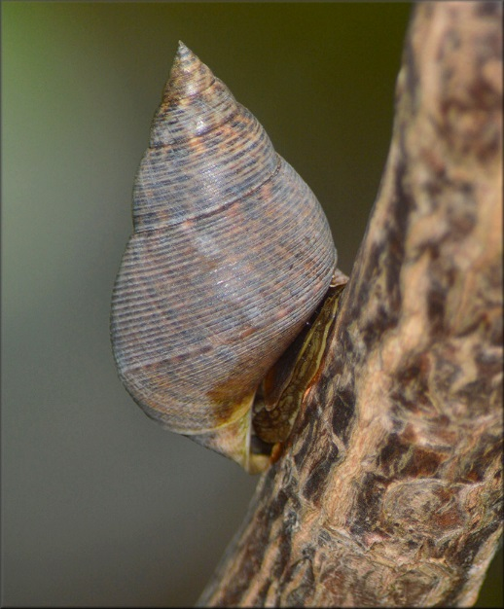
How many clusters?
Scree plot of sum of
squares within groups vs. group #

Slide 30
How many clusters?

Slide 31
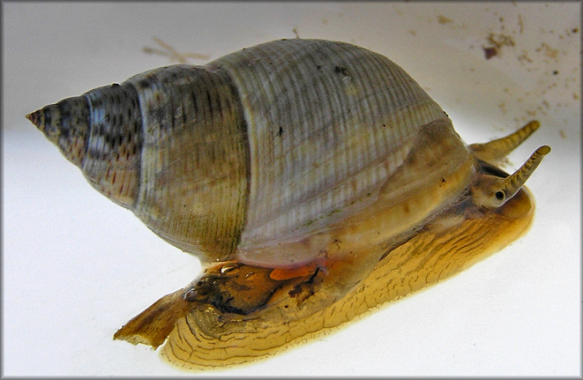
How many clusters?

Slide 32
K-means plot on PCA ordination

Slide 33
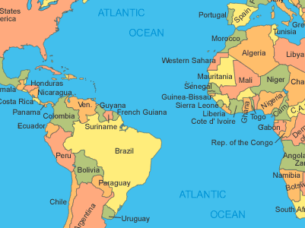
Geographical Pattern?

Slide 34
Testing the “significance” of the clusters?
Are groups significantly different?
- Multivariate Analysis of Variance (MANOVA)
- non-parametric MANOVA (perMANOVA)
- Multi-Response Permutation Procedures (MRPP)
- Analysis of Group Similarities (ANOSIM)
- Mantel’s Test (MANTEL)
* We will cover these in 2 weeks

Slide 35
K-means (and NHC) limitations
NHC procedures make various assumptions about the populations the
data is sampled from (i.e. assumes multivariate normality).
Most NHC methods are strongly biased towards finding elliptical and
spherical clusters.
Not effective at elucidating relationships because there is no structure within
clusters or defined relationship between clusters.

Slide 36
Hierarchical Clustering (HC)
HC places similar samples into groups and arranges groups into a hierarchy.
HC shows relationships among the classified groups.
Limitations
Hierarchies are problematic for large data sets; > 50 samples can be difficult
to display or interpret.
Disadvantage in that samples that are poorly classified early in the analysis
cannot be reallocated to a different cluster.

Slide 37
Polythetic Agglomerative Hierarchical Clustering (PAHC)
Each sample is initially assigned to an individual cluster.
PAHC agglomerates individual clusters in a hierarchy of
larger and larger clusters until a final cluster contains
all samples.
Numerous distance measures and fusion algorithms exist.
As a result, there are many PAHC techniques.
Most popular in ecology/biology (maybe)

Slide 38
Polythetic Agglomerative Hierarchical Clustering (PAHC)
Assumptions:
None really, as a result PAHC is generally a
descriptive approach.
Some distance measures (e.g., Euclidean)
assume that variables are uncorrelated
within clusters.
Basically no sample size requirements.

Slide 39
Polythetic Agglomerative Hierarchical Clustering (PAHC)
General Process
Calculate distance/dissimilarity matrix
Fusion method
Agglomerate samples to build up a hierarchy of increasingly
large clusters.
Choice of fusion method is up to investigator (there are metrics to compare)
All fusion methods cluster the two most similar samples first. Methods differ
in how they fuse subsequent samples (or clusters)

Slide 40
More next week…
Next week we will go over the different fusion methods and…
Because we only have one analysis to run in lab, bring your data
and any questions/issues with previous analyses.
See you Thursday!

