Slide 1
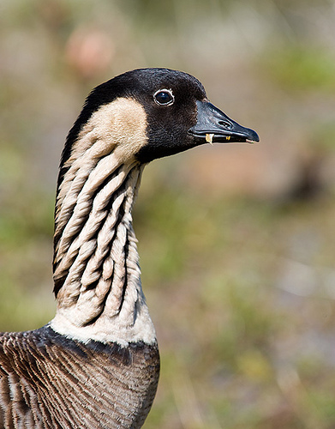
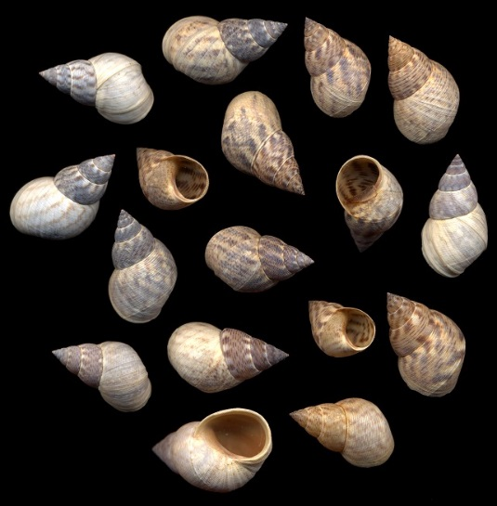
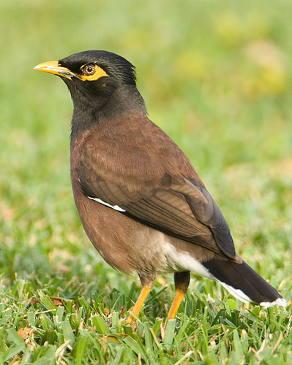
Testing Groups
Historical
Contemporary
Lanai
Molokai
Lanai
NMDS2
Maui
Maui
Molokai
Hawaii
Hawaii
Oahu
Kauai
Oahu
Kauai
NMDS1
MRPP, PerMANOVA, ANOSIM

Slide 2
Are groups significantly different?
Types of Groups Delineated
Treatments Experimental Design
Spatial Sampling Design
Temporal Sampling Design
a posteriori Cluster analysis

Slide 3
Are groups significantly different?
Multiple Response Permutation Procedure (MRPP)
Non parametric MANOVA (PerMANOVA)
Analysis of Group Similarities (ANOSIM)

Slide 4
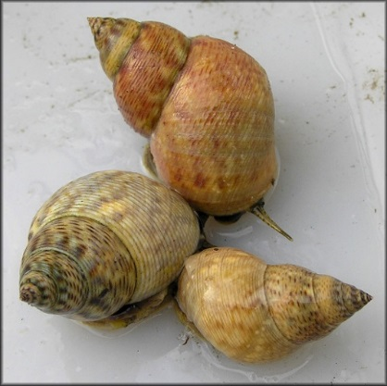
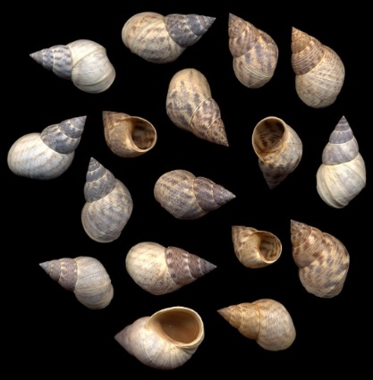
Multiple Response Permutation Procedure (MRPP)
Nonparametric method for testing the hypothesis of
no differences between two or more groups
Is there a difference between the Caribbean and
south Atlantic groups in shell morphology?

Slide 5
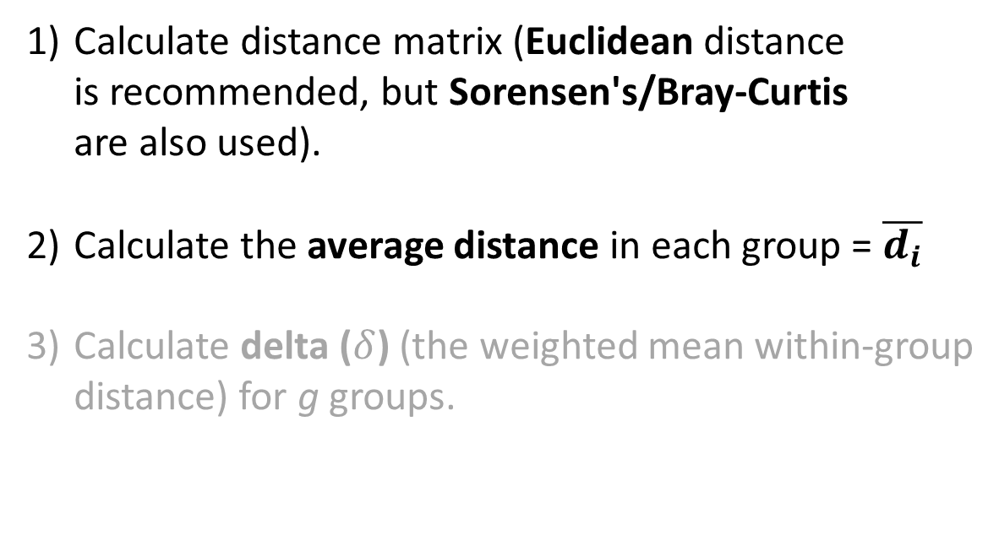
Multiple Response Permutation Procedure (MRPP)
Calculate distance matrix (Euclidean distance
is recommended, but Sorensen's/Bray-Curtis
are also used).
Calculate the average distance in each group = $\overline{d_{i}}$
Calculate delta ($δ$) (the weighted mean within-group
distance) for g groups.

Slide 6


Multiple Response Permutation Procedure (MRPP)
 | 1 | 2 | 3 | 4 | 5 | 6
1 | 0
2 | 2.2 | 0
3 | 2.3 | 3.1 | 0
4 | 6.5 | 7.2 | 4.4 | 0
5 | 8.1 | 5.3 | 8 | 3.4 | 0
6 | 6.6 | 7.1 | 5.5 | 1.1 | 2.8 | 0
2
3
1
4
6
$$\overline{d_{1}}$$
= 2.53
$$\overline{d_{2}}$$
= 2.43
5
Only within-group similarities are used

Slide 7
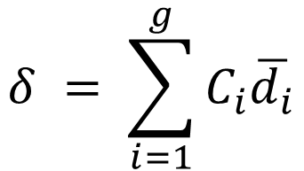
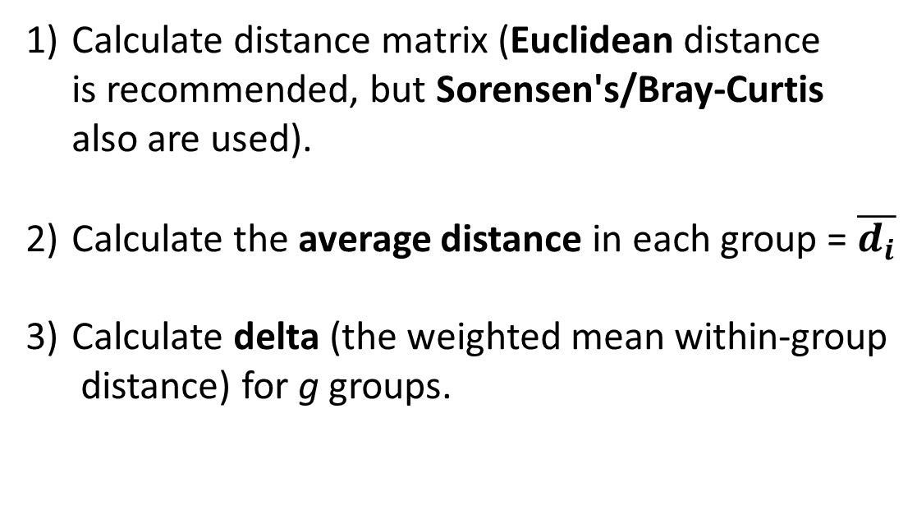
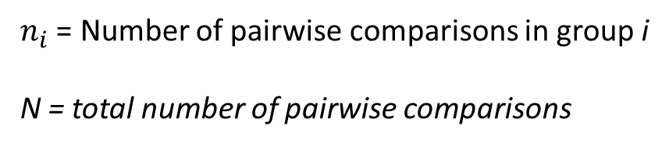

Multiple Response Permutation Procedure (MRPP)
Calculate distance matrix (Euclidean distance
is recommended, but Sorensen's/Bray-Curtis
also are used).
Calculate the average distance in each group = $\overline{d_{i}}$
Calculate delta (the weighted mean within-group
distance) for g groups.
$$δ = \sum_{i=1}^{g}{C_{i}\overline{d_{i}}}$$
$$C_{i} = {n_{i}}/N$$
$n_{i}$ = Number of pairwise comparisons in group i
N = total number of pairwise comparisons

Slide 8


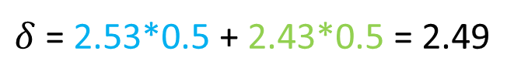
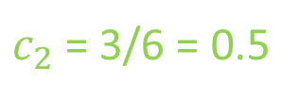
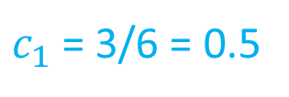
Multiple Response Permutation Procedure (MRPP)
 | 1 | 2 | 3 | 4 | 5 | 6
1 | 0
2 | 2.2 | 0
3 | 2.3 | 3.1 | 0
4 | 6.5 | 7.2 | 4.4 | 0
5 | 8.1 | 5.3 | 8 | 3.4 | 0
6 | 6.6 | 7.1 | 5.5 | 1.1 | 2.8 | 0
2
3
1
4
6
$$\overline{d_{1}}$$
= 2.53
$$\overline{d_{2}}$$
= 2.43
5
$c_{1}$ = 3/6 = 0.5
$c_{2}$ = 3/6 = 0.5
$δ$ = 2.53*0.5 + 2.43*0.5 = 2.49
Only within-group similarities are used

Slide 9
Multiple Response Permutation Procedure (MRPP)
 | 1 | 2 | 3 | 4 | 5 | 6
1 | 0
2 | 2.2 | 0
3 | 2.3 | 3.1 | 0
4 | 6.5 | 7.2 | 4.4 | 0
5 | 8.1 | 5.3 | 8 | 3.4 | 0
6 | 6.6 | 7.1 | 5.5 | 1.1 | 2.8 | 0
2
3
1
4
6
$$\overline{d_{1}}$$
= 2.53
$$\overline{d_{2}}$$
= 2.43
5
$c_{1}$ = 3/6 = 0.5
$c_{2}$ = 3/6 = 0.5
$δ$ = 2.53*0.5 + 2.43*0.5 = 2.49
Determine the probability of delta ≤ 2.49 using Monte Carlo permutations

Slide 10
Multiple Response Permutation Procedure (MRPP)
4) Permute the data by randomly assigning
sample observations to groups.
5) Calculate the significance by taking the
fraction of permuted deltas that are less
than the observed delta.
6) Calculate the effect size independent
of the sample size (chance-corrected
within-group agreement).

Slide 11
Multiple Response Permutation Procedure (MRPP)
 | 1 | 2 | 3 | 4 | 5 | 6
1 | 0
2 | 2.2 | 0
3 | 2.3 | 3.1 | 0
4 | 6.5 | 7.2 | 4.4 | 0
5 | 8.1 | 5.3 | 8 | 3.4 | 0
6 | 6.6 | 7.1 | 5.5 | 1.1 | 2.8 | 0
2
3
1
4
6
 | 1 | 2 | 3 | 4 | 5 | 6
1 | 0
2 | 2.2 | 0
3 | 2.3 | 3.1 | 0
4 | 6.5 | 7.2 | 4.4 | 0
5 | 8.1 | 5.3 | 8 | 3.4 | 0
6 | 6.6 | 7.1 | 5.5 | 1.1 | 2.8 | 0
5
Calculate delta for this permutation

Slide 12
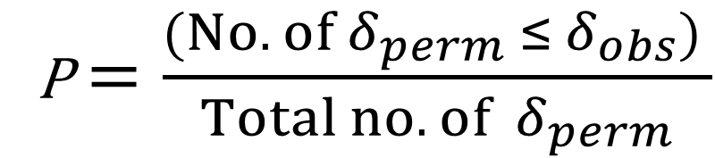
Multiple Response Permutation Procedure (MRPP)
4) Permute the data by randomly assigning
sample observations to groups.
5) Calculate the significance by taking the
fraction of permuted deltas that are less
than the observed delta.
6) Calculate the effect size independent
of the sample size (chance-corrected
within-group agreement).
P$=\frac{(No. of δ_{perm} ≤ δ_{obs}) }{Total no. of{ δ}_{perm}}$

Slide 13
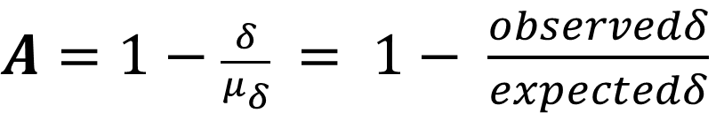
Multiple Response Permutation Procedure (MRPP)
The A statistic describes with-group homogeneity
compared to random expectation.
A = 1 when all items in a group are identical
A = 0 when within-group heterogeneity equals
expectation by chance.
A < 0.1 common in ecology
A > 0.3 is fairly high in ecology
Can still have statistical significance (small p-value) even when “effect size”
is small, with large sample size.
$A=1−\frac{δ}{μ_{δ}}$ $= 1− \frac{observedδ}{expectedδ}$

Slide 14

PAHC example Shell morphology of Littoraria angulifera
 | Proportionality | Circularity | SpireHeight
Angola | 1.36 | 0.76 | 1.69
Bahamas | 1.51 | 0.76 | 1.86
Belize | 1.42 | 0.76 | 1.85
Brazil | 1.43 | 0.74 | 1.71
Florida | 1.45 | 0.74 | 1.86
Haiti | 1.49 | 0.76 | 1.89
Liberia | 1.36 | 0.75 | 1.69
Nicaragua | 1.48 | 0.74 | 1.69
Sierra Leone | 1.35 | 0.73 | 1.72
Photos from jaxshells.org

Slide 15
PAHC –Average- Linkage Method

Slide 16
K-means plot on PCA ordination

Slide 17
MRRP Results – Snail Morphology
Group | N | delta
Caribbean | 4 | 0.06
South Atlantic | 5 | 0.075
400
300
Frequency
200
Chance corrected within-group agreement A: 0.4973
Based on observed delta 0.06852 and expected delta 0.1363
Significance of delta: p = 0.008
Based on 999 permutations
100
0.069
0
0.06
0.08
0.10
0.12
0.14
0.16
delta

Slide 18
Conclusions
We conclude that the two clusters differ significantly
in terms of the shell morphology.

Slide 19
Non Parametric MANOVA PerMANOVA (Adonis)
Nonparametric method for testing the hypothesis of
no differences between two or more groups. Can also
be used for more complex designs.
Predominantly used with NMDS
Historical
Is the community composition of the
Hawaiian Islands significantly different
between the historical and current time
periods?
Contemporary
Lanai
Molokai
Lanai
NMDS2
Maui
Maui
Molokai
Hawaii
Hawaii
Oahu
Kauai
Oahu
Kauai
NMDS1

Slide 20
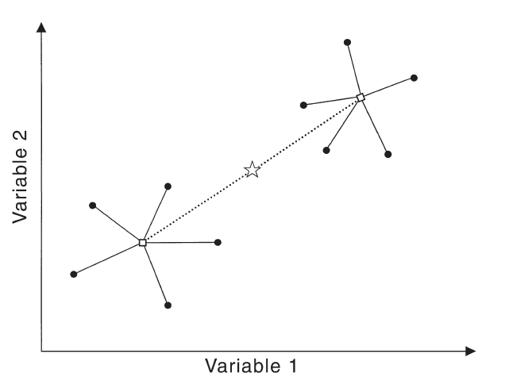
Non Parametric MANOVA PerMANOVA (Adonis)
Group 2
= grand centroid
= group centroid
= samples
Group 1

Slide 21
Non Parametric MANOVA PerMANOVA (Adonis)
SS between points and their centroid…

Slide 22
Non Parametric MANOVA PerMANOVA (Adonis)
… is equal to (and can be calculated directly from) the SS interpoint distances divided by the number of points.

Slide 23
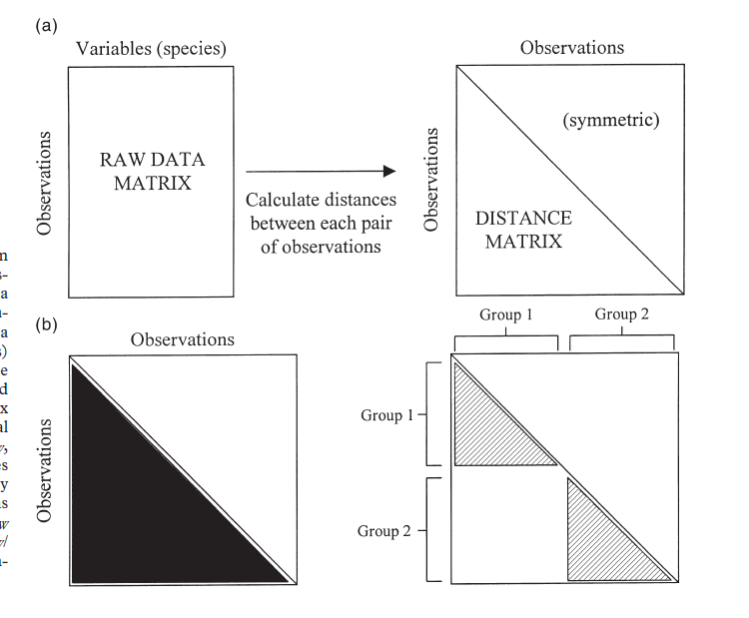
Non Parametric MANOVA PerMANOVA (Adonis)

Slide 24
Non Parametric MANOVA PerMANOVA (Adonis)
Sum of Squares

Slide 25
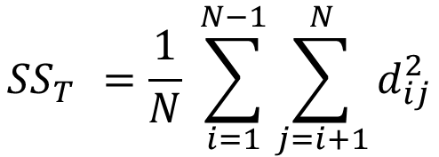
Non Parametric MANOVA PerMANOVA (Adonis)
Total Sum of Squares
$${SS}_{T }=\frac{1}{N} \sum_{i=1}^{N−1}{\sum_{j=i+1}^{N}{d_{ij}^{2}}}$$

Slide 26
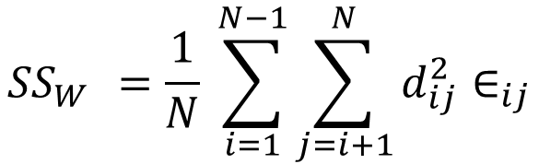
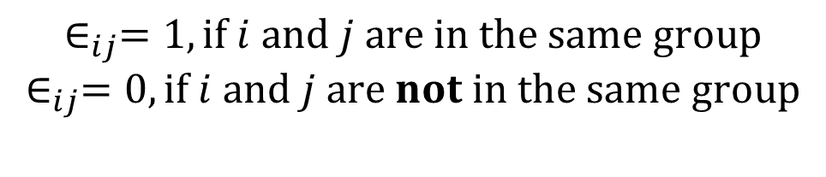
Non Parametric MANOVA PerMANOVA (Adonis)
Within Group Sum of Squares
$${SS}_{W }=\frac{1}{N} \sum_{i=1}^{N−1}{\sum_{j=i+1}^{N}{d_{ij}^{2}∈_{ij}}}$$
$$∈_{ij}=1, if i and j are in the same group$$
$$∈_{ij}=0, if i and j are not in the same group$$

Slide 27

Non Parametric MANOVA PerMANOVA (Adonis)
Among Group Sum of Squares
$${SS}_{A }={SS}_{T }−{SS}_{W }$$

Slide 28
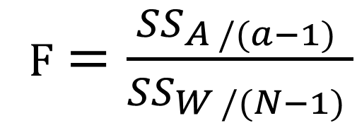
Non Parametric MANOVA PerMANOVA (Adonis)
Pseudo F-Ratio
F$=\frac{{SS}_{A /(a−1) }}{{SS}_{W /(N−1) }}$
a = number of groups

Slide 29
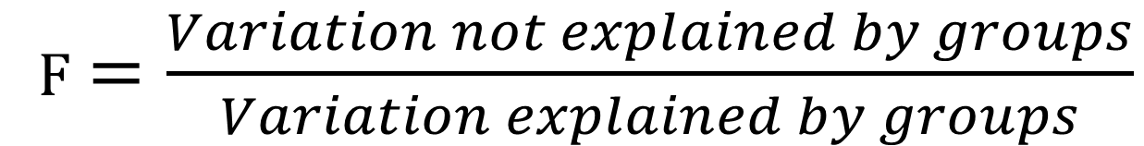
Non Parametric MANOVA PerMANOVA (Adonis)
Pseudo F-Ratio
F$=\frac{Variation not explained by groups}{Variation explained by groups}$

Slide 30
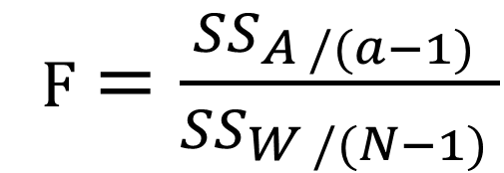
Non Parametric MANOVA PerMANOVA (Adonis)
How do we test our Pseudo F-Ratio?
It is not distributed like Fisher’s F-Ratio.
F$=\frac{{SS}_{A /(a−1) }}{{SS}_{W /(N−1) }}$

Slide 31
Non Parametric MANOVA PerMANOVA (Adonis)
How do we test our Pseudo F-Ratio?
It is not distributed like Fisher’s F-Ratio.
F$=\frac{{SS}_{A /(a−1) }}{{SS}_{W /(N−1) }}$
PERMUTATION!

Slide 32
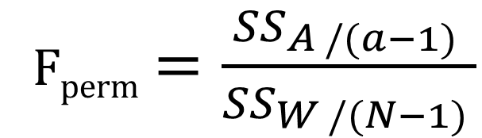
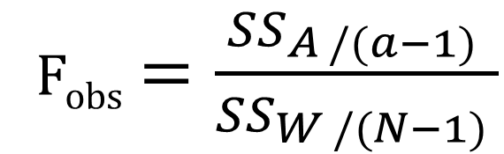
Non Parametric MANOVA PerMANOVA (Adonis)
Observed
 | 1 | 2 | 3 | 4 | 5 | 6
1 | 0
2 | 2 | 0
3 | 3 | 5 | 0
4 | 10 | 13 | 7 | 0
5 | 15 | 14 | 8 | 6 | 0
6 | 11 | 12 | 9 | 1 | 4 | 0
F_{obs}$=\frac{{SS}_{A /(a−1) }}{{SS}_{W /(N−1) }}$
Permuted
 | 1 | 2 | 3 | 4 | 5 | 6
1 | 0
2 | 2 | 0
3 | 3 | 5 | 0
4 | 10 | 13 | 7 | 0
5 | 15 | 14 | 8 | 6 | 0
6 | 11 | 12 | 9 | 1 | 4 | 0
F_{perm}$=\frac{{SS}_{A /(a−1) }}{{SS}_{W /(N−1) }}$

Slide 33


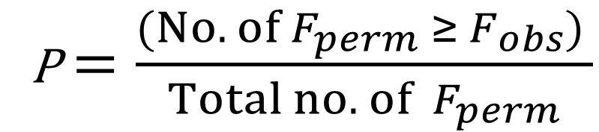
Non Parametric MANOVA PerMANOVA (Adonis)
P$=\frac{(No. of F_{perm} ≥ F_{obs}) }{Total no. of{ F}_{perm}}$
$${ F}_{obs}$$
$${ F}_{perm}$$

Slide 34

Non Parametric MANOVA PerMANOVA (Adonis)
P$=\frac{(No. of F_{perm} ≥ F_{obs}) }{Total no. of{ F}_{perm}}$
$${ F}_{obs}$$
$${ F}_{perm}$$

Slide 35
Non Parametric MANOVA PerMANOVA (Adonis)
Can be used with more complex designs
Post-hoc tests of groups (for more than two groups)
N-way with interactions
Nested and hierarchical (e.g., repeated measures)

Slide 36
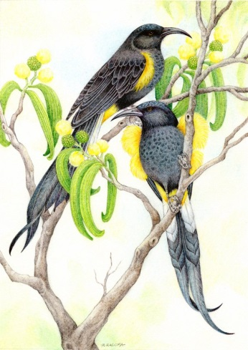
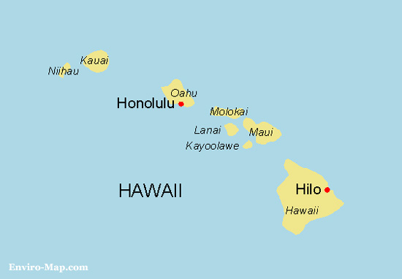
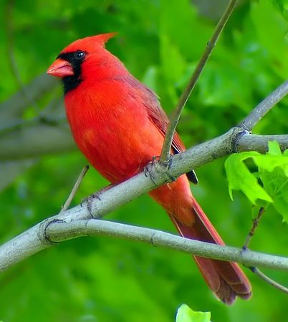
Hawaiian Island Avifauna: Past and Present
Photos by Haole in Hawaii

Slide 37
PerMANOVA – Hawaiian Avifauna
Historical
Stress = 0.126
Contemporary
 | Df | SumsOfSqs | MeanSqs | F.Model | R2 | Pr(>F)
Time per. | 1 | 0.80703 | 0.80703 | 10.785 | 0.5188 | 0.002997
Residuals | 10 | 0.74829 | 0.07483 |  | 0.4811
Total | 11 | 1.55532 |  |  | 1
Lanai
Molokai
Lanai
Maui
Maui
NMDS2
Molokai
Hawaii
Hawaii
Oahu
Kauai
Oahu
Kauai
NMDS1

Slide 38

PerMANOVA – Hawaiian Avifauna
500
 | Df | SumsOfSqs | MeanSqs | F.Model | R2 | Pr(>F)
Time per. | 1 | 0.80703 | 0.80703 | 10.785 | 0.5188 | 0.002997
Residuals | 10 | 0.74829 | 0.07483 |  | 0.4811
Total | 11 | 1.55532 |  |  | 1
400
300
Frequency
200
100
$${ F}_{obs}$$
0
0
2
4
6
8
10
F_{perm}

Slide 39
PerMANOVA – Hawaiian Avifauna
Historical
Stress = 0.126
Contemporary
 | Df | SumsOfSqs | MeanSqs | F.Model | R2 | Pr(>F)
Time per. | 1 | 0.80703 | 0.80703 | 10.785 | 0.5188 | 0.002997
Residuals | 10 | 0.74829 | 0.07483 |  | 0.4811
Total | 11 | 1.55532 |  |  | 1
Lanai
Molokai
Lanai
Maui
Maui
NMDS2
Molokai
Hawaii
Hawaii
Oahu
Kauai
Oahu
We conclude that the current
and historical assemblages differ
significantly in their bird composition.
Kauai
NMDS1

Slide 40
Analysis of Group Similarities ANOSIM
Nonparametric method for testing the hypothesis of
no differences between two or more groups based on
ranks of dissimilarity.
Predominantly used with NMDS
Historical
Is the community composition of the
Hawaiian Islands significantly different
between the historical and current time
periods?
Contemporary
Lanai
Molokai
Lanai
NMDS2
Maui
Maui
Molokai
Hawaii
Hawaii
Oahu
Kauai
Oahu
Kauai
NMDS1

Slide 41
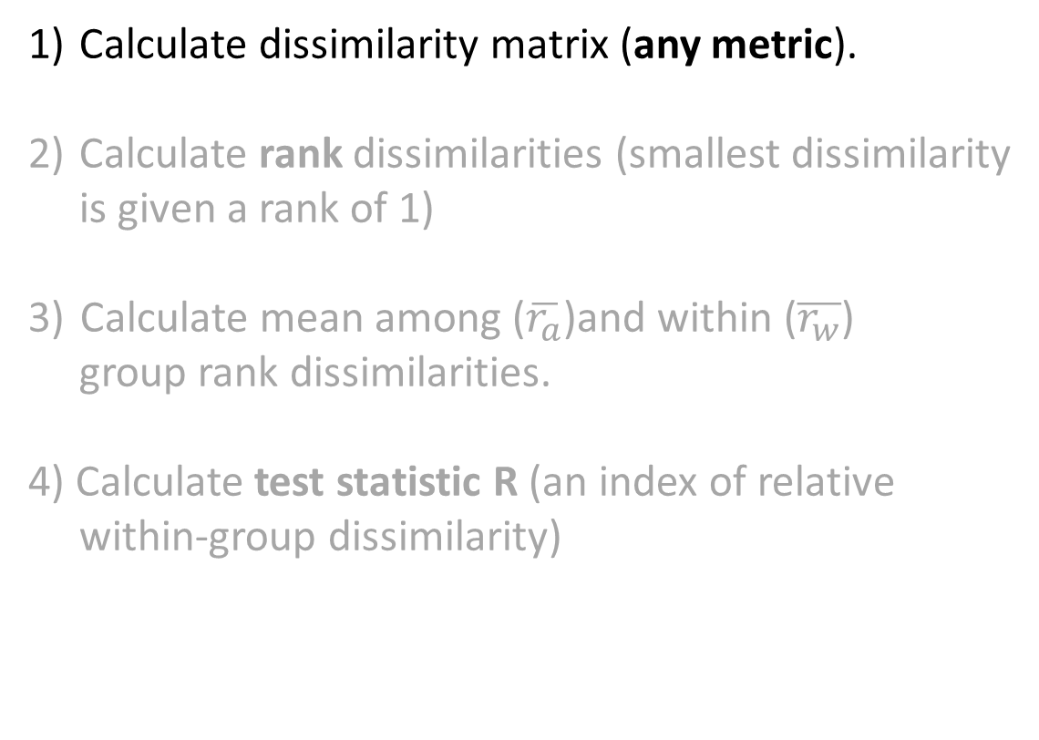
Analysis of Group Similarities ANOSIM
Calculate dissimilarity matrix (any metric).
Calculate rank dissimilarities (smallest dissimilarity
is given a rank of 1)
Calculate mean among ($\overline{r_{a}}$)and within ($\overline{r_{w}}$)
group rank dissimilarities.
4) Calculate test statistic R (an index of relative
within-group dissimilarity)

Slide 42
Analysis of Group Similarities ANOSIM
 | 1 | 2 | 3 | 4 | 5 | 6
1 | 0
2 | 2.2 | 0
3 | 2.3 | 3.1 | 0
4 | 6.5 | 7.2 | 4.4 | 0
5 | 8.1 | 5.3 | 8 | 3.4 | 0
6 | 6.6 | 7.1 | 5.5 | 1.1 | 2.8 | 0
2
3
1
4
6
5

Slide 43
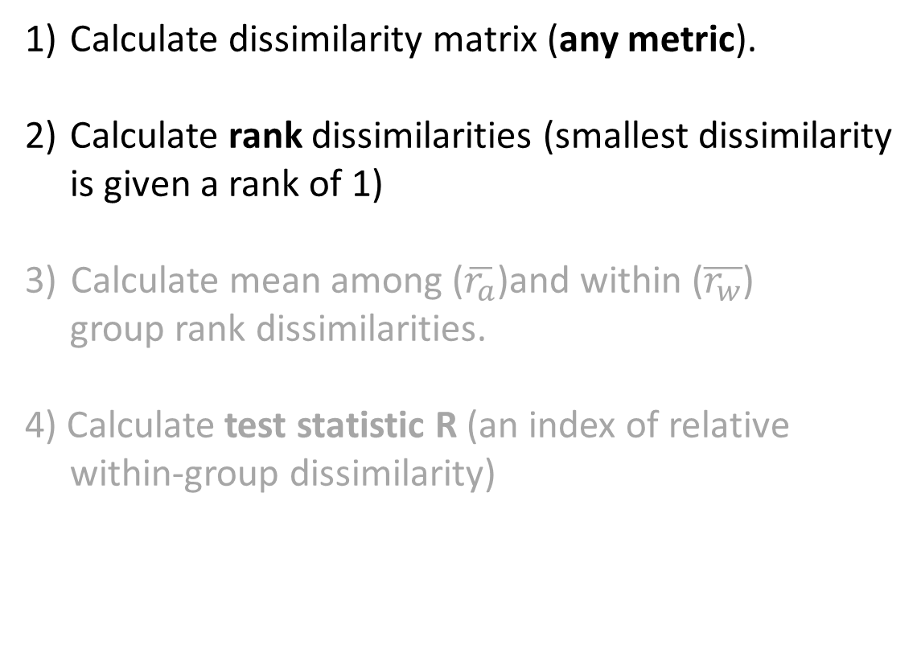
Analysis of Group Similarities ANOSIM
Calculate dissimilarity matrix (any metric).
Calculate rank dissimilarities (smallest dissimilarity
is given a rank of 1)
Calculate mean among ($\overline{r_{a}}$)and within ($\overline{r_{w}}$)
group rank dissimilarities.
4) Calculate test statistic R (an index of relative
within-group dissimilarity)

Slide 44
Analysis of Group Similarities ANOSIM
 | 1 | 2 | 3 | 4 | 5 | 6
1 | 0
2 | 2.2 | 0
3 | 2.3 | 3.1 | 0
4 | 6.5 | 7.2 | 4.4 | 0
5 | 8.1 | 5.3 | 8 | 3.4 | 0
6 | 6.6 | 7.1 | 5.5 | 1.1 | 2.8 | 0
2
3
1
4
6
5
 | 1 | 2 | 3 | 4 | 5 | 6
1 | 0
2 | 2 | 0
3 | 3 | 5 | 0
4 | 10 | 13 | 7 | 0
5 | 15 | 14 | 8 | 6 | 0
6 | 11 | 12 | 9 | 1 | 4 | 0

Slide 45
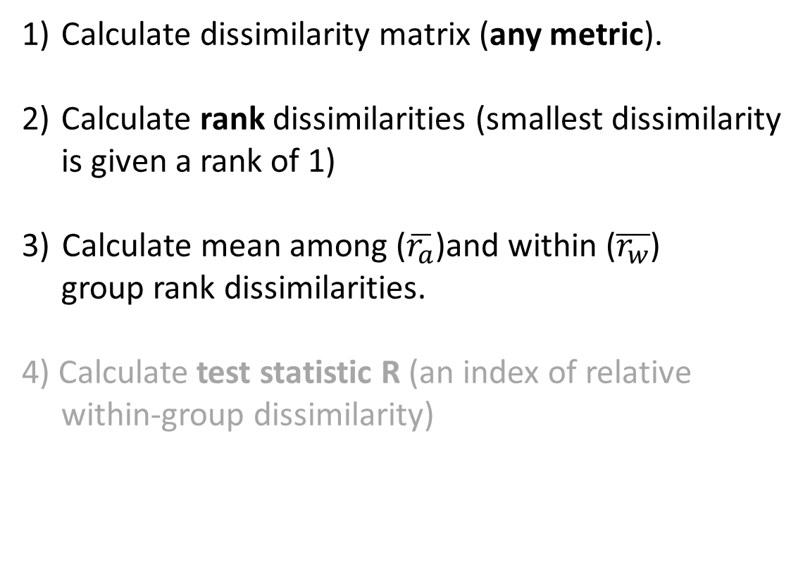
Analysis of Group Similarities ANOSIM
Calculate dissimilarity matrix (any metric).
Calculate rank dissimilarities (smallest dissimilarity
is given a rank of 1)
Calculate mean among ($\overline{r_{a}}$)and within ($\overline{r_{w}}$)
group rank dissimilarities.
4) Calculate test statistic R (an index of relative
within-group dissimilarity)

Slide 46


Analysis of Group Similarities ANOSIM
 | 1 | 2 | 3 | 4 | 5 | 6
1 | 0
2 | 2 | 0
3 | 3 | 5 | 0
4 | 10 | 13 | 7 | 0
5 | 15 | 14 | 8 | 6 | 0
6 | 11 | 12 | 9 | 1 | 4 | 0
2
3
1
4
6
5
$${\overline{r}}_{w}=\frac{2+3+5+6+1+4}{6}=3.5$$
$${\overline{r}}_{a}=\frac{7+8+9+10+11+12+13+14+15}{9}=11$$

Slide 47
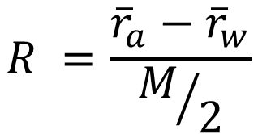
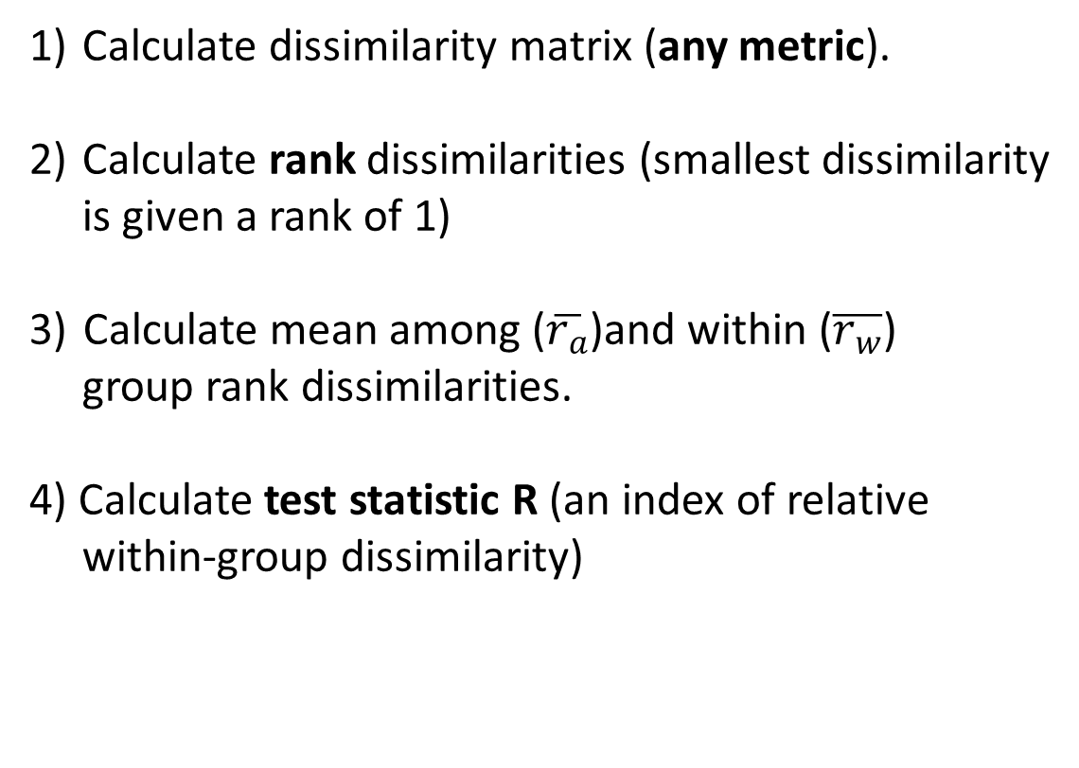
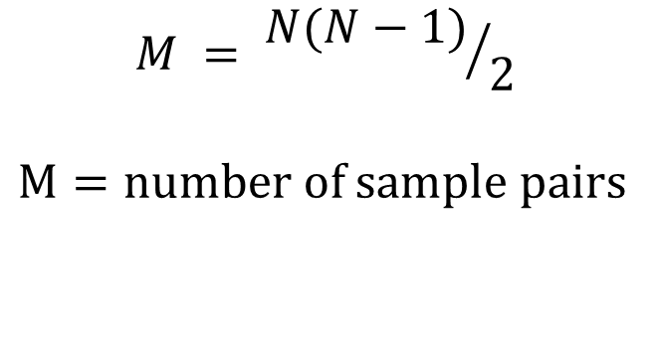
Analysis of Group Similarities ANOSIM
Calculate dissimilarity matrix (any metric).
Calculate rank dissimilarities (smallest dissimilarity
is given a rank of 1)
Calculate mean among ($\overline{r_{a}}$)and within ($\overline{r_{w}}$)
group rank dissimilarities.
4) Calculate test statistic R (an index of relative
within-group dissimilarity)
$$R =\frac{{\overline{r}}_{a}−{\overline{r}}_{w}}{M/2}$$
$$M = {N(N−1)}/2$$
$M=number of$ sample pairs

Slide 48


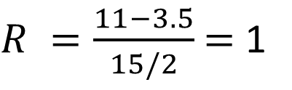

Analysis of Group Similarities ANOSIM
 | 1 | 2 | 3 | 4 | 5 | 6
1 | 0
2 | 2 | 0
3 | 3 | 5 | 0
4 | 10 | 13 | 7 | 0
5 | 15 | 14 | 8 | 6 | 0
6 | 11 | 12 | 9 | 1 | 4 | 0
2
3
1
4
6
5
$${\overline{r}}_{w}=3.5$$
$R =\frac{11−3.5}{15/2}$ $=$ 1
$${\overline{r}}_{a}=11$$
$$M_{a}=15$$

Slide 49
ANOSIM – R statistic
R ranges between -1 to 1
+ indicates different groups
0 indicates random groups
- indicates out-of-group similarity
R = +
R = 0
R = -

Slide 50



Analysis of Group Similarities ANOSIM
 | 1 | 2 | 3 | 4 | 5 | 6
1 | 0
2 | 2 | 0
3 | 3 | 5 | 0
4 | 10 | 13 | 7 | 0
5 | 15 | 14 | 8 | 6 | 0
6 | 11 | 12 | 9 | 1 | 4 | 0
2
3
1
4
6
5
$${\overline{r}}_{w}=3.5$$
$R =\frac{11−3.5}{15/2}$ $=$ 1
$${\overline{r}}_{a}=11$$
$$M_{a}=15$$
Determine the probability of R ≥ 1 using Monte Carlo permutations

Slide 51
Analysis of Group Similarities ANOSIM
4) Permute the data by randomly assigning
sample observations to groups.
5) Calculate the significance by taking the
fraction of permuted R statistics that are
greater than the observed R.

Slide 52
Analysis of Group Similarities ANOSIM
 | 1 | 2 | 3 | 4 | 5 | 6
1 | 0
2 | 2 | 0
3 | 3 | 5 | 0
4 | 10 | 13 | 7 | 0
5 | 15 | 14 | 8 | 6 | 0
6 | 11 | 12 | 9 | 1 | 4 | 0
2
3
1
4
6
 | 1 | 2 | 3 | 4 | 5 | 6
1 | 0
2 | 2 | 0
3 | 3 | 5 | 0
4 | 10 | 13 | 7 | 0
5 | 15 | 14 | 8 | 6 | 0
6 | 11 | 12 | 9 | 1 | 4 | 0
5
Calculate R for this permutation

Slide 53
Analysis of Group Similarities ANOSIM
4) Permute the data by randomly assigning
sample observations to groups.
5) Calculate the significance by taking the
fraction of permuted R’s that are greater
or equal to the observed R.

Slide 54
Hawaiian Island Avifauna: Past and Present
Photos by Haole in Hawaii

Slide 55
ANOSIM – Hawaiian Avifauna
Historical
Stress = 0.126
Contemporary
# Permutations = 999
R = 0.971
P =0.006
Lanai
Molokai
Lanai
Maui
Maui
NMDS2
Molokai
Hawaii
Hawaii
Oahu
Kauai
Oahu
Kauai
NMDS1

Slide 56

ANOSIM – Hawaiian Avifauna
# Permutations = 999
R = 0.971
P =0.006
$${ R}_{obs}$$
R statistic

Slide 57
ANOSIM – Hawaiian Avifauna
Historical
Stress = 0.126
Contemporary
# Permutations = 999
R = 0.971
P =0.006
Lanai
Molokai
Lanai
Maui
Maui
NMDS2
Molokai
Hawaii
Hawaii
Oahu
Kauai
Oahu
We conclude that the current and
historical assemblages differ significantly
in their bird composition.
Kauai
NMDS1

Slide 58
Big picture for testing groups
MRPP for Euclidean distances
PerMANOVA for any distance measure, often used with NMDS
(for multi factor designs)
ANOSIM for ranked dissimilarities (any distance metric),also used with NMDS

Slide 59
Mantel’s Test (MANTEL)
Mantel statistic tests for differences between
two distance matrices (e.g., between ecological
and geographic distances) but can also be used
for finding groups.
Uses all samples and matrices must refer to the
same set of samples in the same order.
How often does randomization of one matrix
result in a correlation as strong or stronger
than the observed correlation?

Slide 60
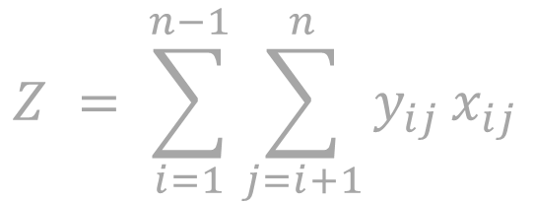
Mantel’s Test (MANTEL)
Calculate distance matrices (any metric).
Calculate test statistic Z.
$$Z = \sum_{i=1}^{n−1}{{\sum_{j=i+1}^{n}{y_{ij}}x}_{ij}}$$

Slide 61
Mantel’s Test (MANTEL)
 | 1 | 2 | 3 | 4 | 5
2 | 2.2
3 | 2.3 | 3.1
4 | 6.5 | 7.2 | 4.4
5 | 8.1 | 5.3 | 8 | 3.4
6 | 6.6 | 7.1 | 5.5 | 1.1 | 2.8
 | 1 | 2 | 3 | 4 | 5
2 | 0
3 | 0 | 0
4 | 1 | 1 | 1
5 | 1 | 1 | 1 | 0
6 | 1 | 1 | 1 | 0 | 0
Contrast Matrix
2
3
1
0 = same groups
1 = different groups
4
6
5

Slide 62
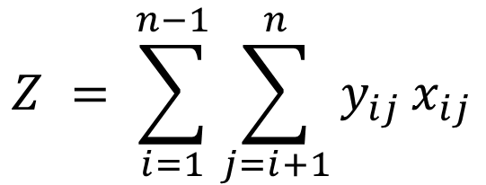
Mantel’s Test (MANTEL)
$$Z = \sum_{i=1}^{n−1}{{\sum_{j=i+1}^{n}{y_{ij}}x}_{ij}}$$
Calculate distance matrices (any metric).
Calculate test statistic Z.

Slide 63
Mantel’s Test (MANTEL)
 | 1 | 2 | 3 | 4 | 5
2 | 2.2
3 | 2.3 | 3.1
4 | 6.5 | 7.2 | 4.4
5 | 8.1 | 5.3 | 8 | 3.4
6 | 6.6 | 7.1 | 5.5 | 1.1 | 2.8
 | 1 | 2 | 3 | 4 | 5
2 | 0
3 | 0 | 0
4 | 1 | 1 | 1
5 | 1 | 1 | 1 | 0
6 | 1 | 1 | 1 | 0 | 0
Contrast Matrix
2
3
1
Z = 58.7
4
6
5

Slide 64
Mantel’s Test (MANTEL)
3) Permute by randomly shuffling one of the
two distance matrices.
4) Calculate the significance by taking the
fraction of permuted Z statistics that are greater or less than the observed Z.
5) Determine the strength of the relationship
between the two matrices by computing
their correlation, r, the standardized Mantel
statistic.

Slide 65
Mantel’s Test (MANTEL)
 | 1 | 2 | 3 | 4 | 5
2 | 2.2
3 | 2.3 | 3.1
4 | 6.5 | 7.2 | 4.4
5 | 8.1 | 5.3 | 8 | 3.4
6 | 6.6 | 7.1 | 5.5 | 1.1 | 2.8
 | 1 | 2 | 3 | 4 | 5
2 | 1
3 | 1 | 1
4 | 0 | 0 | 0
5 | 0 | 0 | 0 | 1
6 | 0 | 0 | 0 | 1 | 1
 | 1 | 2 | 3 | 5 | 4
2 | 2.2
3 | 2.3 | 3.1
5 | 8.1 | 5.3 | 8
4 | 6.5 | 7.2 | 4.4 | 3.4
6 | 6.6 | 7.1 | 5.5 | 2.8 | 1.1
Must permute both rows and
columns.

Slide 66
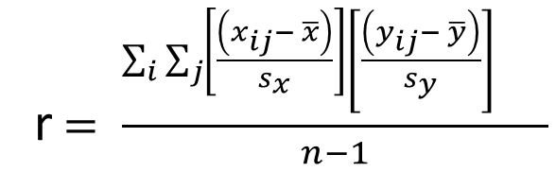
Mantel’s Test (MANTEL)
r ranges between -1 to 1
+ indicates different groups
0 indicates random groups
- indicates out-of-group similarity
r$= \frac{\sum_{i}{{\sum_{j}{{\left[\frac{\left(x_{ij}− \overline{x}\right)}{s_{x}}\right]\left[\frac{\left(y_{ij}− \overline{y}\right)}{s_{y}}\right]}_{}}}_{}}}{n−1}$
r = +
r = 0
r = -

Slide 67
PAHC example Shell morphology of Littoraria angulifera
 | Proportionality | Circularity | SpireHeight
Angola | 1.36 | 0.76 | 1.69
Bahamas | 1.51 | 0.76 | 1.86
Belize | 1.42 | 0.76 | 1.85
Brazil | 1.43 | 0.74 | 1.71
Florida | 1.45 | 0.74 | 1.86
Haiti | 1.49 | 0.76 | 1.89
Liberia | 1.36 | 0.75 | 1.69
Nicaragua | 1.48 | 0.74 | 1.69
Sierra Leone | 1.35 | 0.73 | 1.72
Photos from jaxshells.org

Slide 68
PAHC example Shell morphology of Littoraria angulifera
 | Angola | Bahamas | Belize | Brazil | Florida | Haiti | Liberia | Nicaragua
Bahamas | 0.23
Belize | 0.17 | 0.09
Brazil | 0.08 | 0.17 | 0.14
Florida | 0.19 | 0.06 | 0.04 | 0.15
Haiti | 0.24 | 0.04 | 0.08 | 0.19 | 0.05
Liberia | 0.01 | 0.23 | 0.17 | 0.07 | 0.19 | 0.24
Nicaragua | 0.12 | 0.17 | 0.17 | 0.05 | 0.17 | 0.20 | 0.12
Sierra Leone | 0.04 | 0.21 | 0.15 | 0.08 | 0.17 | 0.22 | 0.04 | 0.13
 | Angola | Bahamas | Belize | Brazil | Florida | Haiti | Liberia | Nicaragua
Bahamas | 1
Belize | 1 | 0
Brazil | 0 | 1 | 1
Florida | 1 | 0 | 0 | 1
Haiti | 1 | 0 | 0 | 1 | 0
Liberia | 0 | 1 | 1 | 0 | 1 | 1
Nicaragua | 0 | 1 | 1 | 0 | 1 | 1 | 0
Sierra Leone | 0 | 1 | 1 | 0 | 1 | 1 | 0 | 0
Distance Matrix
Contrast Matrix

Slide 69
PAHC example Shell morphology of Littoraria angulifera
mantelr | p | N perm
0.89 | 0.009 | 999
We conclude that the two clusters
differ significantly in terms of the shell
morphology variables.
Mantel r

Slide 70
Mantel’s Test (MANTEL)
More often used to test for patterns that drive similarity
Geographic distance, size, precipitation etc.
 | Angola | Bahamas | Belize | Brazil | Florida | Haiti | Liberia | Nicaragua
Bahamas | 0.23
Belize | 0.17 | 0.09
Brazil | 0.08 | 0.17 | 0.14
Florida | 0.19 | 0.06 | 0.04 | 0.15
Haiti | 0.24 | 0.04 | 0.08 | 0.19 | 0.05
Liberia | 0.01 | 0.23 | 0.17 | 0.07 | 0.19 | 0.24
Nicaragua | 0.12 | 0.17 | 0.17 | 0.05 | 0.17 | 0.20 | 0.12
Sierra Leone | 0.04 | 0.21 | 0.15 | 0.08 | 0.17 | 0.22 | 0.04 | 0.13
 | Angola | Bahamas | Belize | Brazil | Florida | Haiti | Liberia | Nicaragua
Bahamas | 1
Belize | 1 | 0
Brazil | 0 | 1 | 1
Florida | 1 | 0 | 0 | 1
Haiti | 1 | 0 | 0 | 1 | 0
Liberia | 0 | 1 | 1 | 0 | 1 | 1
Nicaragua | 0 | 1 | 1 | 0 | 1 | 1 | 0
Sierra Leone | 0 | 1 | 1 | 0 | 1 | 1 | 0 | 0
Distance Matrix
Contrast Matrix

Slide 71
Mantel’s Test (MANTEL)
More often used to test for patterns that drive similarity
Geographic distance, size, precipitation etc.
Multiple Mantel regression
 | Angola | Bahamas | Belize | Brazil | Florida | Haiti | Liberia | Nicaragua
Bahamas | 0.23
Belize | 0.17 | 0.09
Brazil | 0.08 | 0.17 | 0.14
Florida | 0.19 | 0.06 | 0.04 | 0.15
Haiti | 0.24 | 0.04 | 0.08 | 0.19 | 0.05
Liberia | 0.01 | 0.23 | 0.17 | 0.07 | 0.19 | 0.24
Nicaragua | 0.12 | 0.17 | 0.17 | 0.05 | 0.17 | 0.20 | 0.12
Sierra Leone | 0.04 | 0.21 | 0.15 | 0.08 | 0.17 | 0.22 | 0.04 | 0.13
 | Angola | Bahamas | Belize | Brazil | Florida | Haiti | Liberia | Nicaragua
Bahamas | 0
Belize | 0 | 1
Brazil | 1 | 0 | 0
Florida | 0 | 1 | 1 | 0
Haiti | 0 | 1 | 1 | 0 | 1
Liberia | 1 | 0 | 0 | 1 | 0 | 0
Nicaragua | 1 | 0 | 0 | 1 | 0 | 0 | 1
Sierra Leone | 1 | 0 | 0 | 1 | 0 | 0 | 1 | 1
Pairwise distance in explanatory variable
Distance Matrix
Distance Matrix

