Slide 1



Discriminant Analysis (DA)

Slide 2
Discrimination Among Groups
Are groups different?
Multi-Response Permutation Procedures (MRPP)
PerMANOVA (ADONIS)
Analysis of Group Similarities (ANOSIM)
How do groups differ? (i.e. which variables best
distinguish among groups)
Discriminant Analysis(DA)
Classification and Regression (CART)

Slide 3
Discriminant Analysis (DA)
Eigenanalysis that maximally separates a fixed number of groups.
Goal is to find underlying gradients of variation (“discriminant
functions”, “canonical functions”, “canonical axes”) that best
discriminate among groups.
Reduces dimensionality of multivariate data set by condensing
a large number of original variables into new composite axes.
Predicts group membership of future samples or samples from
unknown groups, based on a suite of discriminating characteristics.
Extension of Multivariate Analysis of Variance (MANOVA)

Slide 4
Multivariate Models
Model Technique
y = x1 + x2 + … x Regression, ANOVA
y1 + y2 + … yi = x Multivariate ANOVA , PerMANOVA
Discriminant Analysis, CART
y1 + y2 + … yi = x1 + x2 + … xj Canonical Correlation Analysis,
Can. Correspondence Analysis
y1 + y2 + … yi Ordination, Cluster Analysis
Multivariate Statistics

Slide 5
Multivariate Models
Model Technique
y = x1 + x2 + … x Regression, ANOVA
y1 + y2 + … yi = x Multivariate ANOVA , PerMANOVA
Discriminant Analysis, CART
y1 + y2 + … yi = x1 + x2 + … xj Canonical Correlation Analysis,
Can. Correspondence Analysis
y1 + y2 + … yi Ordination, Cluster Analysis
Multivariate Statistics

Slide 6
Multivariate Models
Model Technique
y = x1 + x2 + … x Regression, ANOVA
y1 + y2 + … yi = x Multivariate ANOVA , PerManova
Discriminant Analysis, CART
y1 + y2 + … yi = x1 + x2 + … xj Canonical Correlation Analysis,
Can. Correspondence Analysis
y1 + y2 + … yi Ordination, Cluster Analysis
Grouping Variable
Multivariate Statistics

Slide 7
Discriminant Analysis
Canonical Axes are calculated
to maximally separate the three
groups on the first axis (DF1).
The second axis is calculated to
additionally separate the blue and
green groups, which overlap on
the first axis.

Slide 8
PCA?
Canonical Axes are calculated
to maximally separate the three
groups on the first axis (DF1).
The second axis is calculated to
additionally separate the blue and
green groups, which overlap on
the first axis.

Slide 9
PCA?
Canonical Axes are calculated
to maximally separate the three
groups on the first axis (DF1).
The second axis is calculated to
additionally separate the blue and
green groups, which overlap on
the first axis.

Slide 10
Discriminant Analysis: Data Set
One categorical grouping variable and 2 or more
continuous discriminating variables.
Groups must be mutually exclusive.
No missing data
Group sizes do not need to be the same, but it helps.
Minimum of 2 samples per group and at least 2 more
samples than the number of variables.
Best practices: For each group, n ≥ (3 x P)

Slide 11
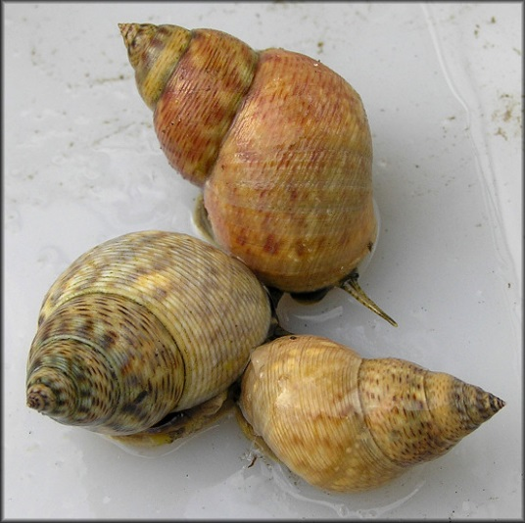
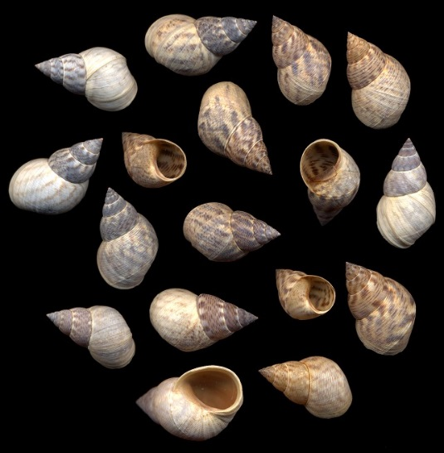
Discriminant Analysis: Data Set
 | Group | Proportionality | Circularity | SpireHeight
Angola | A | 1.36 | 0.76 | 1.69
Bahamas | B | 1.51 | 0.76 | 1.86
Belize | B | 1.42 | 0.76 | 1.85
Brazil | A | 1.43 | 0.74 | 1.71
Florida | B | 1.45 | 0.74 | 1.86
Haiti | B | 1.49 | 0.76 | 1.89
Liberia | A | 1.36 | 0.75 | 1.69
Nicaragua | A | 1.48 | 0.74 | 1.69
Sierra Leone | A | 1.35 | 0.73 | 1.72
A = South Atlantic
B = Caribbean

Slide 12
DA: Assumptions
Descriptive use of DA requires no assumptions, but
may not work well if certain assumptions are not met.
Inferential use of DA requires assumptions.
Certain assumptions can be violated moderately
without large changes to classification results.
Larger sample sizes are more robust to violations
of assumptions.

Slide 13
DA: Assumptions
Homogenous
1.) Equality of Variance-Covariance Matrices:
Homogenous within group variances
Correlation (or covariance) between any
two variables is the same across populations

Slide 14
DA: Assumptions
Heterogeneous
1.) Equality of Variance-Covariance Matrices:
Homogenous within group variances
Correlation (or covariance) between any
two variables is the same across populations

Slide 15
DA: Assumptions
Visually inspect group dispersion in ordination space.
If unsure, compute univariate test of homogeneity
of variances (e.g., Flinger-Killeen test)
Univariate homogeneity of variance is a good indicator of
homogeneity of variance-covariance matrices.
Compute Multivariate test of homogeneity of variances
(e.g., betadisper in R)
Helps determine if variables should be transformed.

Slide 16
DA: Assumptions
2.) Multivariate Normality:

Slide 17
DA: Assumptions
2.) Multivariate Normality: within groups
Look at histograms for univariate normality.
Univariate normality is a good step towards
multivariate normality.
Helps determine if variables should be
transformed.
30
10
25
8
20
6
Frequency
Frequency
15
10
4
5
2
0
0
No
Yes-ish

Slide 18
DA: Assumptions
3.) Multicollinearity:
No two variables are perfectly correlated (r=1).
Calculate all pairwise correlations; high correlations
(r >0.7) suggest potential problems.
Solutions:
- Eliminate one or more correlated variables
- Use PCA to create new composite variable

Slide 19
DA: Assumptions
4.) Outliers: within groups
Outliers have a large affect on canonical axes
Test for outliers and consider removal

Slide 20
DA: Assumptions
5.) Prior Probabilities
Priors represent the probability that a sample will belong
to a certain group.
Priors differ due to unequal group sizes, unequal sampling effort,
or any number of other factors.
Priors are often unknown.
So, we:
- Set the priors as equal
- Set the priors proportional to the number of samples
in a group.

Slide 21
DA: Assumptions
6.) Linearity
Assumes that variables change linearly
along underlying gradients.
Assumes that there is a linear relationship
between variables such that they can be
combined in a linear fashion to create
canonical axes.
Look at scatter plot of variables
Linear transformation

Slide 22
Solutions to Violating Assumptions
Run analysis as is, and see if canonical axes have ecologically
meaningful and consistent interpretation.
Run analysis and don’t make inference.
Try alternative methods such as CART.

Slide 23
Discriminant Analysis
Step 1: Calculate the variance/covariance matrix among groups (A).
Step 2: Calculate the variance/covariance matrix within groups (W).
Step 3: Calculate eigenvalues and eigenvectors.
Step 4: Standardize and plot points on canonical axes.
Step 5: Assess the importance of and interpret the canonical axes
Step 6: Classify samples from the data set and or new samples

Slide 24

Eigenvalues in DA
Equation:
$\left|A−λW\right|=$ $0$
Where: A = among-group covariance matrix
λ = vector of eigenvalue solutions
W = within-group covariance matrix
An N x P data set with G groups has Q (equal to G-1 or P,
whichever is smaller) eigenvalues.
Eigenvalues = variances of corresponding canonical axes;
measure how well groups are differentiated along the
canonical axis
λ₁ > λ₂ > λ₃ > λ₄ > … > λ_{Q}

Slide 25
Eigenvalues in DA
Eigenvalues equal the ratio of the between to within-group standard
deviations of the canonical axes, which are defined by the eigenvectors.
= between-group
= within-group
Large
Small

Slide 26

Eigenvectors in PCA
Equation:
$\left|A−λ_{i}W\right|v_{i}=$ $0$
Where: λ_{i} = eigenvalue corresponding to the i^{th} PC
v_{i} = eigenvector associated with the i^{th} PC
Eigenvectors equal the canonical coefficients (i.e. canonical weights) of the
variables in the linear equations that define the canonical axes.
Coefficients need to be standardized to be interpreted. Standardization
yields the relative importance of the variables contribution to the canonical
axes.

Slide 27
Discriminant Analysis
Step 1: Calculate the variance/covariance matrix among groups (A).
Step 2: Calculate the variance/covariance matrix within groups (W).
Step 3: Calculate eigenvalues and eigenvectors.
Step 4: Standardize and plot points on canonical axes.
Step 5: Assess the importance of and interpret the canonical axes
Step 6: Classify samples from the data set and or new samples

Slide 28
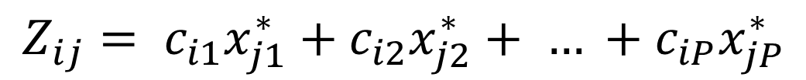
DA: Canonical scores and plots
$$Z_{ij}= c_{i1}x_{j1}^{∗}+c_{i2}x_{j2}^{∗}+ … +c_{iP}x_{jP}^{∗}$$
Z_{ij} = standardized canonical score for i^{th} canonical
axis and j^{th} sample.
c_{iP} = standardized canonical coefficient for i^{th} canonical
axis and P^{th} variable.
x_{jP} = standardized value for j^{th} sample and P^{th} variable.

Slide 29
DA: Canonical scores and plots
$$Z_{ij}= c_{i1}x_{j1}^{∗}+c_{i2}x_{j2}^{∗}+ … +c_{iP}x_{jP}^{∗}$$
Z_{ij} = standardized canonical score for i^{th} canonical
axis and j^{th} sample.
c_{iP} = standardized canonical coefficient for i^{th} canonical
axis and P^{th} variable.
x_{jP} = standardized value for j^{th} sample and P^{th} variable.

Slide 30
DA: Canonical scores and plots
$$Z_{ij}= c_{i1}x_{j1}^{∗}+c_{i2}x_{j2}^{∗}+ … +c_{iP}x_{jP}^{∗}$$
 | Group | Proportionality
Angola | A | 1.36
Bahamas | B | 1.51
Belize | B | 1.42
Brazil | A | 1.43
Florida | B | 1.45
Haiti | B | 1.49
Liberia | A | 1.36
Nicaragua | A | 1.48
Sierra Leone | A | 1.35
Z_{ij} = standardized canonical score for i^{th} canonical
axis and j^{th} sample.
c_{iP} = standardized canonical coefficient for i^{th} canonical
axis and P^{th} variable.
x_{jP} = standardized value for j^{th} sample and P^{th} variable.

Slide 31
Discriminant Analysis
Step 1: Calculate the variance/covariance matrix among groups (A).
Step 2: Calculate the variance/covariance matrix within groups (W).
Step 3: Calculate eigenvalues and eigenvectors.
Step 4: Standardize and plot points on canonical axes.
Step 5: Assess the importance of and interpret the canonical axes
Step 6: Classify samples from the data set and or new samples

Slide 32
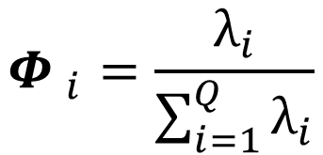
Assessing canonical axes
Relative Percent Variance Criterion
Compare the relative magnitudes of the eigenvalues
Cumulative % variance of all axes is 100%
Can be high even if group separation is poor
Should be used in conjunction with other methods
$${Φ }_{i}=\frac{λ_{i}}{\sum_{i=1}^{Q}{λ_{i}}}$$

Slide 33
Assessing canonical axes
Canonical Correlation Criterion
Multiple correlation between grouping variable and
canonical scores (i.e., ANOVA on canonical scores).
Ranges between 0 – 1; zero means no relationships
between groups and canonical scores, large values
indicate that the axis discriminates groups well.
Squared canonical correlation is equal to the proportion
of total variation in canonical axes explained by differences
between group means.

Slide 34
Assessing canonical axes
Canonical Correlation Criterion
Multiple correlation between grouping variable and
canonical scores (i.e., ANOVA on canonical scores).
Ranges between 0 – 1; zero means no relationships
between groups and canonical scores, large values
indicate that the axis discriminates groups well.
Squared canonical correlation is equal to the proportion
of total variation in canonical axes explained by differences
between group means.

Slide 35
Assessing canonical axes
Significance tests
Assume independent samples, multivariate normality, etc.
to ensure valid p-values.
Null Hypothesis: canonical correlation = 0
Alternative Hypothesis: canonical correlation is > 0

Slide 36
Significance tests
formula = LD2 ~ Iris[, 5])
Residuals:
Min 1Q Median 3Q Max
-2.66850 -0.71494 0.01174 0.75482 2.52246
Coefficients:
Estimate Std. Error t value Pr(>|t|)
(Intercept) -0.7279 0.1414 -5.147 8.35e-07 ***
Iris[, 5]s 0.9430 0.2000 4.715 5.56e-06 ***
Iris[, 5]v 1.2407 0.2000 6.203 5.33e-09 ***
---
Signif. codes: 0 ‘***’ 0.001 ‘**’ 0.01 ‘*’ 0.05 ‘.’ 0.1 ‘ ’ 1
Residual standard error: 1 on 147 degrees of freedom
Multiple R-squared: 0.222, Adjusted R-squared: 0.2114
F-statistic: 20.98 on 2 and 147 DF, p-value: 9.681e-09

Slide 37
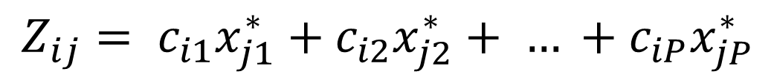
Assessing canonical axes
Canonical scores and plots
$$Z_{ij}= c_{i1}x_{j1}^{∗}+c_{i2}x_{j2}^{∗}+ … +c_{iP}x_{jP}^{∗}$$
Illustrates relatedness among samples due to
variables.
Graphically asses the separation of groups
by canonical axes.

Slide 38
Assessing canonical axes
Classification accuracy
Measures how well the axes discriminate. The higher
the correct classification rate, the greater degree of
group discrimination achieved by the canonical axes.
Classification matrix shows the number of samples that
are correctly or incorrectly classified in each group
Correct classification rate is the percentage of samples
classified correctly.

Slide 39
Assessing canonical axes
Classification accuracy
 | Group 1 | Group 2 | Total
Group 1 | 48 | 2 | 50
Group 2 | 1 | 49 | 50
Total | 49 | 51 | 100
 | Group 1 | Group 2 | Total
Group 1 | 0.96 | 0.04 | 1
Group 2 | 0.02 | 0.98 | 1
Total | 0.49 | 0.51 | 1
Classification Matrix
Correct classification rate = 0.97

Slide 40
Interpreting Canonical Axes
Raw Canonical Coefficients (i.e. eigenvectors) measure each
variables absolute contribution to the canonical score of each sample.
Used to assign scores to unclassified samples.
Standardized Canonical Coefficients (canonical weights) measure the
relative contribution of each variable to the canonical score of each sample.
Total Structure Coefficients are simple correlations between canonical scores
and original variables. Can define canonical axes by noting variables with the
largest structure coefficients.
Squared structure coefficients indicate the % of a variables variance accounted
for by axis.

Slide 41
Discriminant Analysis
Step 1: Calculate the variance/covariance matrix among groups (A).
Step 2: Calculate the variance/covariance matrix within groups (W).
Step 3: Calculate eigenvalues and eigenvectors.
Step 4: Standardize and plot points on canonical axes.
Step 5: Assess the importance of and interpret the canonical axes
Step 6: Validate canonical axes with new data

Slide 42
Validating Canonical Axes
DA is only as good as it’s ability to classify new data correctly.
The best assurance of reliable results is a good sampling design
and large sample size.
Using the same samples to derive axes and classification matrix
can lead to an upward bias (i.e. better predictions).
Use “split-sample” approach to test predictive ability of DA.
Keep similar proportions of each group and use more overall samples
in the “training data”.

Slide 43
DA Example: Iris Morphology
versicolor
setosa
virginica

Slide 44
DA Example: Iris Morphology
Iris data set contains 150 samples, 50 of each species
Sample | Sepal.Length | Sepal.Width | Petal.Length | Petal.Width | Species
1 | 5.1 | 3.5 | 1.4 | 0.2 | setosa
2 | 4.9 | 3 | 1.4 | 0.2 | versi
3 | 4.7 | 3.2 | 1.3 | 0.2 | virgin
4 | 4.6 | 3.1 | 1.5 | 0.2 | setosa
. | . | . | . | . | .
. | . | . | . | . | .
. | . | . | . | . | .
150 | 5 | 3.6 | 1.4 | 0.2 | virgin

Slide 45
DA Example: Iris Morphology
Iris data set contains 150 samples, 50 of each species
Use a training data set of 75 samples (25 of each)
Prior probabilities = 0.33 for each species

Slide 46
DA Example: Iris Morphology
Group means:
 | Sepal.Length | Sepal.Width | Petal.Length | Petal.Width
setosa | 5.01 | 3.51 | 1.48 | 0.23
versicolor | 5.84 | 2.82 | 4.28 | 1.34
virginica | 6.46 | 2.96 | 5.47 | 2.06
Raw Coefficients of Canonical Axes
 | LD1 | LD2
Sepal.Length | 0.17 | 0.41
Sepal.Width | 2.51 | 1.37
Petal.Length | -2.14 | -1.59
Petal.Width | -3.03 | 3.78
Proportion of Trace (Eigenvalues) – Relative % Criterion
LD1 | LD2
0.99 | 0.006

Slide 47
DA Example: Iris Morphology
Group means:
 | Sepal.Length | Sepal.Width | Petal.Length | Petal.Width
setosa | 5.01 | 3.51 | 1.48 | 0.23
versicolor | 5.84 | 2.82 | 4.28 | 1.34
virginica | 6.46 | 2.96 | 5.47 | 2.06
Raw Coefficients of Canonical Axes
 | LD1 | LD2
Sepal.Length | 0.17 | 0.41
Sepal.Width | 2.51 | 1.37
Petal.Length | -2.14 | -1.59
Petal.Width | -3.03 | 3.78
Proportion of Trace (Eigenvalues) – Relative % Criterion
LD1 | LD2
0.99 | 0.006

Slide 48

DA Example: Iris Morphology
virginica
setosa
6
4
virginica
setosa
2
virginica
virginica
virginica
virginica
virginica
virginica
virginica
setosa
virginica
setosa
setosa
versicolor
versicolor
setosa
setosa
setosa
setosa
setosa
virginica
virginica
setosa
virginica
setosa
versicolor
setosa
0
versicolor
setosa
setosa
virginica
virginica
setosa
virginica
virginica
setosa
LD2
virginica
virginica
versicolor
versicolor
setosa
setosa
setosa
virginica
setosa
versicolor
setosa
setosa
setosa
versicolor
setosa
versicolor
versicolor
setosa
versicolor
versicolor
versicolor
versicolor
setosa
setosa
versicolor
versicolor
setosa
versicolor
versicolor
versicolor
versicolor
-2
versicolor
versicolor
virginica
versicolor
versicolor
versicolor
versicolor
virginica
-4
-6
versicolor
-5
0
5
10
LD1

Slide 49
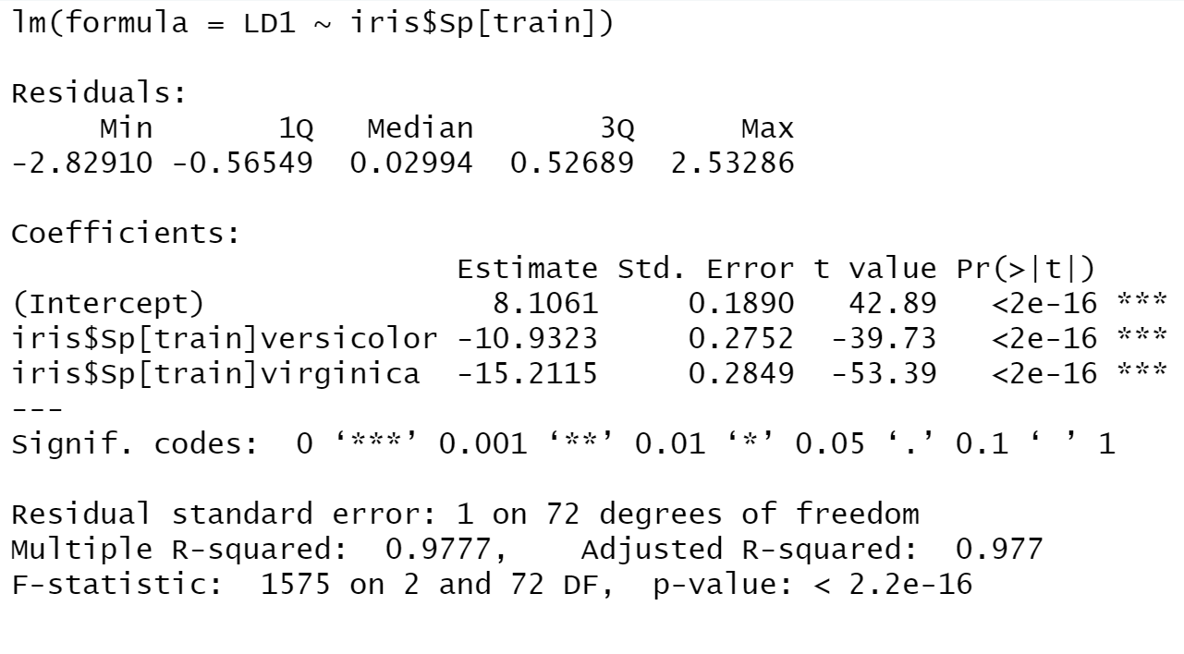
DA Example: Iris Morphology
Canonical Correlation Criterion and Significance Test
v
v

Slide 50
DA Example: Iris Morphology
Classification accuracy
 | setosa | versicolor | virginica
setosa | 28 | 0 | 0
versicolor | 0 | 23 | 2
virginica | 0 | 0 | 22
Correct classification rate = 97%

Slide 51
DA Example: Iris Morphology
Interpreting canonical axes
Raw Coefficients of Canonical Axes
 | LD1 | LD2
Sepal.Length | 0.17 | -0.41
Sepal.Width | 2.51 | -1.37
Petal.Length | -2.14 | 1.59
Petal.Width | -3.03 | -3.78
Standardized Canonical Weights
 | LD1 | LD2
Sepal.Length | 0.08 | -0.19
Sepal.Width | 0.85 | -0.47
Petal.Length | -0.82 | 0.61
Petal.Width | -0.65 | -0.81
Structure Coefficients of Canonical Axes
 | LD1 | LD2
Sepal.Length | -0.79 | -0.26
Sepal.Width | 0.61 | -0.63
Petal.Length | -0.99 | -0.04
Petal.Width | -0.97 | -0.25

Slide 52
DA Example: Iris Morphology
Interpreting canonical axes
Raw Coefficients of Canonical Axes
 | LD1 | LD2
Sepal.Length | 0.17 | -0.41
Sepal.Width | 2.51 | -1.37
Petal.Length | -2.14 | 1.59
Petal.Width | -3.03 | -3.78
Standardized Canonical Weights
 | LD1 | LD2
Sepal.Length | 0.08 | -0.19
Sepal.Width | 0.85 | -0.47
Petal.Length | -0.82 | 0.61
Petal.Width | -0.65 | -0.81
Structure Coefficients of Canonical Axes
 | LD1 | LD2
Sepal.Length | -0.79 | -0.26
Sepal.Width | 0.61 | -0.63
Petal.Length | -0.99 | -0.04
Petal.Width | -0.97 | -0.25

Slide 53
DA Example: Iris Morphology

Slide 54
DA Example: Iris Morphology
Split-sample Classification accuracy
 | setosa | versicolor | virginica
setosa | 25 | 0 | 0
versicolor | 0 | 27 | 1
virginica | 0 | 3 | 19
Correct classification rate = 0.946

Slide 55
DA Example: Iris Morphology
6
4
virginica
setosa
2
virginica
virginica
virginica
virginica
virginica
virginica
virginica
setosa
virginica
setosa
setosa
versicolor
versicolor
setosa
setosa
setosa
setosa
setosa
virginica
virginica
setosa
virginica
setosa
versicolor
setosa
0
versicolor
setosa
setosa
virginica
virginica
setosa
virginica
virginica
setosa
LD2
virginica
virginica
versicolor
versicolor
setosa
setosa
setosa
virginica
setosa
versicolor
setosa
setosa
setosa
versicolor
setosa
versicolor
versicolor
setosa
versicolor
versicolor
versicolor
versicolor
setosa
setosa
versicolor
versicolor
setosa
versicolor
versicolor
versicolor
versicolor
-2
versicolor
versicolor
virginica
versicolor
versicolor
versicolor
versicolor
virginica
-4
-6
-5
0
5
10
LD1

Slide 56
MANOVA and DA
Analyses are the same (i.e. DA is a one-way MANOVA),
questions are different.
In MANOVA, we are interested if groups differ in there measured variables.
In DA, we are interested in a linear combination of variables that
maximize differences between groups.
In DA, we maximize the test statistic used in MANOVA and can perform
significance test.

Slide 57
MANOVA for Iris Data
 | Df | Wilks | Approx F | Num DF | Den DF | P-value
Intercept | 1 | 0.006 | 5203.90 | 4 | 144 | <0.001
Species | 2 | 0.02 | 53.50 | 8 | 288 | <0.001
Residuals | 147
Wilks statistic is a multivariate test statistic similar to F values.
It can be transformed into a pseudo F -statistic to facilitate the
calculation of a p-value.
Can perform posthoc comparisons with Hotelling’s T.

