Slide 1
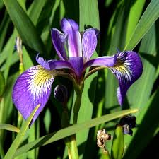


Classification and Regression (CART)

Slide 2
Discrimination Among Groups
Are groups different?
Multi-Response Permutation Procedures (MRPP)
Analysis of Group Similarities (ANOSIM)
Mantel’s Test (MANTEL)
How do groups differ? (i.e. which variables best
distinguish among groups)
Discriminant Analysis(DA)
Classification and Regression (CART)

Slide 3
Classification and Regression Trees (CART)
Nonparametric procedure for exploration, description, and
prediction of grouped data.
Can be used with categorical response variable (Classification Tree)
or continuous response variable (Regression Tree).
Employs recursive partitioning of multivariate space so that
samples within each partition become more and more homogenous.
t₁
t₅
t₃
yes
no
X₁ < 6
t₂
yes
no
t₃
X₂
X₂ < 5
t₄
t₅
t₄
X₁

Slide 4
Classification and Regression Trees (CART)
Requires specification of the following three elements:
A set of questions formulated as: Is x_{m} ≤ c?
where x_{m} is value of variable m and c is a
critical value.
A rule for selecting the best split at any node.
A criterion for choosing the right-sized tree.
t₁
yes
no
X₁ < 6
t₂
yes
no
t₃
X₂ < 5
t₄
t₅

Slide 5
Classification and Regression Trees (CART) Data Set
One categorical grouping variable and 2 or more continuous, categorical and/or count discriminating variables.
Groups must be mutually exclusive.
Doesn’t have many of the assumptions of DA…

Slide 6
Classification and Regression Trees (CART)
Flexibility of CART
Can be applied to any type and structure of data,
including mixed data.
Can handle missing data.
Robust to outliers and misclassified points.
In a standard data set (i.e. all variables are measured for all
samples) invariant to all monotonic transformations (i.e. no
need to transform continuous data).
t₁
yes
no
X₁ < 6
t₂
yes
no
t₃
X₂ < 5
t₄
t₅

Slide 7
CART – Growing Trees
GREEN
Node
GREEN
0.41
X₂
X₁

Slide 8
CART – Growing Trees
RED
GREEN
X₁> 6
GREEN
0.92
RED
0.75
X₂
X₁
Split 1: X₁> 6

Slide 9
CART – Growing Trees
RED
GREEN
X₁> 6
Terminal
Node
GREEN
0.92
X₂> 3
X₂
Split 2: X₂> 3
RED
0.78
Blue
0.57
Blue
X₁
Split 1: X₁> 6

Slide 10
CART – Growing Trees
RED
GREEN
X₁> 6
GREEN
0.92
X₂> 3
X₂
Split 2: X₂> 3
RED
0.78
X₁> 2
RED
BLUE
RED
1
BLUE
1
Split 3: X₁> 2
X₁
Split 1: X₁> 6

Slide 11
CART – Growing Trees
X₁> 6
RED
GREEN
GREEN
0.92
X₂> 3
RED
0.78
X₁> 2
X₂
Split 2: X₂> 3
BLUE
1
RED
1
RED
BLUE
 | RED | GREEN | BLUE
RED | 10 | 0 | 0
GREEN | 1 | 10 | 0
BLUE | 1 | 1 | 4
Split 3: X₁> 6
X₁
Split 1: X₁> 6
Correct Classification Index = 89 %

Slide 12
CART – Growing Trees
At each node, the CART algorithm searches
through the variables one by one, from x₁ to x_{m}.
Finds the best split for each variable.
Then it, selects the best split for each variable and
compares them, selecting the best of the best.
Recursively partitions each node until all nodes
are terminal.
Assigns each node to a terminal class/group.
X₁> 6
GREEN
0.92
X₂> 3
RED
0.78
X₁> 2
BLUE
1
RED
1
 | RED | GREEN | BLUE
RED | 10 | 0 | 0
GREEN | 1 | 10 | 0
BLUE | 1 | 1 | 4
Correct Classification Index = 89 %

Slide 13
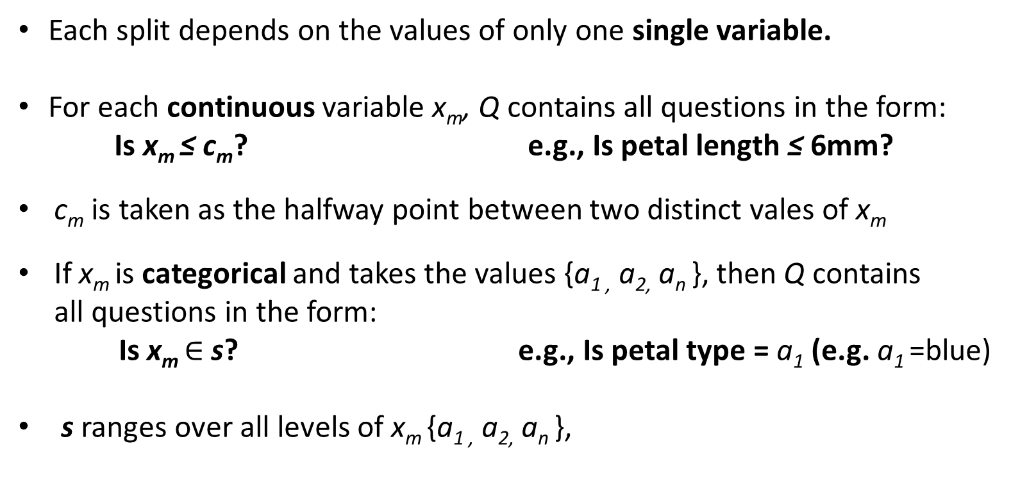
CART – Splitting Criteria the set of questions, Q
Each split depends on the values of only one single variable.
For each continuous variable x_{m}, Q contains all questions in the form:
Is x_{m} ≤ c_{m}? e.g., Is petal length ≤ 6mm?
c_{m} is taken as the halfway point between two distinct vales of x_{m}
If x_{m} is categorical and takes the values {a_{1 ,} a_{2,} a_{n} }, then Q contains
all questions in the form:
Is x_{m} $∈$ s? e.g., Is petal type = a₁ (e.g. a₁ =blue)
s ranges over all levels of x_{m} {a_{1 ,} a_{2,} a_{n} },

Slide 14
CART – Splitting Criteria Node impurity
Node impurity refers to the degree that
any one node is comprised of mixed classes
or groups.
Impurity is greatest when all groups/class
are mixed equally within a node.
Impurity is lowest when a node only
contains one group/class.
High
Impurity
Low

Slide 15
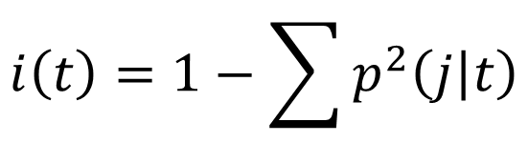
CART – Splitting Criteria Node impurity
There are several ways to calculate node impurity. We will focus on the Gini Index:
$$i\left(t\right)=1−\sum{p^{2}\left(j | t\right)}$$
$p\left(j | t\right)$ = the probability that a sample is from group j given that it is found in node t.

Slide 16
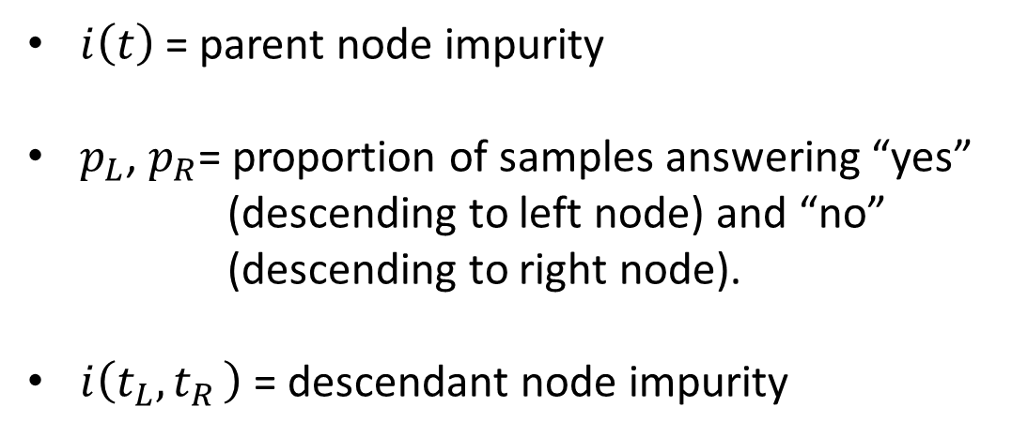
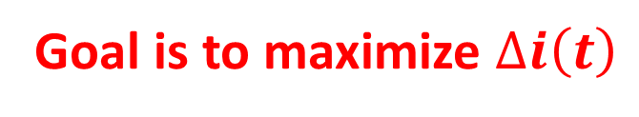
CART – Splitting Criteria
You measure the decrease in impurity at each node t, for each question in the set Q:
$$∆i\left(t\right)=i\left(t\right)−p_{L}i\left(t_{L}\right)−p_{R}i\left(t_{R}\right)$$
$i\left(t\right)$ = parent node impurity
$p_{L}$, $p_{R}$= proportion of samples answering “yes”
(descending to left node) and “no”
(descending to right node).
$i\left(t_{L}{,t}_{R}\right)$ = descendant node impurity
X₁> 6
GREEN
0.92
X₂> 3
X₁> 2
RED
0.78
RED
1
BLUE
1
Goal is to maximize $∆i\left(t\right)$

Slide 17

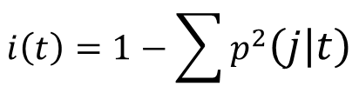
CART – Splitting Criteria
GREEN
27
10 (0.37)
11 (0.41)
6 (0.22)
X₂
$i\left(t\right)$= 0.65
$$i\left(t\right)=1−\sum{p^{2}\left(j | t\right)}$$
$$i\left(t\right)=1−\left({0.37}^{2}+{0.41}^{2}+{0.22}^{2}\right)=0.65$$
X₁

Slide 18



CART – Splitting Criteria
Q1:X₁> 6
RED
GREEN
10 (0.37)
11 (0.41)
6 (0.22)
11
16
X₂
$i\left(t\right)$= 0.65
0 (0.00)
10 (0.92)
1 (0.08)
10 (0.63)
1 (0.06)
5 (0.31)
$i\left(t\right)$= 0.15
$i\left(t\right)$= 0.5
X₁
Split 1:X₁> 6

Slide 19
CART – Splitting Criteria
Q1:X₁> 6
RED
GREEN
27
10 (0.37)
11 (0.41)
6 (0.22)
11
16
X₂
$i\left(t\right)$= 0.65
0 (0.00)
10 (0.92)
1 (0.08)
10 (0.63)
1 (0.06)
5 (0.31)
$i\left(t\right)$= 0.15
$i\left(t\right)$= 0.5
X₁
Split 1:X₁> 6
$$∆i\left(t\right)=i\left(t\right)−p_{L}i\left(t_{L}\right)−p_{R}i\left(t_{R}\right)$$
$$=0.65 −\left(0.41∗0.15\right)−\left(0.59∗0.5\right)=0.29$$

Slide 20


CART – Splitting Criteria
Q2:X₂> 4
GREEN
27
10 (0.37)
11 (0.41)
6 (0.22)
12
15
X₂
$i\left(t\right)$= 0.65
5 (0.42)
7 (0.58)
0 (0.00)
5 (0.33)
4 (0.27)
6 (0.4)
Blue
$i\left(t\right)$= 0.48
$i\left(t\right)$= 0.66
X₁
Split 2:X₂> 4

Slide 21
CART – Splitting Criteria
Q2:X₂> 4
GREEN
27
10 (0.37)
11 (0.41)
6 (0.22)
12
15
X₂
$i\left(t\right)$= 0.65
5 (0.42)
7 (0.58)
0 (0.00)
5 (0.33)
4 (0.27)
6 (0.4)
Blue
$i\left(t\right)$= 0.48
$i\left(t\right)$= 0.66
X₁
Split 2:X₂> 4
$$∆i\left(t\right)=i\left(t\right)−p_{L}i\left(t_{L}\right)−p_{R}i\left(t_{R}\right)$$
$$=0.65 −\left(0.44∗0.48\right)−\left(0.56∗0.66\right)=0.07$$

Slide 22
CART – Splitting Criteria
Q2:X₂> 4
GREEN
10 (0.37)
11 (0.41)
6 (0.22)
X₂
$i\left(t\right)$= 0.65
5 (0.42)
7 (0.58)
0 (0.00)
5 (0.33)
4 (0.27)
6 (0.4)
Blue
$i\left(t\right)$= 0.48
$i\left(t\right)$= 0.66
X₁
Split 1 or 2?
Split 2:X₂> 4
$$∆i\left(t\right)=i\left(t\right)−p_{L}i\left(t_{L}\right)−p_{R}i\left(t_{R}\right)$$
$$=0.65 −\left(0.41∗0.15\right)−\left(0.59∗0.5\right)=0.29$$
$$∆i\left(t\right)=i\left(t\right)−p_{L}i\left(t_{L}\right)−p_{R}i\left(t_{R}\right)$$
$$=0.65 −\left(0.44∗0.48\right)−\left(0.56∗0.66\right)=0.07$$

Slide 23
CART – Splitting Criteria
Q2:X₂> 4
RED
GREEN
10 (0.37)
11 (0.41)
6 (0.22)
X₂
$i\left(t\right)$= 0.65
5 (0.42)
7 (0.58)
0 (0.00)
5 (0.33)
4 (0.27)
6 (0.4)
$i\left(t\right)$= 0.48
$i\left(t\right)$= 0.66
X₁
Split 1:X₁> 6
Split 1 or 2?
$$∆i\left(t\right)=i\left(t\right)−p_{L}i\left(t_{L}\right)−p_{R}i\left(t_{R}\right)$$
$$=0.65 −\left(0.41∗0.15\right)−\left(0.59∗0.5\right)=0.29$$
$$∆i\left(t\right)=i\left(t\right)−p_{L}i\left(t_{L}\right)−p_{R}i\left(t_{R}\right)$$
$$=0.65 −\left(0.44∗0.48\right)−\left(0.56∗0.66\right)=0.07$$

Slide 24
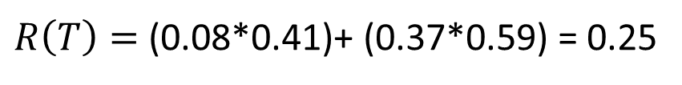
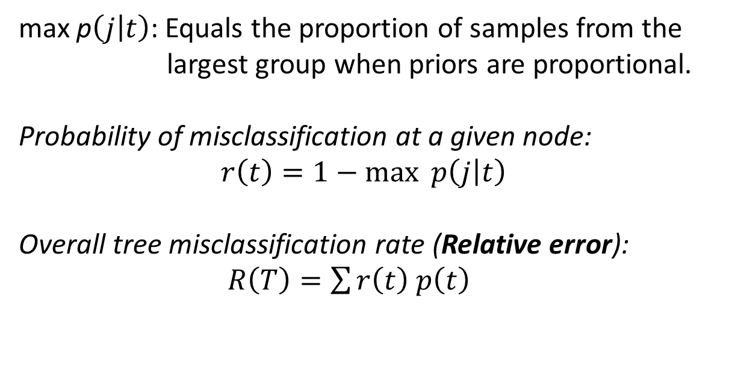
CART – Assigning Classes/Groups
A node is classified as belonging to the group that has the highest
probability of membership (i.e., the group that minimizes the probability
of misclassification).
max p$\left(j | t\right)$: Equals the proportion of samples from the
largest group when priors are proportional.
Probability of misclassification at a given node:
$r\left(t\right)=1−\max{p\left(j | t\right)}$
Overall tree misclassification rate (Relative error):
$R\left(T\right)=\sum{r\left(t\right) p\left(t\right)}$
11
10 (0.37)
11 (0.41)
6 (0.22)
16
0 (0.00)
10 (0.92)
1 (0.08)
10 (0.63)
1 (0.06)
5 (0.31)
$R\left(T\right)=$ (0.08*0.41)+ (0.37*0.59) = 0.25

Slide 25
CART – Assigning Classes/Groups
X₁> 6
GREEN
0.92
X₂> 3
RED
0.78
X₁> 2
BLUE
1
RED
1

Slide 26
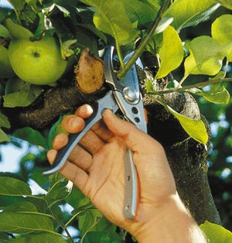
CART- Pruning Trees
In theory you could end up with one sample in each leaf on a tree.
However, this is a case of over parameterization and even though they
have a lower misclassification rate, these trees preform poorly when
confronted with new data.
To solve this problem, we prune the tree to smaller tree that more
accurately predicts the classification of new data.

Slide 27
CART- Pruning Trees Minimum Cost-Complexity Pruning
Attempts to balance the cost of misclassifying known samples (i.e. removing
branches) and the cost of misclassifying unknown samples (i.e. having too many
branches).
Goal is to remove branches that contribute little to the overall classification rate
of a tree.

Slide 28
CART- Pruning Trees Minimum Cost-Complexity Pruning
~
Cost-complexity measure: R_{α} (T) = R(T) + α|T|
R(T) = Overall misclassification cost (rate)
α = Complexity parameter
|T| = Complexity = # terminal nodes
R_{α} (T)
~
~
|T|

Slide 29
CART- Pruning Trees Cross-Validation
V-fold Cross Validation:
1) Divided data into V mutually exclusive subsets of approximately the same size.
2) Drop out one subset (i.e. testing data) at a time and build a tree from the
remaining subsets (i.e., training data), and use the tree on the testing data.
3) Calculate the estimated error (i.e., misclassification) for each subset and sum the
error over all subsets.
4) Repeat steps 2-3 for trees of each size
5) Select the trees size with the minimum estimated error (i.e., least misclassifications)

Slide 30
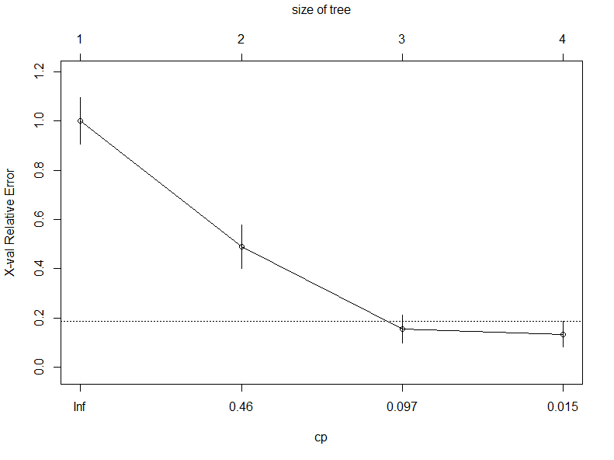
CART- Pruning Trees Cross-Validation
1-SE Rule
A criterion stating that the “best” tree is the smallest tree within
1 standard error of the minimum.

Slide 31
CART Example: Iris Morphology
versicolor
setosa
virginica

Slide 32
DA Example: Iris Morphology
Iris data set contains 150 samples, 50 of each species
Sample | Sepal.Length | Sepal.Width | Petal.Length | Petal.Width | Species
1 | 5.1 | 3.5 | 1.4 | 0.2 | setosa
2 | 4.9 | 3 | 1.4 | 0.2 | versi
3 | 4.7 | 3.2 | 1.3 | 0.2 | virgin
4 | 4.6 | 3.1 | 1.5 | 0.2 | setosa
. | . | . | . | . | .
. | . | . | . | . | .
. | . | . | . | . | .
150 | 5 | 3.6 | 1.4 | 0.2 | virgin

Slide 33
CART Example: Iris Morphology
Iris data set contains 150 samples, 50 of each species
Use a training data set of 75 samples (~25 of each)
Prior probabilities ~ 0.33 for each species

Slide 34
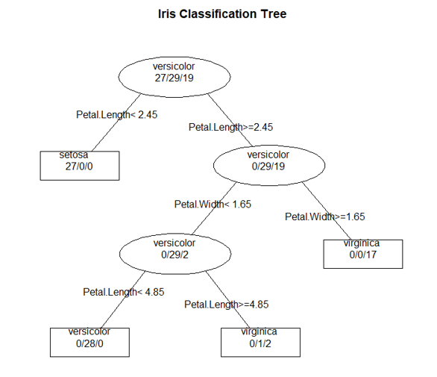
CART Example: Iris Morphology

Slide 35
CART Example: Iris Morphology

Slide 36

CART Example: Iris Morphology

Slide 37
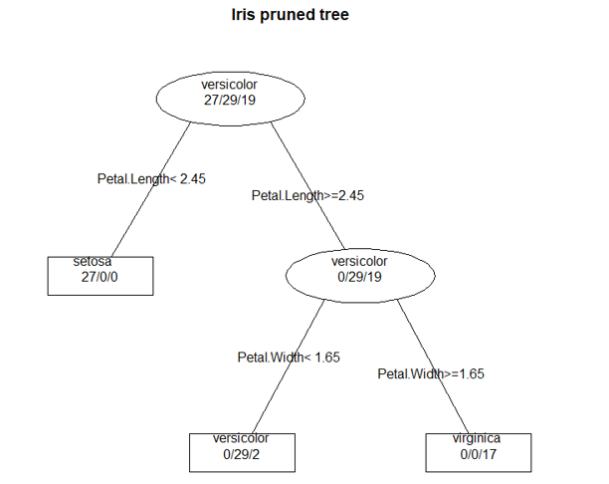
CART Example: Iris Morphology

Slide 38
CART Example: Iris Morphology
Predicting the species of the testing data?
 | setosa | versicolor | virginica
setosa | 23 | 0 | 0
versicolor | 0 | 19 | 2
virginica | 0 | 2 | 29
Classification rate= 0.946
Misclassification rate= 0.054

Slide 39
Discrimination: CART vs DA
CART is non-parametric and as a result does not have nearly the assumptions of DA.
Good for life sciences (especially ecology), because our data often does not meet
these assumptions.
Bad, because the lack of theoretical underpinnings does not allow for an explicit
test of theory (e.g. no MANOVA for CART).
If your data meets the assumptions, use DA. If not, use CART. It’s a good idea to
try both and compare.

