Slide 1
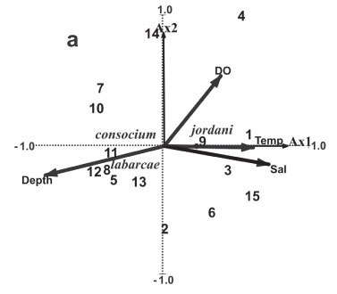
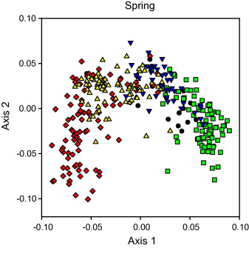
Ordination II
Principal Coordinates Analysis (PCoA), Non-Metric Multidimensional Scaling (NMDS), and Correspondence Analysis (CA)

Slide 2
4 Ordination Techniques
Principal Components Analysis (PCA)
Principal Coordinates Analysis (PCoA)
Non-Metric Multidimensional Scaling (NMDS)
Correspondence Analysis

Slide 3
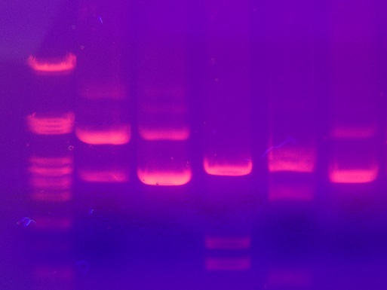
Principal Coordinates Analysis (PCoA)
Also called multidimensional scaling (MDS)
Similar to PCA
Used when Euclidian distance is not appropriate
(e.g. binary data, genetic distances)
PCoA on a Euclidean distance matrix gives the
same eigenvalues and eigenvectors as PCA
Site | 1 | 2 | 3 | 4 | 5 | 6
a | 1 | 1 | 1 | 1 | 1 | 1
b | 1 | 0 | 0 | 1 | 1 | 1
c | 1 | 1 | 1 | 1 | 1 | 1
d | 1 | 1 | 1 | 0 | 0 | 0
e | 1 | 1 | 1 | 1 | 1 | 1
f | 1 | 1 | 1 | 1 | 1 | 1

Slide 4
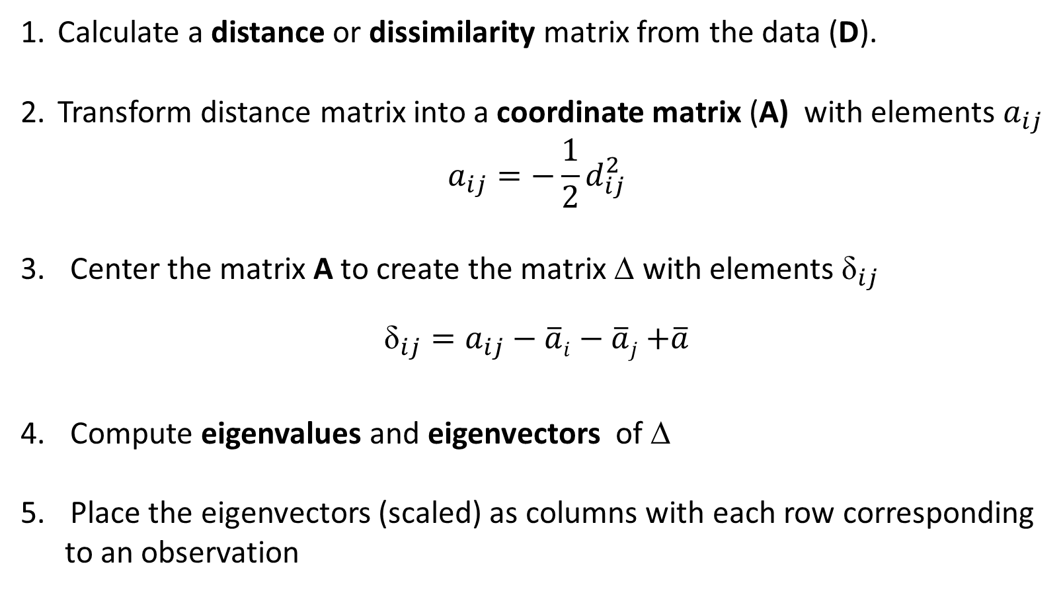
PCoA procedure
Calculate a distance or dissimilarity matrix from the data (D).
Transform distance matrix into a coordinate matrix (A) with elements $a_{ij}$
$$a_{ij}=−\frac{1}{2}d_{ij}^{2}$$
Center the matrix A to create the matrix ∆ with elements ${\text{δ}}_{ij}$
${\text{δ}}_{ij}=a_{ij}−\overline{a}i−\overline{a}j$ $+\overline{a}$
Compute eigenvalues and eigenvectors of ∆
Place the eigenvectors (scaled) as columns with each row corresponding
to an observation

Slide 5
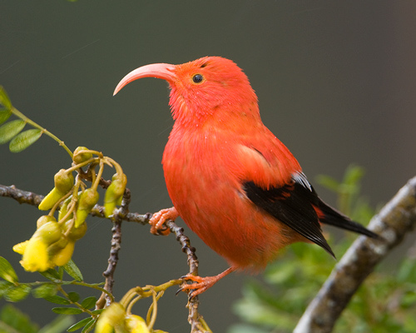
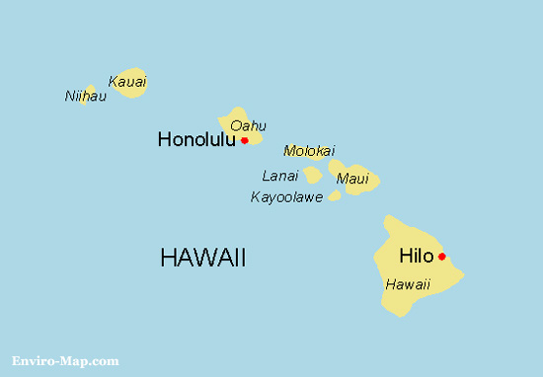
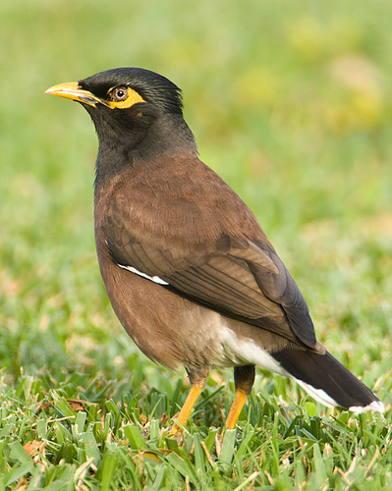
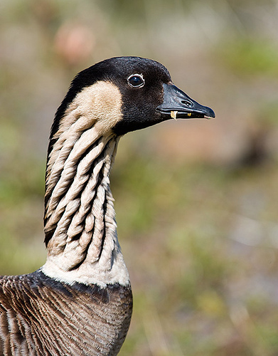
Hawaiian Island Avifauna
Photos by Haole in Hawaii

Slide 6
Hawaiian Island Avifauna
Species Id# | 1 | 2 | 3 | 4 | 5 | 6 | 7 | 8 | 9 | 10 | 11 | 12 | 13
Kauai | 1 | 1 | 1 | 1 | 1 | 1 | 1 | 1 | 0 | 0 | 1 | 1 | 0
Oahu | 1 | 0 | 0 | 1 | 1 | 1 | 1 | 1 | 1 | 1 | 1 | 1 | 0
Molokai | 1 | 1 | 1 | 1 | 1 | 1 | 1 | 1 | 1 | 1 | 1 | 1 | 1
Lanai | 1 | 1 | 1 | 0 | 0 | 0 | 0 | 0 | 1 | 1 | 0 | 1 | 1
Maui | 1 | 1 | 1 | 1 | 1 | 1 | 1 | 1 | 1 | 1 | 1 | 1 | 1
Hawaii | 1 | 1 | 1 | 1 | 1 | 1 | 1 | 1 | 1 | 1 | 1 | 0 | 1
. . .
. . .
. . .
Sørensens’s dissimilarity
 | Kauai | Oahu | Molokai | Lanai | Maui | Hawaii
Kauai | 0 | 0.310924 | 0.326316 | 0.456522 | 0.396226 | 0.391304
Oahu | 0.310924 | 0 | 0.36 | 0.443299 | 0.369369 | 0.383333
Molokai | 0.326316 | 0.36 | 0 | 0.178082 | 0.195402 | 0.3125
Lanai | 0.456522 | 0.443299 | 0.178082 | 0 | 0.214286 | 0.354839
Maui | 0.396226 | 0.369369 | 0.195402 | 0.214286 | 0 | 0.28972
Hawaii | 0.391304 | 0.383333 | 0.3125 | 0.354839 | 0.28972 | 0

Slide 7
Principal Coordinates (Scaled Eigenvectors)
PCoA Axes
 | 1 | 2 | 3 | 4 | 5
Kauai | -0.219 | -0.070 | -0.134 | 0.014 | 0.022
Oahu | -0.203 | 0.000 | 0.165 | -0.022 | -0.003
Molokai | 0.078 | -0.081 | -0.036 | -0.025 | -0.064
Lanai | 0.205 | -0.072 | 0.018 | -0.059 | 0.043
Maui | 0.115 | 0.001 | 0.038 | 0.116 | 0.004
Hawaii | 0.025 | 0.221 | -0.051 | -0.025 | -0.002

Slide 8
Eigenvalues - variance explained
 | Eigenvalues | Proportion of Variance | Cumulative Variance
PCoA 1 | 0.15 | 0.52 | 0.52
PCoA 2 | 0.07 | 0.22 | 0.74
PCoA 3 | 0.05 | 0.17 | 0.91
PCoA 4 | 0.02 | 0.06 | 0.98
PCoA 5 | 0.01 | 0.02 | 1

Slide 9
Scree Plot

Slide 10
Eigenvalues - variance explained
 | Eigenvalues | Proportion of Variance | Cumulative Variance
PCoA 1 | 0.15 | 0.52 | 0.52
PCoA 2 | 0.07 | 0.22 | 0.74
PCoA 3 | 0.05 | 0.17 | 0.91
PCoA 4 | 0.02 | 0.06 | 0.98
PCoA 5 | 0.01 | 0.02 | 1

Slide 11
Contemporary Hawaiian Islands Avifauna
0.3
Hawaii
0.2
Principal coordinate axis 2 (22%)
0.1
0.0
Oahu
Maui
Kauai
Molokai
Lanai
-0.1
-0.2
-0.1
0.0
0.1
0.2
0.3
Principal coordinate axis 1 (52%)

Slide 12
Contemporary Hawaiian Islands Avifauna
0.3
Hawaii
0.2
0.1
Principal coordinate axis 2
0.0
Oahu
Maui
Kauai
Molokai
Lanai
-0.1
-0.2
-0.1
0.0
0.1
0.2
0.3
Principal coordinate axis 1 (52%)

Slide 13
Non-Metric Multidimensional Scaling (NMDS)
Main goal is to place similar observations close together and
dissimilar items far apart in ordination space
Does not assume linear relationship between dissimilarities and axes
Only preserves rank order of original dissimilarities or distances
Can take any dissimilarity or distance measure
Illustrates relatedness among observations

Slide 14
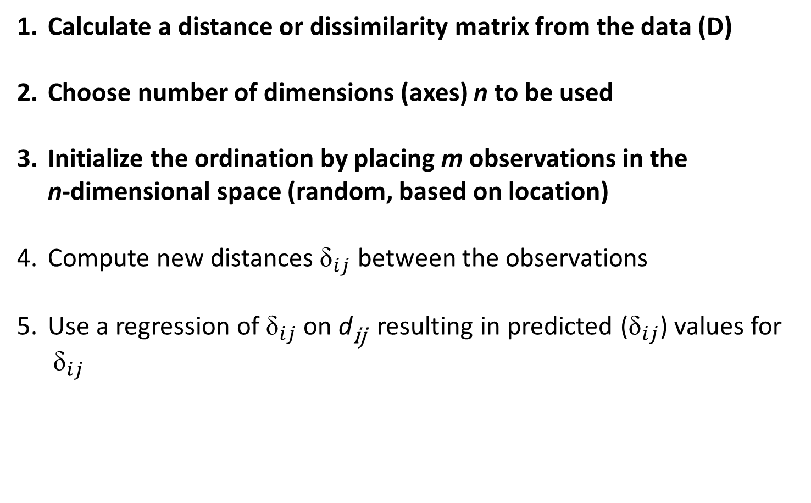
NMDS Procedure
Calculate a distance or dissimilarity matrix from the data (D)
Choose number of dimensions (axes) n to be used
Initialize the ordination by placing m observations in the
n-dimensional space (random, based on location)
Compute new distances ${\text{δ}}_{ij}$ between the observations
Use a regression of ${\text{δ}}_{ij}$ on d_{ij} resulting in predicted (${\text{δ}}_{ij}$) values for
${\text{δ}}_{ij}$
˄

Slide 15
Initial Locations (Random)

Slide 16
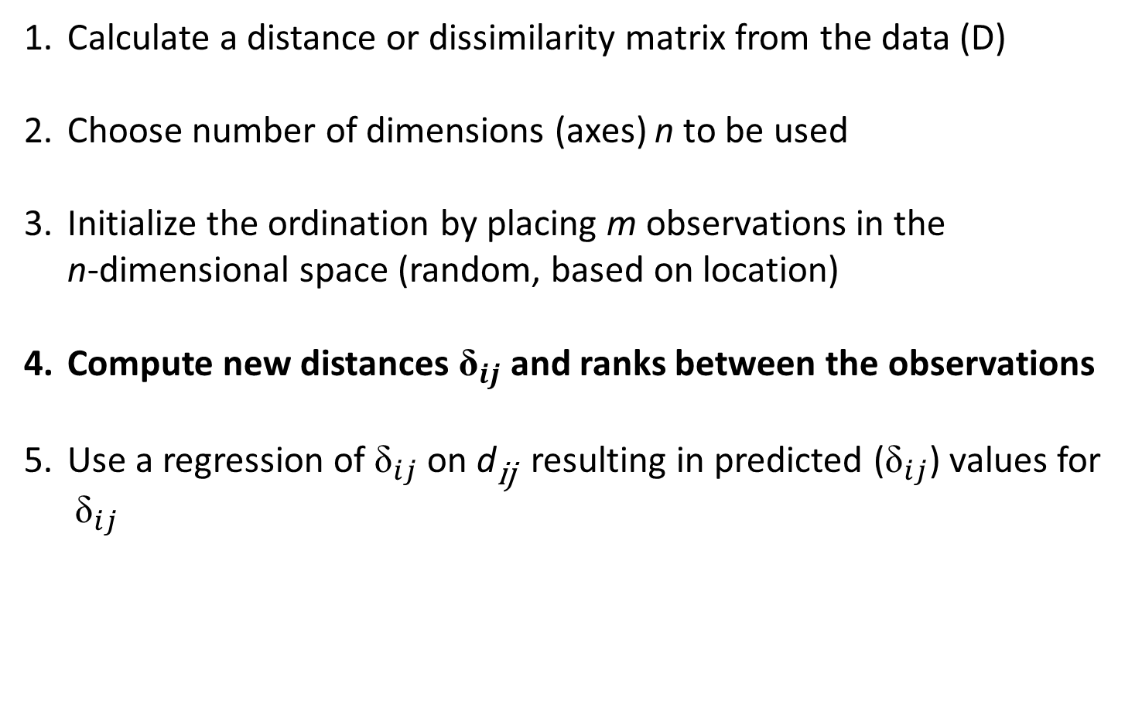
NMDS Procedure
Calculate a distance or dissimilarity matrix from the data (D)
Choose number of dimensions (axes) n to be used
Initialize the ordination by placing m observations in the
n-dimensional space (random, based on location)
Compute new distances ${\text{δ}}_{ij}$ and ranks between the observations
Use a regression of ${\text{δ}}_{ij}$ on d_{ij} resulting in predicted (${\text{δ}}_{ij}$) values for
${\text{δ}}_{ij}$
˄

Slide 17


Measure Distance (${\text{δ}}_{ij}$)Between Initial Locations
$${\text{δ}}_{ij}$$

Slide 18

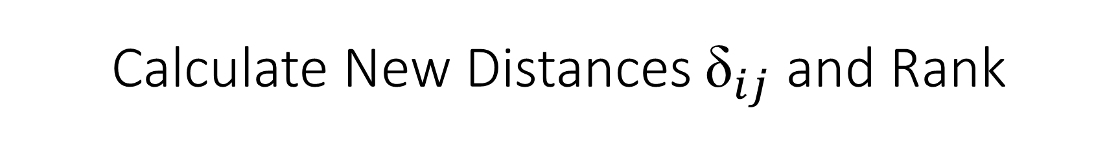
Calculate New Distances ${\text{δ}}_{ij}$ and Rank
Matrix D containing d_{ij}
Matrix D* containing ${\text{δ}}_{ij}$
 | A | B | C | D | E
A
B | 0.31
C | 0.33 | 0.36
D | 0.46 | 0.44 | 0.18
E | 0.39 | 0.37 | 0.19 | 0.21
 | A | B | C | D | E
A
B | 0.33
C | 0.34 | 0.3
D | 0.5 | 0.6 | 0.172
E | 0.39 | 0.4 | 0.18 | 0.29
Rank dissimilarities
 | A | B | C | D | E
A
B | 4
C | 5 | 6
D | 10 | 9 | 1
E | 8 | 7 | 2 | 3
 | A | B | C | D | E
A
B | 5
C | 6 | 4
D | 9 | 10 | 1
E | 7 | 8 | 2 | 3

Slide 19
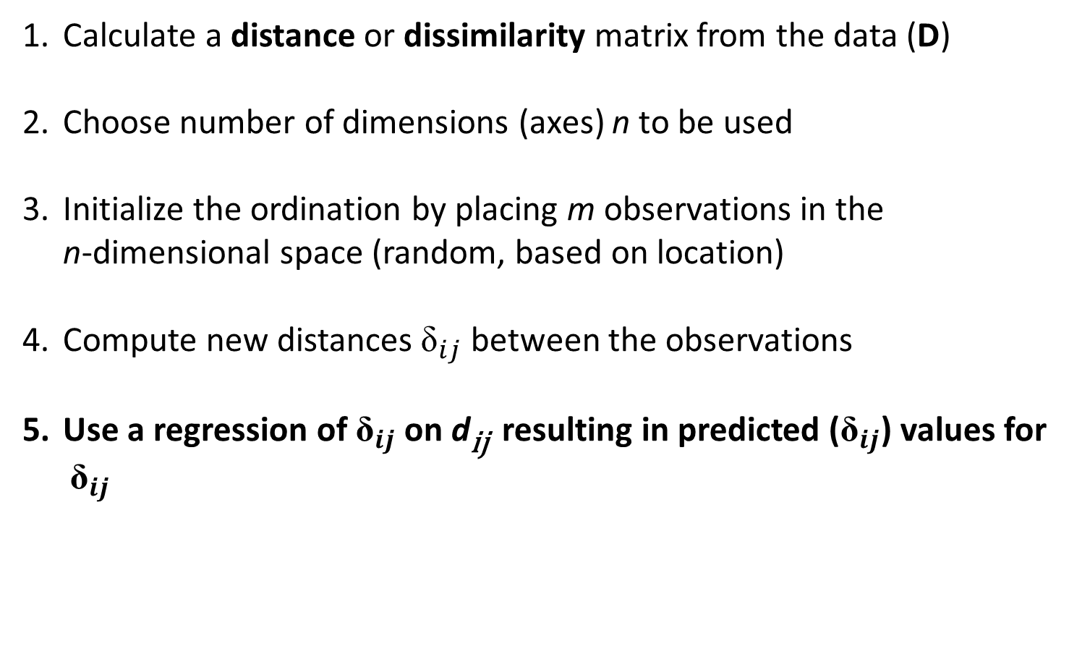
NMDS Procedure
Calculate a distance or dissimilarity matrix from the data (D)
Choose number of dimensions (axes) n to be used
Initialize the ordination by placing m observations in the
n-dimensional space (random, based on location)
Compute new distances ${\text{δ}}_{ij}$ between the observations
Use a regression of ${\text{δ}}_{ij}$ on d_{ij} resulting in predicted (${\text{δ}}_{ij}$) values for
${\text{δ}}_{ij}$
˄

Slide 20
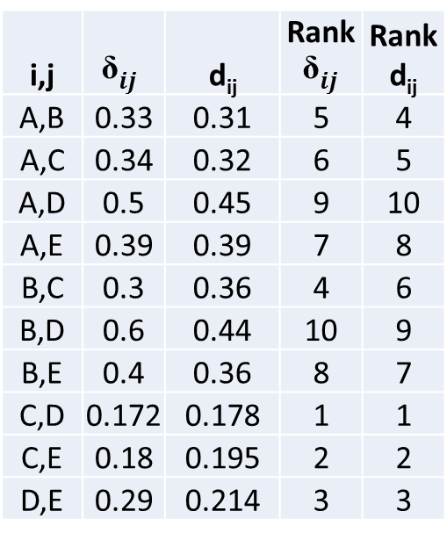
NMDS Regression Table
i,j | $${\text{δ}}_{ij}$$ | d_{ij} | Rank $${\text{δ}}_{ij}$$ | Rankd_{ij}
A,B | 0.33 | 0.31 | 5 | 4
A,C | 0.34 | 0.32 | 6 | 5
A,D | 0.5 | 0.45 | 9 | 10
A,E | 0.39 | 0.39 | 7 | 8
B,C | 0.3 | 0.36 | 4 | 6
B,D | 0.6 | 0.44 | 10 | 9
B,E | 0.4 | 0.36 | 8 | 7
C,D | 0.172 | 0.178 | 1 | 1
C,E | 0.18 | 0.195 | 2 | 2
D,E | 0.29 | 0.214 | 3 | 3

Slide 21

Shepard Plot – Monotonic Regression
3.0
Non-metric fit, R2 = 0.995
Linear fit, R2 = 0.98
2.5
˄
$${\text{δ}}_{ij}$$
2.0
Ordination Distance (${\text{δ}}_{ij}$)
1.5
1.0
0.5
0.2
0.3
0.4
0.5
0.6
0.7
0.8
0.9
Observed Dissimilarity (d_{ij})

Slide 22
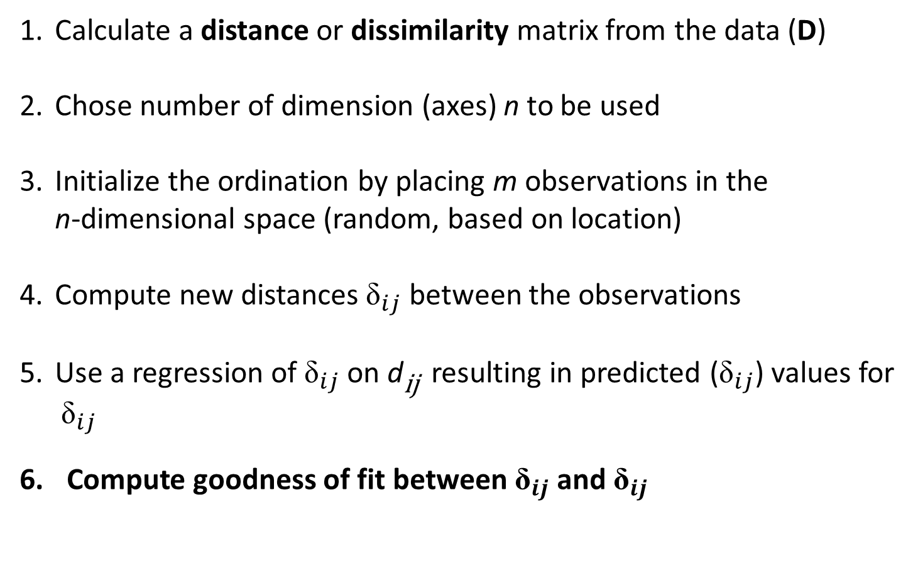
NMDS Procedure
Calculate a distance or dissimilarity matrix from the data (D)
Chose number of dimension (axes) n to be used
Initialize the ordination by placing m observations in the
n-dimensional space (random, based on location)
Compute new distances ${\text{δ}}_{ij}$ between the observations
Use a regression of ${\text{δ}}_{ij}$ on d_{ij} resulting in predicted (${\text{δ}}_{ij}$) values for
${\text{δ}}_{ij}$
Compute goodness of fit between ${\text{δ}}_{ij}$ and ${\text{δ}}_{ij}$
˄
˄

Slide 23

Goodness of fit - Stress
$$Stress=\sqrt{\frac{\sum_{i=1}^{m}{\sum_{j=1}^{n}{{\left({\text{δ}}_{ij}−{\text{δ}}_{ij}\right)}^{2}}}}{\begin{aligned} \\ \sum_{i=1}^{m}{\sum_{j=1}^{n}{{{\text{δ}}_{ij}}^{2}}}\end{aligned}}}$$
˄
˄
minimize stress!

Slide 24
Goodness of fit - Stress
Stress Value | Interpretation
< 0.05 | Excellent representation of original distance matrix
0.05 - 0.10 | Good
0.1 – 0.20 | Fair
> 0.20 | Unreliable
minimize stress!

Slide 25
NMDS Procedure
Alter the position of the m observations to further reduce the stress
Iteratively repeat steps 4-7 until stress can no longer be reduced
For the minimized stress configuration, plot m observations in
n-dimensional space

Slide 26
Reduce Stress

Slide 27
NMDS Procedure
Alter the position of the m observations to further reduce the stress
Iteratively repeat steps 4-7 until stress can no longer be reduced
For the minimized stress configuration, plot m observations in
n-dimensional space

Slide 28
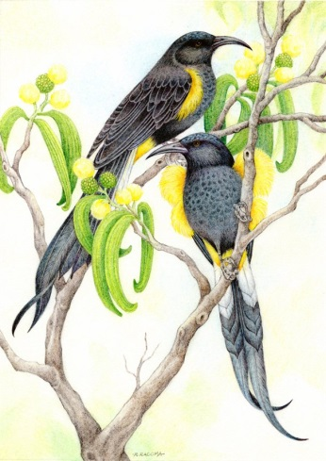

Hawaiian Island Avifauna: Past and Present
Photos by Haole in Hawaii

Slide 29
NMDS – Hawaiian Avifauna
Historical
Stress = 0.126
Contemporary
Lanai
Molokai
Lanai
Maui
Maui
NMDS2
Molokai
Hawaii
Hawaii
Oahu
Kauai
Oahu
Kauai
NMDS1

Slide 30
Correspondence Analysis (CA)
Reciprocal Averaging (RA)
Dual ordination where rows (samples) and columns (variables) are ordinated on the
same axes
Similar to PCA:
- Eigenanalysis problem
- Goal is to reduce multidimensional data cloud into fewer dimensions
- Conveys more information about the relationship between samples
and variables because of the dual ordination.
Different from PCA:
- Assumes unimodal relationship between variables and axes.
- For categorical and count data

Slide 31
Linear and Non-Linear Models
Variable 1
Variable 1
PCA 1
CA 1

Slide 32
CA Procedure
Use two-way data matrix (row-by-column) to calculate a Q matrix whose elements q_{ij} are chi-square values.
Conduct a singular value decomposition (svd):
Plot both row and column scores in ordination space
Obtain eigenvalues/vectors for a non-symmetric matrix
Produces eigenvectors for both the rows and columns
Common eigenvalues for both rows and columns allows for
simultaneous plotting in ordination space

Slide 33
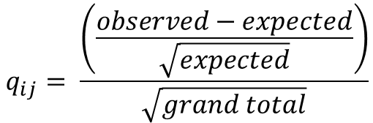
Chi square – X²
 | <3 | 3-5 | 5-8 | 8-10 | >10 | Total
No Reproduction | 21 | 21 | 14 | 13 | 8 | 77
Flowers | 8 | 9 | 6 | 8 | 2 | 33
Fruits | 2 | 3 | 4 | 10 | 10 | 29
Total | 31 | 33 | 24 | 31 | 20 | 139
$$q_{ij}= \frac{\left(\frac{observed−expected}{\sqrt{expected}}\right)}{\sqrt{grand total}}$$

Slide 34
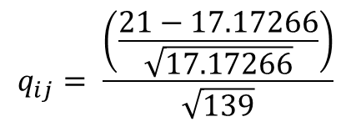
Chi square – X²
 | <3 | 3-5 | 5-8 | 8-10 | >10 | Total
No Reproduction | 21 | 21 | 14 | 13 | 8 | 77
Flowers | 8 | 9 | 6 | 8 | 2 | 33
Fruits | 2 | 3 | 4 | 10 | 10 | 29
Total | 31 | 33 | 24 | 31 | 20 | 139
$$q_{ij}= \frac{\left(\frac{observed−expected}{\sqrt{expected}}\right)}{\sqrt{grand total}}$$
$$q_{ij}= \frac{\left(\frac{21−17.17266}{\sqrt{17.17266}}\right)}{\sqrt{139}}$$
= 0.078338
Expected = row total*column total/grand total =77*31/139 = 17.17266

Slide 35
Chi square – X²
 | <3 | 3-5 | 5-8 | 8-10 | >10
No Reproduction | 0.078338 | 0.053948 | 0.016401 | -0.08541 | -0.07846
Flowers | 0.020019 | 0.035317 | 0.010737 | 0.020019 | -0.10697
Fruits | -0.149 | -0.12558 | -0.03818 | 0.117811 | 0.241967
Positive values indicate that reproductive output happens more often
than expected.
Negative values indicate that reproductive output happens less often
than expected.
In a CA analysis we describe these deviations with new axes.
Chi square values are also called inertia in CA.

Slide 36
CA Procedure
Use two-way data matrix (row-by-column) to calculate a Q matrix whose elements q_{ij} are chi-square values.
Conduct a singular value decomposition (svd):
Scale eigenvectors and calculate row and column scores
Plot both row and column scores in ordination space
Obtain eigenvalues/vectors for a non-symmetric matrix
Produces eigenvectors for both the rows and columns
Common eigenvalues for both rows and columns allows for
simultaneous plotting in ordination space

Slide 37
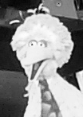
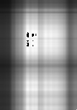
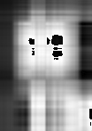
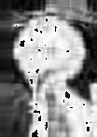

Singular Value Decomposition (Eigenanalysis)
Original Matrix
λ =1
λ =2
λ =10
λ =40

Slide 38
CA Procedure
Use two-way data matrix (row-by-column) to calculate a Q matrix whose elements q_{ij} are chi-square values.
Conduct a singular value decomposition (svd):
Scale eigenvectors and calculate row and column scores
Plot both row and column scores in ordination space
Obtain eigenvalues/vectors for a non-symmetric matrix
Produces eigenvectors for both the rows and columns
Common eigenvalues for both rows and columns allows for
simultaneous plotting in ordination space

Slide 39
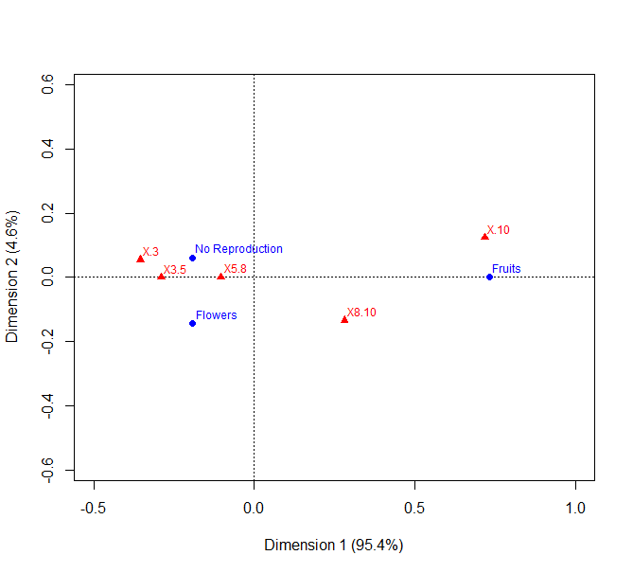
Interpretation
Row Scores
 | Axis 1 | Axis 2
No Reproduction | -0.19333 | 0.061015
Flowers | -0.19237 | -0.14252
Fruits | 0.73222 | 0.000168
Column Scores
 | Axis 1 | Axis 2
<3 | -0.35474 | 0.055021
3-5 | -0.28972 | -0.0003
5-8 | -0.10328 | -0.00011
8-10 | 0.28057 | -0.13423
>10 | 0.716939 | 0.123398
Eigenvalues
 | Axis 1 | Axis 2
Eigenvalue | 0.141348 | 0.006884
Percentage | 95.36% | 4.64%

Slide 40
Interpretation
Distribution of ages (column) along each axis shows
similarity of ages across reproductive status (rows).
Distribution of reproductive status (rows) along each axis
shows similarity of reproductive status across ages (column).
Proximity of ages to reproductive status represent a
combination that occurs more frequently than by chance
in the X². Conversely, ages to reproductive status that are far
apart occur less frequently then would be expected by
chance.

Slide 41
Interpretation
 | <3 | 3-5 | 5-8 | 8-10 | >10
No Reproduction | 0.078338 | 0.053948 | 0.016401 | -0.08541 | -0.07846
Flowers | 0.020019 | 0.035317 | 0.010737 | 0.020019 | -0.10697
Fruits | -0.149 | -0.12558 | -0.03818 | 0.117811 | 0.241967

Slide 42
Interpretation
Distribution of ages (columns) along each axis shows
similarity of ages across reproductive status (rows).
Distribution of reproductive status (rows) along each axis
shows similarity of reproductive status across ages (columns).
Proximity of ages to reproductive status represent a
combination that occurs more frequently than by chance
in the X². Conversely, ages to reproductive status status that
are far apart occur less frequently then would be expected
by chance.

Slide 43
Interpretation
 | <3 | 3-5 | 5-8 | 8-10 | >10
No Reproduction | 0.078338 | 0.053948 | 0.016401 | -0.08541 | -0.07846
Flowers | 0.020019 | 0.035317 | 0.010737 | 0.020019 | -0.10697
Fruits | -0.149 | -0.12558 | -0.03818 | 0.117811 | 0.241967

Slide 44
Interpretation
Distribution of ages (column) along each axis shows
similarity of ages across reproductive status (rows).
Distribution of reproductive status (rows) along each axis
shows similarity of reproductive status across ages (column).
Proximity of ages to reproductive status represent a
combination that occurs more frequently than by chance
in the X². Conversely, ages to reproductive status that are far
apart occur less frequently then would be expected by
chance.

Slide 45
Interpretation
 | <3 | 3-5 | 5-8 | 8-10 | >10
No Reproduction | 0.078338 | 0.053948 | 0.016401 | -0.08541 | -0.07846
Flowers | 0.020019 | 0.035317 | 0.010737 | 0.020019 | -0.10697
Fruits | -0.149 | -0.12558 | -0.03818 | 0.117811 | 0.241967

Slide 46
Interpretation
 | <3 | 3-5 | 5-8 | 8-10 | >10
No Reproduction | 0.078338 | 0.053948 | 0.016401 | -0.08541 | -0.07846
Flowers | 0.020019 | 0.035317 | 0.010737 | 0.020019 | -0.10697
Fruits | -0.149 | -0.12558 | -0.03818 | 0.117811 | 0.241967

Slide 47
Advantages and Disadvantages of Ordination
Advantages:
Reduce complex data
Visualize multidimensional data
Develop hypotheses
Easily applied through statistical packages (e.g.: R, SAS, Primer)
Disadvantages:
Relies heavily on matrix algebra
Principal axes are rescaled, so scores are interpretable only relative
to one another

Slide 48
Comparison of Ordination Techniques
Technique | Data Matrix | Metric | Mapping
PCA | Covariance | Euclidean | Linear
PCoA | Distance | Any | Linear
NMDS | Distance | Any | Nonlinear
CA | Raw | Chi-square | Unimodal

Slide 49
Comparison of Ordination Techniques
Technique | When to use
PCA | Data reduction with continuous data; when linear model is appropriate
PCoA | When Euclidean metric and linear mapping are desirable, but PCA assumptions are not met (e.g. binary data)
NMDS | When other models are not suitable; most flexible
CA | Unimodal assumption (i.e. long gradients); count and categorical data.

